Slide 1
Computer Networks — Mini Project
Congestion Control Lab
TCP congestion window, leaky bucket and token bucket shaping, and a Packet Tracer QoS lab built to enforce the same ideas on a router.
Soha Chand
October 2026

Slide 2
Agenda
What this deck covers
01
Problem
02
TCP Congestion Window
Why uncontrolled sending collapses a shared link
Slow start, congestion avoidance, Reno vs. Tahoe
03
Leaky Bucket
04
Token Bucket
Strict, constant-rate traffic shaping
Burst-tolerant shaping — and real router QoS
05
Packet Tracer Lab
06
Results & Real-World Use
A two-router WAN built, addressed and QoS-shaped
What the simulations show, and where this runs in production
Congestion Control Lab
2

Slide 3
Problem Statement
A shared link, and no one in charge of it
Every link has a finite capacity, but senders don't know that capacity in advance — they only find out by sending.
When several flows push data onto the same bottleneck at once, queues build, delay climbs, and routers start dropping packets.
Left unmanaged, this spirals into congestion collapse: retransmissions add more load to an already-overloaded link.
Two layers have to cooperate to prevent it — the end host (TCP's own congestion window) and the network itself (traffic-shaping queues).
The topic matters because it's invisible when it works: every video call, download and web page relies on these mechanisms running correctly, unnoticed, thousands of times a second.
Without congestion control
Sender load
Queue depth
Delivered throughput
As load rises past capacity, throughput actually delivered collapses — the textbook signature of congestion collapse.
Congestion Control Lab
3

Slide 4
Objectives
What this project set out to build
1
2
3
4
5
Simulate TCP's window
Simulate leaky bucket
Simulate token bucket
Make every parameter live
Enforce it on real hardware
Round-by-round slow start, congestion avoidance, and loss recovery under Reno and Tahoe.
A fixed-rate shaper that queues bursts and drops on overflow.
A burst-tolerant shaper that banks capacity during idle periods.
ssthresh, bucket capacity, rate and burst size as controls — not fixed examples.
Configure QoS traffic shaping in Packet Tracer as the device-level analogue, with full CLI evidence.
Congestion Control Lab
4

Slide 5
TCP Congestion Window
Two growth phases, split by a threshold
Slow start
Tahoe vs. Reno
cwnd starts at 1 MSS and doubles every RTT — exponential growth that quickly finds the rough order of magnitude of the path's capacity.
TAHOE — full restart
cwnd → 1 MSS, slow start from scratch. Simple, but slow to recover.
Congestion avoidance
Once cwnd crosses ssthresh, growth switches to +1 segment per RTT — a cautious linear probe for any headroom left.
RENO — fast recovery
cwnd → new ssthresh directly, congestion avoidance resumes at once. Faster recovery, same caution afterward.
On loss
ssthresh → half of cwnd. Tahoe resets to 1 and restarts; Reno's fast recovery resumes straight from the new ssthresh.
Both treat a loss as proof the path is full — they differ only in how quickly they trust the network again.
Congestion Control Lab
5

Slide 6
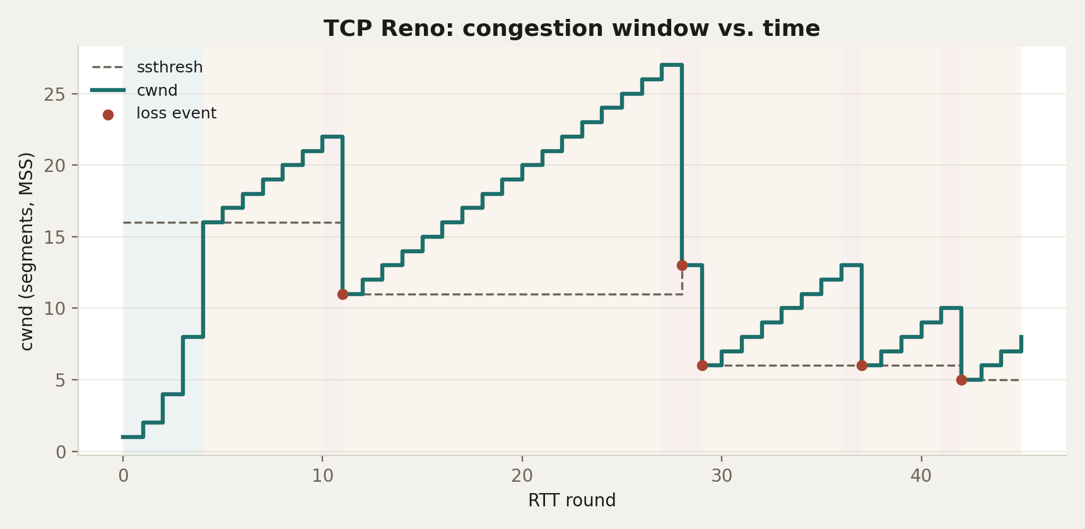
Simulated Run — TCP Reno
The saw-tooth: 45 RTT rounds, ssthresh = 16 MSS
Exponential climb to ssthresh in slow start
Linear climb above it, in congestion avoidance
Halving, not reset at every loss — Reno's signature
Congestion Control Lab
6

Slide 7
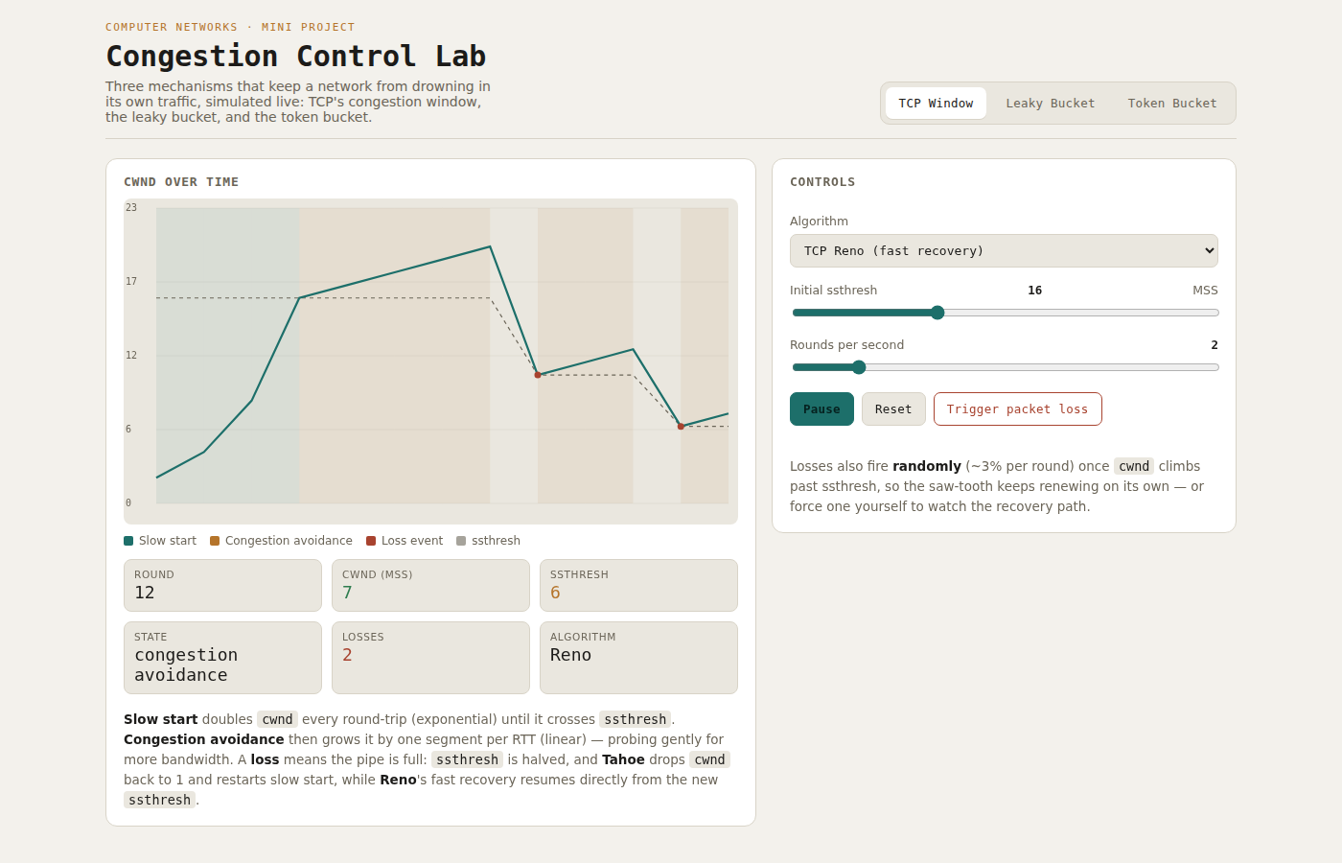
Live Demo
Interactive visualizer — TCP Window panel
Congestion Control Lab
7

Slide 8
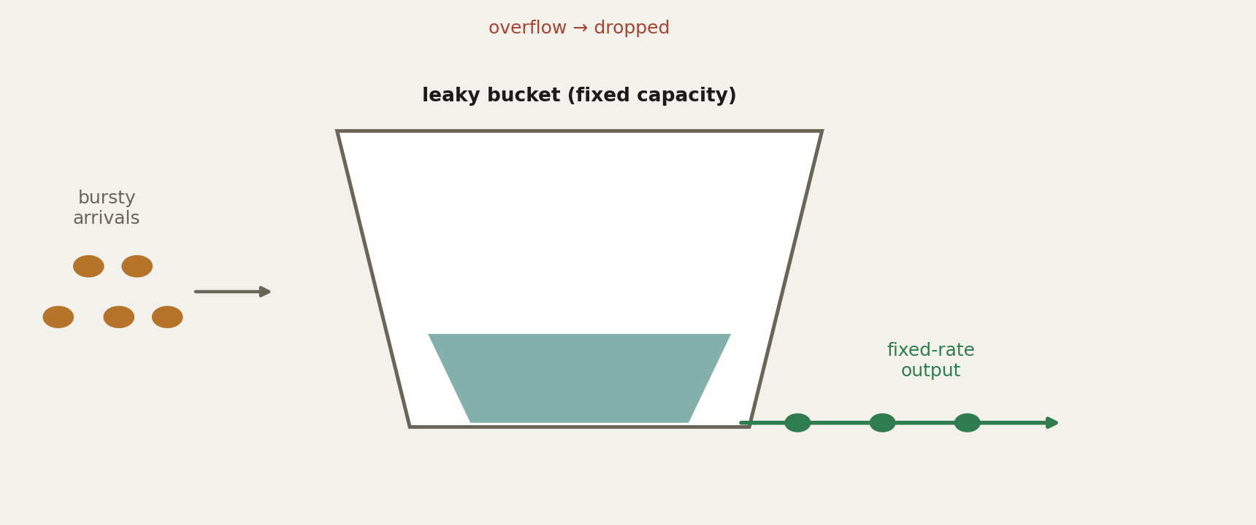
Leaky Bucket
A tap that drains at one constant rate
Arrivals are bursty; the leak is not.
Packets queue in a bucket of fixed capacity.
The bucket leaks (forwards) at a fixed rate every tick, no matter the input.
Output is perfectly smoothed — but a burst beyond capacity overflows and is dropped, exactly like sustained overload.
No benefit from being idle beforehand.
Congestion Control Lab
8

Slide 9
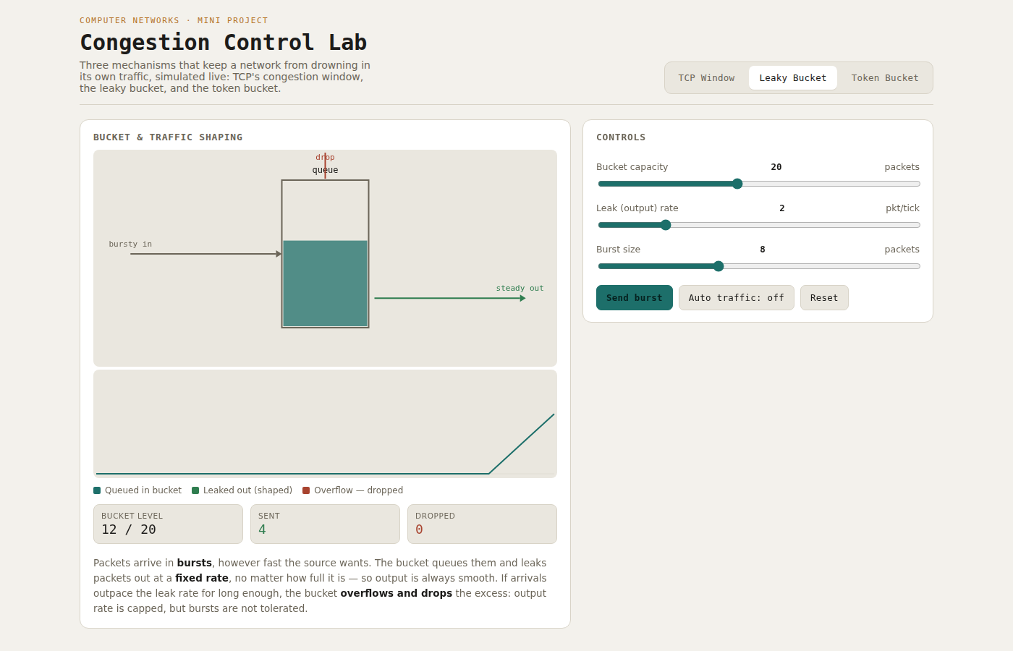
Live Demo
Interactive visualizer — Leaky Bucket panel
Congestion Control Lab
9

Slide 10
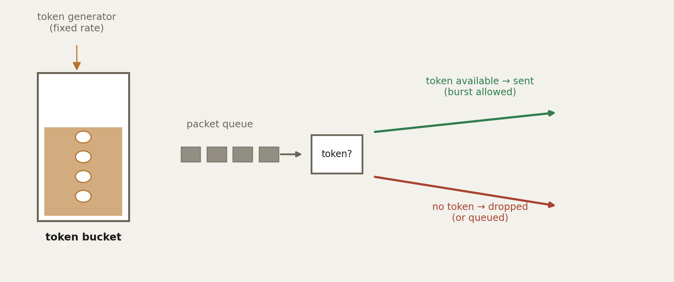
Token Bucket
Idle time is capacity banked for later
A packet needs a token; an empty bucket is the only reason to drop.
Tokens accumulate at a fixed rate, up to the bucket's capacity.
A packet leaves only if it can claim — and spend — a token.
An idle source banks tokens, so the next burst can leave immediately, up to the banked amount.
This is the shaper behind most real QoS policers — including the one configured next.
Congestion Control Lab
10

Slide 11
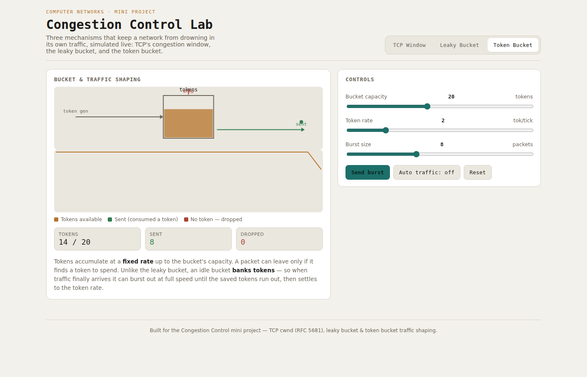
Live Demo
Interactive visualizer — Token Bucket panel
Congestion Control Lab
11

Slide 12
Side by Side
Leaky bucket vs. token bucket
Property
Leaky bucket
Token bucket
Output rate
Constant, regardless of input
Up to burst rate, then capped
Handles bursts
No — smooths everything equally
Yes — up to banked tokens
Idle behaviour
No benefit from idling
Banks tokens for a future burst
Drop condition
Bucket (queue) full
No token available
Typical use
Strict rate smoothing
QoS policing (CIR / burst-size)
Congestion Control Lab
12

Slide 13
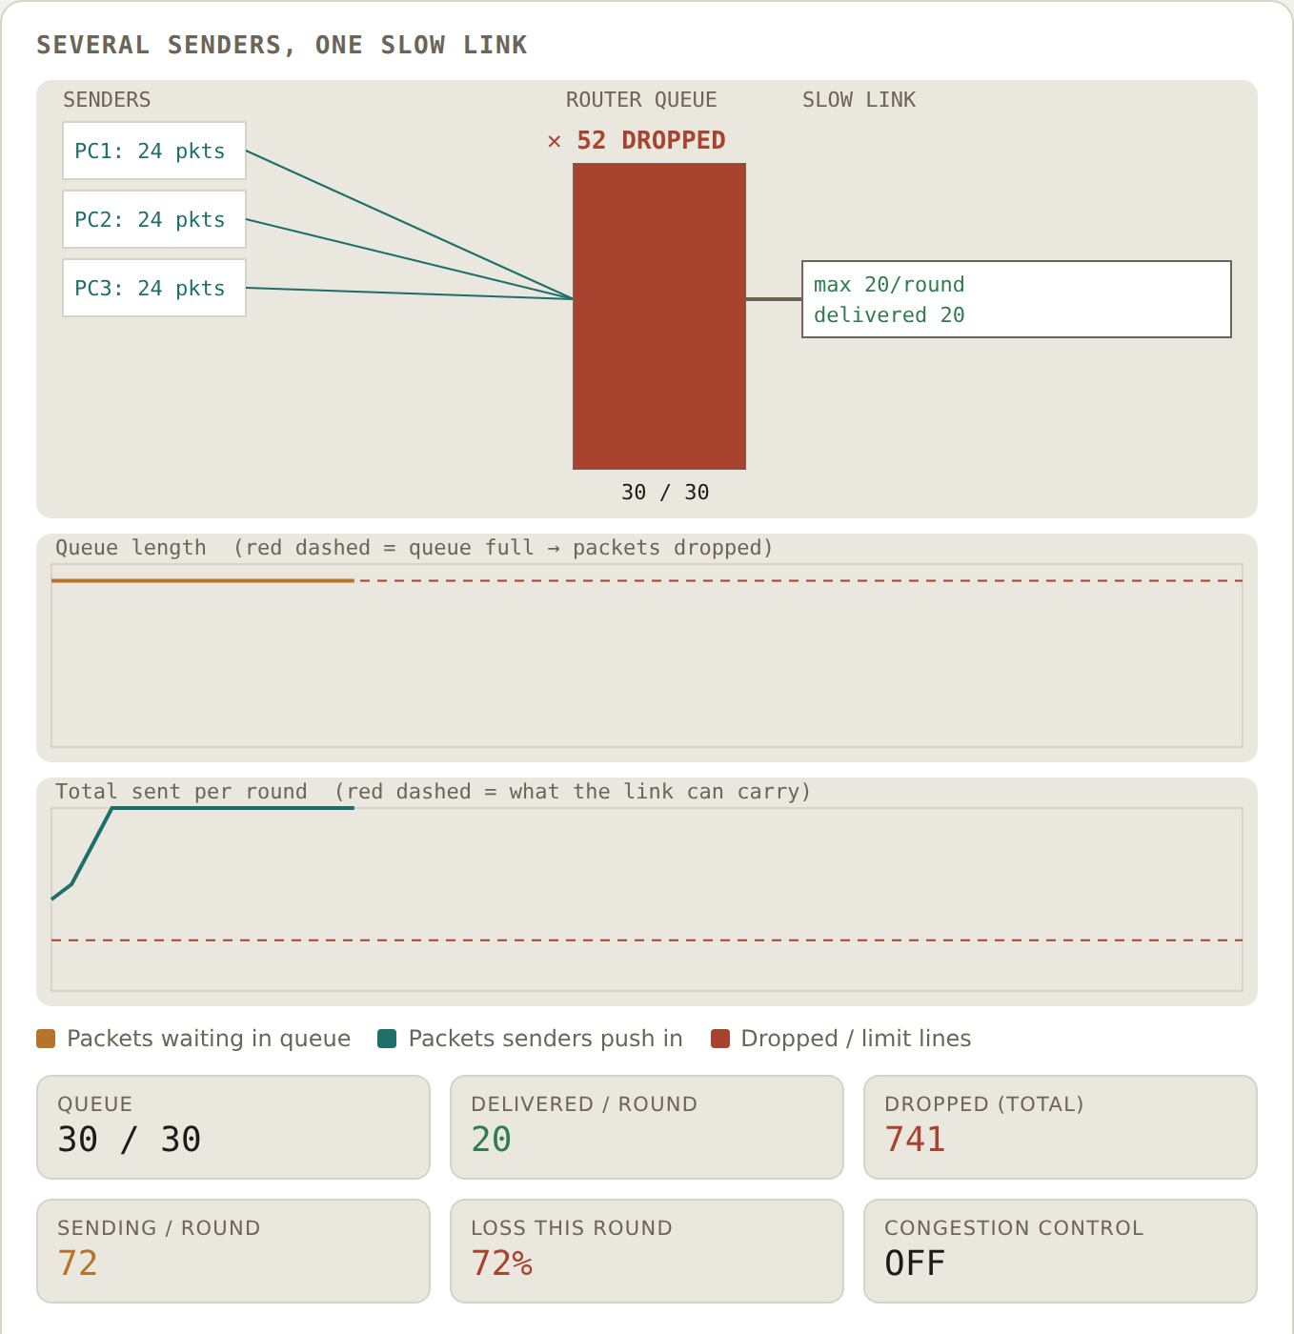
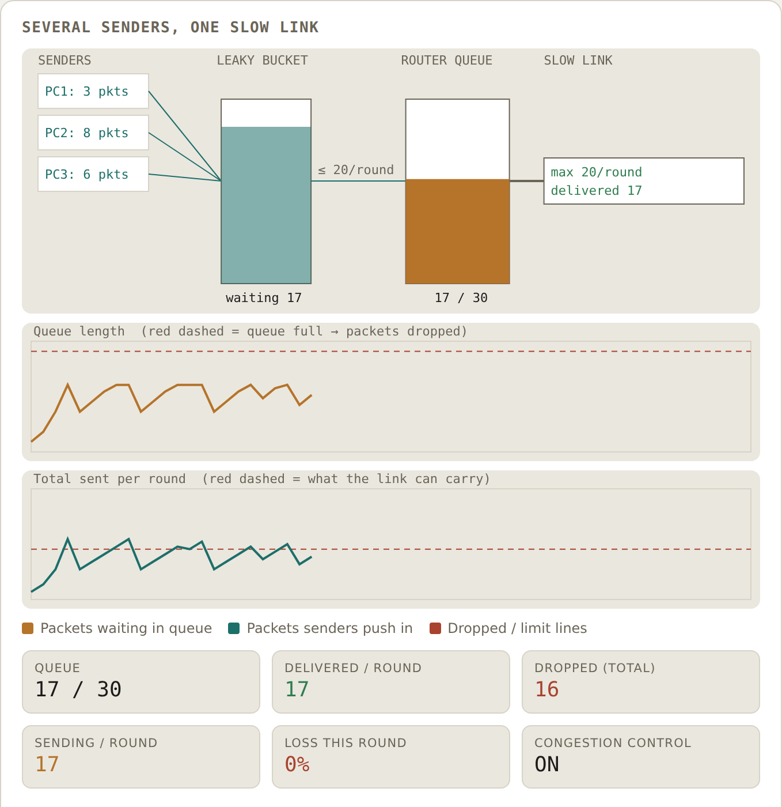
Live Demo
Congestion Demo — the jam, then the fix
Control OFF, no shaper
Control ON + leaky bucket
Three senders share one link that carries 20 packets per round.
OFF: they push 72 per round, the queue sits full and 72% of packets are lost.
ON: senders halve on loss and speed up gently, so the rate hovers around 20 and loss is near 0.
The bucket keeps the router queue from overflowing. TCP makes the senders slow down. Both are needed.
Congestion Control Lab
13

Slide 14
Simulator Results
TCP window: Reno recovers faster than Tahoe
What the run shows
Both start at 1 and double: 1, 2, 4, 8, 16 (slow start), then add 1 per round up to 20.
A loss at cwnd = 20 halves the threshold: ssthresh becomes 10.
Reno drops straight to 10 and keeps adding 1.
Tahoe drops to 1 and doubles back (1, 2, 4, 8, 10) before adding 1.
Four steps after the loss: Reno is at 14, Tahoe is at 10.
Congestion Control Lab
14

Slide 15
Simulator Results
Leaky vs. token bucket: when packets leave
Test (rate 2 per half second)
Leaky bucket
Token bucket
Burst of 8 (capacity 20)
Sent 0, 2, 4, 6, 8 over 2 seconds. 0 dropped.
Sent 8 at once. Tokens 20 to 12. 0 dropped.
Burst of 20 (capacity 20)
Bucket 20 / 20. Sent 8 after 2 seconds, all 20 after 5. 0 dropped.
Sent 20 at once. Tokens 0. 0 dropped.
Two bursts of 20, back to back
First fills the bucket. Second: 20 dropped.
First uses all tokens. Second: 20 dropped.
Burst of 15, capacity 5
5 queued, 10 dropped. The 5 leave over about 1.5 seconds.
5 sent at once, 10 dropped.
Both drop whatever exceeds their capacity. The difference is when packets leave: the leaky bucket spreads them out, the token bucket lets them go at once.
Congestion Control Lab
15

Slide 16
Simulator Results
Congestion Demo: the four combinations
Congestion control
Shaper
What the numbers show
OFF
None
72 packets sent per round into a 20-packet link. Queue stuck at 30 / 30. 72% lost.
OFF
Leaky bucket
Router queue protected, but the shaper drops about 52 per round. Loss still 72%: the senders keep over-sending.
ON
None
Sending settles around 18 to 24 per round. Almost no loss.
ON
Leaky bucket
Sending steady near 20. About 10 packets dropped in 20 rounds.
3 senders, link capacity 20 per round, queue 30, shaper rate 20. A bucket alone moves the drops to the edge. The senders must slow down too.
Congestion Control Lab
16

Slide 17
Simulator Limitations
What the simulator does not claim
It is a simplified model of the algorithms. It does not carry real network traffic.
In the TCP tab, packet loss is simulated: it fires at random (about 3% per round once speeding up) or when the button is pressed. It is not caused by a real overloaded link.
In the Congestion Demo the queue really overflows inside the model, but the senders are simplified TCP senders and the units are packets per round, not real bandwidth.
The Leaky and Token Bucket tabs show the mechanism only. The link behind the bucket appears in the Congestion Demo.
One bottleneck only. No random early drop (RED), no CUBIC, no real round-trip timing.
Congestion Control Lab
17

Slide 18
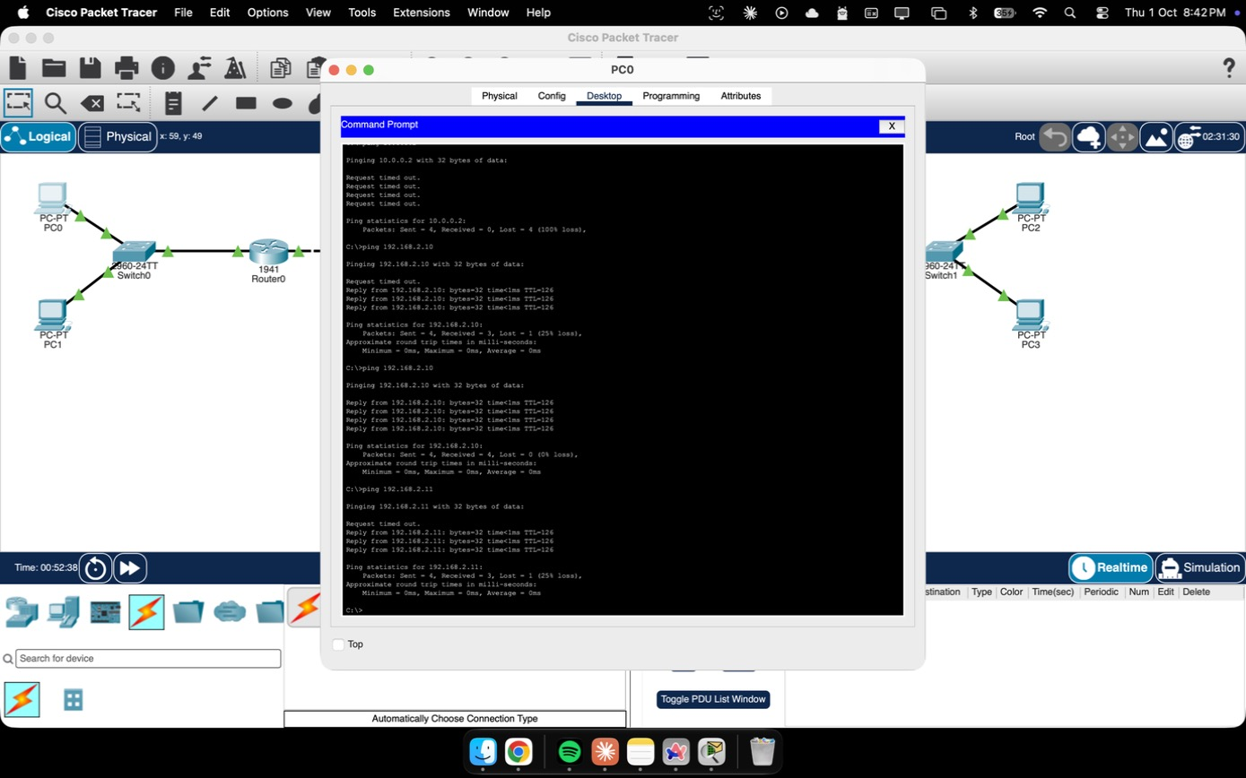
Network-Level Enforcement
Packet Tracer — a two-router WAN QoS lab
A two-router topology (two LANs, four PCs, a routed WAN link) was built and fully addressed, with static routing between both sides.
Router0 is configured with a class-based traffic-shaping policy (MQC: class-map + policy-map, shape average 128 kbps) — a token-bucket-style shaper in real IOS. In Packet Tracer 9.0.1, binding it to the WAN interface blocks all traffic, so the final file keeps the policy configured but not bound.
show policy-map interface confirms the shaper's byte limit, sustain/excess burst and queueing parameters on the live device CLI.
End-to-end IP connectivity was verified with ping across the full path — PC0 to PC2/PC3, through both routers and the WAN link.
Methodology: configure → verify with show commands → test with extended ping → fix → re-verify — the same checklist used on real production routers.
PC0 → PC2/PC3 ping, across both routers and the WAN link
Topology, device configuration and the full CLI evidence log are attached as the companion Packet Tracer (.pkt) file.
Congestion Control Lab
18

Slide 19
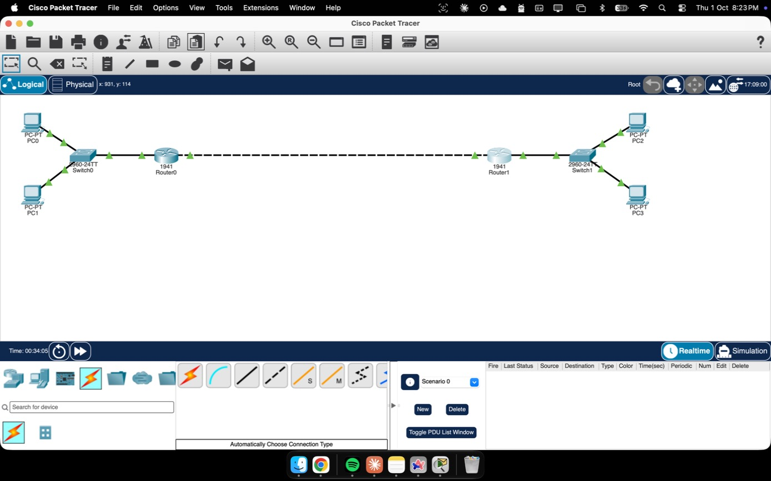
The Topology
Two LANs, two routers, one WAN link
Addressing plan
PC0 / PC1
192.168.1.10–11/24
Router0 Gi0/0
192.168.1.1/24
WAN link
10.0.0.0/30
Router1 Gi0/0
192.168.2.1/24
PC2 / PC3
192.168.2.10–11/24
Static routes on both routers point each LAN at the other, across the point-to-point WAN link.
Congestion Control Lab
19

Slide 20
Results
What the three simulations show
TCP Reno
Leaky Bucket
Token Bucket
Recovers from loss by halving, never by resetting to cwnd = 1 — the saw-tooth renews itself without a full restart.
Enforces a perfectly flat output rate — at the cost of dropping any burst beyond its fixed capacity, whether malicious or legitimate.
Tolerates exactly the burst its banked tokens allow, then settles to the steady rate — the behaviour real QoS policers rely on.
Congestion Control Lab
20

Slide 21
Methodology Detail
Exact parameters behind every run shown
Panel
Key parameters
What they control
TCP (Reno / Tahoe)
MSS = 1 segment · initial ssthresh = 16 MSS · 45 RTT rounds
Growth rate and the threshold where slow start hands off to congestion avoidance
Leaky bucket
Capacity = 20 packets · leak rate = 2 packets/tick
How much burst can queue before overflow, and how fast it drains
Token bucket
Capacity = 20 tokens · fill rate = 2 tokens/tick · default burst = 8 packets
How much idle time converts into an allowed burst
Packet Tracer QoS
class-map CONGESTION_TEST, policy-map POLICE_OUT, shape average 128 kbps, Router0 Gi0/1 (configured, not bound)
The real-device analogue of the token-bucket rate limit above
Every value above is a live control in the visualizer, not a hard-coded constant — these are simply the settings used to produce the charts and screenshots in this deck.
Congestion Control Lab
21

Slide 22
Why It Matters
The same three ideas, running in production networks
TCP Reno / CUBIC
Leaky bucket
Token bucket
Still the default congestion control in most operating-system TCP stacks — every web page load and file download rides a variant of this same saw-tooth.
Used wherever a strictly constant output rate matters more than burst tolerance — e.g. ATM traffic shaping and some strict-priority egress queues.
The algorithm behind almost every real QoS policer and rate limiter in production — Cisco CIR/burst-size policing, cloud API rate limits, and CDN edge throttling all use this exact mechanism.
Congestion Control Lab
22

Slide 23
Conclusion
Three mechanisms, one goal: a link that degrades gracefully, never collapses.
TCP's congestion window, the leaky bucket, and the token bucket attack the same problem from different layers — the end host, and the network path itself.
Making every parameter a live control, instead of a fixed textbook example, is what turns the saw-tooth and the overflow drop from a diagram into something watched happening.
Configuring the equivalent shaping on real router interfaces in Packet Tracer — and working through the simulator issue that came with it — closes the loop from algorithm to actual device configuration.
The same token-bucket logic configured here underlies real QoS policers in production networks, which is what makes this lab more than a classroom exercise.
Congestion Control Lab
23

Slide 24
Thank You
Congestion Control Lab — Computer Networks Mini Project
References
Kurose & Ross, Computer Networking: A Top-Down Approach, 8th ed.
Tanenbaum & Wetherall, Computer Networks, 5th ed.
Allman, Paxson, Blanton — RFC 5681, TCP Congestion Control.
Cisco Networking Academy — Packet Tracer 9.0.1, QoS Policing & Queuing.

