Slide 1
DEEP LEARNING PROJECT
Deep Learning-Guided
Nanorobotic Targeting
U-Net tumor segmentation on brain MRI, driving 3D nanobot navigation
Ojaswi Gondalia · B.Tech Artificial Intelligence · NMIMS MPSTME, Mumbai
Notes:
Good morning ma'am. My project helps a tiny medical robot, a nanobot, find a brain tumor. The AI reads a brain MRI and marks where the tumor is. We turn that into a path the nanobot can follow. I will show how it works, the results, and the limits. (We did not build a real nanobot: we built the AI that finds the target and a simulation of the movement.)

Slide 2
THE PROBLEM
A nanobot can only deliver therapy to a tumor it can locate.
Targeting needs coordinates
MRI already holds the map
This project
Nanorobotic delivery is proposed as a way to concentrate treatment on tumor tissue. To steer, a bot needs a target position, not just a diagnosis.
Brain MRI shows the tumor slice by slice. Outlining it by hand is slow, so the map is rarely turned into usable coordinates.
A U-Net segments the tumor automatically, its centroids form a 3D target, and three navigation strategies are compared in simulation.
Notes:
A nanobot can only treat a tumor if it knows where it is, and it needs a position, not just a diagnosis. MRI already contains that map slice by slice, but drawing the tumor by hand is slow. So the AI does it automatically, we convert it to 3D coordinates, and compare three ways to travel there. Q: Why MRI? It shows soft tissue clearly without radiation and comes as a stack of slices, ideal for a 3D path.

Slide 3
METHOD
Five stages from scan to target
01
02
03
04
05
MRI slices
U-Net
Centroids
3D target
Navigation
FLAIR brain slices, resized to 256 × 256
Per-pixel tumor probability, cut at 0.5
Image moments give each slice's tumor centre
Centroids stacked by slice index
Three pursuit strategies compared
Stages 1–3 run in PyTorch on a Kaggle T4 GPU. Stages 4–5 run both in the notebook and in a browser simulator built with Three.js.
Notes:
Five steps. One: MRI slices resized to 256 by 256. Two: a U-Net gives each pixel a tumor probability, and we call it tumor above 0.5. Three: for each slice we find the centre of the tumor blob. Four: stack the centres by slice number for a 3D path. Five: compare three navigation strategies. Q: What is a centroid? The average position of all tumor pixels in a slice, like the balance point of the blob.

Slide 4
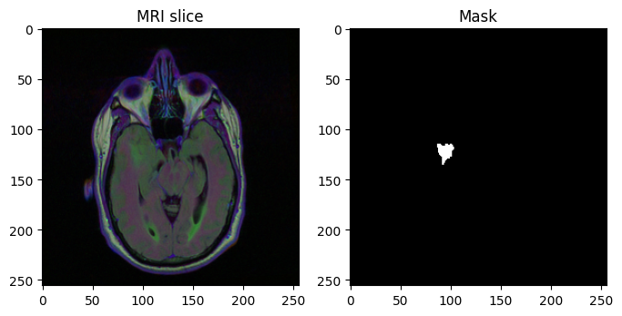
DATA
LGG brain MRI segmentation dataset
110
3,929
patients
slices with masks
Low-grade glioma scans from TCGA/TCIA (Buda et al.), via Kaggle. Each slice stores three MRI sequences as channels, with a binary tumor mask.
Split by patient, 80/20: 88 patients (3,202 slices) for training, 22 patients (727 slices) held out, so no patient appears in both sets.
A training slice and its ground-truth tumor mask
Notes:
We used the public LGG Brain MRI dataset: real scans of 110 patients with low-grade glioma, each slice with a doctor-drawn mask. We split by patient: 88 for training, 22 held out for testing. If slices from the same patient were in both sets, the model could partly memorize that patient and the test would be unfairly easy (data leakage).

Slide 5
MODEL
U-Net trained from scratch
A four-level encoder compresses the slice from 64 to 1,024 feature channels. The decoder upsamples back to full resolution.
Skip connections pass each encoder level's features to the matching decoder level, which keeps tumor boundaries sharp.
Dice + BCE loss: tumors cover few pixels, so Dice rewards overlap directly while BCE keeps per-pixel training stable.
Setting | Value
Input | 3 × 256 × 256
Output | 1 × 256 × 256, sigmoid
Loss | Dice + binary cross-entropy
Optimizer | Adam, learning rate 1e-4
Batch size | 16
Epochs | 20
Hardware | Kaggle Tesla T4 GPU
Threshold | 0.5
Notes:
The model is a U-Net. Think of squinting at a photo to get the big picture, then opening your eyes to trace exact edges. The encoder shrinks the image while learning bigger patterns, 64 up to 1,024 feature channels; the decoder grows it back. Skip connections copy sharp detail across so edges stay precise. Loss is Dice plus binary cross-entropy. Q: Why not a pretrained model? We trained from scratch for simplicity; a pretrained encoder is a next step. Q: What does 0.5 do? Raising it gives fewer false alarms but more missed tumor.

Slide 6
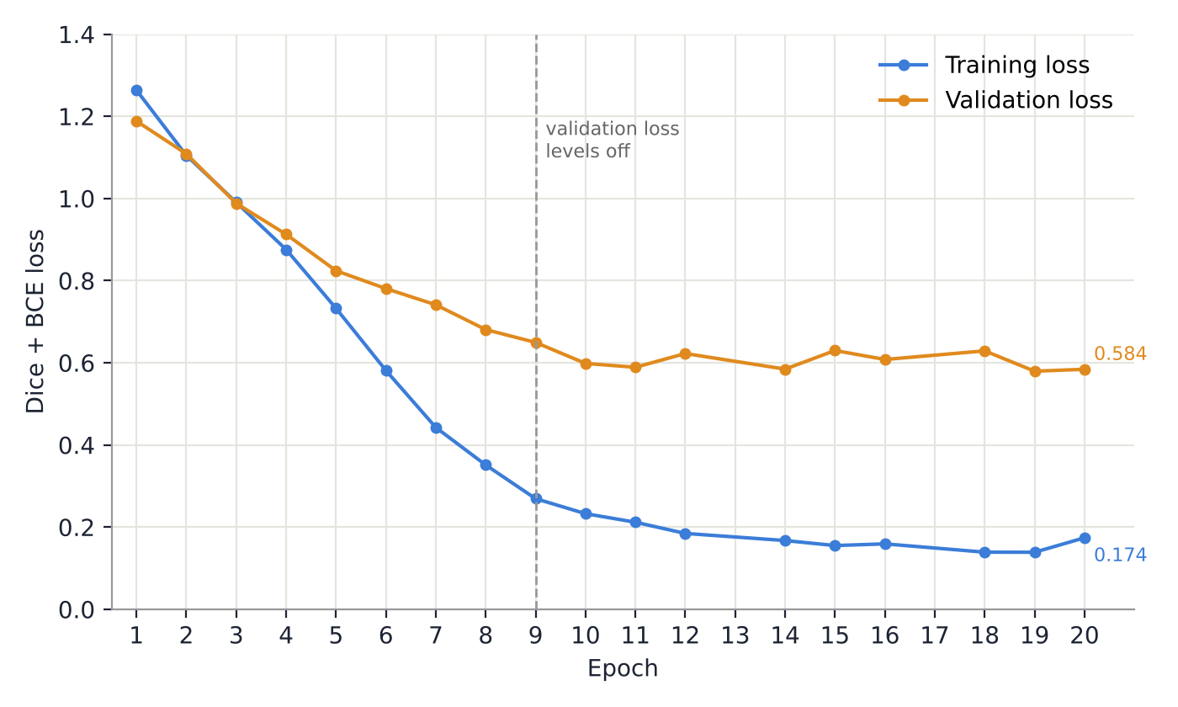
TRAINING
Loss fell over 20 epochs, then validation levelled off
Training loss
1.264 → 0.174
Validation loss
1.188 → 0.584
Validation loss levels off after epoch 9 while training loss keeps falling, an early sign of overfitting. The saved weights are from epoch 20 (0.584), not the best epoch (19, 0.580).
Epochs 13 and 17 were not captured in the saved notebook log; the chart shows the logged epochs only.
Notes:
Training loss fell from 1.26 to 0.17. Validation loss, on patients the model is not learning from, fell from 1.19 to about 0.58 but flattened around epoch 9 while training loss kept falling: early overfitting, the model gets better at the training images rather than learning something general. Our code saves the last epoch, not the best, and epoch 19 was slightly better than 20. Q: How to reduce overfitting? Data augmentation, early stopping, a pretrained encoder, more data.

Slide 7
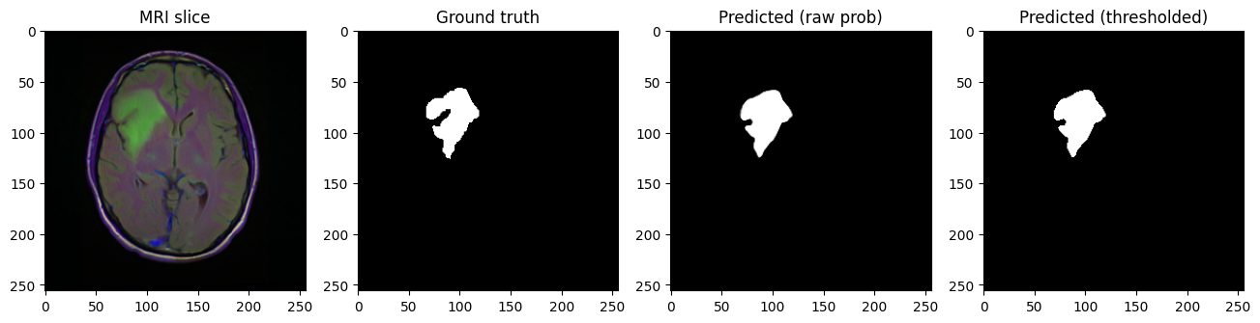
SEGMENTATION RESULTS · 22 HELD-OUT PATIENTS
Predictions closely match the ground-truth masks
0.773
0.746
20 / 22
Mean Dice coefficient
Mean IoU
Patients with tumor detected
Notes:
On the 22 patients the model never saw, mean Dice is 0.773 and mean IoU 0.746. Both measure overlap between the predicted tumor and the doctor's drawing, 1.0 being perfect. It found tumor in 20 of 22 patients; it completely missed two. Q: Dice vs IoU? Dice = 2 x overlap / (sum of both areas); IoU = overlap / combined area; Dice is always a bit higher. Q: Why miss 2? Likely small or faint tumors; a 2D model has no volume context.

Slide 8
A CORRECTION TO THE METRICS
Per-slice precision and recall were misleading, so they are recomputed from pooled counts
What went wrong
The fix
Most validation slices have no tumor. On those, a correct empty prediction gives 0 ÷ 0 for precision and recall, which the first version counted as 0. Averaging pulled the scores down to 0.24 precision and 0.19 recall, which can't be squared with a Dice of 0.77.
Count true positives, false positives and false negatives across every validation pixel (727 slices), then compute each metric once.
0.876
0.579
0.697
Precision
Recall
F1
TP 351,552 · FP 49,579 · FN 255,679 · TN 50,330,198
Notes:
Our first precision and recall were about 0.24 and 0.19 while Dice was 0.77. Both cannot be true. Most slices contain no tumor, so a correct empty prediction gives 0 divided by 0, which the first code counted as zero and dragged the average down. The fix: add up true positives, false positives and false negatives over every pixel first, then compute once. Corrected: precision 0.876, recall 0.579, F1 0.697. When the model says tumor it is right about 88% of the time, but it catches only about 58% of the real tumor pixels: cautious. Q: Is a miss worse than a false alarm? Usually yes in medicine, so the weakness is in the riskier direction; this should assist a radiologist, not replace one.

Slide 9
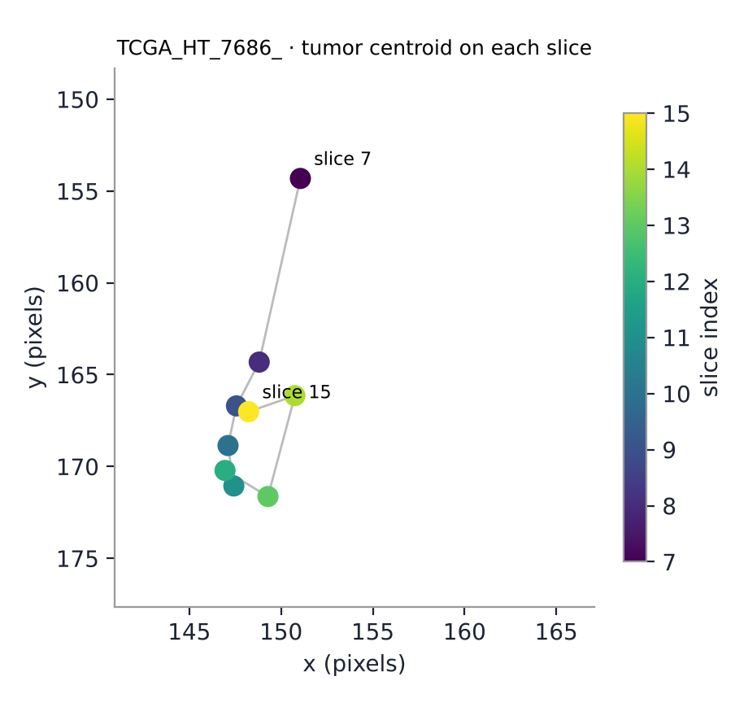
FROM MASK TO TARGET
Each slice's tumor becomes one 3D waypoint
Centroid: the image moments of the binary mask give x = M₁₀ / M₀₀ and y = M₀₁ / M₀₀. A slice with an empty mask gives no waypoint.
3D path: waypoints ordered by slice index trace the tumor through the volume as (slice, x, y).
Example · TCGA_HT_7686
Tumor found on 9 slices (7–15). Mean target at slice 11.0, x 148.6, y 166.7.
Notes:
To turn a mask into a target point we use image moments: M00 is the area, and M10/M00 and M01/M00 give the average x and y, the centre of the blob. A slice with no tumor gives no point. Stacking the points in slice order gives a 3D path (slice, x, y). For patient TCGA_HT_7686 the tumor is on 9 slices and the centre drifts smoothly, so the model found one consistent tumor. Q: Is this step AI? No, it is geometry: averaging pixel positions.

Slide 10
NAVIGATION
Three pursuit strategies, same entry point
Static target
Dynamic tracking
Obstacle-aware
Straight line to the mean of all centroids. Shortest route, but it ends at the tumor's average position.
Visits every slice's centroid in order, moving on once within 1 voxel. Follows the tumor's real shape.
Dynamic tracking plus repulsion from critical structures. Repulsion fades near each waypoint so the bot cannot get trapped.
p ← p + s·(t − p) / |t − p|
pursue c[i] until |c[i] − p| < 1
u = dir(t) + k·f·Σ (p − o) / |p − o|²
All start at slice 0, image centre (128, 128), and move 1.5 voxels per step.
Notes:
Three ways for the nanobot to move, same start, 1.5 voxels per step. Static: straight line to the average of all centres; shortest, but a tumor is a 3D shape, not a point, so it ends beside it. The formula says: each step, move a bit toward the target. Dynamic: visit each slice centre in order, moving on within 1 voxel; this traces the real shape. Obstacle-aware: dynamic plus a push-away from critical structures, stronger when closer and faded near each waypoint so it cannot get stuck. Q: Is dynamic the shortest possible path? No, it is a simple sequential strategy. Q: Are the obstacles real? No, simulated spheres (slide 14).

Slide 11
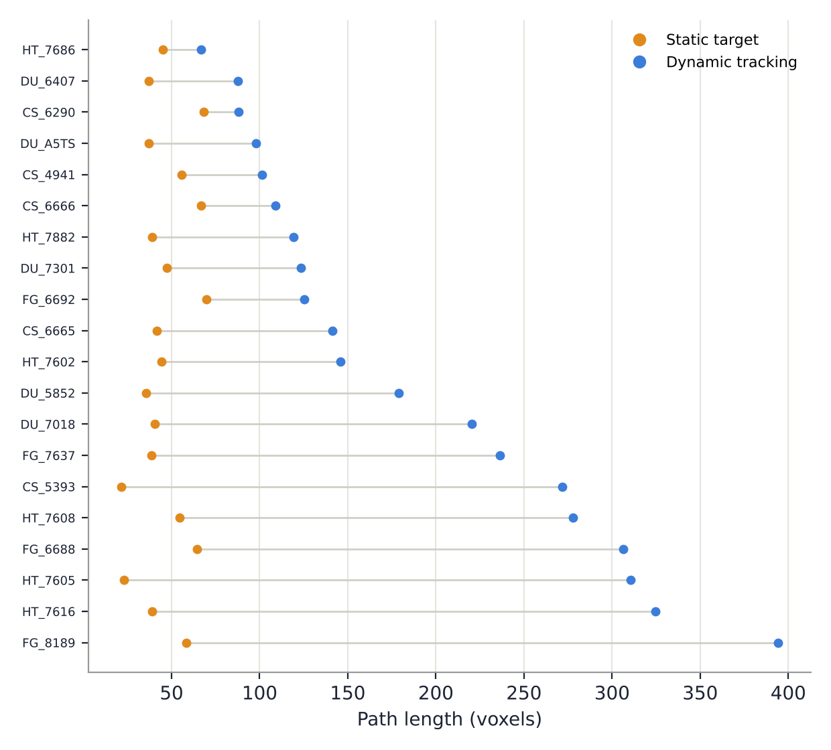
NAVIGATION RESULTS · 20 OF 22 HELD-OUT PATIENTS
Tracking the real tumor costs path length
Mean | Static | Dynamic
Path length | 46.4 | 186.3
Median path | 43.1 | 143.5
Final distance | 5.98 | 0.00
Worst distance | 27.17 | 0.00
Static targeting is about 4× shorter but ends on average 6.0 voxels from any segmented tumor point. Dynamic tracking always ends on tumor tissue.
Units: voxels (pixels and slice index). The 2 patients with no detected tumor have no path.
Notes:
Over the 20 patients with a detected tumor, static paths average 46 voxels and dynamic 186, so static is about four times shorter. But static ends about 6 voxels from the tumor on average, and 27 voxels away in the worst case, patient TCGA_FG_6688 with a tiny scattered tumor. Dynamic always ends exactly on tumor. Fast but imprecise against slow but accurate. Q: Why 20 and not 22? Two patients had no detected tumor, so there is no path.

Slide 12
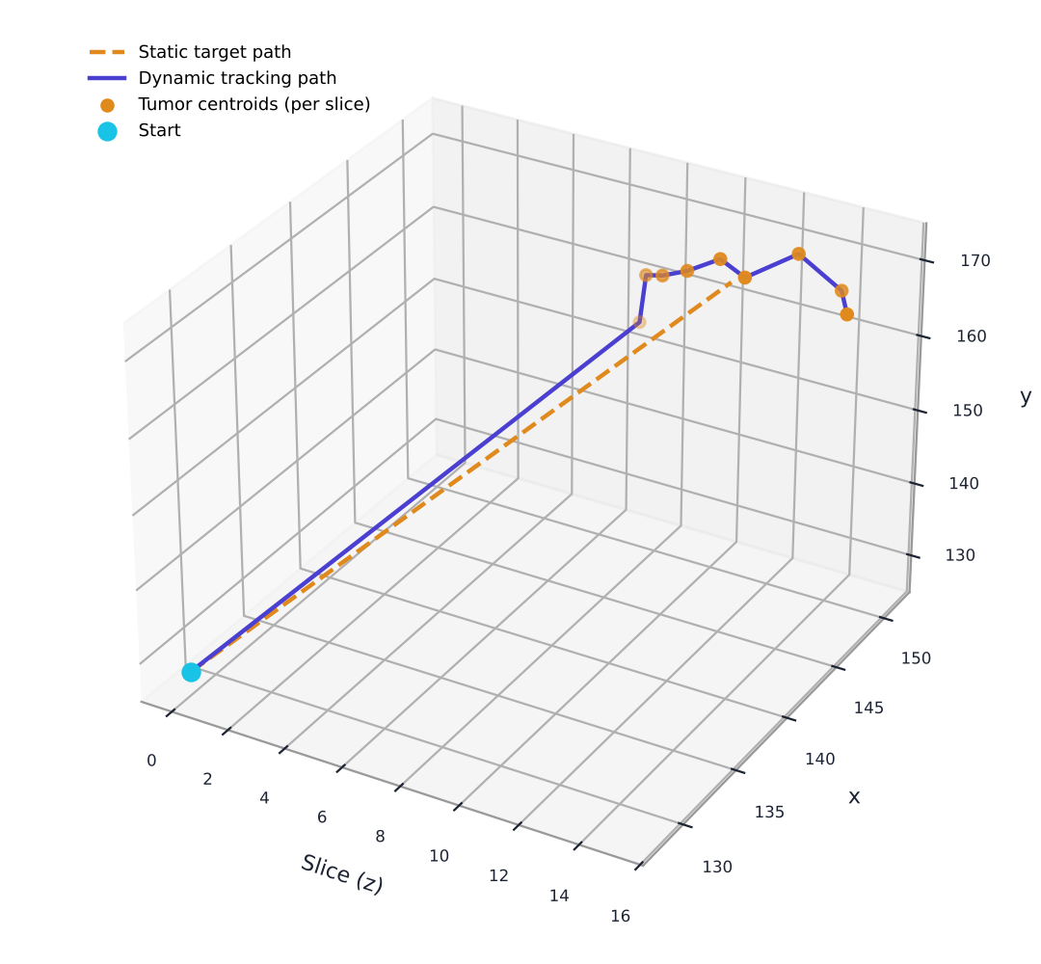
ONE PATIENT · TCGA_HT_7686
Two paths to the same tumor
Static target
45.2 voxels long, ends 2.24 voxels from the nearest tumor centroid
Dynamic tracking
66.6 voxels in 53 steps, visits all 9 tumor slices and ends on a centroid
Notes:
One patient, TCGA_HT_7686. The static path is about 45 voxels and ends about 2 voxels from the tumor. The dynamic path is about 67 voxels in 53 steps, visits all 9 tumor slices and ends on a centre point. The static line cuts straight across while the dynamic line follows the tumor.

Slide 13
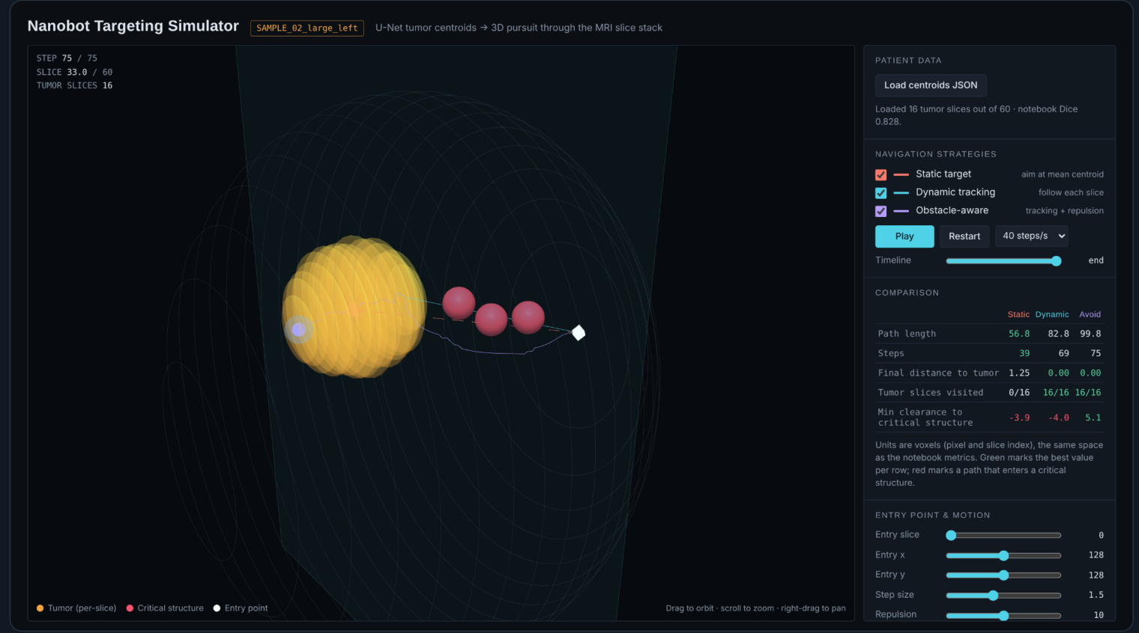
INTERACTIVE SIMULATOR
All three strategies, live in the browser
Loads the notebook's per-patient JSON export of U-Net centroids and runs the same pursuit maths in JavaScript.
Adjustable entry point, step size and repulsion, with a live comparison table.
On the sample patients, only the obstacle-aware bot stays clear of the critical structures, by about 5 voxels.
Shown with a synthetic sample patient
Notes:
We also built a browser simulator. It loads the JSON exported from the notebook, runs the same pursuit maths in JavaScript, and lets you change entry point, step size and repulsion, with a live comparison table. On the sample patients only the obstacle-aware bot stays clear of the critical structures, by about 5 voxels, while the other two cut through them. The patient on this slide is synthetic, not real. Q: Does the simulator detect cancer itself? No: which cells are tumor is decided by the AI model before the simulation starts; the simulator only shows movement.

Slide 14
LIMITATIONS AND NEXT STEPS
What this simulation does not yet show
Limitation | Next step
2D U-Net, one slice at a time | 3D U-Net or slice-stack input for volume context
Validation loss plateaus after epoch 9 | Augmentation, early stopping, a pretrained encoder
Training is not seeded, so results change between runs | Fix random seeds and keep the best-epoch checkpoint
22 validation patients, no separate test set | Patient-level cross-validation and a held-out test split
Critical structures are simulated spheres | Segment real anatomy such as the ventricles as obstacles
Straight-line motion in voxel units | Millimetre spacing, blood flow and tissue drag
Notes:
Honest limits. The model is 2D, one slice at a time; a 3D U-Net would use volume context. Validation loss plateaus after epoch 9, so augmentation, early stopping or a pretrained encoder could help. Only 22 validation patients and no separate test set, so cross-validation is next. Critical structures are simulated spheres, and motion is straight lines in voxel units. Also: re-running our training gives slightly different numbers because the random seed was not fixed. We found this ourselves when the notebook output did not match our first report, and the fix is torch.manual_seed.

Slide 15
CONCLUSION
Segmentation turns an MRI into a target a nanobot can steer to
0.773
0.00
3
Mean Dice on 22 held-out patients
Final distance with dynamic tracking, against 5.98 for a static target
Navigation strategies compared in an open browser simulator
Thank you · Questions
Notes:
To conclude: segmentation turns an MRI into a target a nanobot can steer to. The model reached a mean Dice of 0.773 on 22 unseen patients. With dynamic tracking the nanobot always ends on tumor tissue, against about 6 voxels away for static targeting. We compared three strategies in an open browser simulator. Thank you; happy to take questions.

