Slide 1
SQL Case Study - Paintings

Slide 2
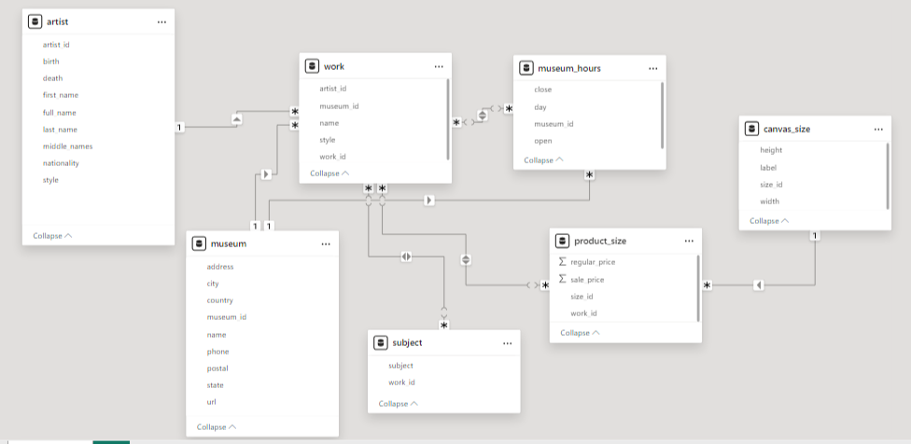

Slide 3
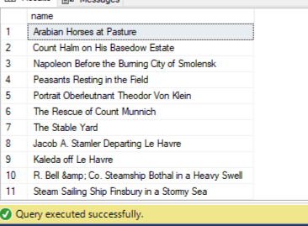
select w.name from [sohag].[dbo].work as w where w.museum_id is null
Problem 1: Fetch all the paintings which are not displayed on any museums?
Input:
Output:

Slide 4
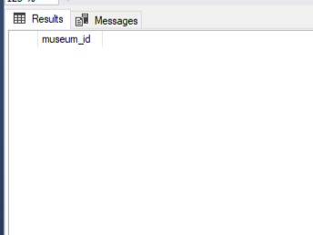
Problem 2: Are there museums without any paintings?
Input:
select m.museum_id from [sohag].[dbo].museum as m
join [sohag].[dbo].work as w on w.museum_id = m.museum_id
group by m.museum_id
having count(w.work_id)=0
Output:

Slide 5
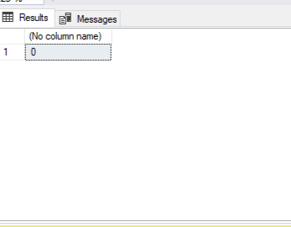
Problem 3:How many paintings have an asking price of more than their regular price?
Input:
select count(p.work_id) from [sohag].[dbo].product_size as p
where p.sale_price>p.regular_price
Output:

Slide 6
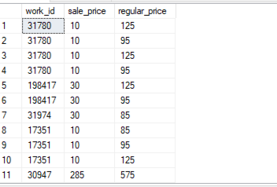
Problem 4: Identify the paintings whose asking price is less than 50% of its regular price
Input:
select p.work_id,
p.sale_price,
p.regular_price
from [sohag].[dbo].product_size as p
where p.sale_price<(p.regular_price*0.5)
Output:

Slide 7
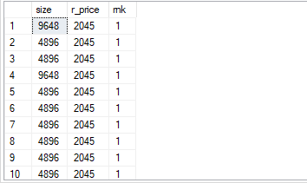
Problem 5:Which canva size costs the most?
Input:
with cte as
(select c.size_id as size ,
p.regular_price as r_price,
rank() over(order by p.regular_price desc) as rnk
from [sohag].[dbo].product_size as p
join [sohag].[dbo].canvas_size as c on c.size_id = p.size_id)
select size,r_price,rnk from cte
where rnk = 1
Output:

Slide 8
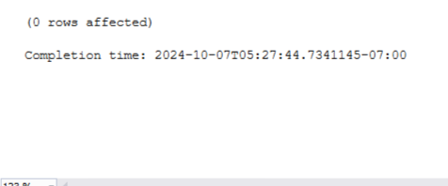
Problem 6: Delete duplicate records from work, product_size, subject and image_link tables
Input:
with cte as
(select w.name,w.artist_id,w.style,w.museum_id,
ROW_NUMBER() over(partition by w.name,w.artist_id,w.style,w.museum_id order by w.work_id) as rnk
from [sohag].[dbo].work as w)
delete from cte
where rnk>1
Output:

Slide 9
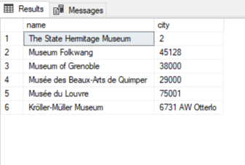
Problem 7: Identify the museums with invalid city information in the given dataset
Input:
select m.name,m.city
from [sohag].[dbo].museum as m
where m.city like '%[0-9]%'
Output:

Slide 10
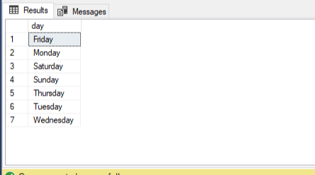
Problem 8: Museum_Hours table has 1 invalid entry. Identify it and remove it.
Input:
Select distinct day
FROM [sohag].[dbo].[museum_hours] as mh
Delete FROM [sohag].[dbo].[museum_hours]
where day ='Thusday'
Output:

Slide 11
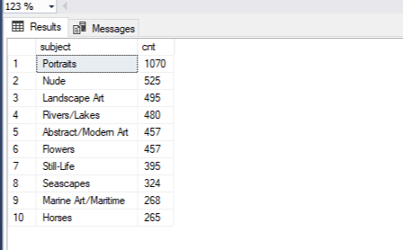
Problem 9: Fetch the top 10 most famous painting
Input:
select top 10 subject,
cnt from(select s.subject,count(*) cnt
from [sohag].[dbo].subject as s
group by s.subject) w
order by cnt desc
Output:

Slide 12
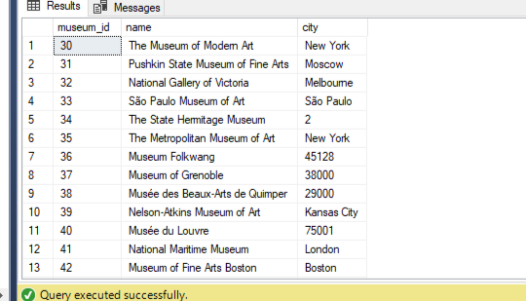
Problem 10: Identify the museums which are open on both Sunday and Monday. Display museum name, city.
Input:
SELECT distinct mh.museum_id,
m.name,m.city
FROM [sohag].[dbo].[museum_hours] as mh
join [sohag].[dbo].museum as m on m.museum_id = mh.museum_id
where mh.day in('Sunday' , 'Monday') and mh.[close]> mh.[open]
Output:

Slide 13
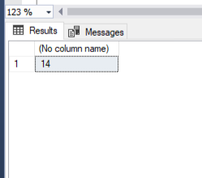
Problem 11: How many museums are open every single day?
Input:
with cte as (
SELECT m.name,
COUNT(mh.day) as no_of_day
from [sohag].[dbo].museum as m
JOIN [sohag].[dbo].[museum_hours] as mh ON m.museum_id = mh.museum_id
GROUP by name
HAVING COUNT(mh.day) = 7
)
SELECT count(1) from cte
Output:

Slide 14
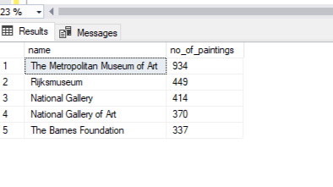
Problem 12: Which are the top 5 most popular museum? (Popularity is defined based on most no of paintings in a museum)
Input:
with cte as (
select m.name,
count(w.work_id) no_of_paintings ,
rank() over(order by count(w.work_id) desc) as rnk
from [sohag].[dbo].work as w
join [sohag].[dbo].museum as m on m.museum_id = w.museum_id
group by m.name)
select name,no_of_paintings from cte
where rnk <= 5
Output:

Slide 15
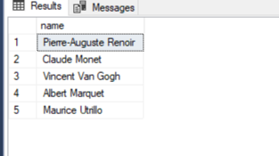
Problem 13: Who are the top 5 most popular artist? (Popularity is defined based on most no of paintings done by an artist)
Input:
with cte as (
select a.full_name as name,
count(w.work_id) no_of_paintings,
rank() over(order by count(w.work_id) desc) as rnk
from [sohag].[dbo].work as w
join [sohag].[dbo].[artist] as a on a.artist_id = w.artist_id
group by a.full_name)
select name from cte
where rnk <= 5
Output:

Slide 16
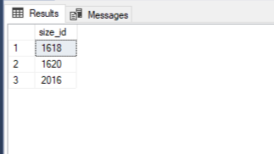
Problem 14: Display the 3 least popular canva sizes
Input:
with cte as
(select *, COALESCE(c.height,0)*COALESCE(c.width,0) as area
from [sohag].[dbo].canvas_size as c),
rnk as (select *, ROW_NUMBER() over(order by area) as rk from cte
where area != 0)
select size_id from rnk
where rk<=3
Output:

Slide 17
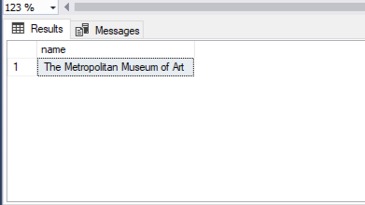
Problem 15: Which museum has the most no of most popular painting style?
Input:
with cte as (
select m.name as name,
count(w.style) as no_style,
ROW_NUMBER() over(order by count(w.style) desc) as rnk
from [sohag].[dbo].work as w
join [sohag].[dbo].museum as m on m.museum_id = w.museum_id
group by m.name)
select name from cte
where rnk=1
Output:

Slide 18
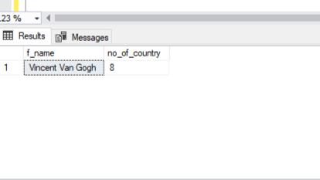
Problem 16: Identify the artists whose paintings are displayed in multiple countries
Input:
with cte as(
select w.artist_id as id,a.full_name as f_name, count(distinct m.country) no_of_country,
ROW_NUMBER() over(order by count(distinct m.country) desc) as rnk
from [sohag].[dbo].work as w
join [sohag].[dbo].[artist] as a on a.artist_id = w.artist_id
join [sohag].[dbo].museum as m on m.museum_id = w.museum_id
group by w.artist_id,a.full_name)
select f_name,no_of_country from cte
where rnk = 1
Output:

Slide 19
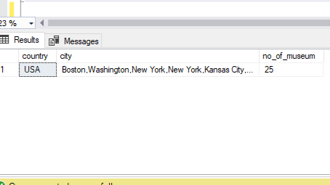
Problem 17:Display the country and the city with most no of museums. Output 2 seperate columns to mention the city and country. If there are multiple value, seperate them with comma.
Input:
with cte as (
select m.country country,
STRING_AGG(m.city,',') as city,
count(m.museum_id) as no_of_museum,
ROW_NUMBER() over(order by count(m.museum_id) desc) as rnk
from [sohag].[dbo].museum as m
group by m.country)
select country,city,no_of_museum from cte
where rnk=1
Output:

Slide 20
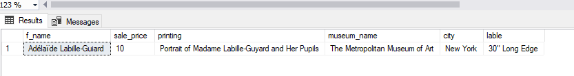
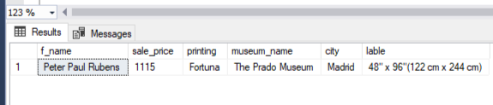
Problem 18:Identify the artist and the museum where the most expensive and least expensive painting is placed. Display the artist name, sale_price, painting name, museum name, museum city and canvas label
Input:
with cte as (select a.full_name as f_name,
p.sale_price as sale_price,
w.name as printing,
m.name as museum_name,
m.city as city,
c.label as lable,
ROW_NUMBER() over(order by p.sale_price desc) as rnk
from [sohag].[dbo].product_size as p
join [sohag].[dbo].work as w on w.work_id = p.work_id
join [sohag].[dbo].[artist] as a on a.artist_id=w.artist_id
join [sohag].[dbo].museum as m on m.museum_id =w.museum_id
join [sohag].[dbo].canvas_size as c on c.size_id =p.size_id)
select f_name,sale_price,printing,museum_name,city,lable from cte
where rnk = 1 or rnk= (select count(1) from cte)
Output:

Slide 21
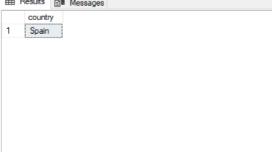
Problem 19:Which country has the 5th highest no of paintings?
Input:
with cte as (select m.country as country,count(w.work_id) as no_of_painting,
ROW_NUMBER() over(order by count(w.work_id) desc) as rnk
from [sohag].[dbo].museum as m
join [sohag].[dbo].work as w on w.museum_id = m.museum_id
group by m.country)
select country from cte
where rnk =5
Output:

Slide 22
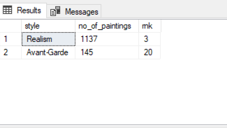
Problem 20:Which are the 3 most popular and 3 least popular painting styles?
Input:
with cte as(
select w.style style,
count(w.work_id) no_of_paintings,
ROW_NUMBER() over(order by count(w.work_id) desc) rnk
from [sohag].[dbo].work as w
where w.style is not null
group by w.style)
select * from cte
where rnk =3 or rnk = (select count(1)-3 from cte)
Output:

Slide 23
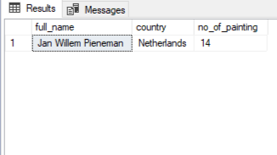
Problem 21:Which artist has the most no of Portraits paintings outside USA?. Display artist name, no of paintings and the artist nationality..
Input:
with cte as (
select a.full_name,
m.country country,
count(s.work_id) no_of_painting,
ROW_NUMBER() over(order by count(s.work_id) desc) as rnk
from [sohag].[dbo].subject as s
join [sohag].[dbo].work as w on w.work_id = s.work_id
join [sohag].[dbo].museum as m on m.museum_id = w.museum_id
join [sohag].[dbo].[artist] as a on a.artist_id = w.artist_id
where s.subject = 'Portraits' and m.country != 'USA'
group by a.full_name,m.country
)
select full_name,country,no_of_painting from cte
where rnk =1
Output:

