Slide 1
// ArrayList of symbolic
// integers
List<Integer> list =
new ArrayList<>(200); ... for (int i = 0;
i < list.size();
i++) {
// list.get(i) returns
// a symbolic integer if (i%2 == 0 &&
list.get(i) == 42) count++; ... } if (count == 75) { //bug
}

Slide 2
List<Integer>.
get(i)
ArrayList<Integer>.
get(i)
(1)
(3)
(2)
ArrayList<E>.
rangeCheck(i)
Integer.
intValue()
ArrayList<E>.
elementData(i)
Integer.
value
ArrayList<E>.
elementData[i]

Slide 3
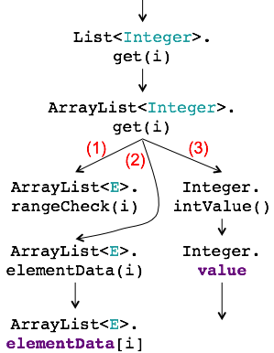

Slide 4
List<Integer> list =
new ArrayList<>(200);
//put 200 symbolic int into list
int wordCount = 0;
boolean inWord;
if (list.size() > 0) {
int firstElement = list.get(0);
if (firstElement == 0)
inWord = false;
else inWord = true;
for (int i = 0;
i < list.size();
i++) {
if (inWord) {
//list.get(i) returns sym. int
if (list.get(i) == 0) {
++wordCount;
inWord = false;
}
} else {
if (list.get(i) != 0)
inWord = true;
}
}
}
return wordCount;
List<Integer>.
get(i)
(3)
ArrayList<Integer>.
get(i)
Integer.
intValue()
(1)
ArrayList<E>.
rangeCheck(i)
Integer.
value
(2)
ArrayList<E>.
elementData(i)
ArrayList<E>.
elementData[i]
region 1
region 2

Slide 5
List<Integer>.
get(i)
(3)
ArrayList<Integer>.
get(i)
Integer.
intValue()
(1)
ArrayList<E>.
rangeCheck(i)
Integer.
value
(2)
ArrayList<E>.
elementData(i)
ArrayList<E>.
elementData[i]

Slide 6
// ArrayList of symbolic
// integers
List<Integer> list =
new ArrayList<>(200);
...
for (int i = 0;
i < list.size();
i++) {
// list.get(i) returns
// symbolic integer
if (i%2 == 0 &&
list.get(i) == 42)
count++;
...
}
if (count == 75) {
//bug
}
List<Integer>.
get(i)
ArrayList<Integer>.
get(i)
(1)
(3)
void
ArrayList<E>.
rangeCheck(i)
throws
IndexOutOf
BoundsException
int
Integer.
intValue()
(2)
Integer.
value
E ArrayList<E>.
elementData(i)
ArrayList<E>.
elementData[i]

Slide 7
local
variable
alpha
renaming
local
variable
substitution
static
summarization
method
inlining
field & array
variables
alpha
renaming
field
references
transformation
array
references
transformation
type
propagation
single-path
cases
transformation
translation
to Green
expression
simplification
transformation
linearization

Slide 8
boolean inWord;
if (firstElement == 0) inWord = false;
else inWord = true;
BB22 51: conditional branch(ne, to iindex=55) v39,v12:#0
BB24
BB23
54: goto (from iindex= 54 to iindex = 57)
BB25
57: v40 = phi #0, #1

