Slide 1


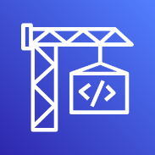






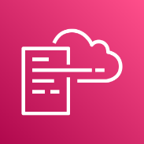
AWS CodePipeline
AWS SAM
template
AWS CloudFormation template
Change set
Stack
AWS CodeCommit
AWS CodeBuild
AWS CodeDeploy
Serverless
application
AWS CloudFormation

