Slide 1
MOVIE RECOMMENDATION SYSTEM
Members: Sohaib Ashraf(20k-0488), Shahzaib(20k-1067), Khawaja Abdullah(20k-0385)

Slide 2
Agenda
Introduction
Primary goals
Methodology
Results
Summary

Slide 3
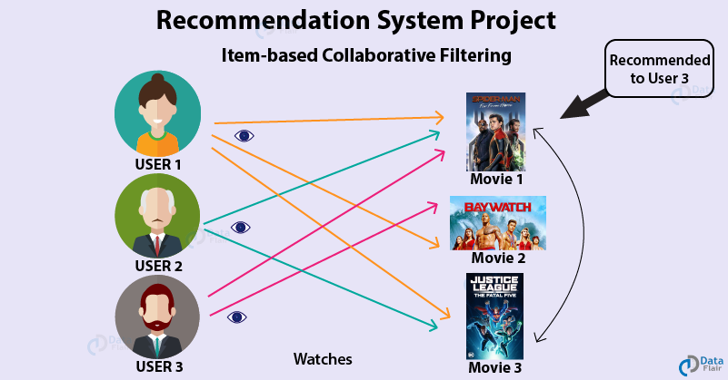
Introduction
This project is a recommendation system that recommends top 10 unwatched movies to a particular user input. The project uses the collaborative filtering technique which recommends movies based on the ratings and behavior of other users who have similar preferences.

Slide 4
Primary goals
The project aims to create a predictive model that can accurately forecast future values of a target variable based on historical data. The model uses a type of neural network called a Long Short-Term Memory (LSTM) network, which is designed to capture temporal dependencies in sequential data. The model is trained on a dataset consisting of time series data, and its performance is evaluated on a separate set of data. The primary goal of the project is to develop a model that can accurately predict future values of the target variable and outperform other benchmark models.

Slide 5
LIBRARIES USED:
Pandas: Used for data manipulation and analysis.
NumPy: Used for numerical operations on arrays and matrices.
Scikit-learn: Used for machine learning algorithms and tools.
Keras: Used for building and training deep learning models.
TensorFlow: Used as a backend for Keras, it's a popular open-source platform for building and deploying machine learning models.

Slide 6

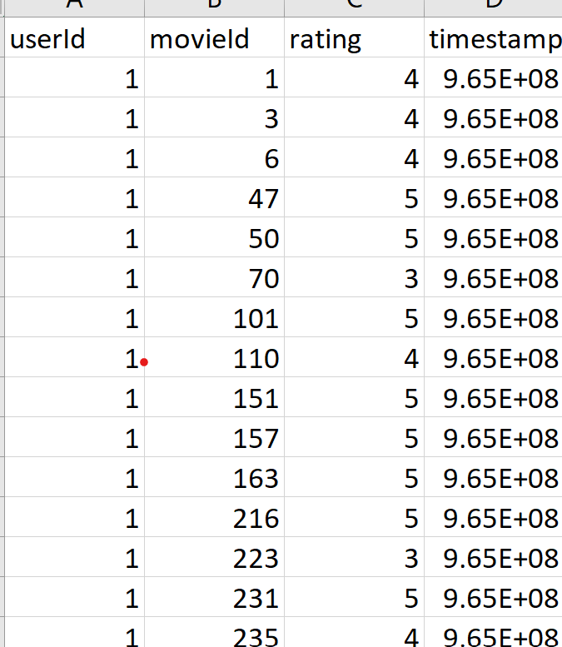
DATA-SET USED:

Slide 7
HOW DID WE GET HERE?
Selection of dataset:
Technique used:
Achieved it:
The ml-latest-small dataset includes 100836 ratings and 3683 tag applications from 610 users on 9742 movies, created between March 1996 and September 2018. It contains no demographic information and is publicly available at grouplens.org/datasets
We employed item based collaborative filtering which is a recommendation algorithm that suggests items based on the similarity between the items themselves, rather than on the similarity between the users. It identifies the items that are frequently co-rated with the target item and recommends them to users who have shown an interest in the target item.
We developed a neural network to calculate the similarities of the movies rated by the calculating the dot product and then passing it to the dense layers to add non-linearity.

Slide 8
MAIN IDEA:
The neural collaborative filtering model is a machine learning algorithm that is designed to predict user ratings for different movies. The model is based on general matrix factorization, where each user and movie are represented by a 50-dimensional vector in a latent space of feature space. These vectors are obtained using embedding layers, which transform the user and movie input data into the latent space. The flattened embedding layers are then passed through a dot product layer, which calculates the similarity between the user and movie latent vectors.
After the dot product layer, the output is passed through a multi-layer perceptron (MLP) that creates non-linearities and increases the dimensionality of the data. The MLP is composed of two dense layers, where the first dense layer increases the dimensionality of the dot product output to 150, and the second layer reduces it back to 50. The final output of the MLP is a single value between 0 and 1, which is treated as a rating prediction for the corresponding user and movie interaction.
The neural collaborative filtering model is trained using a regression task, where the objective is to match the predicted ratings with the actual ratings from the dataset. The model takes two inputs: the user and the movie, and outputs a predicted rating. By iterating over the entire dataset, the model learns the latent space of features and can make accurate rating predictions for new user-movie interactions. Overall, the neural collaborative filtering model is a powerful tool for recommending movies to users based on their past viewing habits and preferences.
Nonlinearity is added by the 3 dense layers which take the output of the dot product, map to 150 outputs and then minimize back to one single normalized rating.

Slide 9
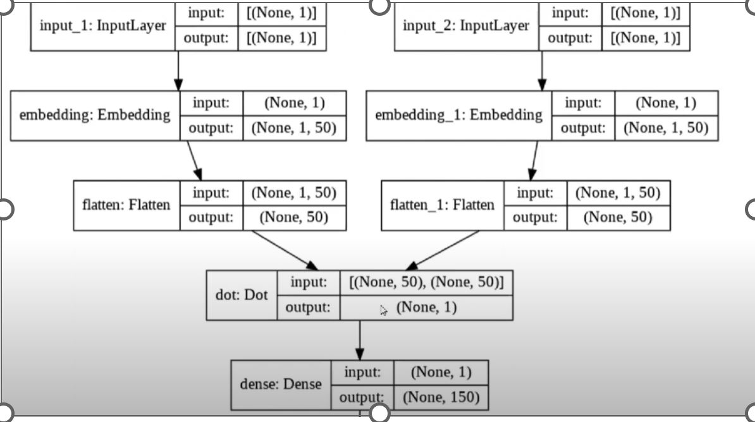
Graphical representation of the network.
This figure depicts how our model is working.

Slide 10
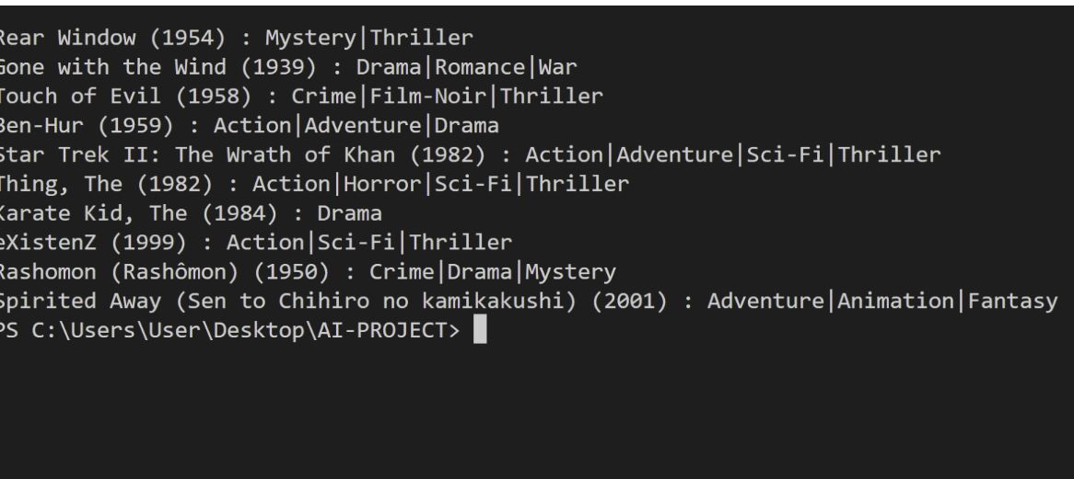
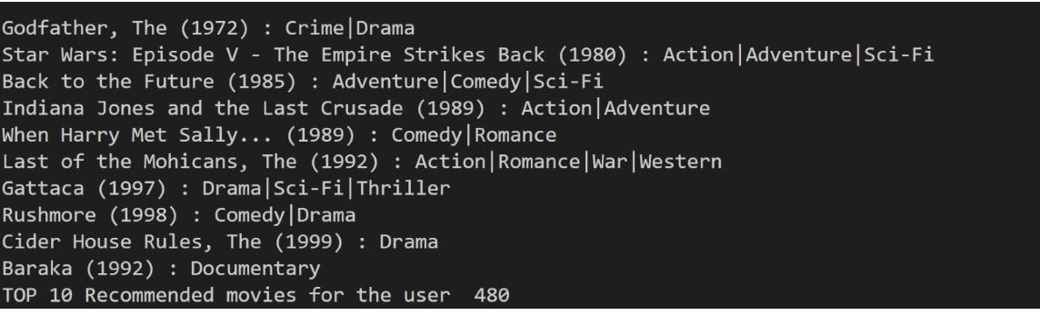
OUTPUTS: Figure of the left shows the movies liked by the user previously and figure on the right shows movies suggested.
These results are outputs of the code run on Vs-code.

Slide 11
CONCLUSION:
A close inspection of the movies proves that our model is showing positive results as the movies suggested and previously highly rated movies are in close conformity in terms of the genres. User prefers Crime, drama and sci-fi movies more often and is suggested accordingly.

