Slide 1

Subscribe to DeepL Pro to edit this document.
Visit www.DeepL.com/Pro for more information.

Slide 2
Analysis and Experimentation of TLS 1.3
OUZINEB Sohaïb, ASSOMANY Marvin, PROIETTI Harith

Slide 3
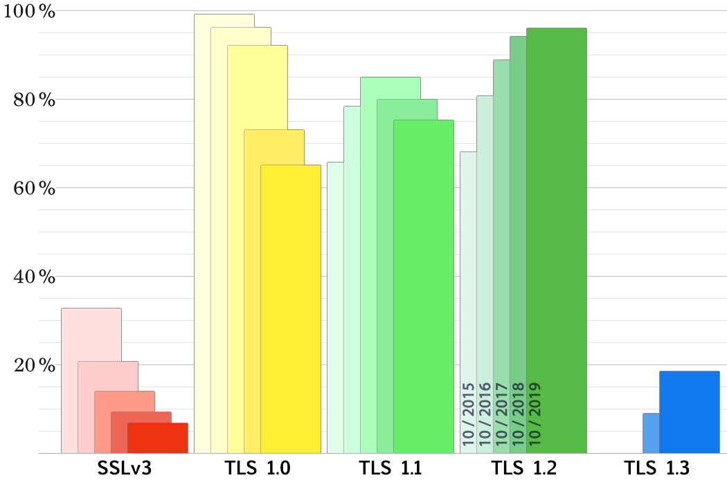
Introduction
‹#›

Slide 4
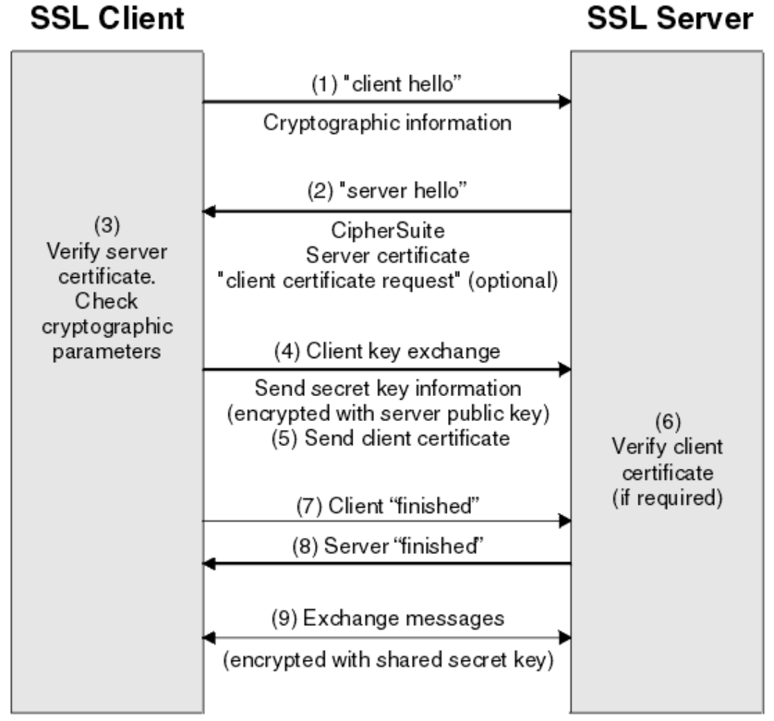
TLS 1.2...
‹#›

Slide 5
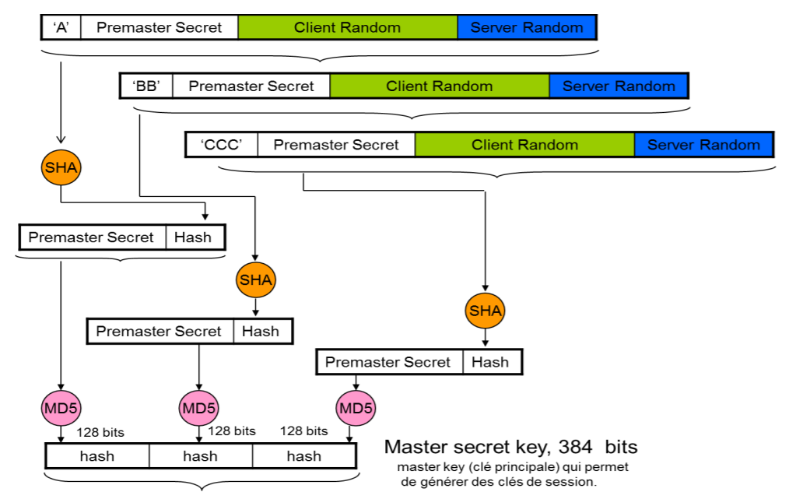
Construction of the master secret
‹#›

Slide 6
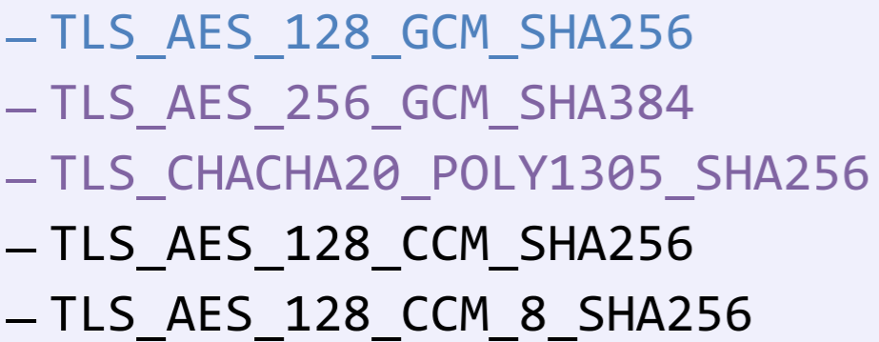
...to TLS 1.3
Removal of all cryptographic suites deemed too weak
Reduction of the handshake duration
0-RTT
Compression removed
‹#›

Slide 7
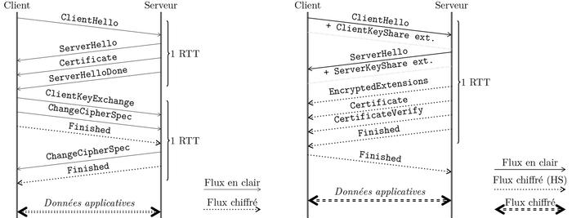
TLS1.2 vs TLS 1.3
‹#›

Slide 8
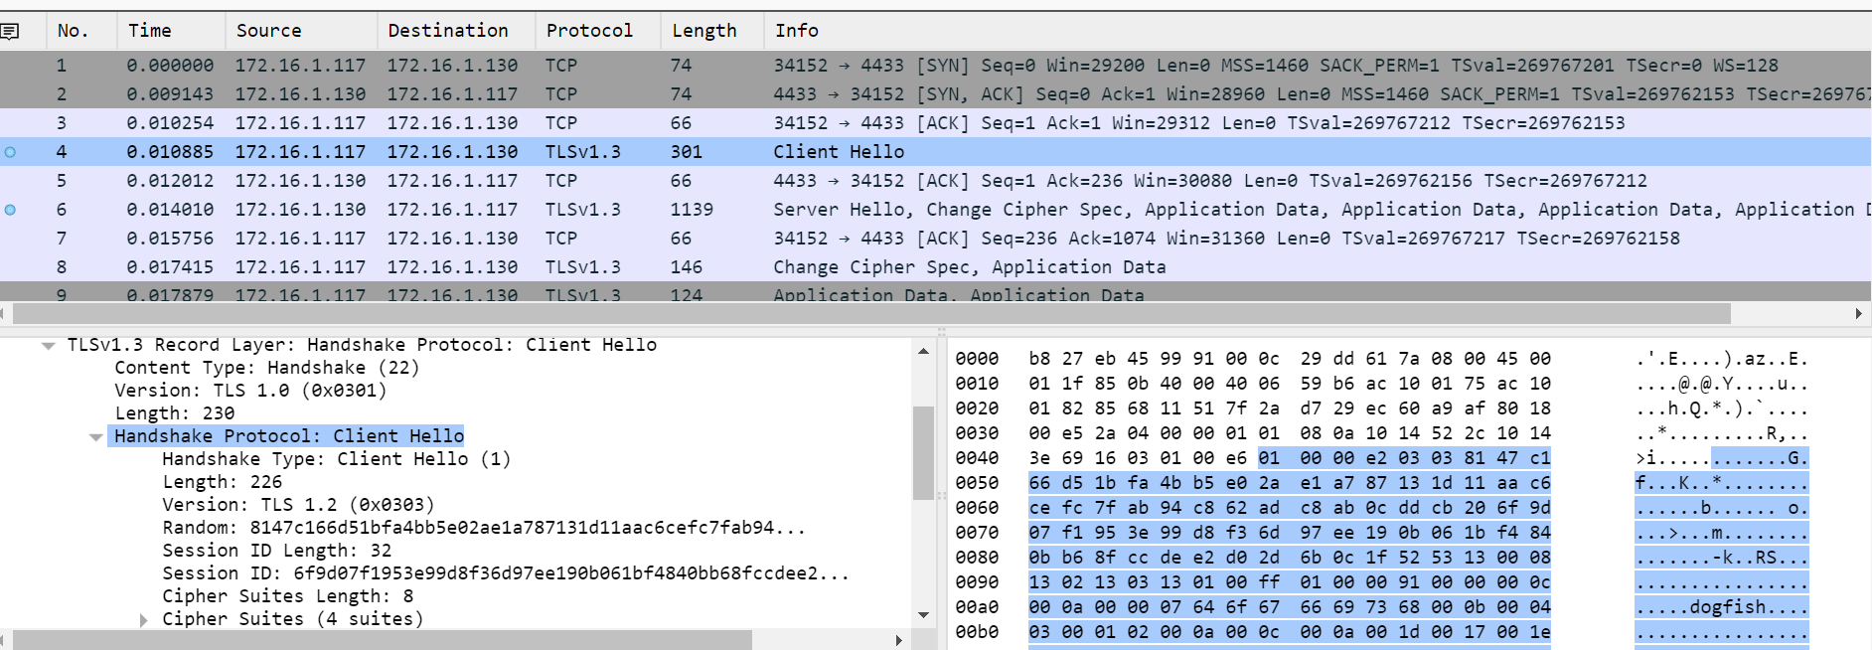
Capture a session establishment - Wireshark
‹#›

Slide 9
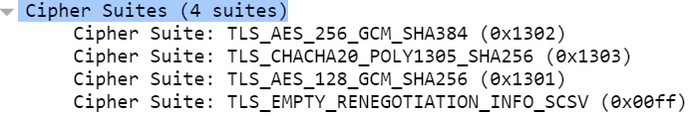
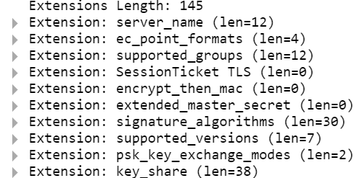
Hello customer
Random Client
Cipher Suites
Key_share*
Signature_algorithms *
pre_shared_key*
psk_key_exchanges_modes*
Extensions
‹#›

Slide 10
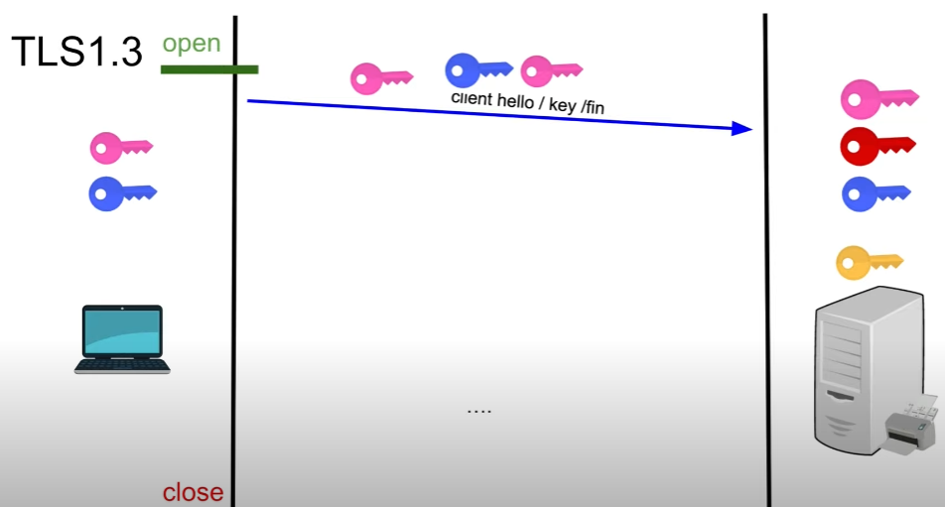
Key Share
‹#›

Slide 11
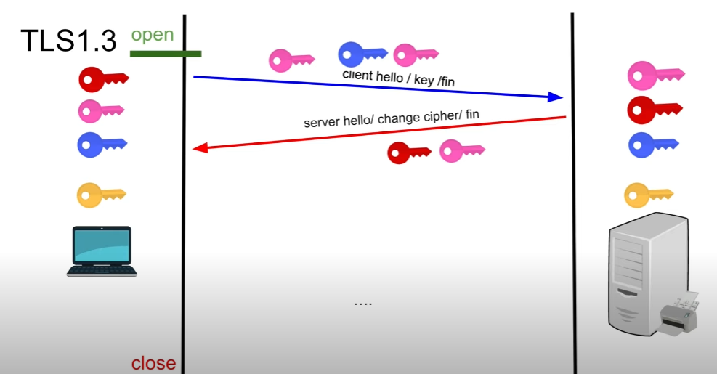
Key Share
‹#›

Slide 12
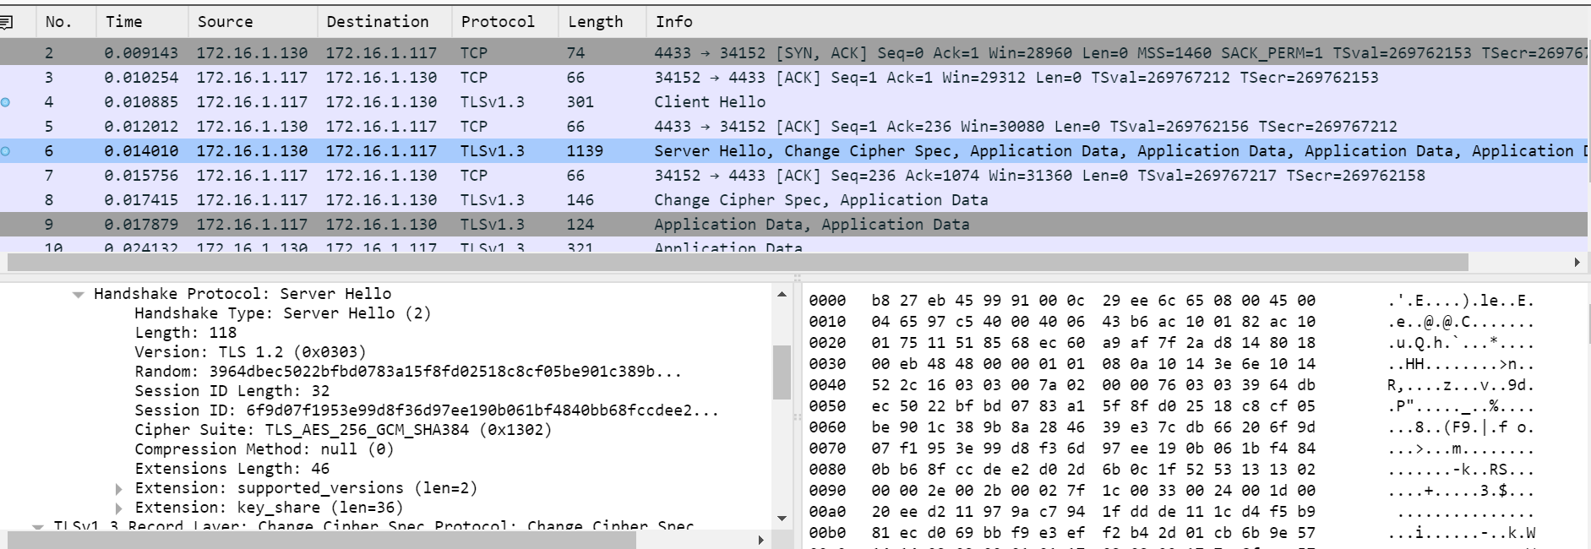
Server Hello
‹#›

Slide 13
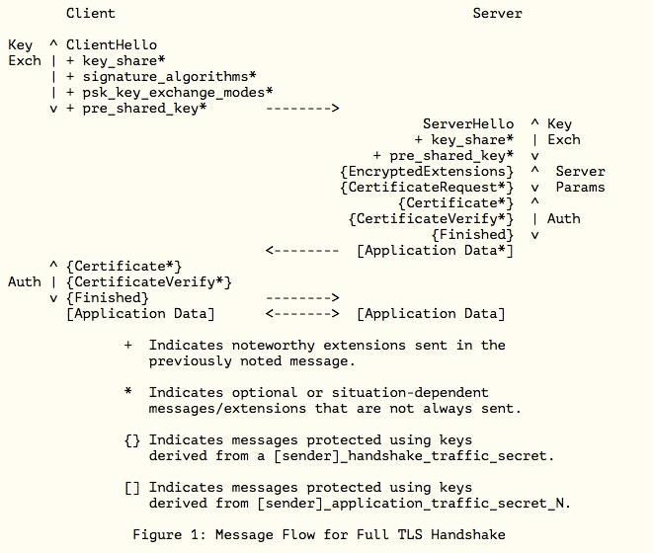
Server Hello
Key share *
pre_shared_key *
{Encrypted_Extensions}
{Certificate Request*}
{Certificate*}
{CertificateVerify*}
{Finished}
[Application Data*]
‹#›

Slide 14
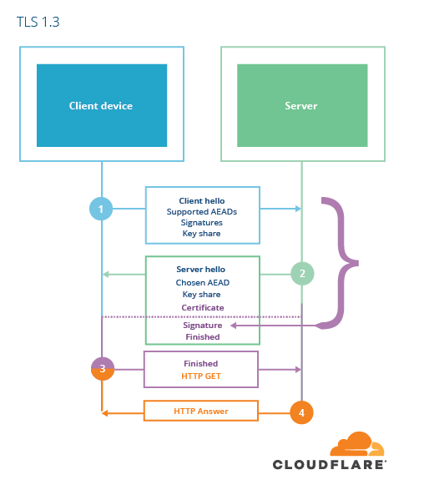
Certificate Verify -
Server Finished
PURPOSE: To ensure the integrity of the handshake and the possession of certain keys
CertificateVerify:
Signature on the whole handshake using the private key corresponding to the public key of the certificate.
Finished:
MAC on the handshake using a context-dependent base_key, allows PSK authentication

Slide 15
Last step
Client authentication optional unless required by the server
Client Finished
Application Data

Slide 16
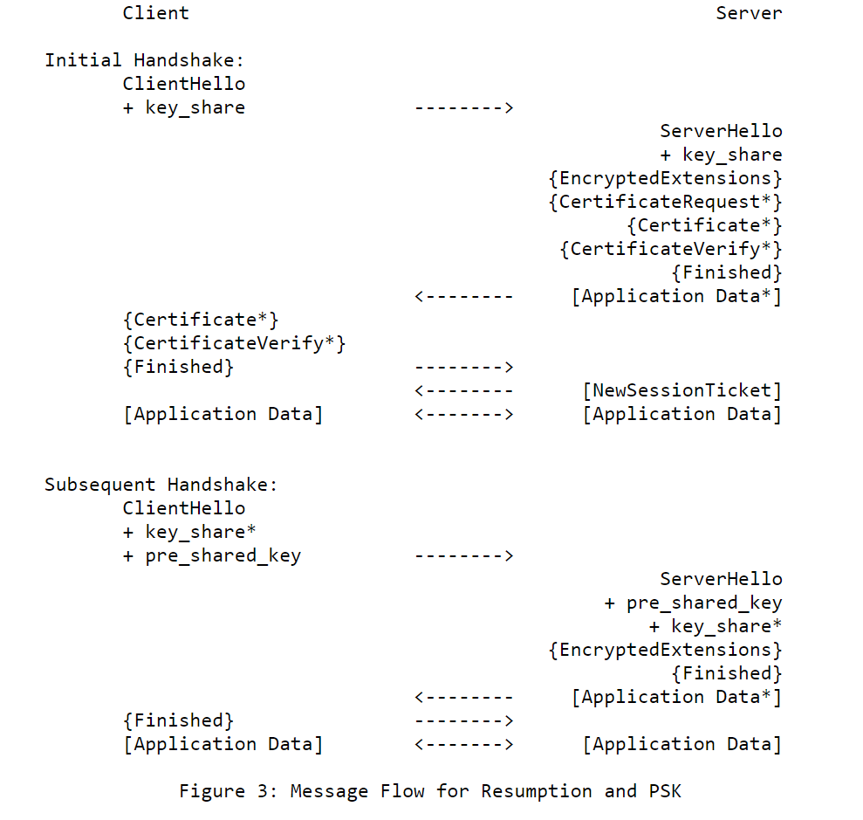
Resume session
Using the PSK
struct { opaque identity<1..2^16-1>; //label on a PSK uint32 obfuscated_ticket_age; //age of the obfuscated key } PskIdentity;
opaque PskBinderEntry<32..255>;//HMAC PSK-handshake
Potentially make a new key share.
The server proves the integrity of the handshake as well as the possession of the PSK through the Finished

Slide 17
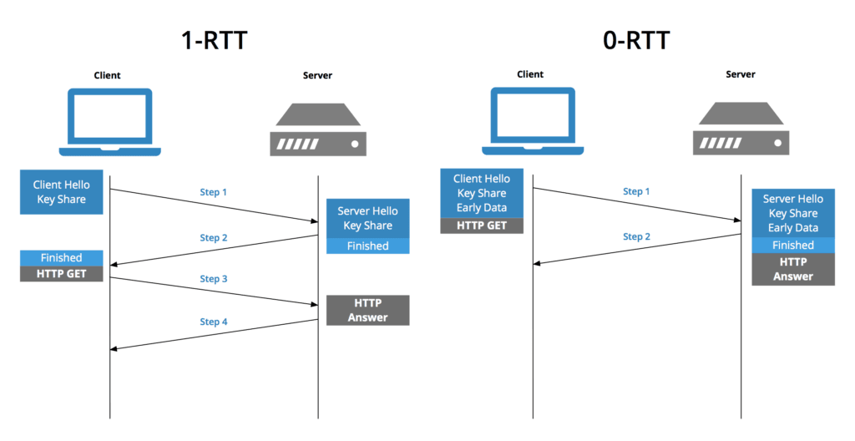
0-RTT
‹#›

Slide 18
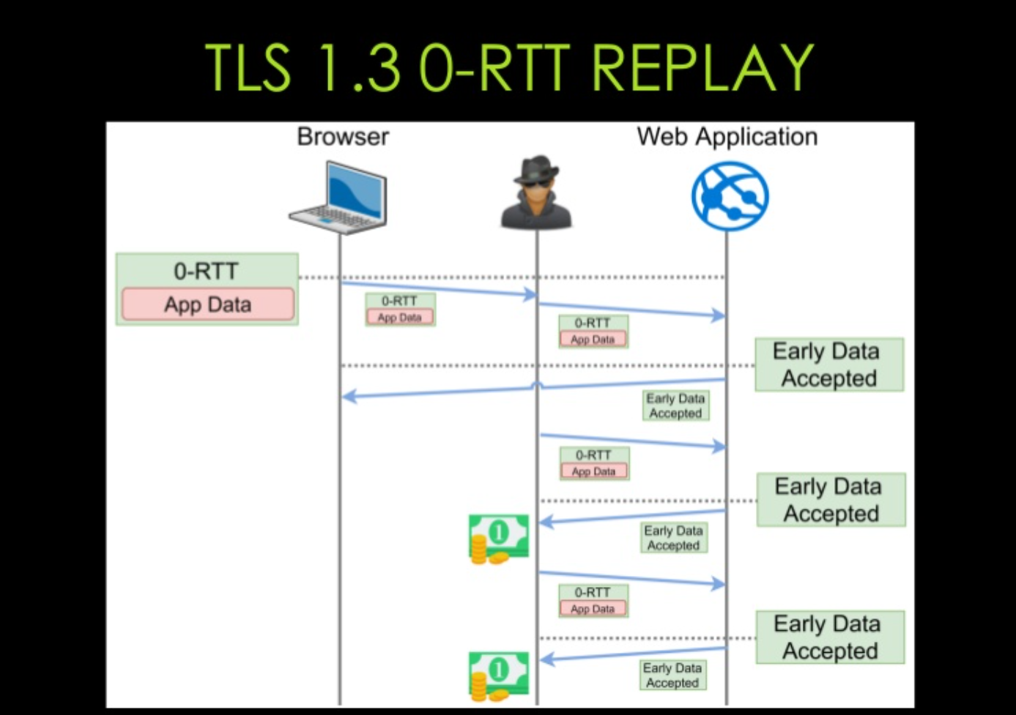
Attacks on the 0-RTT
‹#›

Slide 19
Anti-replay mechanisms: Anti-replay and anti-replay-policy extensions
Single use Tickets : the server deletes the ticket as soon as it has been used
Hello Recording Client: PSK binder
Timestamp: Client signs with the PSK the time of sending
‹#›

Slide 20
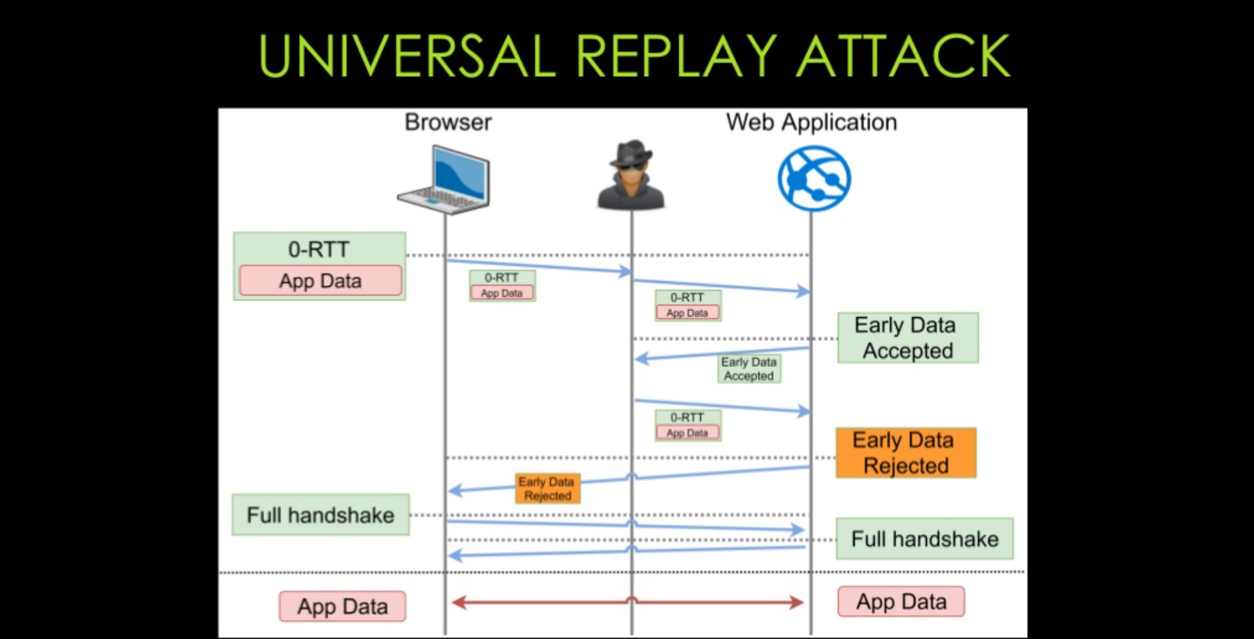
Not enough...
‹#›

Slide 21
Possible solution: require_rejected_reason extension
Ask the server to request the cause of the rejection
As soon as the server detects a replay, it indicates in the Early_data_refused the unique identifier allowing the Client to recognize the 0-RTT that has been replayed
When the client receives
Early_data_refused (cause: replay) > Replayed id PSK_binder : XXXXXX
It understands that its 0-RTT has been sent and processed, so it moves on to the next application content, the server can then forget that there was a replay

Slide 22
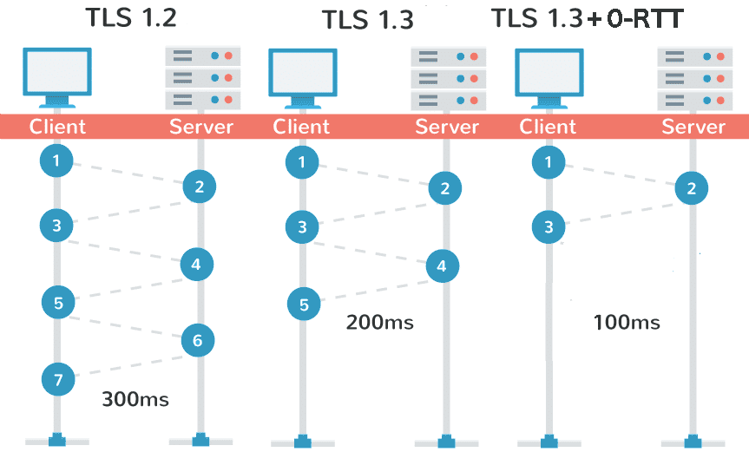
Benchmarking
‹#›

Slide 23
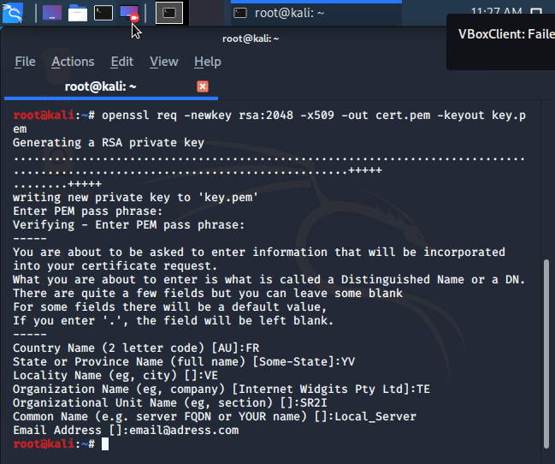
‹#›

Slide 24
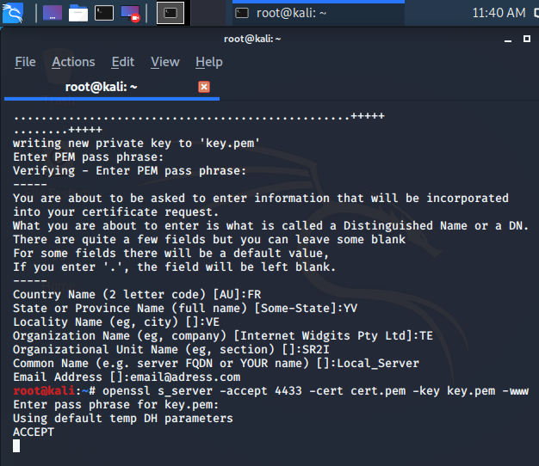
‹#›

Slide 25
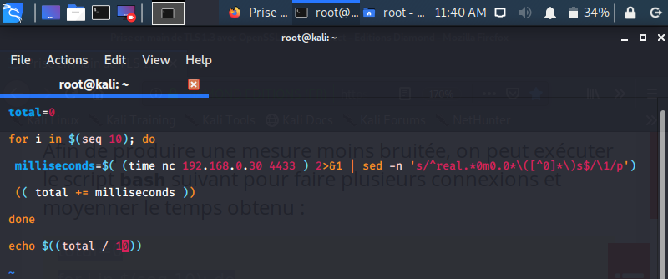
‹#›

Slide 26
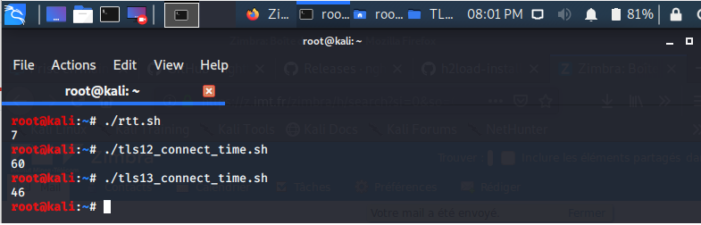
‹#›

Slide 27
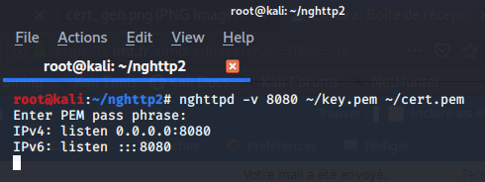
Modeling multiple clients
‹#›

Slide 28
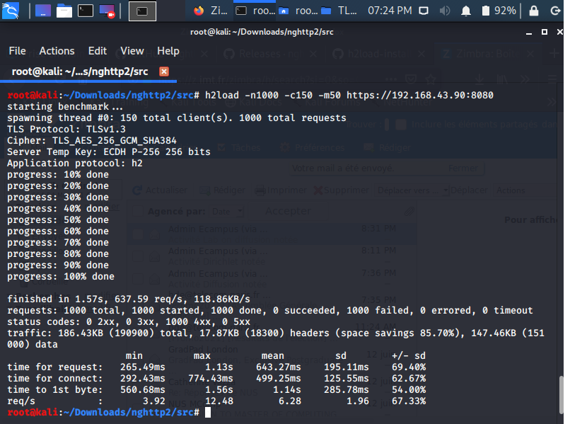
‹#›

Slide 29
Conclusion

Slide 30
Thank you for listening!

