Slide 1
Analysis and Experimentation of TLS 1.3
OUZINEB Sohaïb, ASSOMANY Marvin, PROIETTI Harith

Slide 2
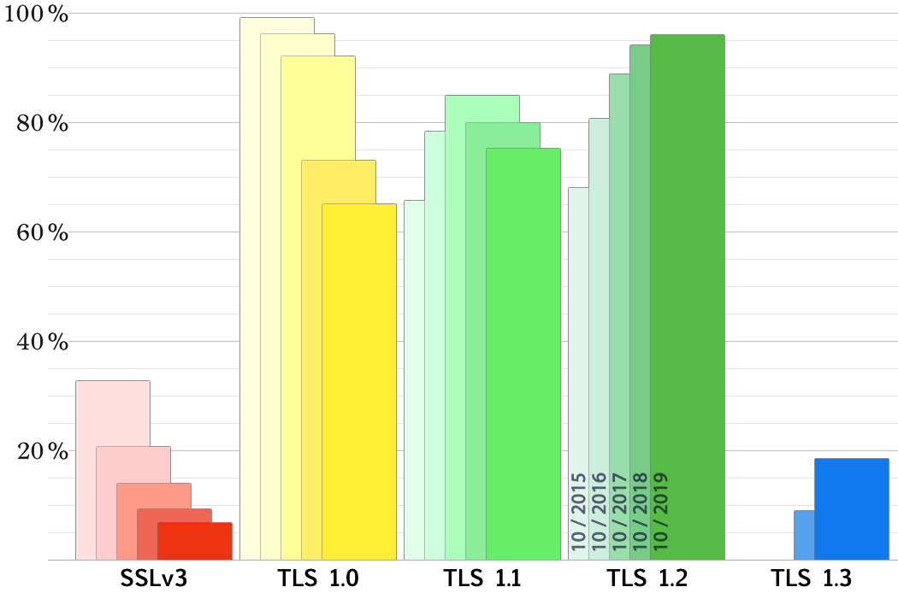
Introduction

Slide 3
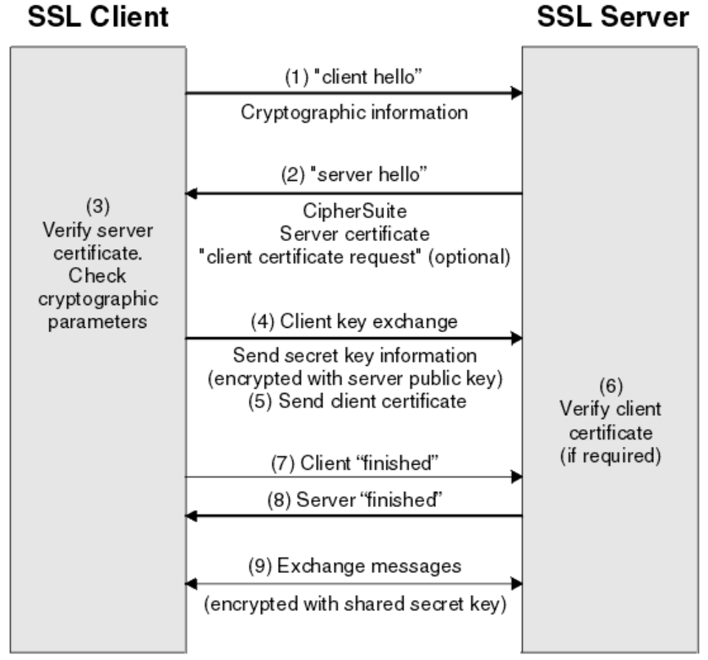
TLS 1.2 ...

Slide 4
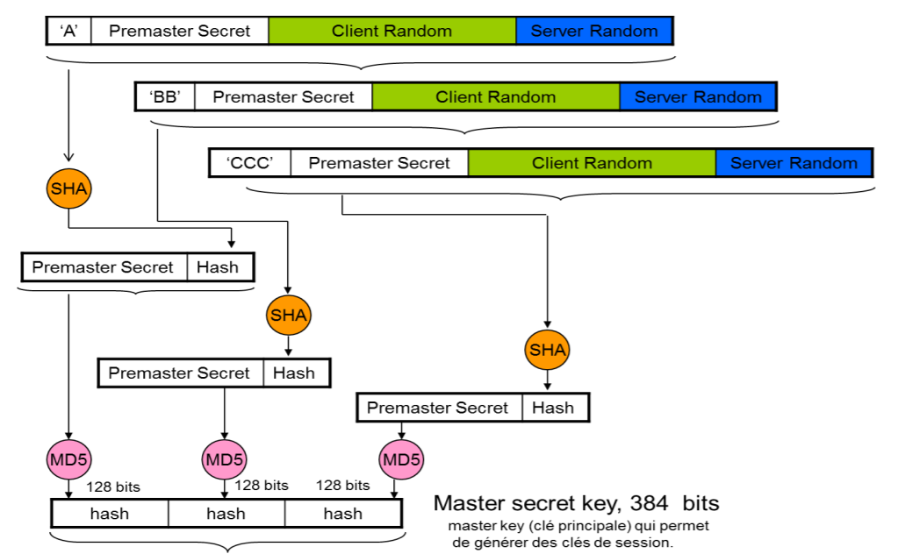
Construction of the master secret

Slide 5
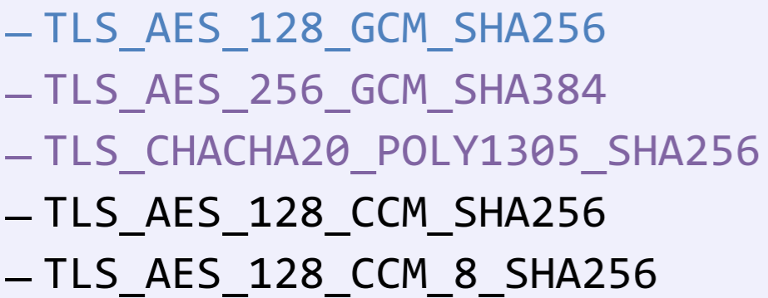
... to TLS 1.3
Ssuppression of all cryptographic suites deemed too weak
Reduced handshake time
0-RTT
Compression removed

Slide 6
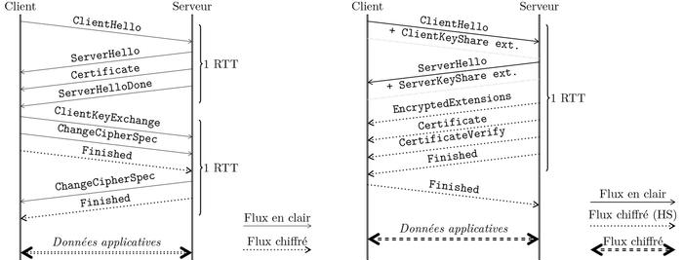
TLS1.2 vs TLS 1.3

Slide 7
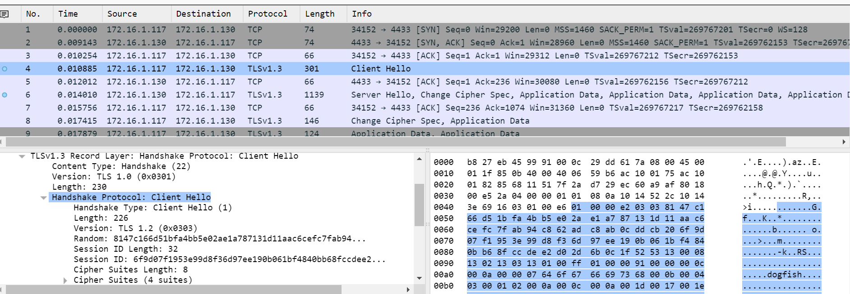
Capturing a session establishment - Wireshark

Slide 8
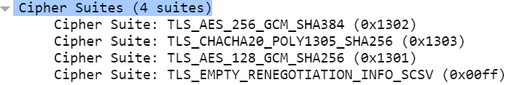
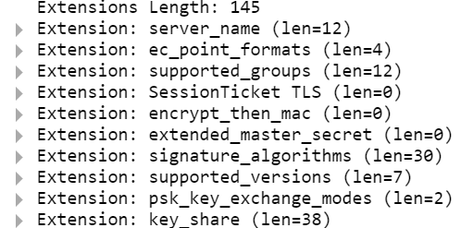
Hello Customer
Random client
Cipher Suites
Key_share *
Signature_algorithms *
pre_shared_key *
psk_key_exchanges_modes *
Extensions

Slide 9
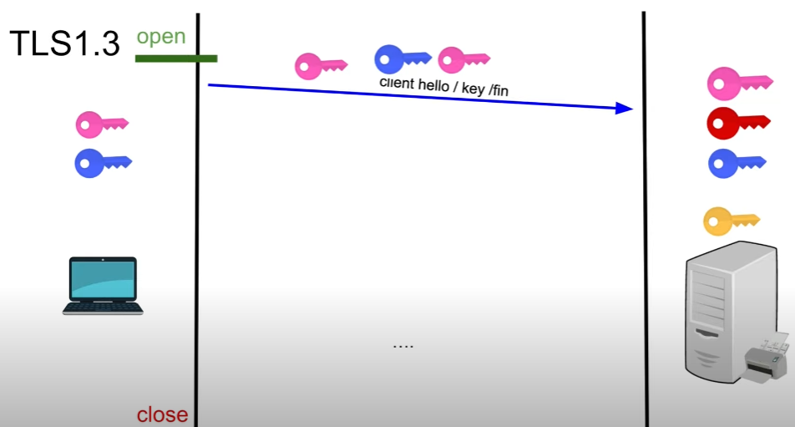
Key Share

Slide 10
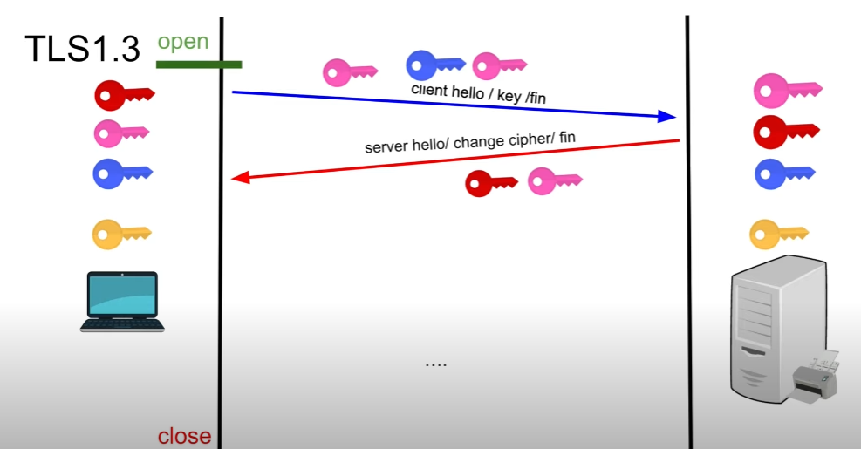
Key Share

Slide 11
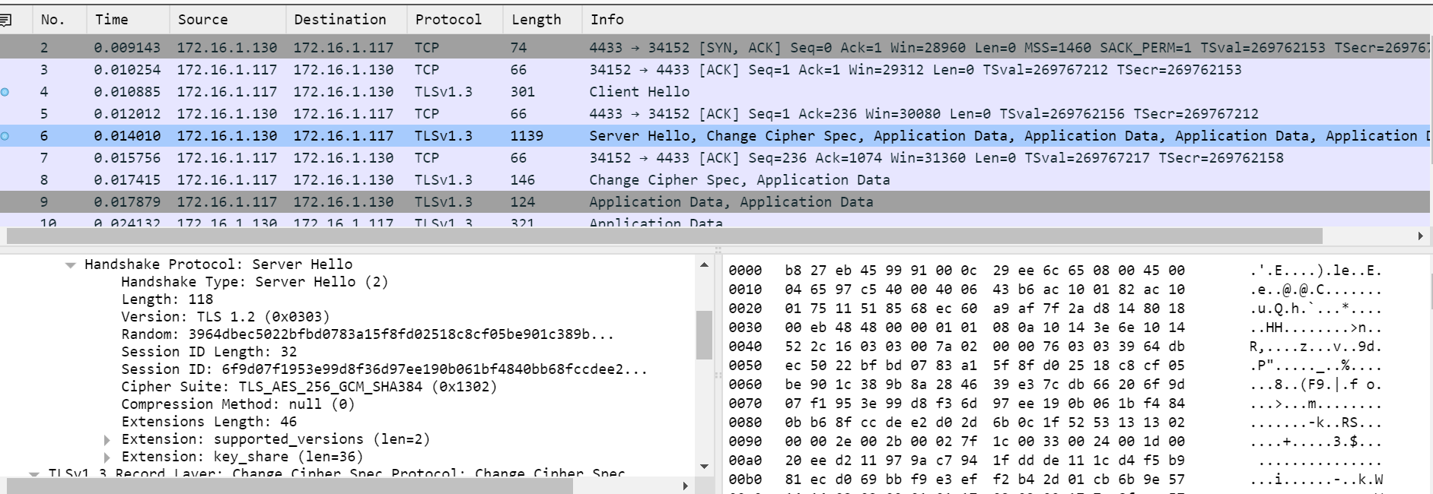
Server Hello

Slide 12
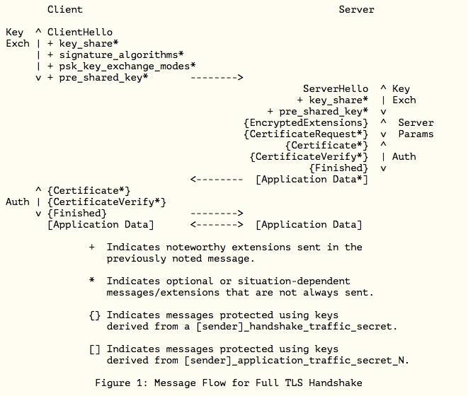
Server Hello
Key share *
pre_shared_key *
{Encrypted_Extensions}
{Certificate Request *}
{Certificate *}
{CertificateVerify *}
{Finished}
[Application Data *]

Slide 13
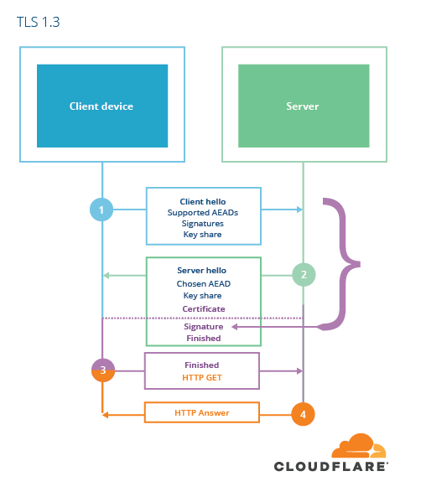
Certificate Verify -
Server Finished
GOAL: To ensure the integrity of the handshake and the possession of certain keys
CertificateVerify:
Signature on the whole handshake using the private key corresponding to the public key of the certificate.
Finished:
MAC on the handshake using a context dependent base_key, allows authentication in PSK mode

Slide 14
Last step
Optional client authentication unless required by the server
Client Finished
Application Data

Slide 15
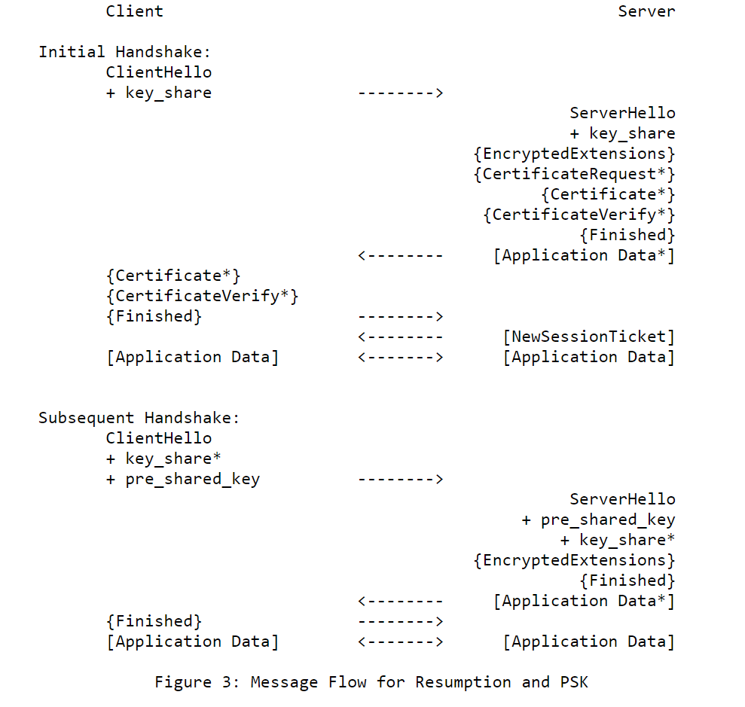
Session resumption
Using the PSK
struct {opaque identity <1..2 ^ 16-1>; // label on a PSK uint32 obfuscated_ticket_age; // age of key obfuscated} PskIdentity;
opaque PskBinderEntry <32..255>; // HMAC PSK-handshake
Potentially make a new key share.
The server proves the integrity of the handshake as well as the possession of the PSK through the Finished

Slide 16
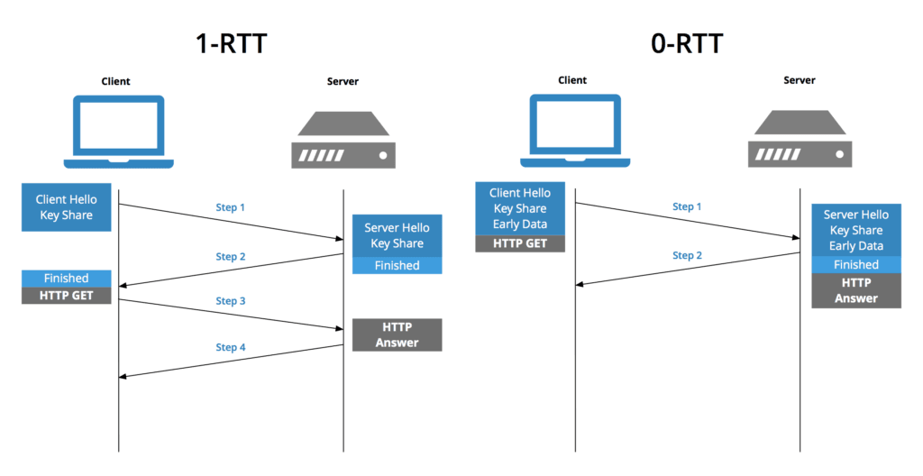
0-RTT

Slide 17
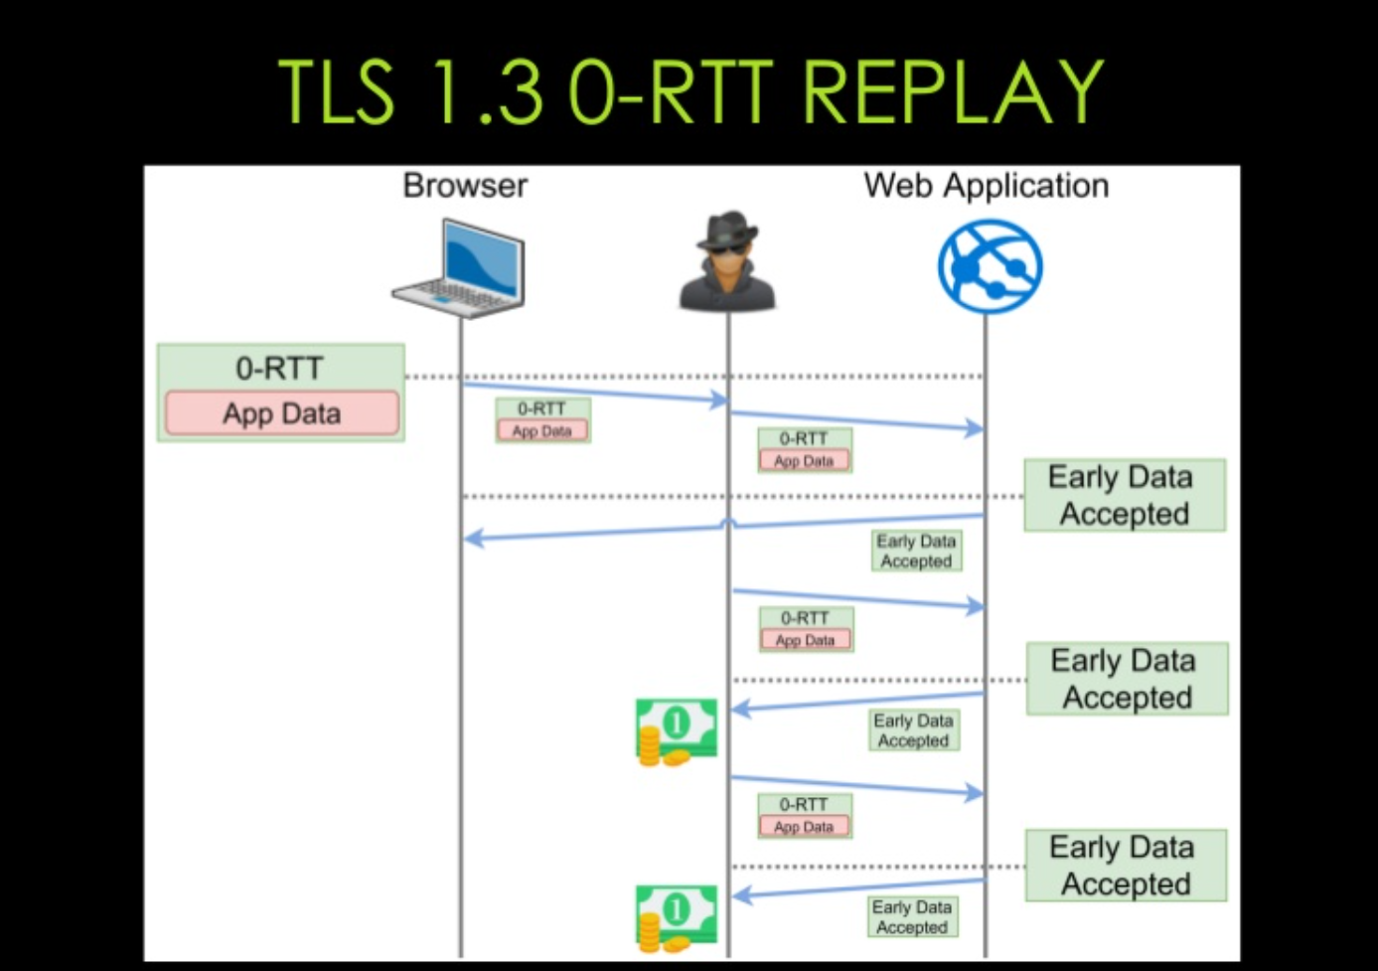
Attacks on 0-RTT

Slide 18
Anti-replay mechanisms: Anti-replay and anti-replay-policy extensions
Single use Tickets: the server deletes the ticket as soon as it has been used
Hello Recording Client: PSK binder
Time stamp: Customer signs the sending time with the PSK

Slide 19
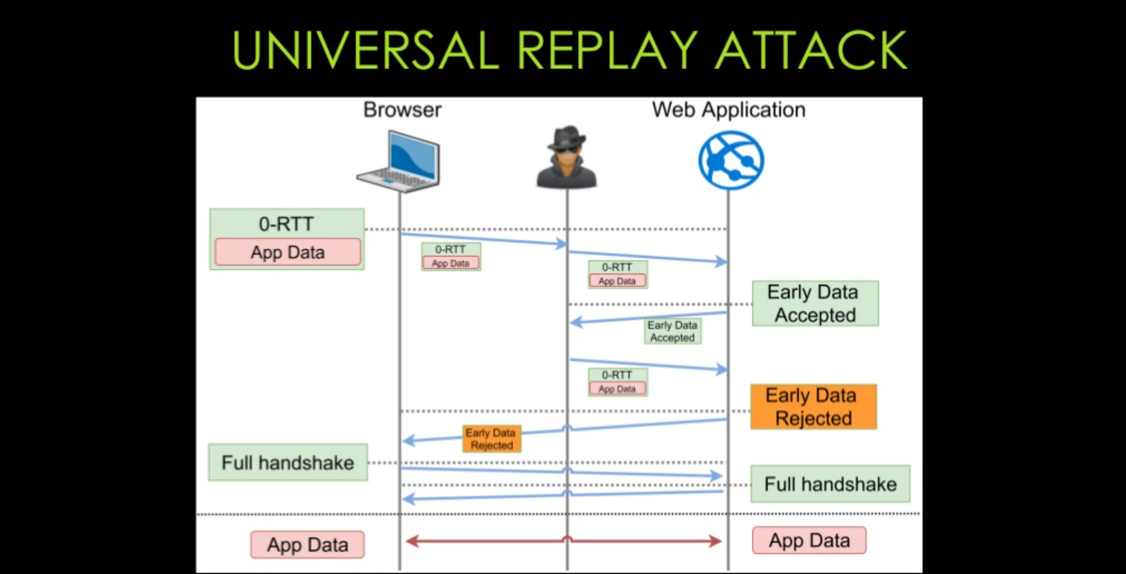
Not enough...

Slide 20
Possible solution: require_rejected_reason extension
Ask the server to request the cause of the rejection
As soon as the server detects a replay, it indicates in the Early_data_refused the unique identifier allowing the Client to recognize the 0-RTT which has been replayed
When the customer receives
Early_data_refused (cause: replay)> Replayed id PSK_binder: XXXXXX
He understands that his 0-RTT has been sent and processed, so he goes on to the next application content, the server can then forget that there has been replay

Slide 21
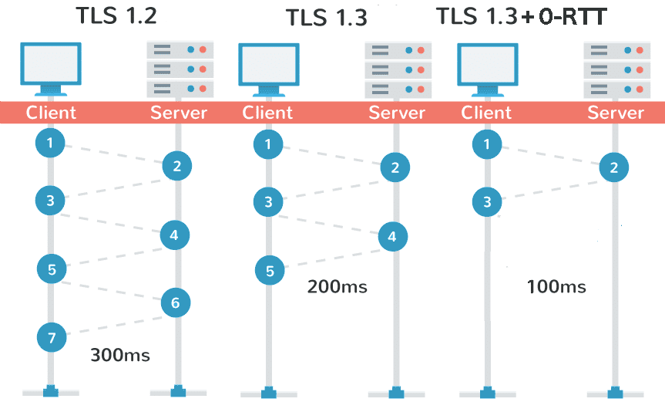
Benchmarking

Slide 22
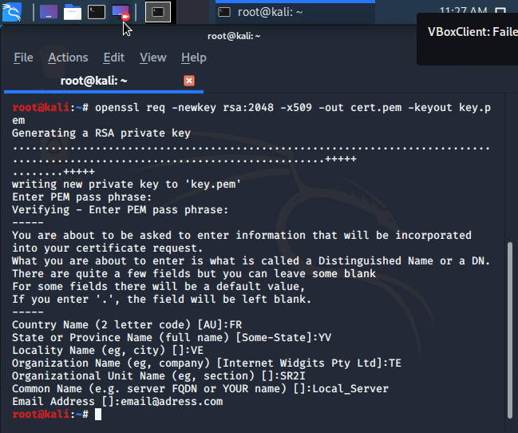

Slide 23
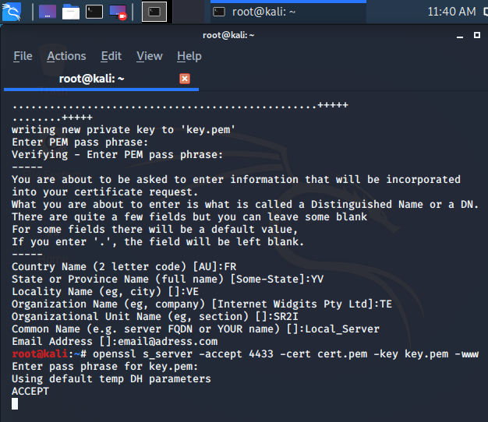

Slide 24
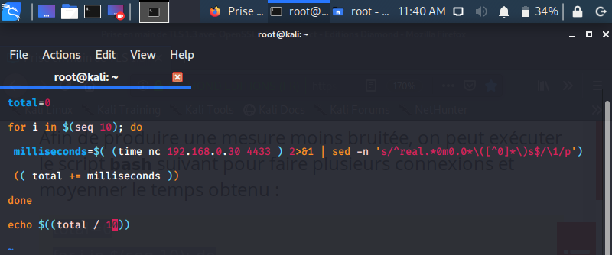

Slide 25
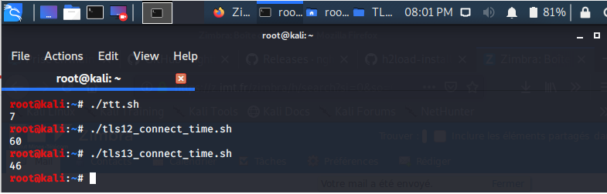

Slide 26
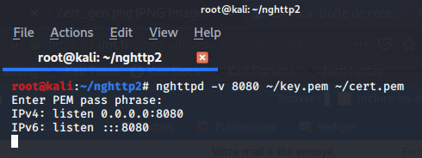
Modeling of several clients

Slide 27
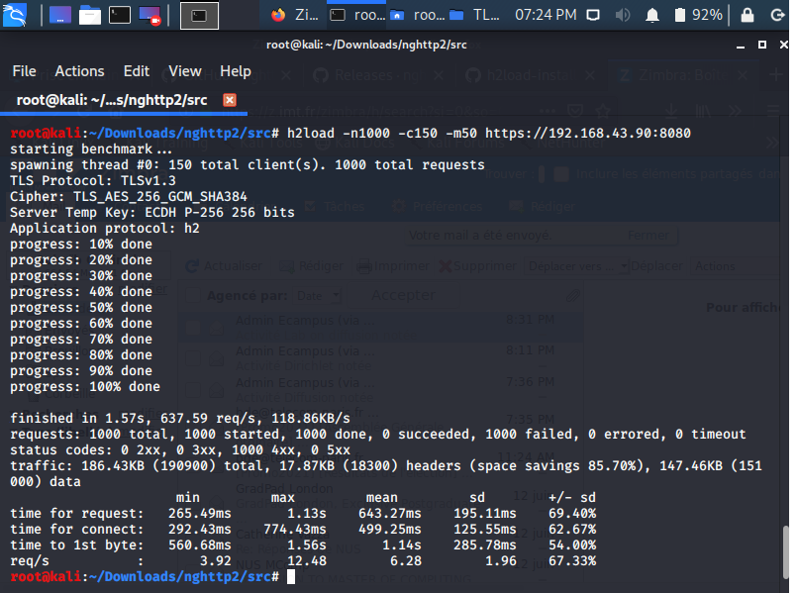

Slide 28
Conclusion

Slide 29
Thank you for your attention !

