Slide 1


The Singleton Pattern
Singleton Pattern
Singelton Pattern
Presented by
Sohaib MANAH

Slide 2
Outlines
What Is Singelton Pattern ?
Why to use it?
How to implement it in your code ?
Disadvantes of it ?

Slide 3
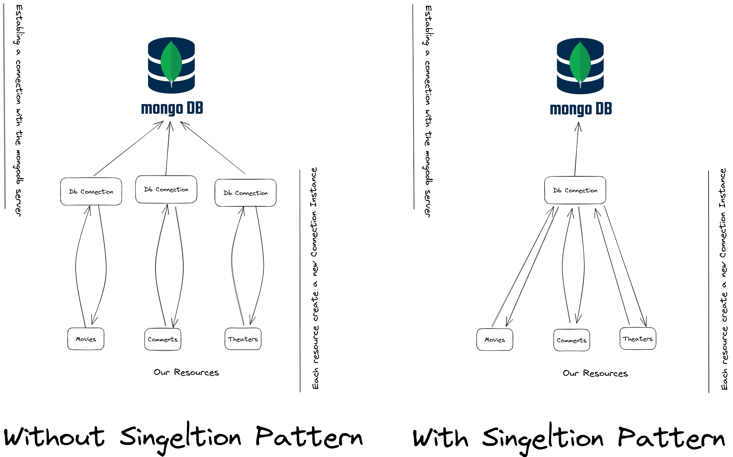
Notes:
Terraform creates and manages resources on cloud platforms and other services through their application programming interfaces (APIs). Providers enable Terraform to work with virtually any platform or service with an accessible API.
HashiCorp and the Terraform community have already written more than 1700 providers to manage thousands of different types of resources and services, and this number continues to grow. You can find all publicly available providers on the Terraform Registry, including Amazon Web Services (AWS), Azure, Google Cloud Platform (GCP), Kubernetes, Helm, GitHub, Splunk, DataDog, and many more.
The core Terraform workflow consists of three stages:
Write: You define resources, which may be across multiple cloud providers and services. For example, you might create a configuration to deploy an application on virtual machines in a Virtual Private Cloud (VPC) network with security groups and a load balancer.
Plan: Terraform creates an execution plan describing the infrastructure it will create, update, or destroy based on the existing infrastructure and your configuration.
Apply: On approval, Terraform performs the proposed operations in the correct order, respecting any resource dependencies. For example, if you update the properties of a VPC and change the number of virtual machines in that VPC, Terraform will recreate the VPC before scaling the virtual machines.

Slide 4
The disadvantages of the Singleton design pattern :
The global nature leads to dependency hiding.
It can be difficult to unit test the code.
It can lead to tightly coupled code.
If the single Instance of the object becomes corrupted, the entire system is compromised.

Slide 5
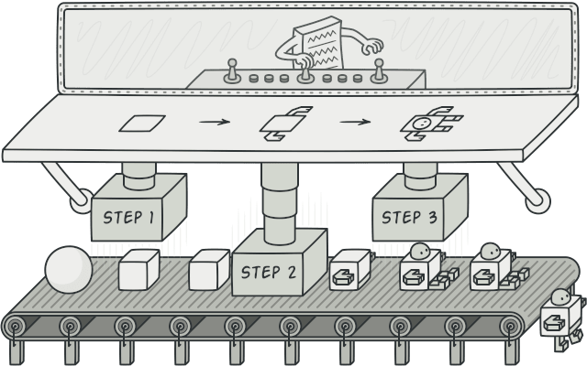
The builder Pattern

Slide 6
Outlines
What Is Builder Pattern ?
Why to use it?
How to implement it in your code ?
Disadvantes of it ?

Slide 7
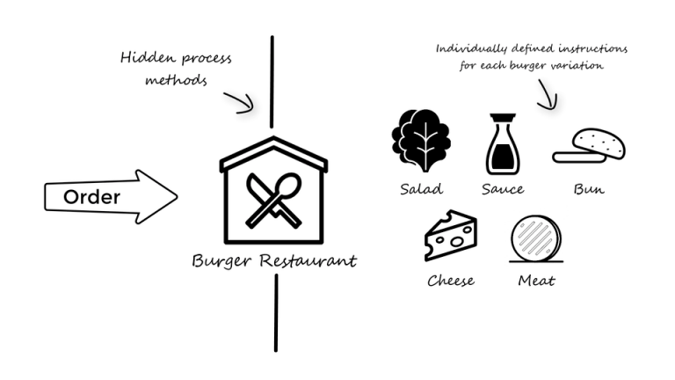
Here is An Example

Slide 8
The disadvantages of the Builder design pattern :
The use of the builder pattern can make the code more verbose and harder to read, because it involves creating separate classes for the builder and the object being built.

Slide 9




@sohaib_manah
sohaibMan
Sohaib manah
Check my Website

