Slide 1

Scheduling with Performance, Accuracy and Cost Trade-offs for Edge-based Applications
Sohaib Ahmad

Slide 2

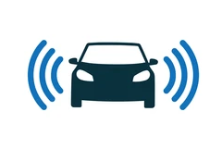
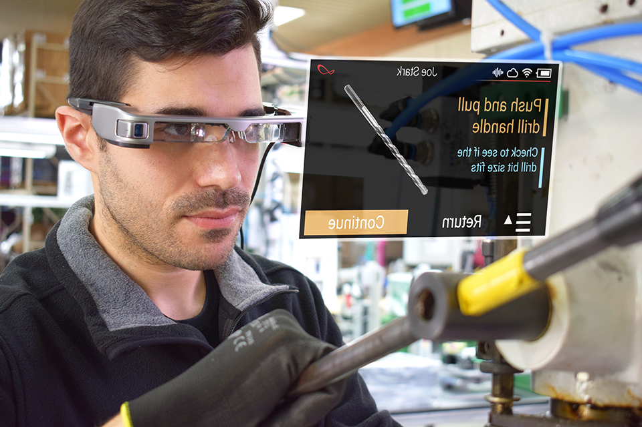
Rise of Edge Computing and ML
Edge computing has enabled many applications
Driverless cars
AR/VR
Wearable cognitive assistance
Most applications use DNNs at the core

Slide 3
Requirements

Slide 4

Requirements
↓ Low latency

Slide 5
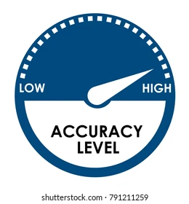
Requirements
↓ Low latency
↑ High accuracy

Slide 6

Requirements
↓ Low latency
↑ High accuracy
↓ Low cost
Often conflicting!

Slide 7


Requirements
$$✅$$
$$✅$$
↓ Low latency
↑ High accuracy
↓ Low cost
Often conflicting!

Slide 8

Requirements
$$✅$$
↓ Low latency
↑ High accuracy
↓ Low cost
Often conflicting!
$$✅$$

Slide 9
Requirements
$$✅$$
↓ Low latency
↑ High accuracy
↓ Low cost
Often conflicting!
Insight: Trade-off one for another
$$✅$$

Slide 10
Serving ML Predictions with Trade-offs
How to schedule when different users have different requirements?
Insight: Identify models that can be shared across user types
User | Latency | Accuracy | Cost
1 | Low | ? | Low
2 | Low | High | ?
3 | ? | High | Low

Slide 11
Published and Future Work
Reducing energy costs for cloud DCs using ML to predict compute usage
Published at ACM e-Energy
Geo-distributed analytics over edge and cloud
Published at ACM Symposium on Edge Computing
Scheduling for ML inference with latency vs. accuracy trade-offs
Work in progress

Slide 12
Thank you for listening!

