Slide 1


AggNet: Cost-Aware Aggregation Networks for Geo-distributed Streaming Analytics
Dhruv Kumar*, Sohaib Ahmad†, Abhishek Chandra*, Ramesh K. Sitaraman†
*
†
Notes:
Hello everyone, my name is Sohaib Ahmad and I am going to be presenting our work AggNet which is a collaborative effort between the University of Massachusetts Amherst and the University of Minnesota. Unfortunately Dhruv who is the first author could not be here with us due to logistic issues, so I will be presenting our work.
So the problem setting we are trying to solve is in the name of the paper itself
The application we target is streaming analytics, and it is geographically distributed
Within this application setting we consider how to do aggregation over a network
And our goal is to minimize cost, so we present cost-aware aggregation networks for geo-distributed streaming analytics

Slide 2
AggNet: Cost-Aware Aggregation Networks for Geo-distributed Streaming Analytics
Dhruv Kumar*, Sohaib Ahmad†, Abhishek Chandra*, Ramesh K. Sitaraman†
*
†
Notes:
So the problem setting we are trying to solve is in the name of the paper itself
The application we target is streaming analytics, and it is geographically distributed
Within this application setting we consider how to do aggregation over a network
And our goal is to minimize cost, so we present cost-aware aggregation networks for geo-distributed streaming analytics

Slide 3
AggNet: Cost-Aware Aggregation Networks for Geo-distributed Streaming Analytics
Dhruv Kumar*, Sohaib Ahmad† Abhishek Chandra*, Ramesh K. Sitaraman†
*
†
Notes:
So the problem setting we are trying to solve is in the name of the paper itself
The application we target is streaming analytics, and it is geographically distributed
Within this application setting we consider how to do aggregation over a network
And our goal is to minimize cost, so we present cost-aware aggregation networks for geo-distributed streaming analytics

Slide 4
AggNet: Cost-Aware Aggregation Networks for Geo-distributed Streaming Analytics
Dhruv Kumar*, Sohaib Ahmad† Abhishek Chandra*, Ramesh K. Sitaraman†
*
†
Notes:
So the problem setting we are trying to solve is in the name of the paper itself
The application we target is streaming analytics, and it is geographically distributed
Within this application setting we consider how to do aggregation over a network
And our goal is to minimize cost, so we present cost-aware aggregation networks for geo-distributed streaming analytics

Slide 5
AggNet: Cost-Aware Aggregation Networks for Geo-distributed Streaming Analytics
Dhruv Kumar*, Sohaib Ahmad† Abhishek Chandra*, Ramesh K. Sitaraman†
*
†
Notes:
So the problem setting we are trying to solve is in the name of the paper itself
The application we target is streaming analytics, and it is geographically distributed
Within this application setting we consider how to do aggregation over a network
And our goal is to minimize cost, so we present cost-aware aggregation networks for geo-distributed streaming analytics

Slide 6
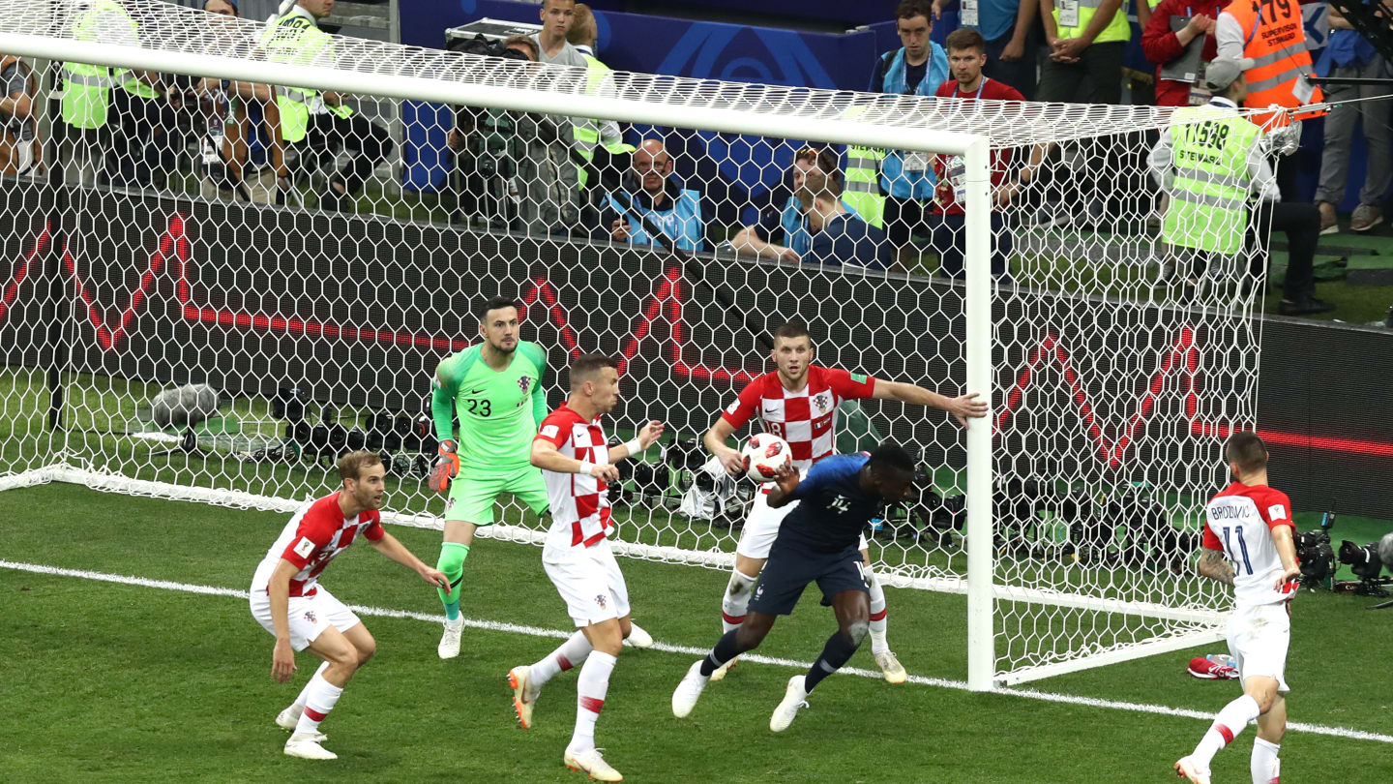
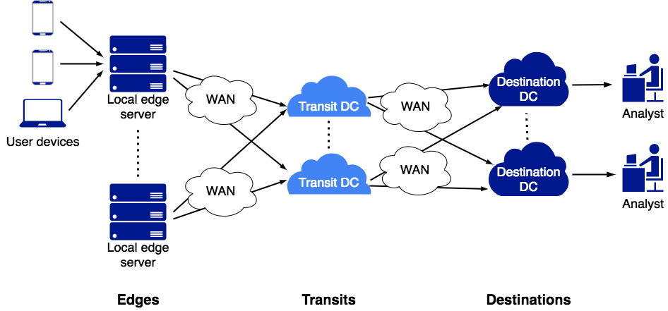
Example Application: QoS Monitoring
Send the QoS metrics from edge to destination within delay bound
Notes:
So just to show you an example of why this is needed, consider a large live streaming event such as the FIFA world cup or the cricket world cup which is being delivered by a content delivery network such as Akamai.
Typically this streaming would be done at end-user devices such as laptops or phones, and the content delivery network would want to monitor the quality of service in order to analyze the quality of the video stream being delivered to the end users.
Information such as the rebuffering rates and video quality is sent by the user devices to their nearest edge servers which then send this information to the central hub or a destination for analysis.
- The goal here is for the video providers to get a real-time view of how their end-users are experiencing their video streams and if there is a noticeable quality degradation, take immediate corrective action.
Given the performance diagnostic goals of the service, it is important to follow strict latency bounds to ensure the application meets its requirements. Hence, we call this application a delay sensitive application.

Slide 7
Insights (Also lessons from optimization)
Cost-agnostic traffic reduction might inflate traffic cost
In practice, common to use the nearest transits or DCs
Using common transits that are farther away from some edges might result in greater reduction in traffic
Simply selecting a common transit for all edges not always best for minimizing traffic cost
Optimal solution is non-trivial
For some edges may use the nearest transit, for others might use a cheap common transit
Depends on: input arrival rates at edges, cost differences across network links, bandwidth availability, etc.
Delay budgeting also important
Aggregating entirely at the first edge not optimal, choose a mix of edge and transits

Slide 8
Continuous Aggregation
Data stream comprises (key, value) records
Aggregation operators
Sum, Max
Sketches
User-defined functions
Similar to
Reduce operation in MapReduce
GroupBy and Aggregate in SQL and LINQ

Slide 9

AggNet: Cost-Aware Aggregation Networks
Notes:
-> So we consider a 3-level topology with edge servers close to the users, followed by some transit datacenters that can carry the traffic to destination datacenters at which some analysis is done.
-> Since the WAN bandwidth is expensive and scarce, it makes sense to aggregate the data as close as possible to the end-users. This can minimize the amount of traffic on the network (for the users and providers both?)
-> Moreover, not only are the WAN links expensive, but they are also often heterogeneous in terms of cost, so some links might be more expensive than others. This means that minimizing the amount of traffic does not always equate to minimizing traffic cost, which is why we look at explicitly minimizing cost instead of the amount of traffic on the network

Slide 10

AggNet: Cost-Aware Aggregation Networks
Minimize the total traffic cost ($$$) for sending data from edges to destination DCs with a user-specified delay budget
Notes:
The goal here is to..

Slide 11
Challenges
100ms
Different queries have different delay sensitivities
Trade-off between delay and traffic
Notes:
Now we take a look at the challenges we face while solving this problem. So the first challenge is that different queries have different delay bounds, which leads to a tradeoff between delay and traffic. Consider the following example: if the delay bound is 100milliseconds then we can aggregate a certain number of records within that time

Slide 12
Challenges
500ms
Different queries have different delay sensitivities
Trade-off between delay and traffic
Heterogeneity in WAN link cost
SA Brazil 8x costlier than US West
Trade-off between traffic and traffic cost
Notes:
But if our delay bound is higher, we can do aggregation for a longer period of time. During this longer period, we will get more records that we can aggregate into a single record, and in this way we can get a greater traffic reduction. In this case we get a larger reduction in traffic, but the delay is high. Whereas in the previous case, where our delay bound was 100ms, we are able to aggregate less records and the traffic is high, but the destination datacenter gets the result earlier. So there exists a natural trade-off between delay and traffic for aggregation
Moreover, since some links can be costlier than others, for example outgoing links from Brazil are 8x more expensive than outgoing links from US West in Amazon EC2, we get a trade-off between traffic and traffic cost.

Slide 13
Challenges
$
Different queries have different delay sensitivities
Trade-off between delay and traffic
Heterogeneity in WAN link cost
SA Brazil 8x costlier than US West
Trade-off between traffic and traffic cost
$$
Notes:
So we may minimize traffic but if we do this in a cost-agnostic way, we may end up sending a small amount of traffic over a very expensive link. Whereas, for the purposes of reducing overall traffic cost, it might be better to use a cheaper link even if we need to send a slightly higher amount of traffic volume.

Slide 14
Challenges
Heterogeneity in resource availability
WAN bandwidth varies from 20-400Mbps on AWS EC2
Notes:
Another challenge that we have to deal with is the heterogeneity in resource availability. For example, on Amazon EC2, the bandwidth of the links varies from 20 Mbps to 400Mbps. We need to keep these constraints in mind while constructing aggregation networks.

Slide 15
Challenges
Heterogeneity in resource availability
WAN bandwidth varies from 20-400Mbps on AWS EC2
Dynamism in workload
Arrival rates change
Link failures common
Notes:
Lastly, there can dynamism in the workload. For example, the arrival rates may change over time and it is common for links to fail, so our approach needs to be adaptive to such changes.

Slide 16




Key Question 1
Path Provisioning: Which transits should be selected for each edge?
Compute path provisioning matrix $P$
$p_{ijk}$= 1 if the traffic from edge $i$ is sent to destination $k$ via transit $j$
There should be exactly one path from each edge to each destination
$$i$$
$$k$$
$$j$$
Notes:
So now we ask two key questions that we want to answer. The first key question is that of path provisioning, which means what path the traffic should take going from an edge to a destination datacenter
(transition)
This involves computing a path provisioning matrix, which denotes the route from each edge i to a destination k through transit j
And within this path provisioning matrix, we constrain the path such that there can only be one path from each edge to each destination

Slide 17



Key Question 2
Delay Budgeting: How to split the delay budget across edges and transits?
Delay budget $K$
Fraction of delay budget allocated to each edge $β$
$$βK$$
$$(1−β)K$$
Notes:
The second key question we want to answer is that of delay budgeting. Recall that each query has its own user-specific delay bound
We treat this delay bound as a budget that we can spend and we ask the following question: how to split the delay budget across edges and transits?
In other words, for what portion of our delay budget do we aggregate the records at an edge vs. a transit? Recall that the longer we aggregate the records at a location, the higher bandwidth reduction we can get since more records that arrive over a longer period of time are compressed into a small aggregate value that is then passed on.
So if we spend Beta of our budget K at an edge, that means we have (1-B) left over to spend at the transit. So delay budgeting is the problem of deciding this value of Beta in order to minimize our traffic cost
Notice that the path provisioning and delay budgeting problems are inter-related. The path that we select affects how the delay budget should be split, and vice versa.
-> What about link latencies?
Notice that we only consider the aggregation latencies here and not the link latencies, since link latencies are of the order of a hundred milliseconds, whereas the total delay budget may be much larger
-> Example of a query with its delay budget?

Slide 18
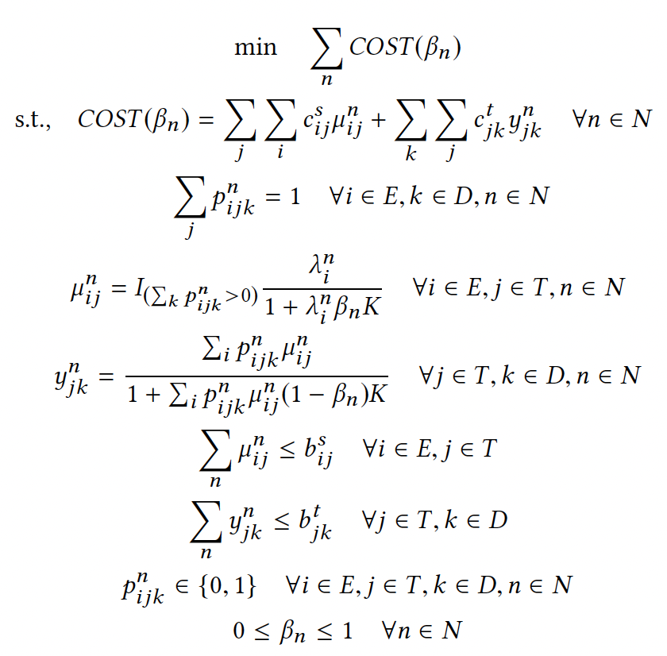


MINLP Formulation
Objective Function
Exactly one path
$$Cost_{(Edge−Transit)}$$
ACM SIGMETRICS’19
$$Cost_{(Transit−Dest.)}$$
Bandwidth Constraints

Slide 19
MINLP Formulation
Objective Function
Transit-to-destination cost
Edge-to-transit cost
Notes:
So we formulate the problem as a joint optimization which turns out to be a mixed integer non-linear program
Our objective function is the traffic cost which consists of two components: the edge-to-transit cost and the transit-to-destination cost

Slide 20
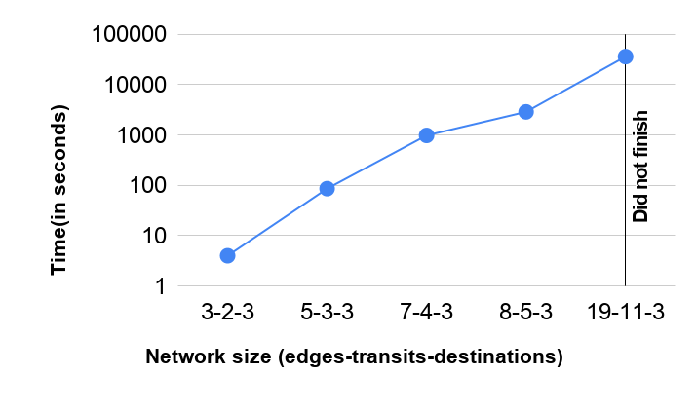
Computational Complexity
Notes:
So we try to solve this optimization and since it is a mixed integer non-linear program, it takes a long time to solve. However, one thing to note is that even though it is slow, the optimization gives us the optimal solution given our constraints, which is the best solution possible for that scenario.
However, for a network size of 7 edges, 4 transits, and 3 destinations, it takes over 16 minutes to solve. And for a network size of 19 edges, 11 transits, and 3 destinations, it does not finish even after 12 hours.
Now recall that our queries are delay sensitive and this is too slow for all practical purposes
But it turns out that while the solution from the optimization cannot be directly used, it provides us with very useful insights that we can use to come up with a much faster solution

Slide 21


Insights from MINLP formulation
Performing entire aggregation at the edges is not always optimal
$$βK$$
$$(1−β)K$$
K = 500ms
Notes:
Now I show the insights from our optimization that we use to build our heuristic. While it may seem intuitive to perform as much aggregation as possible closer to the users and at the edge, in order to reduce traffic and traffic cost, it turns out that this is not always optimal.
Recall the delay budgeting problem where we have to split the delay budget between the edges and the transit datacenters. Now consider an example where this delay budget is 500milliseconds

Slide 22


Insights from MINLP formulation
Performing entire aggregation at the edges is not always optimal
$$500ms$$
$$0ms$$
Notes:
If we spend the entire delay budget to do aggregation at the edge, we do not have any time left over to do aggregation at the transit datacenter. This means that any record arriving at the transit datacenter needs to be forward immediately to the destination without any aggregation.

Slide 23


Insights from MINLP formulation
Performing entire aggregation at the edges is not always optimal
Takeaway: Distributing aggregation across edges and transits is beneficial
$$250ms$$
$$250ms$$
Notes:
Now consider a case where we actually split the delay budget to do some of the aggregation at the edge and some of the aggregation at the transit datacenter. Since the transit datacenter in this case has records coming over from multiple edges, it can aggregate a larger number of records into a single record, and this can lead to a larger reduction in traffic.
So the key takeaway here is that distributing aggregation across edges and transits is beneficial, and it is not always best to do the entire aggregation as close to the users as possible

Slide 24
Insights from MINLP formulation
Routing data to nearest node not always optimal
Notes:
The second insight from our optimization is as following. While it may seem natural to route data from an edge to its closest transit datacenter, this might not always be optimal.

Slide 25
Insights from MINLP formulation
Routing data to nearest node not always optimal
Takeaway: Selecting common (even if far-away) transits may lead to more aggregation
Notes:
In order to perform more aggregation and therefore get a larger reduction in traffic, it may make sense to select a common transit for multiple edges to send their data to, even if the common transit is far-away from some of the edges.

Slide 26
Insights from MINLP formulation
Minimizing traffic ≠ minimizing traffic cost
$
$$
Notes:
And finally, the optimization confirms our hypothesis that minimizing traffic does not necessarily equate to minimizing traffic cost. To minimize traffic cost, it might make sense to choose a cheaper link even if that results in sending a slightly larger amount of traffic on the network.

Slide 27
Insights from MINLP formulation
Minimizing traffic ≠ minimizing traffic cost
Takeaway: Selecting cheaper links can lead to lower traffic cost
$
$$
Notes:
So the key takeaway here is that selecting cheaper links is preferred over minimizing the amount of overall traffic

Slide 28
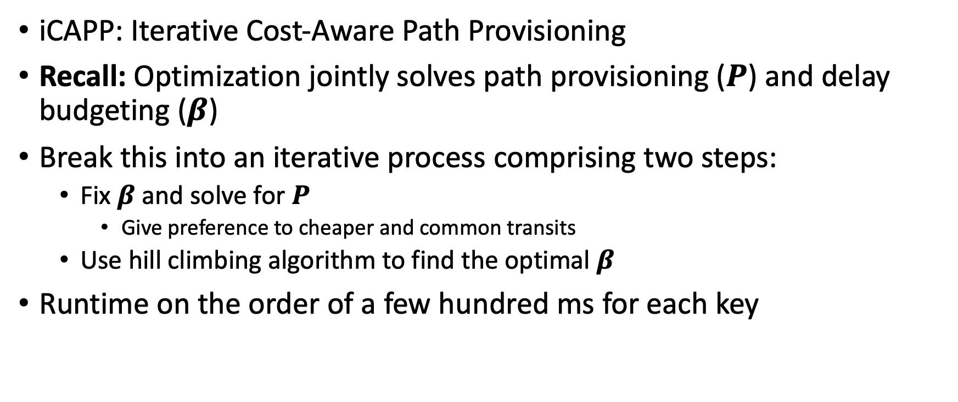
iCAPP: A fast, near-optimal and scalable heuristic to minimize traffic cost
iCAPP: Iterative Cost-Aware Path Provisioning
Recall: Optimization jointly solves path provisioning ($P$) and delay budgeting ($β$)
Break this into an iterative process comprising two steps:
Fix $β$ and solve for $P$
Give preference to cheaper and common transits
Use hill climbing algorithm to find the optimal $β$
Runtime on the order of a few hundred ms for each key

Slide 29
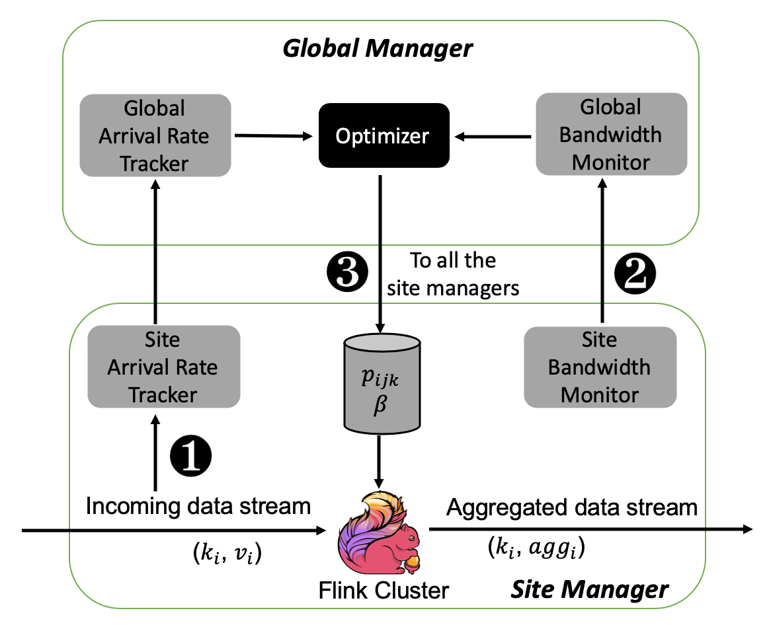
Implementation and Evaluation
Aggregation Network on AWS
Edges | Virginia, Oregon, Ireland, Tokyo, Seoul, Mumbai, Sydney, Sao Paulo
Transits | Virginia, Ireland, Tokyo, Sydney, Sao Paulo
Destinations | California, Frankfurt, Singapore
Notes:
Now we show our evaluation results
We implemented our approach on top of Apache Flink which is a popular framework for streaming applications. At each site we record the arrival rate of the requests coming in and also the bandwidth, which is then fed to a global optimizer which computes the path provisioning matrix and delay budgets, and propagates these to each of the sites where these changes are then made.
We evaluate our approach on AWS with 8 edges, 5 transits, and 3 destination locations
The rationale for choosing these locations are as follows:
Edges spread out across the globe
Destinations one per major continent, which are North America, Europe, Asia
Transits one per continent, which are NA, SA, Europe, Asia, Australia

Slide 30


Datasets and Queries
 | Akamai | Twitter
Description | Anonymized beacon logs from Akamai’s download analytics service | Real tweet stream collected using Twitter API
Duration | Month long trace | Three day
Aggregation queries | Total Number of bytes downloaded Largest successful download size | 1. Word count 2. Trending topics
Notes:
We evaluate our implementation on two datasets. One of them is a month-long trace from Akamai describing an analytics service, and the other one is from Twitter having real tweet streams collected over a three day period
And we consider queries such as trending topics across tweets for a given time, word count, and for Akamai we consider traffic metrics

Slide 31
Baselines
Baselines for Path Provisioning
Nearest Transit Selection (NTS)
Common Transit Selection (CTS)
Cheapest Common Transit Selection (CCTS)
Baselines for Delay Budgeting
Entire Aggregation at Edge (EAE)
Entire Aggregation at Transit (EAT)
Partial Aggregation at Edge (PAE)
Notes:
Baselines chosen represent and generalize commonly used heuristics as well as state-of-the-art works on geo-distributed streaming analytics such as JetStream, AWStream, and ApproxIoT

Slide 32
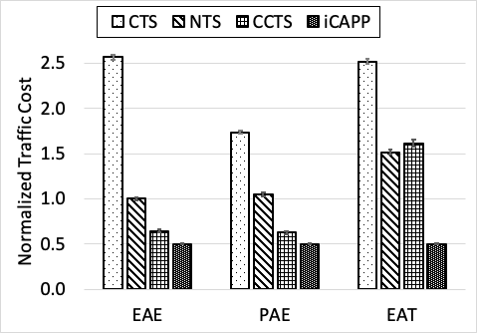
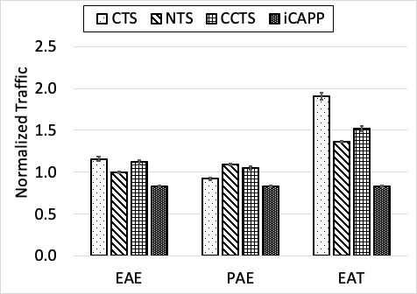
Baseline Comparison for Akamai Trace

Slide 33
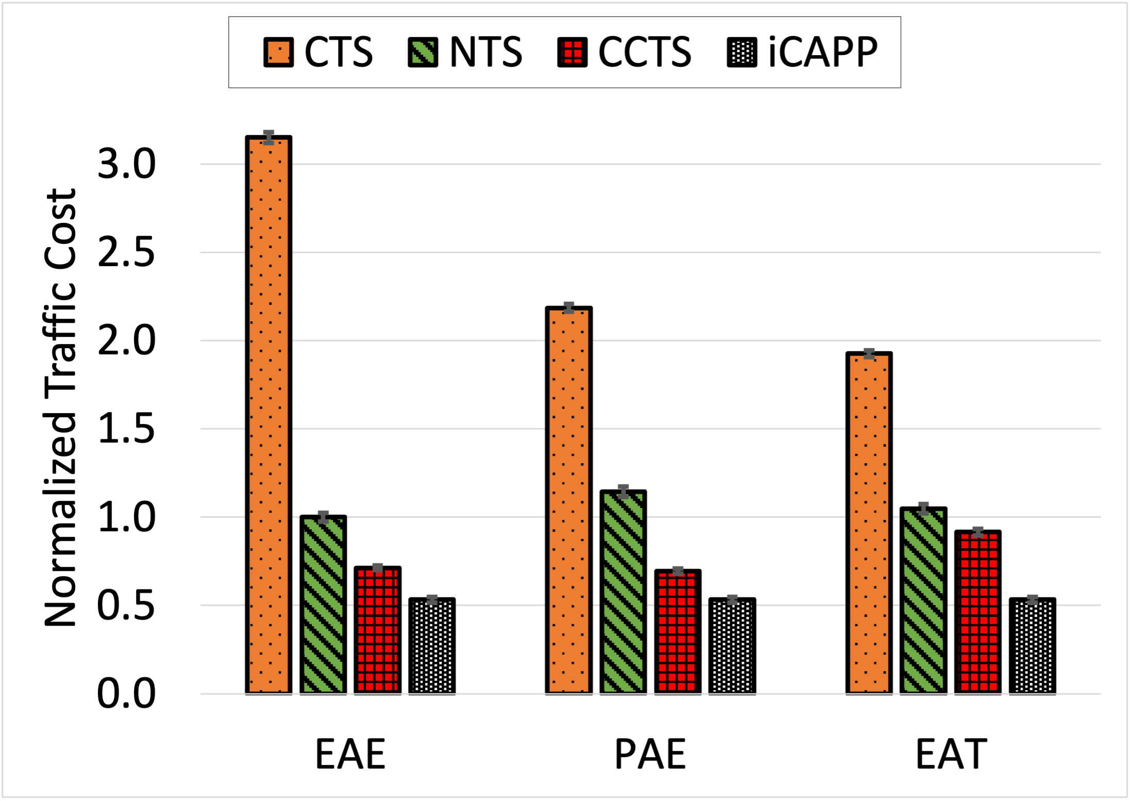
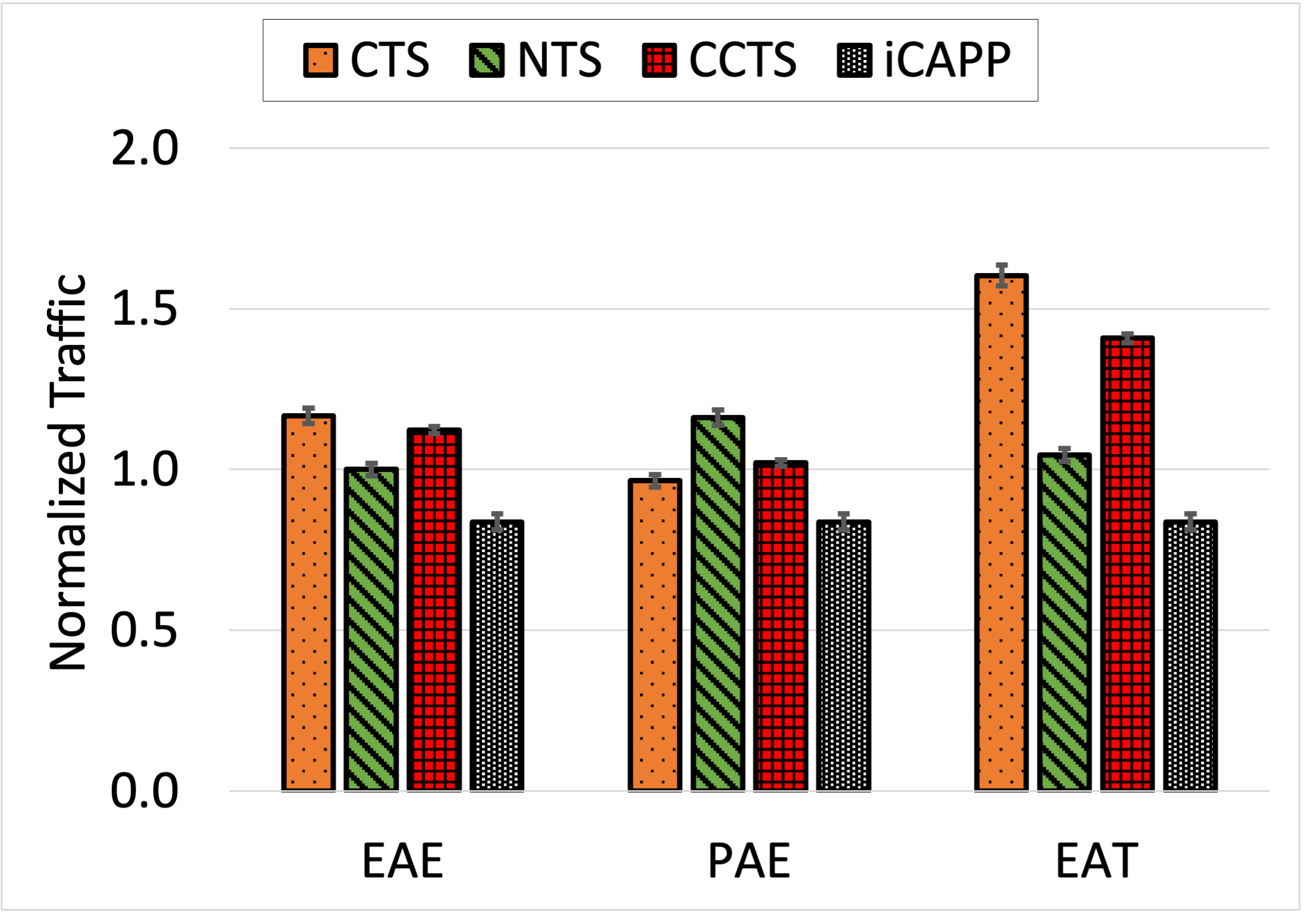
Baseline Comparison for Twitter Trace
Notes:
iCAPP not only beats out other baselines in terms of traffic cost, but is also able to get it without increasing the amount of traffic on the network
(Transition)

Slide 34
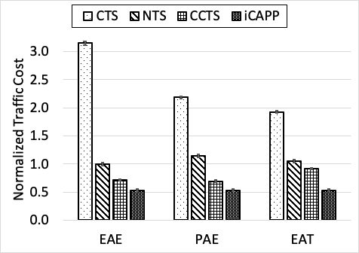
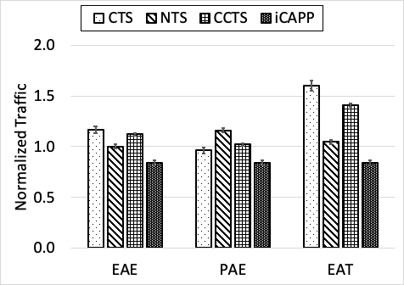
Baseline Comparison for Twitter Trace
iCAPP results in 23% to 81% reduction in traffic cost as compared to other approaches

Slide 35
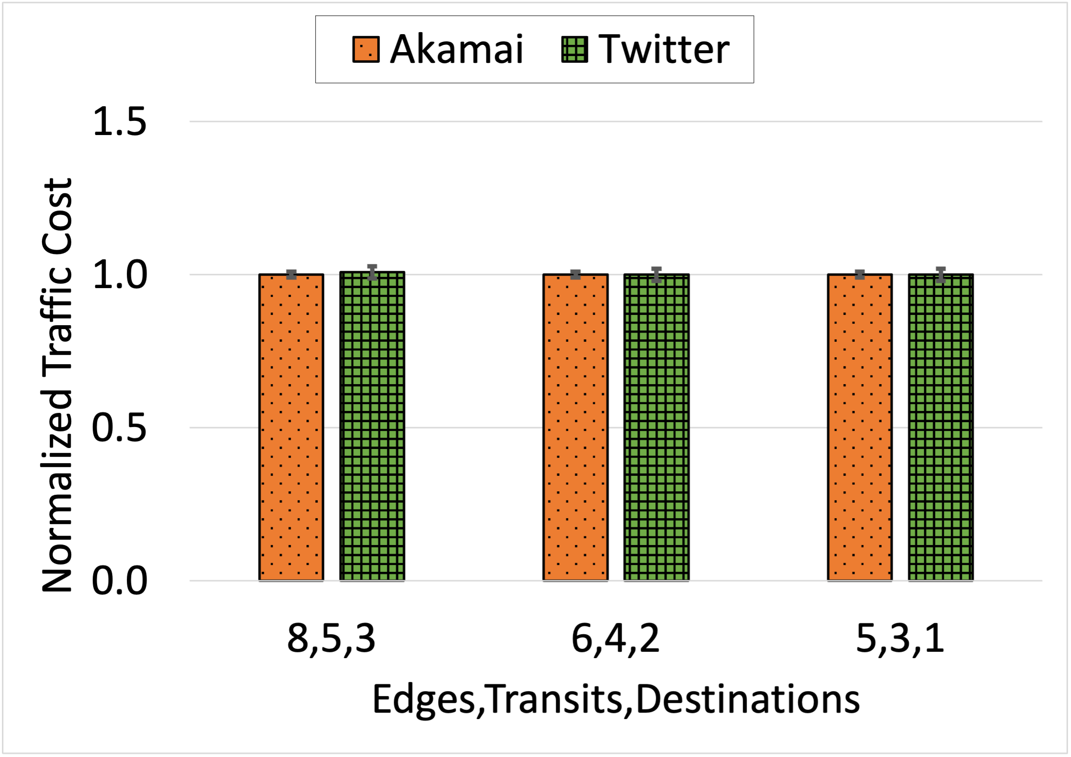
How close is it to optimal solution?

Slide 36
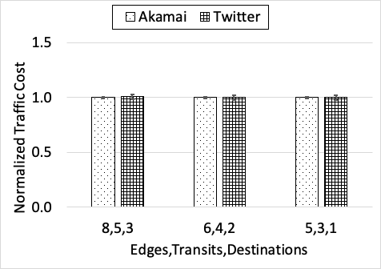
How close it is to optimal solution?
iCAPP is within 1% of the optimal

Slide 37
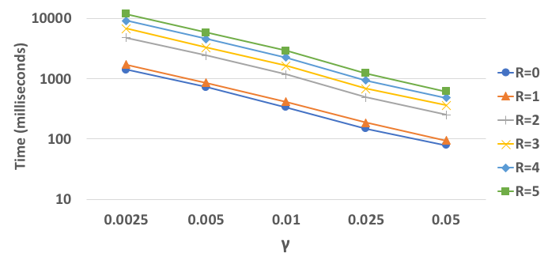
Computational Overhead
Notes:
What factor faster than optimal/optimization?
Don't need internal comparison, we want direct comparison to optimal
Bar graph, two network sizes (optimal vs iCAPP)
x times faster

Slide 38
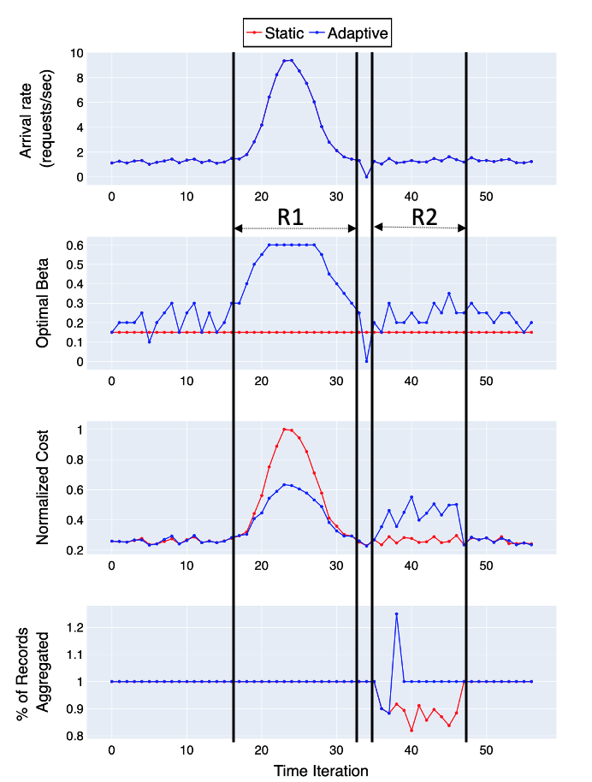
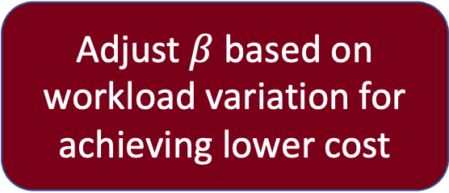
Adaptivity to Dynamism
Workload variation
WAN link failure
Adjust $β$ based on workload variation for achieving lower cost
Shift the traffic to the second cheapest link for ensuring no data loss
Notes:
And finally we construct a synthetic workload to show how iCAPP responds to dynamism in the workload, such as changing arrival rates and link failures. So the graph on the top shows the input arrival rates and the region R1 here shows variation in the arrival rates over a small period of time. In the region marked as R2 here, we introduce a link failure and see how iCAPP responds to it. We show two approaches, one which is static and the other is our adaptive iCAPP approach.
The second graph shows how iCAPP changes the value of the Beta parameter according to changes in workload.
The third graph shows the cost achieved by both the approaches, and the fourth graph shows the percentage of records that are aggregated.
So in the third graph we can see that during R1 when arrival rates change over time, iCAPP is able to adaptively change the value of Beta to get a much better reduction is cost as compared to the static approach.
For the region R2, while the static approach achieves a smaller cost as compared to our adaptive approach, this is at the cost of lost records. So we can see from the fourth graph that the static approach ends up losing up to 10-20% of the records, whereas iCAPP is able to quickly adjust after a short time and goes back to 100% quickly.
So iCAPP is response to not only changes in the arrival rates of the workload, it can also quickly adapt to link failures.

Slide 39
Adaptivity to Dynamism
iCAPP can efficiently adapt to changes in workload and resource availability

Slide 40
Conclusion
Cost-aware approach towards aggregation networks for streaming analytics
Trade-offs between delay, traffic and cost
iCAPP heuristic for minimizing traffic cost subject to delay bound
Implemented on top of Apache Flink
Reduces up to 83% traffic cost as compared to cost-agnostic frameworks without increasing traffic

Slide 41

Thank you for listening!
Notes:
With that I would like to thank you all for listening. For more details on our solution and experimental results, I encourage you to go through our full paper. And I can now take questions if there are any.

Slide 42
Expected Questions
Why not consider computational capacities of edge servers?
Why not consider computational delay?
Computational delay = aggregation delay

Slide 43
iCAPP: A fast, near-optimal and scalable heuristic to minimize traffic cost
Select cheaper transits
Route edges to common and/or co-located transits
Distribute delay budget between edges and transits
Implemented on top of Apache Flink
Evaluated on AWS testbed using Twitter and Akamai traces
Reduces up to 83% traffic cost compared to state-of-the-art
Dynamically adapts to workload and bandwidth variations
Computational overhead is modest

