Slide 1


Proteus: A High-Throughput Inference-Serving System with Accuracy Scaling
Sohaib Ahmad, Hui Guan, Brian D. Friedman, Thomas Williams, Ramesh K. Sitaraman, Thomas Woo

Slide 2
Lifecycle of ML models
Model Development
Model Training
Model Tuning
Inference Serving

Slide 3
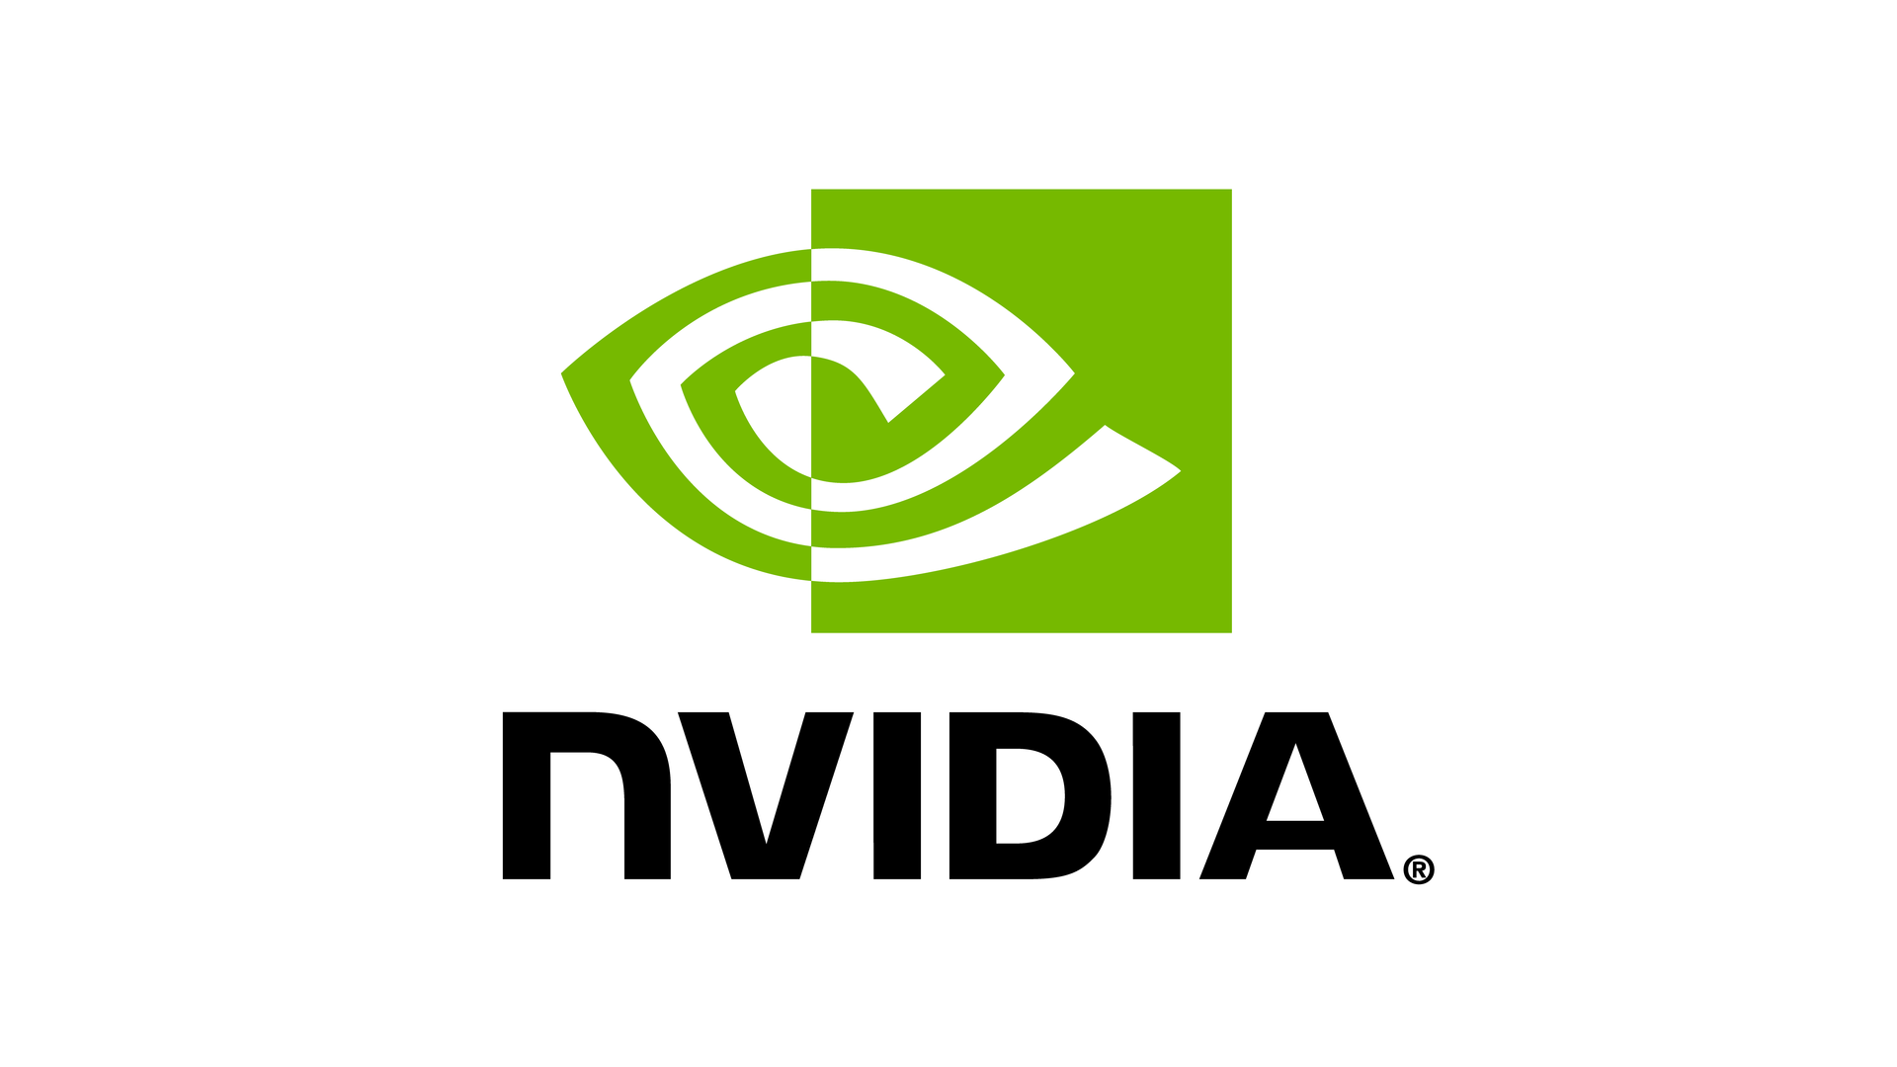

Lifecycle of ML models
Model Development
Model Training
Model Tuning
Inference Serving
Expanded capacity by 2.5x
to meet inference demand
Carole Jean Wu et al., MLSys 2022
“Inference is the big market, with an
estimated 80% to 90% cost of ML”
Jensen Huang, GTC

Slide 4

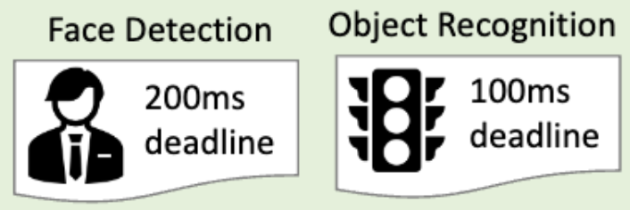

Inference serving system
DNNs
Query
Response
Servers
Applications
Provider
Care about: Throughput
Clients
Care about: Latency, Accuracy

Slide 5

Limitations of hardware scaling
ML Models
Servers

Slide 6
Limitations of hardware scaling
Disadvantages:
1. Expensive $$
2. May not be feasible → Delayed or dropped requests
ML Models
Servers

Slide 7
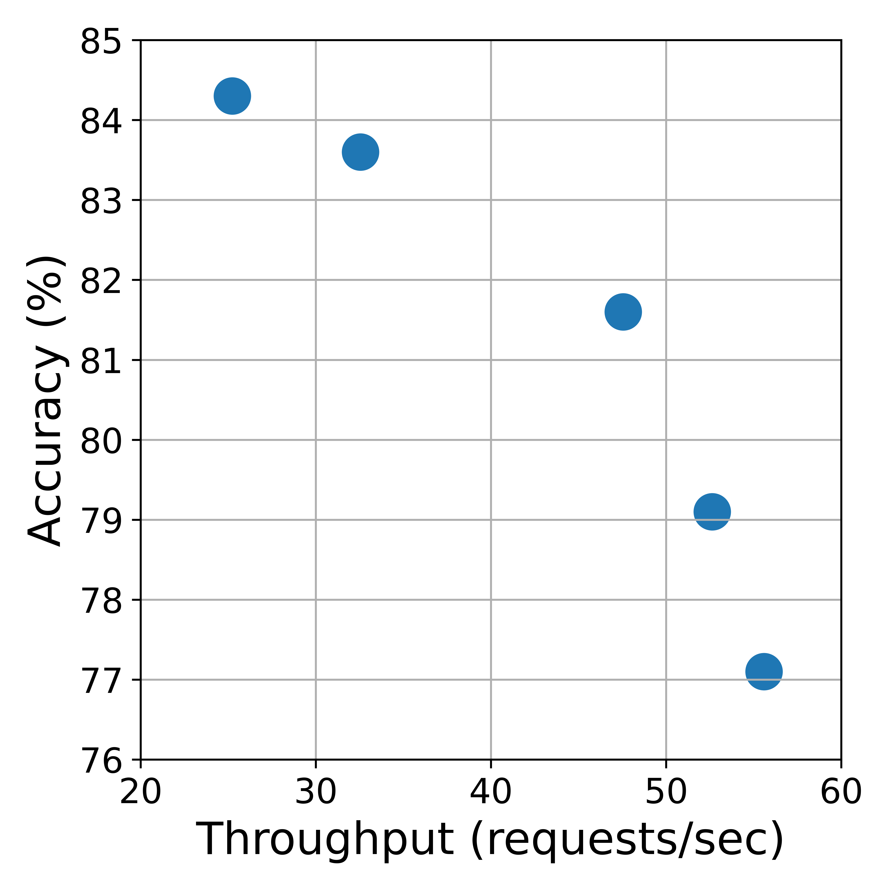
Key idea: Accuracy scaling
EfficientNet-b0
EfficientNet-b1
EfficientNet-b3
EfficientNet-b5
EfficientNet-b7

Slide 8
Challenge 1: Varying query loads
1
2
3
4
5
Server queue
Macro-scale variations
Micro-scale variations

Slide 9
Challenge 2: Right amount of scaling
Suppose we want to serve a demand of 45 requests/sec

Slide 10
Challenge 2: Right amount of scaling
Suppose we want to serve a demand of 45 requests/sec
Under-scale → Dropped requests

Slide 11
Challenge 2: Right amount of scaling
Suppose we want to serve a demand of 45 requests/sec
Under-scale → Dropped requests
Over-scale → Degraded accuracy

Slide 12
Challenge 2: Right amount of scaling
Suppose we want to serve a demand of 45 requests/sec
Right amount of scaling

Slide 13
Challenge 2: Right amount of scaling
Q1: Which model variant to use?
Q3: Which (model variant, server) to serve queries?
DNNs
Query
Servers
Q2: Which server to place model variant on?

Slide 14
Proteus: Two-level system design
Cluster level
Periodically adjust
resource allocation
Macro-scale variations
Server level
Adaptively adjust
batch size according to request arrivals
1
2
3
4
5
Micro-scale variations

Slide 15
Proteus: Resource allocation algorithm
Model
Selection
Q1: Which model variant to use?
Query
Assignment
Q3: Which (model variant, server) to serve queries?
DNNs
Query
Jointly formulate the three subproblems as a MILP
Servers
Model
Placement
Q2: Which server to place model variant on?
See paper for the formulation

Slide 16
Proteus: Adaptive batching
Time to execute (q+1) queries
1
2
q
…
MaxWaitingTime(q)
1 times out
Query arrives before MaxWaitingTime(q) → Batch with queries 1-q

Slide 17



Proteus Architecture
Face Detection
Object Recognition
Application
200ms
deadline
100ms
deadline
Developer
Client sends
query
Query
response
Register
app/model
1
4
Registered
1
4
Control path:
Register application
Allocate resources
Data path:
Serve queries
Resource Manager
Request Router
2
Model Registry
Load Balancer
Controller
Monitoring Daemon
Model Profiler
Statistics Collector
2
3
3
Adaptive Batching
Worker
Hardware Executor
Control path
Data path

Slide 18
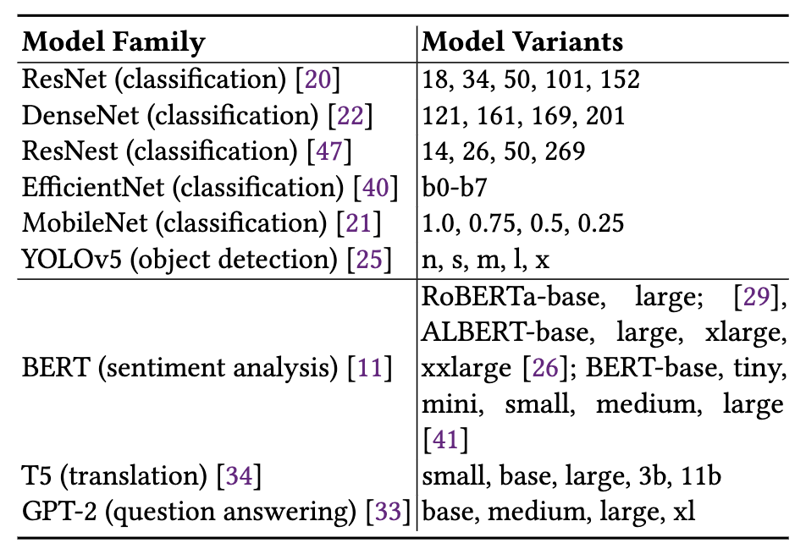
Experimental setup
Fixed size cluster
20 CPUs, 20 GPUs (10 NVIDIA 1080Ti, 10 NVIDIA V100)
Models used
9 model families, 55 variants
Workload
Twitter trace from 2018
Poisson arrivals
See paper for detailed results and ablation studies

Slide 19
Baselines
No accuracy scaling:
Clipper-High Accuracy
Clipper-High Throughput
With accuracy scaling:
Sommelier
INFaaS-Accuracy

Slide 20
Vs. Static (High-Acc)
Compared to Clipper-HA:
Proteus:
Highest throughput improvement
Much less SLO violation

Slide 21
Vs. Static (High-Thput)
Compared to Clipper-HT:
Proteus:
Less SLO violations
Significantly smaller accuracy drop (4x)

Slide 22
Vs. Accuracy Scaling
Compared to systems extended to perform accuracy scaling,
Proteus:
Drops up to 3x less accuracy while meeting throughput requirements
Violates latency SLOs 2-10x less

Slide 23
Vs. Accuracy Scaling
Compared to systems extended to perform accuracy scaling,
Proteus:
Drops 3x less accuracy while meeting throughput requirements
Violates latency SLOs 2-10x less

Slide 24
Capacity increase
We can serve 4x more requests using the same amount of hardware
4x

Slide 25
Key takeaways
Proteus advocates accuracy scaling as an alternative option to hardware scaling in a cluster setting
Reduces latency timeouts by 2-10x and accuracy drop by up to 3x compared to SOTA baselines
Accuracy scaling allows us to serve 4x more requests using the same hardware

Slide 26

Questions?
Contact: sohaib@cs.umass.edu
https://github.com/UMass-LIDS/Proteus

