Slide 1
Brain Buster (Quiz game)
SUPERVISOR:
MA’AM MAMOONA TASADDUQ
TEAM MEMBERS:
SOHAIB AHMAD (FA16-BCS-101)
MUHAMMAD RIZWAN (FA16-BCS-249)
ALI AHMAD (FA16-BCS-291)

Slide 2
objectives
Development a quiz-based web application to educate students upon their core subject offered at university.
Multi-level MCQS with gamification features.
Supervised class environment.

Slide 3
Importance and need
No such personalized tool was present for teaching important subjects for university students via gamification.
Need of quiz based on different difficulty levels and learn their weak topics via video lectures
Specialized tool for university students supervised by instructor

Slide 4
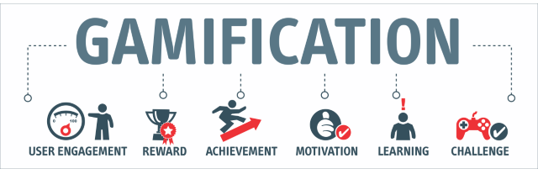
Gamification and personalized learning

Slide 5




Existing systems

Slide 6

Overview and limitations
 | Brain Buster | Kahoot | Khan Academy | Quizizz
Personalized Quiz
Badges
Leaderboard
Challenge a friend
Discussion Forum
Specific courses

Slide 7
features
Personalized Quiz
Gamified Scoring system
Discussion Forum
Badges as awards
Leaderboard
Feedback System
Challenge a Friend

Slide 8




Technology used

Slide 9
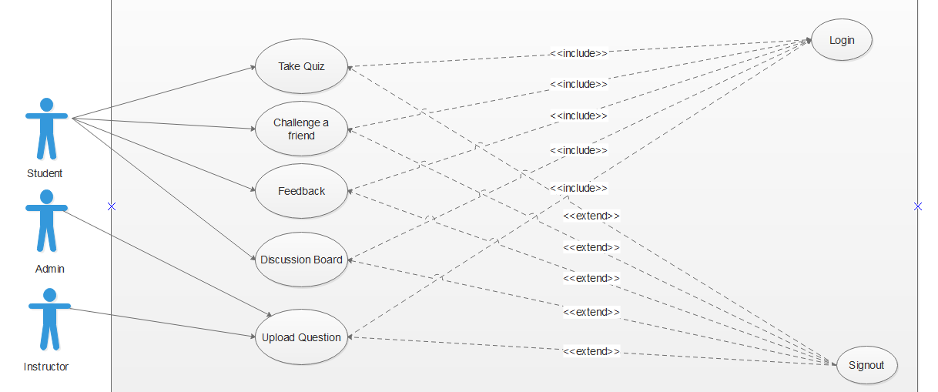
Use case diagram

Slide 10
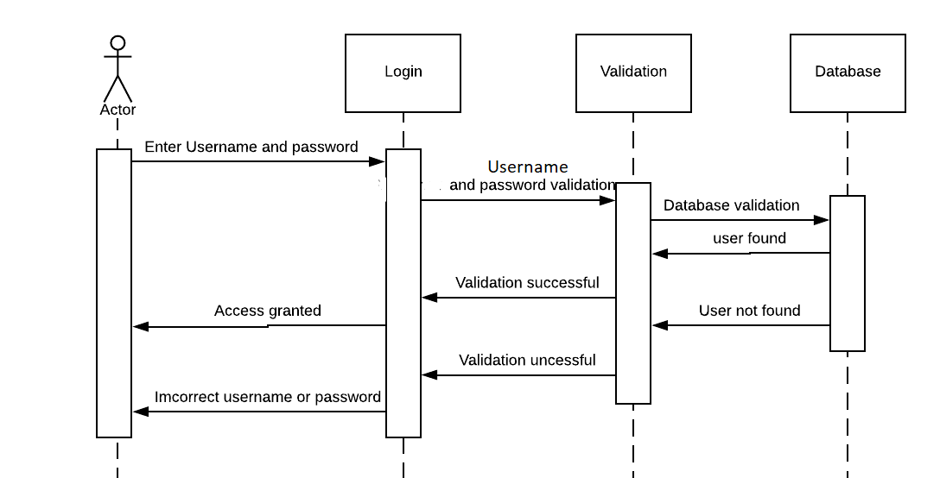
sequence diagram

Slide 11
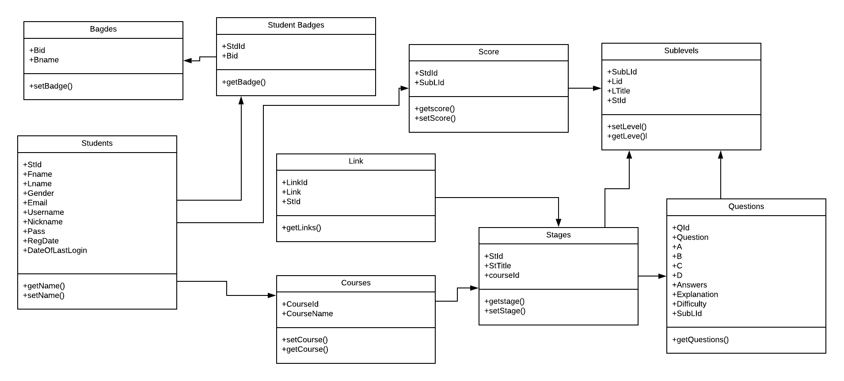
Class diagram

Slide 12
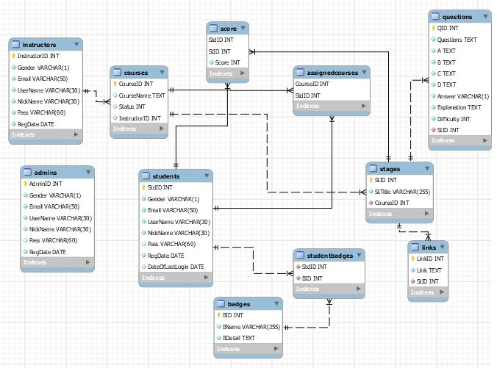
Database diagram

Slide 13
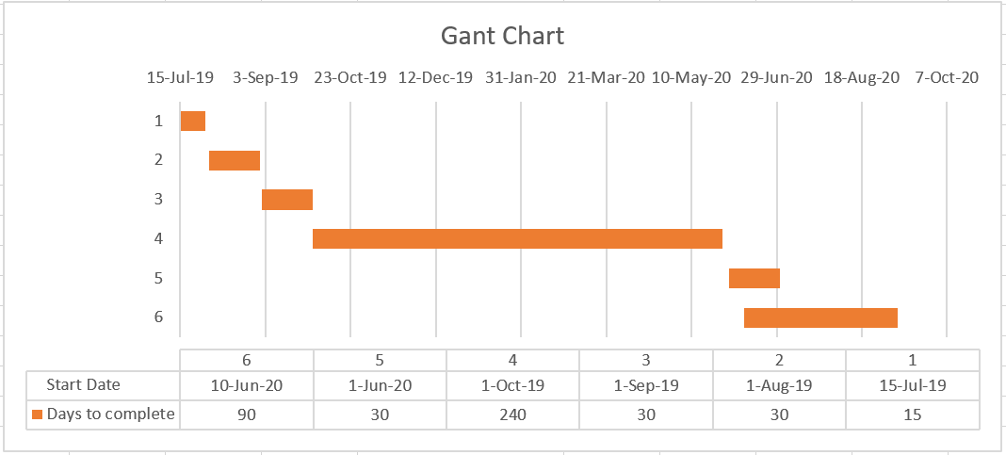
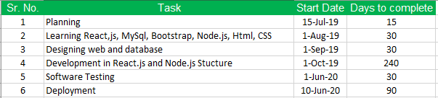
Gantt chart

Slide 14
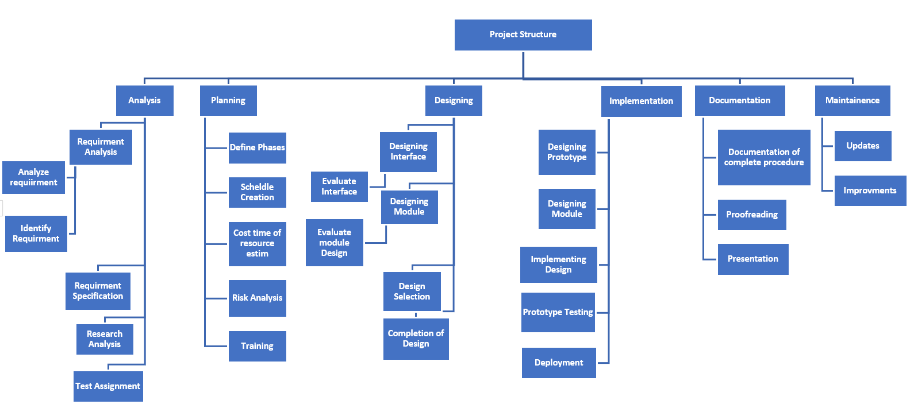
Work breakdown structure

Slide 15
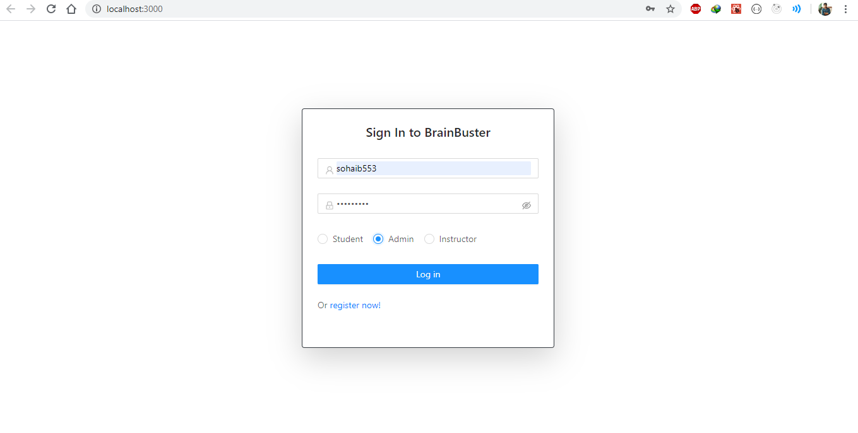
Login page

Slide 16
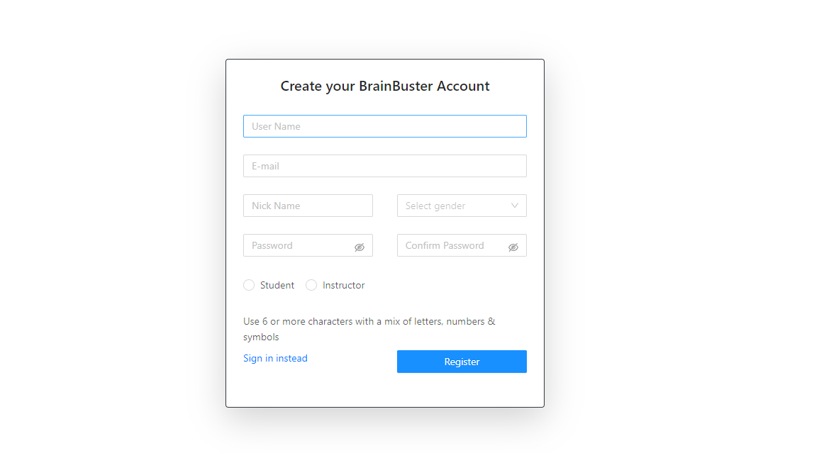
signup

Slide 17
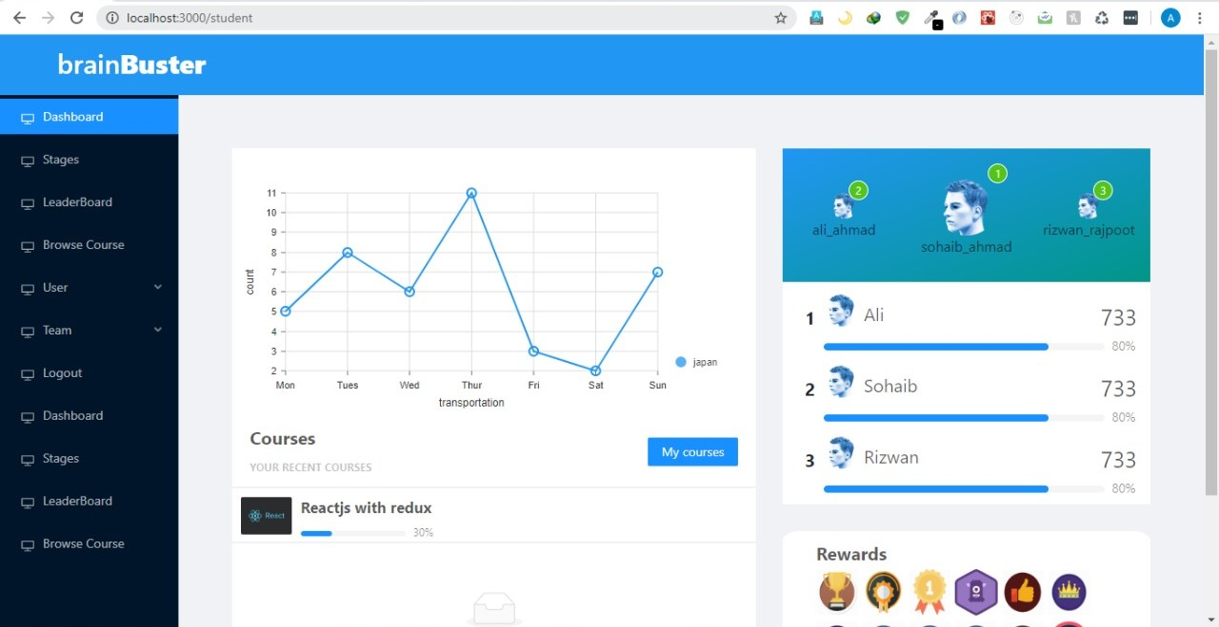
Student: dashboard

Slide 18
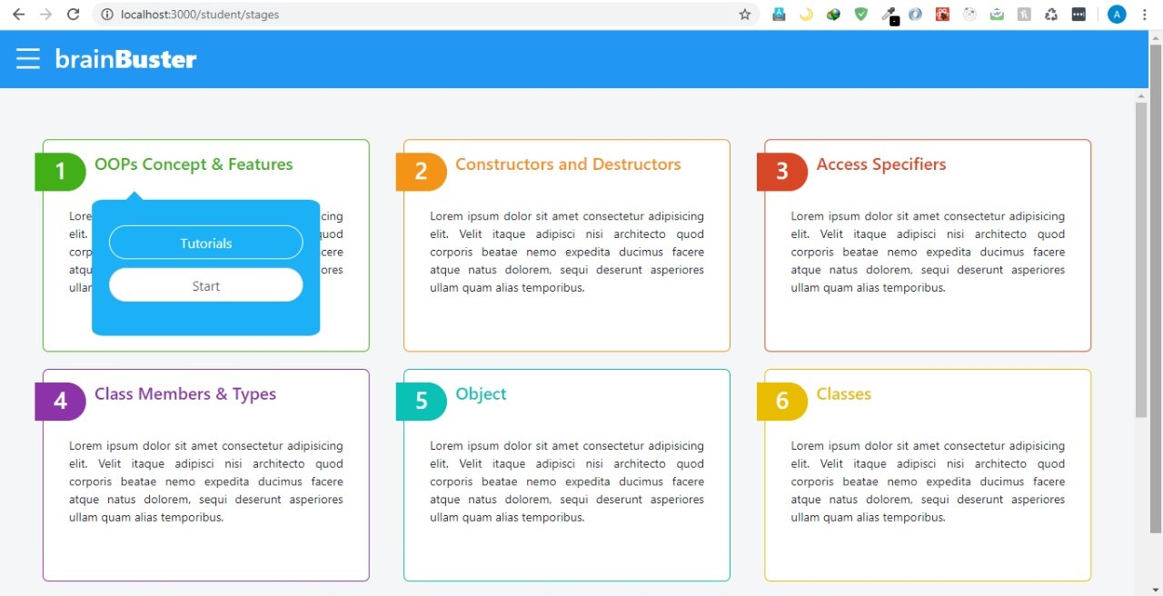
Student: courses

Slide 19
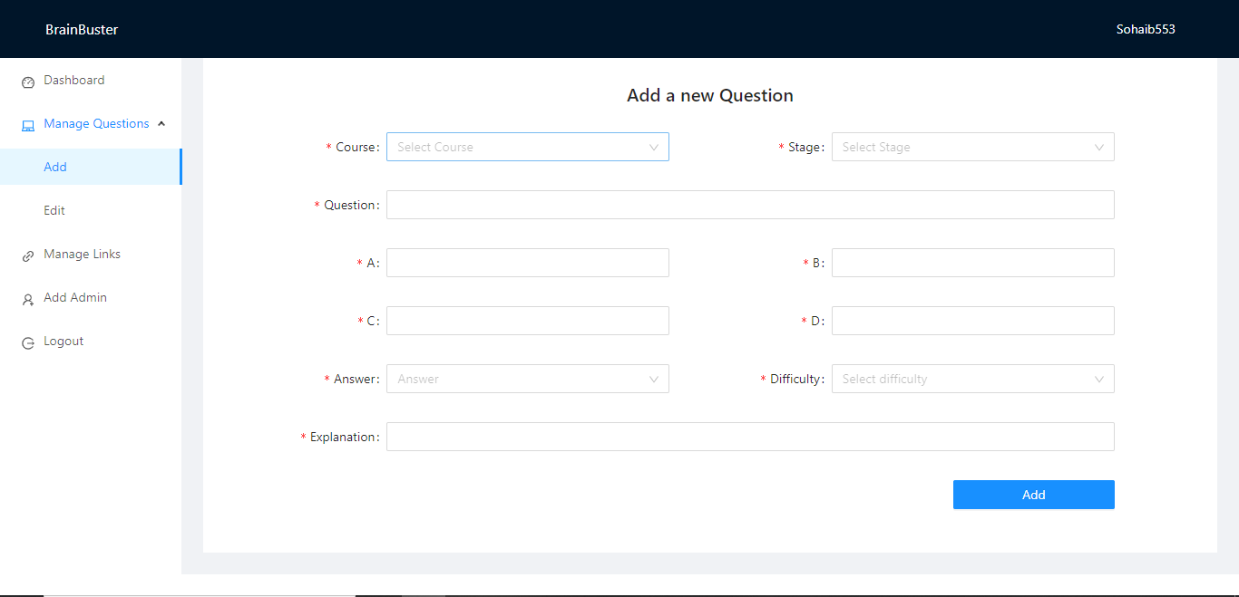
Admin: add new question

Slide 20
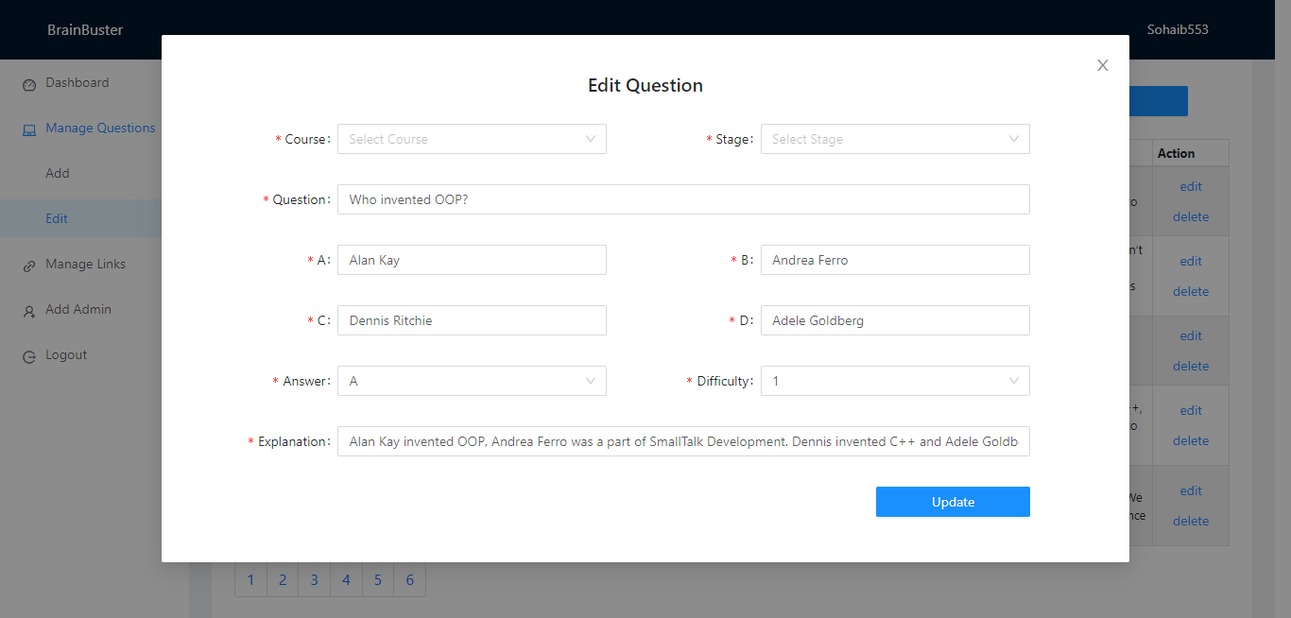
Admin: edit question

Slide 21
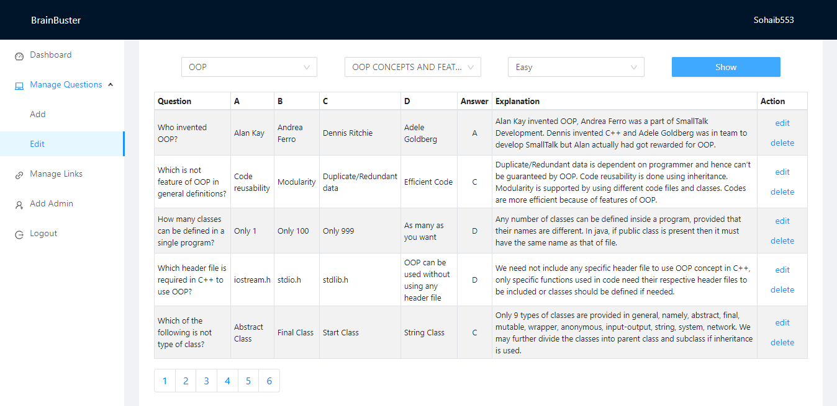
Admin: question display

Slide 22
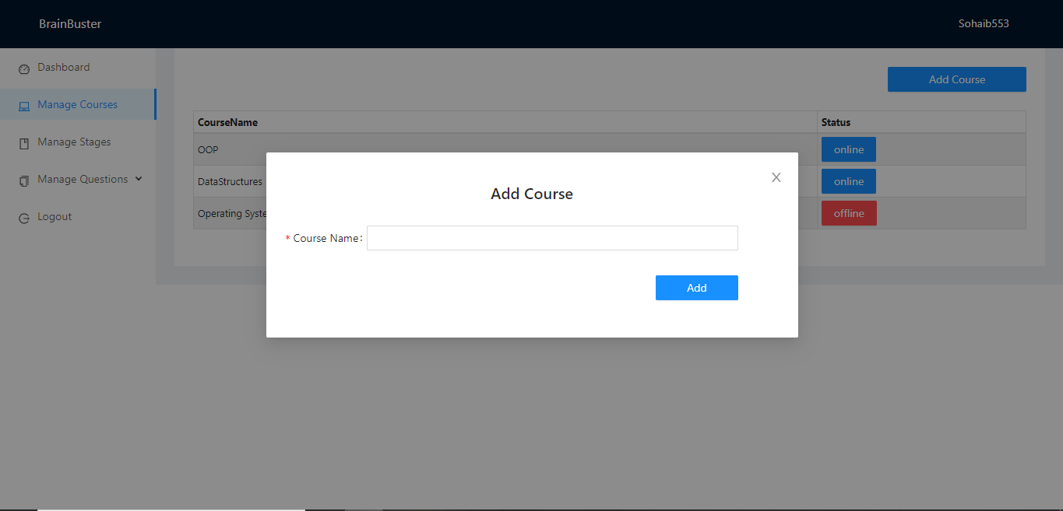
Instructor: add course

Slide 23
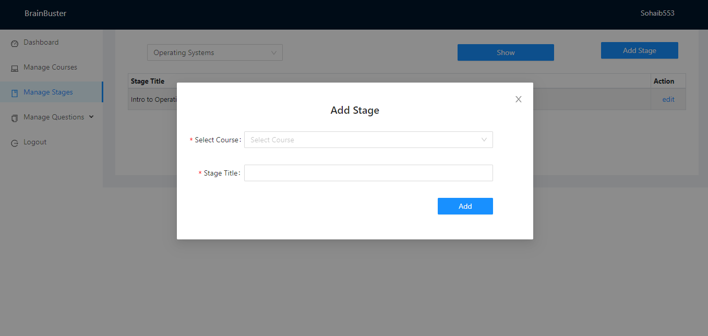
Instructor: add stage

Slide 24
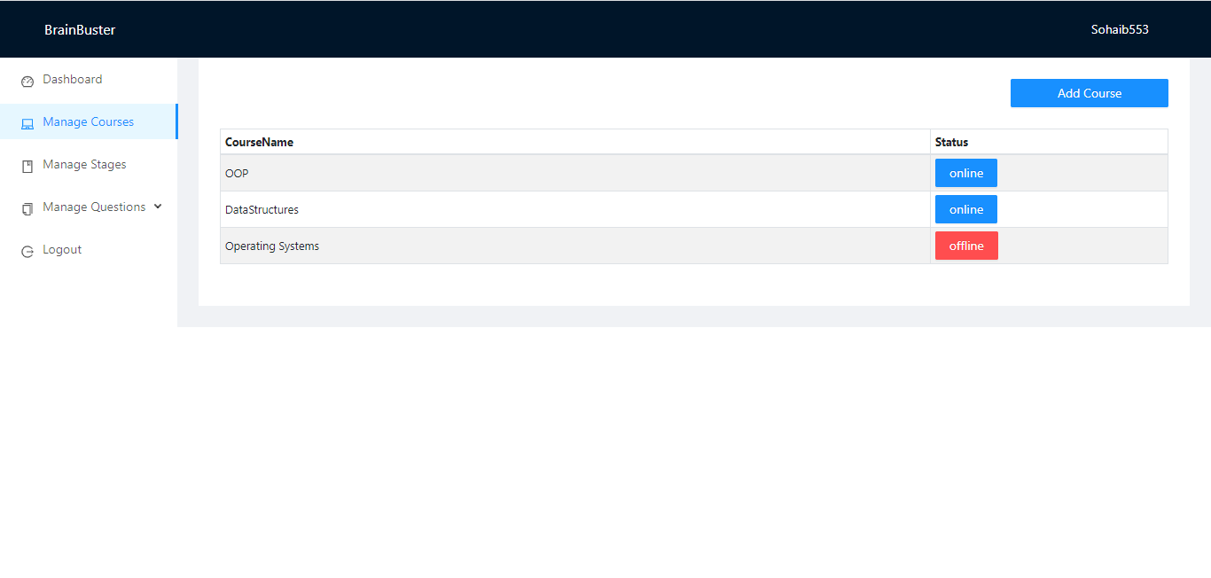
Instructor: course details

Slide 25
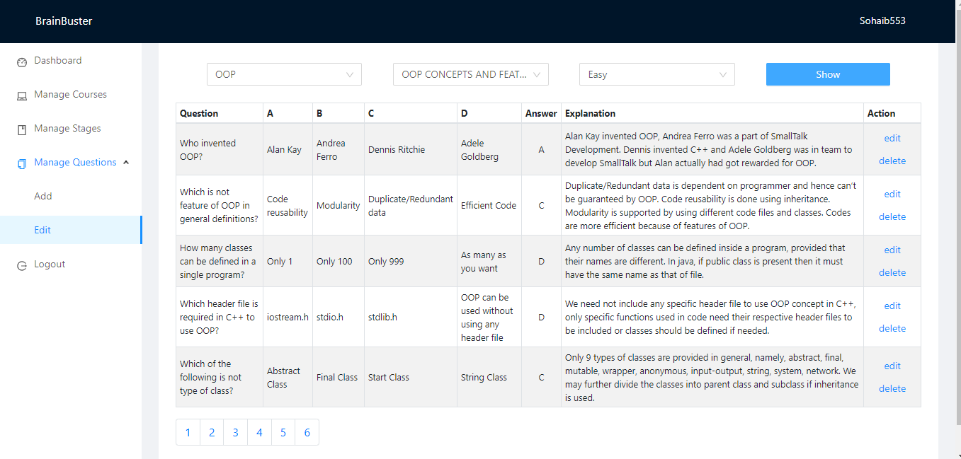
Instructor: manage questions

Slide 26
conclusion
Our aim to build an online tool to learn core subjects offered at university.
Adopted strategy of Gamification and Personalized Learning.
Some existing technologies are also available but having limitations.
With exciting features our tool motivates students in learning process.

Slide 27
Brain buster quiz game
Completed Tasks to date
Remaining tasks
Detailed review of existing technology
Documentation
Categorized Dataset
Personalized Quiz
Gamified Scoring System
Leaderboard
Feedback System
Discussion Board
Challenge a Friend
Assigning Badges

Slide 28
Future work
Upgrading scope of project.
More gamification features can be added like goals to meet in a week, creating student avatars and catchy name
Furthermore we can collaborate our tool with google classroom and other google tools for students.

Slide 29
references
https://en.wikipedia.org/wiki/Gamification
https://en.wikipedia.org/wiki/Personalized_learning
https://www.duolingo.com/
https://quizizz.com/
https://kahoot.com/
http://softwaretestingfundamentals.com/unit-testing/
https://dl.acm.org/citation.cfm?id=2554956
https://www.researchgate.net/institution/Carnegie_Mellon_University/department/Human-Computer_Interaction_Institute/publications?nav=overview
https://books.google.com.pk/books?hl=en&lr=&id=IedEBQAAQBAJ&oi=fnd&pg=PA50&dq=gamification+in+education&ots=bF-k2S-m02&sig=SxHJHDLRe7iJYl9JhXzDyCbK4CY&redir_esc=y#v=onepage&q=gamification%20in%20education&f=false
https://elucidlearning.co/11-must-have-gamification-features-to-train-new-age-workforce/

