Slide 1
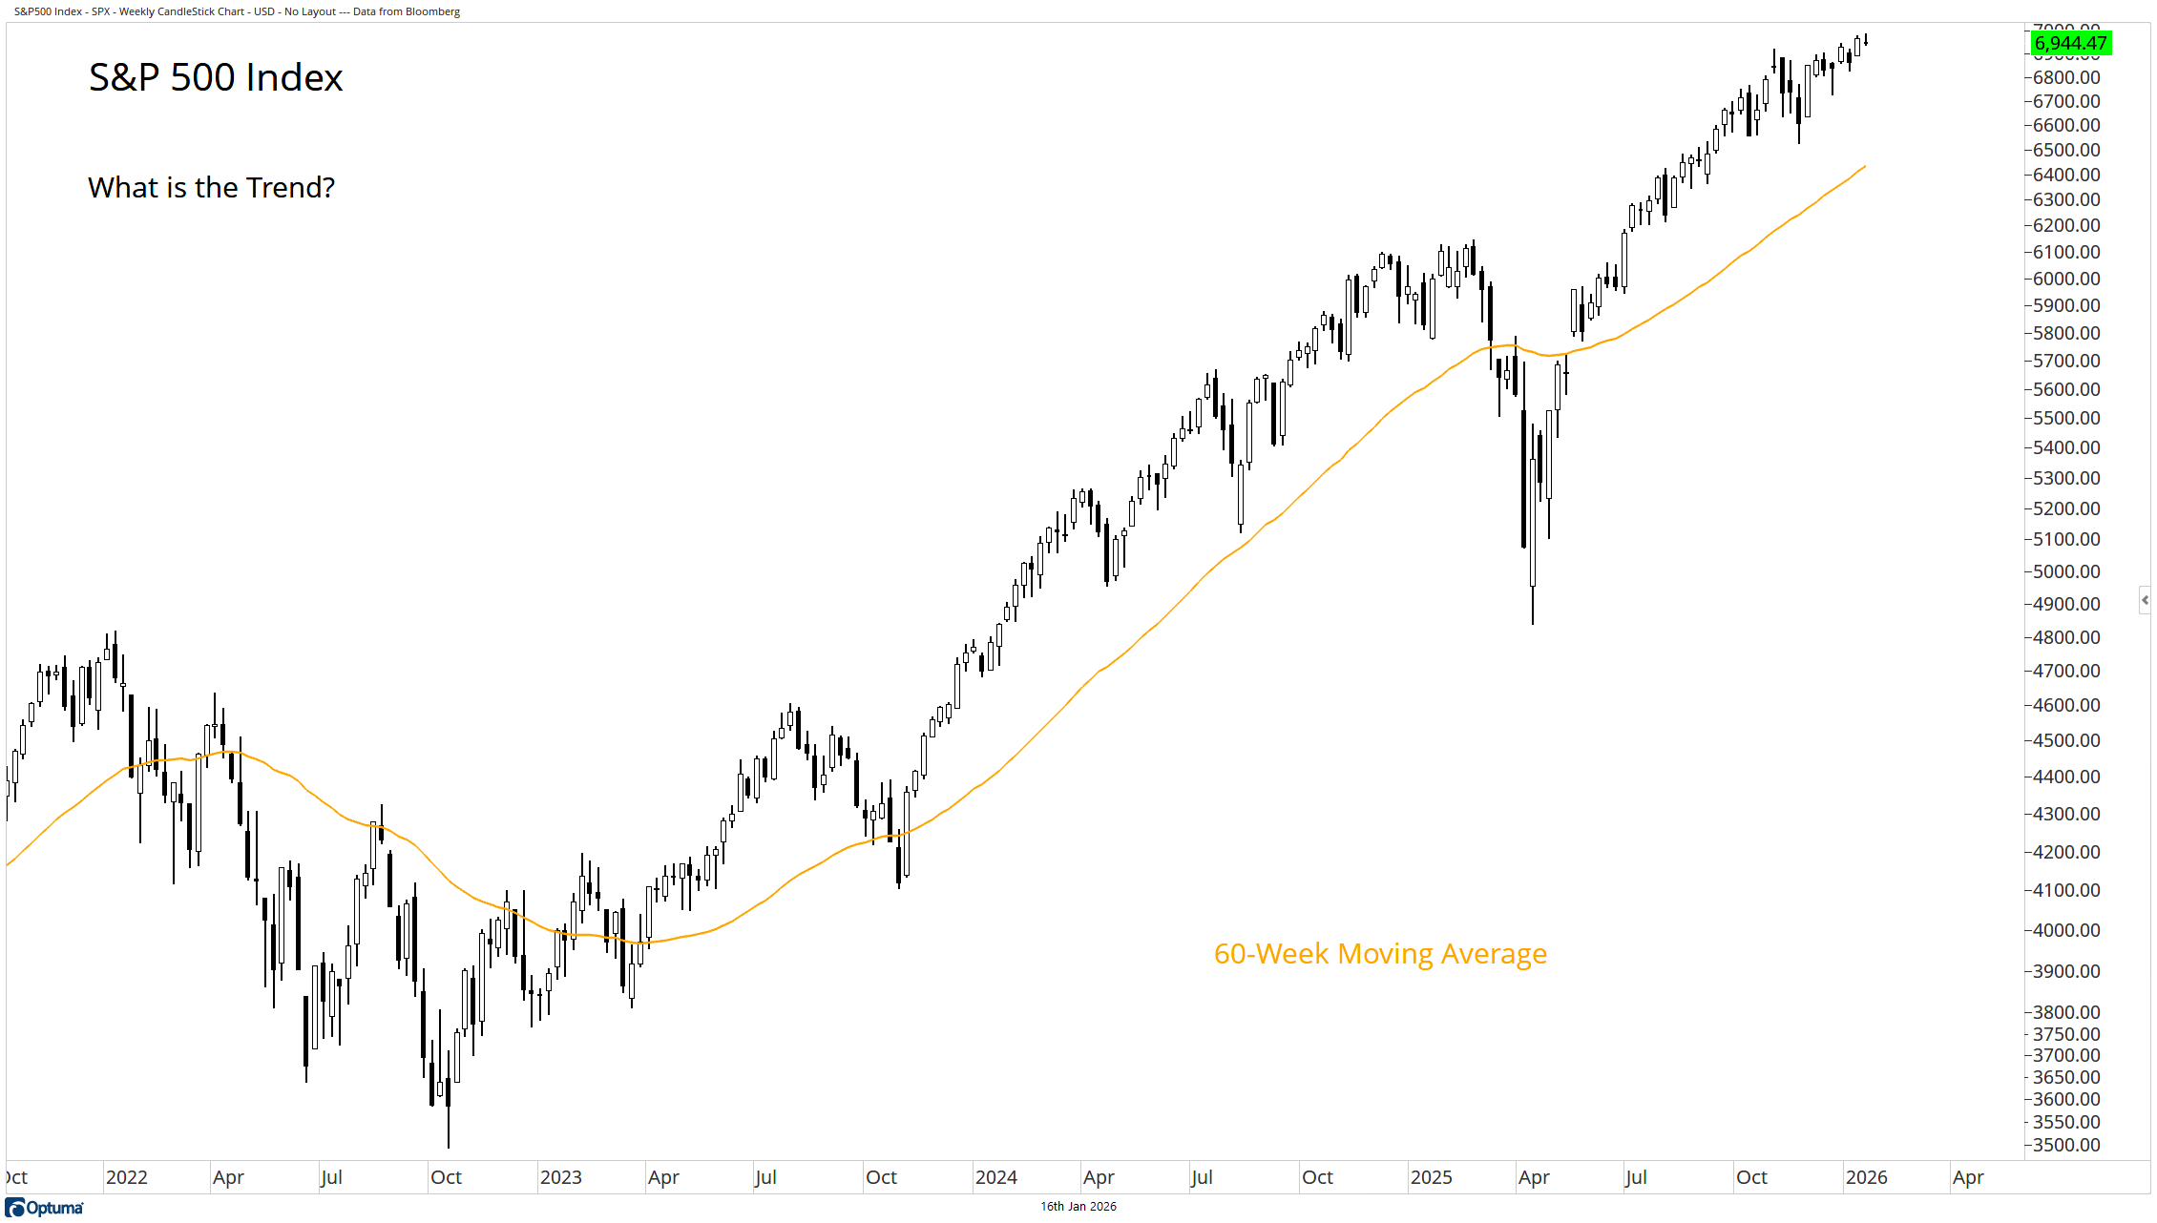
process
trend direction
For illustrative purposes only.

