Slide 1
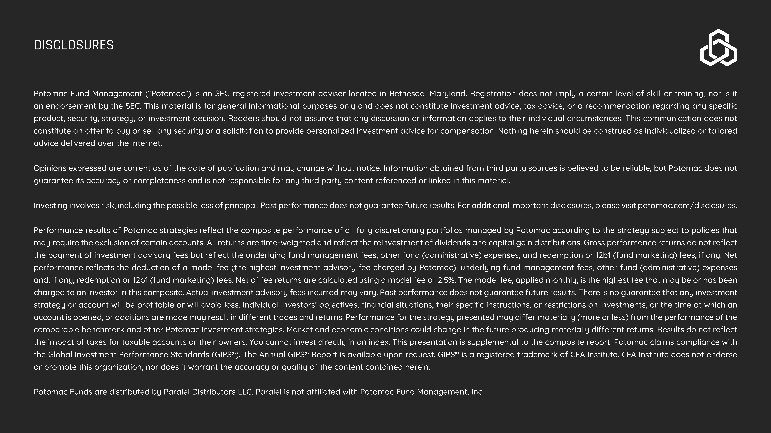
{{slide_title}}
{{body_text}}

