Slide 1
City Tour Planner
Final Project – University of Leicester
Supervisor: Dr. Rayna Dimitrova
Second Marker: Dr. Reiko Heckel
Presented By: Muhammad Sohaib Furqan (Student #179031465)
Degree: MSc Advanced Software Engineering (2017-2019)
Email: msf7@student.le.ac.uk

Slide 2
About City Tour Planner
An android application to help users plan short one-day trips within a city
The users get the flexibility to plan custom trips around their individual daily routine

Slide 3
Motivation
The computing industry has undergone a major paradigm shift from the use of PCs to smart mobile phones
Finding time to attend to hobbies in today’s fast day-and-age is seldom possible
Build upon the ideas of already existing trip planner apps but with a different objective – single day trips of a particular city
Users will not have to set aside time beforehand for exploring a city. Can use the trip planner to create trips on the go
Will save time and effort involved in free-style trips and also allow for more informed decision-making

Slide 4
Literature Review
Sygic Travel (by Sygic) [1]
RoadTrippers [2]
TripIt [3]
Brief discussion coming up…

Slide 5
Sygic
Founded in 2004
Became the first company to launch GPS navigation for the iPhone in 2009
Expanded services to travel planning and management in 2016 (Sygic Travel)
Sygic Travel is only one of the products of this company, there are many more

Slide 6
RoadTrippers
Founded in 2011
Lets users plan road trips in the US and Canada
Originally a web application but launched an iPhone app in November 2012

Slide 7
TripIt
Automates the creation of a trip itinerary
Users need to forward confirmation emails to a designated email address: plans@tripit.com
TripIt will create an itinerary with all travel plans at one place

Slide 8
Where does our app come in?
Helps users plan trips, FLEXIBLY!
Single day, single city approach
(More in the demo…)

Slide 9
City Tour Planner - Features
Allow users to set up a profile to save trips (and history)
Allow users to customize trip experience
Optimize search results based on user location so that only the most relevant data is returned
Include pictures of venues where available
Incorporate user feedback for the app

Slide 10
City Tour Planner – The Tech Stack
Android Studio ( official IDE for programming Android apps)
Google’s Firebase real-time database – A cloud-based NoSQL database that allows real time synchronization of data (more on NoSQL in the next slide)
The Google Places API – for retrieving information regarding places
The Volley Library – for efficiently handling HTTP requests
Picasso Library– Allows for loading and displaying media from many different sources such as remote servers or the local file system
And others – as needed

Slide 11
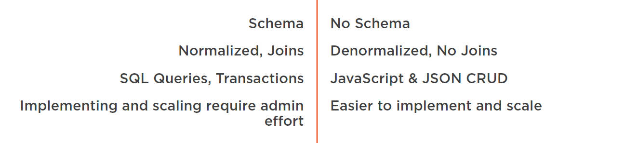
SQL vs NoSQL
Taken from [4]

Slide 12
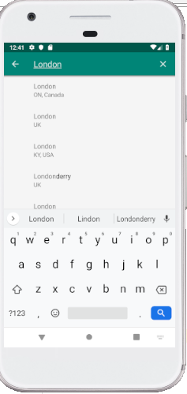



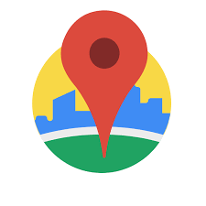
City Tour Planner – The workflow

Slide 13
Challenges
Calculating trip duration and end time from start time
Restricting the autocomplete dialog to a specific city when adding a place to an existing trip
Modifying the application settings screen to include a toolbar and an “up” navigation button

Slide 14
References
Sygic Travel, Available at https://travel.sygic.com/en (Accessed: 15 February, 2019)
RoadTrippers, Available at http://www.roadtrippers.com (Accessed: 15 February, 2019)
TripIt, Available at http://www.tripit.com/web (Accessed: 15 February, 2019)
“Creating your first Android Application with Firebase” by Simone Alessandria, Available at http://www.pluralsight.com (Accessed: 02 June, 2019)
Sygic Wikipedia Page, Available at https://en.wikipedia.org/wiki/Sygic (Accessed: 05 September, 2019)
RoadTrippers Wikipedia Page, Available at https://en.wikipedia.org/wiki/Roadtrippers (Accessed: 05 September, 2019)

