Slide 1

Amir Sohail | 181029
Sohaib Shahbaz | 180965
FYP Semester: | VII
FYP-ID: | CS-SP-21-28
Date: | 21-12-2021
Dynamic Pricing Model For Knowledge sharing services
Supervisor: | Sir Shoaib Malik
Examiner: | Dr. Awais
Moderator: | Salman Masih

Slide 2
Table of Contents
Dynamic Pricing Model
Introduction
Problem Statement
Literature Review
Requirement Analysis
SWOT Analysis / Business Plan
Gantt Chart for Project Progress
Proposed Methodology (Flow Chart)
Results
References

Slide 3
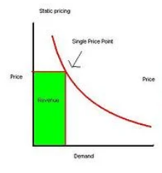
Introduction
Dynamic Pricing Model
Dynamic pricing model is a pricing strategy that has variable prices rather than fixed ones.
Dynamic Pricing is based on:
Demand Rating and Value

Slide 4
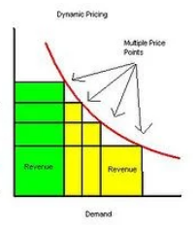
Dynamic Pricing Model
Dynamic Pricing Model

Slide 5




Examples of Dynamic Pricing
Dynamic Pricing Model

Slide 6
Problem Statement
Dynamic Pricing Model
It is difficult to judge the content of a scientific information without any prior knowledge of the author.
Our goal is to make a platform that gives a platform to scientific authors to publish and monetize their content.
We want to develop a pricing solution that can leverage scientific content prices based upon author’s rating, content’s rating and feedbacks.
In this project, we will discuss a relevant solution to this problem by collecting data set and creating a solution.

Slide 7
Literature Review
Dynamic Pricing Model
Sentimental Analysis:
Sentiment analysis (or opinion mining) is a natural language processing (NLP) technique used to determine whether data is positive, negative or neutral.
Statistical Modeling:
In statistical modelling, regression analysis is a set of statistical processes for estimating the relationships between a dependent variable and one or more independent variables.

Slide 8
Requirement Analysis
Dynamic Pricing Model
The main users of this project are the scientific content authors and buyer of the content.
The data-set has to be collected, pre-processing should be applied and algorithm must be applied on it to predict price of the scientific content.
The main requirement of our project is to predict scientific content’s price.
GUI is not the ultimate goal of our project.

Slide 9
Business Plan
Dynamic Pricing Model
This is a revolutionary step to monetize scientific content.
This model could be used in market for specific domain as it will be making more accurate results.
This model is very domain specific.
This is going to create a result for future projects to be based on.

Slide 10
SWOT Analysis
Dynamic Pricing Model
POSITIVE
NEGATIVE
STRENGTH
WEAKNESS
INTERNAL
It is usable for monetizing scientific content.
It uses sentimental analysis as well as machine learning algorithm.
In some cases, the results may not be similar for predicting the price as there are always some exceptions in computer trained models.
OPPORTUNITY
THREAT
EXTERNAL
It will give a platform for monetizing scientific content.
Unsafe dataset or database.
Algorithm might not be accurate all the time.
Fig 1: SWOT Analysis of the project

Slide 11
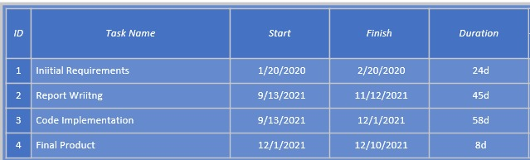
Gantt Chart
Dynamic Pricing Model
Fig 2: Gantt Chart (Project Timeline) of the project

Slide 12
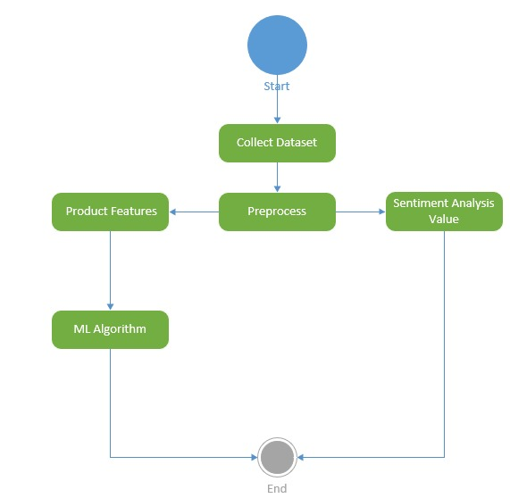
Flow Diagram
Dynamic Pricing Model
Fig 4: Flow diagram of the project

Slide 13
Proposed Methodology
Dynamic Pricing Model
We have collected dataset of best-sellers books from Amazon.
The dataset has gone through pre-processing.
Sentimental analysis value has also been found.
We have used machine learning algorithms like linear regression to predict price.

Slide 14
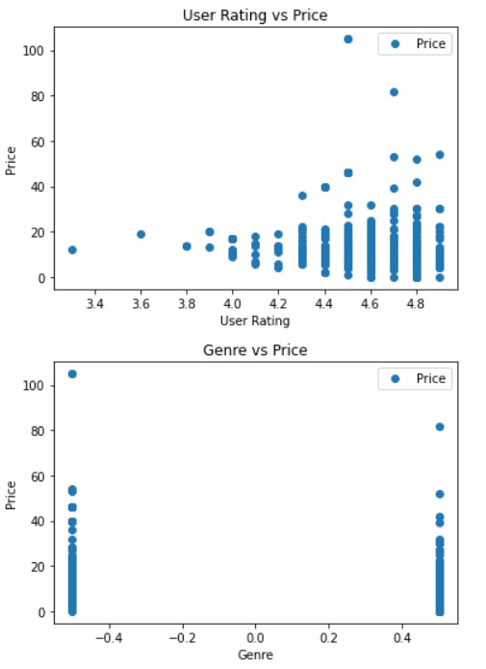
Results
Dynamic Pricing Model
We have predicted the price of the book using genre and user-rating.

Slide 15
Conclusion
Dynamic Pricing Model
To conclude, we applied machine learning algorithm on amazon scientific content using different features such as user rating and genre.
As a result, we predicted the price using those features.

Slide 16
Tools and Technologies
Dynamic Pricing Model
The package scikit-learn was used to calculate linear regression.
Moreover, to convert categorical values to numerical values we used category encoders library in python.

Slide 17
References
Dynamic Pricing Model
(Base Paper) A Dynamic Pricing Mechanism Model Based on Sentiments Analysis
Akkaya, Cem, Janyce Wiebe, and Rada Mihalcea. Subjectivity word sense disambiguation. in Proceedings of the 2009 Conference on Empirical Methods in Natural Language Processing (EMNLP-2009). 2009
Barbosa, Luciano and Junlan Feng. Robust sentiment detection on twitter from biased and noisy data. in Proceedings of the International Conference on Computational Linguistics (COLING-2010). 2010.

