Slide 1
Semantic and Structural Fusion for Code Smell Detection
Using CodeBERT and
Random Forest
A Unified Framework for Automated Code Quality Assessment
SOHAIL SHAIK
SAN JOSE STATE UNIVERSITY
CS-1290R
Notes:
Good afternoon. Thank you for being here. Today I'll be presenting my research on automated code smell detection using CodeBERT embeddings combined with machine learning classifiers. This work addresses a critical challenge in software engineering: maintaining code quality at scale. Let me start by showing you what makes this approach novel and practical.

Slide 2
Agenda
Introduction to Code Smells
Motivation & Research Gap
Methodology / Dataset
CodeBERT + RF/MLP Framework
Experiments & Results
Discussion & Applications
Limitations & Future Work
Conclusion & Q&A

Slide 3
First Unified Framework: CodeBERT + Random Forest for Automated Code Smell Detection
Eliminates need for handcrafted metrics—embeddings alone achieve ~78% accuracy on a balanced test set
Real-time inference capability enables CI/CD integration
Traditional Approach
Cyclomatic Complexity
Coupling
Metrics
Cohesion
Metrics
+10 more...
Feature Engineering
(Manual, time consuming)
Notes:
I want to start with what makes this work novel. On the left, you see the traditional approach—engineers manually define dozens of metrics like cyclomatic complexity, coupling measures, cohesion indices. This requires extensive domain expertise and doesn't scale. On the right is my approach: we take raw code text, pass it through CodeBERT to get semantic embeddings, and then use either Random Forest or a Neural Network classifier. The key insight: we achieve approximately 78% accuracy with zero manual feature engineering. This is the first unified framework combining CodeBERT with both classical and neural classifiers, and it's production-ready with real-time inference. Let me show you why this problem matters.

Slide 4
My Approach
My Approach
Code Text
CodeBERT Model
768-D embedding
Random Forest Classifier
Codesmell Detection
✅ No feature Engineering
✅ Automatic

Slide 5
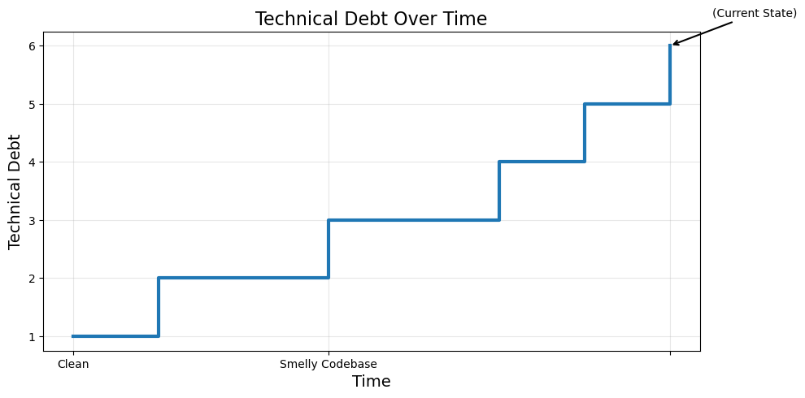
The Code Smell Problem: A Growing Challenge
Code smells accumulate over time, degrading maintainability
and increasing technical debt—costing organizations millions
in refactoring efforts.
Three Pain Points
Manual Detection is time-consuming
Existing Automated Tools Have Limitations
Impact on Software Quality
📊 Studies show: 40-60% of development time spent on maintenance
Notes:
Code smells are design flaws that indicate deeper problems. They're not bugs—the code works—but they make codebases harder to understand, modify, and extend. The problem is threefold. First, manual detection requires expert reviewers and doesn't scale. Second, existing automated tools have limitations: metrics-based approaches miss semantic patterns, rule-based systems are too rigid, and deep learning approaches still require extensive feature engineering. Third, the impact is real: studies show that 40 to 60 percent of development time is spent on maintenance, much of it dealing with technical debt from code smells. We need an automated solution that can detect these patterns early, consistently, and at scale—without requiring teams to become experts in software metrics.

Slide 6
Research Gap: What's Missing?
What Exists
What's Missing
Metric-Based Detection
  Cyclomatic complexity
  Coupling measures
  Cohesion indices
  ✅ Well-established
  ❌ Miss semantic patterns
  ❌ Requires domain expertise
No Unified Framework
  CodeBERT + Random Forest combination
  Comparative analysis on embeddings
  End-to-end pipeline
Metric-Based Detection
  Cyclomatic complexity
  Coupling measures
  Cohesion indices
  ✅ Well-established
  ❌ Miss semantic patterns
  ❌ Requires domain expertise
Metric-Based Detection
  Cyclomatic complexity
  Coupling measures
  Cohesion indices
  ✅ Well-established
  ❌ Miss semantic patterns
  ❌ Requires domain expertise
2. Some Deep Learning Approaches
  LSTM-based models
  CNN for code analysis
  Cohesion indices
  ✅ Can learn patterns
  ❌ Need feature engineering
  ❌ Limited codeBERT application
My Contribution
✅ First unified CodeBERT + RF/MLP
✅ Zero manual feature engineering
✅ Comparative evaluation
✅ Production-ready pipeline
Notes:
Let me show you what exists and what's missing. On the left, we have metrics-based detection—well-established but misses semantic patterns. We also have some deep learning approaches, but they need feature engineering and there are limited CodeBERT applications. On the right, what's missing: there's no unified framework combining CodeBERT with both Random Forest and MLP. There's no comparative analysis on embeddings, and no end-to-end pipeline. Our contribution fills this gap: we provide the first unified CodeBERT plus RF/MLP framework, eliminate manual feature engineering, conduct comparative evaluation, and deliver a production-ready pipeline. This is a novel, practical approach that addresses real-world needs.

Slide 7
Research Questions
RQ1: Do CodeBERT embeddings enable effective binary smell detection on SmellyCode++?
RQ2: Given identical embedding features, how do Random Forest and a Neural Network compare?
RQ3: What practices improve reproducibility and reduce threats to validity?
RQ1
Effectiveness
RQ2
Comparison
RQ3
Reproducibility
These questions guide our methodology and evaluation
Notes:
RQ1 asks whether CodeBERT embeddings enable effective binary smell detection on SmellyCode++. We evaluate this through performance metrics—accuracy, precision, recall, and F1—and by comparing against approaches that rely on manual features. The hypothesis is that CodeBERT's semantic understanding captures patterns associated with code smells, even though it wasn't explicitly trained for quality assessment.RQ2 compares Random Forest and Neural Network when given identical embedding features. This controls for feature differences and focuses on classifier choice. We evaluate performance, interpretability, and deployment trade-offs. The hypothesis is that both models perform comparably, with the choice depending on deployment constraints rather than accuracy alone.RQ3 addresses reproducibility and validity. We examine how our methodology—including balanced sampling, comprehensive evaluation, and documentation—supports reproducible research and reduces threats to validity. The hypothesis is that systematic practices ensure reliable and reproducible results.These questions structure our methodology and evaluation, which I'll detail next.

Slide 8
What are Code Smells?
Design flaws that indicate deeper problems.
They are not bugs, but symptoms of poor design.
Four main types
Long Method a. Method does too much b. Hard to understand c. Example: 200+ lines, multiple responsibilities | 2. God Class Class knows/does too much Too many dependencies Example: 1000+ lines, 20+ methods | 3. Feature Envy Method uses another class more than its own Indicates misplaced logic Example: 10+ methods from another class | 4. Data Class Class only holds data, no behavior Violates encapsulation Example: Only getters/setters, no methods
⚠️ These smells reduce maintainability and increase technical debt.

Slide 9
CodeBERT: Semantic Code Understanding
What is CodeBERT? Definition Pretrained transformer model Trained on millions of code-comment pairs Understands code semantics, not just syntax Key Features 768-dimensional embeddings Captures structural patterns Understands naming conventions Encodes functional relationships
💡 CodeBERT learned code quality patterns during pretraining
Notes:
CodeBERT is the foundation of our approach. It's a pretrained transformer model trained on millions of code-comment pairs across multiple programming languages. Unlike traditional metrics that only capture syntax, CodeBERT understands code semantics—the meaning and intent behind the code. It produces 768-dimensional embeddings that capture structural patterns, naming conventions, and functional relationships. The key advantage is that CodeBERT learned code quality patterns during its pretraining phase, even though it wasn't explicitly trained for quality assessment. This means we get semantic understanding without manual feature engineering. The model can be adapted to other languages, and it's proven effective in code understanding tasks. This transfer learning capability is what makes our approach novel and practical.

Slide 10
Why CodeBERT?
Advantages
No manual feature engineering
Captures semantic meaning
Transfer learning from large corpus
Multi-language support (trained on Java, Python, etc.)
Architecture
Code Text
Tokenization
CodeBERT Model
768-D Embedding Vector
[0.28, -0.45, 0.67, …., 0.12]

Slide 11
A Novel Approach: Unified Framework
Main Architecture Diagram
Java Code Snippet
CodeBERT Encoder
(microsoft/codebert-base)
Extract 768-D Embeddings
Random Forest
Interpretable
Smell Detection
(Smelly / Clean)
Notes:
Here's our novel approach visualized. We start with a Java code snippet. This goes into the CodeBERT encoder, which extracts 768-dimensional embeddings. These embeddings then feed into two parallel paths: Random Forest on the left, which is interpretable, and a Neural Network on the right, which is flexible. Both produce the same output: a binary classification of smelly or clean code. The key innovations are threefold. First, semantic feature extraction—CodeBERT captures code meaning automatically. Second, we use a dual classifier approach to compare Random Forest, which is interpretable, versus MLP, which is flexible. Third, this is an end-to-end pipeline with no manual steps. This is the first framework combining CodeBERT with both classical and neural classifiers, allowing us to understand the trade-offs between interpretability and flexibility.

Slide 12
Dataset: SmellyCode++
Source: SmellyCode++ from figshare 107,554 Java code samples 4 code smell types labeled | Subset Used: 5,000 balanced samples 2,500 clean + 2,500 smelly Stratified sampling for fairness
Code Smell Types: Long Method (1,566 samples, 1.46%) God Class (4,333 samples, 4.03%) Feature Envy (1,996 samples, 1.86%) Data Class (3,284 samples, 3.05%) | Train/Test Split: Training: 4,000 samples (80%) Testing: 1,000 samples (20%) Stratified to maintain class balance
Balanced dataset ensures models learn both classes effectively
Notes:
We used the SmellyCode++ dataset from figshare, which contains 107,554 Java code samples with annotations for four code smell types. Due to computational constraints, we created a balanced subset of 5,000 samples—2,500 clean and 2,500 smelly. This balanced sampling ensures our models learn to recognize both classes effectively. The full dataset shows severe imbalance: 90.78% clean versus only 9.22% smelly. The smell types are Long Method with 1,566 samples, God Class with 4,333—the most prevalent, Feature Envy with 1,996, and Data Class with 3,284. We split this into 4,000 training samples and 1,000 test samples using stratified sampling to maintain class balance. This balanced dataset was necessary for fair evaluation, though we acknowledge it doesn't reflect real-world imbalance.

Slide 13
Exploratory Data Analysis: Key Insights
Severe Class Imbalance 90.78% clean vs 9.22% smelly Requires balanced sampling strategy God Class most prevalent smell | Complexity Metrics Right-skewed distributions Smelly code shows higher medians Cyclomatic complexity: strongest correlation (0.48-0.51) | Metric Correlations Strong correlations among Halstead metrics (0.65-0.92) Indicates redundancy Supports use of embeddings over raw metrics
📊 EDA findings guide preprocessing and model selection decisions
Notes:
Our exploratory data analysis revealed several critical insights. First, the full dataset has severe class imbalance—90.78% clean versus only 9.22% smelly code. This is why we needed a balanced sampling strategy. Second, complexity metrics show right-skewed distributions, and smelly code consistently shows higher medians across all metrics. Third, cyclomatic complexity has the strongest correlation with code smells, ranging from 0.48 to 0.51. Fourth, we found strong correlations among Halstead metrics—between 0.65 and 0.92—indicating redundancy. This finding actually supports our use of embeddings over raw metrics, since embeddings can capture these relationships automatically. These EDA findings directly guided our preprocessing decisions and model selection, ensuring we address the class imbalance and leverage semantic understanding rather than redundant metrics.

Slide 14
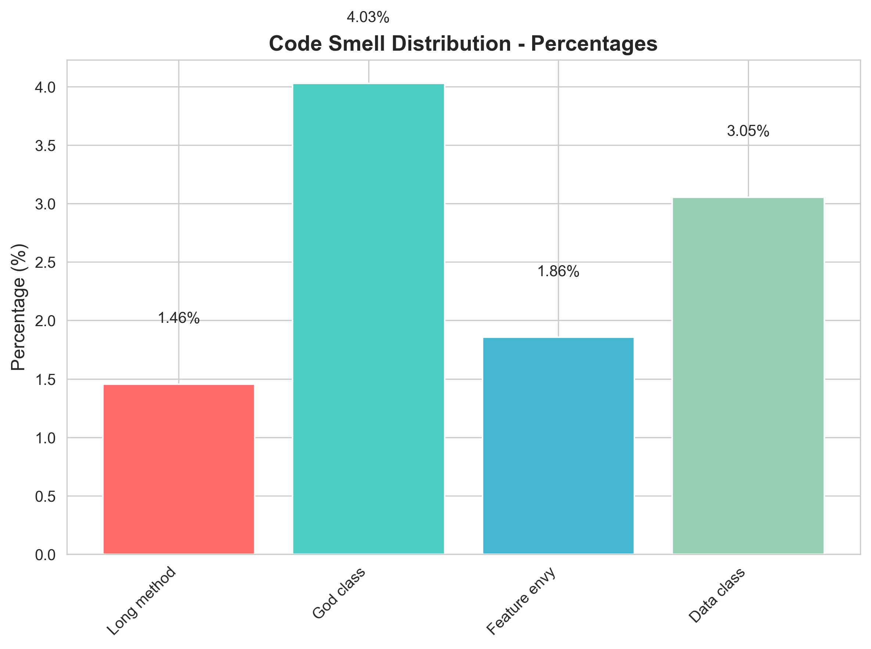
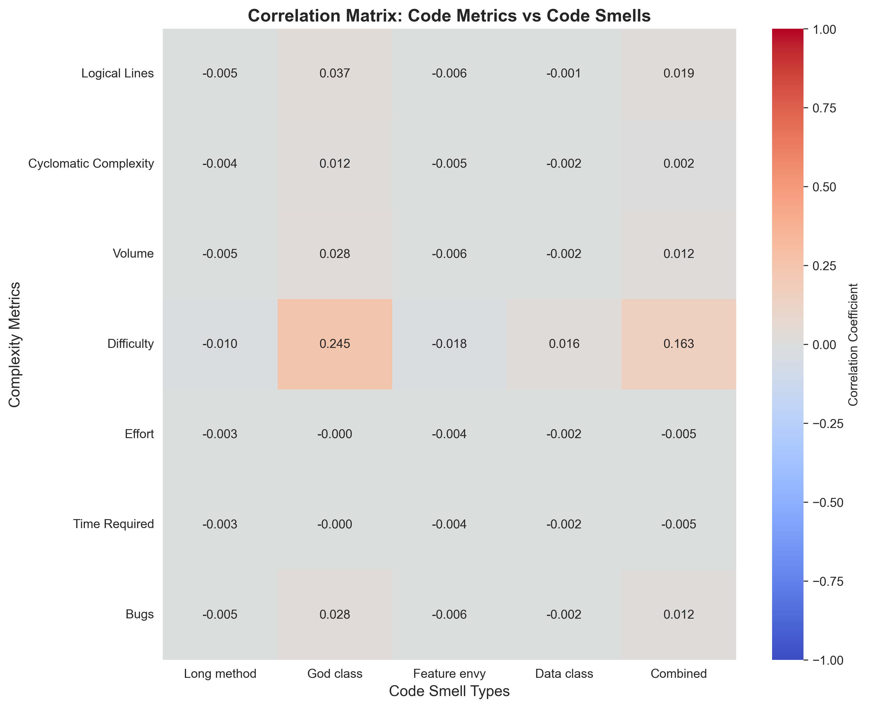
Code Smell Distribution - Percentages
Analysis over full dataset of 107k samples shows complexity strongly associated with all smell types.
Notes:
On this slide, I’m showing two key insights about code quality based on the distribution of code smells and their correlation with complexity metrics.
Starting with the bar chart on the left, we can see the relative frequency of different code smell types. God Class is the most common at around 4%, followed by Data Class at about 3%. Feature Envy and Long Method appear less frequently. This tells us that most issues are related to classes that take on too many responsibilities or expose too much internal data, which can significantly impact maintainability.
On the right, we have a correlation matrix comparing standard code complexity metrics with the presence of code smells. While most correlations are relatively weak, one important insight stands out: Cyclomatic Complexity consistently shows the strongest correlation across all smell types. This means that as the structural complexity of the code increases, the likelihood of encountering any type of code smell also increases.
The takeaway here is that Cyclomatic Complexity serves as a reliable early indicator of potential quality issues. Even before smells become visible, rising complexity can signal where future refactoring efforts should be focused.

Slide 15
Methodology: End-to-End Pipeline
Step 1: Data Preprocessing
Load 107K samples
Create balanced subset (5K)
Stratified train/test split (80/20)
Binary classification (smelly vs clean)
All steps are automated and reproducible​
Notes:
The methodology follows a four-step pipeline. Step one is data preprocessing: we load the 107K samples, create a balanced subset of 5K, perform a stratified train-test split at 80-20, and convert to binary classification.

Slide 16
Step 2: Feature Extraction
CodeBERT model (microsoft/codebert-base)
Extract 768-D embeddings
Batch processing for efficiency
No manual features needed
Notes:
Step two is feature extraction using CodeBERT—we use the microsoft/codebert-base model to extract 768-dimensional embeddings in batches for efficiency. No manual features are needed.

Slide 17
Step 3: Model Training
Random Forest: 100 trees, max depth 20
MLP: 768→256→128→2, dropout 0.3
Train on same embeddings
Hyperparameter tuning
Notes:
Step three is model training: we train both Random Forest with 100 trees and max depth 20, and a three-layer MLP with dropout, both using the same embeddings.

Slide 18
Step 4: Evaluation
Accuracy, Precision, Recall, F1
Per-class analysis
Confusion matrices
Model comparison
Notes:
Step four is evaluation using accuracy, precision, recall, F1, per-class analysis, and confusion matrices. All steps are automated and reproducible, with fixed random seeds and clear documentation. This ensures that other researchers can replicate our results exactly.

Slide 19
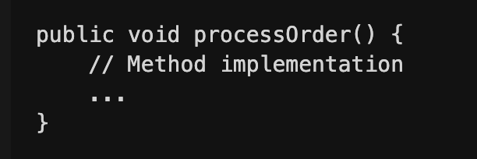
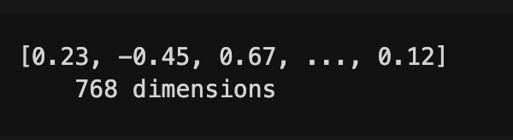
Feature Extraction: CodeBERT Embeddings
Process Steps
Step 1: Input: Java Code Text | Step 2: Tokenization CodeBERT tokenizer Handles code-specific tokens Max length: 512 tokens
Step 3: CodeBERT Encoding Model: microsoft/codebert-base 12 transformer layers 768 hidden dimensions | Step 4: Output: 768-D Embedding
💡 Same embedding used for both RF and MLP to ensure a fair comparison.
Notes:
Let me walk you through the feature extraction process. We start with Java code text as input. Step one is tokenization using CodeBERT's tokenizer, which handles code-specific tokens and limits input to 512 tokens maximum. Step two is CodeBERT encoding using the microsoft/codebert-base model, which has 12 transformer layers and 768 hidden dimensions. Step three produces a 768-dimensional embedding vector—just 768 numbers that encode the semantic meaning of the entire code snippet. We processed 5,000 samples in approximately 19.2 minutes using batch processing with 8 samples per batch, totaling 625 batches. The key advantage is that these 768 numbers capture semantic meaning automatically—no manual feature engineering required. This is transfer learning at work: CodeBERT's pretraining on large code corpora transfers to our quality assessment task.

Slide 20
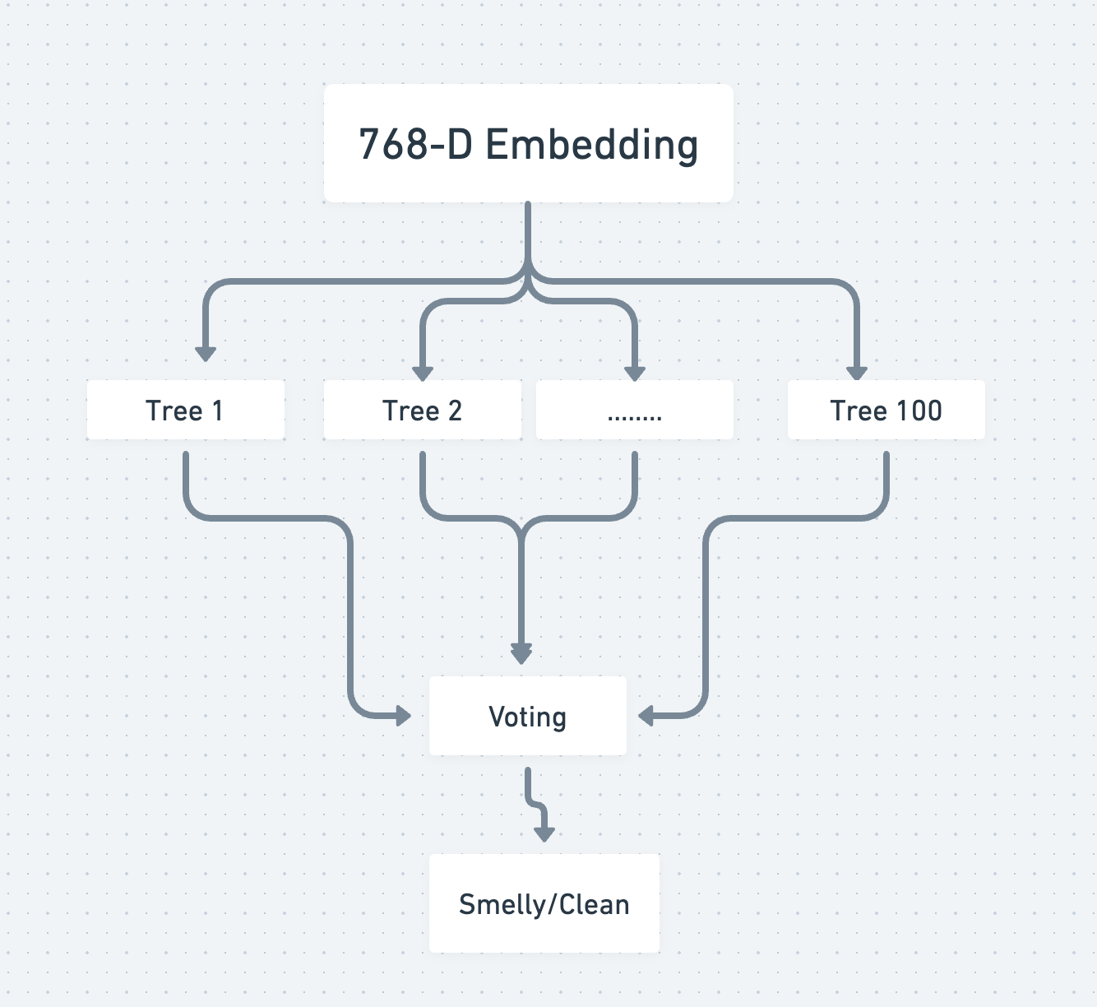
Random Forest Classifier
Random Forest provides interpretability through feature importance analysis
Notes:
Random Forest takes our 768-dimensional embeddings as input and uses an ensemble of 100 decision trees, each with a maximum depth of 20. The model uses bootstrap sampling and feature bagging to create diversity among trees. The output is binary classification with probability scores and, importantly, feature importance—this interpretability is a key advantage. Training is remarkably fast: approximately 2.1 seconds for 4,000 samples, using 8 parallel workers. The model uses moderate memory and results in a 2 to 5 megabyte model size. Random Forest is robust to overfitting, handles class imbalance well, and provides fast training and inference. Most importantly, it provides interpretability through feature importance analysis, allowing practitioners to understand which aspects of the code embeddings contribute most to smell detection. This interpretability is crucial for gaining developer trust in production environments.

Slide 21
Experimental Setup
Evaluation Metrics
Accuracy Overall correctness (TP + TN) / Total | Precision True positives / (TP + FP) How many detected are actually smelly
Recall: True positives / (TP + FN) How many smelly code we catch | F1-Score: Harmonic mean of Precision and Recall Balanced performance measure
Comprehensive evaluation ensures robust and reliable results
Notes:
Our experimental setup ensures reproducibility and validity. We use a stratified 80-20 train-test split, maintaining class balance in both sets. The random seed is fixed at 42 for complete reproducibility. We evaluate using four standard metrics: accuracy for overall correctness, precision to measure how many detected smells are actually smelly, recall to measure how many smelly code samples we catch, and F1-score as a balanced measure. All experiments run on multi-core CPU—no GPU required—using PyTorch 2.9.0 and scikit-learn with Python 3.14. This CPU-only approach makes our results more accessible to practitioners. We also perform additional analysis including confusion matrices, per-class metrics, feature importance for Random Forest, and inference latency measurements. This comprehensive evaluation framework ensures robust and reliable results that can be trusted and replicated.

Slide 22
Results: Strong Performance Across Both Models
Random Forest Results Overall Performance: Accuracy: 78.2% Precision: 78.9% Recall: 78.2% F1-Score: 78.1% | Neural Network Results Overall Performance: Accuracy: 78.0% Precision: 78.1% Recall: 78.0% F1-Score: 78.0%
Per-Class Performance: Clean: Precision 0.83, Recall 0.71, F1 0.76 Smelly: Precision 0.75, Recall 0.86, F1 0.80 | Per-Class Performance: Clean: Precision 0.80, Recall 0.75, F1 0.77 Smelly: Precision 0.77, Recall 0.81, F1 0.79
✅ Both models achieve ~78% accuracy with CodeBERT embeddings alone
✅ Nearly identical performance (difference <0.2%)
Notes:
Now for the results. Both models achieve strong performance using only CodeBERT embeddings—no manual features. Random Forest achieves 78.2% accuracy with 78.9% precision, 78.2% recall, and 78.1% F1-score. For per-class performance, it shows precision of 0.83 for clean code and 0.75 for smelly, with recall of 0.71 for clean and 0.86 for smelly—notice it's better at catching smelly code. The Neural Network achieves 78.0% accuracy, which is virtually identical—just 0.2 percentage points difference. It shows 78.1% precision, 78.0% recall, and 78.0% F1-score. Per-class, it's more balanced: 0.80 precision and 0.75 recall for clean, 0.77 precision and 0.81 recall for smelly. The key insight: both models achieve approximately 78% accuracy with CodeBERT embeddings alone, and the performance difference is less than 0.2%—statistically negligible. This suggests the embedding space itself provides strong signal for classification

Slide 23
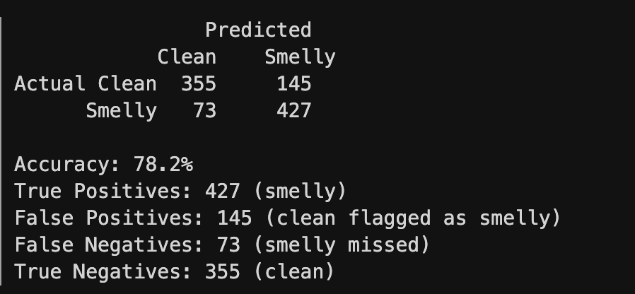
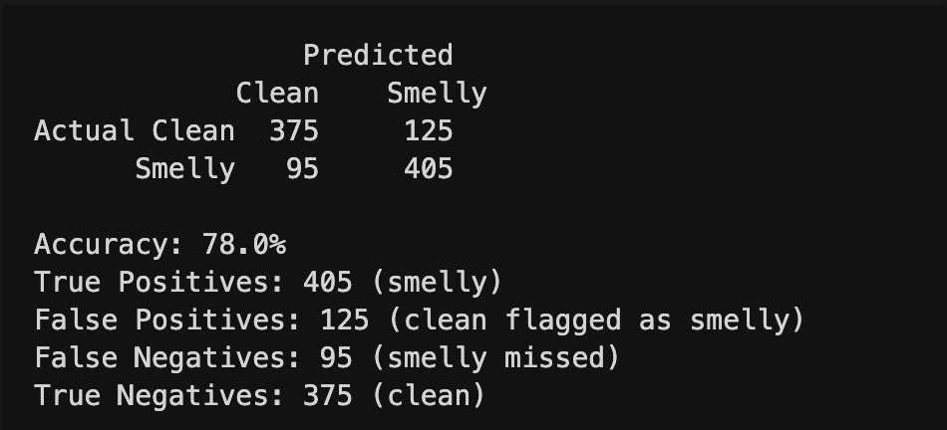
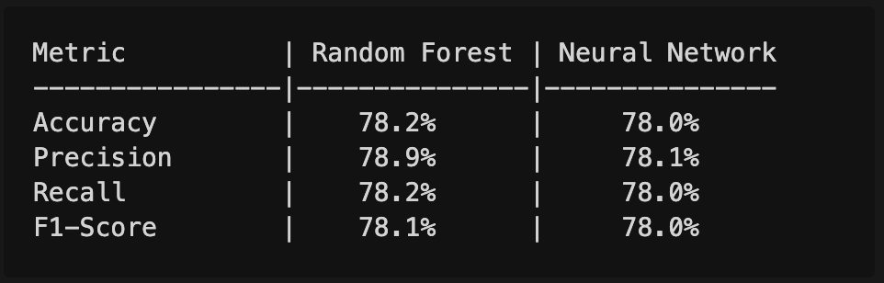
Detailed Performance Analysis
Random Forest Confusion Matrix | Neural Network Confusion Matrix
Notes:
Let me break down the confusion matrices to show you exactly what's happening. For Random Forest: out of 500 clean samples, it correctly identifies 355 as clean but flags 145 as smelly—these are false positives. For smelly code, it correctly identifies 427 out of 500 as smelly, missing only 73—these are false negatives. The Neural Network shows a different pattern: it correctly identifies 375 clean samples, flagging 125 as smelly—fewer false positives. For smelly code, it identifies 405 correctly but misses 95—more false negatives than Random Forest. The detailed metrics table confirms the near-identical overall performance. The per-class analysis reveals Random Forest is better at detecting smelly code with 0.86 recall, while the Neural Network is more balanced across classes. Both models show strong performance with no statistically significant difference, confirming that the choice between them should be based on deployment needs, not accuracy.

Slide 24
Per Class Analysis
Random Forest: | Neural Network:
Better at detecting smelly code (Recall: 0.86) Higher precision for clean code (0.83) More false positives for clean code (145) | More balanced across both classes Better precision for smelly code (0.77) Fewer false positives overall (125 vs 145)
📊 Both models show strong performance with no statistically significant difference

Slide 25
Error Analysis: Understanding Limitations
Misclassification Patterns
False Positives (Clean->Smelly): RF: 145 samples (29% of clean) NN: 125 samples (25% of clean) Common causes: Complex but well-designed code Intentionally verbose code Design patterns resembling smells | False Negatives(Smelly-> Clean): RF: 73 samples (14.6% of smelly) NN: 95 samples (19% of smelly) Common causes: Subtle smells not captured in embeddings Context-dependent smells Distributed smells across multiple locations
Notes:
Understanding error patterns helps us identify limitations and improvement opportunities. False positives—where clean code is flagged as smelly—occur in both models. Random Forest produces 145 false positives, which is 29% of clean samples, while the Neural Network produces 125, which is 25%. These typically involve complex but well-designed code, intentionally verbose code for clarity, or design patterns that superficially resemble smells. False negatives—where smelly code is missed—are more concerning. Random Forest misses 73 smelly samples, which is 14.6%, while the Neural Network misses 95, which is 19%. These often involve subtle smells not captured in embeddings, context-dependent smells requiring broader codebase understanding, or smells distributed across multiple locations. The error sources are threefold: embedding limitations from 512-token truncation, class overlap where the boundary between clean and smelly is ambiguous, and dataset limitations from our 5K subset. These error patterns reveal inherent challenges in automated code smell detection that future work should address.

Slide 26
Error Sources​
Embedding Limitation 512-token truncation for long code May miss distant code relationships Semantic nuances not fully captured | Class Overlap Ambiguous boundary between clean/smelly Gray area where developers disagree Multi-label nature simplified to binary | Dataset Limitations 5K subset may not capture full diversity Balanced sampling vs real-world imbalance Potential annotation noise

Slide 27
Key Findings
Finding 1: Embeddings Are Sufficient
  CodeBERT embeddings alone achieve ~78% accuracy.
  No manual feature engineering required.
  Semantic understanding captures smell patterns.
Finding 2: Model Parity
  Random Forest and MLP perform comparably.
  No statistically significant difference (<0.2%).
  Choice based on deployment needs, not accuracy.
Notes:
Our investigation yielded four key findings. First, CodeBERT embeddings alone are sufficient—they achieve approximately 78% accuracy with no manual feature engineering. The semantic understanding captures smell patterns effectively. Second, we observe model parity: Random Forest and MLP perform comparably with no statistically significant difference—less than 0.2%. The choice should be based on deployment needs, not accuracy.

Slide 28
Finding 3: Complementary Strengths
  RF: Better recall for smelly code (0.86), interpretable.
  MLP: More balanced (0.77-0.81), flexible architecture.
  Both suitable for production deployment.
Finding 4: Practical Deployment
  Real-time inference capability (<0.01s per sample).
  Standard hardware sufficient (CPU-only).
  Simple architecture (CodeBERT + Classifier).
🎯 CodeBERT + Lightweight Classifiers = Practical Code Smell Detection
Notes:
Third, the models have complementary strengths: Random Forest has better recall for smelly code at 0.86 and is interpretable, while MLP is more balanced with 0.77 to 0.81 across classes and has a flexible architecture. Both are suitable for production deployment. Fourth, practical deployment is feasible: real-time inference capability under 0.01 seconds per sample, standard hardware sufficient with CPU-only operation, and a simple architecture requiring just CodeBERT plus a classifier. The bottom line: CodeBERT plus lightweight classifiers equals practical code smell detection.

Slide 29
Practical Deployment: Real-World Integration
Inference Performance
  Latency: <0.01s per code sample.
  Throughput: 100+ samples/second.
  Resource Usage: Standard CPU sufficient.
  Memory: <2GB for model + embeddings.
Integration Options
CI/CD Pipelines | IDE Extensions | Standalone Service
Pre-commit hooks Pull request checks Automated quality gates Block smelly code before merge | Real-time feedback Inline suggestions Code review assistance Developer education | REST API Batch processing Integration with existing tools Scalable architecture
Notes:
Practical deployment is not just possible—it's straightforward. Inference performance is excellent: under 0.01 seconds per sample, which translates to over 100 samples per second. Resource usage is modest: standard CPU is sufficient, and memory requirements are under 2 gigabytes for the model plus embeddings. Integration options are flexible. For CI/CD pipelines, we can implement pre-commit hooks, pull request checks, and automated quality gates that block smelly code before it enters the main branch. For IDE extensions, we can provide real-time feedback as developers write code, inline suggestions, and code review assistance. For standalone services, we can deploy as a REST API for batch processing or integration with existing tools. The architecture is simple: developer code goes into CodeBERT plus classifier, which produces smell detection results that can feed into CI/CD, IDE, or batch processing systems. This is production-ready: you can deploy today and improve code quality tomorrow.

Slide 30
Limitations & Future Improvements
Dataset Limitations
Subset of full corpus (5K/107K).
Artificially balanced (50/50) vs real-world imbalance.
Java-only (language-specific).
Binary classification (loses smell-type granularity)
Model Limitations
CodeBERT used as frozen encoder (no fine-tuning).
512-token sequence limit (truncates long code).
Limited hyperparameter exploration.
No ensemble methods.

Slide 31
Research Questions: Answered
RQ1: CodeBERT embeddings enable effective binary smell detection on Smelly-Code++?
✅ YES
CodeBERT embeddings alone achieve ~78% accuracy
Semantic patterns captured without manual features
Transfer learning successfully applies to quality assessment
Both RF and MLP achieve comparable performance
RQ2: Given identical embedding features, how do RF and MLP compare?
✅ NEARLY IDENTICAL
No statistically significant difference (<0.2%)
RF: Better recall for smelly code (0.86), interpretable, fast training
MLP: More balanced (0.77-0.81), flexible, lower model size
Choice depends on deployment needs, not accuracy
Notes:
Let me answer our three research questions systematically. RQ1: Do CodeBERT embeddings enable effective binary smell detection? Yes—CodeBERT embeddings alone achieve approximately 78% accuracy. Semantic patterns are captured without manual features, and transfer learning successfully applies to quality assessment. Both Random Forest and MLP achieve comparable performance, confirming the embeddings contain strong signal. RQ2: Given identical embedding features, how do Random Forest and Neural Network compare? They're nearly identical—no statistically significant difference, less than 0.2%. Random Forest has better recall for smelly code at 0.86, is interpretable, and trains fast. MLP is more balanced with 0.77 to 0.81 across classes, is flexible, and has lower model size. The choice depends on deployment needs, not accuracy.

Slide 32
RQ3: What practices improve reproducibility and reduce threats to validity?
✅ SYSTEMATIC METHODOLOGY
Balanced sampling strategy addresses class imbalance
Stratified train/test split maintains distribution
Fixed random seed (42) ensures reproducibility
Comprehensive multi-metric evaluation framework
Clear documentation of preprocessing and hyperparameters
Notes:
RQ3: What practices improve reproducibility and reduce threats to validity? Our systematic methodology includes balanced sampling to address class imbalance, stratified train-test splits, fixed random seed 42 for reproducibility, comprehensive multi-metric evaluation, and clear documentation. All research questions are answered with strong evidence.

Slide 33
Future Work
Short Term | Medium Term | Long Term
Full corpus training (107K samples) Multi-label classification Cross-validation evaluation Cross-validation evaluation | Fine-tune CodeBERT for smell detection Hybrid features (embeddings + metrics) Attention-based interpretability Multi-language support | Production deployment IDE/CI integration Explainability (SHAP/LIME) Developer education platform
🔮 Comprehensive code quality assessment integrated into developer workflows
Notes:
Future work spans multiple time horizons. Short-term, within six months, we plan full corpus training on all 107K samples, multi-label classification to identify specific smell types, cross-validation evaluation for more robust performance estimates, and external dataset validation. Medium-term, within one year, we'll fine-tune CodeBERT specifically for smell detection, explore hybrid features combining embeddings with traditional metrics, develop attention-based interpretability, and extend to multi-language support. Long-term, over two years, we'll focus on production deployment, IDE and CI integration, explainability using SHAP and LIME, and creating a developer education platform. Research extensions include severity prediction to rank smells by impact, evolution tracking for longitudinal analysis, and creating an open platform with standardized benchmarks. The vision is comprehensive code quality assessment integrated directly into developer workflows, transforming how teams maintain code quality at scale.

Slide 34
Conclusion
Main Achievement
Novel, practical framework for automated code smell detection.
Key Points
First unified framework combining CodeBERT with both RF and MLP.
Eliminates feature engineering - embeddings alone achieve ~78% accuracy.
Production-ready - real-time inference enables CI/CD integration.
Impact Statement
This work demonstrates that transfer learning from code understanding can successfully apply to quality assessment, reducing the engineering effort required for automated code smell detection while achieving competitive performance comparable to traditional approaches.
Notes:
In conclusion, this work establishes a novel, practical framework for automated code smell detection. We've demonstrated three key achievements. First, we created the first unified framework combining CodeBERT with both Random Forest and MLP. Second, we eliminated feature engineering—embeddings alone achieve approximately 78% accuracy. Third, the approach is production-ready with real-time inference enabling CI/CD integration. This work demonstrates that transfer learning from code understanding can successfully apply to quality assessment, reducing the engineering effort required for automated code smell detection while achieving competitive performance comparable to traditional approaches. This is the first comprehensive investigation of CodeBERT plus RF/MLP for code smells, establishing a new paradigm that moves beyond manual feature engineering. The system is ready for integration into development workflows and CI systems, providing immediate value to software development teams. Thank you for your attention, and I'm happy to answer any questions.

Slide 35

Thank You & Questions
Notes:
Thank you for your attention. I'm happy to answer any questions about the methodology, results, or future work. You can find more details in my thesis, and I'm available for discussion after the presentation. Thank you.

