Slide 1
Portal Dash game

Slide 2
Portal Dash
Stealth-puzzle game
Reach to the portals
30 levels
Avoid enemies

Slide 3
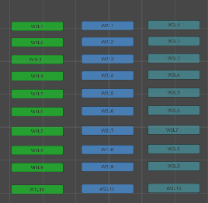
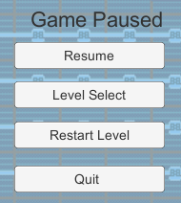
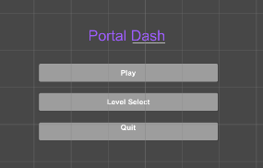
GUI
Created in Unity using assets
Tied together with scripts
3 menus

Slide 4



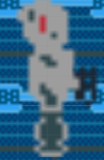
Enemies
Doesn’t move
Move Speed: 2
Has a line of sight
Rotates (speed 10)
Otherwise inactive
Ray distance of 5
Back is exposed
Will chase player if caught
Objects block line of sight
Move Speed: 1.25
Static
Shoots a projectile
Chases the player indefinitely
Levels are usually designed around this enemy
(W1L4)
Bullet shoots to player’s last position
(W2L5)

Slide 5

Enemies pt 2
Move speed 0.5
Uses Unity physics
Glides along wall

Slide 6

Enemy Weaknesses

Slide 7



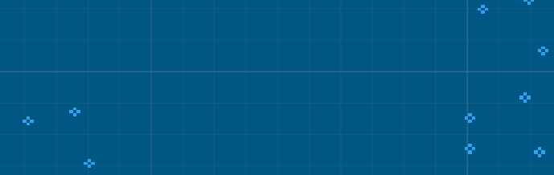
Traps

Slide 8


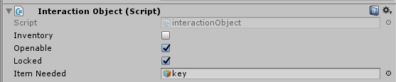
Doors
Both of interactionObject type
Key has parameters:
Inventory
Door has parameters
Locked, Required Item: Key

Slide 9





Keycard mechanic

Slide 10




Player Scripts
Player interaction logic
Logic for actual inventory array
Movement controls

Slide 11
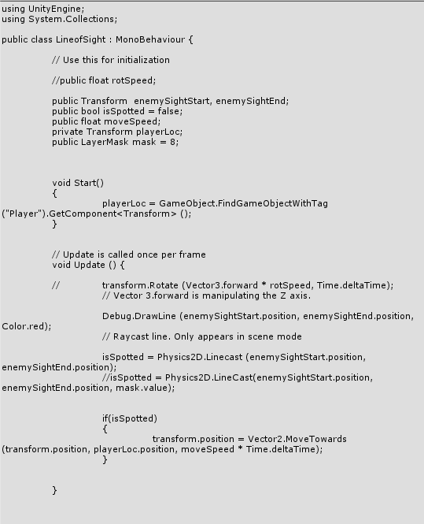

Line of Sight Enemy Script

Slide 12
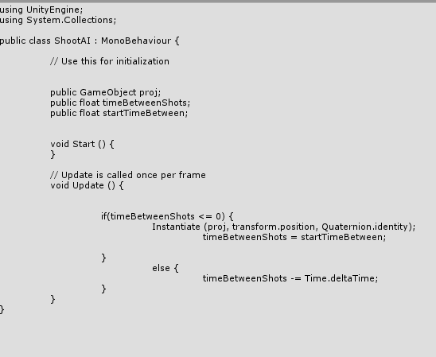
Shooter Enemy

Slide 13
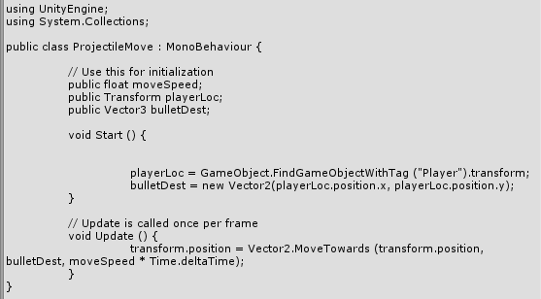
Projectile

Slide 14
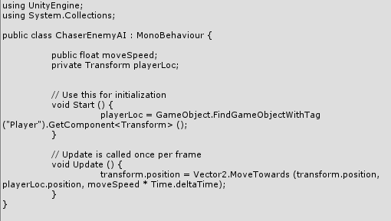

Chaser Enemy

Slide 15
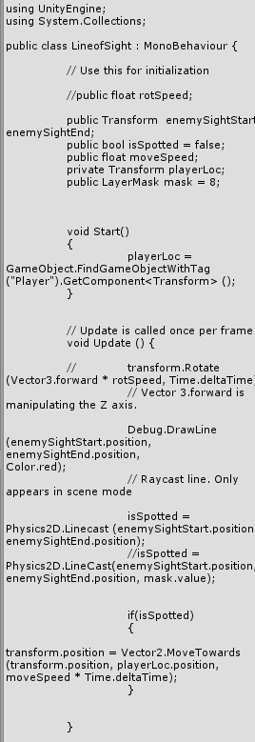

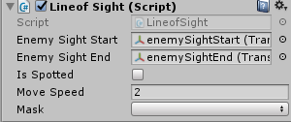
Patrol Enemy

