Slide 1

Movie Recommendation System
Nandhini Gopalakrishnan
(235830000) Mohammed Sohail Ahmed
(235807480)

Slide 2


Introduction to Movie Recommendation Systems
Purpose of Movie Recommendation Systems
Movie recommendation systems are designed to provide personalized movie recommendations to users based on their preferences(Keywords). These systems aim to enhance the user experience by suggesting movies that are likely to be of interest to the user.
Benefits of Movie Recommendation Systems
Improved user engagement and satisfaction
Increased user retention
Enhanced movie discovery
Efficient utilization of movie catalog
Personalized movie recommendations based on user preferences.

Slide 3

Movie Recommendation System
Overview
A movie recommendation system is an application or a webpage that suggests movies to users based on their search keywords. It uses various algorithms and techniques to analyze user data and generate personalized recommendations. In this project, we implemented a movie recommendation system using Python and explored different approaches to improve recommendation accuracy.

Slide 4
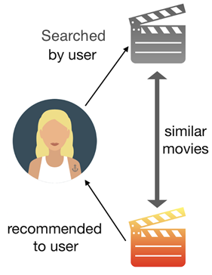
Types of Recommender System
Collaborative Filtering
Collaborative filtering is a popular technique used in recommendation systems. It analyzes user behavior and preferences to identify similar users or items and make recommendations based on their similarities. In our implementation, we used collaborative filtering algorithms such as user-based and item-based filtering to generate movie recommendations.
Content-Based Filtering
Content-based filtering is another approach used in recommendation systems. It focuses on the characteristics and features of items to make recommendations. In our implementation, we used content-based filtering to recommend movies based on their search text.
Hybrid Approaches
Hybrid approaches combine collaborative filtering and content-based filtering techniques to improve recommendation accuracy. In our implementation, we explored hybrid approaches that leverage the strengths of both collaborative and content-based filtering to provide more personalized and accurate movie recommendations.
Our Approach
Our approach relies solely on content-based filtering due to the absence of user dataset.

Slide 5
Content-Based Recommender System
Advantages
Personalized Recommendations: Content-based filtering provides recommendations based on the user's text.
No Cold Start Problem: It can make recommendations even for new users with limited data.
Transparency: The system's recommendations are based on explicit movie attributes, making it transparent to users.
Limitations
Limited Diversity: Content-based filtering tends to recommend similar movies, which may limit the discovery of new genres or styles.
Limited Serendipity: The system may not recommend movies that are outside the user's preference, missing out on potential surprises.
Dependency on Movie Attributes: The effectiveness of content-based filtering heavily relies on the availability and accuracy of movie data.

Slide 6
Data Analysis for Movie Recommendations
Dataset | Description | Size
Movie Ratings | Contains average ratings and a few other attributes of the movie such as title, genre, and release year. | 5000
Cast and Crew | Includes information about the movie's cast and crew | 5000
Datasets Used

Slide 7
Data Analysis Process
Step | Description
1. Data Collection | Gathered movie details and ratings from two different datasets.
2. Data Exploration | Analyzed the datasets to gain insights into the distribution of ratings, movie genres, and user demographics.
3. Data Preprocessing | Cleaned and transformed the data by handling missing values, removing duplicates, and encoding categorical variables.
4. Feature Engineering | Created new features such as tags based on the existing data.
5. Model Building | Built a recommendation model using content - based filtering techniques to recommend movies for users based on the title searched.
6. Model Evaluation | Evaluated the performance of the recommendation model using metrics such as cosine similarity and TF-IDF.
7. Model Deployment | Deployed the movie recommendation system to provide personalized movie recommendations based on their search to users.

Slide 8
Evaluation Metrics for Recommendation Systems
Precision
Precision measures the proportion of recommended items that are relevant to the user. It is calculated as the number of true positives divided by the sum of true positives and false positives.
Recall
Recall measures the proportion of relevant items that are recommended to the user. It is calculated as the number of true positives divided by the sum of true positives and false negatives.
F1 Score
F1 score is an evaluation metric that assesses the predictive skill of a model by elaborating on its class-wise performance rather than an overall performance as done by accuracy. F1 score combines two competing metrics- precision and recall scores of a model.

Slide 9
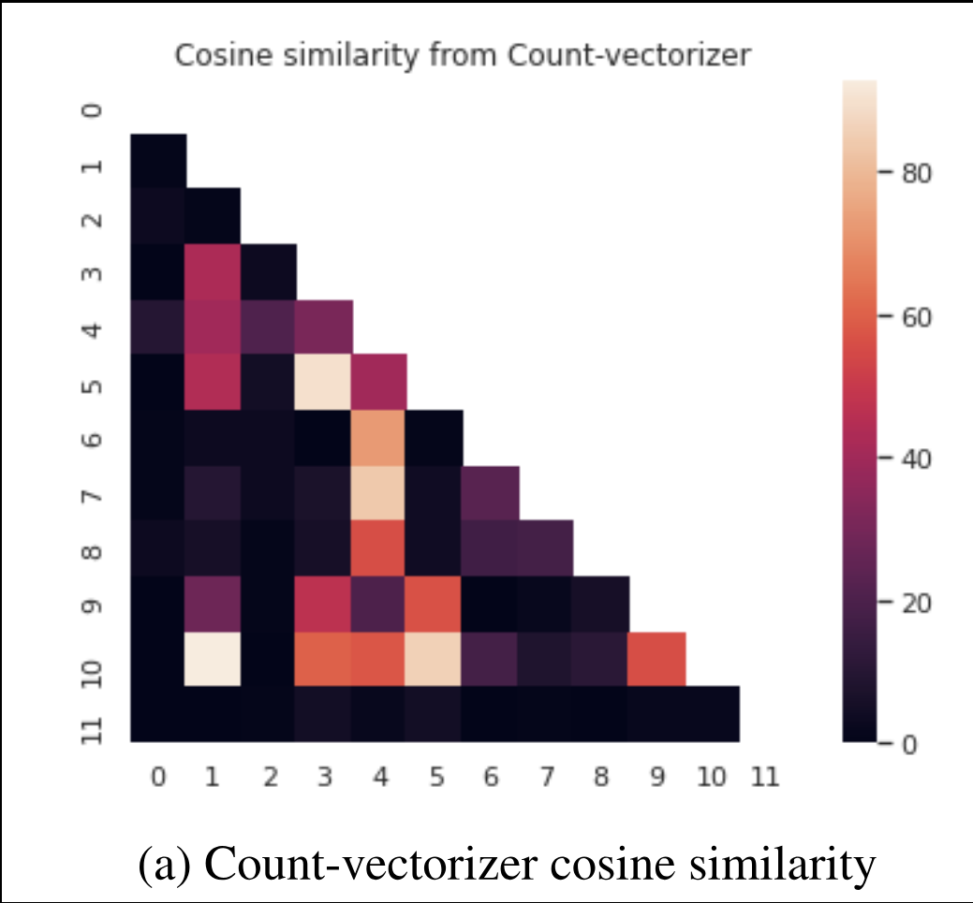
First Approach: Count Vectorization with Cosine Similarity
Description: Our initial custom-made algorithm employed count vectorization combined with cosine similarity for text classification tasks.
Count Vectorization: This technique converts text documents into numerical vectors, representing the frequency of each term in the document.
Cosine Similarity: Measures the cosine of the angle between two vectors, providing a measure of similarity between documents based on their term frequency distributions.
Strengths: Simple implementation, effective for capturing textual similarities.
Limitations: Limited ability to capture the importance of terms and their relevance to document classification.

Slide 10
Second Approach: Count Vectorization with Cosine Similarity & KNN
Introduction to KNN Algorithm: K-Nearest Neighbors (KNN) is a machine learning algorithm that relies on the similarity between data points.

Slide 11
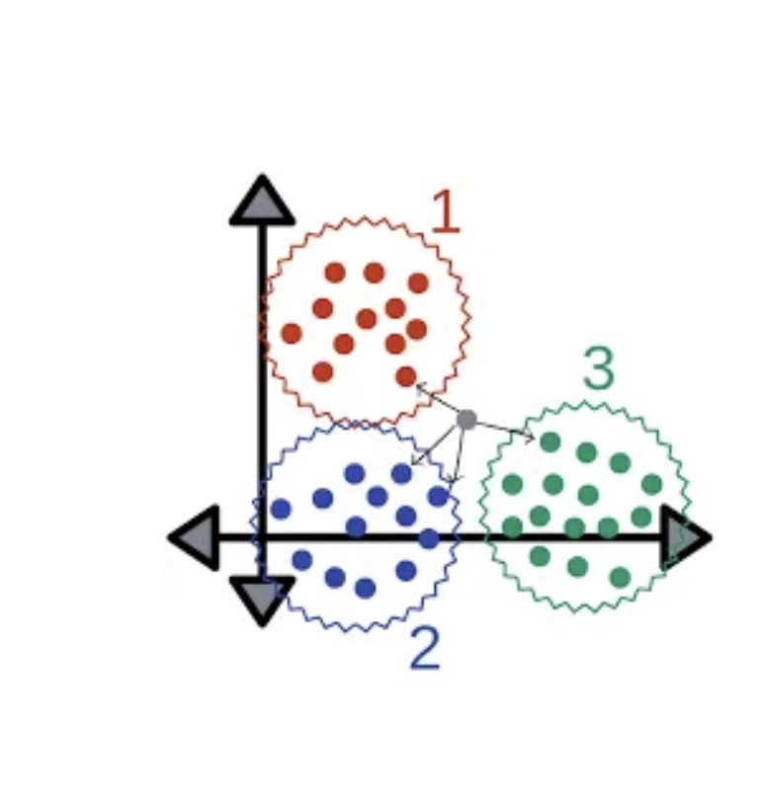
Third Approach: TF-IDF Vectorization
Utilizing TF-IDF Vectorization: TF-IDF (Term Frequency-Inverse Document Frequency) captures the importance of terms in documents by weighing down frequent terms and emphasizing rare ones.
Integration with Pivot Table: Pivot tables aid in organizing and summarizing data, potentially providing insights to enhance the performance of the algorithm.

Slide 12

Advantages of KNN with TF-IDF
TF-IDF Captures Term Importance: TF-IDF takes into account the importance of terms in documents, providing a more nuanced representation compared to simple count vectorization.
KNN Leverages Similarity Between Data Points: KNN utilizes the similarity between data points to make predictions, which can be effective for text classification tasks where similar documents tend to belong to the same class.
Pivot Tables Aid in Data Organization: Pivot tables help in organizing and summarizing data, potentially uncovering patterns or relationships that can enhance the performance of the algorithm.

Slide 13
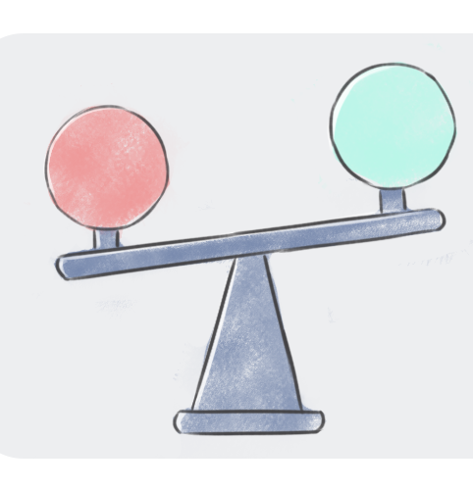
Comparison: Previous Approach vs. New Approach
TF-IDF vs. Count Vectorization: TF-IDF captures term importance, whereas count vectorization only considers term frequency.
Cosine Similarity vs. Euclidean Distance: Cosine similarity measures textual similarity based on term frequency distributions, while KNN typically uses Euclidean distance (or other distance metrics) to measure similarity between data points.
Performance Differences: The new approach with KNN and TF-IDF may exhibit improved accuracy compared to the previous approach, especially in scenarios where term importance plays a crucial role in classification.

Slide 14
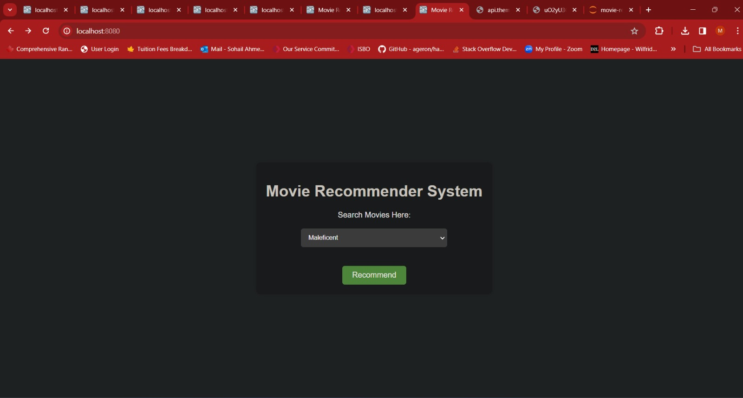
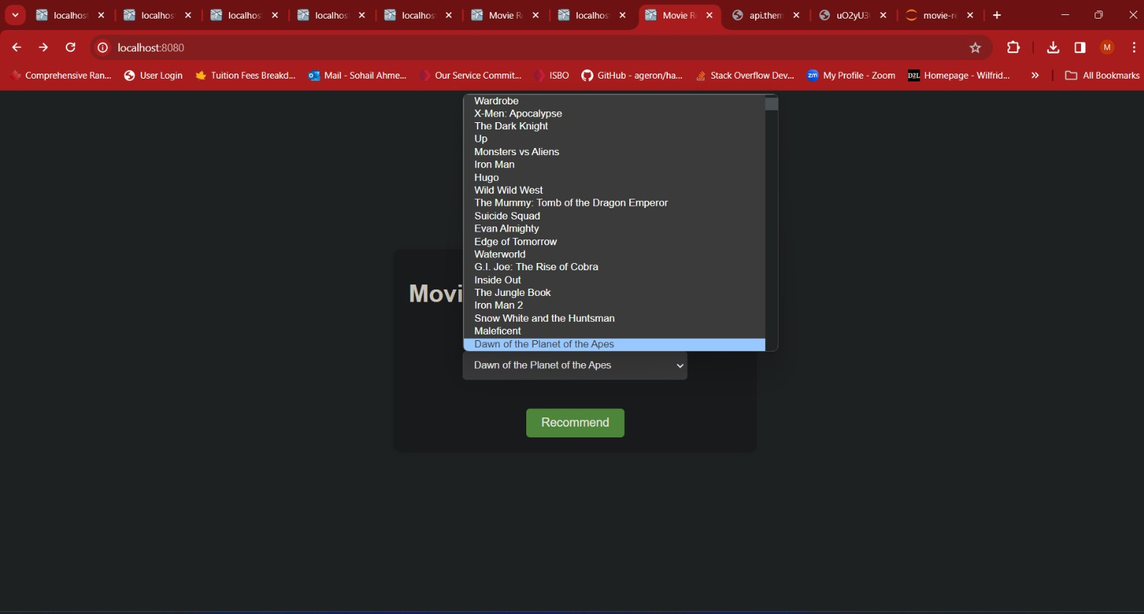
Screenshots

Slide 15
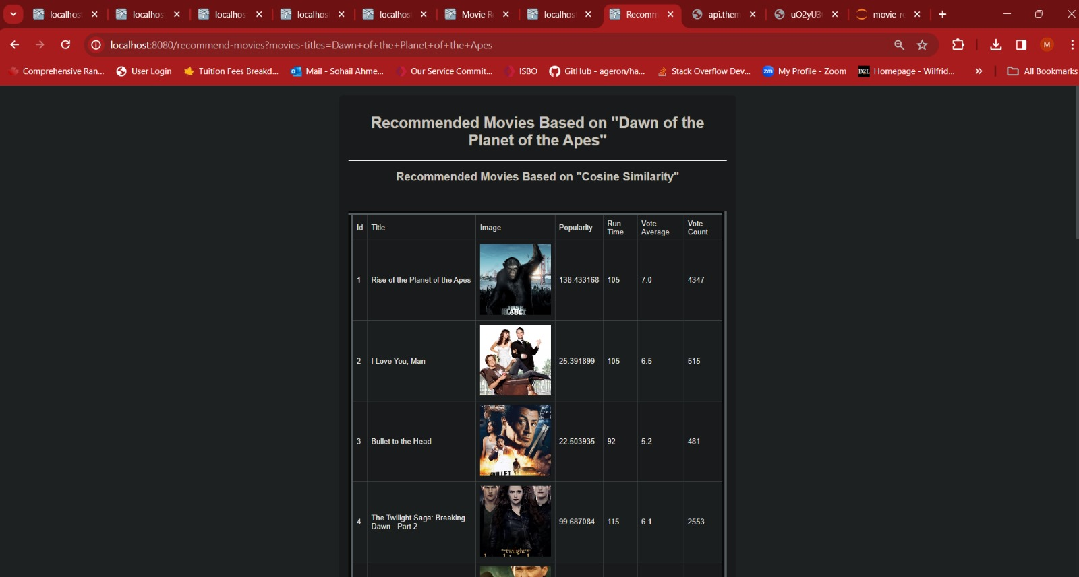
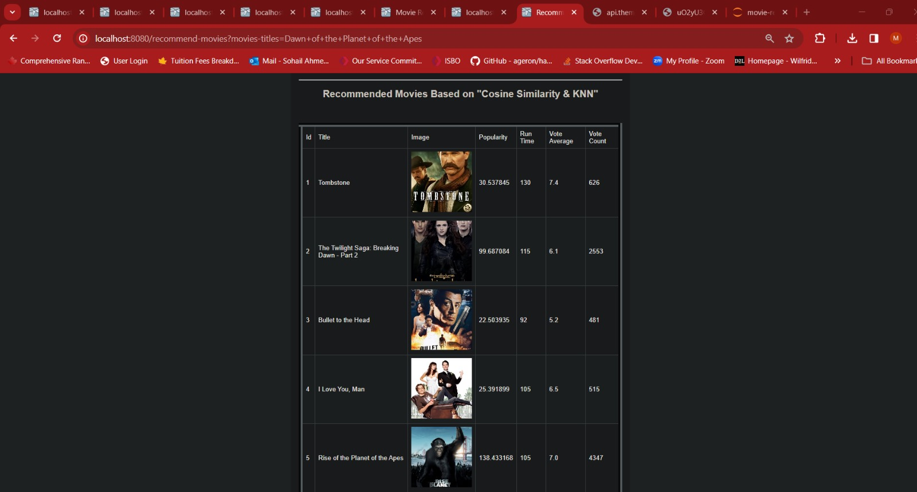
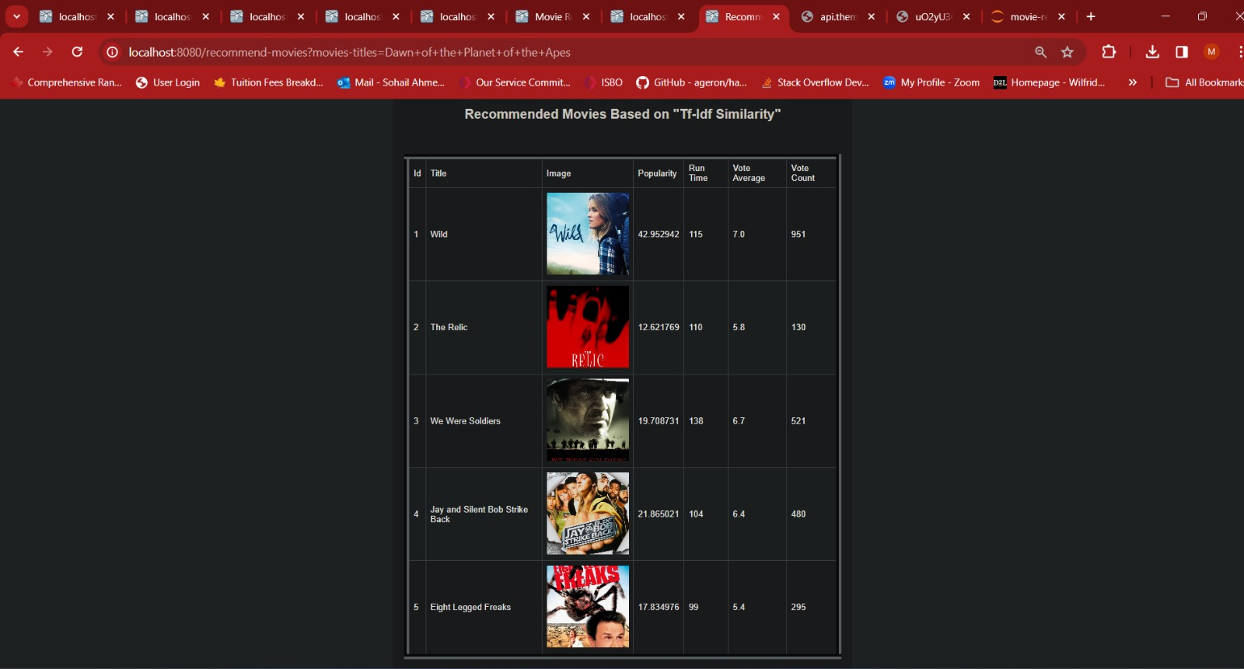
Screenshots

Slide 16

Challenges and Limitations
Cold Start Problem
One of the main challenges in movie recommendation system is the cold start problem, which occurs when there is insufficient data about a movie. This makes it difficult to provide accurate recommendations until enough data is gathered.
Inability to learn from history
Another limitation of our approach is the inability to learn from past behavior due to the absence of stored history or user data. Although this decision mitigates privacy concerns and minimizes data storage requirements, it also restricts the recommendation system's capacity to adapt and improve based on users' prior interactions with the platform. Without access to user data or interaction history, our model lacks the capability to personalize recommendations over time, potentially resulting in less accurate suggestions.

Slide 17

Conclusion and Future Work
Conclusion
The movie recommendation system has been successfully developed and implemented using Java Spring Boot Framework.
The system utilizes content-based filtering algorithms to provide personalized movie recommendations to users.
The system has shown promising results in terms of accuracy and user satisfaction.
Future Work
Further improvement can be made to enhance the performance and accuracy of the recommendation system.
Additional features can be incorporated, such as sentiment analysis and genre preferences, to provide more personalized recommendations.
Future research directions could include exploring deep learning techniques and incorporating user feedback to continuously improve the recommendation system.

Slide 18
Future Trends in Movie Recommendation Systems
Utilizing Deep Learning
Deep learning algorithms can analyze large amounts of user data and extract complex patterns and preferences.
This enables more accurate and personalized movie recommendations based on individual tastes and preferences.
Incorporating Contextual Information
Movie recommendation systems can incorporate contextual information such as time of day, location, and social media activity.
This allows for more relevant and timely recommendations based on the user's current situation and interests.

