Slide 1


Mini Project (B C S 554)Presentation
on
SmartEats:Digital canteen platform
Submitted By:
Group No . 41
Kishan Sharma(2301430100120)
Jesvin Cherian (2301430100106)
Majid Ali(2301430100133)
Supervisor:
Mr. Asim Kumar Rai
Assistant Professor Department of CS E
Karan Kr. Maurya (2301430100113)
Mohd. Sohail(2301430100140)
Department of Computer Science & Engineering IMS Engineering College, Ghaziabad
Dr. A.P.J Abdul Kalam Technical University, Lucknow
(2025-26)

Slide 2
Problem Statement:-
In most canteen, managing daily tasks manually often becomes time-consuming and unorganized. Simple things like updating the menu, keeping track of stock, and handling orders take a lot of effort and can lead to mistakes. This sometimes causes delays, wrong orders, and wastage, which affects both the customer experience and how smoothly the canteen run.

Slide 3
Project Objective:-
The main goal of this project is to create a Canteen Management System that makes managing the canteen easier and more efficient. It’s designed mainly for the admin to help with tasks like updating the menu, keeping track of stock, handling orders, and getting real-time feedback. This system will help speed up daily operations, reduce manual work, and make the overall experience better for both staff and customers.

Slide 4
Literature Survey:-
“QR-Based Canteen Management System” [2024]
This paper presents a canteen management system using QR codes for login, ordering, and payments. It focuses on reducing wait times and improving order accuracy through a digital and contactless process. While it offers faster transactions, it lacks real-time menu updates and stock tracking. The system is mainly centered around automation of ordering but limited in admin-side control.
“A Review on Smart Canteen Management System” [2023]
This paper reviews various smart canteen technologies like RFID, Android-based systems, and automated billing. It highlights the benefits of reduced manual work, quicker service, and better customer handling. However, it mainly surveys existing technologies without proposing a fully integrated or real-time system. Features like customer feedback and dynamic menu control are not discussed.
“Canteen Food Ordering and Managing System” [2022]
This project introduces an online food ordering system for canteens with account-based login, order tracking, and digital payments. It aims to reduce queues and manage orders more efficiently using a virtual queue method. While useful, the system lacks features like real-time inventory updates, admin dashboard, or feedback collection. The focus is mostly on order placement and time-saving.
.

Slide 5
Technical details:-
Frontend Languages:-HTML (Hyper Text Markup Language), CSS (Cascading Style Sheets), JavaScript
Backend :- Node.js/Express server with Mongoose.
Database:- Mongodb.
Development Tools:-
Code Editor: Such as Eclipse,Visual Studio Code
Browser: Google Chrome, Firefox, or any modern web browser for testing and debugging.
Version Control:- Git and GitHub/GitLab

Slide 6
Methodology:-
Development Steps:
Requirement Analysis: Defined the project goals for a multi-portal canteen system. Identified three main user roles: Customer, Admin, and Kitchen.
System Design: Planning the architecture, database structure, and overall flow.
Frontend and Backend Development: Creating a three separate user-friendly portals (Customer, Admin, Kitchen) by using HTML, CSS, Java script and robust backend using Node.js/Express server with Mongoose to connect to MongoDB.
Integration & Testing: Connected the frontend portals to the backend API to test the full workflow (registration, login, ordering, adding items) and preform usability testing, security testing, and load testing to Ensure the system can handle high-demand periods such as lunchtime.
Security Measures: Integrated Bcrypt.js to hash and secure all user passwords.
Deployment (Cloud-Based): The backend API is connected to MongoDB Atlas, a secure cloud database, making it ready for server deployment.

Slide 7
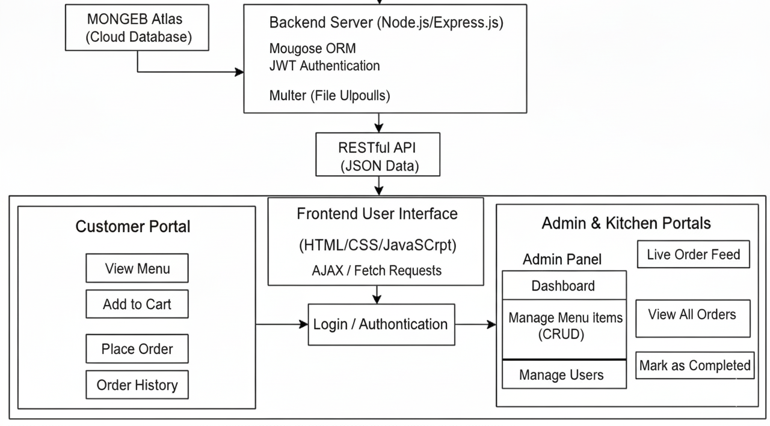




Slide 8
Implementation:
Fully Functional Admin, Customer, and Kitchen portals.
Admin can securely log in to a dedicated dashboard.
Admin can add new items,delete existing items, view and manage all incoming orders from customers.
Customer can register for a new account and login via a existing account.
Customer can browse the full menu, add items to a cart, and place a final order.
Customer can view their own personal order history and check order status.
Kitchen can login to a separate portal to view a live feed of pending order.
Kitchen can mark order as “Completed”, removing them from the live feed.

Slide 9
References:-
[1] I. B. Bhattarai, A. Bhandari, and S. Joshi, “QR-based Canteen Management System,” International Research Journal of Engineering and Technology (IRJET), vol. 11, no. 3, pp. 1–6, Mar. 2024. [Online]. Available: https://irojournals.com/itdw/article/view/6/3/1
[2] P. Auti, M. Bawankar, and P. Bochare, “A Review on Smart Canteen Management System,” International Journal for Research in Applied Science & Engineering Technology (IJRASET), vol. 11, no. 5, pp. 1–5, May 2023. [Online]. Available: https://www.ijraset.com/research-paper/a-review-on-smart-canteen-management-system
[3] C. Antony, “Canteen Food Ordering and Managing System,” ResearchGate, 2022. [Online]. Available: https://www.researchgate.net/publication/361630088_Canteen_Food_Ordering_and_Managing_System

