Slide 1

ADVANCED BANK LOCKER SYSTEM USING RFID AND GSM TECHNOLOGY
Department of Electronics & Communication Engineering
MAJOR PROJECT
(EC7CO4)
Presented By (G10) :
Manoj N G 4NI18EC039
Sohail Maidargi 4NI18EC088
Vedaraj Vittal Shetti 4NI18EC104
Veerendra S M 4NI18EC105
Guided By :
Ms. kavitha S S
Assistant professor
NIE Mysuru.

Slide 2
PROBLEM STATEMENT
Security:
Traditional bank locker system that uses keys for their bank accounts.
Security is the main concern in today’s era.
Implementing two level authenticated RFID based bank locker system using AT89C51 and GSM technology which will give us more security.
Objective
To build a system that verifies user in two steps before giving access to the locker.

Slide 3
INTRODUCTION
In this present age, safety has becomes an essential issue for most of the people especially in the rural and urban areas.
Some people will try to cheat or steal the property which may endanger the safety of money in the bank, house, and office.
In this system only authentic person can recover money from bank locker.
This system consists of microcontroller AT89c51, RFID reader, GSM modem, keyboard, and LCD, in this system.

Slide 4
LITERATURE SURVEY
Title | Authors | Journels/Conference | Summary
Arduino Based Bank Locker Security System | Miss. Kausalya, Dr.T.Menaka Devi, Kaviya, Manoranjitha, Monisha | International Journal of Innovative Research in Science, Engineering and Technology, March 2020, 8th National Conference on Frontiers in Communication and Signal Processing Systems (NCFCSPS '20) | It tells about the design and implementation of secured locker system based on RFID reader, GSM modem, Arduino AT mega2560 board which can be used in bank, secured offices and homes.
Bank security system using RFID and GSM | R ramani Selvaraju, Niranjan Valarmathy | International journal of computer application, Volume 57 - No.18 | It provides a picture about the working of AT89C51 Microcontroller and its interface with other components.
Community alarm design based on MCU and GSM | Zhaoxia Wang, Hanshi Wang, Lizhen Liu | 4th International Conference on computer Science and network technology, 2015 | We got idea about embedded c coding in keil software and software simulation in Proteus.

Slide 5
WORK FLOW
RFID
NO
“NOT MATCHED”
START
YES
“CREATE PASSWORD”
SEND
GSM
“ENTER PASSWORD”
RECEIVE
KEYPAD
NOT MATCHED
“INVALID PASSWORD”
MATCHED
MOTOR ON
“LOCKER OPENED”

Slide 6
WORKFLOW
The RFID reader reads the id number from passive tag and send to the microcontroller.
If the id number is valid then microcontroller send the SMS request to the authenticated person mobile number, for the original password to open the bank locker.
If not then microcontroller sends a warning message to the user.
If the person generates and sends the password to the microcontroller, which will verify the passwords entered at the keyboard and received from authenticated mobile phone .
If these two passwords are matched the locker will be opened otherwise it will be remain in locked position.

Slide 7
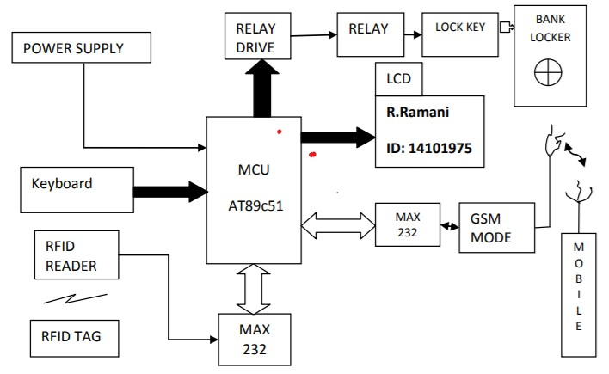
SYSTEM DESIGN
USER

Slide 8
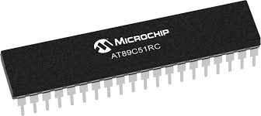
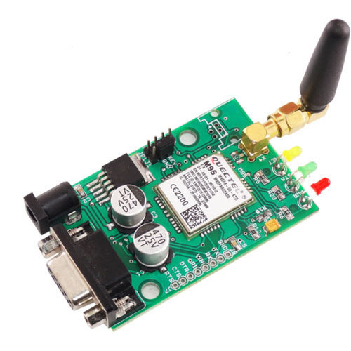
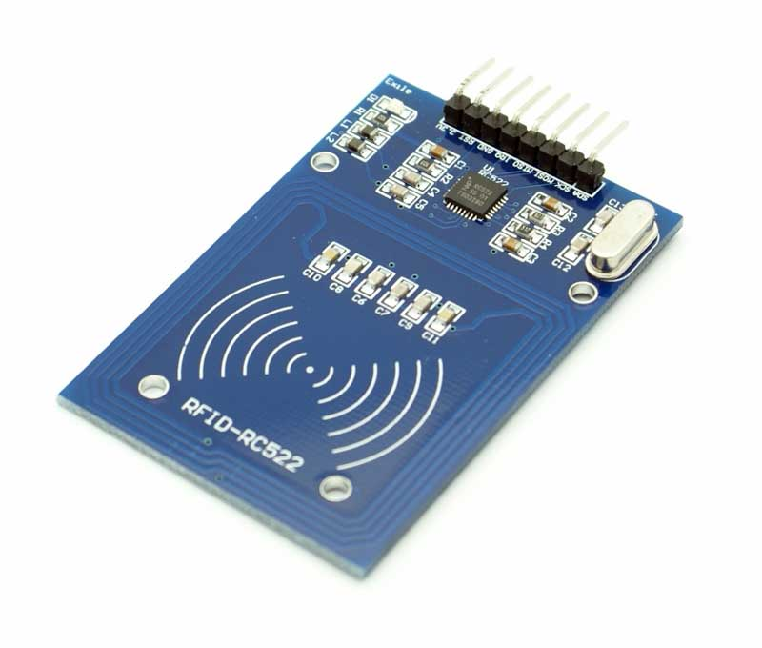
Tools survey
AT89C51 microcontroller
RFID
GSM module
LCD display
MAX232
Keil software.
Proteus software.

Slide 9
Comparison
S.No | Existing system | Proposed system
1. | Traditional key system used | Rfid and GSM Technologies used
2. | One password is referred | Two password are referred
3. | May be in-secured due to robbery of key | More secured due to double password
4. | Involvement of Bank Employee | No Involvement of Bank Employee

Slide 10
.
FUTURE SCOPE
With addition to this project, we can use “FACE” or “IRIS and Retina” Scanning for visual identification of the person
If there are multiple unauthorized attempts, it will results in self lock.
We can use multiple gateway (GPRS, 3G, 4G volte) for communication.

Slide 11
Thank you

