Slide 1
LSVT APPLICATION
Lee Silverman Voice Treatment
PRODUCED BY: Ahmed Gamal Mahmoud
Sohaila Mohamed Ahmed Shrouq Abd-Allah Amr Abd-Elsalam Mahmoud Mohamed Gamal Youssef

Slide 2
01
INTRODUCTION
02
CLASSIFIERS
CONTENT
03
EQUATIONS
04
RESULTS

Slide 3
PART 01
INTRODUCTION

Slide 4
INTRODUCTION
Lee
Silverman
Treatment
Voice
Is a treatment for speech disorders associated with Parkinson's disease (PD). It focuses on increasing vocal loudness and is delivered by a speech therapist in sixteen one-hour sessions spread over four weeks. A derivative of this treatment, known as LSVT BIG, is used in treating movement aspects of Parkinson's disease.

Slide 5
PROCEDURE
4-Calculations
3-Reduction
Probability of features given each class
Using Equations, then we reduced 310 Features to 4
5-Coding
PROCEDURE
2-Features
Using Matlab
310 Features
6-Results
1-Dataset
Accuracy, Sensitivity & specicfity
126 samples, 14 patients

Slide 6
PART 02
CLASSIFIERS

Slide 7
CLASSIFIERS
Naïve Bayes
KNN
In machine learning, naive Bayes classifiers are a family of simple "probabilistic classifiers" based on applying Bayes' theorem with strong (naive) independence assumptions between the features.
In pattern recognition, the k-nearest neighbors algorithm (k-NN) is a non-parametric method used for classification and regression. In both cases, the input consists of the k closest training examples in the feature space. The output depends on whether k-NN is used for classification or regression

Slide 8
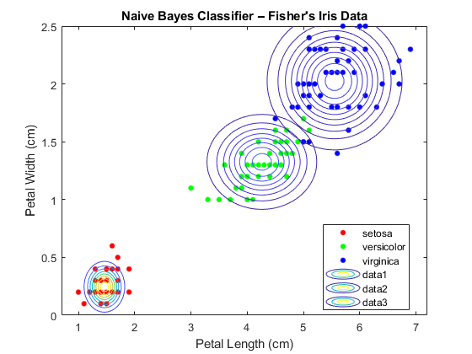
Naïve Bayes

Slide 9
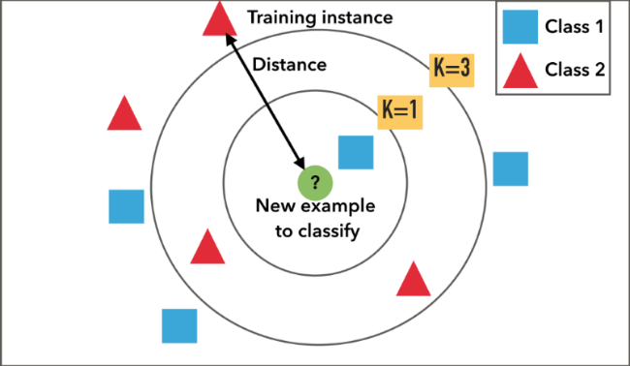
KNN

Slide 10
PART 03
EQUATIONS

Slide 11
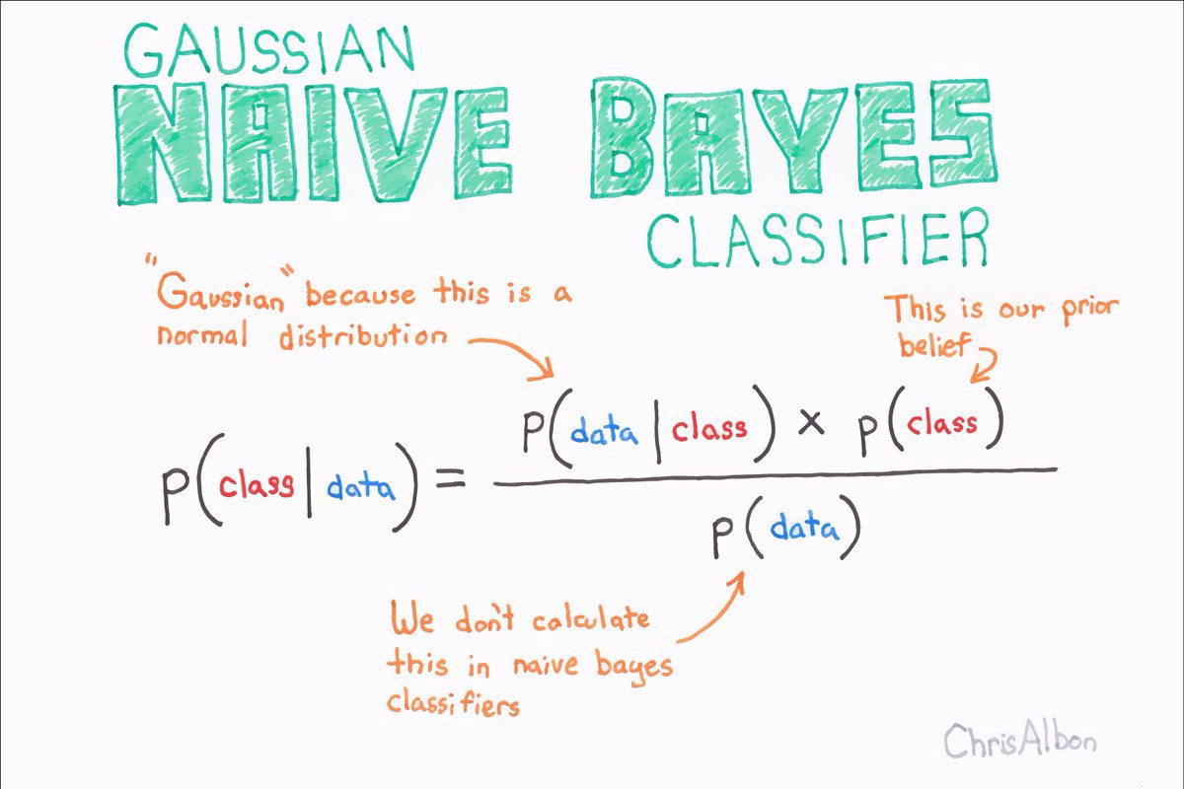
Naïve Bayes

Slide 12
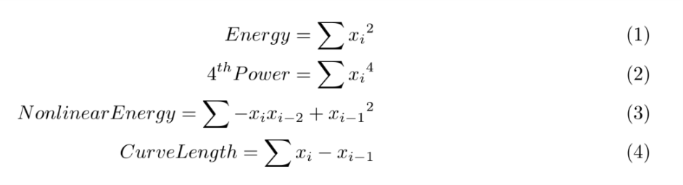
Reduction Equations

Slide 13
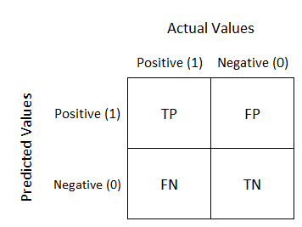
Confusion matrix

Slide 14
PART 04
RESULTS

Slide 15



Results
Accuracy
$$Accuracy=\frac{TP+TN}{TP+TN+FP+FN}$$
Sensitivity
$$Sensitivity=\frac{TP}{TP+FN}$$
Specificity
$$Specificity=\frac{TN}{TN+FP}$$

Slide 16
THANK YOU

