Slide 1
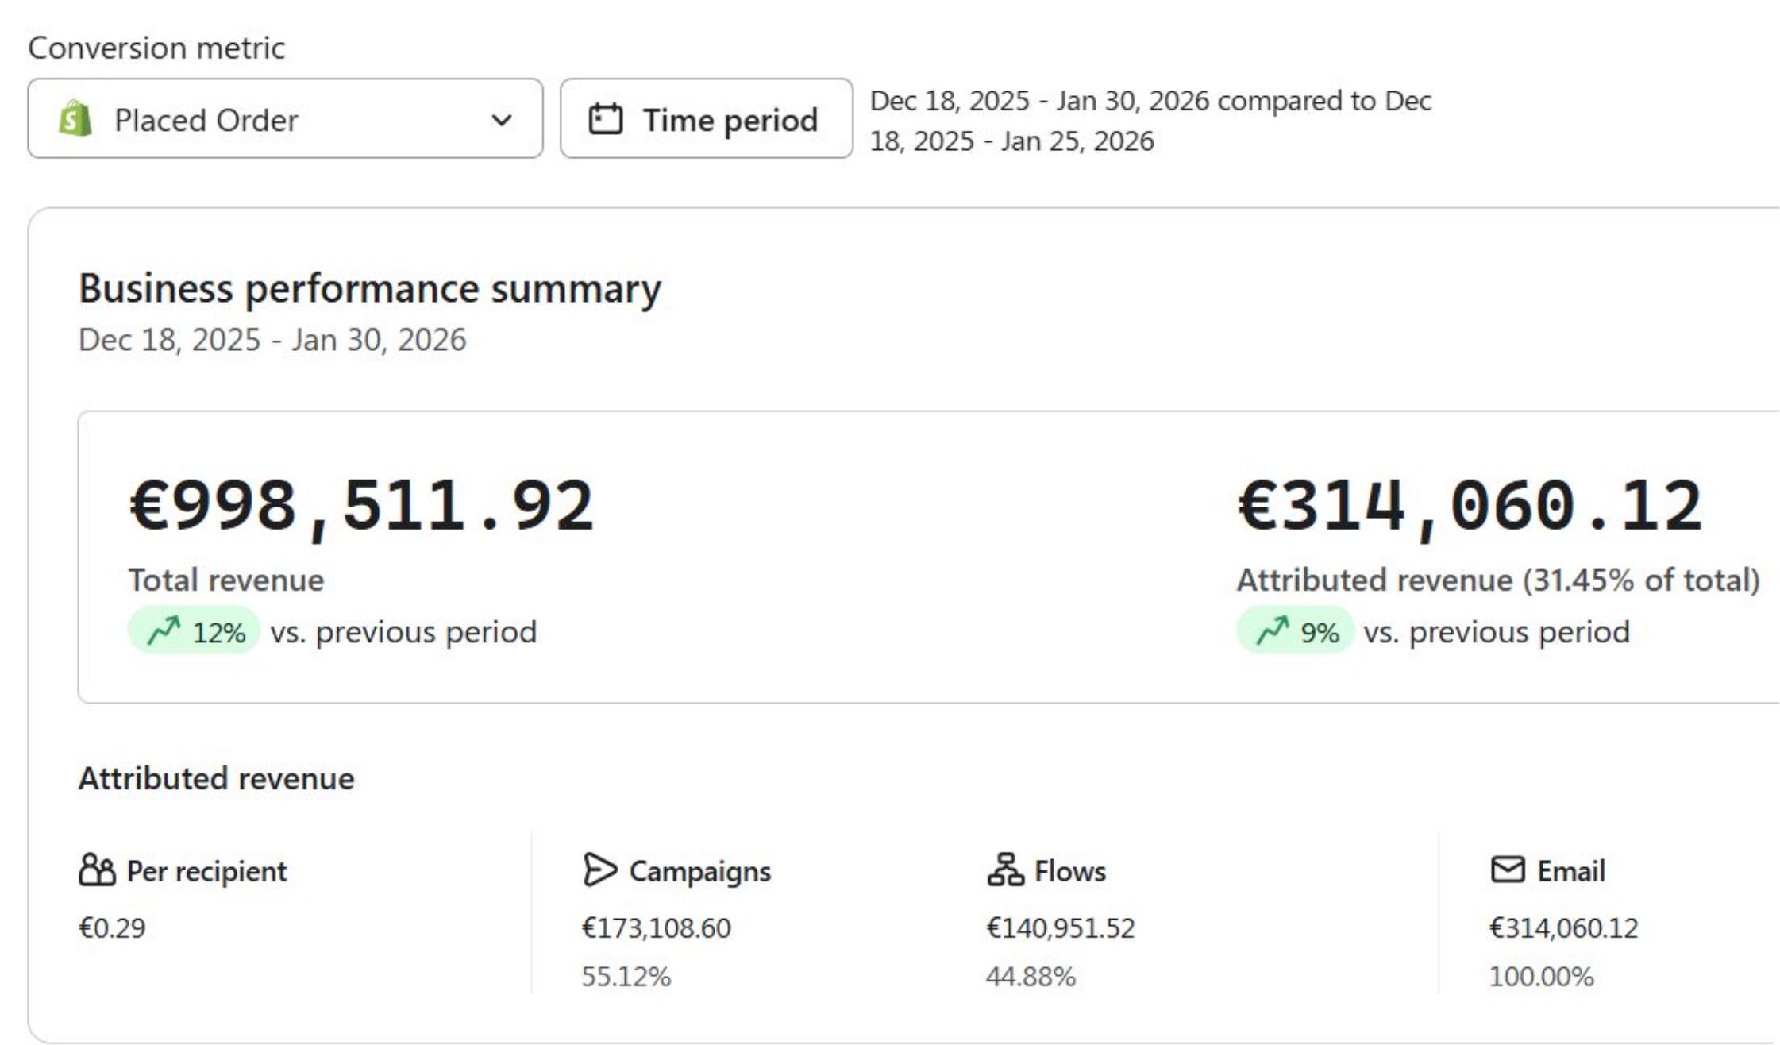
HOW I HELPED A BRAND GENERATE OVER €3,14,060.12 IN JUST 42 DAYS

Slide 2

WHY YOU SHOULD LISTEN TO ME?
Hey, I'm Sameer. My Clients call me Sam haha. I'm the founder and CEO of Bad Retention. We're building Nepal's first premium Retention Marketing agency for 8-9 figure Ecom stores in the beauty, health, supplement and fashion niche. My agency has generated over $800k in atrributed email revenue in the past 90 days for our partner brands.
Find me here
Instagram: https://www.instagram.com/_sameerakhtar_22/
Twitter: https://x.com/EcomSameer
LinkedIn: https://www.linkedin.com/in/sameer-akhtar-388259300/

Slide 3
CASE BACKGROUND
This is a 8 figure brand. They have over 100k email list, they were looking for someone who can get the most out of that list and we eventually met them at the right time.
Tbh they were doing 100K EVERY DAY in Black friday. Their Top of the funnel was dialed in. They were doing decent sending emails internally but they knew they can do alot better, And we came in.
Generally the sales starts to get low post black friday. They were also blasting email to the whole list which is 100k people every time they hit send which was a bad practice.
It was getting hard for them to perform good post black friday. Their design was generic and bad deliverability. And WE CAME IN

Slide 4
HERE'S WHAT WE DID!!!

Slide 5
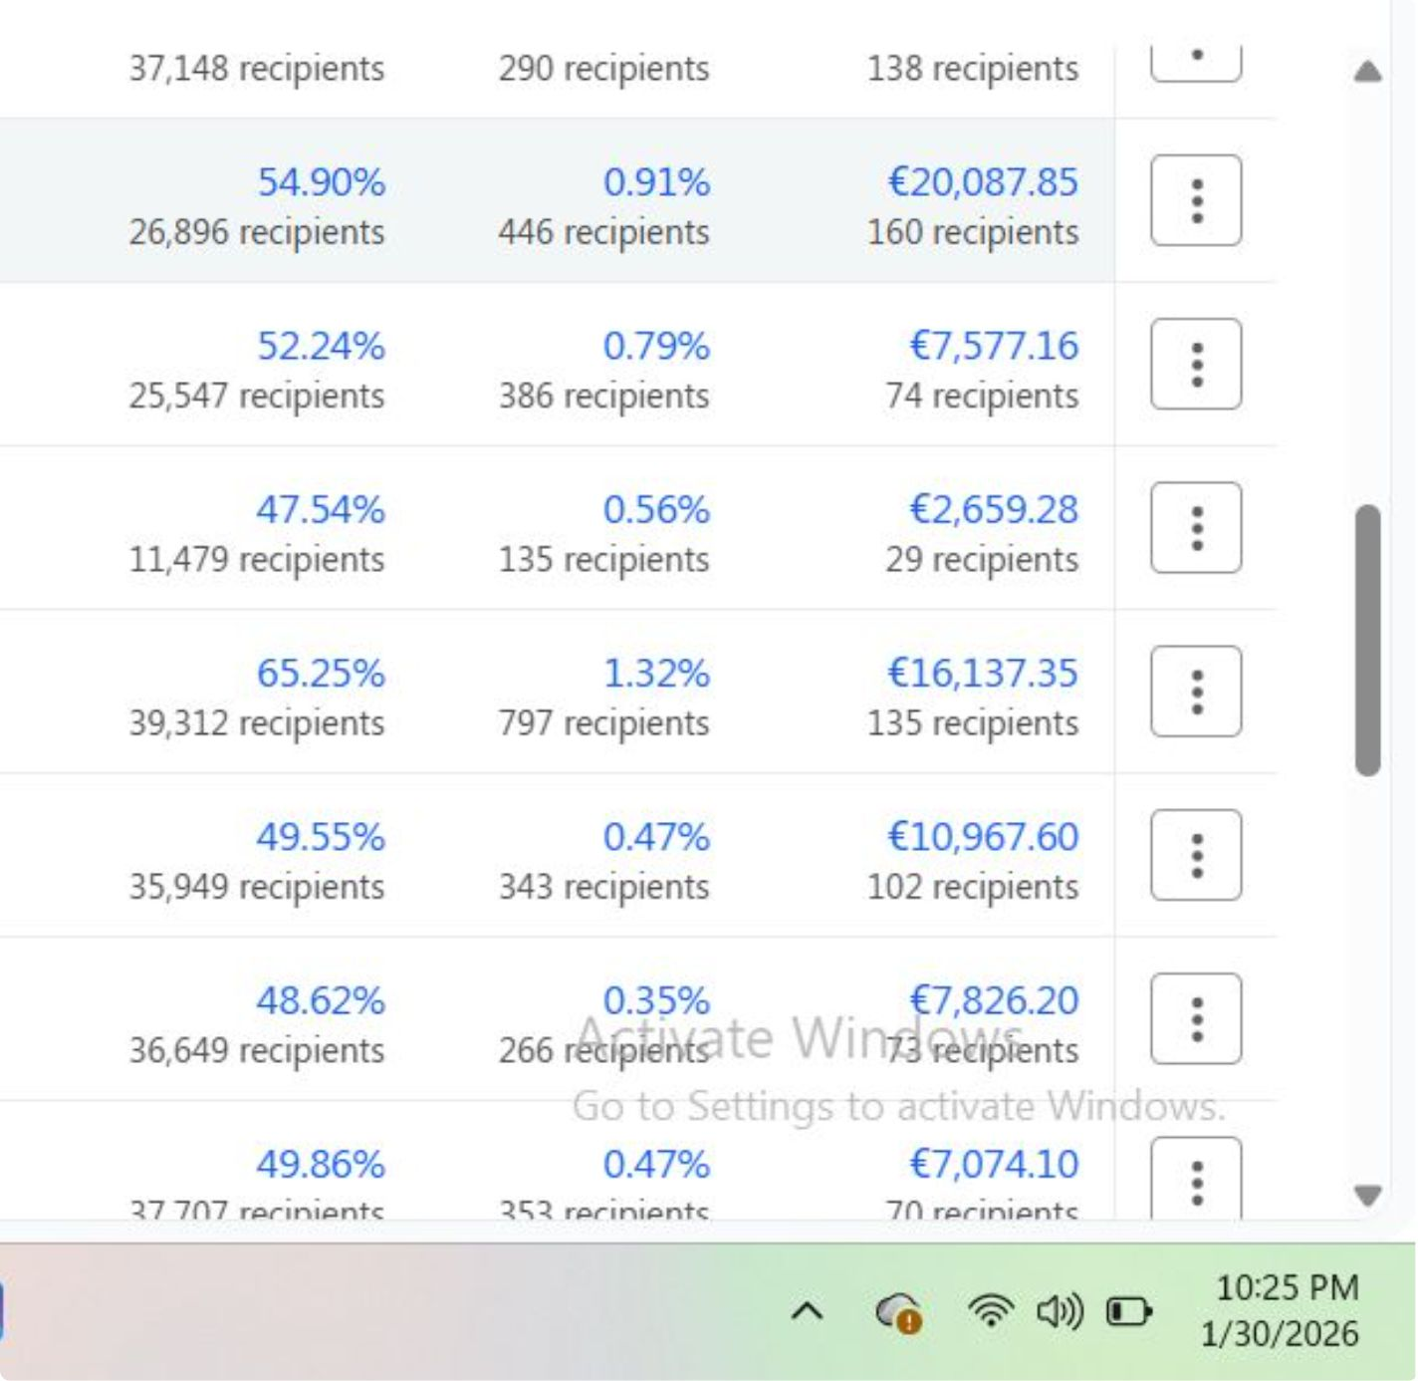
1. DELIVERABILITY
Focuses on deliverability. After the bump of black friday emails, emails generally get ignored. So we built a segment that excludes all the people:
- who have never opened our emails
- All emails which have bounced
- Never engaged with our store in a long time
Highest open rates and the second highest revenue per campaign from this email
TOOK THE OPEN RATES FROM 40% TO 65%. MORE OPENS = MORE REVENUE.

Slide 6
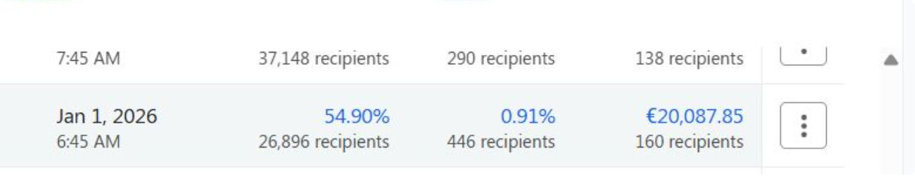
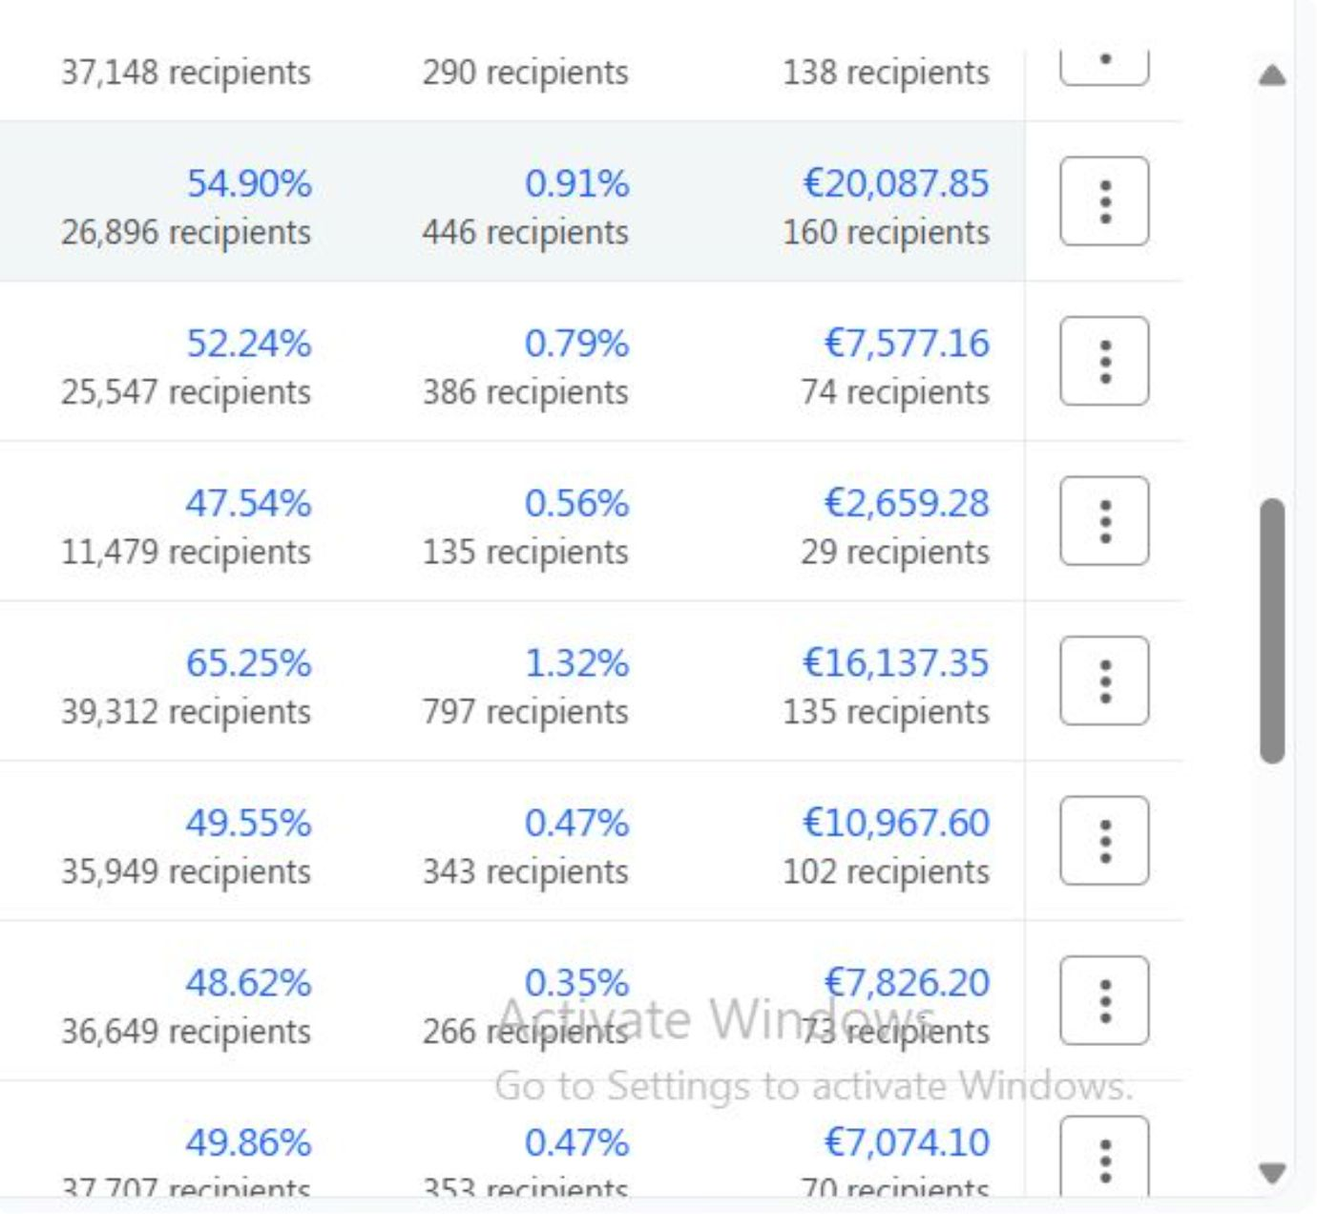
2. CAMPAIGN PERFORMANCE
Campaigns were sent very strategically. It includes promo email such as upto 50% off on best sellers. We were using bunch of different angles. Also New drops targeting various angles that their audience were reasonating with the message. Targeted and relevant messge always prints.
Highest revenue from a single email is €20k and it's from New year. A great way to start the New year. Umahhhhhh
Typical campaign performances

Slide 7
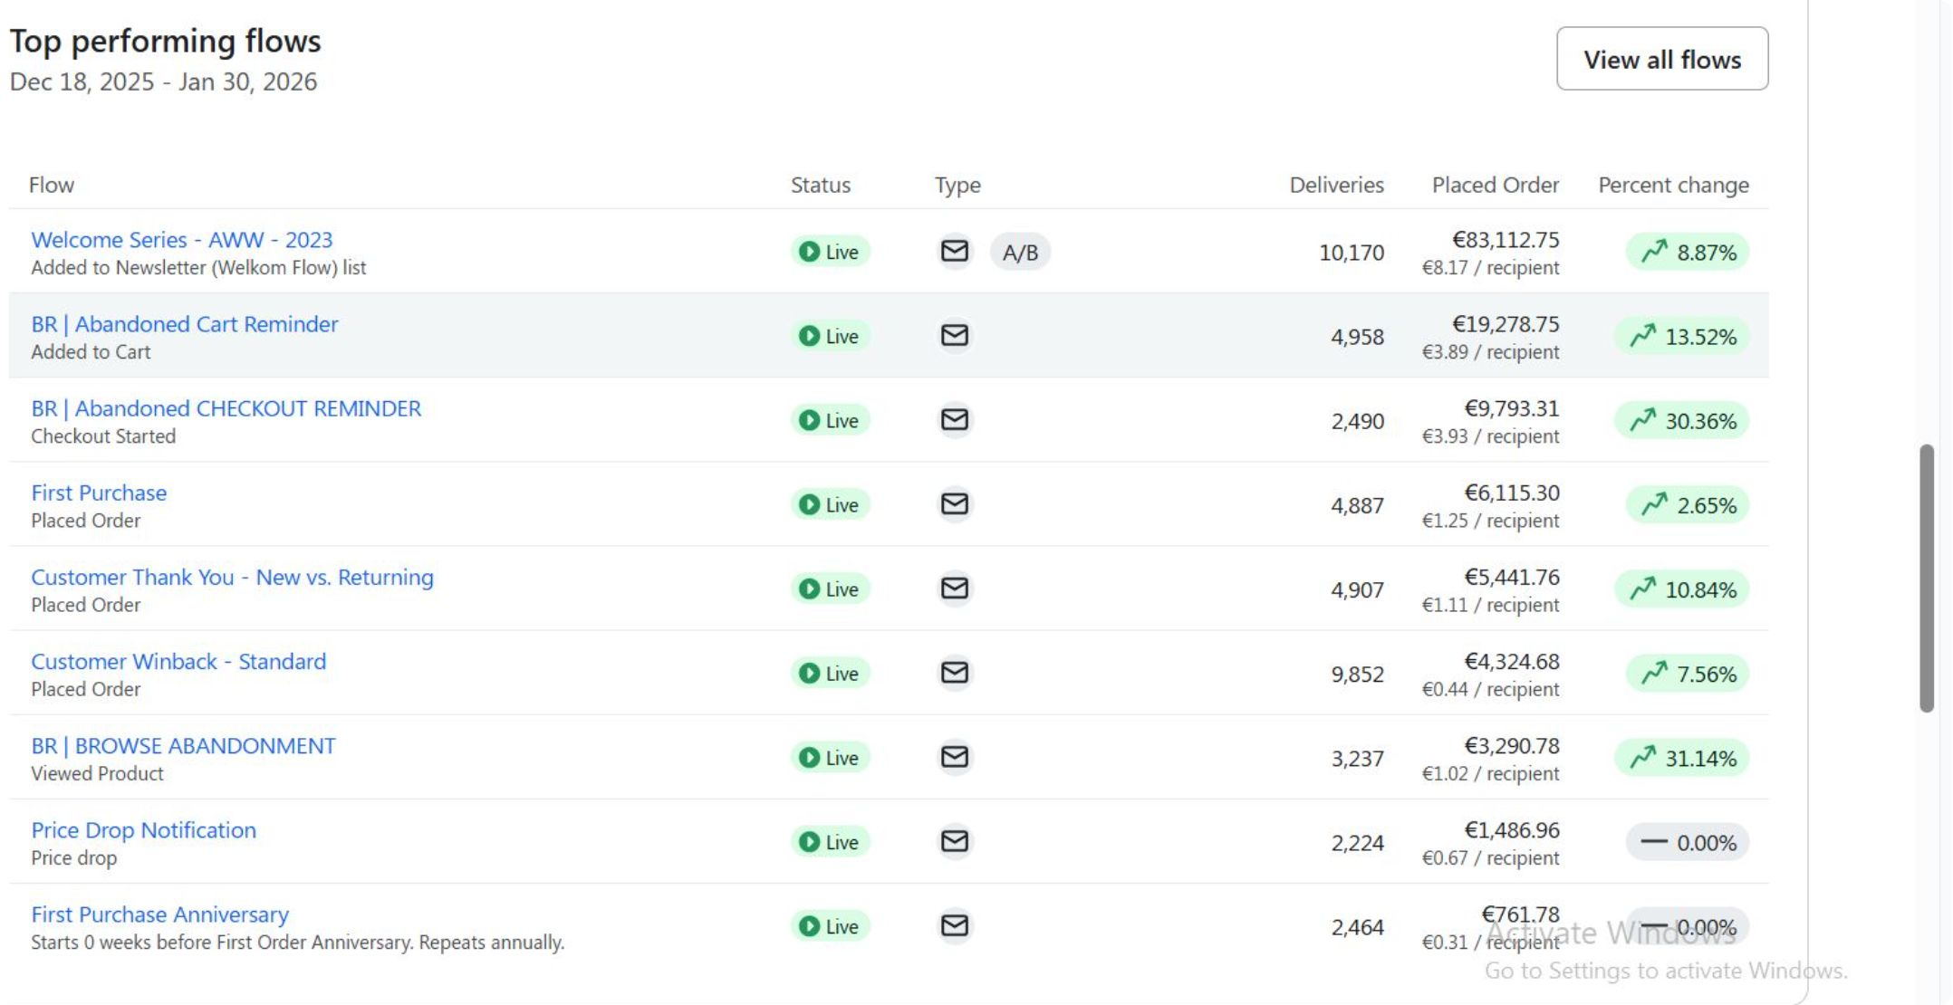
3. FLOWS PERFORMANCE
ADDING €3OK EVERY SINGLE MONTH ON AUTOPILOT FROM FLOWS WHICH THEY'VE COMPLETELY BEEN MISSING PREVIOUSLY. I BET THESE 3OK WOULD BE AN EXTRA 100K IN BLACK FRIDAY.
OVERALL FLOWS PERFORMANCE
I LOVE GREENS, I BET YOU LOVE IT TOO

Slide 8
WANT A FREE 1-1 AUDIT WITH ME?

Slide 9
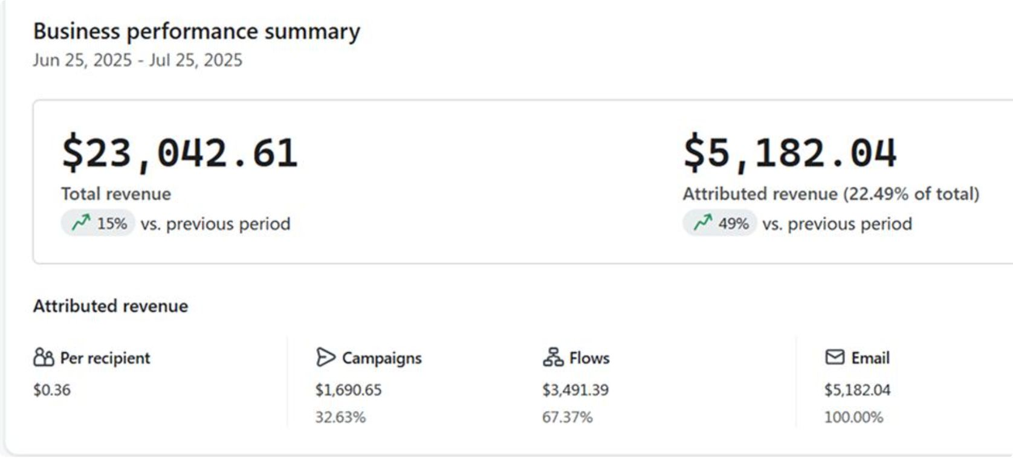
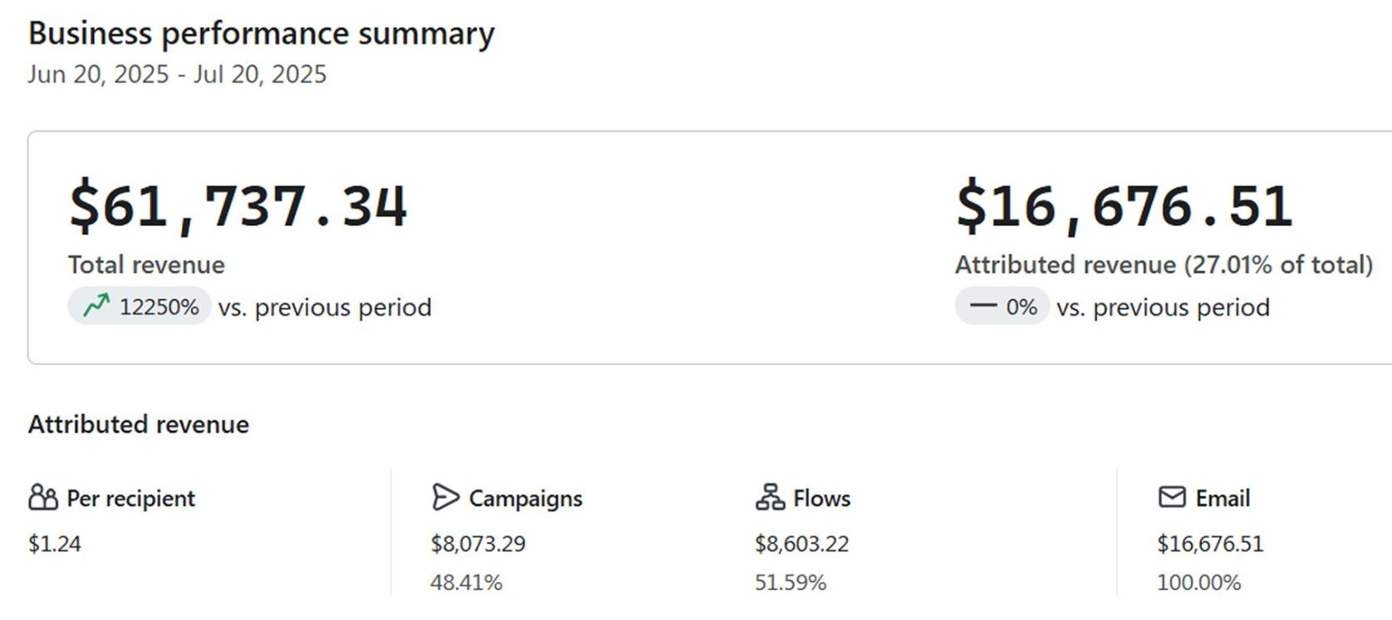
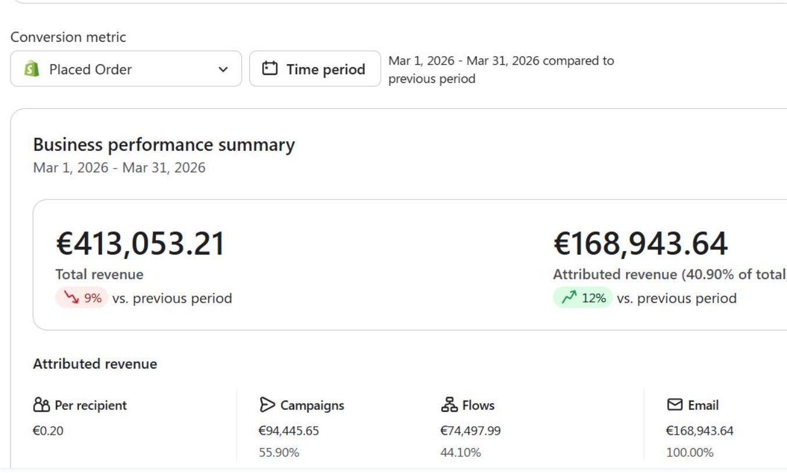
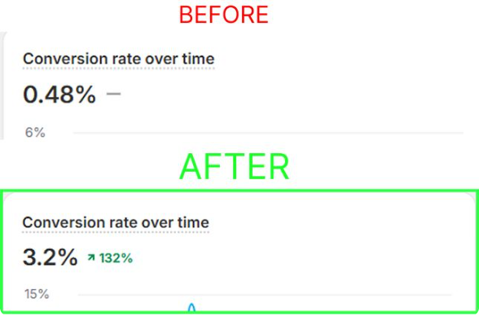
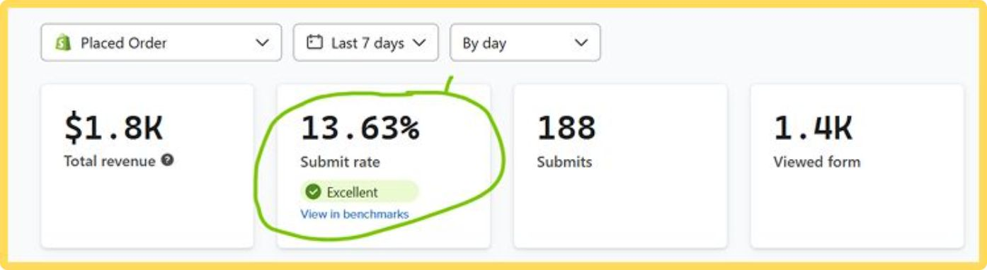
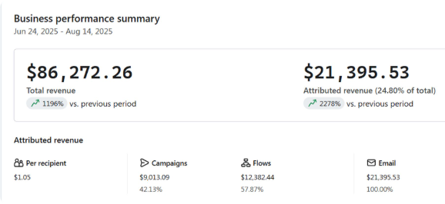
Some more results

Slide 10
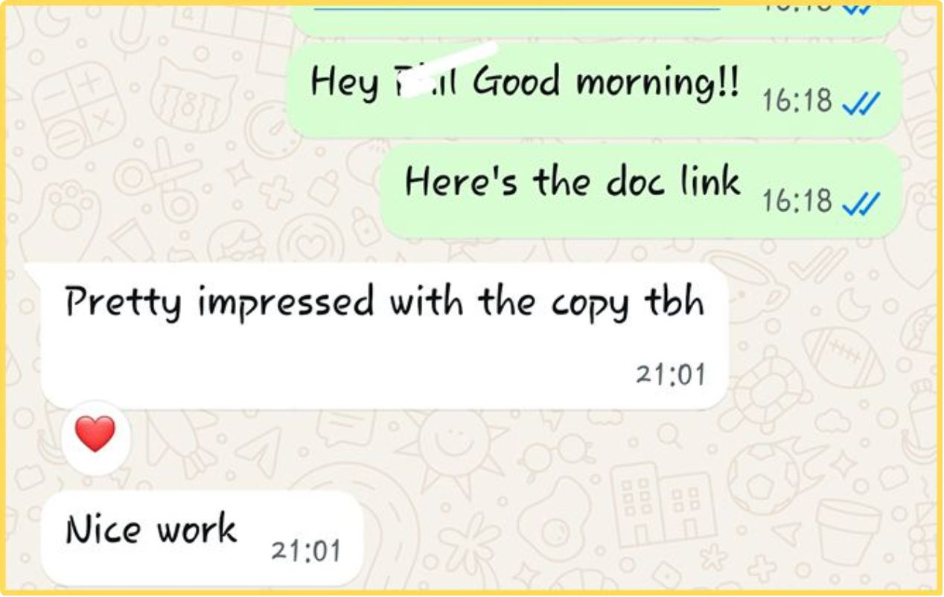
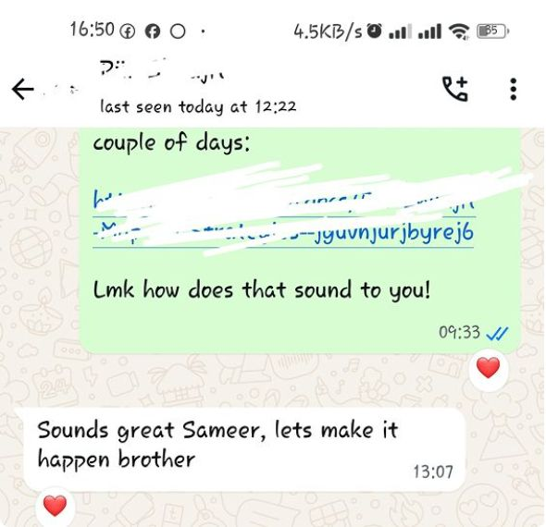
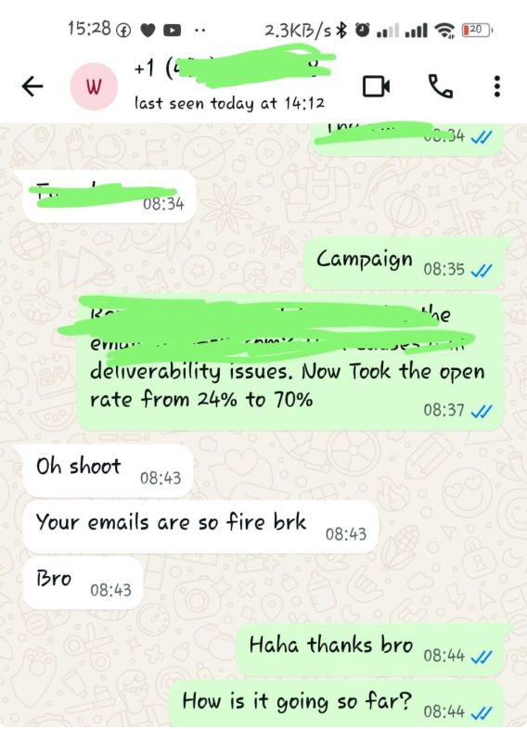
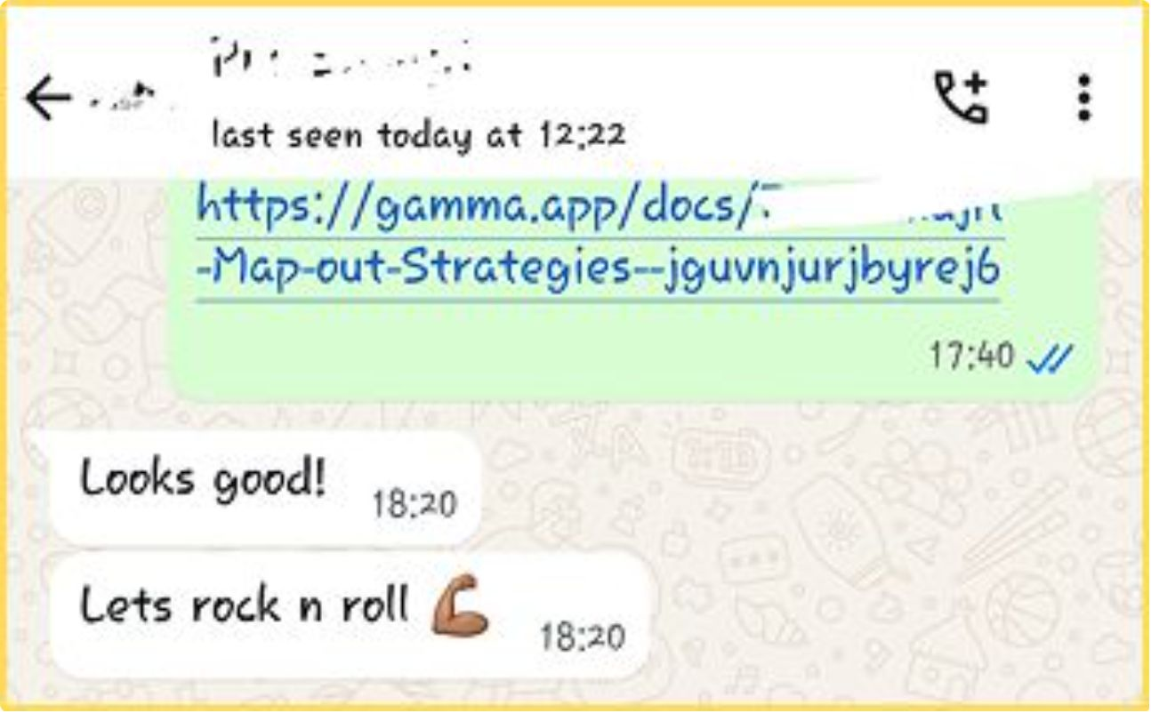
We do it right

Slide 11
READY TO SAVE $7.5K AND GET ALL THE SAUCE FOR FREE?

