Slide 1
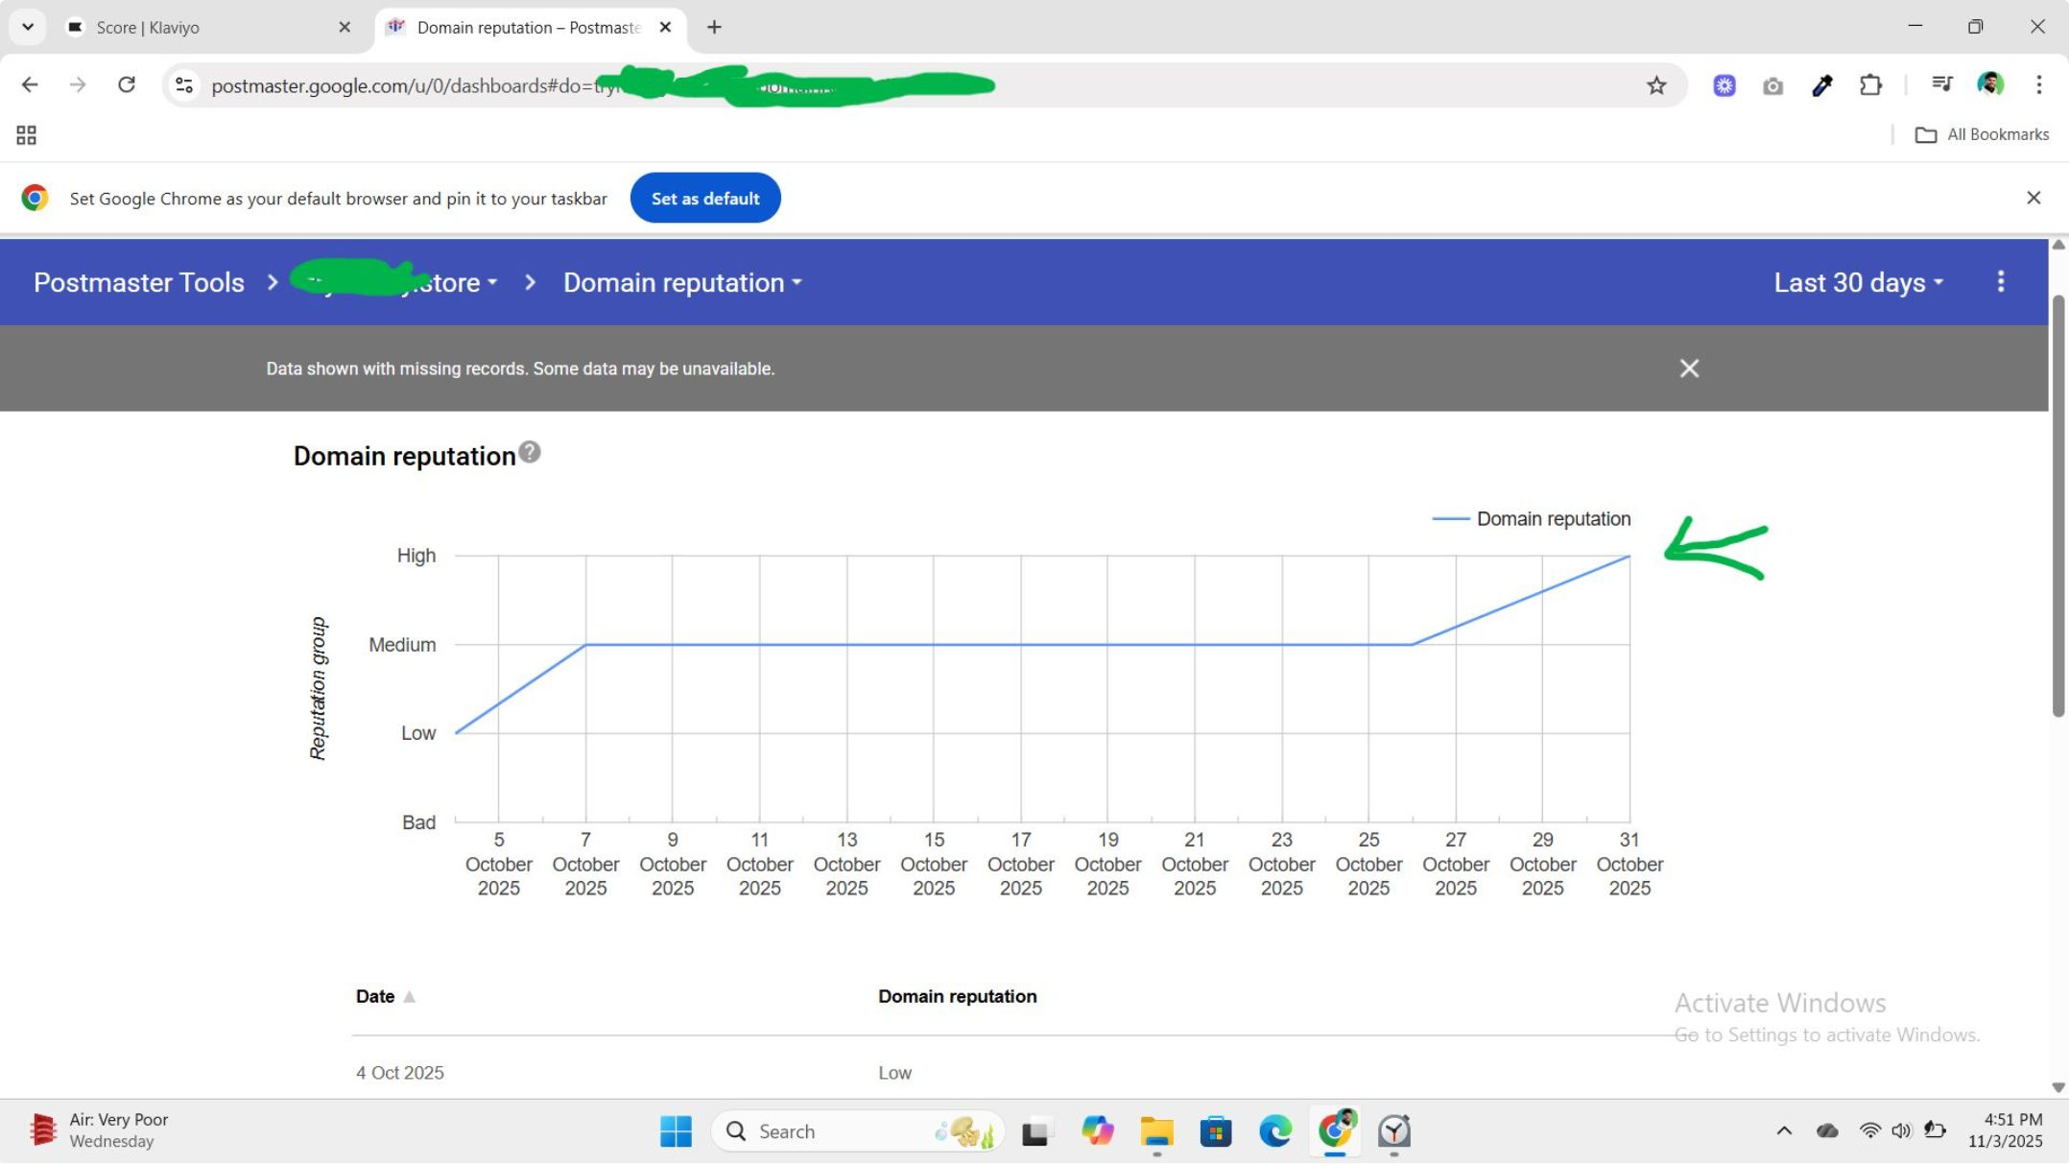
HOW WE TOOK THIS BRAND’S EMAIL OUT OF SPAM AND INTO THE INBOX IN LESS THAN 30 DAYS FOR HIGHER OPEN RATES AND HIGHER REVENUE
Note: Before we start, you should know that taking a brand’s email out of spam is the hardest thing to do. It’s not easy. It requires a lot of time and a lot of effort. We literally took this brand’s email out of spam in less than 30 days (You can see the Google postmaster report here)

Slide 2
CASE BACKGROUND
We met with this brand in late November. But we actually started working with them in early October. If you see the timeline we started working on spam issues from 4th october. It’s 31 october, the day we got out of spam and we saw 78% open rate.

Slide 3
Here’s the exact thing we did from start to finish
DNS records were already setup, so no issues there
We tested where our emails are landing with the help of Glockapps(hell lotta workkkk)
we noticed a 80% of this brand emails were landing into spam, we also noticed a spike in spam complaint rate
The next we do is turned off all the non essentials flows, we keep welcome, abandoned carts, checkouts, thankyou email
Made the first welcome email fully text based
We made the following segment ( if someone can or cannot receive email marketing, can receive email because person subscribed) and started by sending to 10 days engaged segment)FREE MONEY COZ NO ADS SPENDS, NOTHING HAHA
Before sending the campaign we also analysed which ISP are getting low open rates
we noticed yahoo, some gmails and aol were causing all the issues.
The next step we did was we remove the yahoos and aol from the 10 days engaged segment and made the segment more tighter for yahoo and aol ( separately )
10 days engaged for gmail and 7 days engaged for yahoo and aol
Here's the imp part: we started sending plain text emails (pure value, educational) without expecting rev
we started sending 2 campaigns a week fully plain text
When we started seeing 40%+ open rate, we moved the 15 days engaged for gmail and 8 days for yahoo and aol
we again saw 45%+ open rate, we moved 30 days for gmail and 15 for yahoo and aol.
Now even with the graphic emails campaigns are getting around 50% + open rate, placed order has been increased.
Welcome email open rates went from 33% to 59% so does the placed order rate even with the graphic emails.

Slide 4
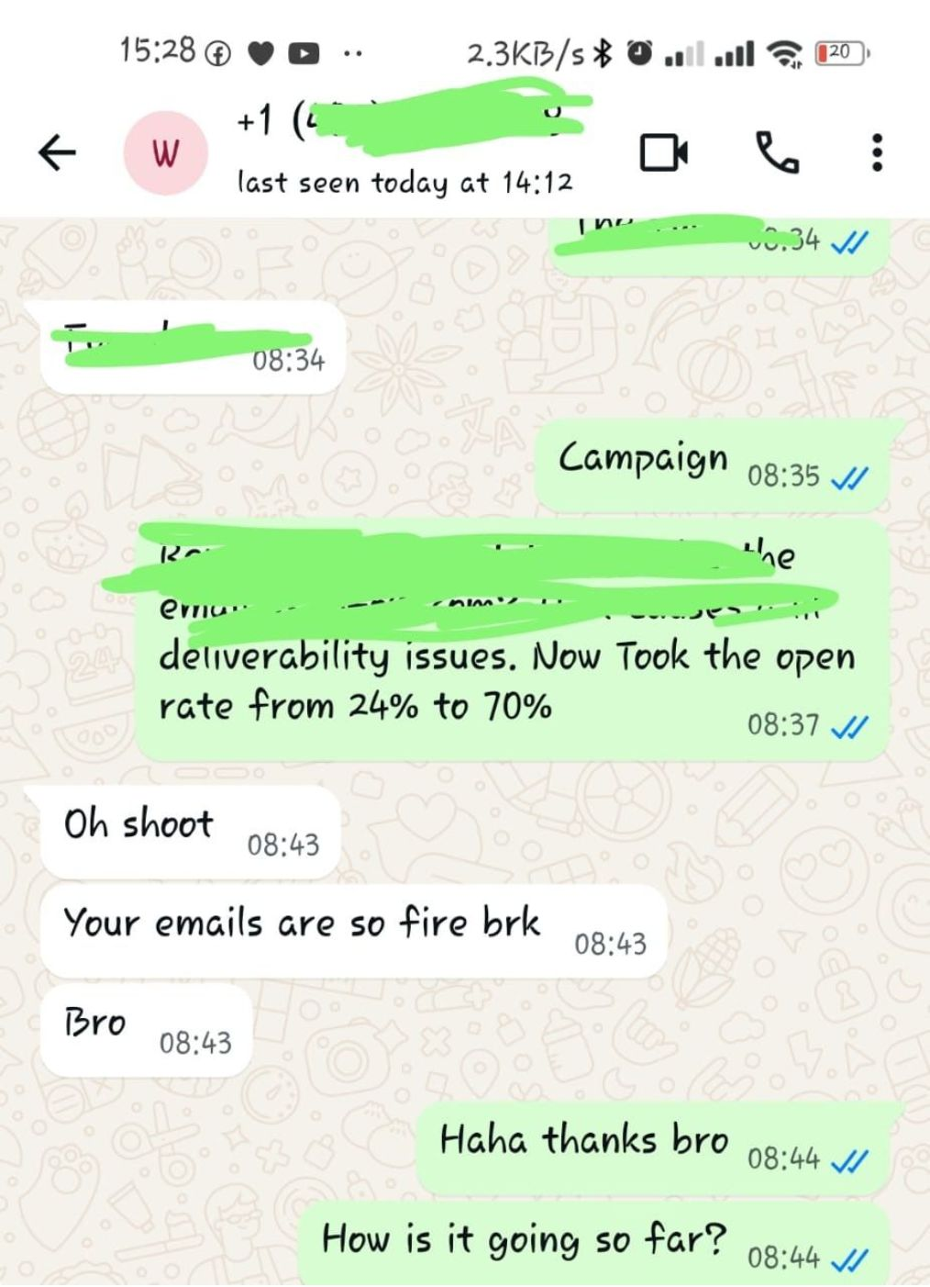
We did all of these but the main happiness was hearing this from Our client:

Slide 5
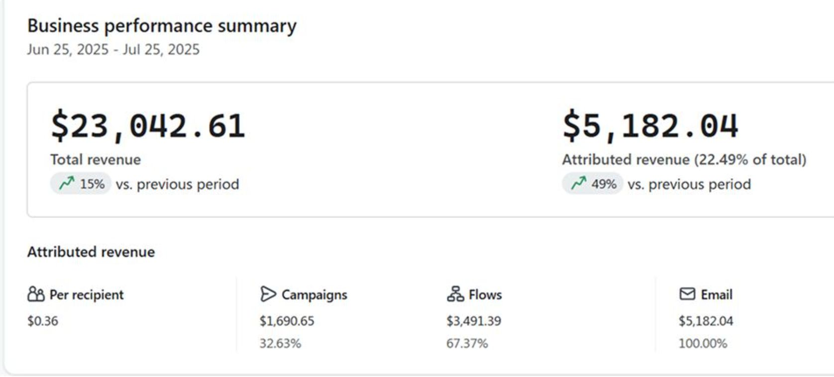
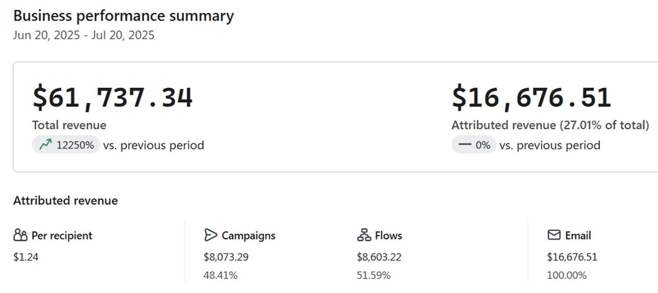
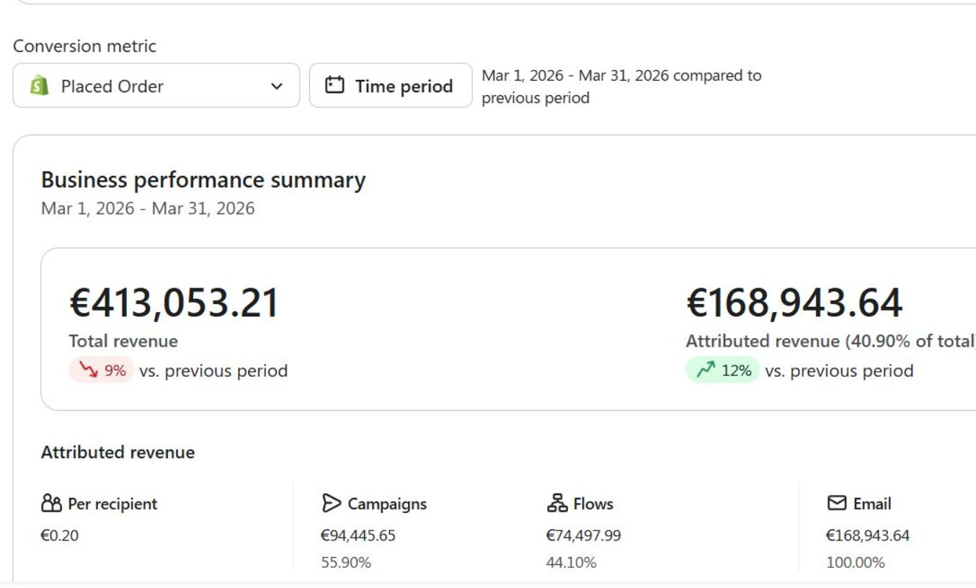
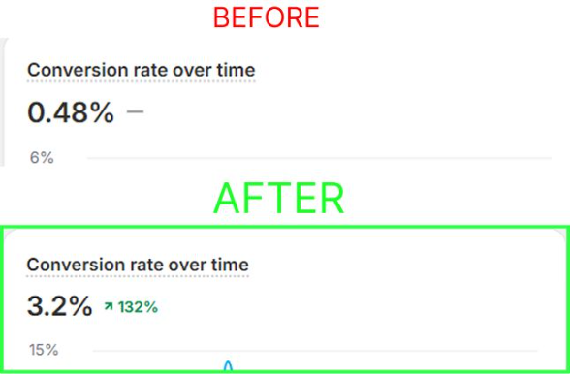
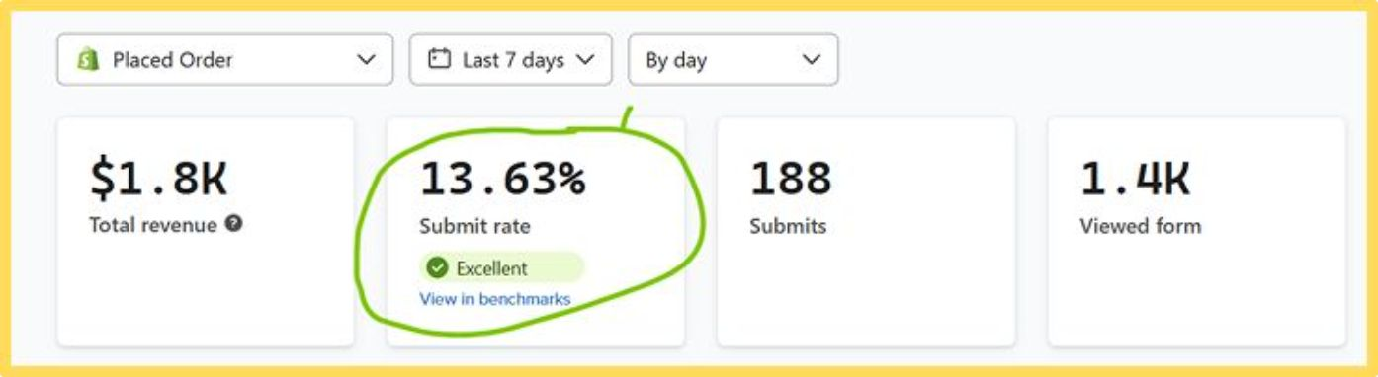
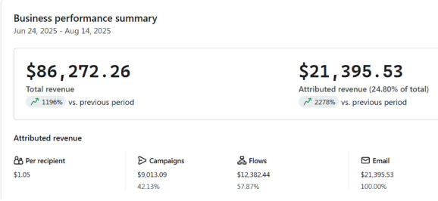
SOME MORE RESULTS

Slide 6
WANT A FREE 1-1 AUDIT WITH ME?

Slide 7
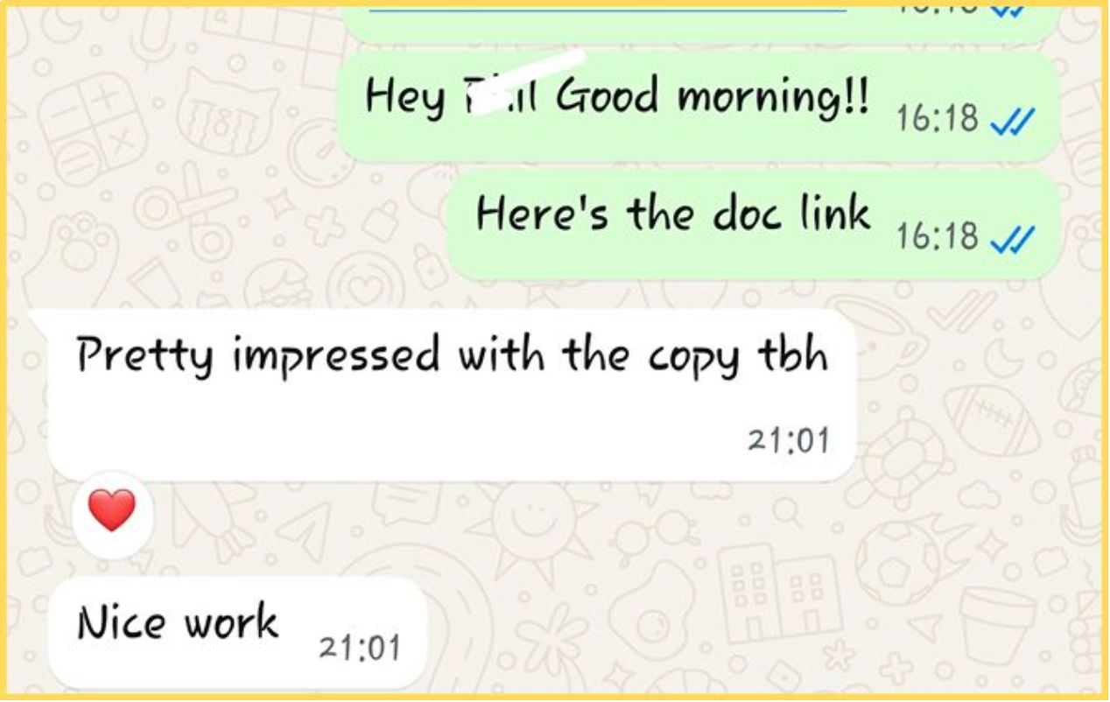
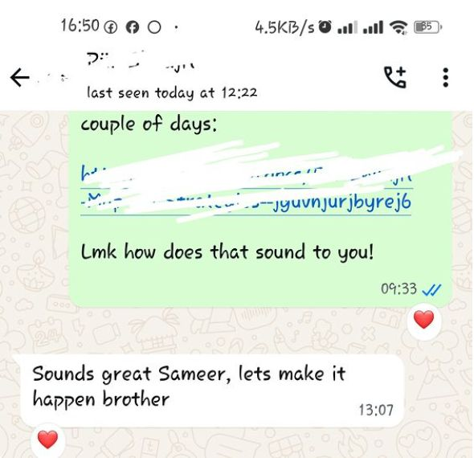

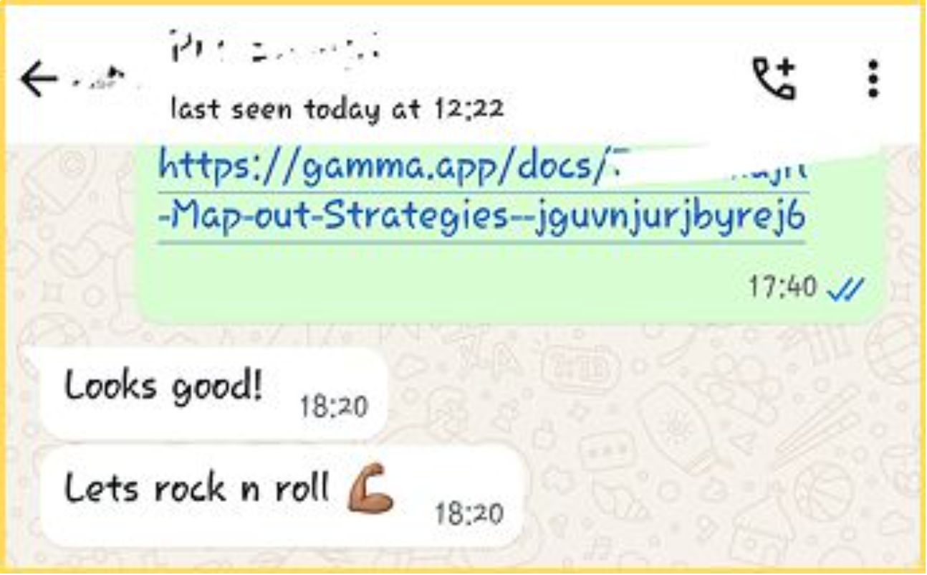
We do it right

Slide 8
READY TO SAVE $7.5K AND GET ALL THE SAUCE FOR FREE?

