Slide 1
Wireless Networks
Lecture 4
Error Detecting and Correcting Techniques
Asra Ashraf

Slide 2
Outlines
Transmission Errors
Parity Check
Cyclic Redundancy Check
Block Error Code

Slide 3
Coping with Transmission Errors
Error detection codes
  Detects the presence of an error
Error correction codes, or forward correction codes (FEC)
  Designed to detect and correct errors
  Widely used in wireless networks
Automatic repeat request (ARQ) protocols
  Used in combination with error detection/correction
  Block of data with error is discarded
  Transmitter retransmits that block of data

Slide 4
Error Detection Process
Transmitter
  For a given frame, an error-detecting code (check bits) is calculated from data bits
  Check bits are appended to data bits
Receiver
  Separates incoming frame into data bits and check bits
  Calculates check bits from received data bits
  Compares calculated check bits against received check bits
  Detected error occurs if mismatch

Slide 5

Error Detection
Transmitter
Receiver
  Error detection not 100% reliable!
  protocol may miss some errors, but rarely
  larger EDC field yields better detection and correction

Slide 6
Parity Checks
Single bit
Even or Odd parity
Only single bit error detection
What about multiple bit errors
Use when probability of bit errors is small and independent
Errors are usually clustered together
The ability of receiver to both detect and correct errors
is known as forward error correction (FEC)

Slide 7
Examples of parity bit check
Adding parity bit
1 1 0 0 0 1 0 1 1 Odd
1 1 0 0 0 1 0 1 0 Even
Odd parity errors
1 1 0 1 0 1 0 1 1 error detected
1 1 0 1 0 0 0 1 1 error undetected

Slide 8
Two-dimensional parity checks
Generalization of 1-bit
D bits are divided into i rows and j columns.
Receiver can not only detect but correct as well using row, column indices
D_{1,1} | D_{1,2} | … | D_{1,j} | D_{1,j+1}
D_{2,1} | D_{2,2} | … | D_{2,j} | D_{2,j+1}
. . . | . . . | … … … | . . . | . . .
D_{i,1} | D_{i,2} | … | D_{i,j} | D_{i,j+1}
D_{i+1,1} | D_{i+1,2} | … | D_{i+1,j} | D_{i+1,j+1}

Slide 9
Example of 2D Odd parity check
1110010101111010
Let i = 4, j = 4
1 1 1 0 0
0 1 0 1 1
0 1 1 1 0
1 0 1 0 1
1 0 0 1 1
1 1 1 0 0
0 0 0 1 1
0 1 1 1 0
1 0 1 0 1
1 0 0 1 1
1 1 1 0 0
0 0 1 1 1
0 1 1 1 0
1 0 1 0 1
1 0 0 1 1
Parity bits
Error detection/correction
Error detection/ no correction

Slide 10
Cyclic Redundancy Check (CRC)
Transmitter
  For a k-bit block, transmitter generates an (n-k)-bit frame check sequence (FCS)
  Resulting frame of n bits is exactly divisible by predetermined number
Receiver
  Divides incoming frame by predetermined number
  If no remainder, assumes no error
Algorithm
  Generator: Transmitter and receiver agree on an r + 1 bit pattern P.
  Transmitter chooses r additional bits to append with k data bits.
  Which is remainder of d / P.
  Receiver: if remainder of D / P is 0 , success otherwise error

Slide 11
CRC using Modulo 2 Arithmetic
Exclusive-OR (XOR) operation
Parameters:
    T = n-bit frame to be transmitted
    D = k-bit block of data; the first k bits of T
    F = (n – k)-bit FCS; the last (n – k) bits of T
    P = pattern of n–k+1 bits; this is the predetermined divisor
    Q = Quotient
    R = Remainder

Slide 12
CRC Example
Let d = 10111, P=1001
Q
1 0 1 0 1 1
P
1 0 0 1
1 0 1 1 1 0 0 0 0
1 0 0 1
1 0 1 0
1 0 0 1
1 1 0 0
1 0 0 1
D
1 0 1 0
1 0 0 1
0 1 1
R
T = 10111011

Slide 13
Wireless Transmission Errors
Error detection requires retransmission
Detection inadequate for wireless applications
  Error rate on wireless link can be high, results in a large number of retransmissions
  Long propagation delay compared to transmission time

Slide 14
Block Error Correction Codes
Transmitter
  Forward error correction (FEC) encoder maps each k-bit block into an n-bit block codeword
  Codeword is transmitted; analog for wireless transmission
Receiver
  Incoming signal is demodulated
  Block passed through an FEC decoder

Slide 15
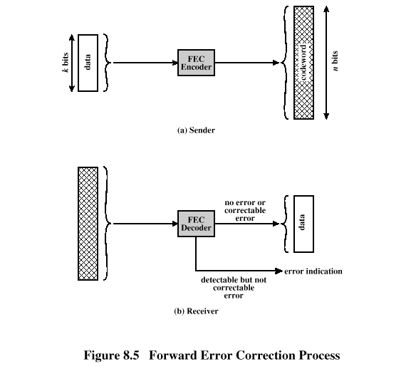

Slide 16
FEC Decoder Outcomes
No errors present
  Codeword produced by decoder matches original codeword
Decoder detects and corrects bit errors
Decoder detects but cannot correct bit errors; reports uncorrectable error
Decoder detects no bit errors, though errors are present

Slide 17
Block Code Principles
Hamming distance – for 2 n-bit binary sequences, the number of different bits
  E.g., v₁=011011; v₂=110001;
  011011 XOR 110001 = 101010
  d(v1, v₂)=3
Redundancy – ratio of redundant bits to data bits
Code rate – ratio of data bits to total bits
Coding gain – the reduction in the required E_{b}/N₀ to achieve a specified BER of an error-correcting coded system

Slide 18
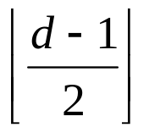
Block Codes
The Hamming distance d of a Block code is the minimum distance between two code words
Error Detection:
  Upto d-1 errors
Error Correction:
  Upto

Slide 19
Example of Block code
Let k = 2, n = 5
Suppose we receive 0 0 1 0 0 pattern
Minimum distance is with codeword 0 0 0 0 0, so we deduct 0 0 as data bits.
Data block
Codeword
0 0 0 0 0 0 0
0 1 0 0 1 1 1
1 0 1 1 0 0 1
1 1 1 1 1 1 0

