Slide 1

School of Computing and Computer Engineering CSC 691 PROJECT ON MACHINE LEARNING FUZZY COLOR IMAGE PREDICTION USING FUZZY ALGORITHMS INSTRUCTOR: DR. ANDREW SUNG STUDENT: SOHAIL KHAN
PAGE: 1

Slide 2
Contents
Methodology.
Objectives.
Problem Statement.
Libraries.
Importance of libraries.
Dataset.
Loading of dataset.
Steps.
Result.
Result Continued.
Conclusion.
References.
PAGE: 2

Slide 3
Methodology
Digital images are modified during the process of image enhancement to provide outcomes that are better suited for display or additional image analysis. To make it simpler to spot important details, you can eliminate the noise of the image, sharpen, or brighten an image [1].
The key component of visual perception is color, which is also very crucial in many computer vision applications. Therefore, one of the most important tasks in computer vision and image processing is the, accurate prediction of color in images. The complexity and variety of real-world images are difficult to understand for traditional color prediction models which rely on deterministic algorithms.
Contrarily, fuzzy algorithms allow a more subtle approach to color prediction by taking into consideration the inherent ambiguities and uncertainties included in visual data.
This project's main objective is the creation of a fuzzy color image prediction model, that can correctly forecast the colors of individual pixels in a picture based on their surrounding environment. The proposed model will utilize a variety of machine learning approaches to enhance its performance and will be based on fuzzy logic principles, which allow for partial truths and uncertainty [2].
PAGE: 3

Slide 4
Objectives
Data gathering and preprocessing: We will compile a sizable color image dataset and preprocess it using resizing, cropping, and normalization. Fuzzy membership functions, rules, and inference systems are used to create a fuzzy logic-based color prediction model that can take into account the uncertainties and ambiguities in image data.
Machine learning optimization: we will use few machine learning methods such as, including decision trees, support vector machines, and artificial neural networks, to improve the suggested model.
Performance assessment: Using suitable metrics like mean squared error, accuracy, and precision-recall curves, we will evaluate how well the suggested fuzzy color image prediction model performs [3].
Comparison with conventional models: To evaluate how well the proposed model predicts colors compared to conventional models based on categorization and regression.
Comparison with conventional models: To evaluate how well the proposed model predicts colors compared to conventional models based on categorization and regression.
Analysis of the strengths and shortcomings of the suggested model: We will look for areas that could use more analysis and development. Examine the possible uses of the suggested fuzzy color image prediction model in areas including picture segmentation, object recognition, and scene comprehension.
The overall goal of this model is to create a fuzzy logic-based color prediction model that can precisely forecast the colors of pixels in an image based on their surrounding context while taking into consideration the ambiguities and uncertainties in picture data [4].
PAGE: 4

Slide 5
Problem statement
The goal of "Fuzzy Color Image Prediction Using Fuzzy Algorithm in Machine Learning" is to create a model that can precisely forecast the colors of pixels in an image based on their surroundings. Because color perception is subjective and can vary depending on personal preferences and cultural backgrounds.
Fuzzy logic allows partial truths and uncertainty. The objective is to build a robust model capable of correctly predicting the colors of pixels in images even in the presence of unclear or missing data. This approach is used in a variety of industries, such as machine learning, computer vision, and image processing [5].
In order to fully clarify the issue statement, it should be noted that color prediction is a crucial step in a number of computer vision applications, scene understanding, object recognition, and image segmentation.
The complexity and variety of real-world images might be difficult for traditional color prediction models to take into consideration because they frequently rely on deterministic algorithms. Contrarily, fuzzy algorithms enable a more suitable approach to color prediction by taking into consideration the inherent ambiguities and uncertainties included in visual data.
PAGE: 5

Slide 6
Fuzzy Algorithm
The basic idea of fuzzy logic is that truth can be expressed as a continual, in other words, an event can be partially true or partially false rather than absolutely true or false. As regions of interest in a data collection, fuzzy logic allows values of system variables to be described using language phrases like ‘high’, ‘low’, and ‘medium’. Fuzzy sets (or areas) are the name given to these language expressions. Therefore, fuzzification offers a way whereby each observation is given a level of affiliation with each of the fuzzy sets. This enables us to create a language summary of a set of numerical data and generate a sense of the underlying patterns.

Slide 7
Libraries
Python library is a collection of linked modules. It includes code bundles that can be applied to numerous programs. This makes Python programming easier and more convenient for programmers. Since we don’t have to create the same code for various programs repeatedly [6]. Below are few examples of libraries,
Pandas.
NumPy.
Keras.
TensorFlow.
Scikit Learn.
Eli5.
SciPy.
PyTorch.

Slide 8
Importance of libraries
Reusability: There are pre-written codes in libraries that can be used in different projects [7].
Speed and efficiency: There are algorithms that are optimized in libraries and this makes it easy in its computation.
Functionality: There are a lot of functions for libraries and they can be used in machine learning, visualization, data analysis.
Standardization: There is a provision of standardization tools and functions in Python libraries and this makes it easy for its manipulation [8].

Slide 9
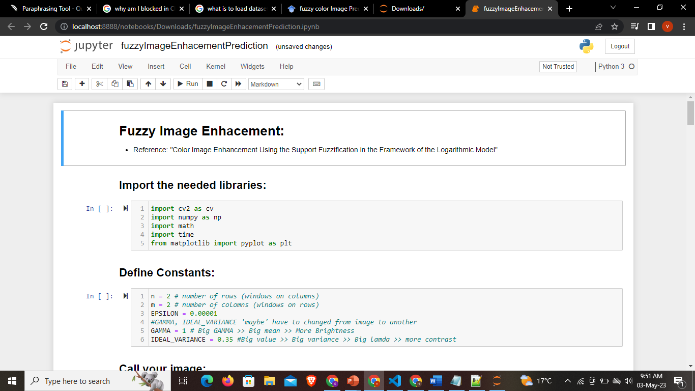
Importing Libraries

Slide 10
Dataset
The dataset was taken from Kaggle.
The dataset had a collection of pictures which were poorly defined and were ambiguous objects.
The actual color values of the objects in each image and level of fuzziness needed to be annotated.
The dataset was directed into training, validating, and testing data.
We trained the data with the purpose of teaching the algorithm. Validating of data was done to tune the algorithm with parameters and to prevent overfitting.

Slide 11
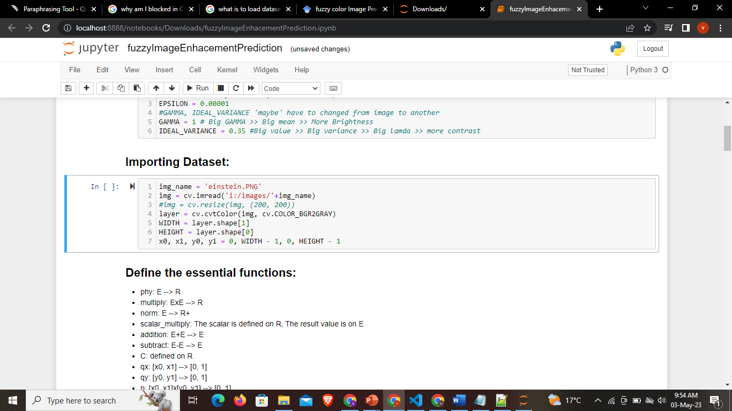
Loading dataset
The first thing we did was to look for a dataset at Kaggle.
The open() method that is included in Python, allowed me to read and write the files. The Python CSV library's writer() and DictReader() methods made it even simpler to work with CSV files in programs.
Python offers a variety of libraries and tools for working with datasets, including Scikit-learn, Pandas, and NumPy. These libraries include functions for loading numerous dataset types such as CSV, Excel, JSON, and so on. For instance, you can use the read_csv() function of the Pandas library to load a CSV dataset.

Slide 12
STEP: 1 The first step is to convert the image to gray level space, (if it is RGB, we need to convert every channel and work on one channel at once and then eventually, re-merge them).

Slide 13
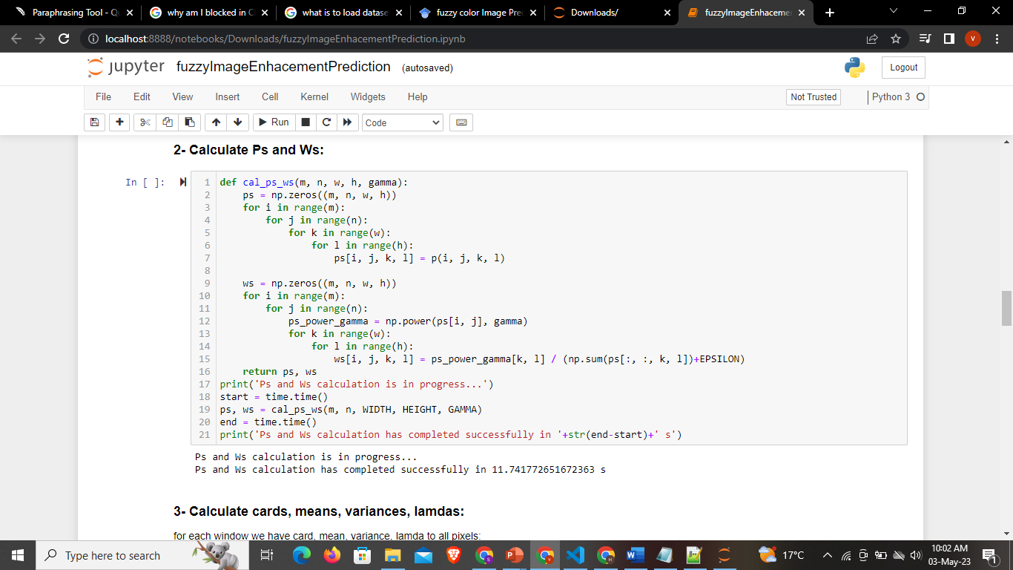
Step 2 In this step, we calculate the weight of every pixel in the window. The image below shows how the step was implemented.

Slide 14
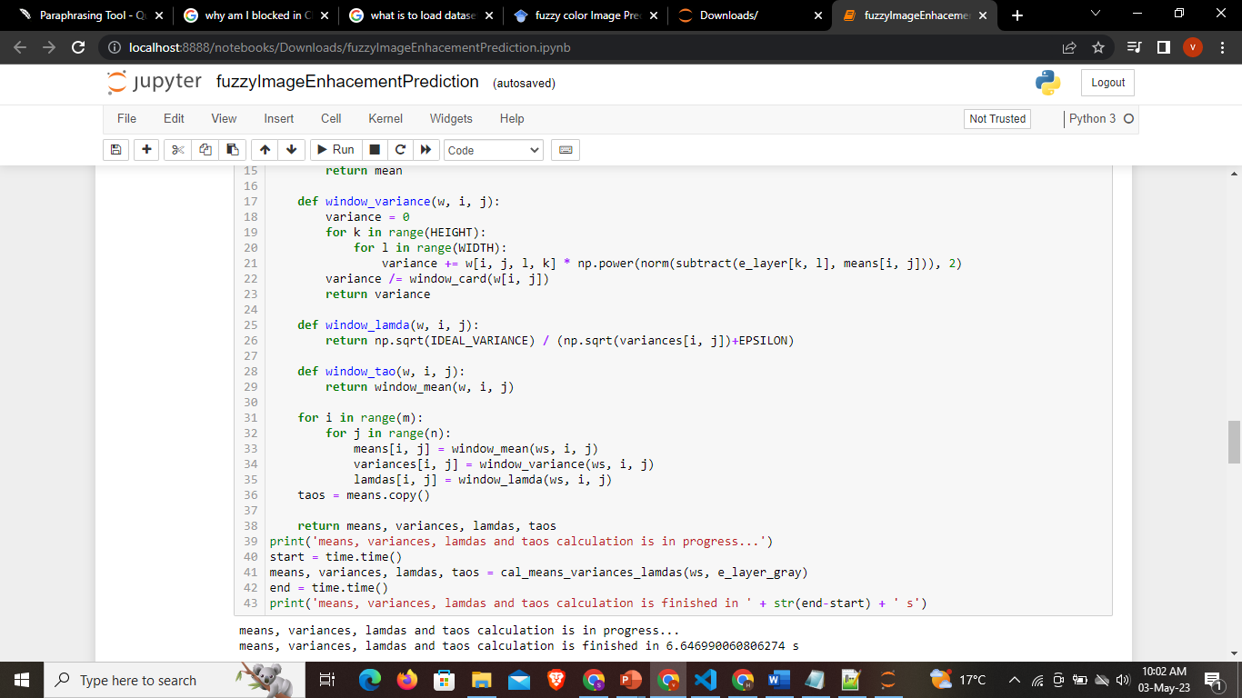
Step 3 This is the step of Calculating window’s means and variances in a weighted way. The image below shows how the step was implemented

Slide 15
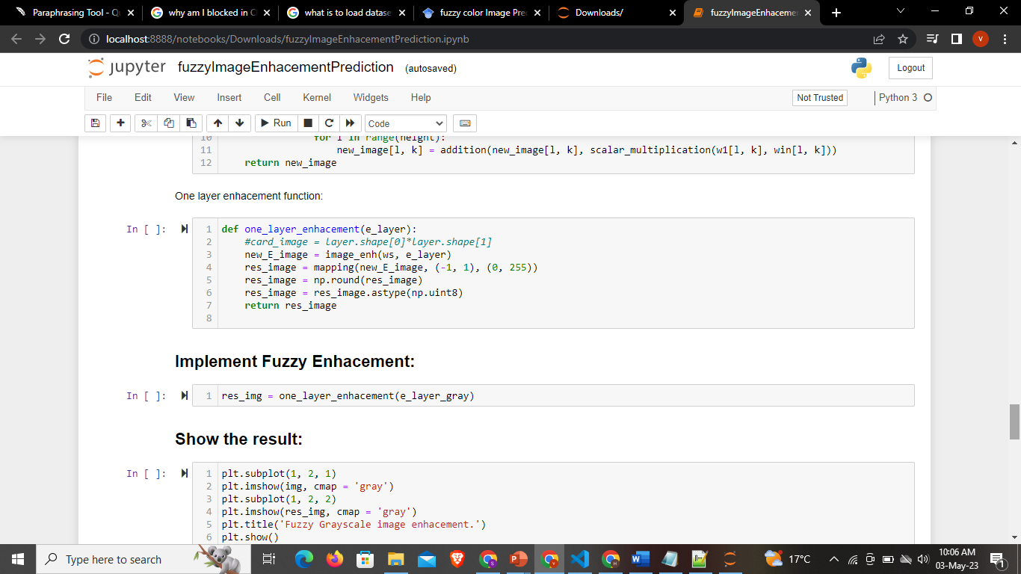
Step 4 Summing up the images of every fuzzy window in a weighted way. The image on the right shows how the step was implemented.

Slide 16
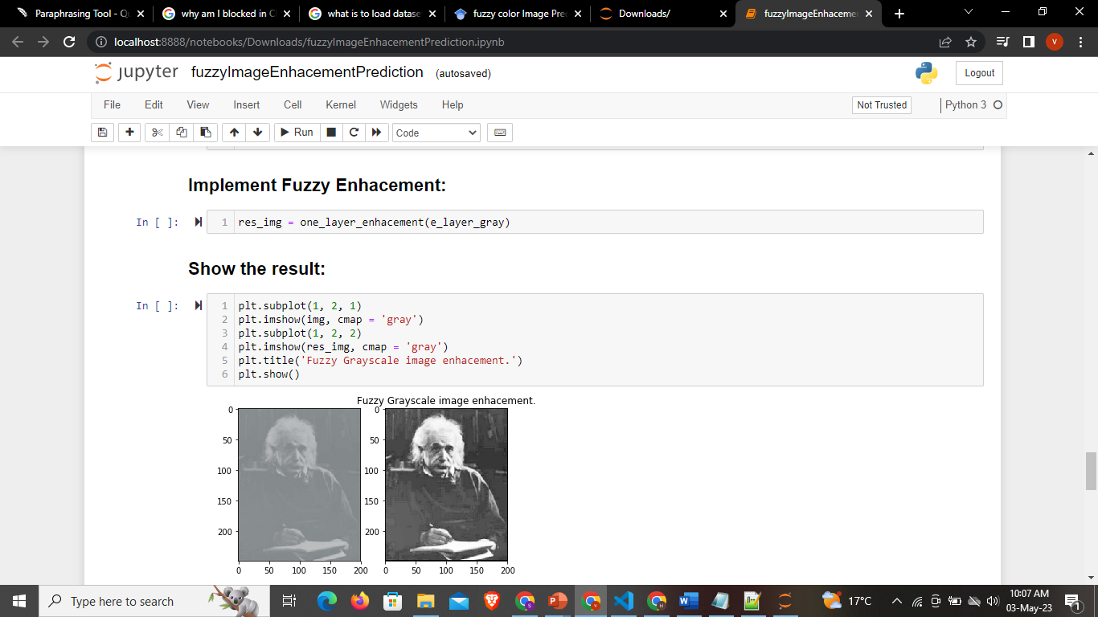
Result Here, the Image has been enhanced. The RGB Color Space Image enhancement has not been done on it yet. Only one layer enhancement has done.

Slide 17
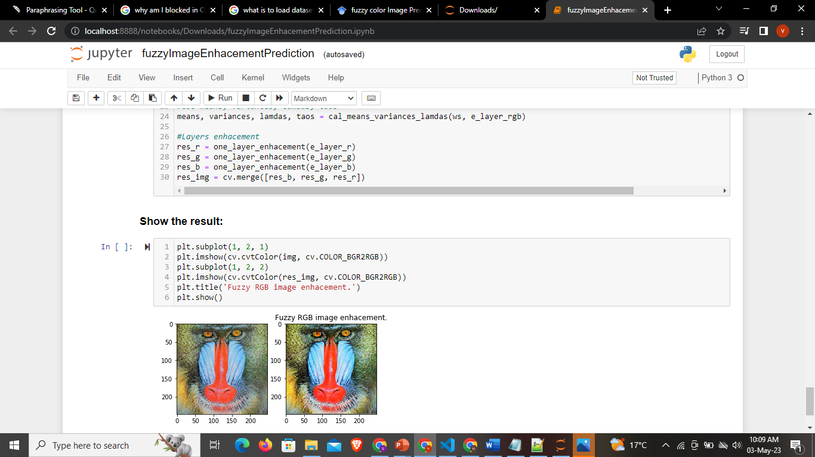
Result continued The image below shows the enhanced image. Hence, RGB Color Space Image Enhancement has been done.

Slide 18
Conclusion
We created a fuzzy color image prediction model that can correctly forecast the colors of individual pixels in a picture based on their surrounding environment. Moreover, it has high accuracy and stability. Throughout the project, I learned a lot of new skills which would help me in the near future.

Slide 19
References
Toğaçar, (2021). Enhancing of dataset using DeepDream, fuzzy color image enhancement and hypercolumn techniques to detection of the Alzheimer's disease stages by deep learning model. Neural Computing and Applications, 33(16), 9877-9889, https://link.springer.com/article/10.1007/s00521-021-05758-5.
Ergen, B, (2020). COVID-19 detection using deep learning models to exploit Social Mimic Optimization and structured chest X-ray images using fuzzy color and stacking approaches. Computers in biology and medicine, 121, 103805 https://link.springer.com/article/10.1007/s00521-021-05758-5
Sibiya M, (2021). Automatic fuzzy logic-based maize common rust disease severity predictions with thresholding and deep learning. Pathogens, 10(2), 131 https://www.sciencedirect.com/science/article/pii/S0010482520301736.
Sibiya, M, (2021). Automatic fuzzy logic-based maize common rust disease severity predictions with thresholding and deep learning. Pathogens, 10(2), 131. Pegalajar, M. C., Ruíz, L. G. B., Sánchez-Marañón, M., & Mansilla, L. (2020). A Munsell colour-based approach for soil classification using Fuzzy Logic and Artificial Neural Networks. FUZZY sets and systems, 401, 38-54 https://www.sciencedirect.com/science/article/pii/S0010482520301736
Al Mamun, A., Em, P. P., Ghosh, T., Hossain, M. M., Hasan, M. G., & Sadeque, M. G. (2021). Bleeding recognition technique in wireless capsule endoscopy images using fuzzy logic and principal component analysis. International Journal of Electrical and Computer Engineering (IJECE), 11(3), 2688-2695 https://www.sciencedirect.com/science/article/pii/S0165168416303528.
https://www.sciencedirect.com/science/article/pii/S1568494610003261
https://ieeexplore.ieee.org/abstract/document/7977003/
https://ieeexplore.ieee.org/abstract/document/7977003/

Slide 20
Thank You!

