Slide 1


PROJECT ON
Title : Motorcycle Market Analysis Using Web Scraping

Slide 2
Preface:
INTRODUCTION
BUSINESS PROBLEM
OBJECTIVE
TOOLS USED
WEB SCRAPPING
DATA CLEANING STEPS
DATA VISUALIZATION
CONCLUSION

Slide 3
Introduction:
BikeWale is a popular website that provides detailed information about different motorcycles, including price, engine capacity, mileage, weight, and user ratings.
This project focuses on collecting motorcycle data from the BikeWale website using web scraping techniques in Python.
The scraped data includes attributes such as bike name, price, engine CC, mileage, weight, rating, and number of ratings.
After collecting the data, it is processed and analyzed using Python libraries like Pandas, Matplotlib, and Seaborn.
The main goal of this project is to extract useful insights from bike data and demonstrate how web scraping can be used for real-world data analysis

Slide 4
Business Problem:
Customers face difficulty in choosing motorcycles due to wide variations in price, engine capacity, and mileage.
There is a lack of clear insights on how specifications like CC, mileage, and weight influence bike pricing and ratings.
Dealers and sellers need data-driven insights to understand customer preferences and optimize product offerings.

Slide 5
Objectives:
To analyze the price distribution of motorcycles across different brands.
To examine the impact of engine capacity (CC), mileage, weight, and ratings on bike pricing.
To identify popular bike brands and models based on customer ratings and reviews.
To provide data-driven insights that help customers and sellers make better purchasing and pricing decisions.

Slide 6
Web Scraping:
Collected motorcycle data from the BikeWale website using web scraping techniques.
Extracted key details such as bike name, price, engine capacity (CC), mileage, weight, ratings, and number of ratings.
Used powerful Python libraries like BeautifulSoup and Requests for data extraction and sent HTTP requests to fetch web pages.
Automated the process to gather large-scale bike data efficiently from multiple pages.
Cleaned and structured the scraped data using Pandas for exploratory data analysis (EDA) and visualization.

Slide 7






Tools & Libraries Used:

Slide 8
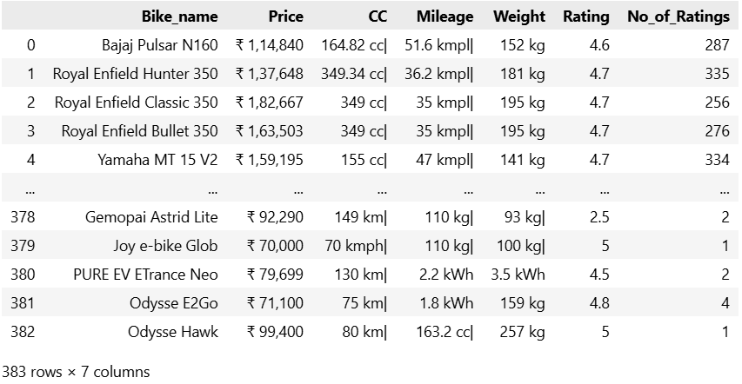
Raw Dataset:

Slide 9
Simple description of each column in the dataset:
Bike_name – The name or model of the motorcycle.
Price – The selling price of the bike in Indian Rupees (₹).
CC – The engine capacity of the bike measured in cubic centimeters.
Mileage – The fuel efficiency of the bike measured in kilometers per liter (kmpl).
Weight – The total weight of the bike measured in kilograms (kg).
Rating – The average user rating given by customers for the bike.
No_of_Ratings – The total number of users who rated the bike.

Slide 10
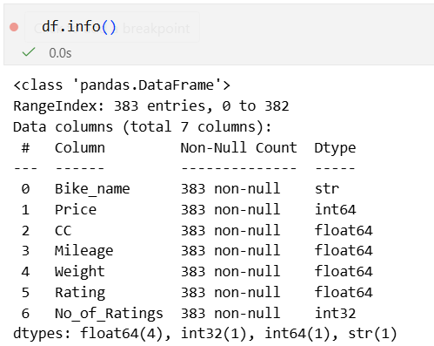
Data Cleaning Steps:
Handled missing values by checking for null or empty entries in the dataset.
Removed unwanted symbols such as ₹, commas, and units (cc, kmpl, kg) from columns.
Converted data types of columns like Price, CC, Mileage, and Weight into numeric format.

Slide 11
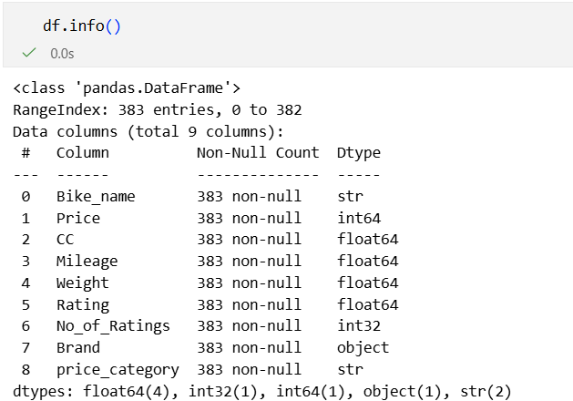
Extracted brand names from the bike name column to create a new Brand column.
Checked for duplicate records to maintain data accuracy.
Created new categorical columns such as Price_Category for better analysis.
Structured and prepared the dataset for exploratory data analysis and visualization.

Slide 12
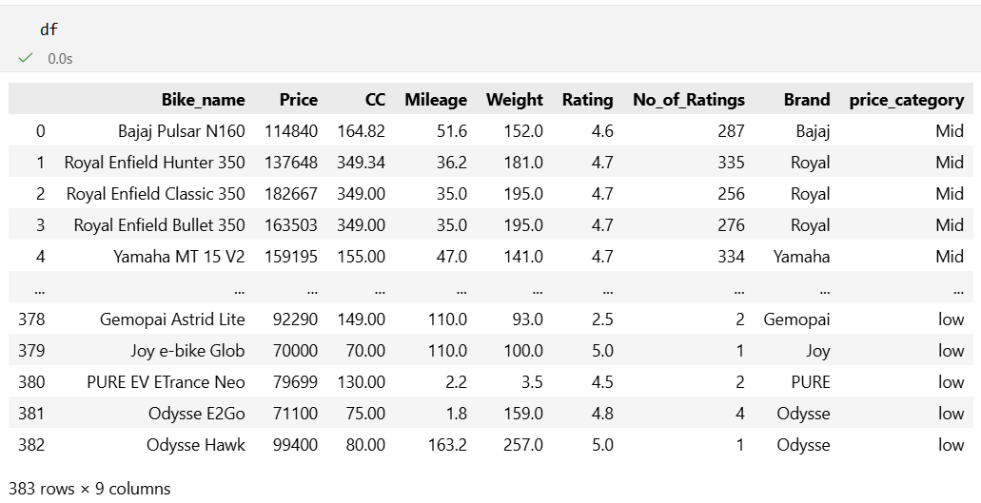
The final dataset:

Slide 13
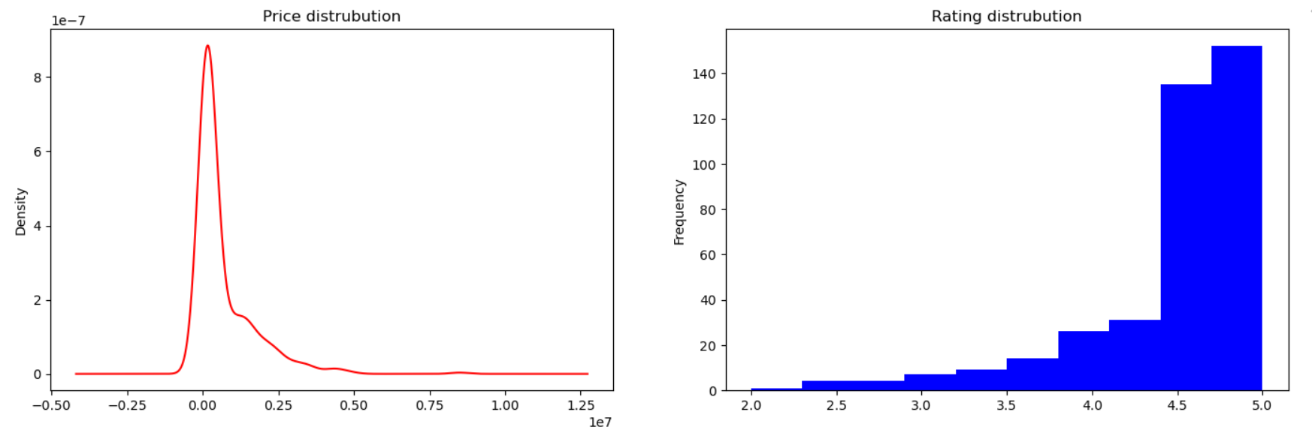
Data Analysis through Visualizations (Univariate Analysis)
1. Price Distribution (KDE)
Most cars are concentrated in the lower price range, while only a few cars have very high prices.
The long tail on the right side indicates some premium or luxury cars with very high prices.
2. Rating Distribution (Histogram)
Most ratings fall between 4.5 and 5.0, showing that many cars receive good customer feedback. There are very few ratings below 3, indicating that most vehicles are generally well-rated by users.

Slide 14
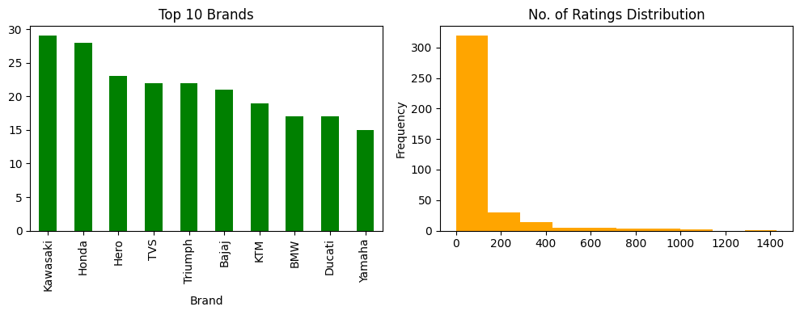
3. Top 10 Brands (Bar Chart)
Kawasaki and Honda have the highest number of models , indicating strong market presence or larger product variety.
Yamaha and Ducati have comparatively fewer models , showing lower counts, suggesting limited models in the dataset compared to other brands.
4. Number of Ratings Distribution (Histogram)
The majority of vehicles fall in the lower rating-count range, meaning most bikes receive fewer customer reviews.
The long right tail indicates some popular bikes receive a very large number of ratings.

Slide 15
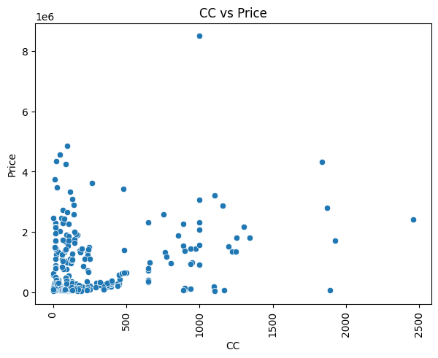
Bivariate Analysis- Numerical and Numerical
CC vs Price (Scatter Plot)
As engine capacity (CC) increases, the price of bikes tends to increase, showing a positive relationship.
Most bikes are concentrated in lower CC and lower price range
A large number of bikes fall between 100–400 CC with relatively lower prices, indicating this is the most common segment.

Slide 16
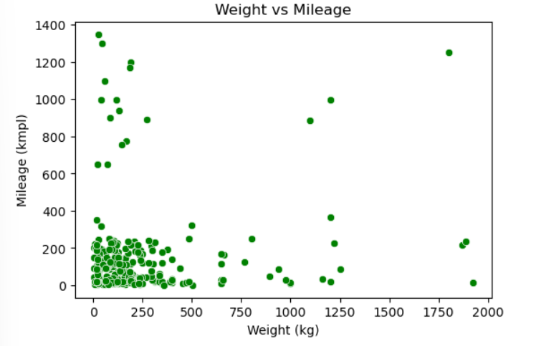
Bivariate Analysis- Numerical and Numerical
Weight vs Mileage (Scatter Plot)
Most bikes are concentrated in lower weight and moderate mileage range
The highest density of data points is around lower weights with mileage roughly between 40–80 kmpl.
No strong relationship between weight and mileage
Mileage values are spread across different weights, indicating vehicle weight does not strongly determine mileage in this dataset.

Slide 17
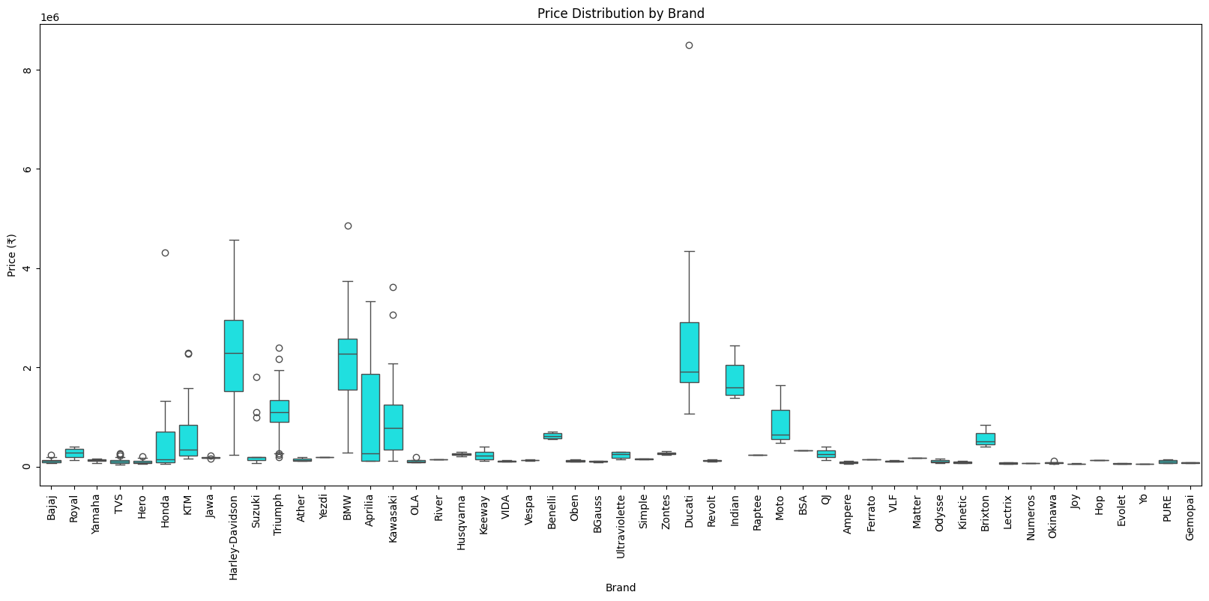
Bivariate Analysis- Numerical And Categorical
Price Distribution by Brand (Box Plot)
Premium brands have higher price ranges
- Brands like BMW, Harley Davidson, and Kawasaki show higher median prices, indicating they belong to the premium bike segment.
Some brands show large price variation
- Brands such as Kawasaki and BMW have wider box ranges and outliers, meaning they offer both mid-range and very expensive models.

Slide 18
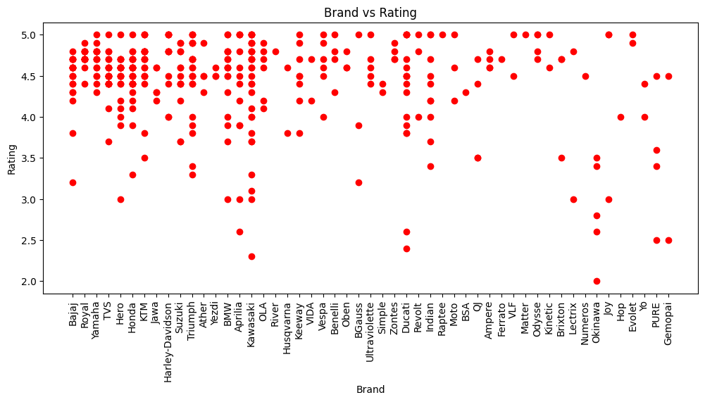
Brand vs Rating (Scatter Plot)
Most brands receive high ratings
- The majority of ratings are between 4 and 5, indicating that most bike brands are positively rated by customers.
Few brands have lower ratings
- Some points appear between 2 and 3.5 ratings, showing that a few models or brands receive comparatively lower customer satisfaction.

Slide 19
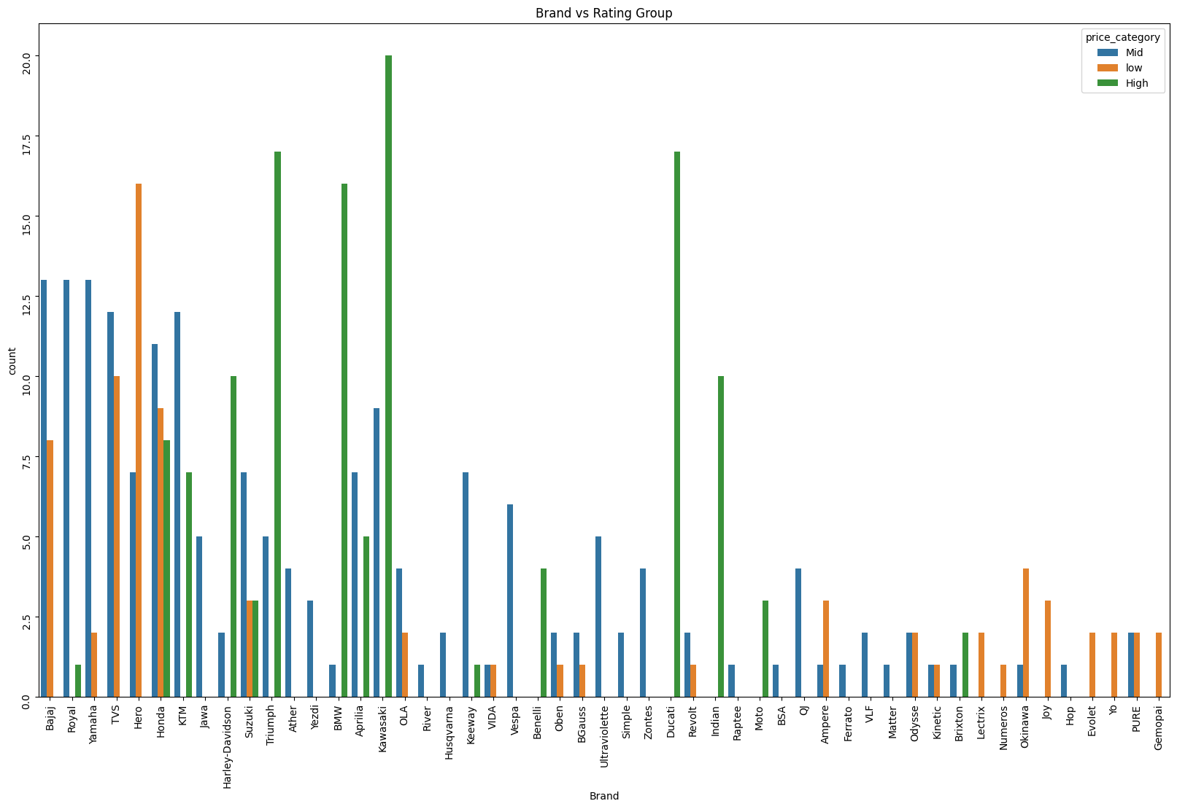
Bivariate Analysis-Categorical and Categorical
Brand vs Rating Group (Grouped Bar Chart)
High price category bikes appear more in premium brands
- Brands like Kawasaki, Ducati, and BMW show more bikes in the high price category, indicating their focus on premium segments.
Mid and low price categories dominate common brands
- Brands such as Bajaj, Honda, and TVS have more bikes in mid and low price categories, showing they mainly target the mass market segment.

Slide 20
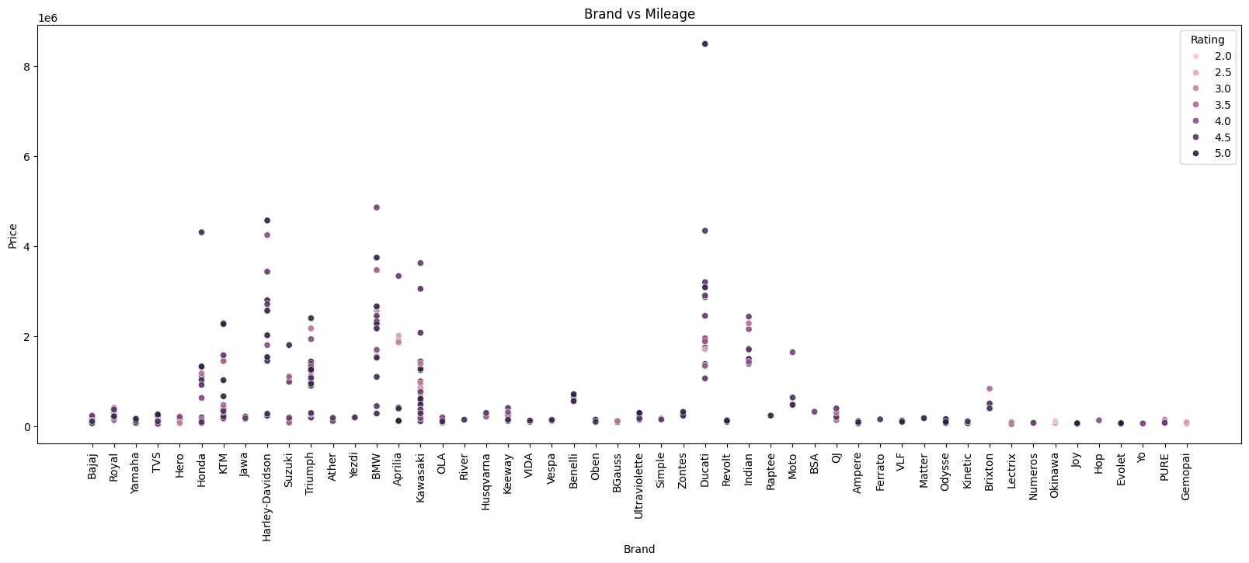
Multivariate Analysis
Brand vs Mileage (Scatter Plot)
Most bikes from common brands have moderate mileage
- Brands like Bajaj, Honda, TVS, and Hero show bikes clustered in the normal mileage range, indicating good fuel efficiency for regular users.
Premium brands tend to have lower mileage with higher prices
- Brands such as BMW, Ducati, and Kawasaki appear at higher price levels but relatively lower mileage, showing their focus on performance rather than fuel efficiency.

Slide 21
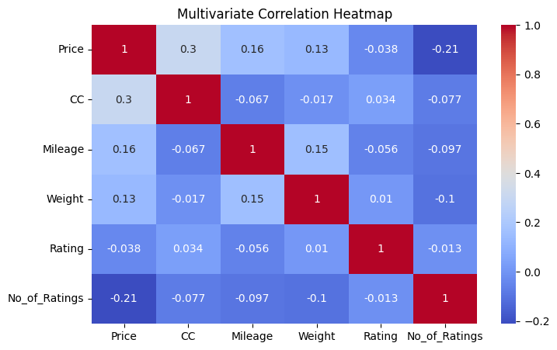
Engine Capacity Influences Price , like cars with larger engines tend to be more expensive.
The correlation between Price and Mileage is weak (0.16),suggests that fuel efficiency doesn’t affect the car price.
Customer Engagement is Higher for Lower-Priced Cars indicating that more affordable cars tend to receive more customer reviews.
customer ratings remain largely independent of technical specifications ,i.e customer mostly satisfies on user experience that on specifications.

Slide 22
Summary
Collected bike data from an online website using Python web scraping techniques.
Used libraries like Requests, BeautifulSoup, and Pandas to extract and store the data.
Cleaned and prepared the scraped data for analysis.
Performed Exploratory Data Analysis (EDA) to understand relationships between features like price, mileage, CC, and ratings.
Created different visualizations such as bar charts, scatter plots, heatmaps, and distribution plots.
Identified market trends, brand popularity, and customer rating patterns from the collected data.

Slide 23

Thank You

