Slide 1
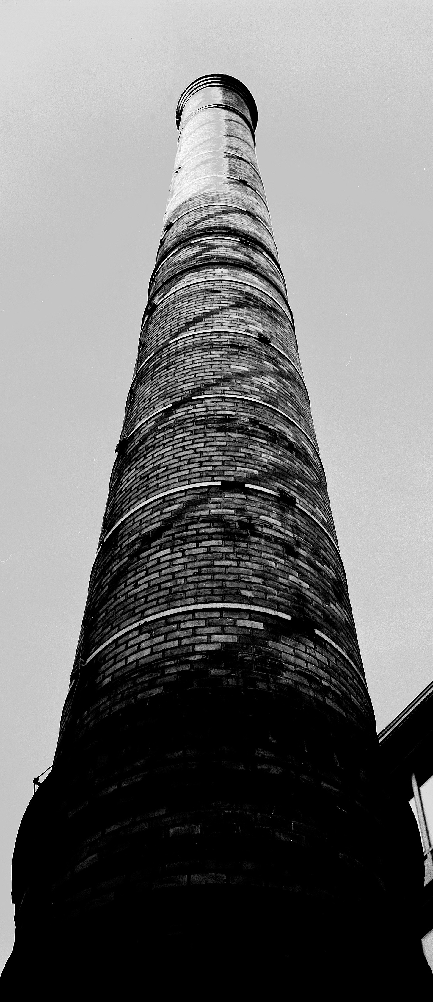
Question Type Classification
Sohail Pasha Anandham Akanksha Santhapuri Sai Srujana Anumalla Suchitha
Photo: Ronny Østnes / OsloMet

Slide 2
Table of contents
Objective
Methodology
Corpus Description
Input Features for models
Model Implementation
Statistical Methods
Experiments
Future Work and Conclusions
References
Question Type Classification

Slide 3
Objective
Our main objective is to identify and categorize a given telugu question or query into its corresponding domain category(NER) from a predefined domain category set.
This domain category set consists of eight category labels: Person, Date, Money, Number, Percentage, Location, Organization, Time
Question Type Classification

Slide 4
Methodology
We have gone through the following steps for Question Type classification
Data Preparation: We have differentiated queries and lables in the dataset given and combined them in dataframe with queries and tags as labels .
Feature Engineering: Then After we tranformed data in the dataframe into flat features which can be given as input for machine learning model and deep learning neural networks
Model Training: Machine learning models are trained on giving the features as input to them
Model Prediction: Given an unknown telugu question as input model predicts the answer type to that question.
Question Type Classification

Slide 5
Corpus Description
The Model is preprocessed by using the datasets that are provided by the organizers of IIITH.
Statistics: Using the preprocessed data, we performed some data analysis. The values shown in below table.
Category | Label | Number of questions
Number | NUMB | 438
Person | PERS | 321
Location | LOCA | 315
Date | DATE | 136
Money | MONE | 51
Percentage | PERC | 35
Organization | ORGA | 25
Time | TIME | 18
Question Type Classification

Slide 6
Input Features
Word Level TF-IDF : Matrix representing tf-idf scores of every term in different documents.
n-gram Level TF-IDF : N-grams are the combination of N terms together. This Matrix representing tf-idf scores of N-grams.
char Level TF-IDF : Matrix representing tf-idf scores of character level n-grams in the corpus.
Count Vectors : Matrix notation of terms and document frequency count of that corresponding terms.
Word Embeddings : Word embeddings can be trained using the input corpus itself or can be generated using pre-trained word embeddings such as Glove, FastText, Byte-Pair-Encoding embeddings.
We used FastText and Byte-Pair-Encoding pre-trained Telugu word Embeddings.
Question Type Classification

Slide 7
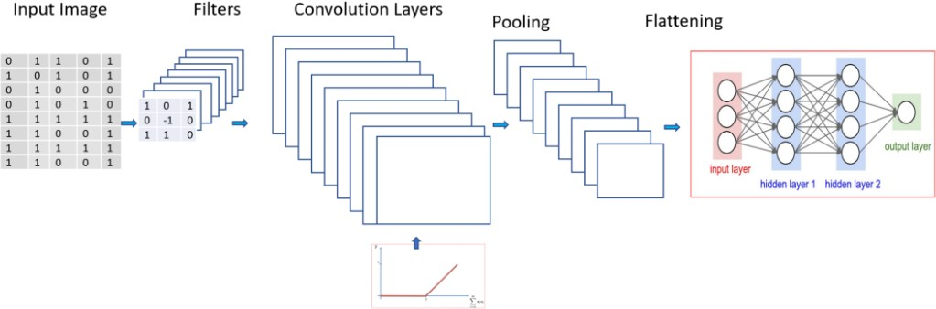
Model Implementation
For model implementation we have gone through Long Short Term Memory network, Convolutional Nueral Network mechanisms.
1.Convolutional Nueral Network(CNN): A CNN is composed of "convolutional" layers and downsampling or subsampling layers.
Question Type Classification

Slide 8
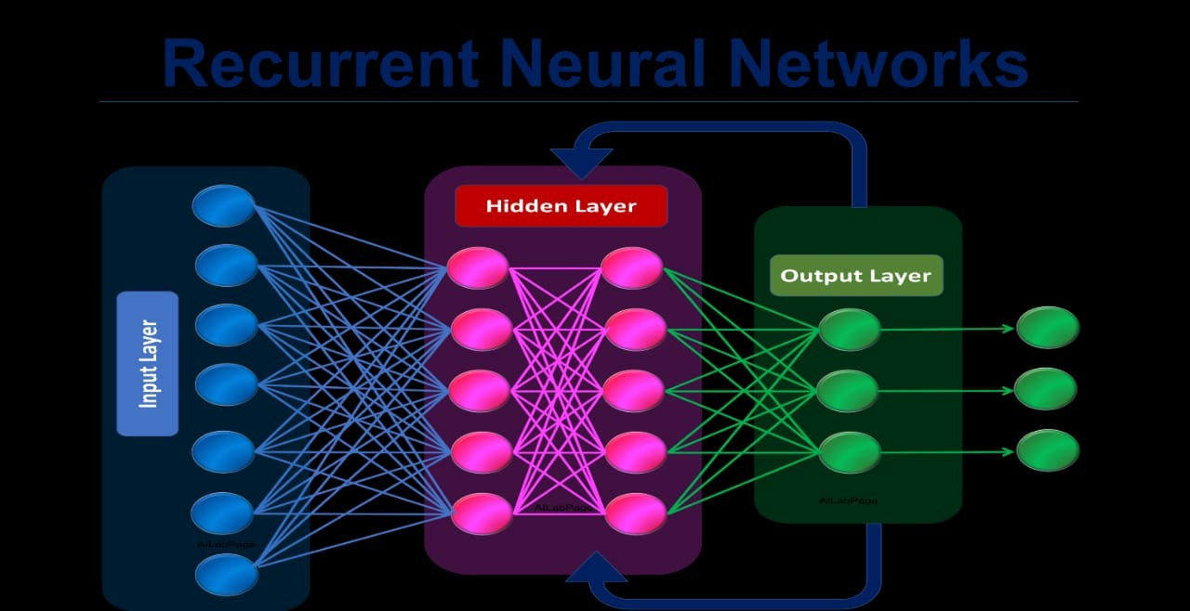
2.Recurrent Neural Network: RNNs are particularly useful if the prediction has to be at word-level, for instance, Named-entity recognition (NER) or Part of Speech (POS) tagging. As it stores the information for current feature as well neighboring features for prediction. A RNN maintains a memory based on history information, which enables the model to predict the current output conditioned on long distance features.
Figure: RNN
Question Type Classification

Slide 9
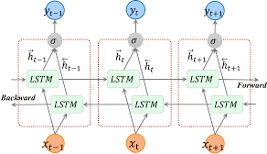
3.Bidirectional RNN: Bidirectional recurrent neural networks(RNN) are putting two independent RNNs together. The input sequence is fed in normal time order for one network, and in reverse time order for another.The outputs of the two networks are usually concatenated at each time step.
Figure: Bidirectional RNN
Question Type Classification

Slide 10
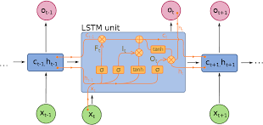
4.Long Short Term Memory network(LSTM) : It is a special kind of Recurrent Neural Network(RNN), they are capable of learning long-term dependencies.
Instead of having a single neural network layer, LSTMs have four interacting layers.
Figure: LSTM RNN
Question Type Classification

Slide 11
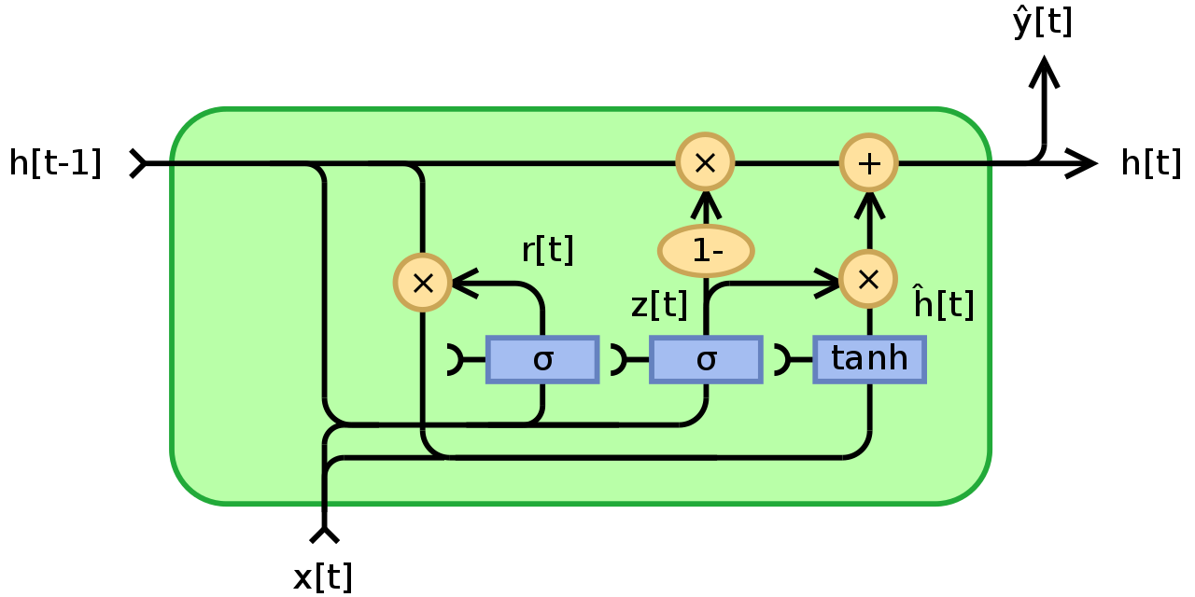
5.Gated Recurrent Unit: Unlike LSTM, GRU has only two gates, a reset gate and an update gate and they lack output gate. GRU’s got itself free of the cell state and instead uses the hidden state to transfer information.The basic work-flow of a Gated Recurrent Unit Network is similar to that of a basic Recurrent Neural Network when illustrated, the main difference between the two is in the internal working within each recurrent unit as Gated Recurrent Unit networks consist of gates which modulate the current input and the previous hidden state.
Figure: GRU
Question Type Classification

Slide 12
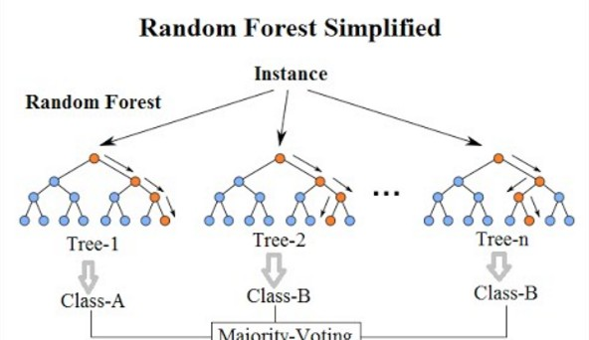
Statistical Methods
1.Random Forest: Random forest is a supervised machine learning algorithm that can be used for solving classification and regression problems both. However, mostly it is preferred for classification. It is named as a random forest because it combines multiple decision trees to create a “forest” and feed random features to them from the provided dataset. Instead of depending on an individual decision tree, the random forest takes prediction from all the trees and selects the best outcome through the voting process.
Question Type Classification

Slide 13
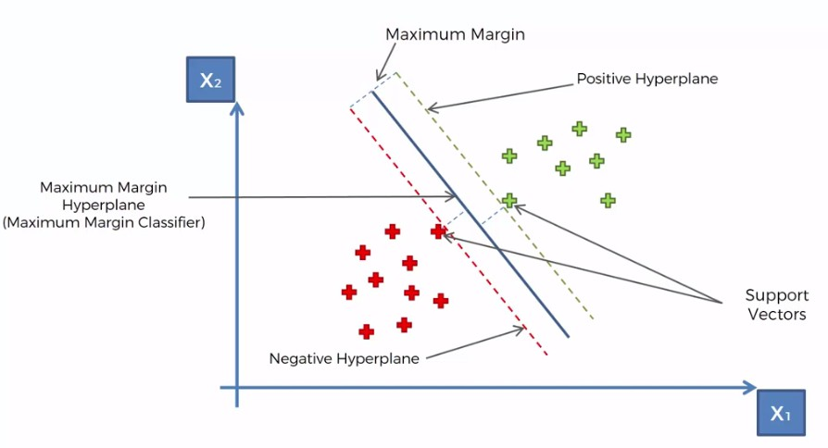
2.Support Vector Machine: SVM algorithm is a supervised learning algorithm categorized under Classification techniques. This hyperplane is used to classify new sets of data. The SVM algorithms are used to classify data in a 2-dimensional plane as well as a multidimensional hyperplane. It is always desired to have a maximum distinction between the classified data points. This means that they should have maximum distance.
Figure: SVM
Question Type Classification

Slide 14
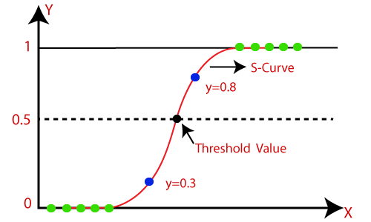
3.Logistic Regression: Logistic regression predicts the output of a categorical dependent variable. Therefore the outcome must be a categorical or discrete value. It can be either 0 or 1. but instead of giving the exact value as 0 and 1, it gives the probabilistic values which lie between 0 and 1.In Logistic regression, instead of fitting a regression line, we fit an "S" shaped logistic function, which predicts two maximum values (0 or 1).
Figure: LR
Question Type Classification

Slide 15
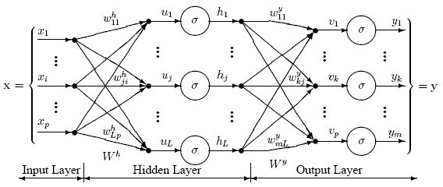
4.Multi-Layer Perceptron: The MultiLayer Perceptron (MLPs) breaks the restriction and classifies datasets which are not linearly separable. The Perceptron consists of an input layer and an output layer which are fully connected. MLPs have the same input and output layers but may have multiple hidden layers.
Figure: MLP
Question Type Classification

Slide 16
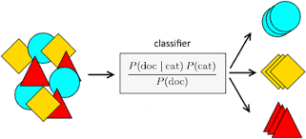
5.Naive Bayes: Naïve Bayes Classifier is a probabilistic classifier and is based on Bayes Theorem. It is primarily used for text classification which involves high dimensional training data sets. A few examples are spam filtration, sentimental analysis, and classifying news articles.
Figure: Naive bayes
Question Type Classification

Slide 17
BERT :
Bidirectional Encoder Representations from Transformers (BERT), it means, unlike most techniques that analyze sentences from left-to-right or
right-to-left.BERT goes in both directions using the Transformer encoder.
Its goal is to generate a language model. The bidirectional approach uses means, it gets more of the context for a word than if it were just training in one direction.
Since we use pre-trained model which is avilable in Trnasformers library in this BERT. It gives incredible accuracy and performance on smaller data sets even which solves a huge problem in natural language processing.
We Got 88 % accuracy using BERT
Question Type Classification

Slide 18
Experiments
Experiments: Experiments were done on the provided Telugu text, Which were primarily preprocessed, trained and then tested.
Preprocessing:
We pre-processed the questions by removing all the special characters, punctuations in Feature learning techniques and then splitted dataset into training and validation sets.
Model Training:
In model training, the preprocessed data is given as input.So we tarin all the classifiers using training set and test on validation set.
Question Type Classification

Slide 19
Results
2.Results: Adopted some statistical and Deep Neural Network models. We got accuracies in percentage as in table below
Models | WordLevel | N-gram | CharLevel | Count | FastText | BytePair
LR | 76 | 78 | 82 | 73 | - | -
SVM | 81 | 84 | 88 | 72 | - | -
MLP | 76 | 81 | 85 | 72 | - | -
NB | 74 | 74 | 78 | 74 | - | -
RF | 79 | 80 | 83 | 77 | - | -
CNN | - | - | - | - | 90 | 85
RNN LSTM | - | - | - | - | 88 | 86
RNN BI LSTM | - | - | - | - | 89 | 85
RNN GRU | - | - | - | - | 89 | 85
Table: Accuracies with different models
Question Type Classification

Slide 20
Future Work and Conclusions
Future Work :
In BERT model, we can use pre-trained model "XLM- Roberta" with which we can increase the performance of model.
It is a multilingual model trained on 100 different languages. It does not require tensors to understand which language is used. It can identify the language from input ids.
Conclusions: To predict the answer type of a given Telugu question we have
Implemented Staticals models LR, SVM, NB, MLP, RF.
Implemented Deep Neural Network models like CNN, RNN-LSTM, RNN-GRU, Bidirectional RNN and BERT.
Question Type Classification

Slide 21
References
Shivam Bansal. A comprehensive guide to understand and implement text classification in python. Analytics Vidhya, 2018.
Kadri Hacioglu and Wayne Ward. Question classification with support vector machines and error correcting codes. In Companion Volume of the Proceedings of HLT-NAACL 2003-Short Papers, pages 28–30, 2003.
Sunsan Li. Text classification with bert. https://github.com/susanli2016/NLP-with-Python
/blob/master/Text-Classification-With-BERT, 2016.
Priyanka Ravva, Ashok Urlana, and Manish Shrivastava. Avadhan: System for open-domain telugu question answering. In Proceedings of the 7th ACM IKDD CoDS and 25th COMAD, pages 234–238. 2020.
Question Type Classification

