Slide 1



COVID_19_Live
View in Power BI
Last data refresh:
6/22/2021 4:38:55 PM UTC
Downloaded at:
7/8/2021 10:10:54 AM UTC

Slide 2
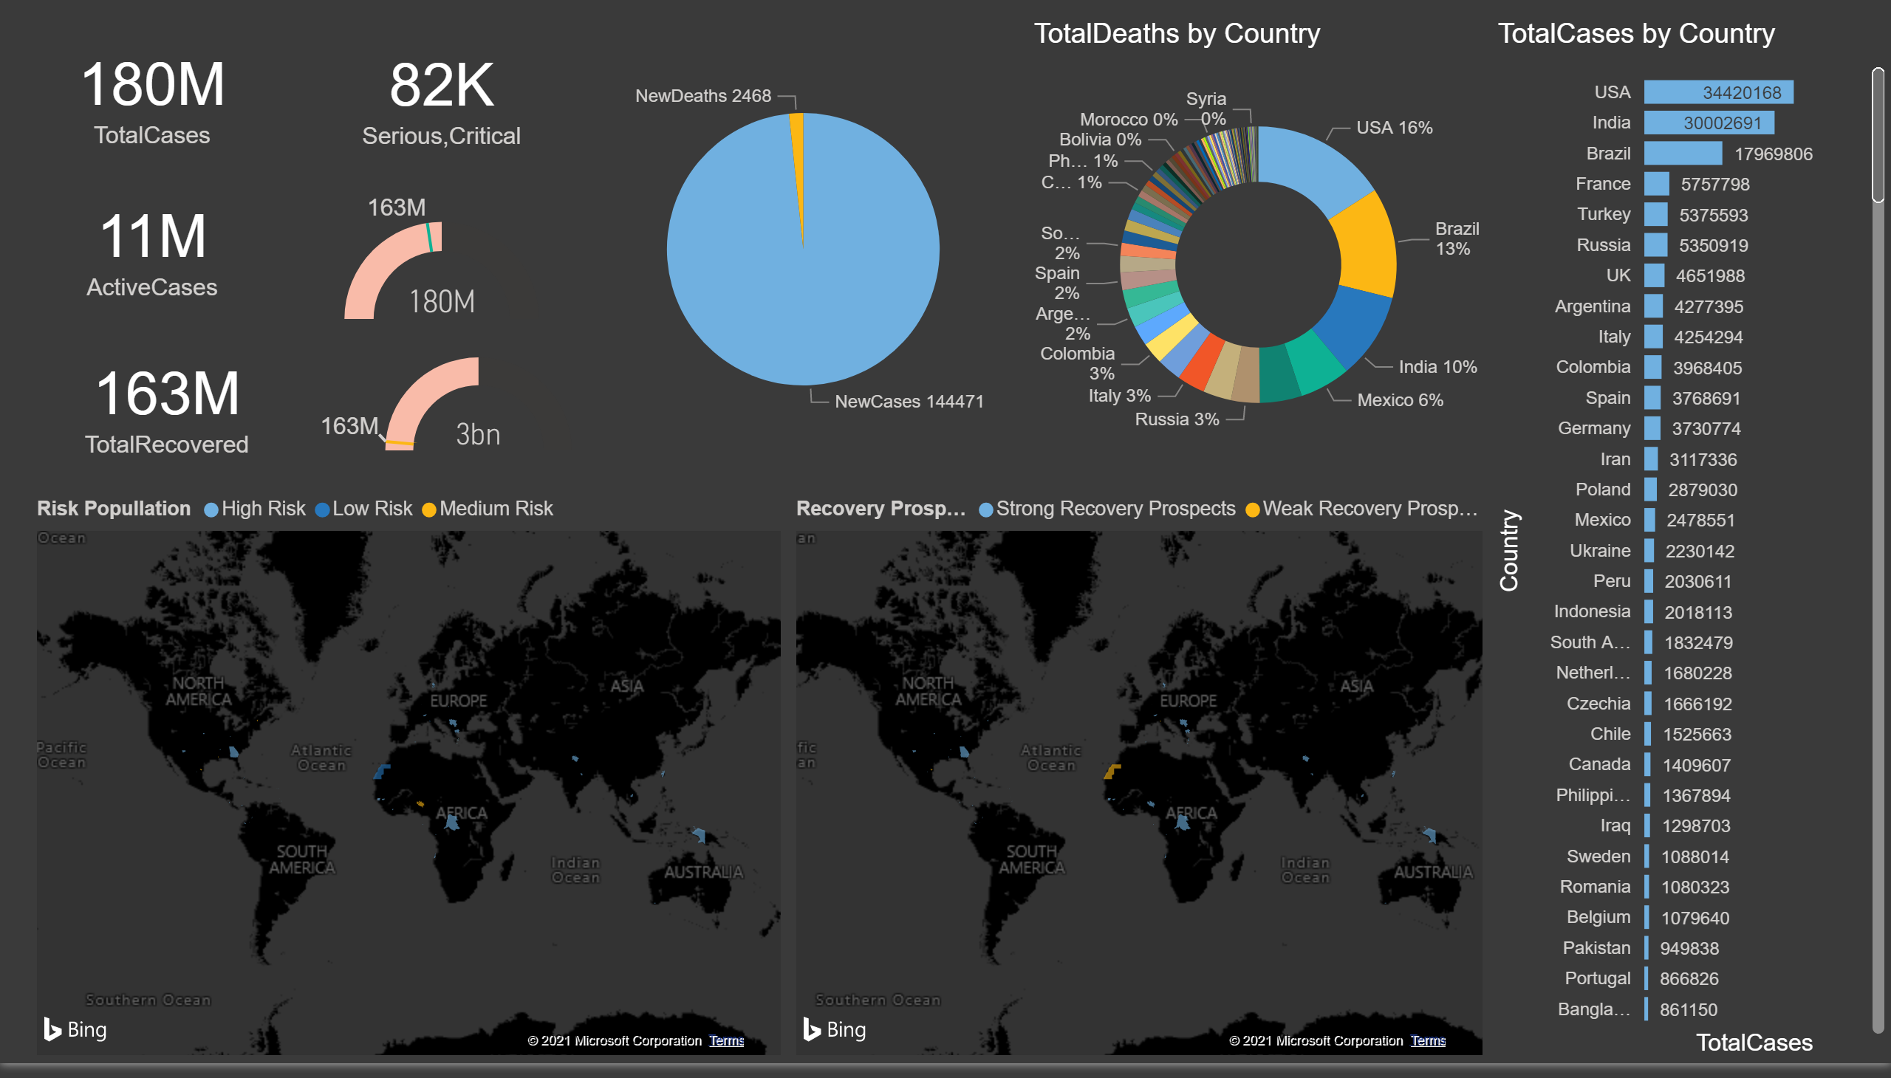
Page 1
Notes:
card
No alt text provided.
card
No alt text provided.
card
No alt text provided.
card
No alt text provided.
gauge
No alt text provided.
gauge
No alt text provided.
pieChart
No alt text provided.
donutChart
No alt text provided.
clusteredBarChart
No alt text provided.
filledMap
No alt text provided.
filledMap
No alt text provided.

