Slide 1
Computer Programming Introduction
Lecture – 1

Slide 2
Computer Basics
Computer systems consist of hardware and software
A set of instructions for the computer to carry out is called a program
All the different kinds of programs used to give instructions to the computer are collectively referred to as software

Slide 3
Hardware and Memory
The CPU, or central processing unit, or processor, performs the instructions in a program
Computer’s memory holds data for the computer to process
  It holds the result of the computer’s intermediate calculations
  A byte is the quantity of memory
    1 gigabyte of RAM is approximately 1 billion bytes of memory

Slide 4
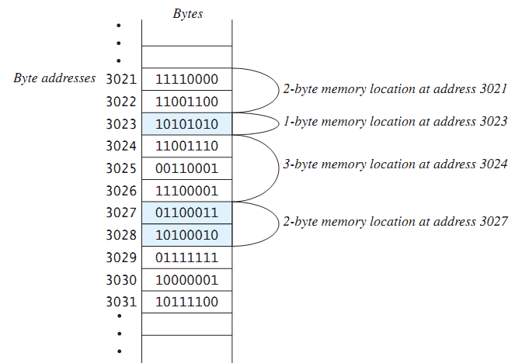
Hardware and Memory
Main memory consists of a long list of numbered bytes
The number of a byte is called its address
A byte is the smallest addressable
unit of memory
Data (numbers, letters and string of characters) is encoded as a series of 0s and 1s and placed in the computer’s memory

Slide 5
Programming Languages
Computer programs(software) are instructions that tell a computer what to do
Many programming languages
  All programs are converted into instructions that computer can execute
Types of Languages
  Machine Language
  Assembly Language
  High-Level Language
Example
To add Two Numbers:
1101101010011010
  add 2, 3, result
  result = 2 + 3

Slide 6
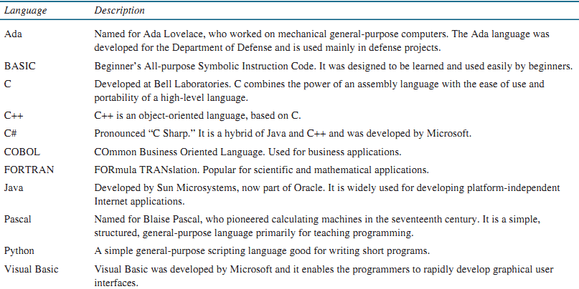

Slide 7
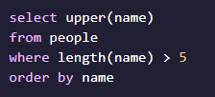
Programming Paradigm
A programming paradigm is a fundamental style of computer programming
Imperative in which the programmer instructs the machine how to change its state.
Examples: C, C++, Java, PHP, Python, Ruby etc.
Declarative the programmer states only what the result should look like, not how to obtain it. Example SQL, HTML , CSS
Notes:
HOW means describing the Inputs and describing how the Outputs are produced.

Slide 8
Programming Paradigm
Structured Programming
  Kind of imperative programming
  Control flow is defined by nested loops, conditionals, and subroutines
  Sequence, Selection and Repetition
x= 5;
y = 11;
z = x + y;
System.out.println(z);
if (x % 2 == 0)
{
System.out.println("The number is even.");
}
while(x < 100)
{
System.out.println(x);
x = x * x
}

Slide 9
Programming Paradigm
Object Oriented Programming (OOP)
  Object-oriented programming is about creating objects that contain both data and methods
  Classes and objects are the two main aspects of object-oriented programming
Examples: C++, C#, Java, Python.
Class | Object
Fruit | Apple, Banana, Mango
Car | Volvo, Audi, Toyota
Student | Ali, Hamza, Ahmad

Slide 10
Programming Paradigm
Example
public class Car {
String carReg;
int carModel;
String carClass;
public Car(String num) {
carReg = num;
}
public String getReg(){
return carReg;
}
public static void main(String[] args) {
Car Audi = new Car("AX-7865");
System.out.println(Audi.getReg());
}
}

Slide 11
Programming Paradigm
Functional Programming
  Basic method of computation is the application of functions to arguments
  Supports and encourages the functional style
  Examples of FP languages
    Lisp, Haskell, Python

