Slide 1
Lecture-2

Slide 2
Program Development

Slide 3
Programming: Plan First, Then Code
A good programmer will plan first and write second
  Breaking down a large programming task into several smaller tasks

Slide 4
Algorithm
Set of well-defined logical steps that must be taken to perform a task
For example, suppose you have been asked to write a program to calculate and display the gross pay for an hourly paid employee.
Here are the steps that you would take:
  1. Get the number of hours worked.
  2. Get the hourly pay rate.
  3. Multiply the number of hours worked by the hourly pay rate.
  4. Display the result of the calculation that was performed in Step 3.

Slide 5
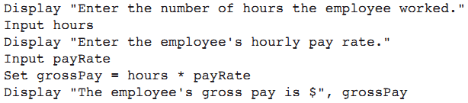
Pseudocode
Pseudocode: fake code
  Informal language that has no syntax rule
  Not meant to be compiled or executed
  Used to create model program
    No need to worry about syntax errors, can focus on program’s design
    Can be translated directly into actual code in any programming language

Slide 6
Flowcharts
Flowchart: diagram that graphically depicts the steps in a program
  Ovals are terminal symbols
  Parallelograms are input and output symbols
  Rectangles are processing symbols
  Symbols are connected by arrows that represent the flow of the program

Slide 7
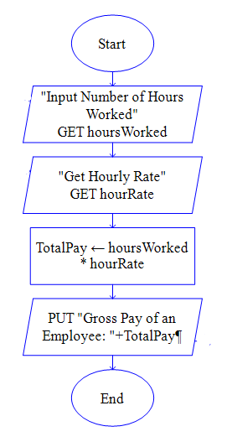
Flow Chart – Example

Slide 8
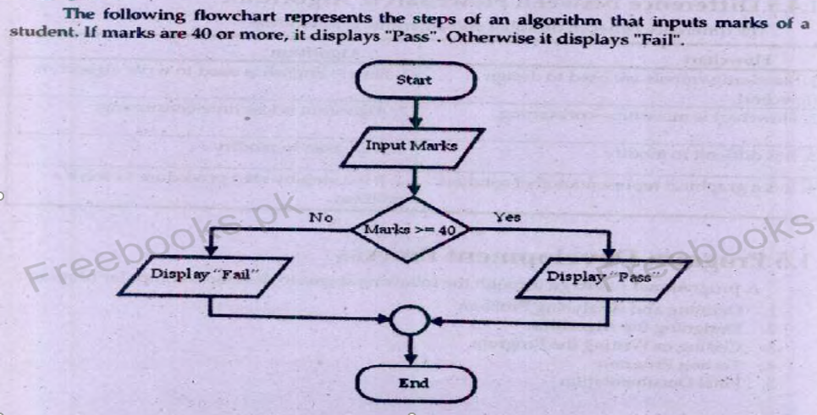

Slide 9
About Java
Java is a powerful and versatile programming language for developing software running on mobile devices, desktop computers, and servers
Developed by James Gosling in 1995
Popular because of write a program once and run it anywhere
Java is a programming language and a platform
Platform: Any hardware or software environment in which a program runs, is known as a platform. Since Java has a runtime environment (JRE) and API, it is called a platform.

Slide 10
Types of Java Applications
Four types of applications that can be created using Java programming
  Standalone Application
  Web Application
  Enterprise Application
  Mobile Application

Slide 11
JDK Editions
Java Standard Edition (Java SE)
Java Enterprise Edition (Java EE)
Java Micro Edition (Java ME)

Slide 12
JDK Versions
History of JDK version
  https://en.wikipedia.org/wiki/Java_version_history
Latest is Java SE 21[Java SE 21]
Download from:
  https://www.oracle.com/java/technologies/downloads/#jdk20-windows

Slide 13
Installing Java
To check if Java is installed (open command prompt and type following command)
java –version
Setting Java Path
  Temporary Path
    Open the command prompt
    Copy the path of the JDK/bin directory
    Write in command prompt: set path=copied_path
  Permanent Path using Environment Variables Settings

Slide 14
Popular Java IDEs
NetBeans
Eclipse
IntelliJ

Slide 15
JDK, JRE, and JVM
Java Virtual Machine (JVM)
  Provides a platform-independent way of executing Java source code
  JVM comes with JIT(Just-in-Time) compiler that converts Java source code into low-level machine language
Java Runtime Environment
  Set of software tools which are used for developing Java applications
  Contains JVM
  JRE = JVM + rt.jar (lang, util, awt, swing, math packages)
Java Development Tool kit (JDK)
  Software development environment which is used to develop Java applications

Slide 16
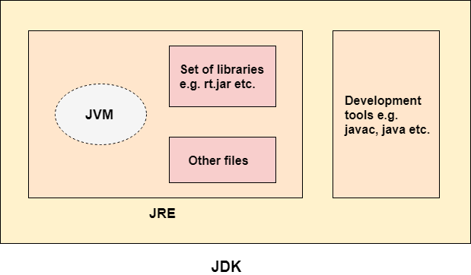
JDK, JRE, and JVM

Slide 17


Java Program Phases
Phase 1: Creating a Program
Phase 2: Compiling a Java Program into Bytecodes
  Bytecodes are re-executed by the JVM

Slide 18
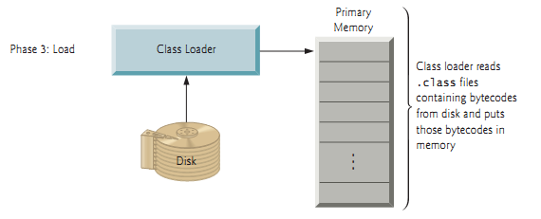
Java Program Phases
Phase 3: Loading a Program into Memory
  JVM class loader takes the .class file (along with associated class files provided by Java) and loads in memory

Slide 19
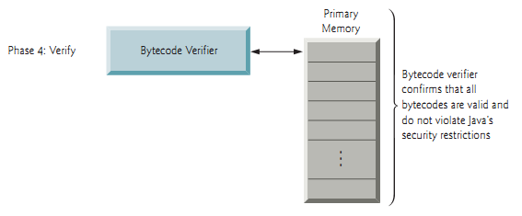
Java Program Phases
Phase 4: Bytecode Verification
  Java enforces strong security to make sure that Java programs arriving over the network do not damage your files or your system (as computer viruses and worms might).

Slide 20
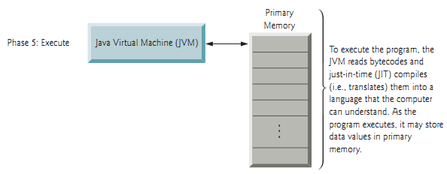
Java Program Phases
Phase 5: Execution
  Interpreter
    JVM execute bytecode using interpreter (one bytecode at a time) which slows execution
  Just In Time(JIT) Compiler
      Translates the bytecodes into the underlying computer’s machine language

Slide 21
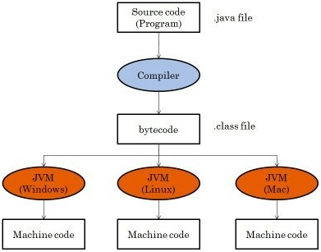

Slide 22
Interpreting/Compiling Source Code
A program written in a high-level language is called a source program or source code
A source program must be translated into machine code for execution

Slide 23
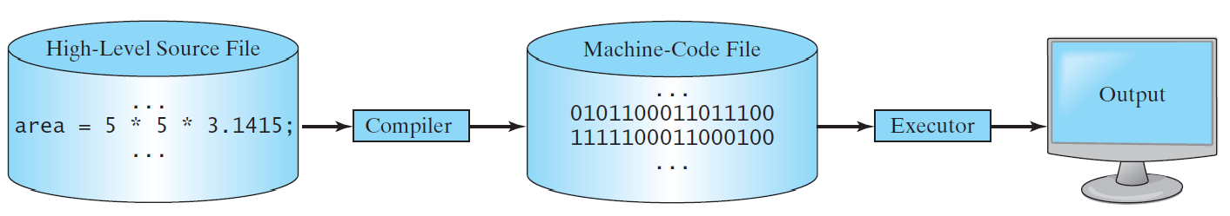
Compiling Source Code
A compiler translates the entire source code into a machine-code file, and the machine-code file is then executed

Slide 24
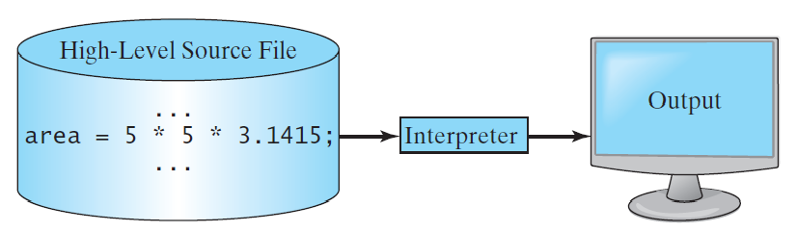
Interpreting Source Code
An interpreter reads one statement from the source code, translates it to the machine code or virtual machine code, and then executes it right away

Slide 25
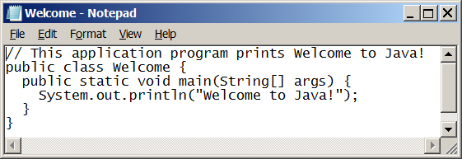
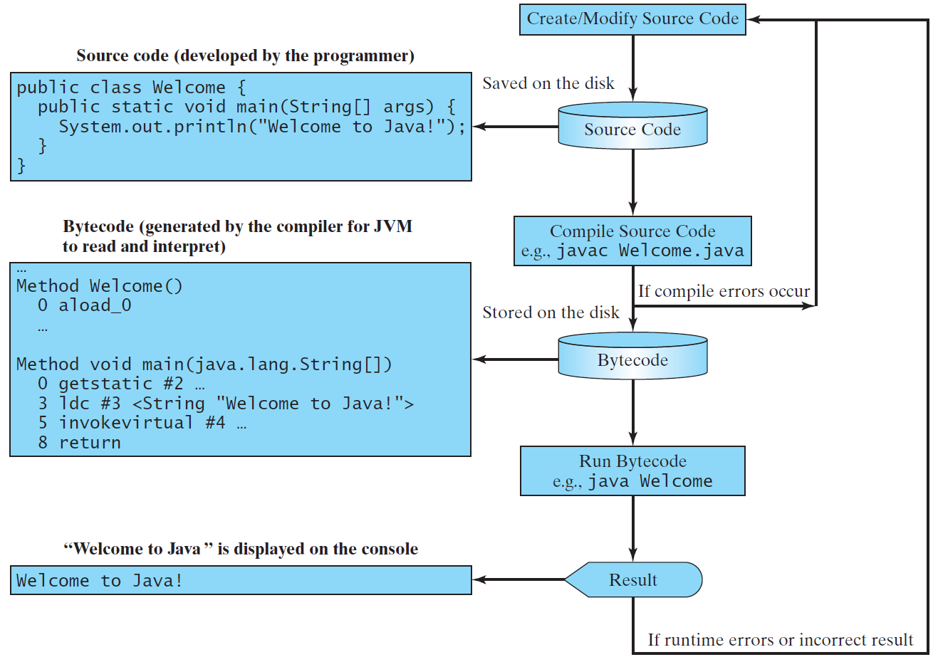
Creating, Compiling, and Running Programs

Slide 26
Types of Program Errors
Syntax Error
These are mistakes in the code structure, such as using incorrect syntax or forgetting to close a bracket. Syntax errors are usually caught by the compiler or interpreter, so they are easy to fix.
Logical Error
Logic errors are mistakes in the logic of the code, which can result in the program behaving unexpectedly or failing to produce the desired output.
For example, average = marks * 5;

Slide 27
Types of Program Errors
Run time error
Runtime errors are mistakes that occur while the program is running.
For example, anything divided by zero.

Slide 28
Common errors
Common Error 1: Missing Braces
Common Error 2: Missing Semicolons
Common Error 3: Missing Quotation Marks
Common Error 4: Misspelling Names(e.g. Main)

Slide 29
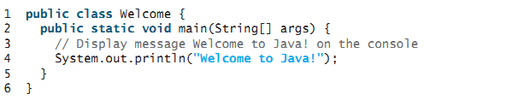
A Simple Java Program
Save this file as Welcome.java
To compile: | javac Welcome.java
To execute: | java Welcome

