Slide 1

Linkedin Job Analytics
Team Members -
Greeshma Tom | Aditya Malav | Md. Sohal Khan | Manish Hemnani

Slide 2

Content
INTRODUCTION
TABLE ATTRIBUTES
DASHBOARD
1
3
5
2
4
6
PRIMARY GOALS
TASK & ANALYSIS
USER INTERFACE

Slide 3


INTRODCUTION
LinkedIn is a professional social networking platform with over 700 million members. It provides a valuable source of data for professionals and Job market.
We are providing the job finding solution on the basis
of the skills.

Slide 4
PRIMARY GOALS
Scrapping the Data from website.
Sanitization of Data Using Python library Pandas.
Skills Extraction & Clustering task using M.L. (Pandas, Cluster).
Visualize Dataset to get different K.P.I. & Insights Using Python library pandas.
Creating U.I. using Python library Streamlit.
Dashboard for state wise analysis using Tableau.

Slide 5
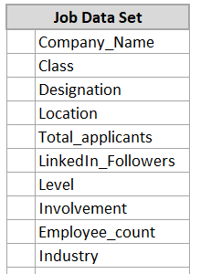
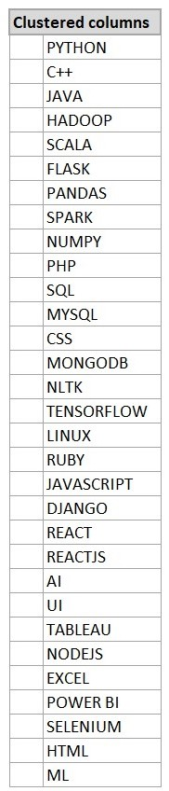
TABLE ATTRIBUTES

Slide 6
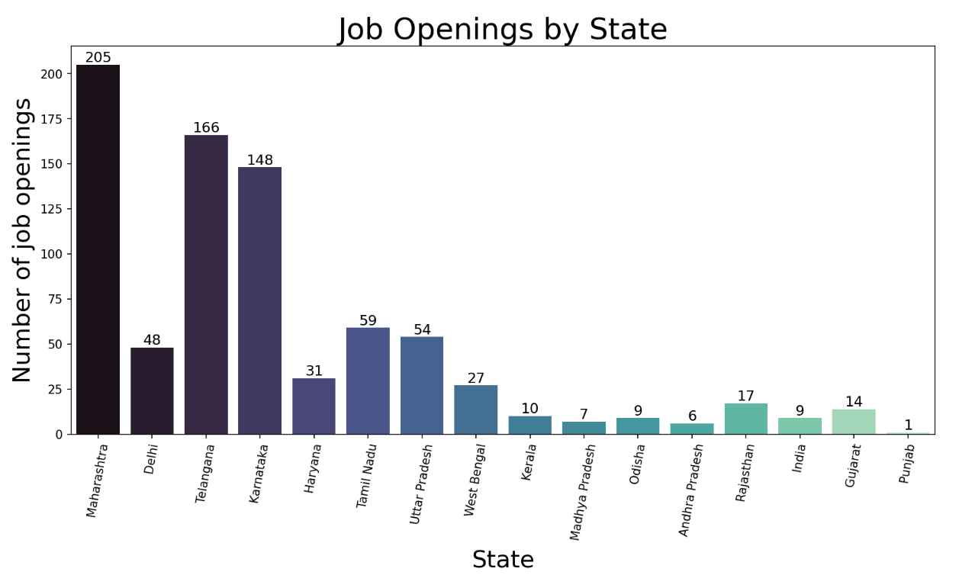
Job Opening By States

Slide 7
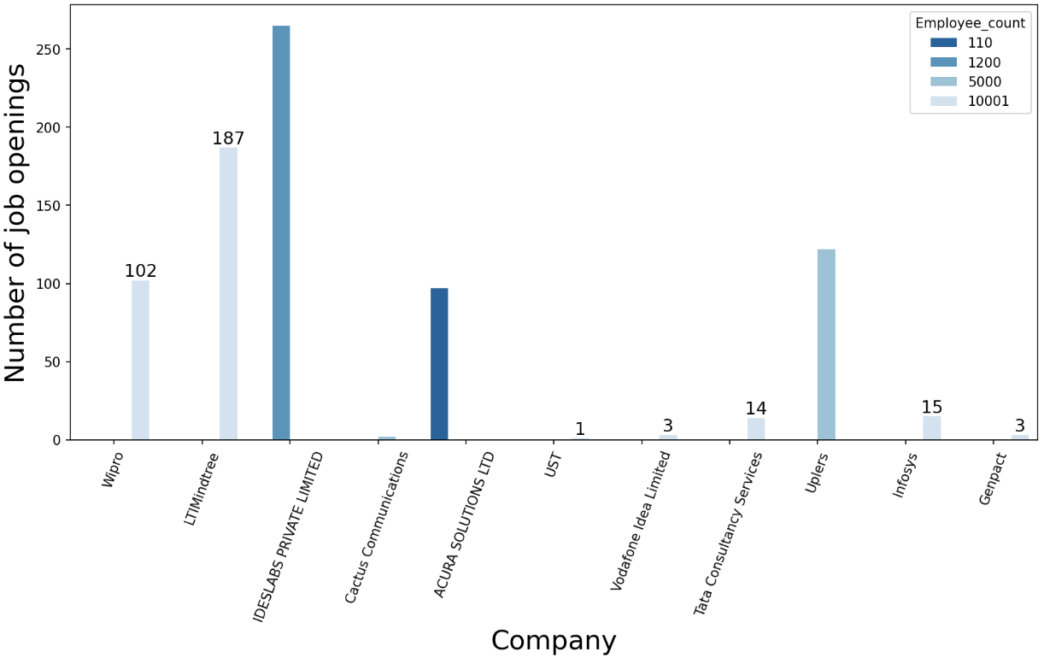
Job Opening By Company

Slide 8
Job Opening By Involvement Nature

Slide 9
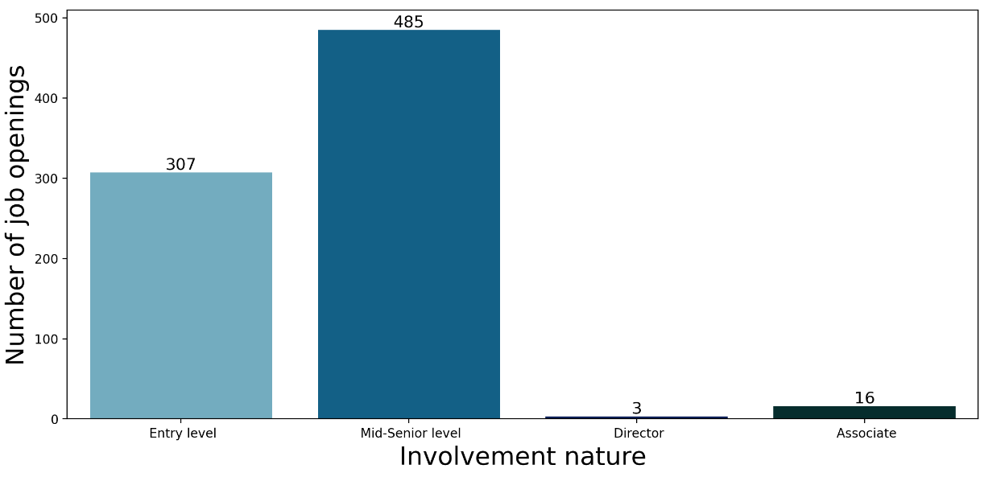
Job Openings At Different Levels

Slide 10
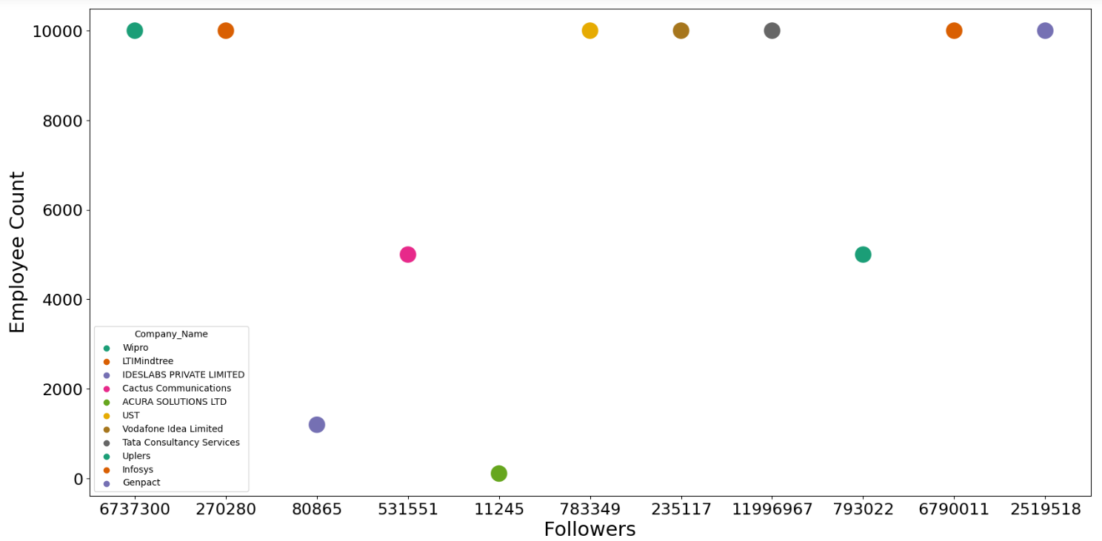
Relation Between Followers & Employee Count

Slide 11
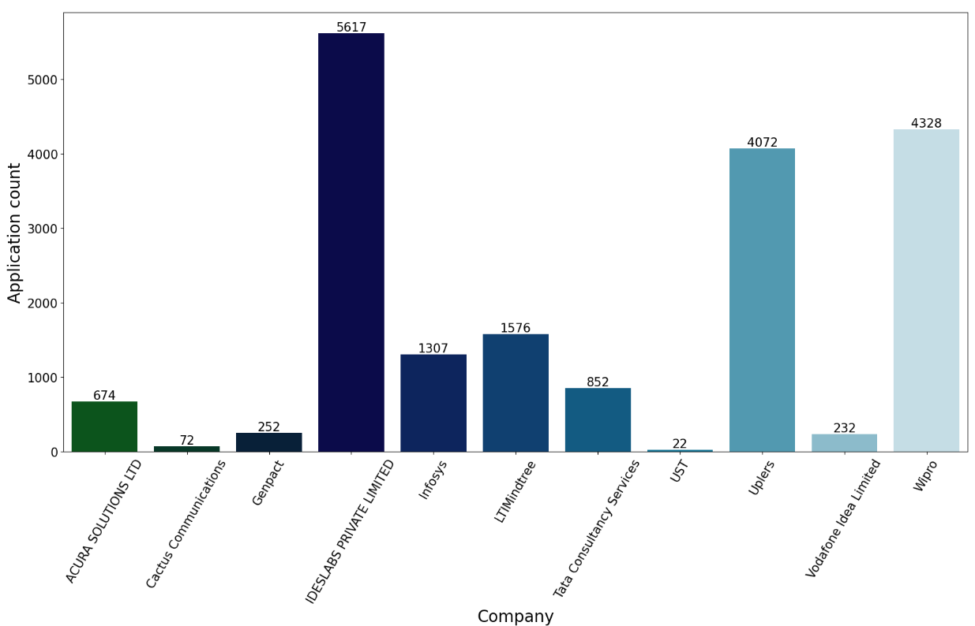
Total Applications Received By Each Company

Slide 12
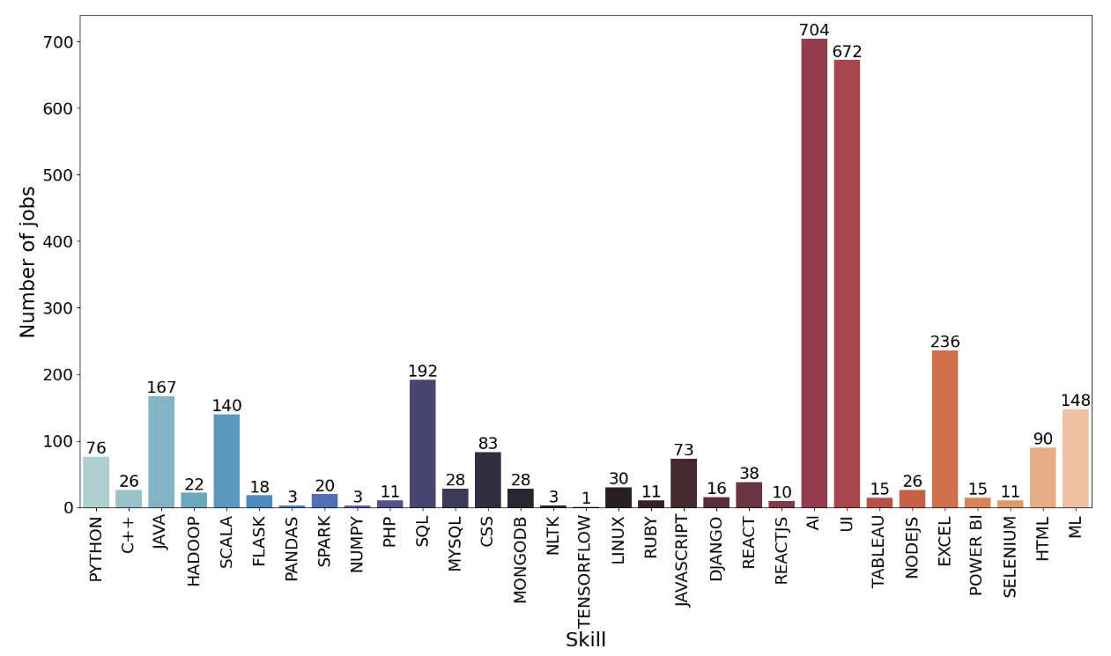
Jobs That Require Specific Particular Skill
Blue
Is the colour of the clear sky and the deep sea. It is located between violet and green on the optical spectrum.

Slide 13
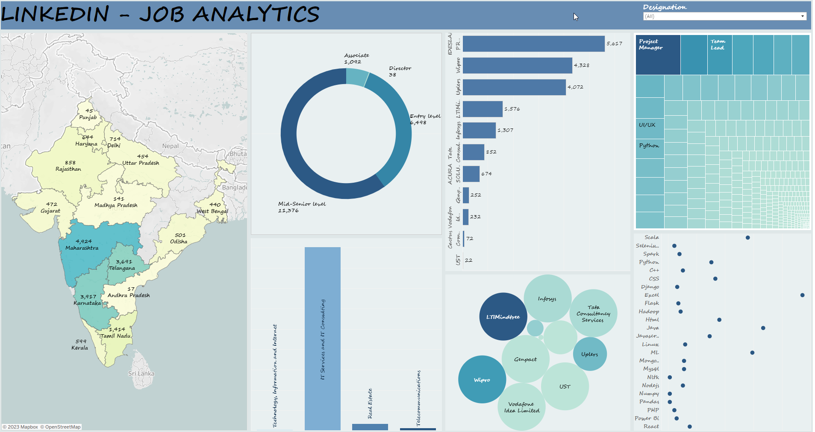
Dashboard

Slide 14
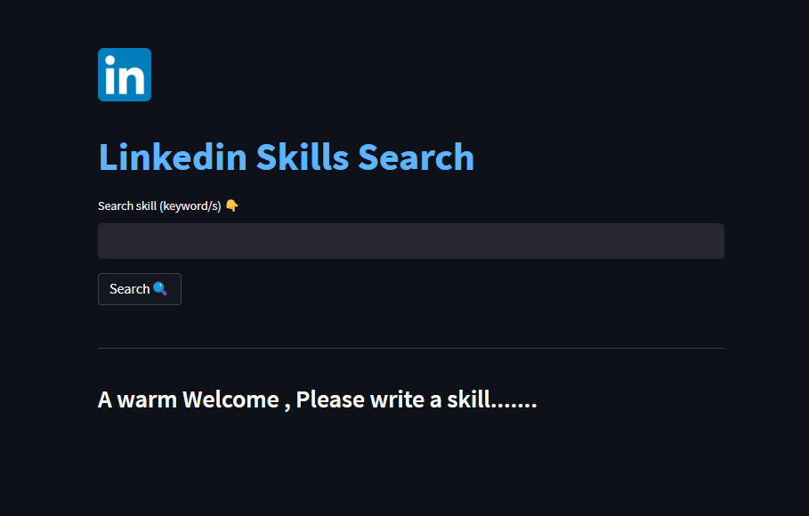
USER INTERFACE

Slide 15
CHALLENGES FACED
Scrapping LinkedIn which is a dynamic website.
Extracting Skills from Job description.
Creating Web based UI using Streamlit.
Efforts

Slide 16

Thank you
We are Open for Questions & Suggestions

