Slide 1
CNS ISE PROJECT — GROUP 5
Heuristic URL Feature Profiling for Phishing Domain Spotting Using Hyper-Tuned Random Forest Ensembles
• Model: Hyper-Tuned Random Forest (150 Trees, 30 Max Depth)
• Dataset: Kaggle 11,054 Phishing & Legitimate URLs (30 Features)
• Final Score: 97.42% Accuracy | 97.70% F1 | 61.5 μs Latency

Slide 2
CNS ISE — GROUP 5: RANDOM FOREST
The Real-World Problem: Why Phishing Still Fools People
• What is Phishing?: Fake websites built by attackers that look 100% like real banks, Google, or PayPal to steal passwords.
• Why Traditional Blacklists Fail: Companies like Google keep lists of bad websites, but attackers create new fake websites in minutes and kill them in 4 hours. By the time a site is added to a blacklist, thousands are already hacked.
• Our Goal (The Big Picture): Can we detect fake websites instantly just by looking at the URL itself — before a user even opens the page?
• Our Superpower (Group 5): We used Random Forest — an ensemble of 150 AI decision trees — to catch sneaky URL clues with 97.42% accuracy!

Slide 3
CNS ISE — GROUP 5: RANDOM FOREST
The 30 URL Clues We Analyzed (Without Opening the Page)
• Lexical & Address Clues: Does it use an IP address instead of a domain? Is the URL ridiculously long? Does it use @ symbol or // redirects?
• Suspicious Subdomains: Does it have 4 subdomains like 'paypal.com.verify-account.login-secure.xyz' to trick mobile users?
• SSL Certificate Checks: Is HTTPS legitimate, or is it a self-signed fake certificate with mismatched authority?
• Anchor & Link Behavior: Do the buttons and links on the page actually point back to the real site, or to an attacker's server?
• Domain Reputation: Is the domain brand new (created 3 days ago)? Does it have zero web traffic on Alexa?

Slide 4
CNS ISE — GROUP 5: RANDOM FOREST
How Random Forest Works (The 150 Detective Analogy)
• A Single Decision Tree is Like 1 Detective: One detective might make a mistake, have personal bias, or get tricked by an unusual clue.
• Random Forest is a Committee of 150 Detectives: We build 150 distinct trees. Each tree is trained on a different random subset of data (Bootstrap Sampling) and looks at different random clues (Subspace Projection).
• Democratic Majority Voting: When a URL arrives, all 150 trees vote: 'Phishing' or 'Safe'. If 140 say Phishing, the final verdict is Phishing! This completely removes individual mistakes.
• The Secret Weapon (OOB Score): Because each tree only saw ~63% of samples, the remaining 37% (Out-of-Bag) act as an instant self-test without needing a separate test set.

Slide 5
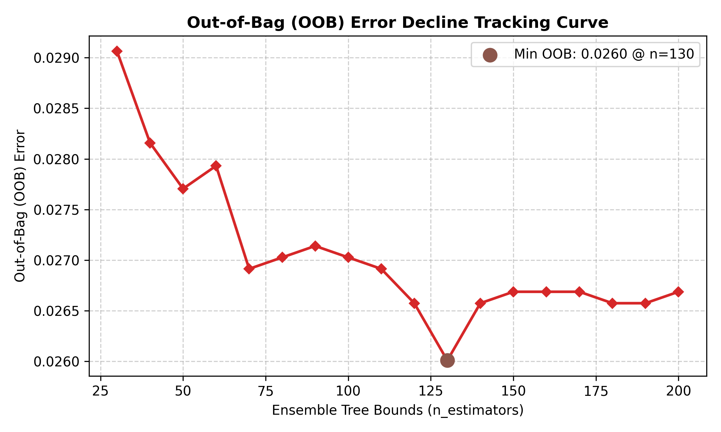
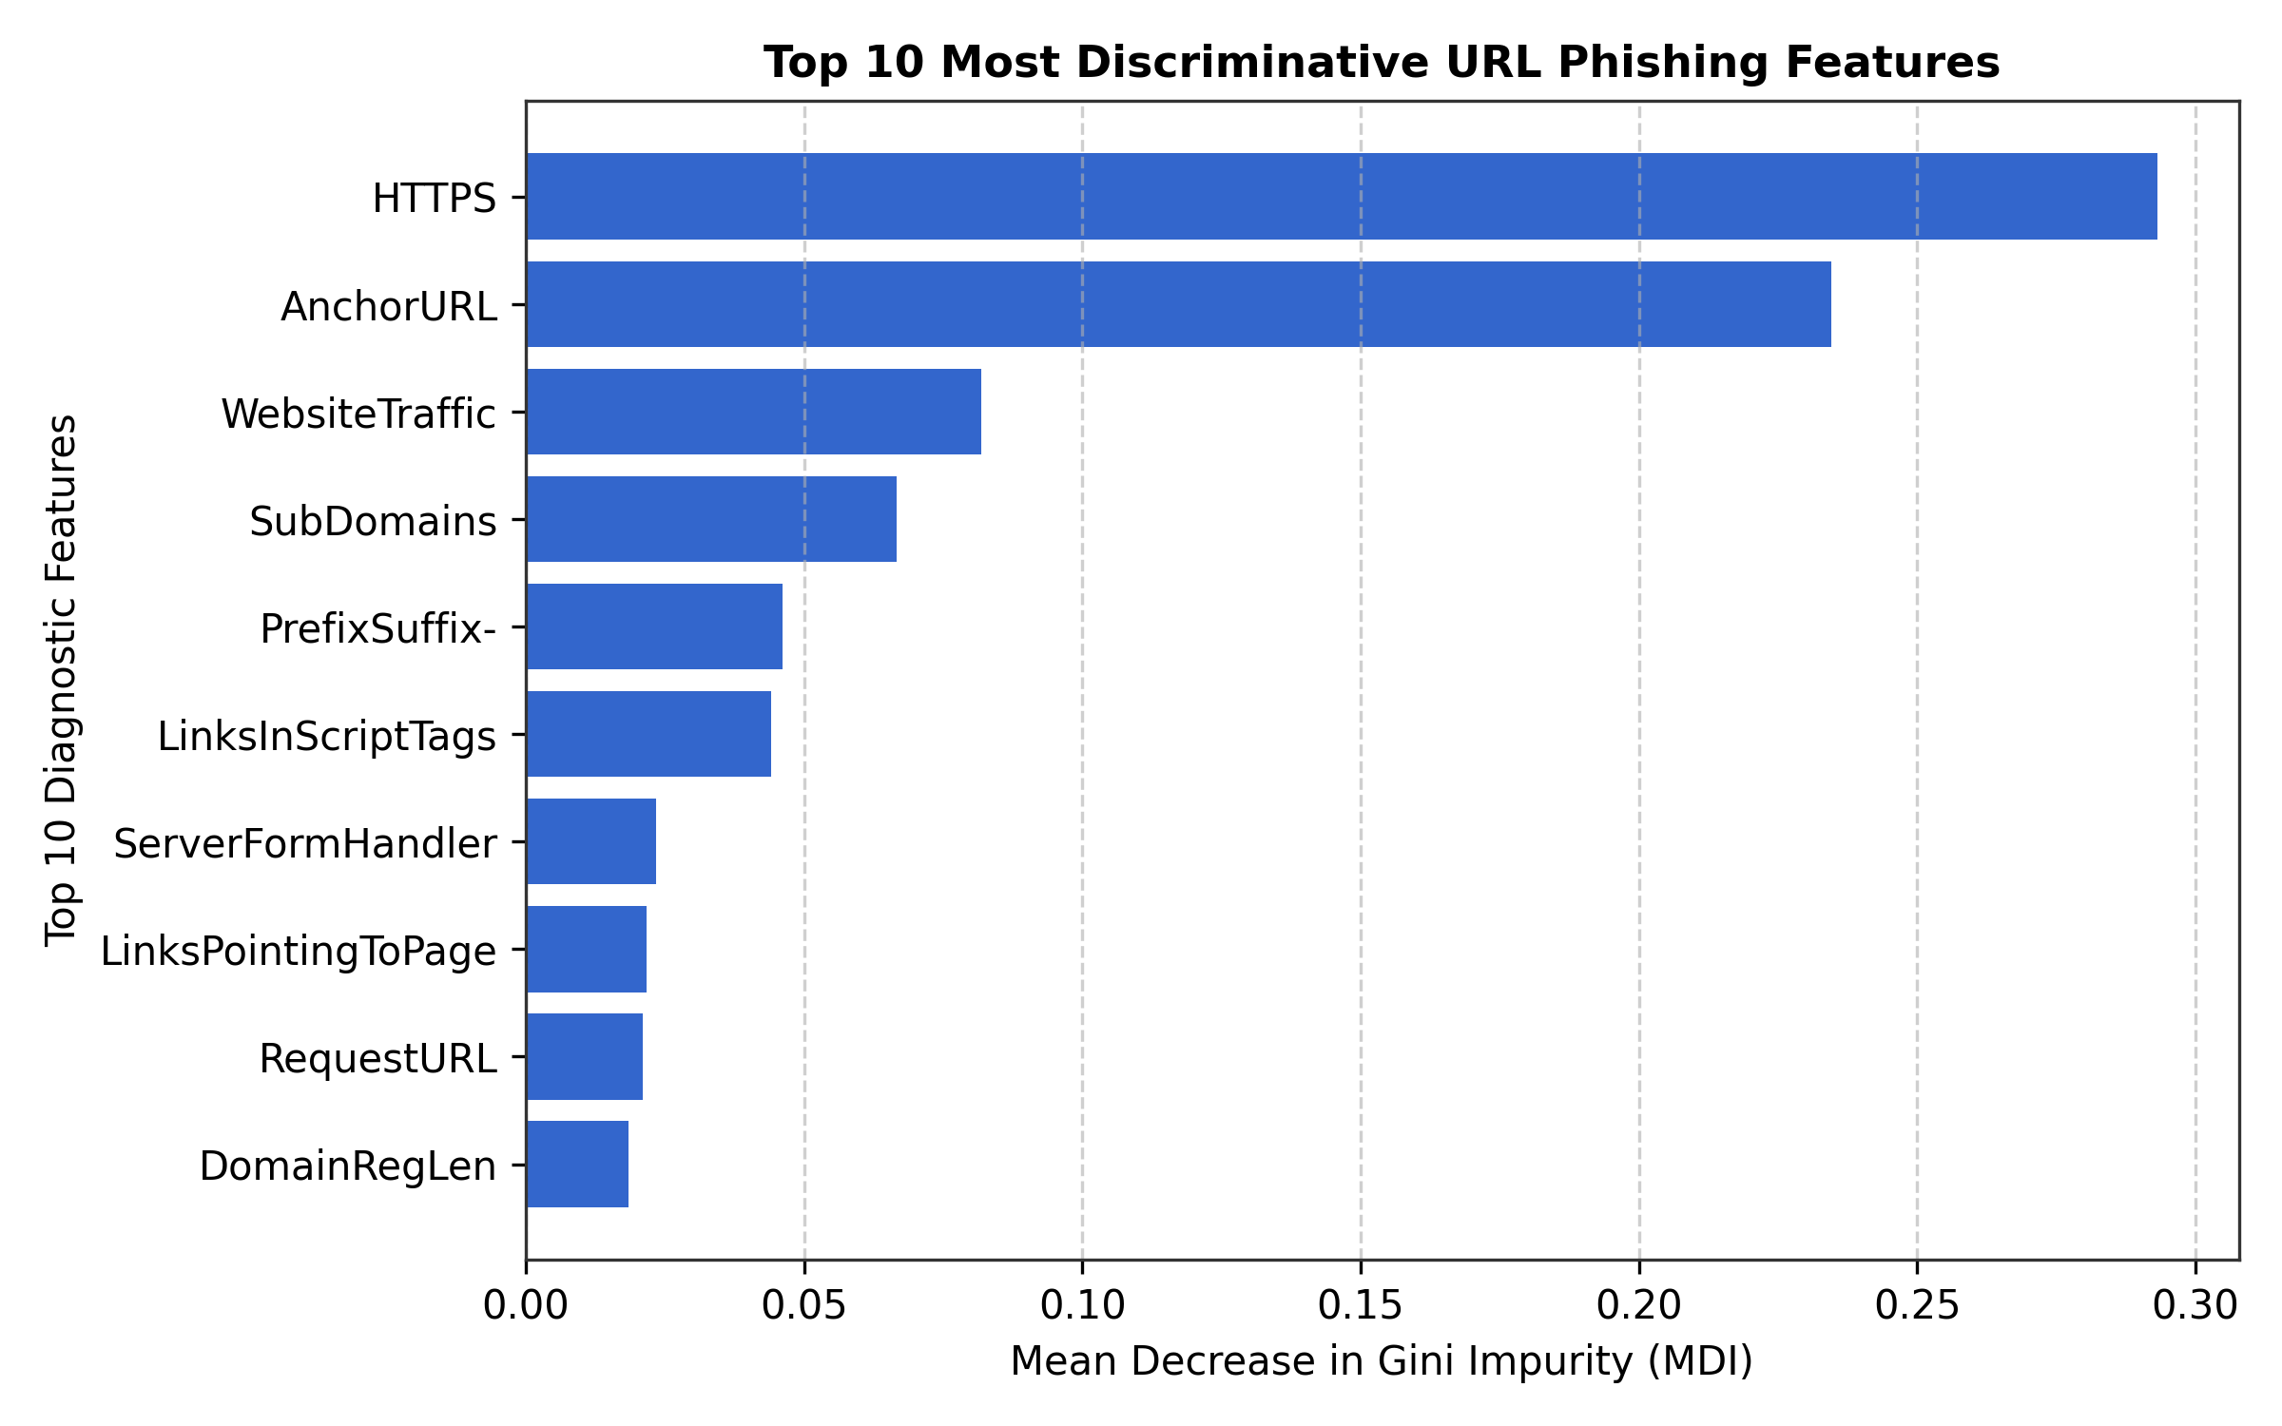
CNS ISE — GROUP 5: RANDOM FOREST
Out-of-Bag (OOB) Decline & Top Predictive Features
Left: As we added trees from 30 to 200, the error rate dropped steadily and stabilized at just 2.60% (97.40% OOB accuracy).
Right: The top 3 diagnostic clues: HTTPS/SSL validity (29.3%), Anchor URL tags (23.5%), and Web Traffic volume (8.2%).

Slide 6
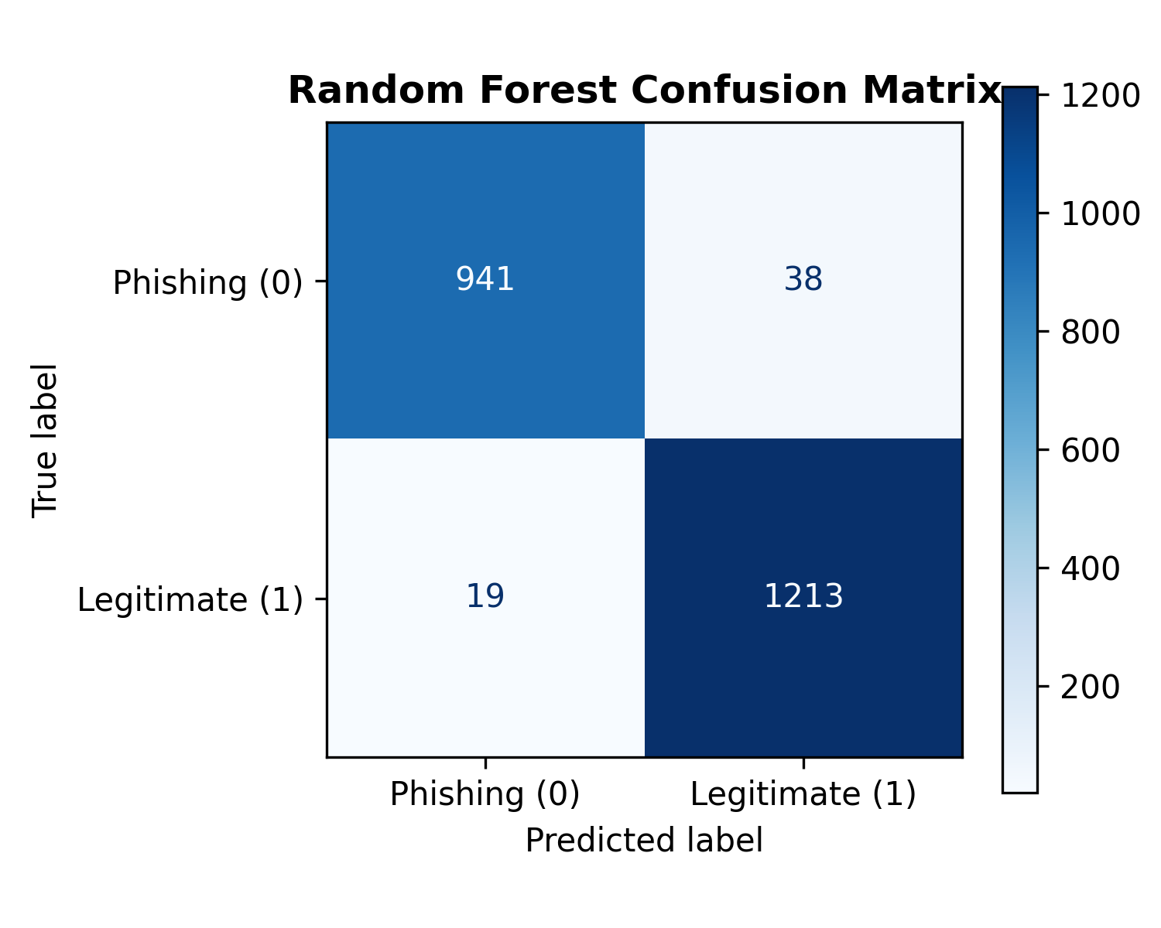
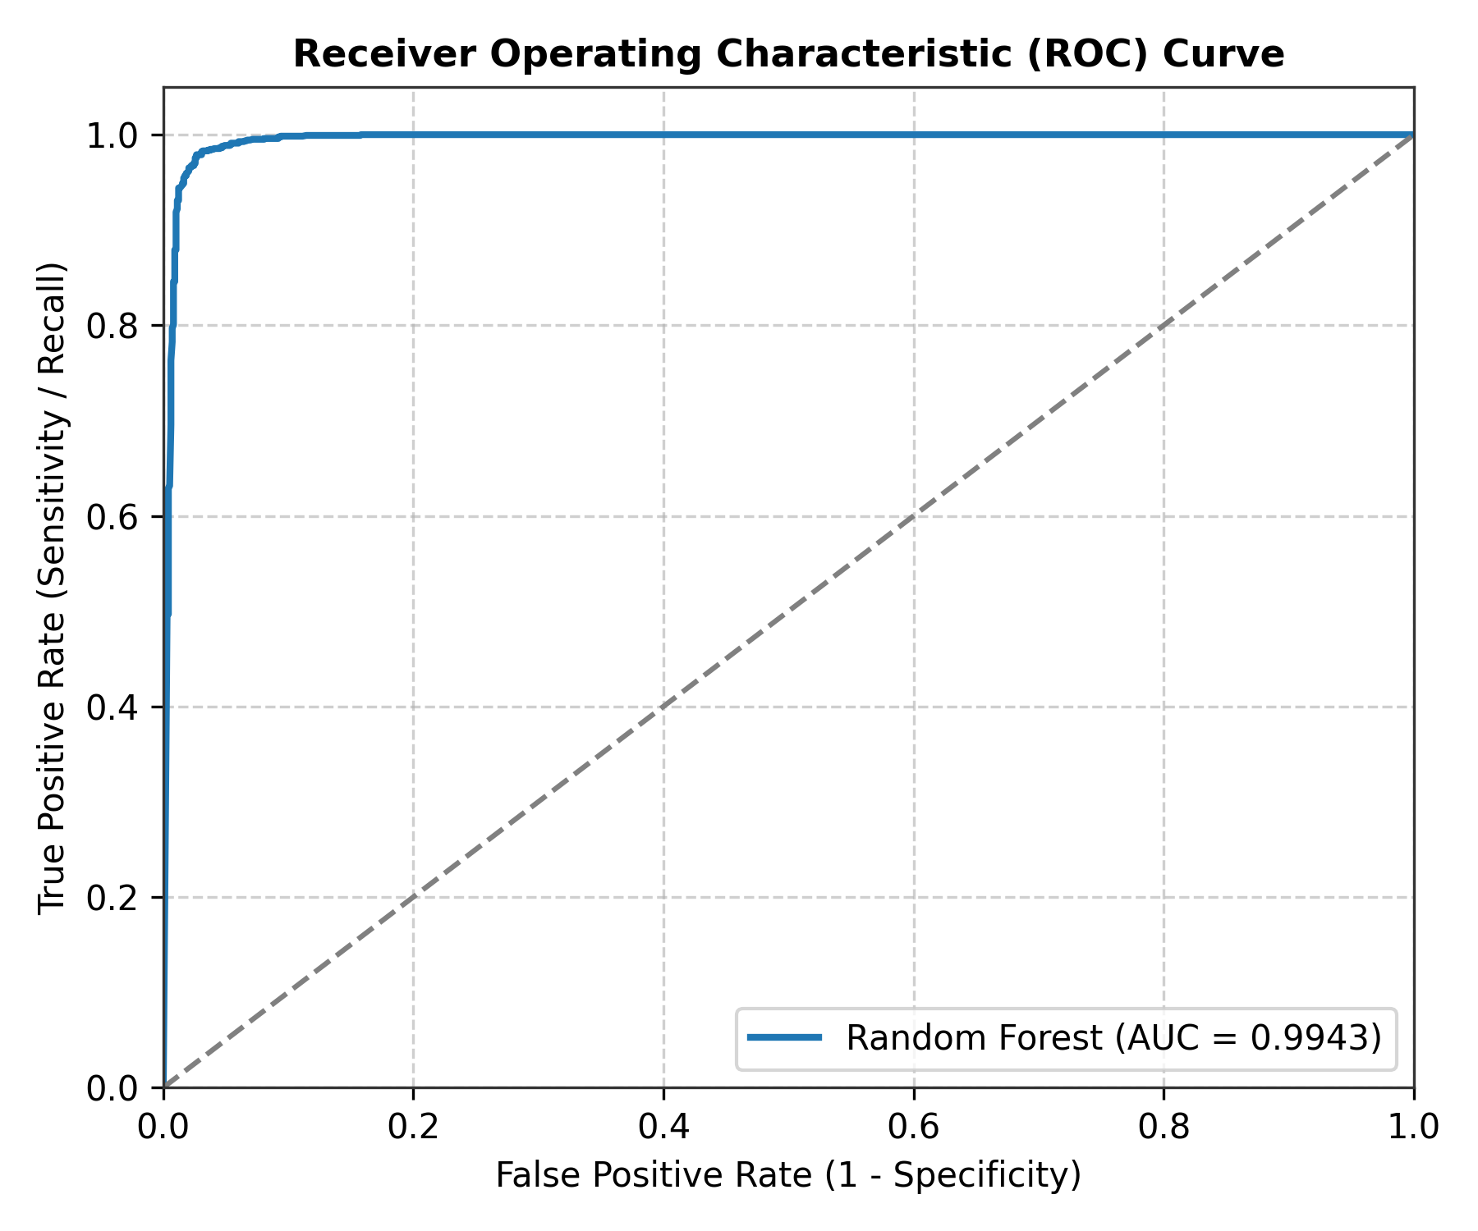
CNS ISE — GROUP 5: RANDOM FOREST
Champion Results: 97.42% Accuracy & 0.9943 ROC-AUC
Left: Confusion matrix on 2,211 test URLs — 1,213 safe sites and 941 phishing sites correctly caught with only 19 missed (98.46% Recall).
Right: ROC curve hugs the top-left corner with an AUC of 0.9943, proving near-perfect separation power.

Slide 7
CNS ISE — GROUP 5: RANDOM FOREST
Blazing Speed: Ready for Real-Time Edge Deployment
• Training Speed: Trained 150 deep decision trees across 8,843 training URLs in just 0.9793 seconds!
• Ultra-Low Latency: Classifying a single URL takes only 61.51 microseconds (0.0000615 seconds).
• Real-World Throughput: A standard single-core CPU can process over 16,000 URLs per second in real time.
• Handover to Group 1 (Section 5.2): We exported all timing metrics into CSV and text summaries for Group 1's hardware latency report.

Slide 8
CNS ISE — GROUP 5: RANDOM FOREST
CNS ISE Teamwork: Handover Packets for Groups 1 to 4
• To Group 1 (Latency Lead): Handed over training speed (0.98s) and single-sample latency (61.5 μs) for Section 5.2.
• To Group 2 (Data Lead): Confirmed schema: 30 features, 80/20 stratified split, zero null values, target mapped for Section 3.1.
• To Group 3 (Tournament Lead): Handed over Accuracy (97.42%), F1 (97.70%), Precision (96.96%), and Confusion Matrix for Section 5.1.
• To Group 4 (System Setup Lead): Handed over exact Python 3.10.11, Scikit-learn 1.7.2, and Windows environment specs for Section 4.

Slide 9
CNS ISE — GROUP 5: RANDOM FOREST
Conclusion & What Comes Next (Section 6)
• Key Takeaway: Hyper-tuned Random Forest delivers world-class phishing detection without needing to download malware payloads.
• Real-World Browser Extension: Our model is lightweight enough to be compiled into WebAssembly or ONNX and put directly inside Chrome/Brave.
• Next Steps (Explainable AI): Add TreeSHAP so users can see exactly why a link was blocked (e.g. 'Blocked because SSL is fake and anchor tags point to unknown IP').
• Continuous Learning: Hook the model to live security feeds (PhishTank) to automatically adapt to new tricks every week.

Slide 10
Thank You! Any Questions?
CNS ISE — Group 5 Research Consortium
Accuracy: 97.42% | Latency: 61.5 μs | Model: Random Forest Ensemble

