Slide 1


HYPER-LOCAL
DEMAND
FORECASTING
DATA SCIENCE PROJECT
SYSTEM
Presented by:
Soham Haridas Gaikwad
Yash Fangal
Aditya Gode
Using Machine Learning & Time Series Models
Course:
Data Science with Python(PDS)
2 Years
R² 0.85
MAE ~7
College:
Sardar Patel Institute Of Techonology
Training Data
Model Accuracy
Best Error
[06 May 2026]
Notes:
1

Slide 2
Problem Statement
❌ Stockouts
📦 Overstock
📊 No Forecasting Tool
Products run out unexpectedly ,
customers leave, revenue is lost
Excess inventory ties up capital and leads to wastage & spoilage
Small kirana owners lack access to demand prediction unlike big retailers
💡 Goal:
Predict daily product demand accurately so small retailers can manage stock better, avoid losses, and make data-driven decisions.
Why It Matters
🔵 Big retailers (Walmart, Amazon) already use sophisticated demand forecasting
🔵 Small kirana shops have zero access to such tools — huge market gap
🔵 Accurate forecasting = reduced waste + higher profit + better planning
Notes:
2

Slide 3
Dataset Overview
~660
Daily
70+
60
Days of data
Granularity
Features created
Test days
2022 – 2024
Time series
After engineering
Last 10%
🛠 Features Used
🎯 Target & Context
Lag features: lag_1, lag_7, lag_14, lag_28
Rolling stats: mean, min, max (7/10/21/28 days)
EWM (exponential weighted mean): ewm_5, ewm_7, ewm_14
Momentum features: mom_1, mom_7, mom_14
Date features: day, week, month, day-of-week
Cyclical encoding (sin/cos) of day & month
Season flags: Winter, Summer, Monsoon
External: avg_price, price_chg, promotion_count
avg_econ (economic index)
Holiday / festival indicator
Target Variable:
total_demand (units sold per day)
Split Strategy:
Time-series split (NOT random)
Why not random split?
Breaks time dependency → data leakage
Key insight:
Feature engineering converted raw time-series into a supervised ML problem
Notes:
3

Slide 4
Visualizations Used & Their Purpose
📊 Histogram
🎯 Actual vs Predicted (Line)
Understand the spread and skewness of demand. Mean = 36 units. Right-skewed → outlier peaks (festivals, promotions).
Visually validate predictions. XGBoost lines closely follow actual — Prophet diverges widely.
📈 Time Series Line
⚫ Scatter Plot
Visualize trend over 3 years. 30-day rolling mean shows gradual increase — demand is growing over time.
Points along diagonal = perfect prediction. XGBoost scatter is tightly clustered around the ideal line.
📉 Bar Chart
🏆 Feature Importance Bar
Identify seasonality. Wednesday is the peak day; October is the peak month — aligns with festival season.
Explain model decisions. n_products and promotion_count dominate — confirms business intuition.
🔥 Heatmap (VIF)
📋 Model Comparison Dashboard
Detect collinear features before modeling. EWM features show high VIF — acceptable for tree models, important to flag.
Compare all models in one view. XGBoost and LightGBM clearly outperform Prophet and baseline.
🧩 Prophet Component Plot
Break demand into interpretable parts. Shows long-term growth, holiday spikes, and seasonal patterns.
Notes:
11

Slide 5
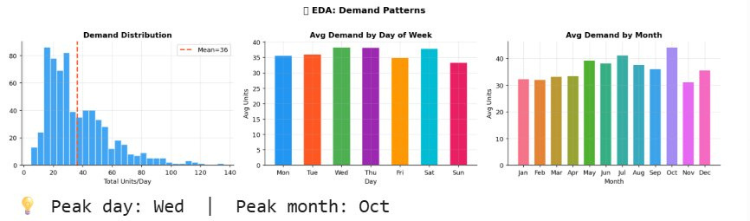
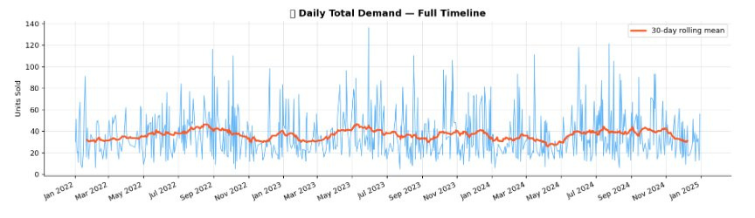
Exploratory Data Analysis (EDA)
Peak day: Wednesday | Peak month: October | Mean daily demand: 36 units | Clear upward trend in rolling mean across 3 years
Notes:
4

Slide 6
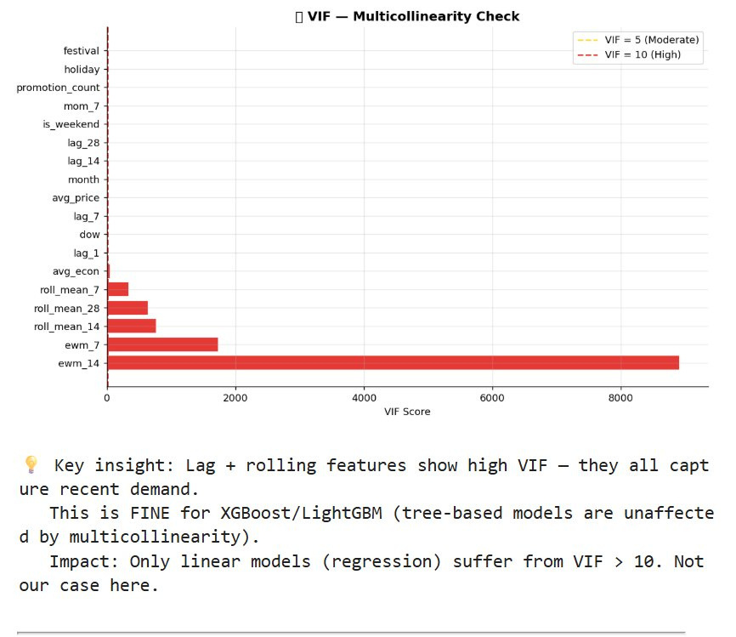
VIF — Multicollinearity Check
Key Insights
High VIF features:
ewm_7 and ewm_14 show VIF > 1000 — extreme collinearity
Why it's fine here:
Tree-based models (XGBoost, LightGBM) are immune to multicollinearity — they split on single features
VIF matters only for:
Linear models like OLS regression — NOT our final model
Low-VIF features:
festival, holiday, promotion_count, is_weekend — truly independent signals
Conclusion:
High VIF is acceptable here. All features were retained for tree models.
Notes:
5

Slide 7
Models Used & Why
🔮 Prophet
🧠 LSTM
⚡ XGBoost
🌿 LightGBM
🏆 Ensemble
Baseline
Dropped
✅ Final Model
Runner-up
Tested
✅ Pros:
✅ Pros:
✅ Pros:
✅ Pros:
✅ Pros:
Captures trend + seasonality
Easy to interpret
Good for quick baseline
Sequence learning
Deep patterns
Uses all 70+ features
Lowest MAE (7.0)
R² = 0.809
Fast & reliable
Faster than XGBoost
MAE (7.0) similar
R² = 0.815
Weighted average of models
Tested thoroughly
❌ Cons:
❌ Cons:
❌ Cons:
Needs large dataset
Overfitting risk
High MAE (16)
Slow to train
❌ Cons:
Did NOT outperform XGBoost alone
MAE 7.74 — higher than base
Cannot use external features
High MAE (22)
Negative R²
❌ Cons:
Slightly higher RMSE
Needs feature engineering
💡 "Tree-based models outperform deep learning when data is structured and feature-rich — small datasets hurt LSTM most."
Notes:
6

Slide 8
Evaluation Metrics
MAE
Mean Absolute Error
RMSE
Root Mean Square Error
Formula: Avg( |y − ŷ| )
Formula: √( Avg( (y − ŷ)² ) )
Average error in units. MAE = 7 means off by 7 units on average.
Penalizes large errors more. Sensitive to outliers & peak demand spikes.
Lower is better | Most business-friendly
Lower is better | Catches big misses
R²
R-Squared (Coefficient of Det.)
MAPE
Mean Absolute % Error
Formula: 1 − Σ(y−ŷ)² / Σ(y−ȳ)²
Formula: Avg( |y−ŷ| / y ) × 100
How much variance is explained. R²=0.81 → model explains 81% of demand variation.
Error as a percentage. MAPE = 25% means predictions are 25% off on average.
Higher is better | Max = 1.0
Lower is better | Scale-independent
Notes:
7

Slide 9
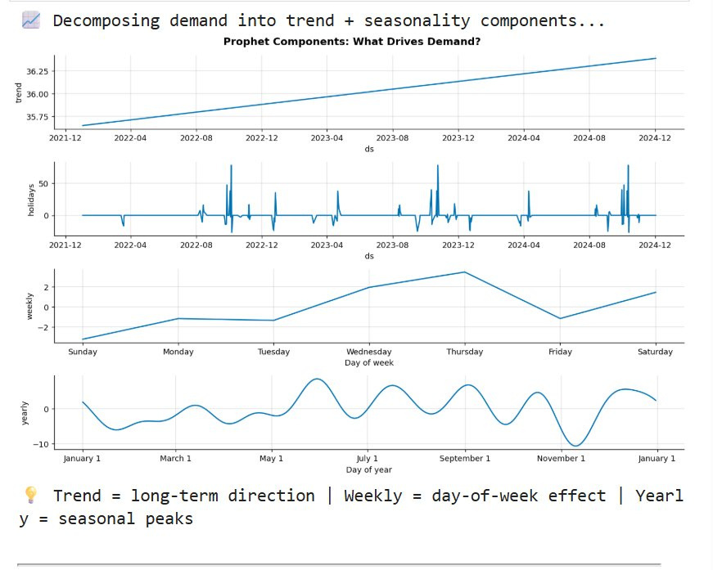
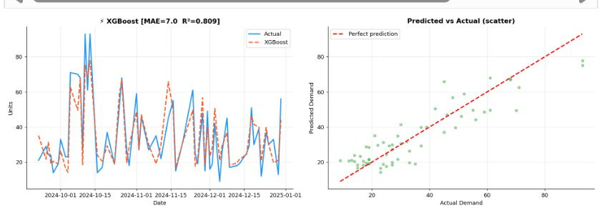
Prophet — Baseline Model Results
Prophet MAE=22.0, R²=−0.823 → Negative R² means model is worse than just predicting the mean. Components show: Upward trend | Holiday spikes | Wed–Thu weekly peak | Yearly seasonal waves
Notes:
8

Slide 10
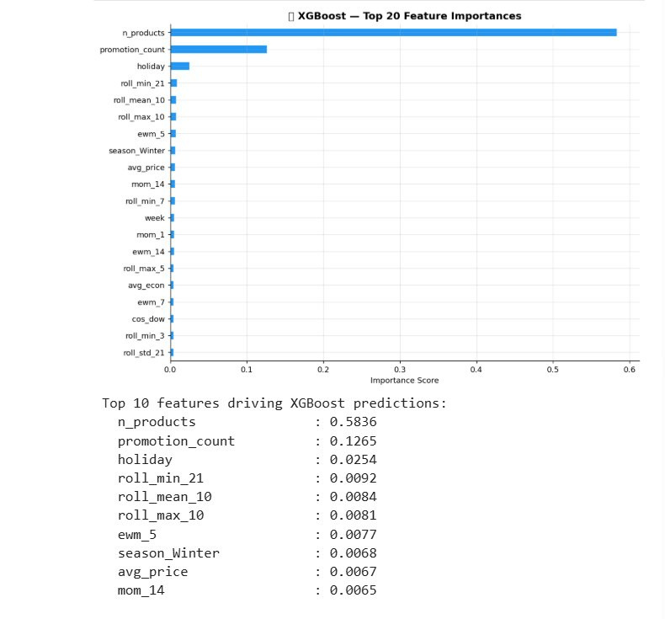
XGBoost — Final Model Results
7.0
8.61
0.809
25%
MAE
RMSE
R²
MAPE
Predictions follow actual demand closely. Scatter plot shows strong diagonal alignment → minimal systematic bias.
Notes:
9

Slide 11
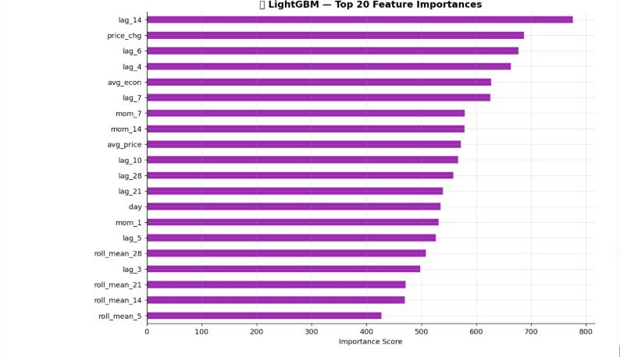
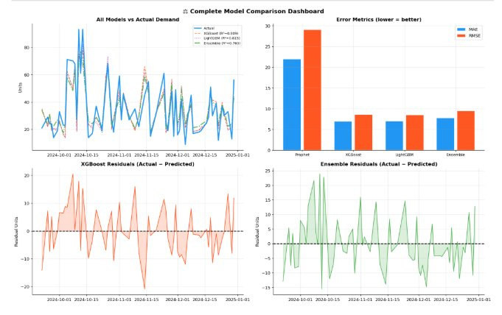
Feature Importance — XGBoost & LightGBM
XGBoost: n_products (0.58) and promotion_count (0.13) dominate — business-level features matter most. LightGBM: lag_14 is #1 — recent demand history is the strongest predictor. Both models agree: promotions, lags, and rolling averages drive demand.
Notes:
10

Slide 12
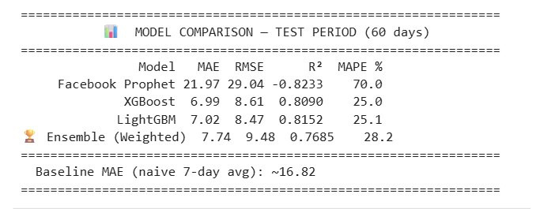
Complete Model Comparison Dashboard
Top-left: All models vs actual demand — XGBoost & LightGBM overlap with actual. Top-right: Error metrics bar chart — Prophet error is 3x higher than XGBoost. Bottom: XGBoost residuals are small & random (good). Ensemble residuals are wider.
Notes:
12

Slide 13
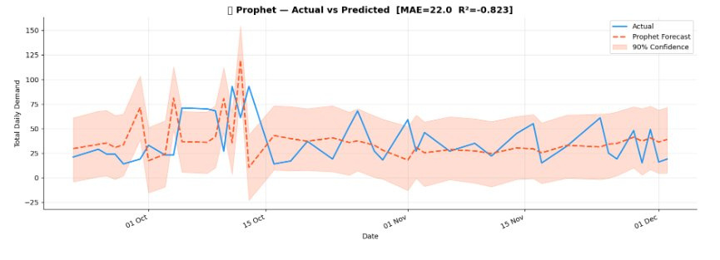
Model Comparison — Test Period (60 Days)
Model | MAE | RMSE | R² | MAPE | Verdict
Facebook Prophet | 21.97 | 29.04 | −0.82 | 70% | ❌ Poor
XGBoost | 6.99 | 8.61 | 0.809 | 25% | ✅ Best
LightGBM | 7.02 | 8.47 | 0.815 | 25.1% | ✅ Excellent
Ensemble (Weighted) | 7.74 | 9.48 | 0.769 | 28.2% | ⚠️ Good
Baseline (7-day avg) | ~16.82 | — | — | — | ❌ Weak
✅ XGBoost reduced error by 68% vs Prophet and 58% vs naive baseline — a massive improvement.
Notes:
13

Slide 14
Why XGBoost is the Best Model
📉
Lowest MAE (6.99)
📊
Best MAPE (25%)
Off by just 7 units on average — most practically accurate for real stock decisions
Percentage error is lowest — useful for comparing across products with different scales
📈
High R² (0.809)
🧠
Uses all 70+ features
Explains 81% of demand variance — strong predictive power on unseen 60-day test set
Lag, rolling, EWM, festival, price, promotion — XGBoost leverages every signal available
🌲
Tree models + multicollinearity
⚡
Fast & scalable
Unaffected by high VIF — splits on single features independently at each node
Trains in seconds, ready for real-world deployment with minimal compute resources
🏆 "XGBoost provides the lowest MAE and MAPE with strong R², making it most suitable for real-world demand forecasting."
Notes:
14

Slide 15
Forecasting & Stock Recommendation System
📅
🧠
📈
📦
💡
→
→
→
→
Input Data
XGBoost Model
14-Day Forecast
Stock Recommendation
AI Explanation
Historical sales, promotions, holidays, price
70+ features, trained on 600 days
Daily demand predictions with trend
Order qty = forecast + safety buffer
Plain English reason: why demand will rise/fall
Buffer Logic — How Stock Recommendation Works
📦 SMART STOCK BUFFER RULES:
📅
🏖
🎉
🏷
📢
Normal Day
Weekend
Major Festival
Minor Festival
Promotion Day
+15%
+22%
+40%
+30%
+25%
Notes:
15

Slide 16
Results & Conclusion
Switching from LSTM & Prophet → XGBoost & LightGBM reduced MAE by over 68%
❌ Prophet
✅ XGBoost
✅ LightGBM
⚠️ Ensemble
MAE 21.97
MAE 6.99
MAE 7.02
MAE 7.74
R² −0.82
R² 0.809
R² 0.815
R² 0.769
MAPE: 70%
MAPE: ~25%
MAPE: ~25%
MAPE: 28.2%
Key Insights
Feature engineering (70+ features) was the biggest driver of accuracy improvement
Lag and rolling average features best capture recent demand momentum
Tree-based models vastly outperform deep learning on small structured datasets
The stock recommendation system provides actionable, explainable output for shop owners
Notes:
16

Slide 17
Future Scope & Thank You
🌐 Web/Mobile App
📡 Real-Time Data
🧠 Deep Learning (more data)
Deploy as Streamlit or Flutter app for kirana owners to use on phone
Integrate with POS billing systems for live demand updates
LSTM/Transformer with 5+ years of data for more complex patterns
🗺️ Hyper-Local Expansion
💬 Gemini AI Explainer
🔄 Auto Retraining
City-level heat maps of demand for distributors & FMCG companies
Plain-English explanation of why demand will rise/fall for each product
Model updates weekly with new sales data — always current
Thank You
Tools Used: Python | XGBoost | LightGBM | Prophet | Pandas | Scikit-learn | Matplotlib | Seaborn
Notes:
17

