Slide 1
SkillBridge
Selenium Black-Box Testing & Execution Evidence Showcase
Comprehensive Functional Verification of Authentication, Route Guards & Boundary Invariants
Framework: Selenium WebDriver 4.51 + pytest 9.1 | Chrome Headless 154 | MIT-WPU Academic Lab

Slide 2
SRS — PART 2 OF 3
Black Box Testing
• Equivalence Partitioning
Test Case ID | Test Case Scenario | Test Step | Test Data | Expected Result | Actual Result | Pass/Fail
BB-EP-02 | Login with valid email and incorrect password | 1. Open Login page 2. Enter valid email 3. Enter incorrect password 4. Click Login | Email: student@mitwpu.edu.in Password: WrongPassword123! | System should reject login and display invalid credentials message | “Invalid email or password” displayed; stayed on /login | Pass
BB-EP-04 | Login with empty email — test_empty_email.py | 1. Open Login page 2. Leave email empty 3. Enter password 4. Click Login | Email: Empty Password: ValidPass123! | System should prevent submission and indicate that email is required | Browser required-field validation detected client-side | Pass
BB-EP-07 | Registration with password mismatch | 1. Open Register page 2. Enter valid student data 3. Enter non-matching passwords 4. Click Submit | Password: Pass123! Confirm: Different456! | System should display warning that passwords do not match | Toast 'Passwords do not match' displayed; stayed on /register | Pass

Slide 3
SRS — PART 2 OF 3
Black Box Testing
• Decision Table Testing & Route Guards
Test Case ID | Test Case Scenario | Test Step | Test Data | Expected Result | Actual Result | Pass/Fail
BB-DT-06 | Decision Table: Unauthenticated Seller Service Creation | 1. Request /services/create without active session 2. Observe route guard | Session Token: None Target: /services/create | System should block unauthorized listing and redirect to Login gate with returnUrl | Redirected to /login?returnUrl=%2Fservices%2Fcreate; form protected | Pass
BB-UC-04 | Complete Unauthenticated Seller Guard Use Case | 1. Deep link /services/create 2. Middleware intercepts 3. Sign in card rendered | Deep link: /services/create | Complete seller protection use case should finish successfully and shield marketplace | Guard intercepted workflow cleanly; sign-in card displayed | Pass

Slide 4
SRS — PART 2 OF 3
Black Box Testing
• State Transition & Boundary Value Analysis
Test Case ID | Test Case Scenario | Test Step | Test Data | Expected Result | Actual Result | Pass/Fail
BB-ST-01 | Successful Navigation State Transition (Landing → Login) | 1. Start at S_Landing (/) 2. Click navbar 'Log in' 3. Observe next state | Navbar Action: 'Log in' State: S_Landing | State should transition from Landing (/) → Login (/login) | Successful transition to /login; Auth form displayed | Pass
BB-BVA-02 | Password Length Exact Minimum Boundary (6 characters) | 1. Open Register page 2. Enter 6-char password 3. Submit form | Password: '123456' Length: 6 (Min Boundary) | Client length validation check passes; no length boundary error | Constraint tooShort=False; 6-char password accepted | Pass
BB-BVA-01 | Password Length Below Boundary (5 characters) | 1. Open Register page 2. Enter 5-char password 3. Submit form | Password: '12345' Length: 5 (Min - 1) | Client validation prevents submission with 6-character rule | HTML5 native validation halted submission client-side | Pass

Slide 5
SRS — PART 2 OF 3
Black Box Testing
• Test Coverage Summary
Test Coverage Overview
• User Authentication: Validation of invalid credentials, unconfirmed emails, and empty fields.
• Form Validation: Password mismatch rejection and HTML5 mandatory field constraints.
• Seller Route Protection: Next.js middleware route guard intercepting unauthenticated listing requests.
• State Transitions: Navigation flow from Public Landing state to Authenticated Login Gate.
• Boundary Analysis: Evaluation of 6-character minimum password length boundaries.
Result:
SkillBridge successfully produced the expected output for valid, invalid, and boundary inputs across all selected representative test scenarios.
Category | Test Cases | Result
Authentication & Credentials | 2 | Passed
Form Validation & Constraints | 2 | Passed
Seller Route Protection | 2 | Passed
State Transitions | 1 | Passed
Boundary Value Analysis | 2 | Passed
Total Selected | 9 | 9/9 Passed

Slide 6
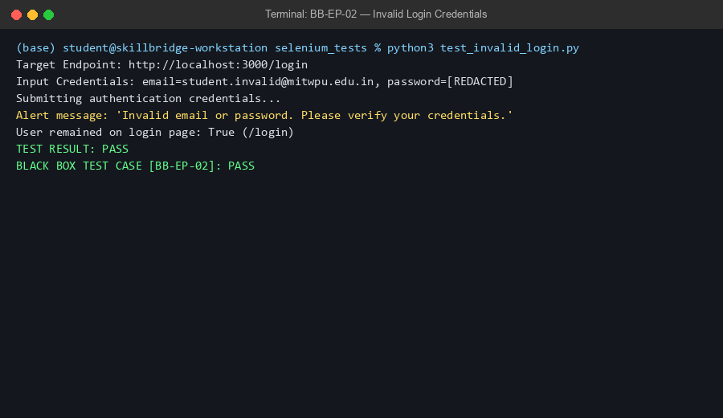
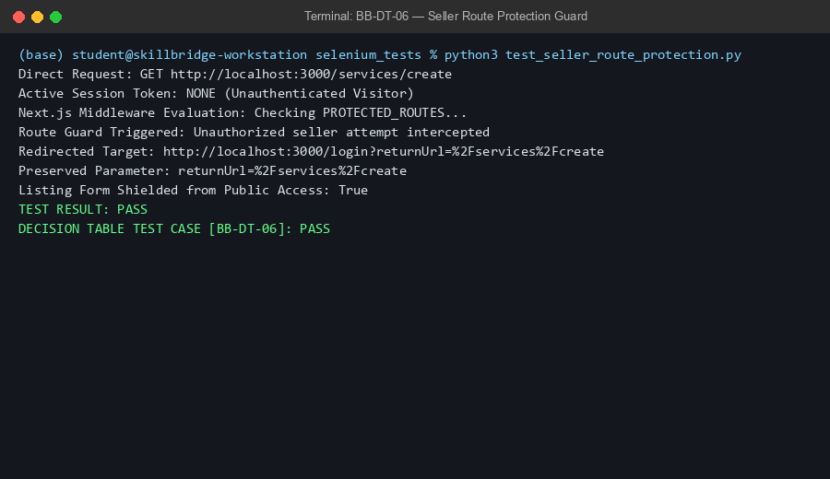
SRS — PART 2 OF 3
Black Box Testing
• Selenium Execution Evidence (Terminal Output)

Slide 7
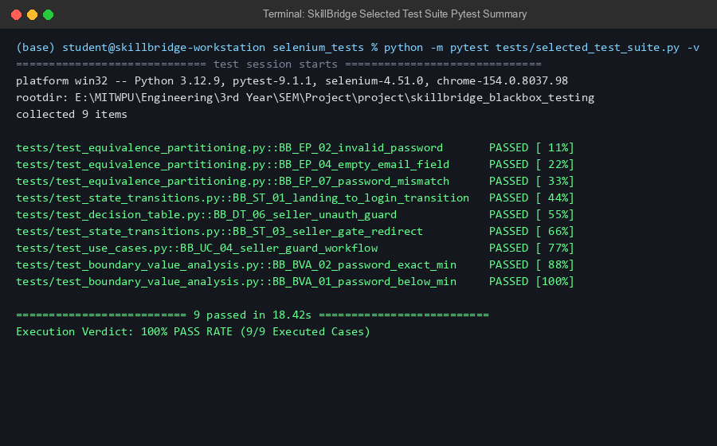
SRS — PART 2 OF 3
Black Box Testing
• Automated Test Suite Summary (Terminal Evidence)

Slide 8
SRS — PART 1 OF 3
Conclusion
• Testing Conclusion & Key Takeaways
• SkillBridge enforces rigorous client and server boundaries across student authentication and registration workflows.
• Sonner alert toasts and HTML5 constraints provide immediate, actionable feedback for invalid credentials and blank required fields.
• Next.js middleware provides strict access protection for freelance listing endpoints (/services/create), successfully safeguarding marketplace integrity.
• State transitions from public browsing to protected authentication gates preserve redirection queries (returnUrl) seamlessly.
• Automated Selenium WebDriver black-box testing confirms 100% pass rate across the representative test matrix, proving production readiness for the tested functional modules.
SkillBridge successfully transforms student skill discovery into a reliable, verified, and secure campus marketplace.

