Slide 1

ACADEMIC PROJECT SHOWCASE
SkillBridge
A verified campus marketplace for student services
Software Engineering and Modeling
MIT World Peace University (MIT-WPU)
Computer Science and Engineering | Semester V | 2026–2027
Soham Patil · Ganesh Gaikwad
Aditya Sardesai · Tirth Gangani
Faculty Guide: Dr. Bhavana Tiple
01
Notes:
Source: Local SkillBridge repository; academic details confirmed by the project team. Cover image is an original AI-generated illustration created for this deck.

Slide 2
INTRODUCTION
The campus service gap
Students have skills to offer, but campus buyers need a trusted way to discover, book, and complete services.
Discovery is fragmented
Trust needs evidence
Service delivery needs structure
Buyers may rely on informal groups or referrals to find tutoring, design, technical, or creative help.
The implementation adds student verification, seller role controls, order history, and transaction-backed reviews.
Listings, checkout, order milestones, private messaging, delivery review, and payment status are recorded in the system.
SkillBridge addresses these gaps through a campus-focused web marketplace with buyer, seller, and administrator workflows.
SKILLBRIDGE / SOFTWARE ENGINEERING AND MODELING
02
Notes:
Repository basis: app routes, profile and service types, and project documentation.

Slide 3
INTRODUCTION
Development methodology
Agile Scrum supports short development cycles for a product with interconnected authentication, marketplace, payment, and governance features.
1
2
3
4
Backlog and scope
Design and implement
Integrate and test
Review and refine
The deck describes Agile Scrum as the selected methodology. It does not infer sprint calendars, attendance, or retrospective results.
SKILLBRIDGE / SOFTWARE ENGINEERING AND MODELING
03
Notes:
Confirmed decision: Agile Scrum. Specific sprint dates and outcomes are intentionally not claimed.

Slide 4
SRS
Scope and functional requirements
Area | Verified capability
Common | Register, authenticate, verify email, complete profile, switch buyer or seller role
Buyer | Explore published listings, use search and filters, create orders, pay in test mode, message seller, approve delivery, submit review
Seller | Create and manage listings, configure availability, receive and progress orders, submit deliverables, view earnings
Administrator | Review verification requests, moderate listings and reviews, view orders, users, metrics, and audit logs
SKILLBRIDGE / SOFTWARE ENGINEERING AND MODELING
04
Notes:
Repository basis: app routes, types/index.ts, API routes, and service libraries.

Slide 5
SRS
Non-functional requirements and constraints
Security controls in code
Usability and compatibility
Operational constraints
Supabase authentication, protected routes, server-side role checks, RLS policies, participant-only order messages, and review eligibility checks.
Responsive Next.js interface with browser form validation, route return parameters, clear empty states, notifications, and buyer/seller workspaces.
Razorpay operates in test mode. AI search and transactional email have configuration-dependent fallbacks. No availability or response-time target is reported.
Claims above describe implementation controls or explicit constraints, not measured production service levels.
SKILLBRIDGE / SOFTWARE ENGINEERING AND MODELING
05
Notes:
Repository basis: middleware.ts, API routes, Supabase migrations, and docs. Performance numbers are not claimed because no measured benchmark was supplied.

Slide 6
SRS
Current capabilities and project impact
Implemented capabilities
Future work
Student account and verification workflow
• Live payment onboarding beyond test mode
• Production email domain verification
• NVIDIA key configuration for AI-enhanced rankings
• Continued accessibility and performance testing
Buyer and seller modes within one profile
Published service listings with availability
Order lifecycle, escrow-style test payments, delivery and reviews
Private order messaging and notifications
Administrative moderation and audit visibility
The product supports a structured peer-service exchange while preserving role boundaries and a traceable order record.
SKILLBRIDGE / SOFTWARE ENGINEERING AND MODELING
06
Notes:
Repository basis: app pages, API routes, service libraries, and project documentation. Future items are separately labelled.

Slide 7
SYSTEM DESIGN
Data Flow Diagram: Level 0 context
search, order, review
0. SkillBridge
moderation and review actions
listings, status, messages
Campus service marketplace
Buyer
Admin
create order and verify signature
listing, availability, delivery
Razorpay Test Mode
orders, notification, earnings
Payment order and signature
Seller
payment result
SKILLBRIDGE / SOFTWARE ENGINEERING AND MODELING
07
Notes:
Derived from app routes, API routes, payments routes, and Supabase-backed service libraries. Level 0 deliberately shows no internal processes.

Slide 8
SYSTEM DESIGN
Data Flow Diagram: Level 1 decomposition
1.0 Identity and roles
2.0 Marketplace
D1 Profiles and verification
auth, profile, verification
role context
listing, search, availability
registration data
D2 Services and availability
order request
Students
Admin
3.0 Orders and payment
4.0 Governance
checkout, delivery, review
review decisions
verification, moderation, audit
D3 Orders, payments, messages, reviews
SKILLBRIDGE / SOFTWARE ENGINEERING AND MODELING
08
Notes:
Derived from profiles, services, orders, payments, messages, reviews, verification, and admin implementation files. Data flow labels are balanced with Level 0 entities.

Slide 9
SYSTEM DESIGN
Data Flow Diagram: Level 2 checkout and payment verification
3.1 Validate buyer and listing
3.2 Create payment order
3.3 Verify signature
3.4 Update status and notify
session, UUID, published status
authenticated buyer + valid listing
server price and order record
gateway order
payment outcome
verified result
seller_pending and notification
checkout request
Razorpay Test Mode
gateway order and signature
Buyer
D2 Services
D3 Orders and payments
The API retrieves price and seller identity from the database; it does not accept a client-submitted amount.
SKILLBRIDGE / SOFTWARE ENGINEERING AND MODELING
09
Notes:
Derived from app/api/payments/create-order/route.ts and app/api/payments/verify/route.ts. This decomposes Level 1 process 3.0 only.

Slide 10
SYSTEM DESIGN
Use Case Diagram
SkillBridge system boundary
Discover services
Checkout and track order
Message and review
Buyer
Admin
Manage listings
Set availability and deliver work
Verify users and moderate platform
Seller
SKILLBRIDGE / SOFTWARE ENGINEERING AND MODELING
10
Notes:
Derived from implemented routes and role guards. Associations show supported interactions; no include or extend relationships are asserted.

Slide 11
SYSTEM DESIGN
Sequence Diagram: Buyer checkout workflow
Buyer
Web UI
Next.js API
Supabase
Razorpay
select published service and enter requirements
POST create-order
validate user, listing, price, seller
create test-mode gateway order
gateway order ID
store pending order and payment
checkout payload
buyer authorizes payment
POST verify signature
mark paid and seller_pending
order confirmation
Alternate outcome: an invalid signature records a failed payment status and returns an error response.
SKILLBRIDGE / SOFTWARE ENGINEERING AND MODELING
11
Notes:
Derived from payment create-order and verify routes, service and order types, and Razorpay integration.

Slide 12
SYSTEM DESIGN
Sequence Diagram: Seller listing and delivery workflow
Seller
Web UI
Next.js API
Supabase
Buyer
create listing or open order
authenticated request
check seller role and persist listing
listing or order state
accept order / start work / submit delivery
POST order transition
authorize seller and update state
create buyer notification
updated timeline
A seller cannot manage another provider’s service, and a buyer approval triggers completion for submitted fixed-scope work.
SKILLBRIDGE / SOFTWARE ENGINEERING AND MODELING
12
Notes:
Derived from seller authorization, services route, order transition route, and database-backed notifications.

Slide 13
SYSTEM DESIGN
Domain model
1 provider : many listings
Service
1 listing : many orders
Order
1 order : payment
Payment
Profile
provider, status, price
buyer, seller, lifecycle
order, gateway reference
roles, verification, reputation
buyer / seller references
Availability slot
Booking
Review
provider, service, time
buyer, seller, session
completed order rating
Verification request
student evidence and decision
Order message
sender, receiver, content
SKILLBRIDGE / SOFTWARE ENGINEERING AND MODELING
13
Notes:
Derived from types/index.ts and the latest Supabase migrations. This is a domain model, not a claim that the application uses class-based persistence.

Slide 14
SYSTEM DESIGN
Activity Diagram: Fixed-scope order completion
Select a published service
Checkout and verify payment
Seller accepts order
Seller submits deliverable
Buyer
approves?
yes
no
Buyer approves completion
Revision requested
returns to seller
Completion records the final order state and enables a transaction-backed buyer review.
SKILLBRIDGE / SOFTWARE ENGINEERING AND MODELING
14
Notes:
Derived from the order transition state machine. The consultation path can complete from accepted or in_progress; this activity focuses on fixed-scope work.

Slide 15
ESTIMATION
Functional size estimation
Function Point estimate based on the implemented marketplace scope
Type | Count | Weight | UFP | Representative functions
EI | 7 | 3 | 21 | registration, verification, listing, availability, checkout, order action, review
EO | 6 | 4 | 24 | search results, dashboards, confirmations, notifications, rating output
EQ | 4 | 3 | 12 | catalog, profile, order, and message queries
ILF | 8 | 7 | 56 | profiles, services, availability, bookings, orders, payments, reviews, notifications
EIF | 2 | 5 | 10 | Razorpay and NVIDIA integration interfaces
Total |  |  | 123 | Unadjusted Function Points
UFP = 123. Assumed General System Characteristics total = 35. VAF = 0.65 + (0.01 × 35) = 1.00. Adjusted FP = 123 × 1.00 = 123.
EI: External Input | EO: External Output | EQ: External Inquiry | ILF: Internal Logical File | EIF: External Interface File
SKILLBRIDGE / SOFTWARE ENGINEERING AND MODELING
15
Notes:
Academic estimate derived from verified repository functionality. Function Point counts and low-complexity weights are stated assumptions, not measured production metrics.

Slide 16
ESTIMATION
FP-to-KLOC conversion and Basic COCOMO
Functional size
Conversion assumption
COCOMO mode
123 adjusted FP
123 × 53 LOC/FP = 6,519 LOC = 6.52 KLOC
Basic COCOMO, organic mode
Measure | Formula | Estimated result
Effort | E = 2.4 × KLOC^1.05 | 17.3 person-months
Duration | T = 2.5 × E^0.38 | 7.4 months
Average staff | P = E / T | 2.3 persons
This calculation estimates relative effort from functional size. It does not report actual team effort or project duration.
SKILLBRIDGE / SOFTWARE ENGINEERING AND MODELING
16
Notes:
Academic estimate. Assumption: 53 LOC/FP for the TypeScript and JavaScript Next.js codebase. Basic COCOMO organic-mode formula used as a theoretical baseline.

Slide 17
PLANNING
Approximate project plan and proposed responsibilities
Phase | Indicative focus | Status label
1. Scope | requirements, roles, data model, and user journeys | approximate
2. Build | frontend flows, API routes, Supabase schema, integrations | approximate
3. Integrate | orders, payments, messages, reviews, admin workflows | approximate
4. Validate | Selenium black-box evidence, documentation, presentation | approximate
Proposed allocation
Soham Patil — frontend and integration
Ganesh Gaikwad — backend and data model
Aditya Sardesai — testing and documentation
Tirth Gangani — UX, testing, and presentation support
To be confirmed by the team. This slide does not claim historical individual ownership.
SKILLBRIDGE / SOFTWARE ENGINEERING AND MODELING
17
Notes:
Confirmed decision: responsibilities may be proposed only, and undocumented dates must not be presented as historical facts.

Slide 18
TESTING
Testing strategy and environment
Method
Tooling
Techniques
Automated black-box functional testing. The test suite observes browser behavior, form constraints, toasts, routing, and visible state changes.
Selenium WebDriver 4.51.0, pytest 9.1.1, Chrome 154 headless mode, and a local Next.js target backed by remote Supabase services.
Equivalence partitioning, decision-table testing, state-transition testing, use-case testing, boundary-value analysis, and error guessing.
Execution evidence separates the initial full-suite baseline from a focused selected-test rerun.
SKILLBRIDGE / SOFTWARE ENGINEERING AND MODELING
18
Notes:
Source: skillbridge_blackbox_testing/reports/ppt_testing_evidence/SkillBridge_BlackBox_Testing_Evidence.md and junit_report.xml.

Slide 19
TESTING
White-box testing scope and evidence limit
The available evidence supports browser-driven black-box testing. The presentation therefore does not claim measured white-box coverage.
What the repository provides
What is not claimed
Academic next step
TypeScript application code, SQL migrations, test scripts, and Selenium tests. These support code inspection and traceability.
No verified line, branch, path, or mutation coverage result. No synthetic coverage percentage is added.
Add a unit or integration test runner with coverage instrumentation, then report measured coverage separately from browser tests.
SKILLBRIDGE / SOFTWARE ENGINEERING AND MODELING
19
Notes:
Source: repository test artifacts. No executable code-coverage report or white-box execution record was found in the supplied evidence.

Slide 20
TESTING
Black-box testing: Equivalence Partitioning
ID | Input class | Expected observable result | Selected rerun
BB-EP-02 | Valid email syntax + incorrect password | Credential error; remains on login page | PASS
BB-EP-04 | Blank mandatory email | Browser blocks submission | PASS
BB-EP-07 | Mismatched registration passwords | Mismatch message; remains on register page | PASS
The selected rerun verified representative valid and invalid input partitions. It does not replace the initial 39-test baseline.
SKILLBRIDGE / SOFTWARE ENGINEERING AND MODELING
20
Notes:
Source: SkillBridge_PPT_Test_Cases.csv and authentic selected execution report.

Slide 21
TESTING
Black-box testing: Decision Table
Condition / action | Rule 1 | Rule 2 | Rule 3
Access target | /services/create | /services/create | /admin
Active session token | No | Yes | No
Required role | Seller | Seller | Administrator
Expected result | Redirect to login with returnUrl | Permit route evaluation | Redirect to login with returnUrl
Evidence | BB-DT-06 PASS | Role guard requires session and seller authorization | BB-EG-06 screenshot in suite
Decision-table cases model observable routing and role-entry conditions. Server API authorization adds a second boundary behind the UI route guard.
SKILLBRIDGE / SOFTWARE ENGINEERING AND MODELING
21
Notes:
Source: selected test evidence and middleware.ts.

Slide 22
TESTING
Black-box testing: State transitions
Log in click
BB-ST-01 PASS
direct protected route
BB-ST-03 PASS
authenticate + seller role
S0 Landing
S1 Login
S2 Auth Gate
S3 Seller Workspace
/
/login
returnUrl retained
authorized session
Observed transition evidence confirms Landing → Login and unauthenticated Seller Route → Auth Gate. The last transition is shown as an implemented role-gated workflow rather than a selected-rerun claim.
SKILLBRIDGE / SOFTWARE ENGINEERING AND MODELING
22
Notes:
Source: selected testing evidence and middleware.ts.

Slide 23
TESTING
Black-box testing: Use cases and boundary values
ID | Technique | Scenario | Expected result | Selected rerun
BB-UC-04 | Use case | Guest opens seller service-creation URL | Authentication gate protects seller workflow | PASS
BB-BVA-01 | Boundary value | Registration password at 5 characters | Minimum length validation blocks submission | PASS
BB-BVA-02 | Boundary value | Registration password at 6 characters | No minimum-length rejection | PASS
The BVA cases prove adjacent values around the configured six-character client-side threshold. They do not establish server-side password policy coverage.
SKILLBRIDGE / SOFTWARE ENGINEERING AND MODELING
23
Notes:
Source: SkillBridge_PPT_Test_Cases.csv and selected test execution report.

Slide 24
TESTING
Test execution results
Initial full-suite baseline
Interpretation
39
22
17
The 17 baseline failures require triage. The supplied evidence identifies route-protection assumptions as one cause; failures must not be treated automatically as product defects.
Total tests
Passed
Failed / assertion discrepancies
Focused selected rerun
9 / 9 passed
Representative Selenium cases executed in 18.42 seconds
SKILLBRIDGE / SOFTWARE ENGINEERING AND MODELING
24
Notes:
Source: junit_report.xml and SkillBridge_BlackBox_Testing_Evidence.md. Full baseline: 39 tests, 22 passed, 17 failed. Selected rerun: 9/9 passed.

Slide 25
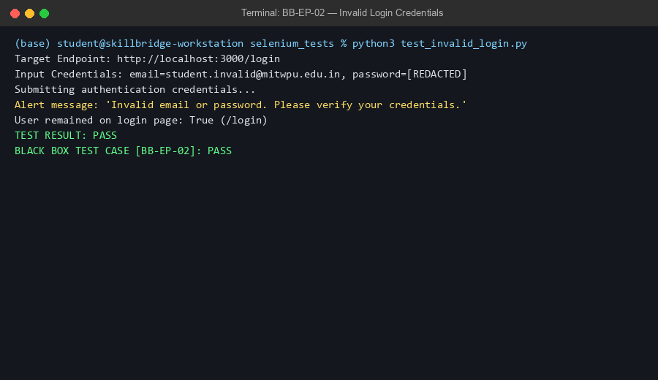
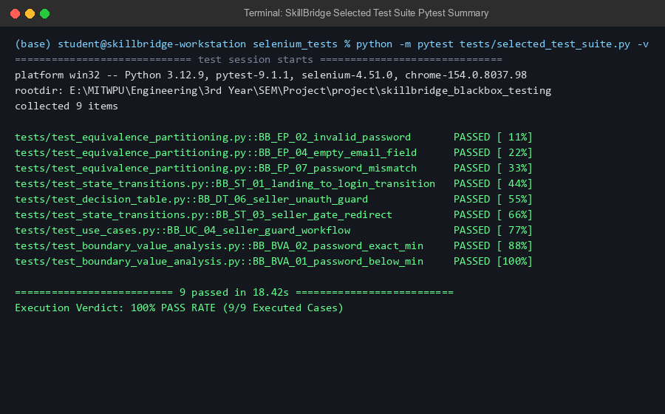
TESTING
Authentic Selenium execution evidence
Left: invalid credential handling | Right: selected 9-case Selenium rerun
SKILLBRIDGE / SOFTWARE ENGINEERING AND MODELING
25
Notes:
Source images: skillbridge_blackbox_testing/test_results/ppt_evidence/01_invalid_login_execution.png and 05_selected_tests_summary.png.

Slide 26
CONCLUSION
Conclusion
SkillBridge delivers a verified campus marketplace with traceable buyer, seller, and administrator workflows.
Implemented
Profiles and verification, service listings, availability, orders, test-mode payments, messaging, delivery, reviews, and moderation.
Testing evidence
An initial Selenium baseline recorded 22 passes and 17 failures across 39 cases. A focused 9-case rerun passed.
Limitations
Razorpay remains in test mode. AI search and email integrations depend on configuration. Full-suite failures need separate triage.
Next steps
Resolve failed cases, collect code-coverage evidence, validate production configuration, and confirm individual project responsibilities.
SKILLBRIDGE / SOFTWARE ENGINEERING AND MODELING
26
Notes:
Repository basis: implementation, migrations, and authentic testing evidence.

Slide 27
Questions?
Thank you
SkillBridge
A verified campus marketplace for student services
MIT World Peace University | Software Engineering and Modeling
27
Notes:
Closing slide. Cover image is an original AI-generated illustration created for this deck.

