Slide 1
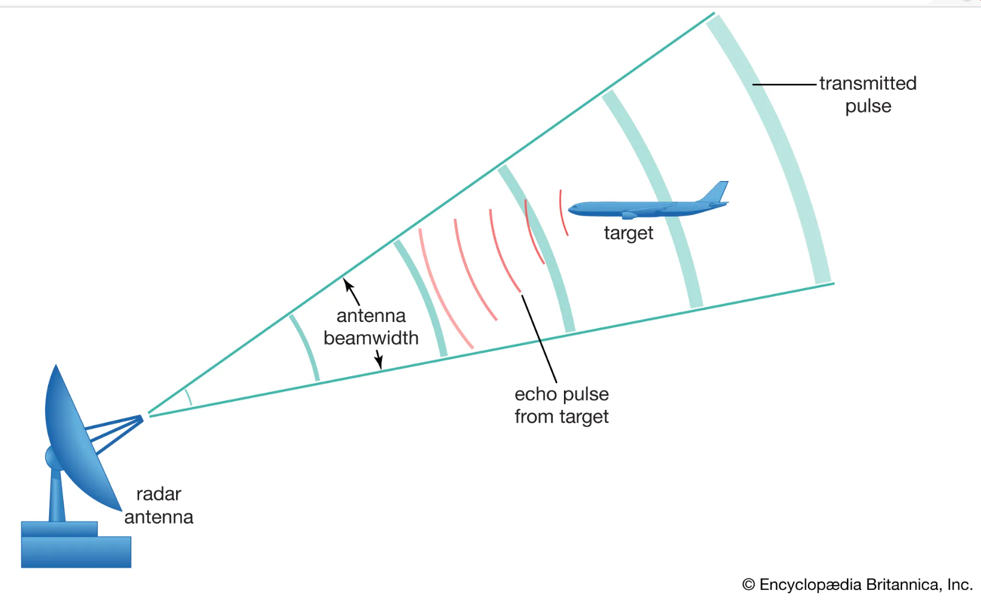
Test of Hypotheses
Motivation:

Slide 2
States of a binary detector
Usual State – No Signal only Noise – Null Hypotheses – H₀
Special State – Signal detected – Alternate Hypotheses—H_{a}
Possible outcomes of a binary detector
D₀|H₀—correct decision -- "proper dismissal"
D₁|H₀— Type I Error -- "false alarm"
D₀|H₁ – Type II Error -- "miss"
D₁|H₁—correct decision-- "action"
D₀ – decide noise
D₁ – decide signal

Slide 3
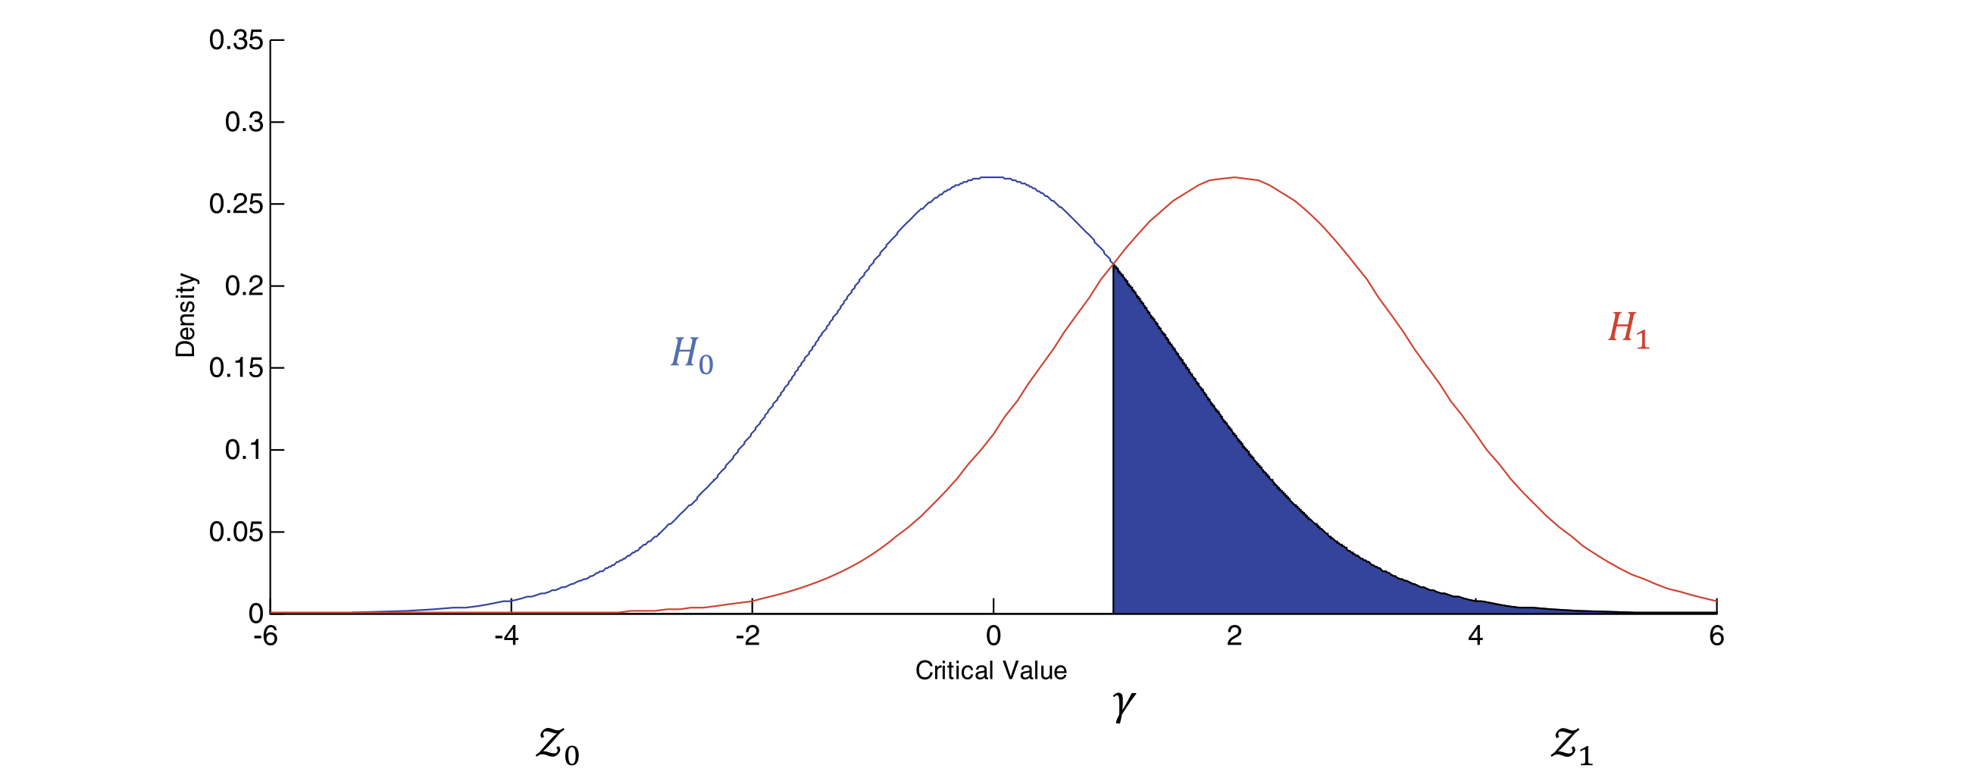
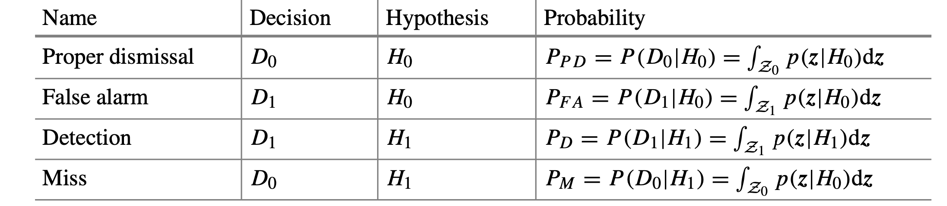
Decision Procedure in a detector

Slide 4
Test of Hypothesis Procedure
Formulate the Null hypothesis– H₀
Formulate the Alternate hypothesis – H_{a}
Choose an appropriate test statistic(TS) and compute its value from the samples
Decide an 𝛼 – level of significance or Type I error
Using TS and 𝛼 compute the rejection region(RR)
If the observed value of TS lies in the RR reject H₀ in favor of H_{a} else state: not able to reject H₀ on the basis of observed evidence
Compute the p-value from the null distribution of the TS and interpret it

Slide 5
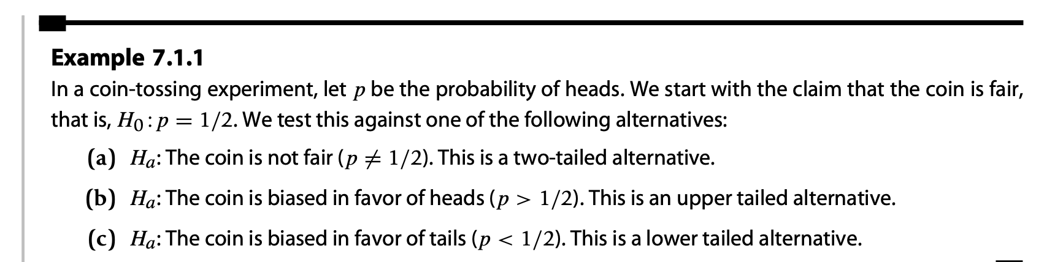
Examples
Usual format:
H₀: 𝜇 = 𝜇₀
against one of the alternatives
H_{a}: 𝜇 ≠ 𝜇_{a} --- two tailed alternative
H_{a}: 𝜇 < 𝜇₀ --- lower or left tailed alternative
H_{a}: 𝜇 > 𝜇₀ --- upper or right tailed alternative

Slide 6
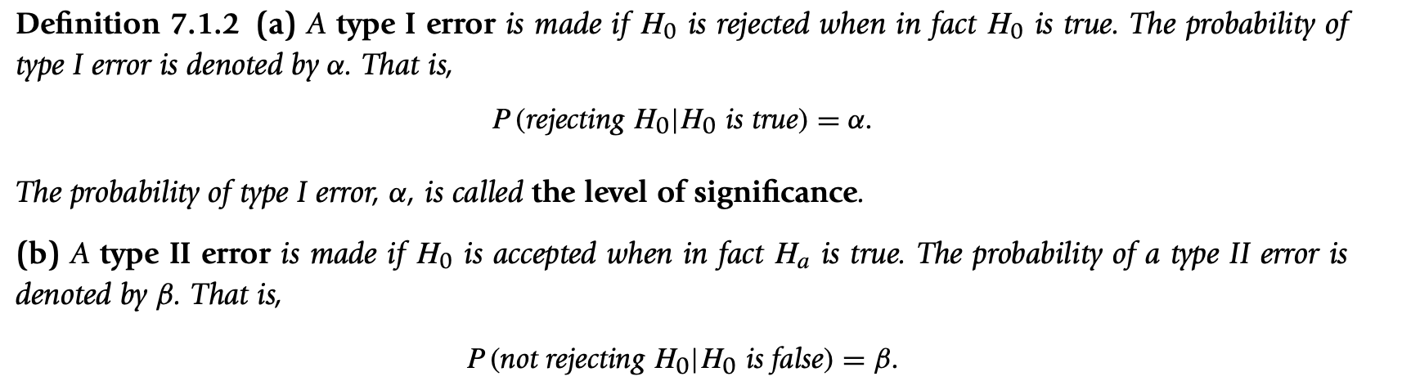
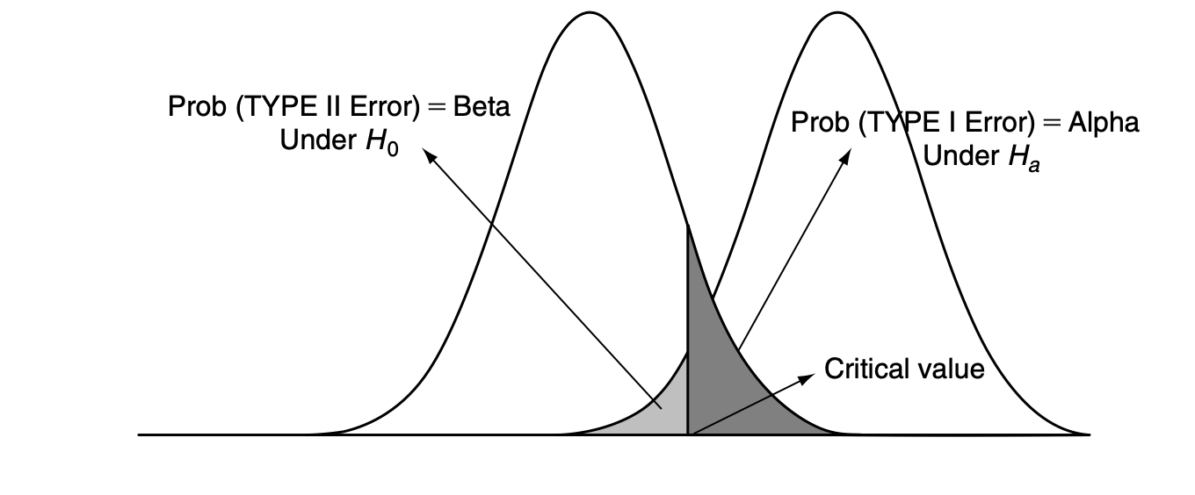
Few Definitions
Ack: Mathematical Statistics with Applications– Ramachandran and Tsokos

Slide 7
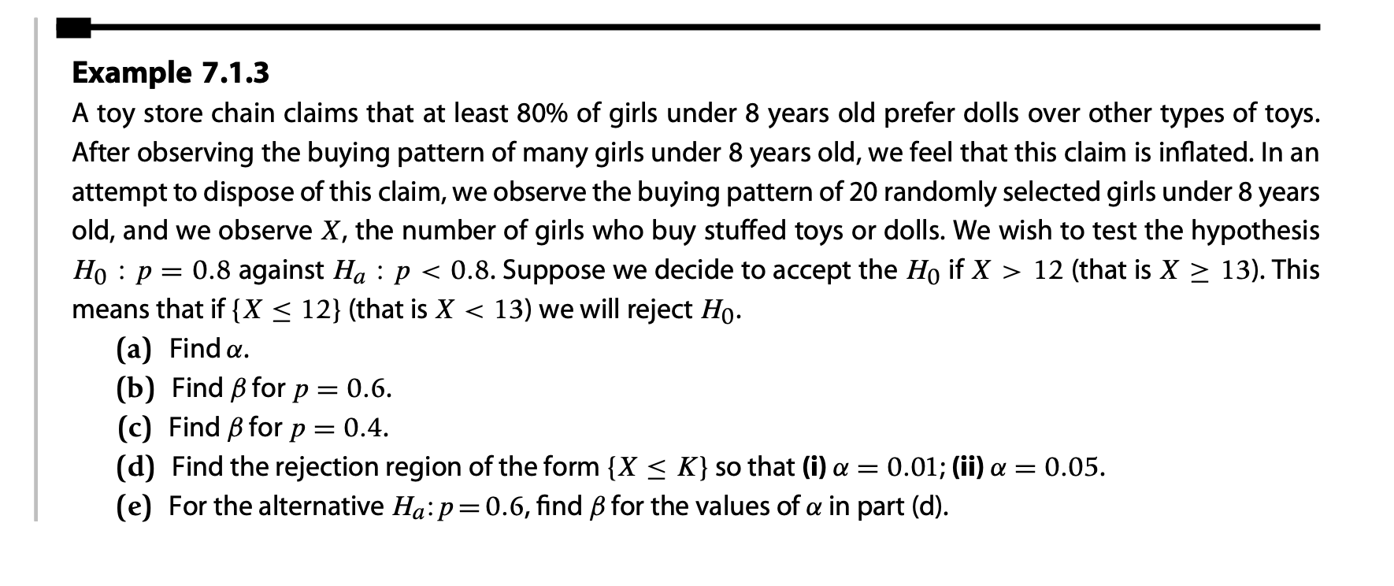
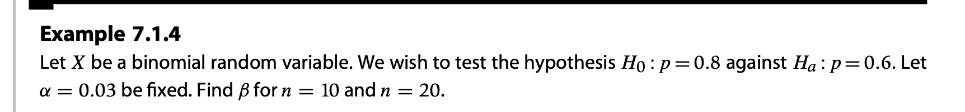
Examples

Slide 8
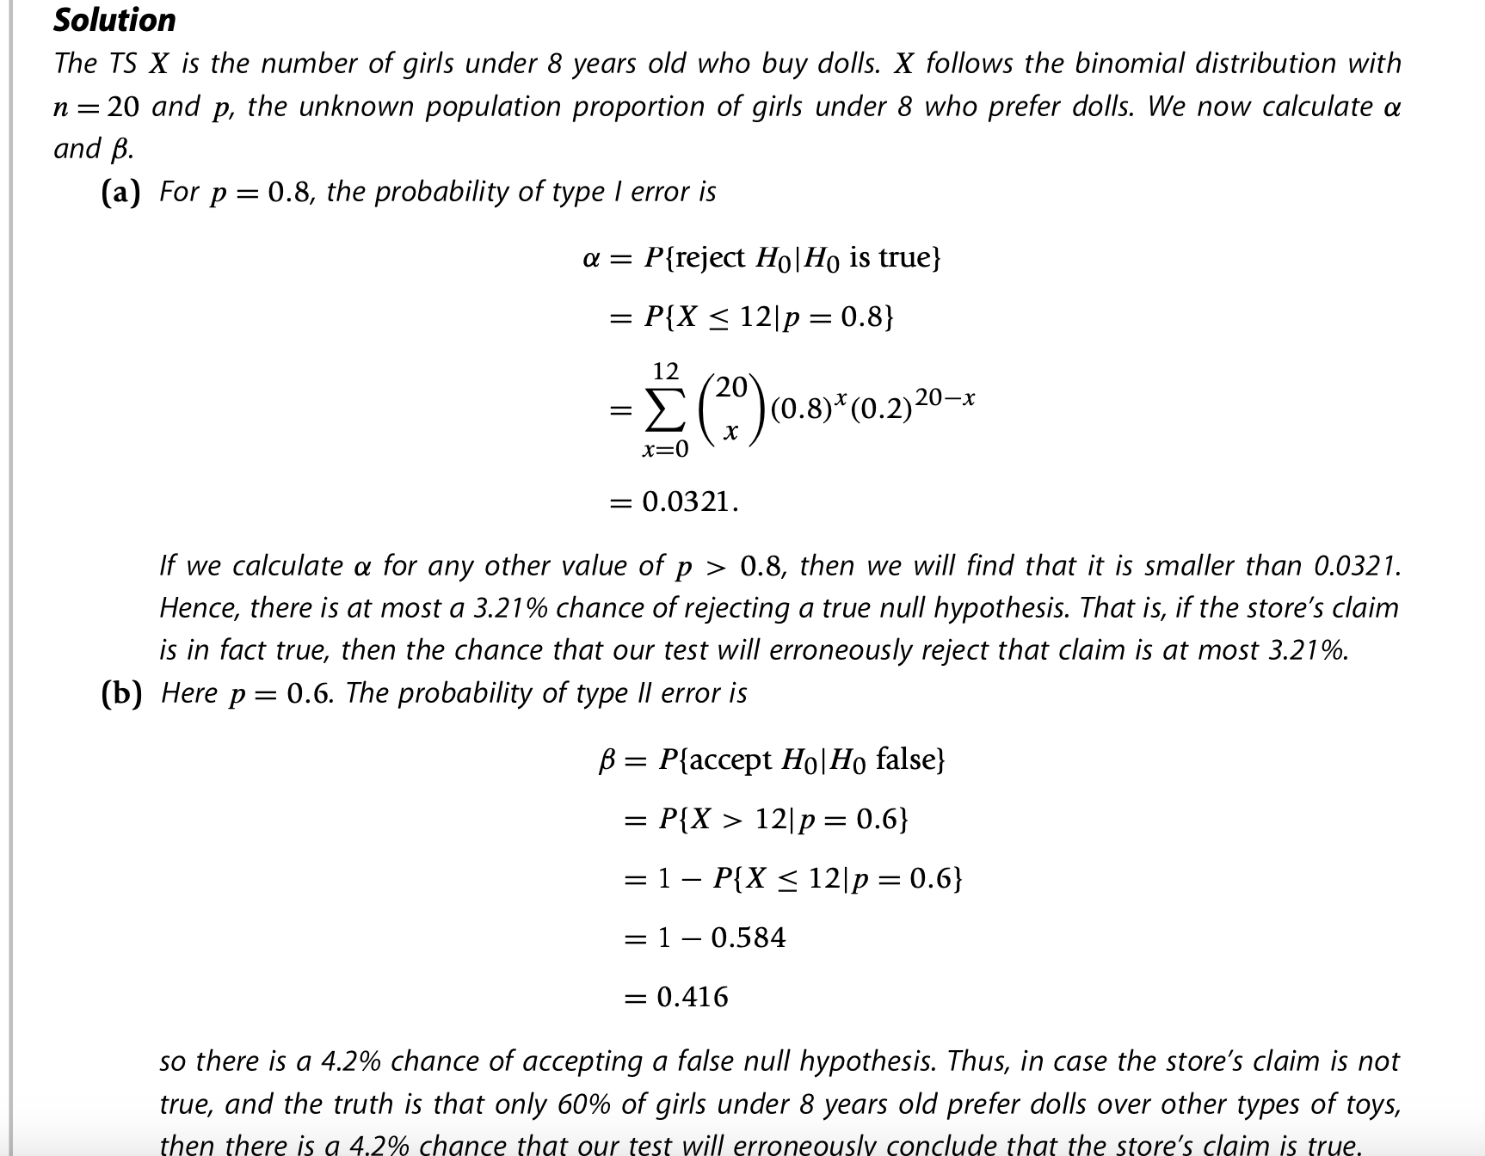

Slide 9
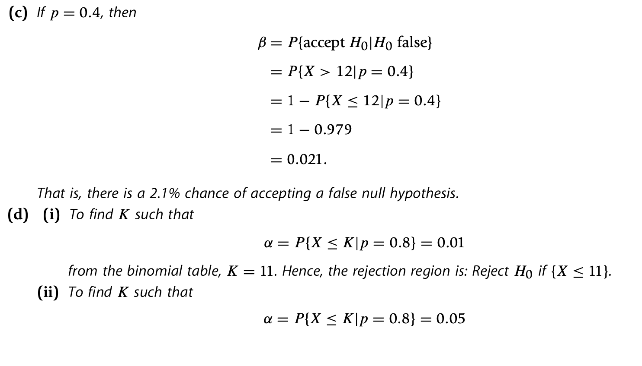

Slide 10
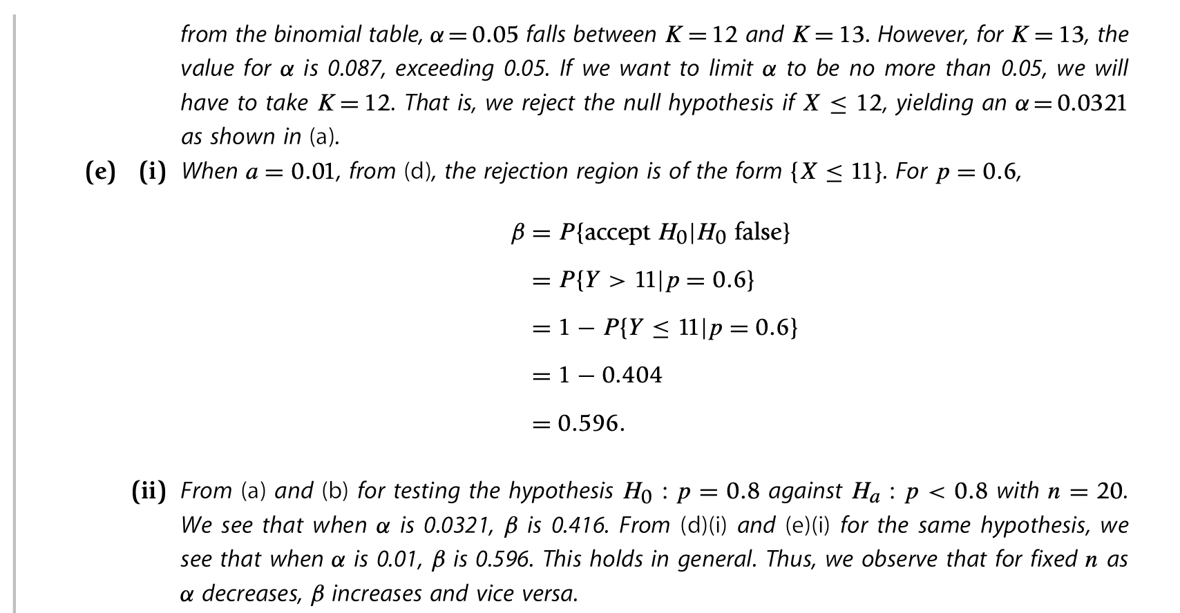

Slide 11
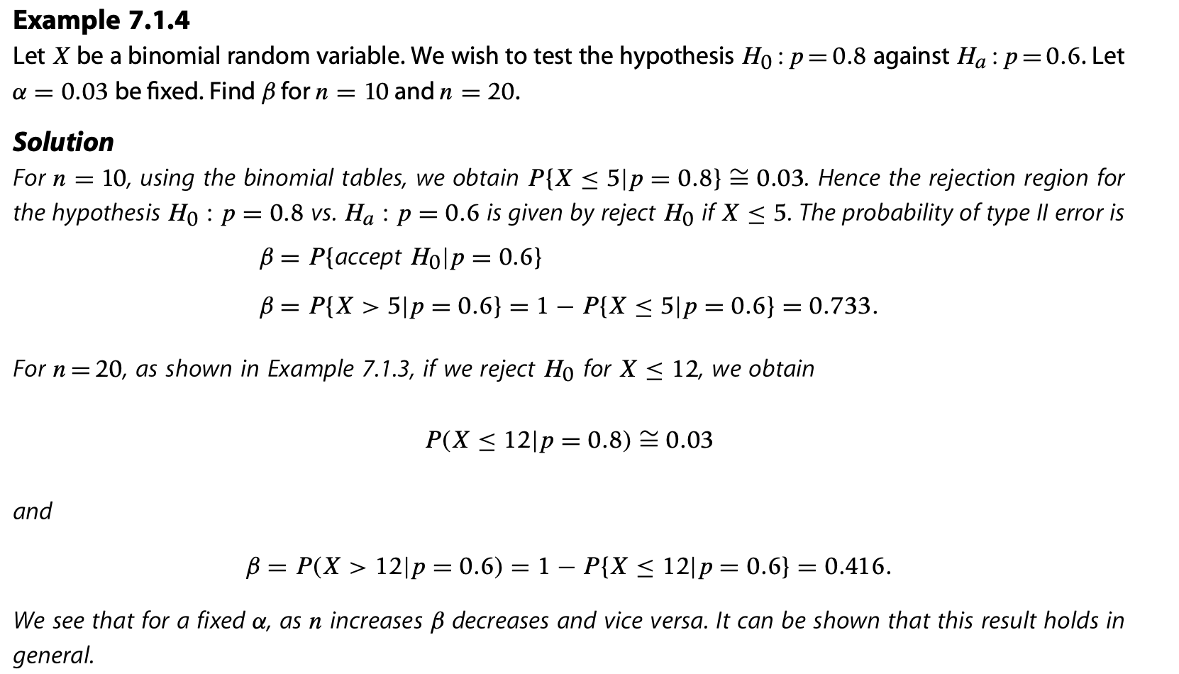

Slide 12
Text Books:
Modern Mathematical Statistics with Applications -- Jay L. Devore Kenneth N. Berk Matthew A. Carlton
Mathematical Statistics with Applications – K. M. Ramachandran, Chris P. Tsokos
Reference Books:
1. Statistical Inference -- George Casella, Roger L. Berger

