Slide 1

Predictive Maintenance System for Electric Vehicle Motors
Ensuring Reliability and Efficiency

Slide 2
Introduction & Problem Statement
EVs: The Future
Motor Criticality
Electric Vehicles are key to future transportation.
EV motors are vital for performance and safety.
Reactive Maintenance Issues
Need for Proactivity
Unexpected failures lead to high costs, downtime, and safety risks.
Lack of real-time insights demands a preventive solution.

Slide 3





Proposed Solution: Predictive Maintenance
Data-Driven Forecast
Predicts equipment failure before it occurs.
Proactive Approach
Shifts from reactive fixes to preventive action.
Sensor-Driven Monitoring
Continuous real-time health monitoring of EV motors.
Timely Maintenance
Minimizes downtime and operational expenses.

Slide 4
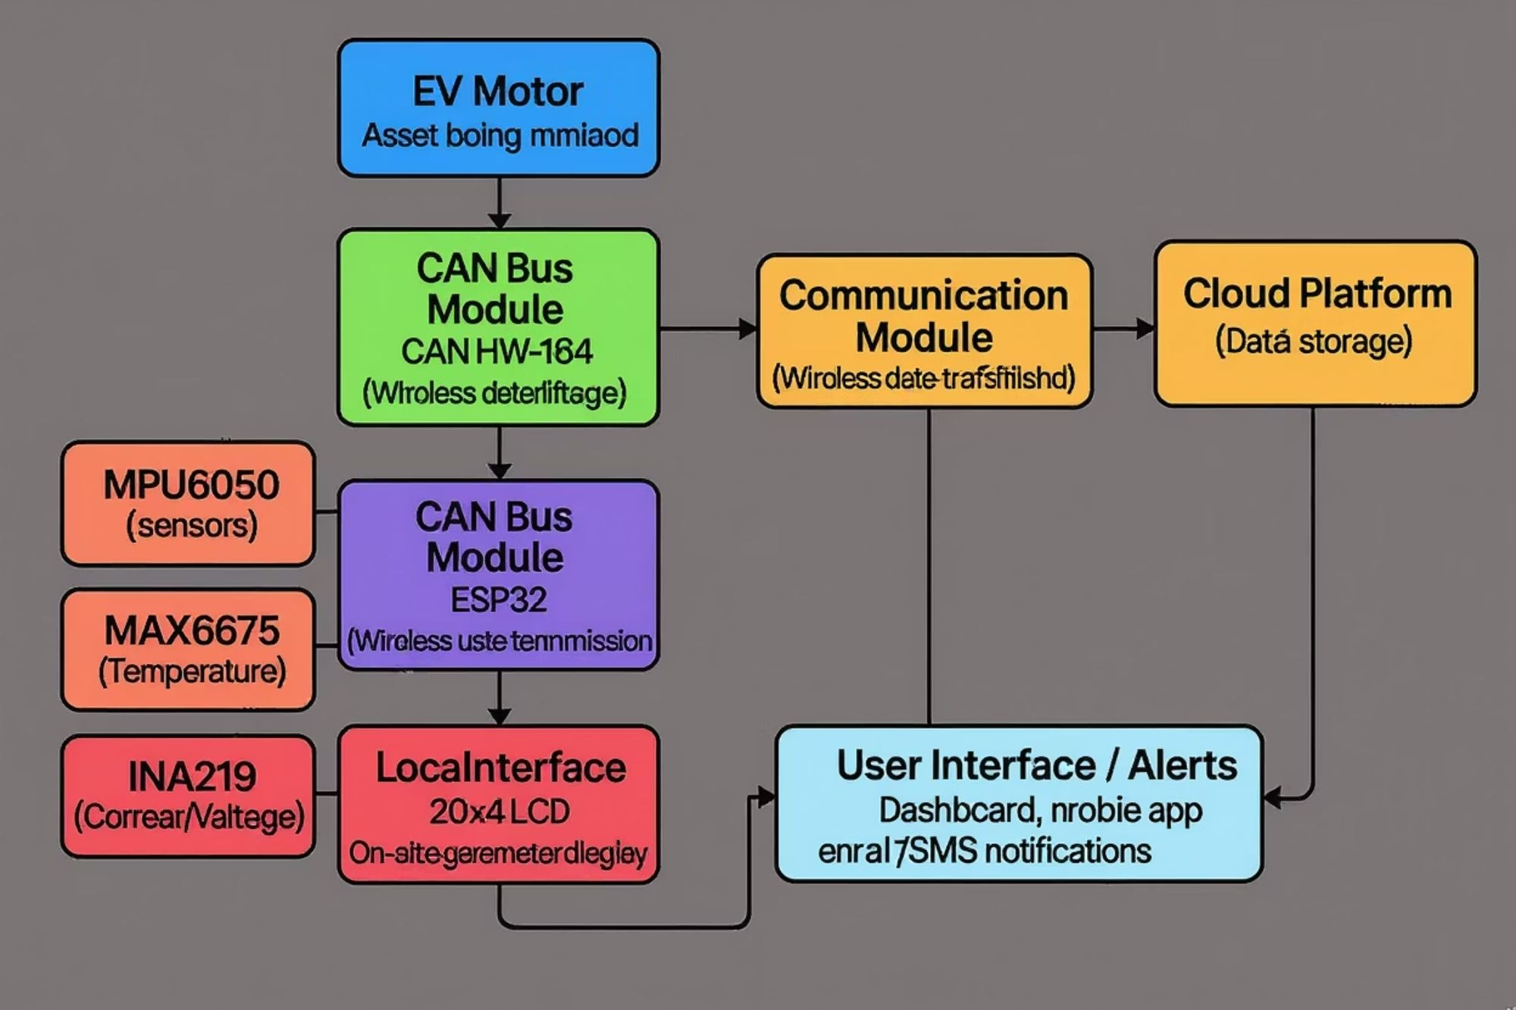
System Architecture

Slide 5
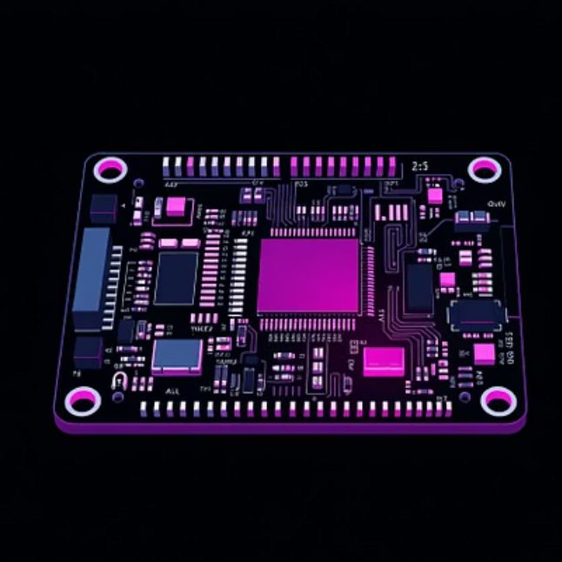


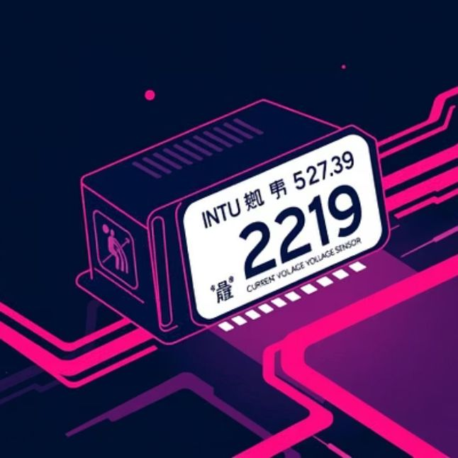

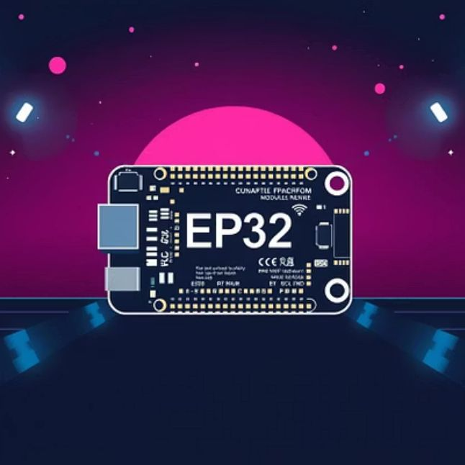

Hardware Components

Slide 6

Software & Algorithms
Data Acquisition & Pre-processing
Data Transmission
Cloud Platform & Analytics
Secure Wi-Fi connection.
Scalable time-series database.
Reads sensor data.
Transmits data via MQTT/ HTTP/HTTPS.
Threshold-based alerting.
Filters noise.
Scales and formats data.
Handles connection stability.

Slide 7
Data Flow & Cloud Integration
Sensor Data Collection
Wireless Transmission (ESP32)
Cloud Ingestion & Storage
Raw signals from MPU6050, MAX6675, INA219, CAN bus.
Validated data in secure database.
Encrypted data packets over Wi-Fi.
Alerting & Visualization
Interactive dashboards, predictions, alerts.

Slide 8






Expected Outcomes & Benefits
Reduced Downtime
Lower Costs
Proactive maintenance scheduling.
Prevents failures, optimizes inventory.
Increased Lifespan
Enhanced Safety
Early detection extends motor life.
Mitigates sudden failure risks.
Improved Efficiency
Data-Driven Decisions
Maximizes EV uptime.
Insights for design and optimization.

Slide 9

Future Scope & Conclusion
Future Scope
Conclusion
Advanced AI/ML integration.
Robust, intelligent solution for EV motor reliability.
Dedicated mobile app.
Transforms reactive to proactive, cost-effective maintenance.
Monitor other EV components.
Edge computing for anomaly detection.
Crucial for sustainable EV growth.
Vehicle telematics integration.

