Slide 1


Communication
Dr. Ashna Jacob
Faculty of English
HSSM
IIT BBS

Slide 2
The Process of Communication
community
dynamic
Symbolic exchange of meaning
words
intonation
gestures
interactive

Slide 3
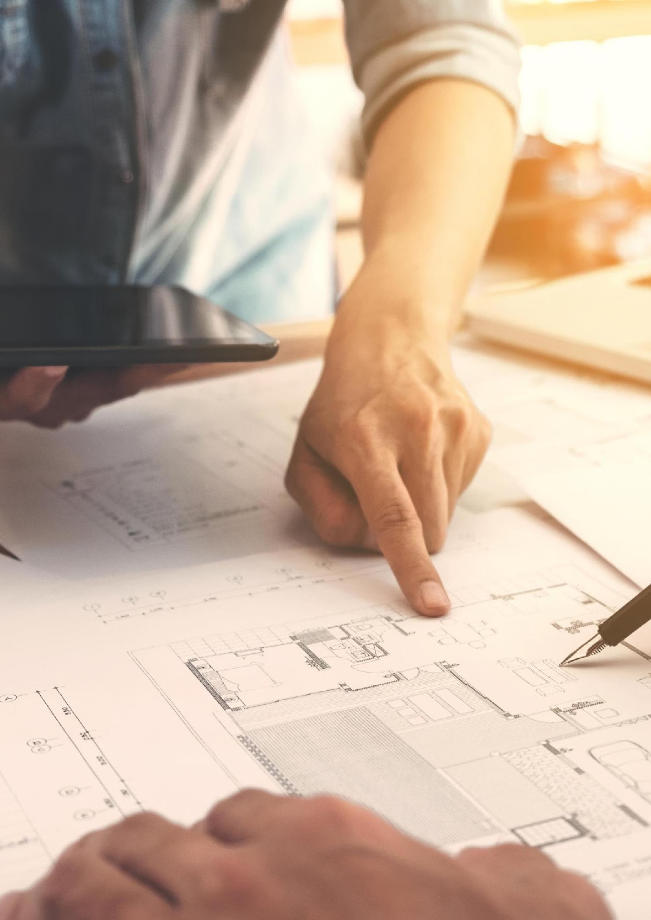
65% in English
80% of time used for Communication
27% in Hindi
8% in other languages

Slide 4

Sender
Channel
Message
Receiver

Slide 5
The Communication Process
1
Encoding
Sender converts Idea into Words or Gestures
2
3
4
5
Transmission
Message travels over a Channel
Decoding
Receiver decodes Message
Response
Receiver Responds
Ideation
Sender has Idea

Slide 6
Selection
Speaking
Execution
Sender
Selection
Writing
Execution
Identification
Listening
Interpretation
Receiver
Identification
Reading
Interpretation

Slide 7
Improper Encoding
Psychological Interference
Bypassing
Barriers
Intercultural Semantics
Frame of Reference
Physical Factors
Poor Retention

Slide 8
Non-verbal Communication
Kinesics
Paralinguistics
Proxemics
Chronemics
Body language
Rate of speech
Spacing between Parties
Arriving Early
Accent
Facial expressions
Volume
Objects in Space
Arriving Late
Voice Modulation
Eye contact
Pitch
Standing/ Sitting
Speaking out of Turn
Fluency

Slide 9

Channels of Communication
Formal and Informal Communication
Internal and External Communication
Downward Communication
Upward Communication
Horizontal Communication
Diagonal Communication

Slide 10
Technical Communication: specific message to specific audience with specific purpose
Subject Competence
Technical Communication
Linguistic Competence
Organizational Competence

Slide 11





Technical content and specialised vocabulary
Formal elements and formal style
Factual and Objective
Organised and Structured
Specific audience

Slide 12

Corporate Communications
Meetings
Presentations
Interview
Tele/Video conferencing
Group Discussions
Reports
Proposals
Notice, Agenda, Minutes
Memos
Business Letters/ Emails

Slide 13

Effective Communication
Ask and answer questions
Provide clarifications, give explanations
Ask for opinions, seek suggestions
Express criticism/ objection/ doubt
Agreeing/ Disagreeing
Initiate Discussions
Coordinating Discussions, Topic transitions
Conducting, Coordinating, Participating, Summarizing and Concluding meetings
Interpreting Data
Negotiating, Persuading

Slide 14
Thank You

