Slide 1
DTL – Bash Scripting – Sample Scripts
112103047
Soham M. Gupte
Batch – S3

Slide 2



Slide 3


Slide 4


Slide 5



Slide 6



Slide 7



Slide 8


Slide 9


Slide 10
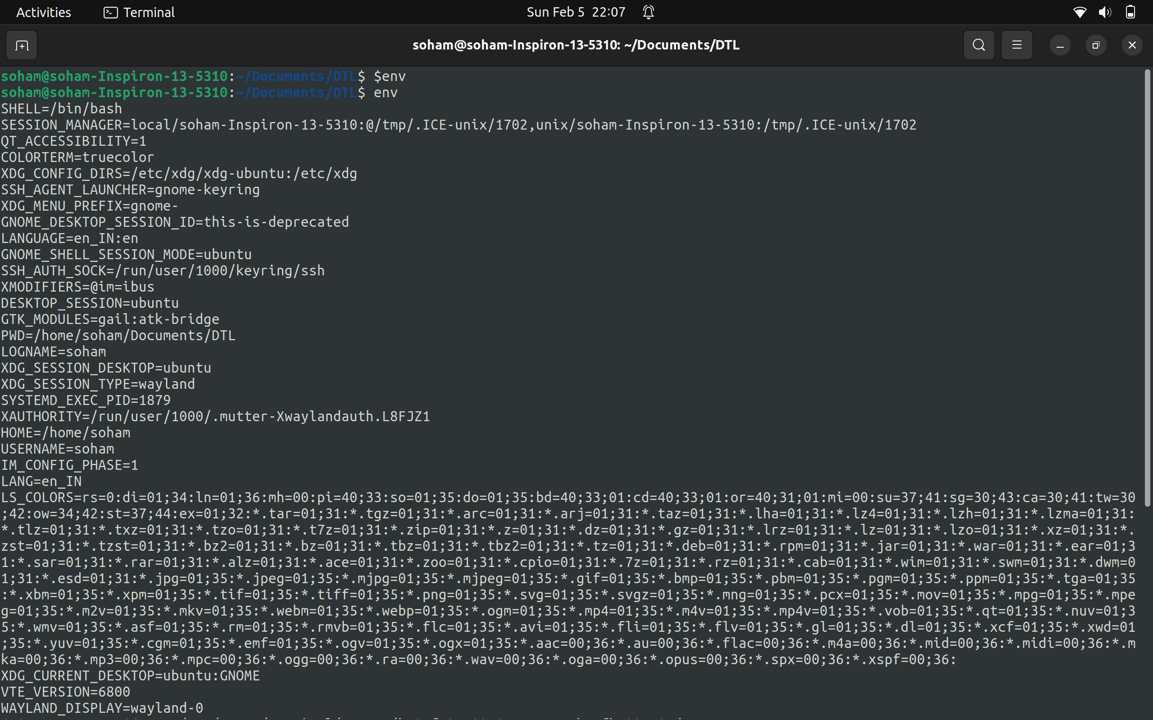

Slide 11
