Slide 1







Capstone Project
Soham Jain
November 8

Slide 2



OUTLINE
Executive Summary
Introduction
Methodology
Results
Visualization – Charts
Dashboard
Discussion
Findings & Implications
Conclusion
Appendix

Slide 3

EXECUTIVE SUMMARY
Covers Data collection, Data Wrangling, Exploratory Data analysis (EDA), and Data Visualization via charts & dashboard
Data collection sources were:
API’s
Web Scraping
Data Wrangling included handling duplicates and missing values
EDA consisted of outlier detection and in-depth analysis of data
Insights were represented by various charts
Dashboard was created for concise representation

Slide 4

INTRODUCTION
This analysis is a deep dive into the data related to technologies and its demographics
Questions we’re trying to answer:
Trends and insights in technologies
Trends and insights in demography for technology
What technologies are most popular currently and likely to be learnt in the future
Any kind of correlation between two parameters of the data

Slide 5

METHODOLOGY
Data sources for the project includes:
Web-scraping
API’s
The data is extracted using beautiful soup library from various URL’s and combined into final dataset
Similarly, data is extracted from API’s and merged into the final dataset.

Slide 6
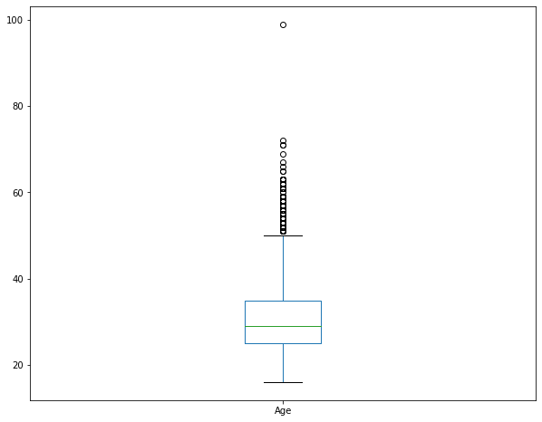
RESULTS
The initial data had 11552 rows and 85 columns (parameters)
There were 154 duplicate rows
The Age parameter has correlation of 0.1 with modified compensation
Age distribution

Slide 7
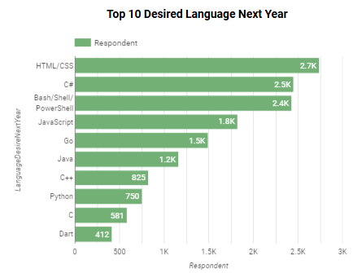
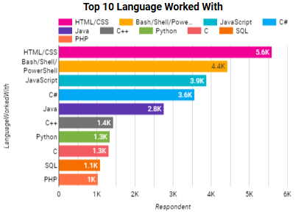
PROGRAMMING LANGUAGE TRENDS
Current Year
Next Year

Slide 8
PROGRAMMING LANGUAGE TRENDS - FINDINGS & IMPLICATIONS
Findings
Top 3 currently worked language with consists of :
HTML/CSS, BASH/SHELL/PowerShell & Java
Top 3 preferred language to learn in future consists:
HTML/CSS, C#, BASH/SHELL/PowerShell
Javascript is 3rd in current and 4th in future language list
Implications
HTML/CSS is a language which is in demand in both current and future
BASH/SHELL/PowerShell is another candidate which remains relevant in both current and future times
C# has high potential in future
Javascript is a language decreasing in importance

Slide 9
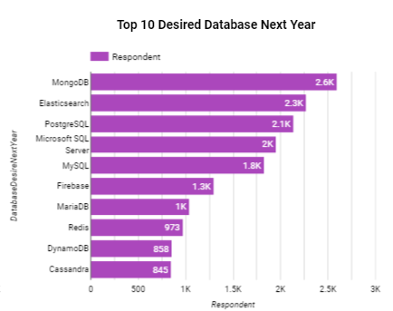
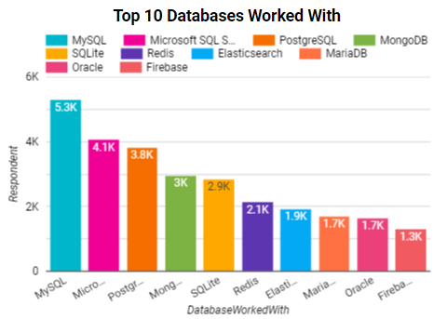
DATABASE TRENDS
Current Year
Next Year

Slide 10
DATABASE TRENDS - FINDINGS & IMPLICATIONS
Findings
The top 3 databases being used are MySQL, MS SQL & PostgreSQL
Top 2 future database to learn are MongoDB and Elastisearch
The top 3 current databases being used take spots 3 and below in database to learn in future
Implications
The top databases being used are no longer sought after in future preference
MongoDB and Elastisearch might take over in future as database used

Slide 11

DASHBOARD
https://github.com/soham-jain/python_capstone_project/blob/main/Looker_Dashboard.pdf

Slide 12
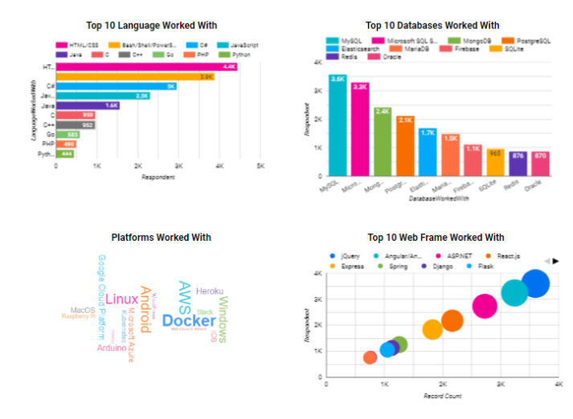
DASHBOARD TAB 1

Slide 13
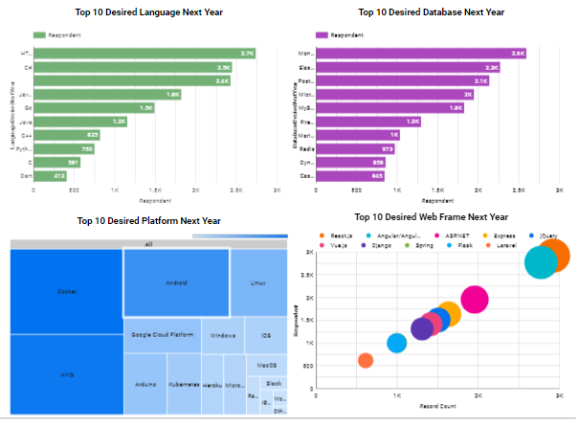
DASHBOARD TAB 2

Slide 14
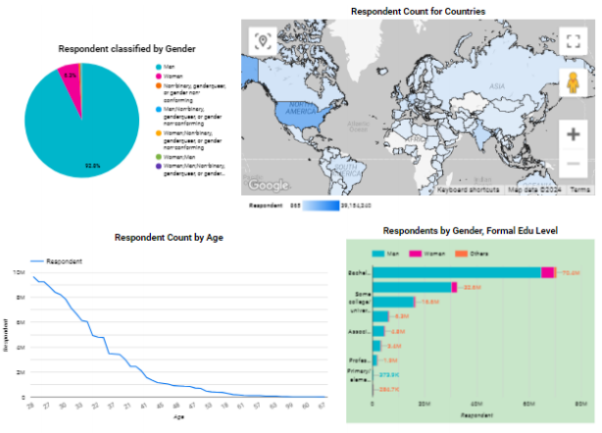
DASHBOARD TAB 3

Slide 15
DISCUSSION
We are open for further questions!

Slide 16
OVERALL FINDINGS & IMPLICATIONS
Findings
Top Language and database being currently used are HTML/CSS and MySQL
Top to learn language and database are HTML/CSS and MongoDB
The survey takers were highly dominated by males
Implications
The language HTML/CSS seems to be relevant
The database SQL and its variants might be replaced with likes of MongoDB and Elastisearch
There seems to be a huge gender disparity in coding world

Slide 17

CONCLUSION
Over 92% were male respondents with 9.8M respondents being aged 28
Majority education level for 72M was bachelors
Maximum respondents in the survey reside in country USA – 39M

Slide 18
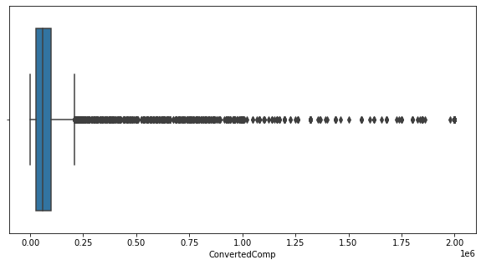
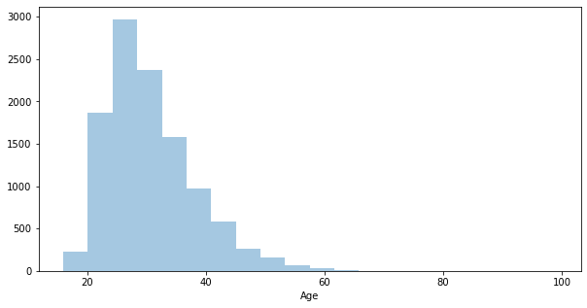
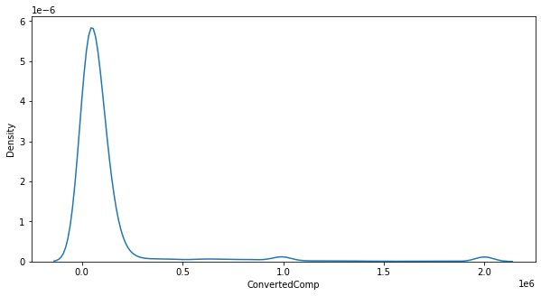
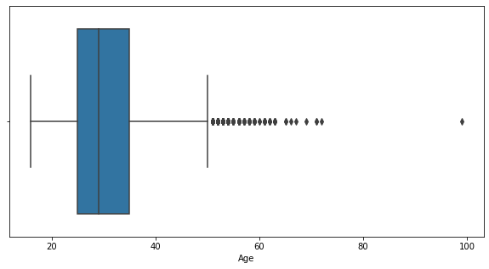
APPENDIX
Converted Comp
Histogram for
Age parameter
Distibution curve of
Converted Comp parameter
Age

Slide 19
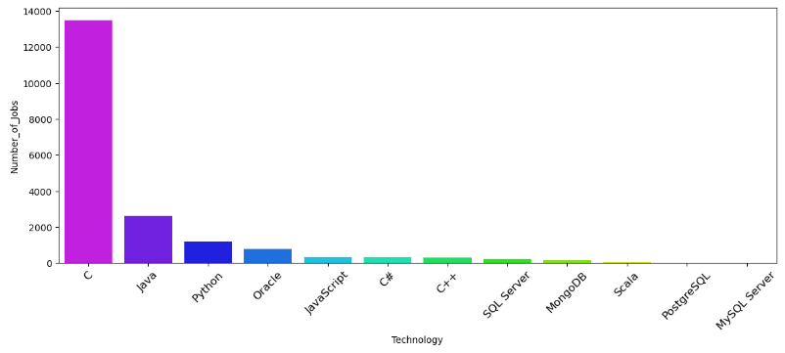
JOB POSTINGS

Slide 20
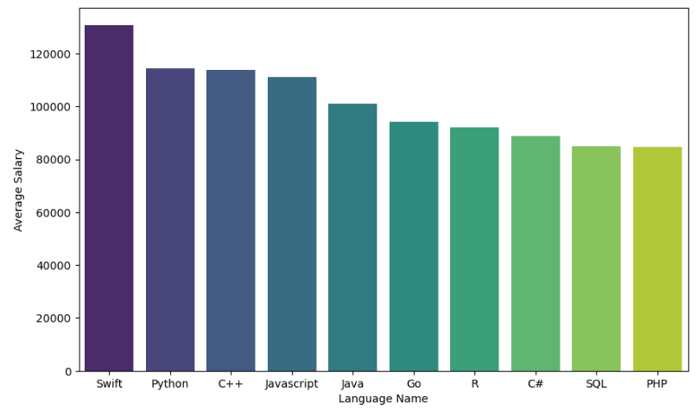
POPULAR LANGUAGES

