Slide 1
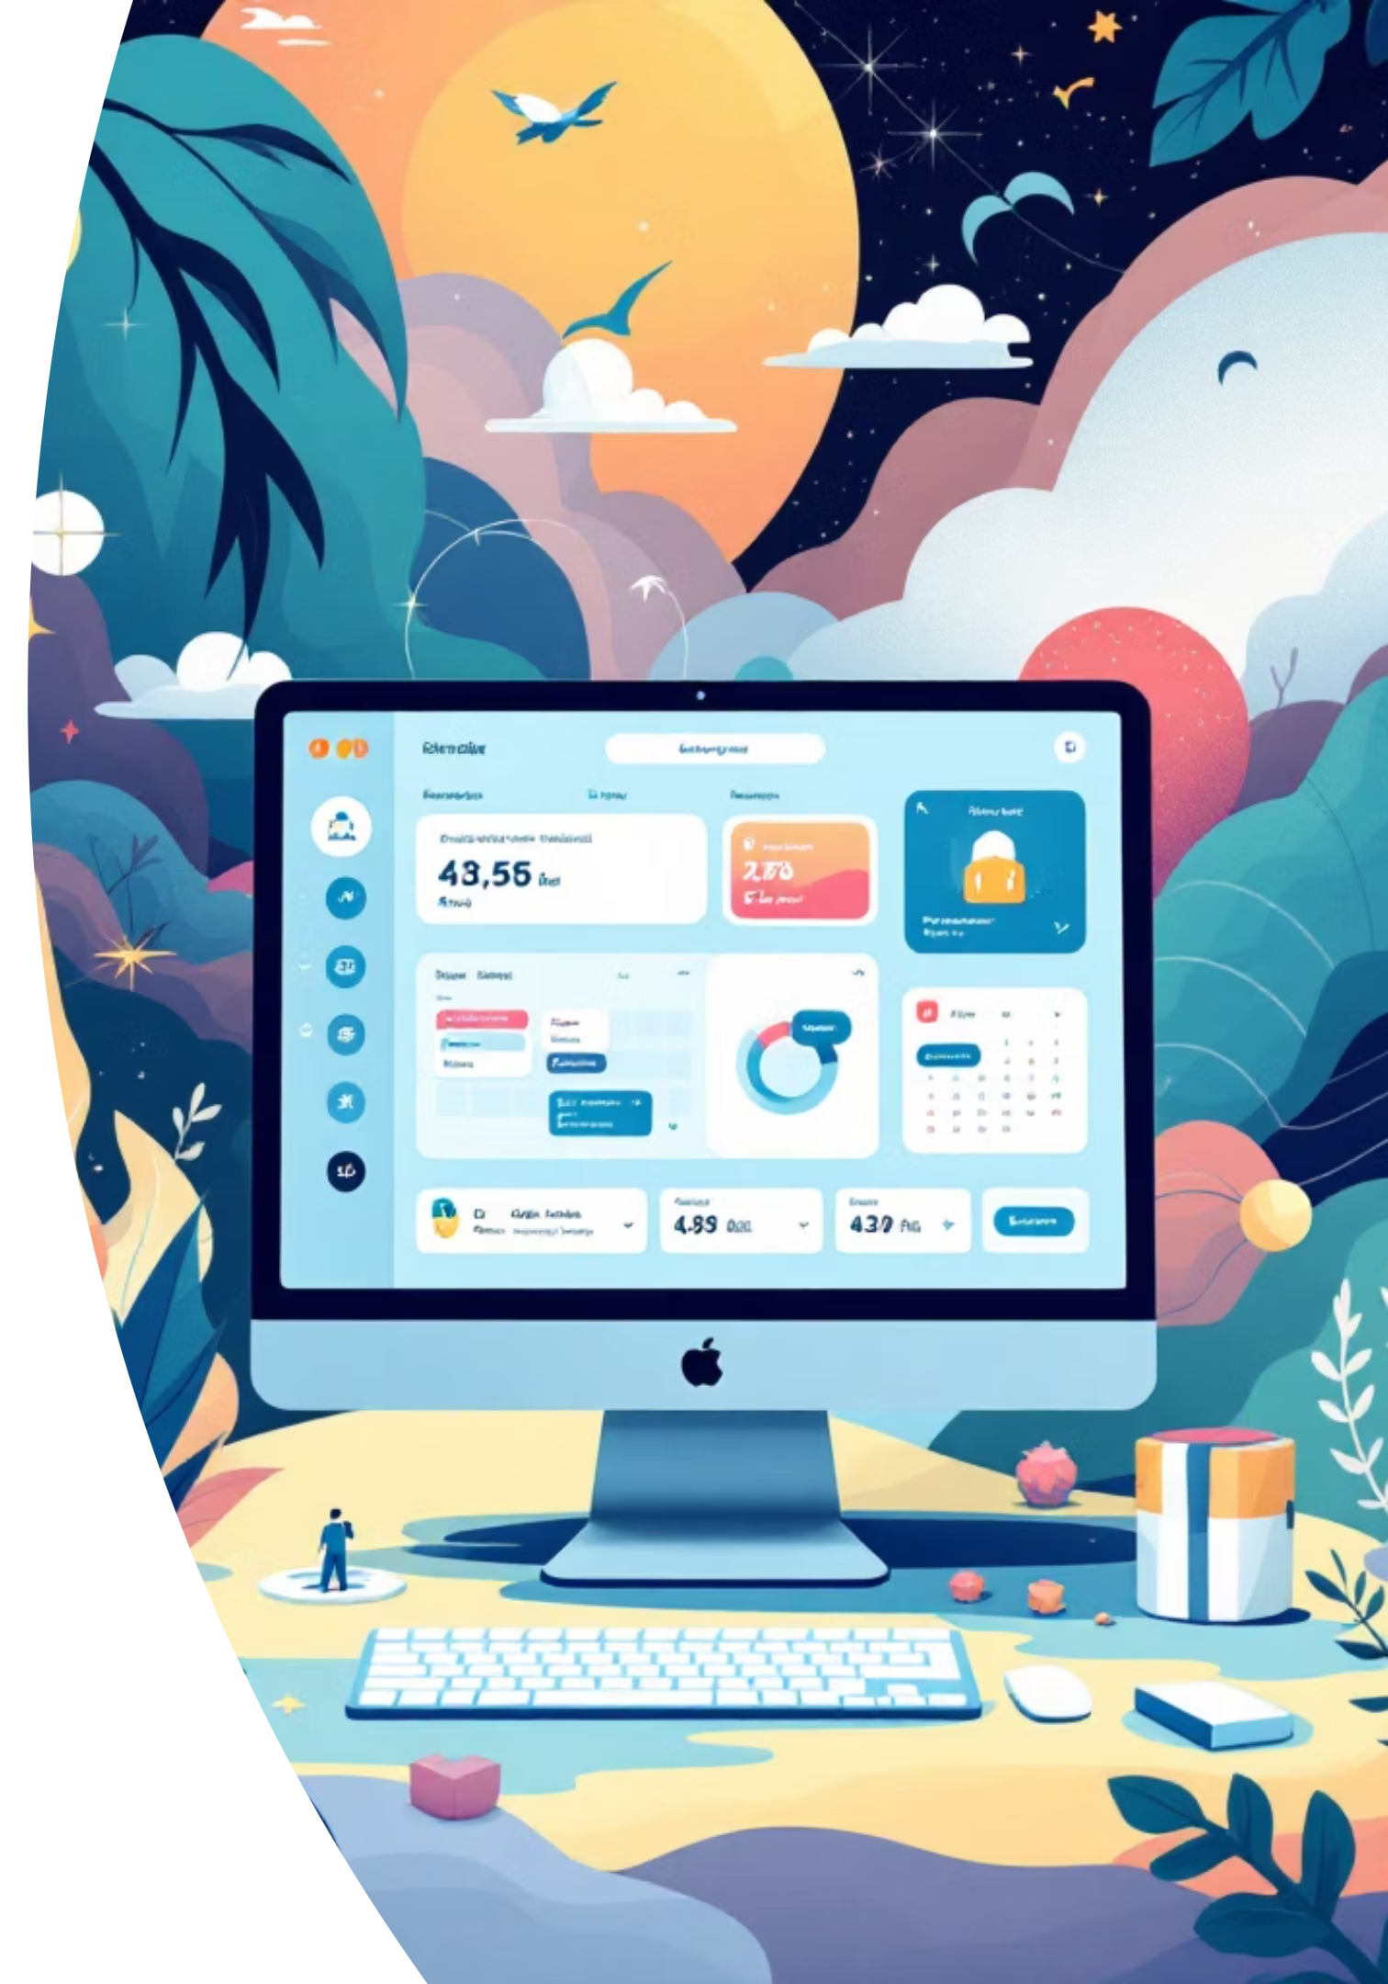
Enterprise Event Hub
A Microservices-Based Event Management Platform
Transforming email chaos into organized event discovery

Slide 2

The Email Overload Problem
Current Pain Points
Multiple teams conducting events across all locations and business units
Email-based communication creates massive inbox noise and clutter
Employees consistently miss events relevant to their interests
No centralized discovery mechanism for finding events
Event organizers depend on other teams for campaign management
100+
Event Emails
Received monthly per employee
60%
Missed Events
Relevant events overlooked in inbox

Slide 3





Event Hub: The Unified Solution
A centralized platform that transforms event management from chaotic email chains to organized, discoverable experiences
Discoverability
Personalization
Find events that matter to you through intelligent search and filtering
AI-based suggestions tailored to your interests, role, and preferences
Automation
Integration
End-to-end event lifecycle management from proposal to completion
Seamless connectivity with Calendar, Teams, Viva Engage, and more

Slide 4
Five Key User Personas
Application Administrator
Event Organizer
Governance Team
Configures platform settings, manages user access and permissions, monitors system logs and performance metrics
Creates and approves events, validates scheduling clashes, manages campaign distribution
Provides campaign support, manages event promotion strategies, ensures compliance
Event Speaker
Event Audience
Proposes speaking sessions, provides session metadata and descriptions, manages content
Discovers relevant events, registers for attendance, provides feedback and ratings

Slide 5
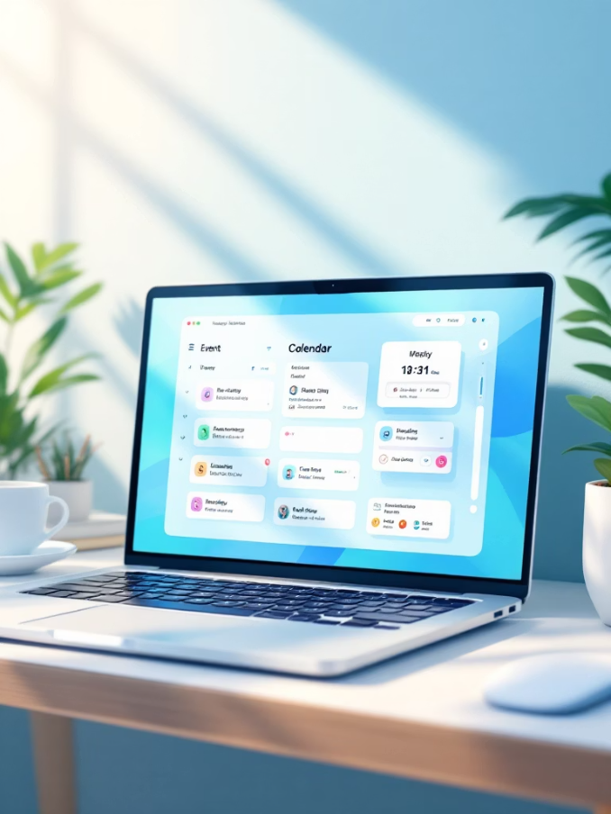
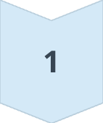
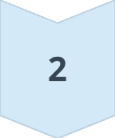
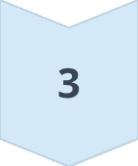
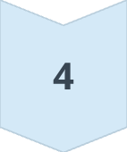
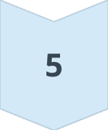
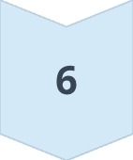
Audience-Centric Features
Personalized Experience
Smart preferences by event type, frequency, and topic areas
Intuitive calendar views: 1-day, multi-day, and weekly formats
Smart popups based on settings or after 1-hour inactivity
One-click calendar synchronization with Outlook integration
Advanced preference-based filtering and search
User Journey
Login
Set Preferences
View Events
Register
Add to Calendar
Attend & Feedback

Slide 6
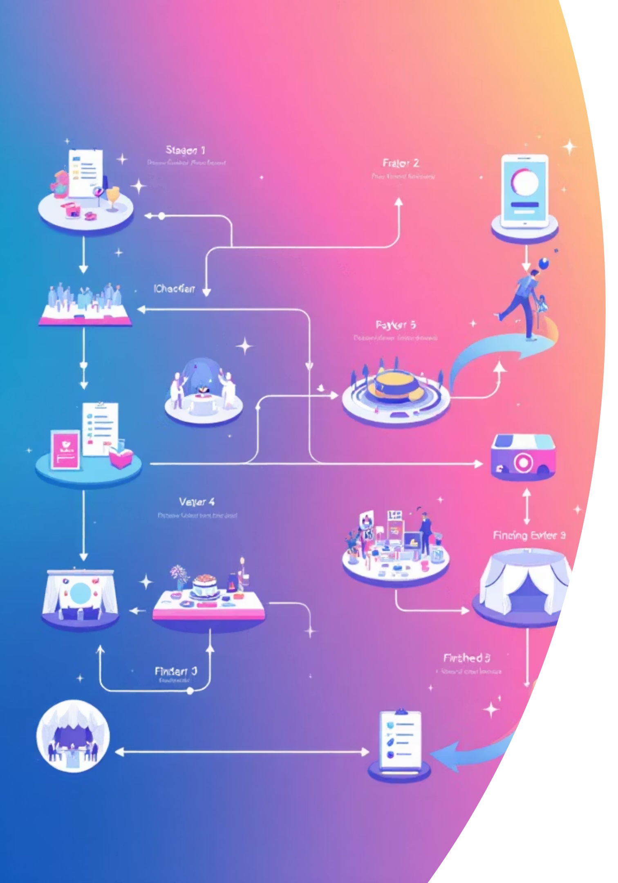
Organizer & Speaker Workflow
Event Lifecycle
01
Draft
Speaker proposes event with metadata
02
Proposed
Organizer reviews and validates
03
Approved
Clash detection and capacity check
04
Published
Auto-campaign to channels
Speaker Actions
Organizer Actions
Propose events with complete metadata
Provide session details and descriptions
Manage speaker profiles
Review event proposals efficiently
Validate scheduling clashes
Setup meeting bridges automatically
Schedule campaigns to channels

Slide 7
System Architecture
Microservices + Event-Driven Design
Domain-Driven Design
Database per Service
API Gateway Pattern
Bounded contexts for clear service boundaries and responsibilities
Each service owns its data with eventual consistency via events
Single entry point for authentication and request routing
SAGA Pattern
Circuit Breaker
Coordination of distributed transactions across services
Fault tolerance and graceful degradation strategies

Slide 8
Six Core Microservices
Each service handles specific domain responsibilities with dedicated databases
Service
Port
Database
Responsibility
User Service
8081
eventhub_users
Auth, Profiles, Roles
Event Service
8082
eventhub_events
CRUD, Approval, Clash Detection
Session Service
8083
eventhub_sessions
Sessions, Speakers, Venues
Registration Service
8084
eventhub_registrations
Registration, Waitlist
Notification Service
8085
eventhub_notifications
Email, FCM Push, WebSocket
Campaign Service
8086
eventhub_campaigns
Teams, Viva Engage Publishing

Slide 9
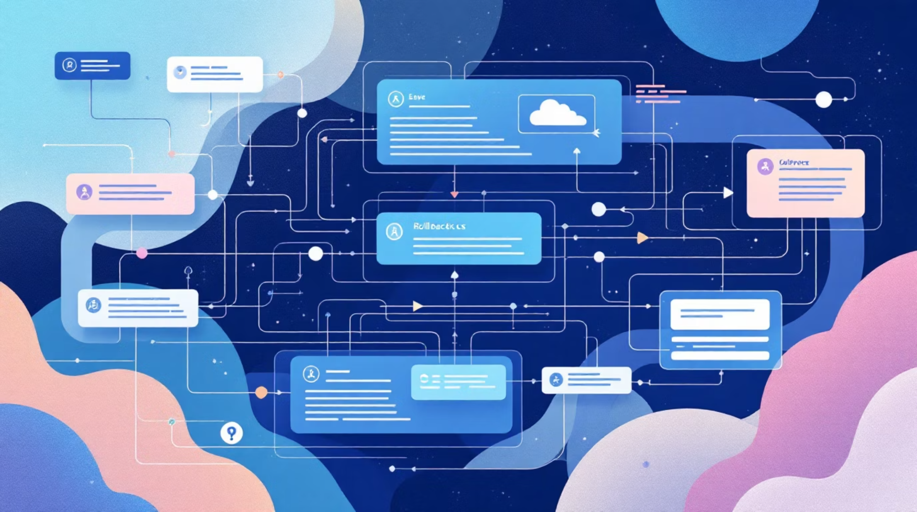
SAGA Pattern for Data Consistency
Why SAGA?
Ensures reliable transaction handling across microservices without tight coupling. Uses compensating transactions instead of ACID rollbacks for eventual consistency.
Registration Saga Flow
Reserve Seat in Registration Service
Send Confirmation via Notification Service
Update Capacity in Session Service
Failure Handling
If any step fails, compensating actions automatically rollback previous operations to maintain data integrity.

Slide 10





Technology Stack
Backend
Spring Boot 3.2+, Java 17+, MySQL 8.0+, Apache Kafka, Spring Security with OAuth2/JWT
Frontend
React 18+, Redux Toolkit, Material-UI, WebSocket with STOMP protocol
Infrastructure
Docker containers, Kubernetes on AKS, Spring Cloud Gateway, Prometheus + Grafana monitoring
External APIs
FCM for push, MS Graph API, Viva Engage API, Azure Communication Services

