Slide 1
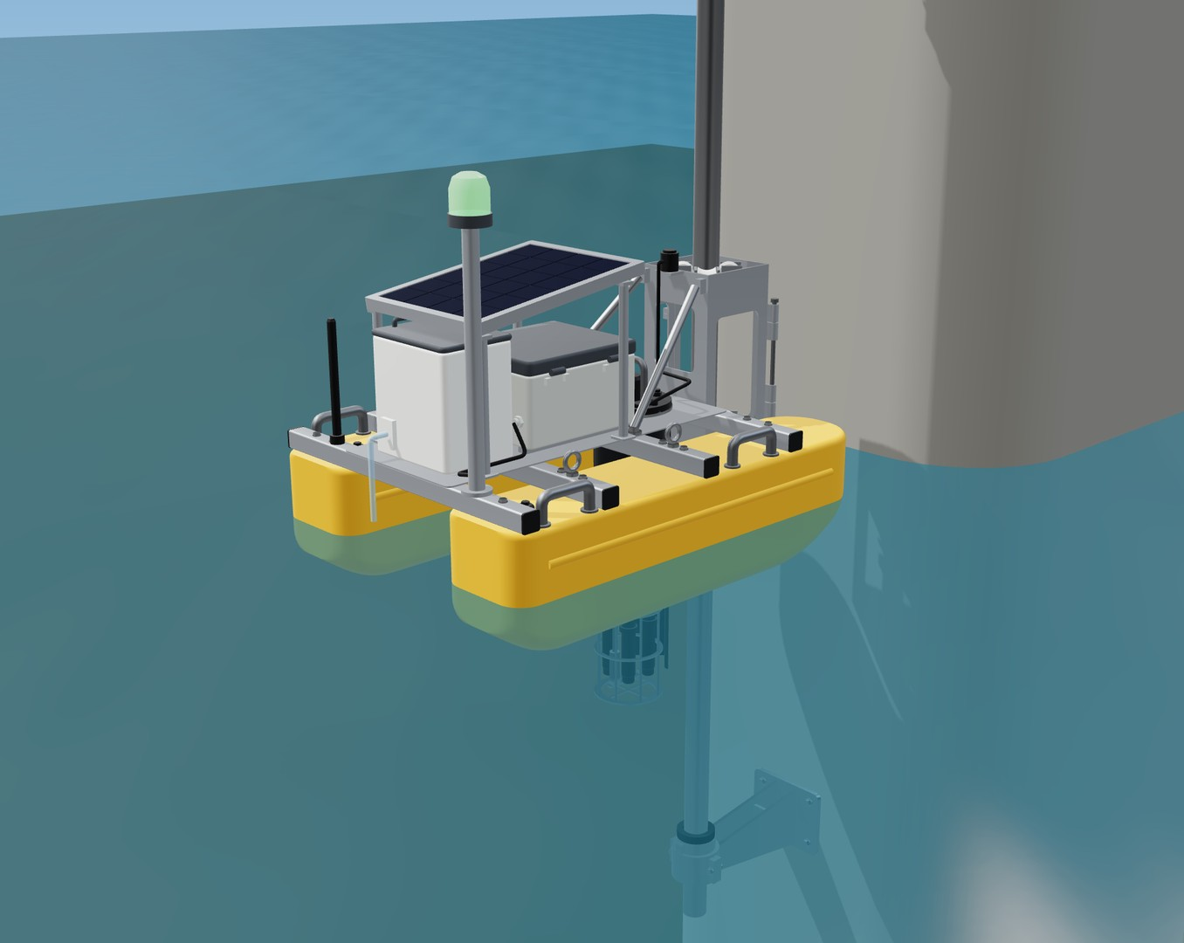
AquaSentinel
AAKRUTI INNOVATION COMPETITION 2026 · INDIA SEMI-FINAL
Catches the spill that monthly sampling misses.
An autonomous river robot on a guide pole. It is designed to read the river every 15 minutes, decide on board, and when a spill passes, turn its beacon red, alert the water-works and bottle a sample for the lab.
SENSE every 15 min
THINK on board
ACT beacon, alert, sample
Team Sanjivani Hero's Journey
Sanjivani University, Kopargaon · AAKRUTI 2026 · Robotics · AG26-1500$41
Concept render of the R3 design
Notes:
before the timer | Soham | Cover
Show the cover while we are introduced. When the 8-minute timer starts, click once to slide 2. Animations play by themselves. In Q&A, type 13 and press Enter for the questions menu (slides 10-11 are prior art; 14-22 are backups A1-A9).

Slide 2
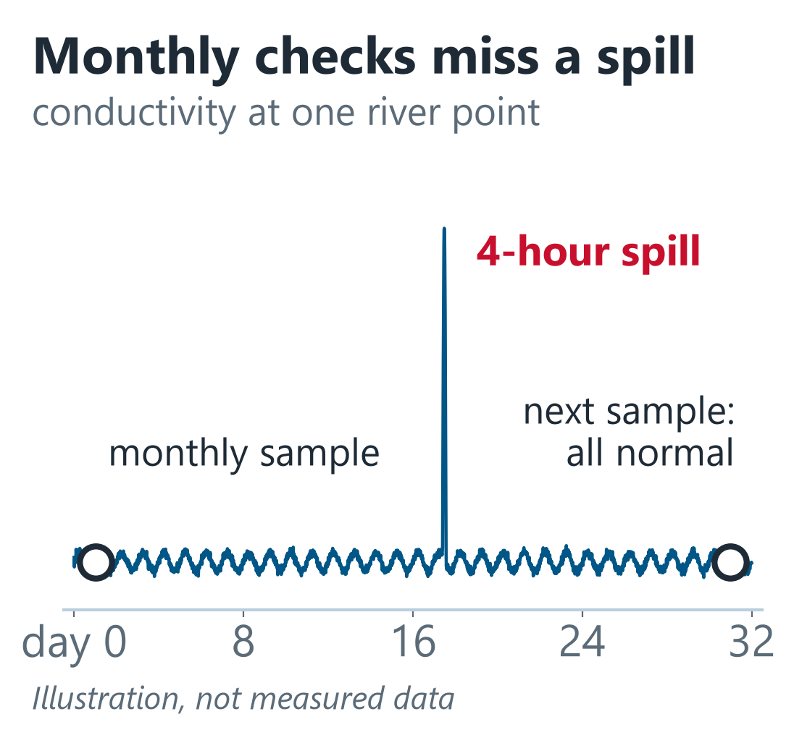
A spill passes in hours; sampling is periodic
54 of 296
polluted river stretches/locations in India are in Maharashtra, still the most of any state (CPCB, 2025)
Monthly or quarterly
manual grab samples at most national monitoring points (NWMP)
2:00 a.m.
a night-time discharge is gone long before the next sample
54 of 296: CPCB assessment published 2025 (2022–23 data; PIB, 16 Mar 2026).
Team Sanjivani Hero's Journey · Sanjivani University, Kopargaon · AG26-1500$41 · Robotics
Notes:
0:00-0:40 | S1 Soham | The problem
It's two in the morning on the Godavari. A tanker opens its valve, and by sunrise the river looks normal again. Nobody saw it, and the next official sample may be weeks away. India's latest CPCB assessment lists 296 polluted river stretches and locations, and Maharashtra, our state, has the most: 54. Most monitoring points are sampled by hand, monthly or quarterly. Real-time stations exist, but they cost tens of lakhs each, so there are very few. A spill that lasts a few hours falls through the gap. We are Team Sanjivani Hero's Journey, and AquaSentinel is our answer.

Slide 3
An autonomous river robot: sense, think, act
1
SENSE
2
THINK
3
ACT
pH, conductivity, dissolved oxygen, turbidity, temperature and river level
An ESP32 on board decides every 15 minutes, with no cloud needed
Beacon, LTE alert, and a pump, valve and 4-bottle carousel take a sample
Objective | Target | Status
Detect a spill | flagged within 30 min | ● shown on synthetic data only
Keep station, no drive motor | ride 2 m of river rise | ● calculated · 1:5 model next, then tank test
Survive a flood | 1.5 m/s current + 500 N debris | ● static case calculated · impact and anchors to verify
Run without sun | about 12 days (with beacon) | ● design estimate · measure on the bench
Service from the bridge | no tools, nobody wades in | ● designed (tool-free gate)
Notes:
1:45-2:25 | S2 Tanmay or Bhakti | What it is
AquaSentinel is a river robot designed to sense, think and act on its own. It senses pH, conductivity, dissolved oxygen, turbidity, temperature and river level. An ESP32 on board decides every fifteen minutes, with no cloud needed. When the water changes, the beacon turns red, an alert goes to the water-works, and a pump fills a sample bottle for the lab. It is an early-warning system, not a chemical identifier. The table shows each objective, and honestly, how far it is proven.

Slide 4
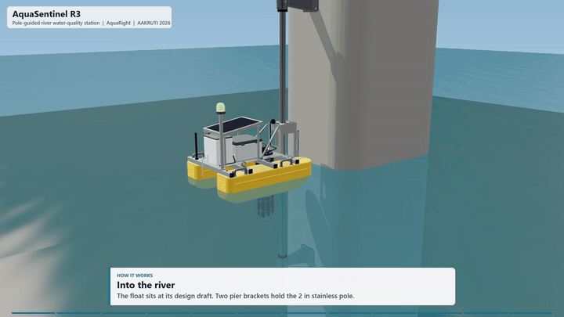
The river moves it; the robot decides
1
A 2-inch 316L guide pole clamped to a bridge pier: no riverbed work
2
8 rollers in 2 tiers let the river lift the float through 2 m
3
Its side area sits behind the pole, so it trails the current like a weathervane
4
A pull-up probe cartridge; a wiper cleans the optical windows every 6 hours
Our CAD animation: the river lifts the float up its pole
Every 15 minutes, on the float
2 m
of river rise
0
drive motors
8
rollers, 2 tiers
Hard limit crossed
pH < 6 or > 9 · DO < 4 mg/L · EC > 2250 µS/cm
ACT
beacon turns red
LTE alert
1 bottle sampled
2 of the last 3 readings unusual
vs a baseline learned for each hour of the day
Notes:
2:25-3:10 | S2 | How it works
How does it stay in place without a motor? A two-inch stainless pole is clamped to a bridge pier, so nobody works in the riverbed. Eight rollers in two tiers let the river itself carry the float up and down through two metres, and its side area sits behind the pole, so the current turns it like a weathervane. Every fifteen minutes it checks hard limits, like pH outside six to nine or oxygen below four, and a baseline it learns for every hour of the day. Two unusual readings out of three make an event.

Slide 5
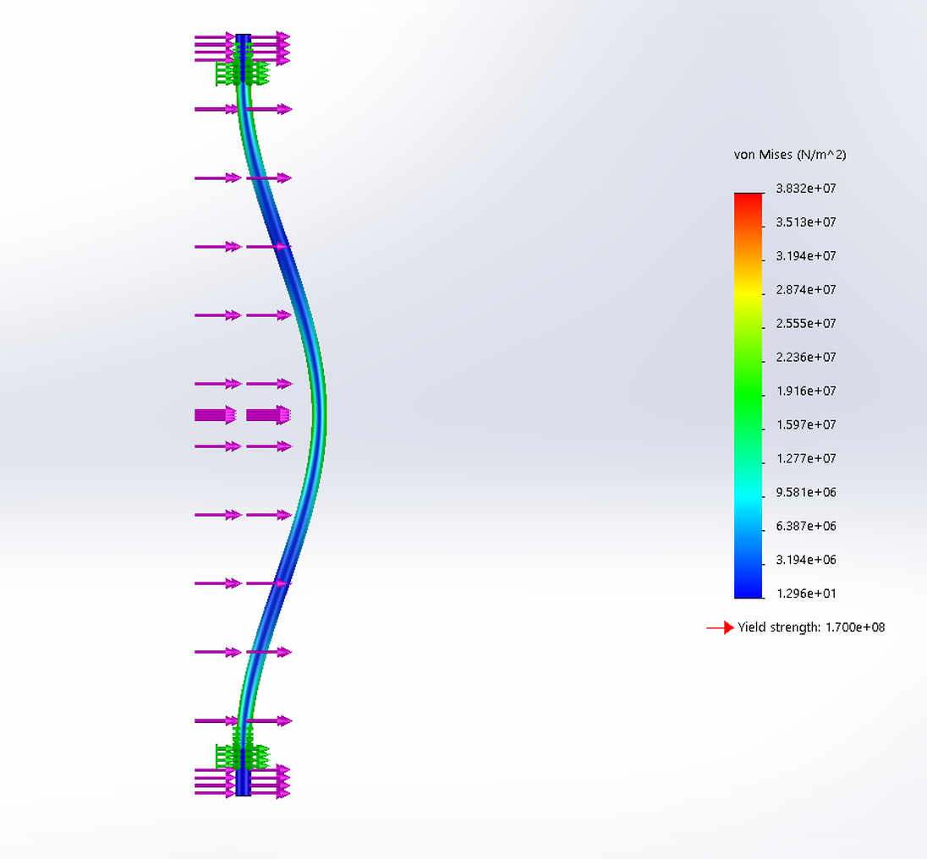
Every requirement checked on the CAD model
143 mm
2.27×
freeboard
reserve buoyancy
requirement ≥ 100 mm
requirement ≥ 2.0×
60°
642 N
righting arm still positive at
flood + debris load at the float
max 180 mm at 25°
142 N drag at 1.5 m/s + 500 N debris
2.66
8.6×
pole safety factor, static load case
carriage anti-jam margin
pinned + carriage moment: 64 vs 170 MPa
1.7× even with seized rollers
SOLIDWORKS Simulation of the pole under the flood + debris load. Fixed ends give 4.4; we quote 2.66. Static case: dynamic impact and anchors still to verify.
14 of 14 design checks pass · values computed from the R3 CAD geometry
Notes:
3:10-3:50 | S3 (whoever knows the CAD best) | Design checks and simulation
We checked every requirement on the CAD model itself. The float weighs 48.5 kilograms by our estimate, floats with 143 millimetres of freeboard and more than twice the buoyancy it needs, and rights itself up to sixty degrees. For a flood we designed for 1.5 metres per second plus a 500-newton debris load. Simulation with fixed ends gives a safety factor of 4.4; we quote our most conservative case, 2.66. That is a static case: impact and anchors are still to verify.

Slide 6
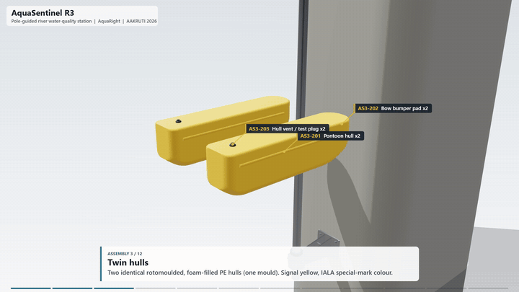
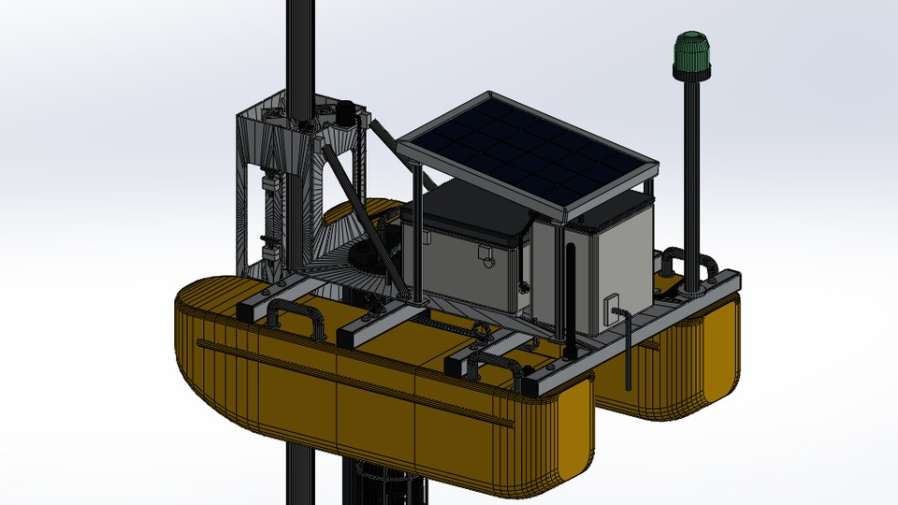
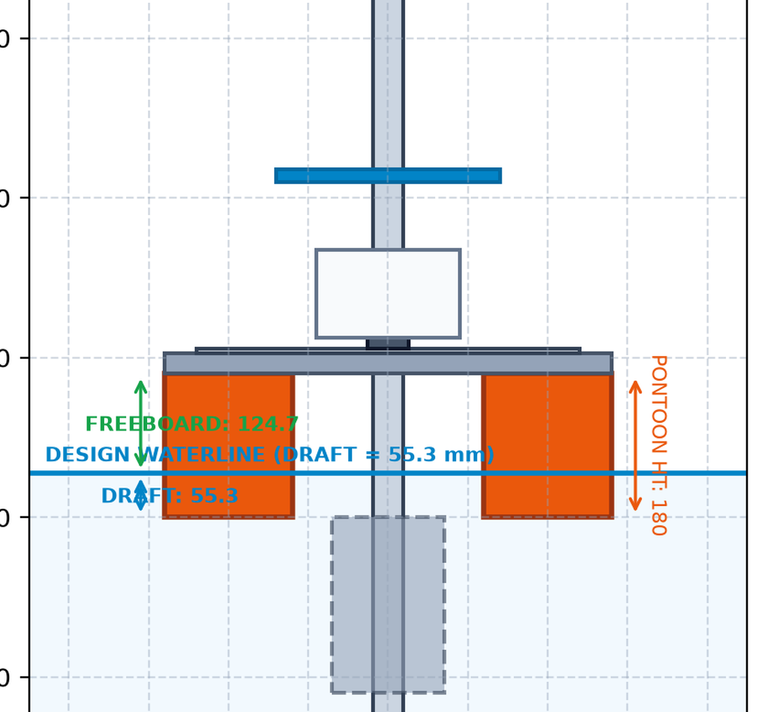
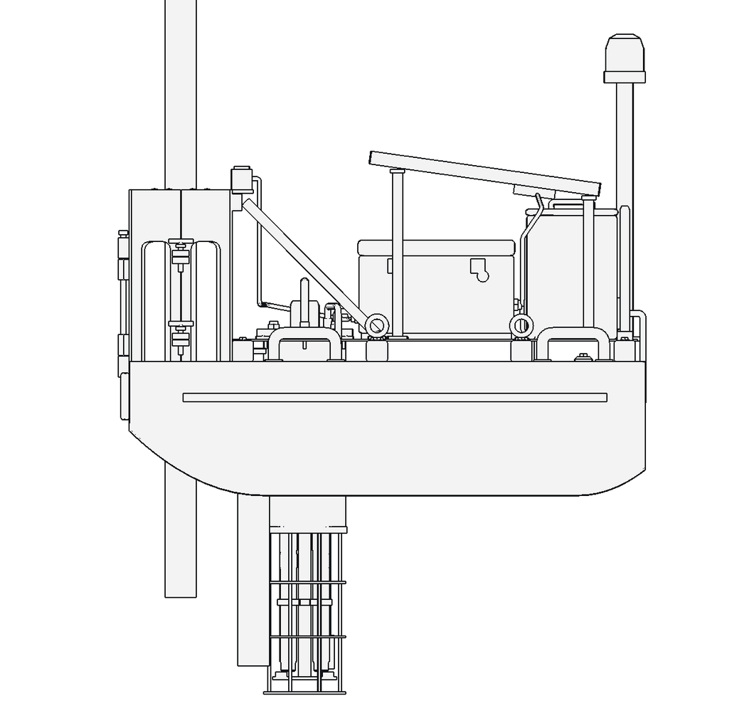
66 parts, one mould, off-the-shelf electronics
PE hulls
UV-stabilised, rotomoulded: one mould makes both hulls
6061 aluminium
deck and carriage: cut, bent and TIG-welded
316L stainless
pole and brackets: standard 2-inch pipe and 6 mm plate
Off the shelf
RS485 probes, ESP32, LTE modem, 20 W solar, LiFePO4 battery
The float in SOLIDWORKS
CAD caught our two biggest mistakes
Real mass from CAD: 25.4 → 48.5 kg, so the hulls grew (draft 55 → 117 mm)
Built with SOLIDWORKS, SOLIDWORKS Simulation, Pack and Go and ENOVIA Project Planner
v2 (old values): pole through the pod
R3: pole at the bow
Notes:
3:50-4:20 | S3 | Materials and manufacturing
R3 is a 66-part SOLIDWORKS assembly with a real material on every part: two polyethylene hulls from one rotomould, aluminium deck and carriage, a stainless pole, and off-the-shelf electronics, so a local fabricator can build it. CAD also caught our two biggest mistakes: the pole once ran through the electronics pod, and the real mass came out at 48.5 kilograms, not 25.

Slide 7
A service for those who must act on spills
Pollution boards
Water-works
Irrigation / WRD
Industrial estates
catch discharges; know when to sample
close the intake in time
a continuous record with river level
an independent downstream record
What it costs
Versus a real-time station
How we earn
≈ ₹1.57 lakh
per float, ex-GST, + ₹0.29 lakh bridge kit
■ probes 44 %
■ everything else 56 %
≈ ₹1.24 lakh at 100 units (estimate)
₹35–40 lakh
Monitoring as a service
₹12,000 a month per float, 5-year contract: hardware, install, service, alerts, data
Hardware paid back in ≈ 20 months; ≈ 46 % margin over 5 years
Or buy: ≈ ₹3 lakh installed + maintenance contract
for one station's 10-parameter instruments (CSE)
Not like-for-like: stations measure more. We add the dense early-warning layer between them.
Kopargaon pilot
3 floats, one stretch
MPCB regional programme
Maharashtra's 54 polluted sites
Sources: CPCB assessment (2025); CSE (station cost); our costed R3 bill of materials (Indian prices, 23 Oct 2026, ex-GST). Fee (5-year contract) and roll-out are proposals, at the 100-unit cost.
Notes:
4:20-5:30 | S1 Soham | Customers, cost and business model
Who pays? Pollution control boards, water-works protecting their intakes, irrigation departments and industrial estates. We priced all 66 parts from Indian suppliers: one float costs about 1.6 lakh rupees before GST, plus a 29-thousand-rupee bridge kit; at a hundred units, about 1.5 lakh together. But a board doesn't buy it. It pays twelve thousand rupees a month on a five-year contract, like station maintenance tenders. That pays back the hardware in about twenty months, with a margin of about 46 percent. One real-time station's instruments alone cost thirty-five to forty lakh. We start with three floats at Kopargaon, then Maharashtra's 54 polluted sites.

Slide 8
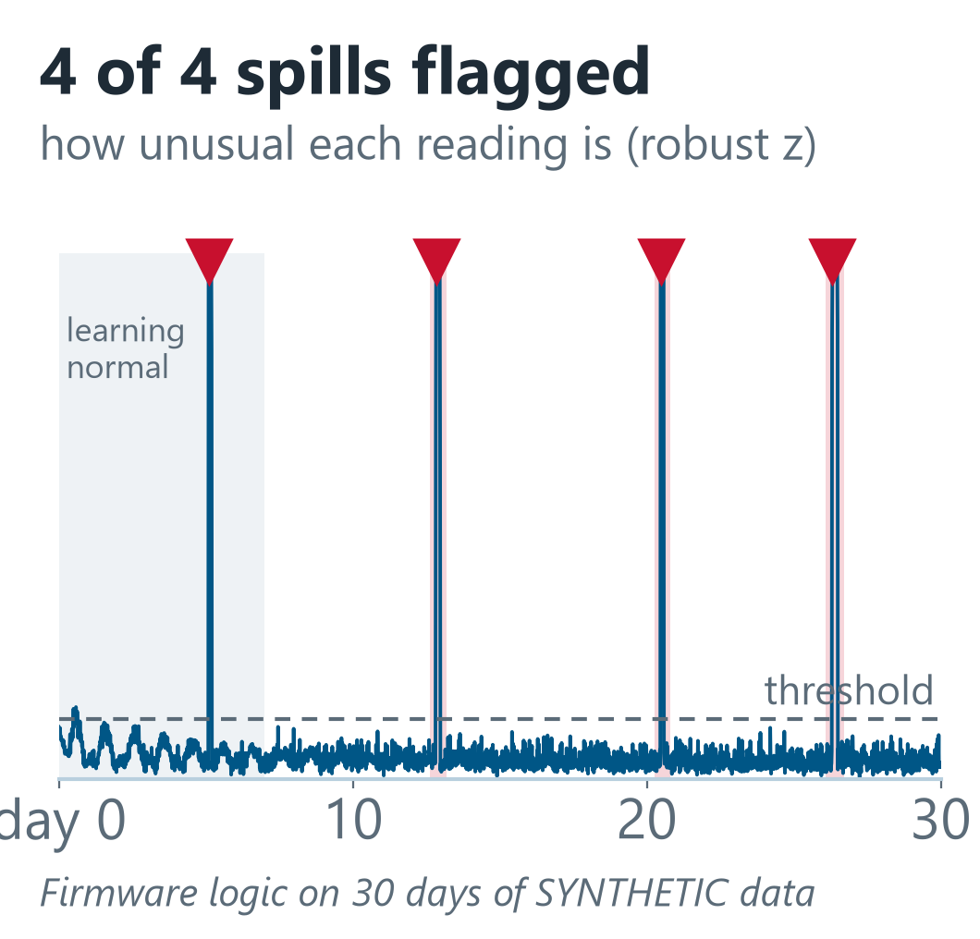
Where we are, and what proves it next
✓
Designed
66-part CAD, hand calculations, SOLIDWORKS Simulation
✓
Simulated
synthetic-data test only: 4 of 4 injected spills flagged within 30 min
3
Before the finale: 1:5 model in water
draft, level trim and the float riding up its pole, measured
4
Before the finale: electronics bench demo
ESP32 with a real probe: reads, decides, acts (light, pump, alert)
5
After the finale: full-size tank test
draft, 2 m travel and roller friction, measured
6
After permits: 30-day Godavari pilot
probes checked against lab samples at Kopargaon
Not tested in water yet
Notes:
5:30-6:15 | S2 | Where we are, honestly
Where are we, honestly? AquaSentinel is designed, calculated and simulated; it has not been in the water yet. On thirty days of synthetic data, our logic flagged all four injected spills within thirty minutes. That proves the logic, not field accuracy. Power, including the beacon, is about twelve days without sun, an estimate we will measure. Before the finale: the 1:5 model in water and the logic on an ESP32 with a real probe. Then a full-size tank test, and after permits, a thirty-day pilot at Kopargaon checked against lab samples.

Slide 9
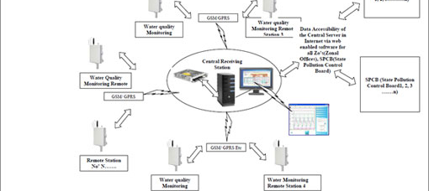
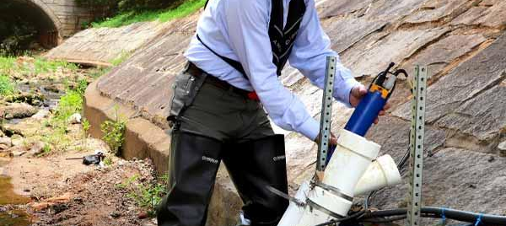
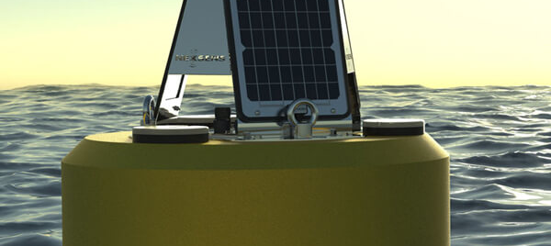
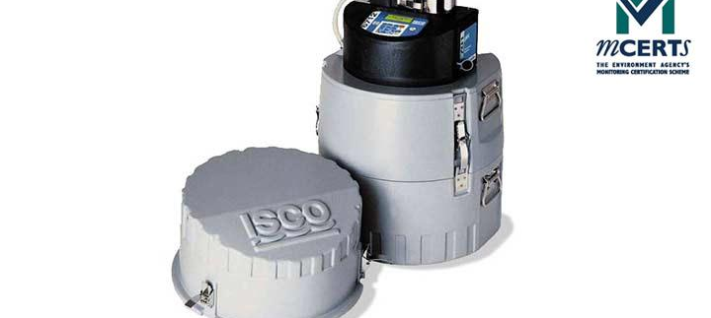
Prior art: what already exists, and what it does well
↩ Back to questions
CPCB real-time stations (Ganga)
Deployed system · India
YSI EXO2 sonde (Xylem)
Commercial product
NexSens CB-450 data buoy
Commercial product
Teledyne ISCO 6712 sampler
Commercial product
Does well
• ≈ 17 parameters incl. BOD, COD, ammonia, TOC, level
• Every 15 min over GSM/GPRS to a central server
• 36 stations commissioned in 2017
Trade-offs
• Instruments ≈ ₹35–40 lakh per station, so few stations
•; Fixed sites physical sampling n.p.v.
Does well
• 7 ports: up to 6 sensors + anti-fouling wiper
• RS-485, SDI-12, Modbus output
• ≈ 90 days on 4 D-cells at 15-min logging
Trade-offs
• An instrument: needs a mount, logger and telemetry for live alerts
• Price on request
Does well
• Carries sondes and sensors, 3 × 15 W solar
• LTE or Iridium with the X3 logger; web data
• 86 cm foam hull, 56 kg
Trade-offs
• Moored by anchors (3 eye-nuts), not on a guide
• Beacon and sampler not in the listed product; price not listed
Does well
• From 24 × 1 L bottles to one 5.5 gal container
• Time, flow or event sampling; triggers on up to 16 inputs incl. SDI-12 sondes
• Optional modem dial-out alarms
Trade-offs
• Bank or manhole unit with an intake hose
• Collects samples; no continuous readings itself
Source: CPCB CSE
Source: YSI
Source: NexSens
Source: RS Hydro / Teledyne ISCO
Patents (preliminary, English-language search): related documents exist, e.g. CN117446093B (floating detection units held by fixed rods) and US8352213 (pier-mounted rod sliding vertically, for riverbed level). No exact match found. Not a novelty or freedom-to-operate opinion.
Product facts from manufacturer or distributor pages, looked up 24 Oct 2026. n.p.v. = not publicly verified. Images: CPCB via CSE, YSI, NexSens, RS Hydro.
Notes:
6:15-6:45 | S1 Soham | Prior art
We are not the first to watch rivers. CPCB's real-time stations read seventeen parameters every fifteen minutes. YSI's sonde is the reference instrument, NexSens floats sondes on solar buoys, and Teledyne ISCO's samplers can be triggered by a sonde. Each does its job well. But each does one part of the job.

Slide 10
Existing solutions vs AquaSentinel (design)
↩ Back to questions
 | CPCB real-time station | YSI EXO2 sonde | NexSens CB-450 buoy | ISCO 6712 sampler | AquaSentinel R3 (design)
Readings, parameters | every 15 min; ≈ 17 incl. BOD, COD | user-set; up to 6 sensors | set by its logger; carries sondes | samples only; reads a sonde via SDI-12 | every 15 min; pH, EC, DO, turbidity, temp, level
Mounting | fixed station; layout n.p.v. | user-supplied mount, pipe or buoy | moored, 3 eye-nuts | bank or manhole, intake hose | float on a guide pole clamped to a bridge pier
River-level change | n.p.v. | depends on mount | floats within mooring scope | hose reach (max lift per spec) | rides 2 m on 8 rollers, no drive motor (calculated)
Decision on site | data to central server | logs; alarm logic not listed | logger and web portal; alarms n.p.v. | event trigger on up to 16 inputs | on board: limits + learned baseline (synthetic test)
Local light / remote alert | n.p.v. | not part of the sonde | n.p.v. | modem dial-out alarm option | beacon + LTE/SMS alert (designed)
Physical sample | n.p.v. | no (sensor) | not in listed product | yes, up to 24 bottles | 4 × 250 mL, one per event (designed)
Indicative cost | ₹35–40 lakh instruments (CSE) | price on request | not listed | not listed | ≈ ₹1.87 lakh prototype estimate incl. bridge kit
Power, upkeep | calibration, batteries (CSE) | 4 D-cells, ≈ 90 days at 15 min | 3 × 15 W solar | 12 V DC battery or mains | 20 W solar + LiFePO4, ≈ 12 days dark (estimate); monthly visit
What we combine differently (narrow, to be proven): each capability exists separately, and a buoy + sonde + triggered sampler could be integrated. Our difference is the architecture: a pier-guided float that follows river level without a mooring, an on-board decision, a beacon for people on the bank and one-bottle-per-event sampling in one unit, at a prototype estimate under ₹2 lakh. Not yet validated in a river; no novelty claim.
Sources as on slide 12: CPCB · CSE · YSI EXO2 · NexSens CB-450 · ISCO 6712 · n.p.v. = not publicly verified. AquaSentinel values are design estimates (backup A1–A5).
Notes:
6:45-7:15 | S1 Soham | How AquaSentinel differs
Our difference is how we combine them: a float on a pier-mounted guide pole that follows the river without a mooring, a decision made on board, a light people on the bank can see, and one sample bottle per event, in one unit under two lakh. Each capability exists separately; the combination is what we must now prove in water.

Slide 11
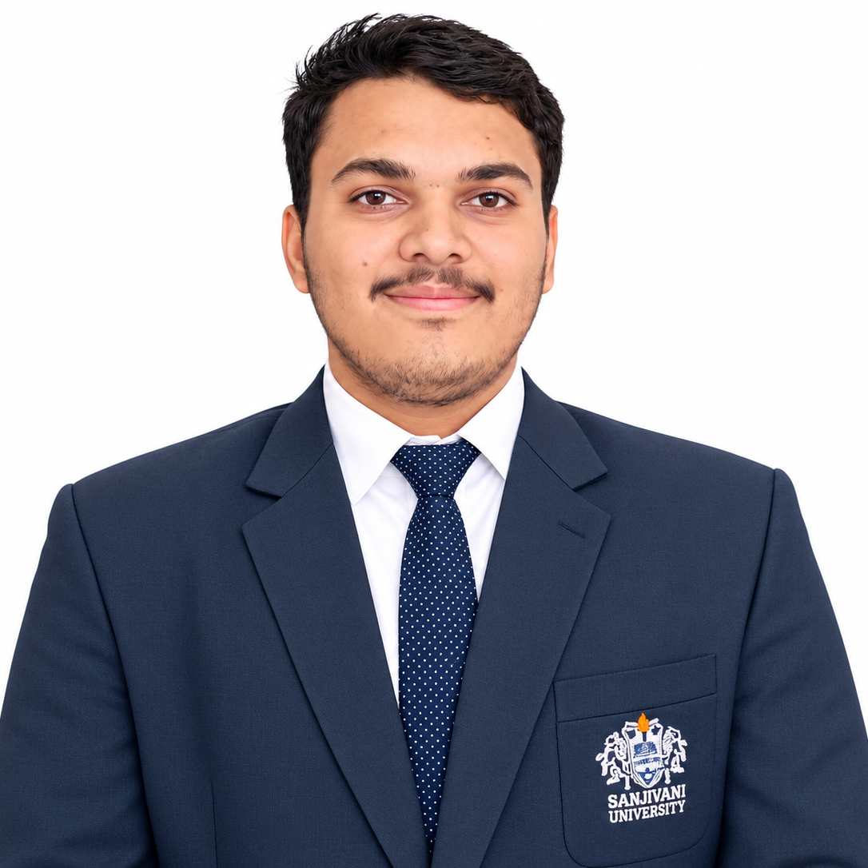

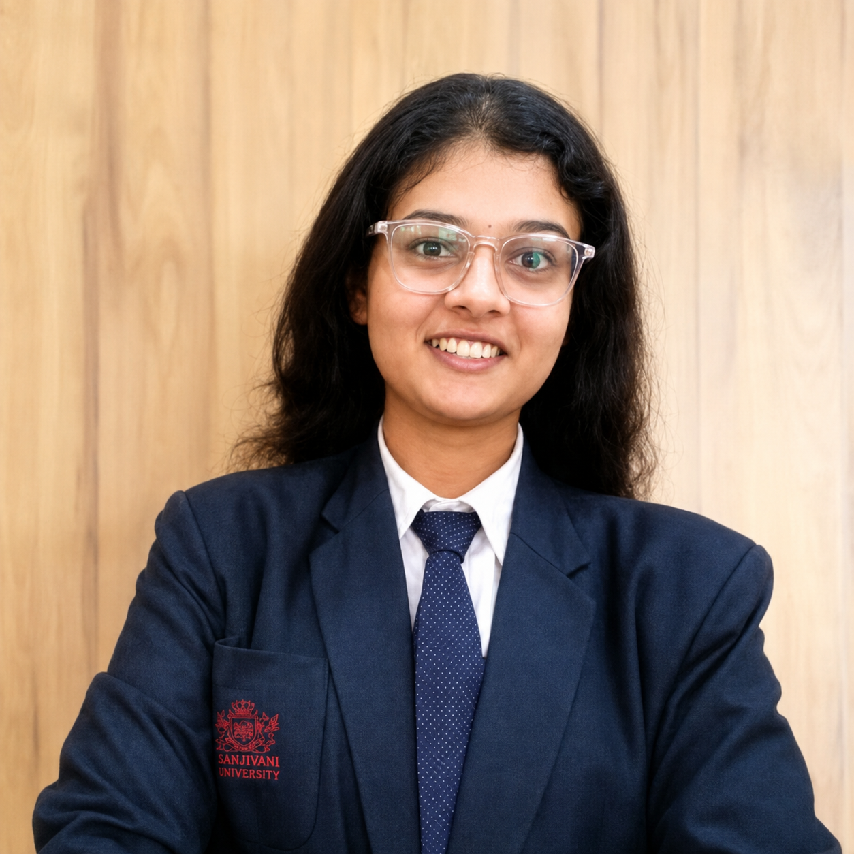
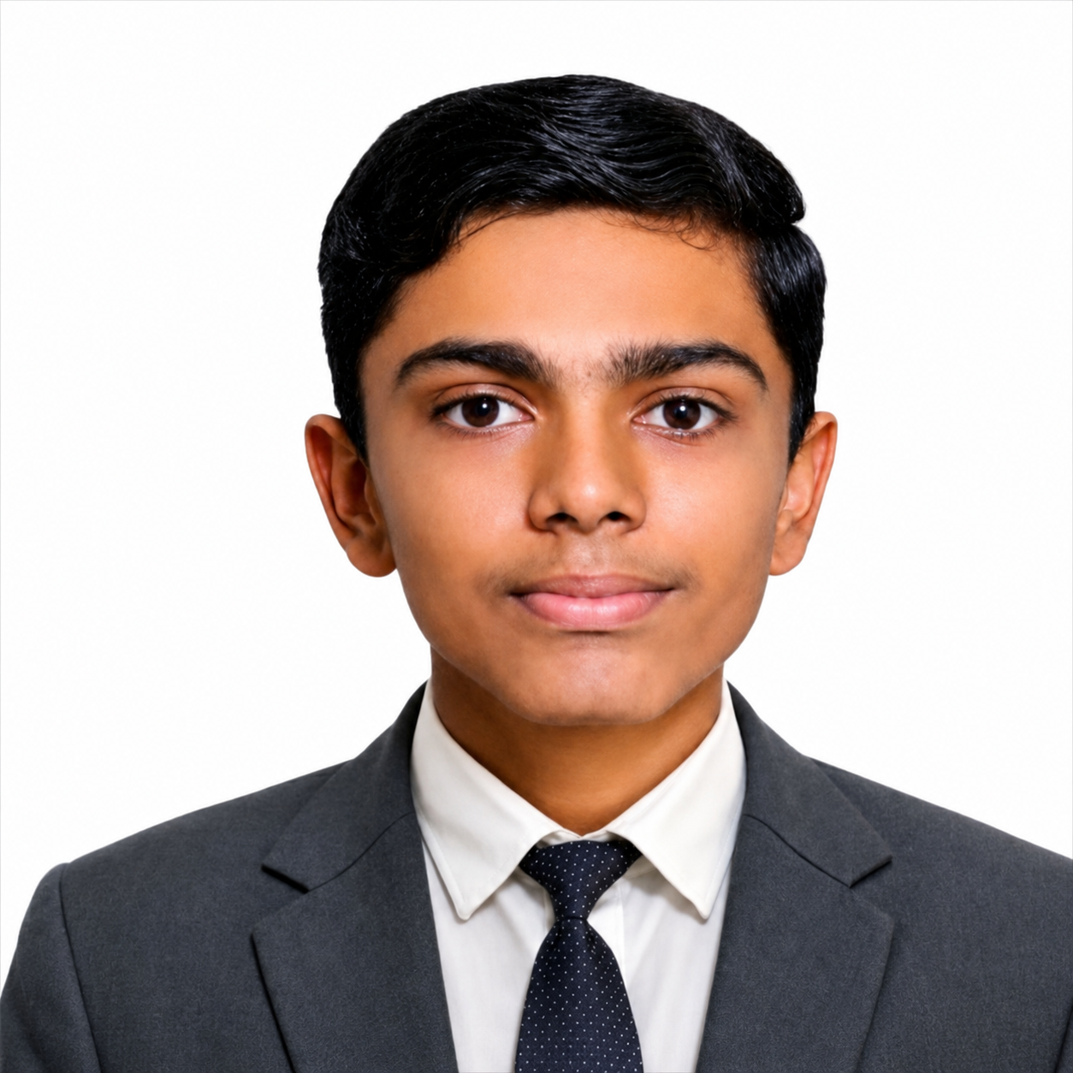
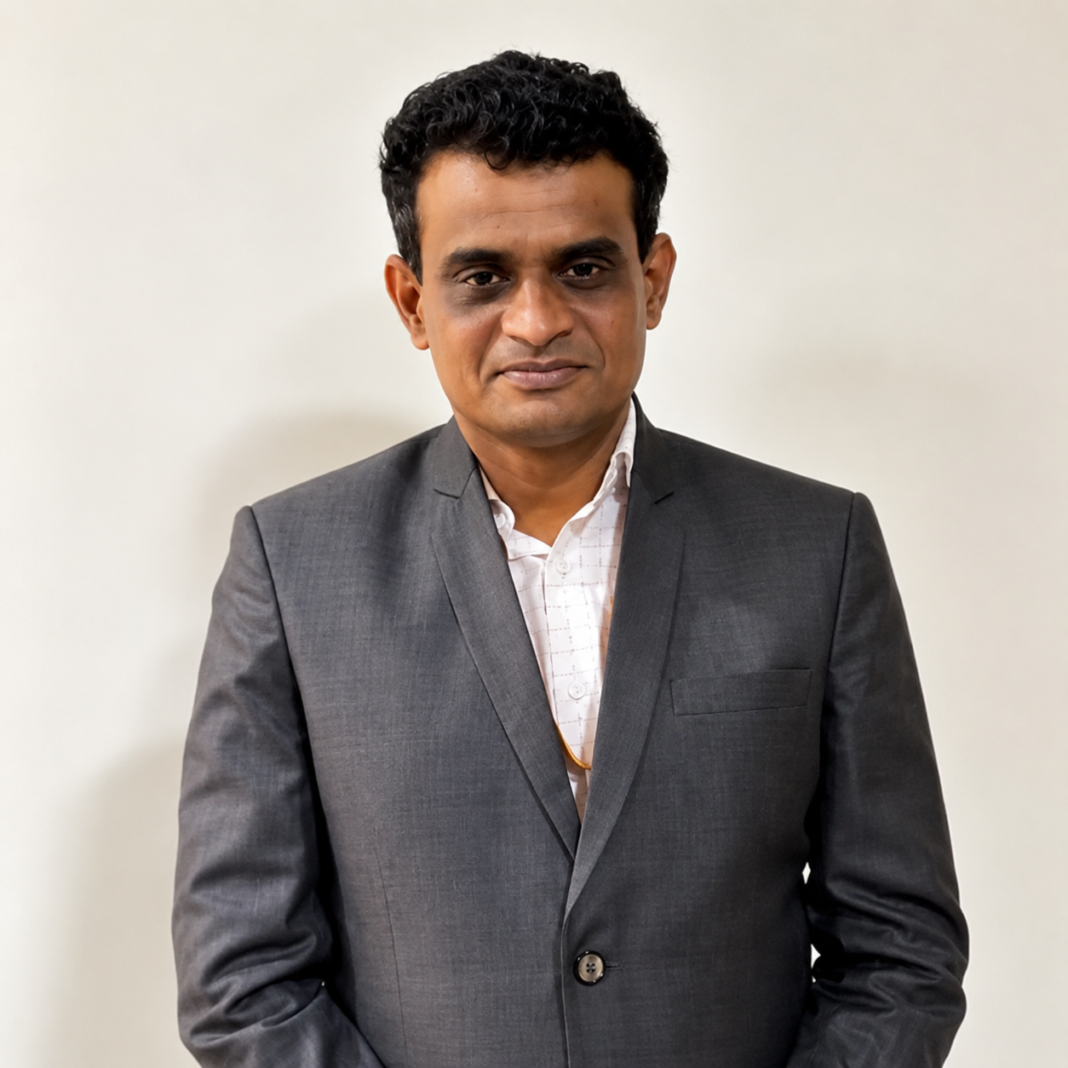
Watching the river every 15 minutes
Earlier warning for people downstream
A sample that tells the lab where to look
A light anyone on the bank can read
1
2
3
Soham Kadu
Prasad Ugale
Bhakti Kadam
Tanmay Pendbhaje
Dr. Kiran Wakchaure
Project Lead
System Design
Electronics Lead
Software Lead
Mentor
Thank you. We'd love your questions.
Sanjivani Hero's Journey · Sanjivani University, Kopargaon · AG26-1500$41
Notes:
7:15-7:50 | S1 Soham | Close
A spill lasts hours. A sample comes once a month. AquaSentinel is designed to close that gap: ninety-six readings a day, a decision on the spot, a red light on the bank, and a sample that tells the lab where to look. We are Soham, Shriraj, Bhakti and Tanmay, guided by Dr. Kiran Wakchaure. Thank you. We'd love your questions.

Slide 12
Questions? Click a topic
Prior art: slides 10–11
A1
All 14 design checks pass
A6
Market: a large problem, sparse monitoring
A2
Pole safety factor: we quote the lowest
A7
Risks we know, and how we handle them
A3
Power: about 12 days without sun
A8
Roadmap to the finale and the pilot
A4
Decision engine, and the fixes we found
A9
Prototype levels: where the 1:5 model fits
Cost: ₹1.57 lakh, ₹1.24 lakh at 100
Explore it live (opens the browser)
A5
3D model ↗
Dashboard ↗
GitHub ↗
Notes:
Not shown in the 8 minutes. In Q&A, click a topic to jump straight to its slide; each backup slide has a 'Back to questions' button at the top right. The three buttons at the bottom open our live 3D model, dashboard and GitHub in the browser (needs internet; check Zoom is sharing the screen, not just PowerPoint).

Slide 13
A1 · All 14 design checks pass
↩ Back to questions
Check | Result | Criterion
Reserve buoyancy | 2.27× | ≥ 2.0×
Freeboard | 143 mm | ≥ 100 mm
Transverse GM | 0.55 m | ≥ 0.15 m (IMO reference)
Righting arm | positive to 60°, max 180 mm at 25° | positive to 60°
Pole safety factor, pinned | 3.1 (2.66 with carriage moment) | ≥ 2.0
Pole deflection, pinned | 5.8 mm | ≤ span / 200 (13.4 mm)
Jamming, rollers (μ 0.05) | margin 8.6 | no self-locking
Jamming, seized rollers (μ 0.25) | margin 1.7 | no self-locking
Float lag at full design load | 17.7 mm | ≤ 30 mm
Weathervane stability | lateral centre 351 mm aft of the pole | aft of the pole
Pole corridor clearance | 9.7 mm | ≥ 5 mm
Float vs fixed parts, 2 m travel | no clash | none
Only rub rails touch the pier | rub rail 12 mm outboard | rub rails outermost
Part-to-part interference | none in 101 pairs | none
Source: mechanical/checks/design_checks.json, computed from the R3 CAD; masses partly catalogue estimates.
Notes:
Every value is computed from the R3 CAD geometry by the design engine (mechanical/checks/design_checks.json). Masses are partly catalogue estimates, so weigh the parts when they are built.

Slide 14
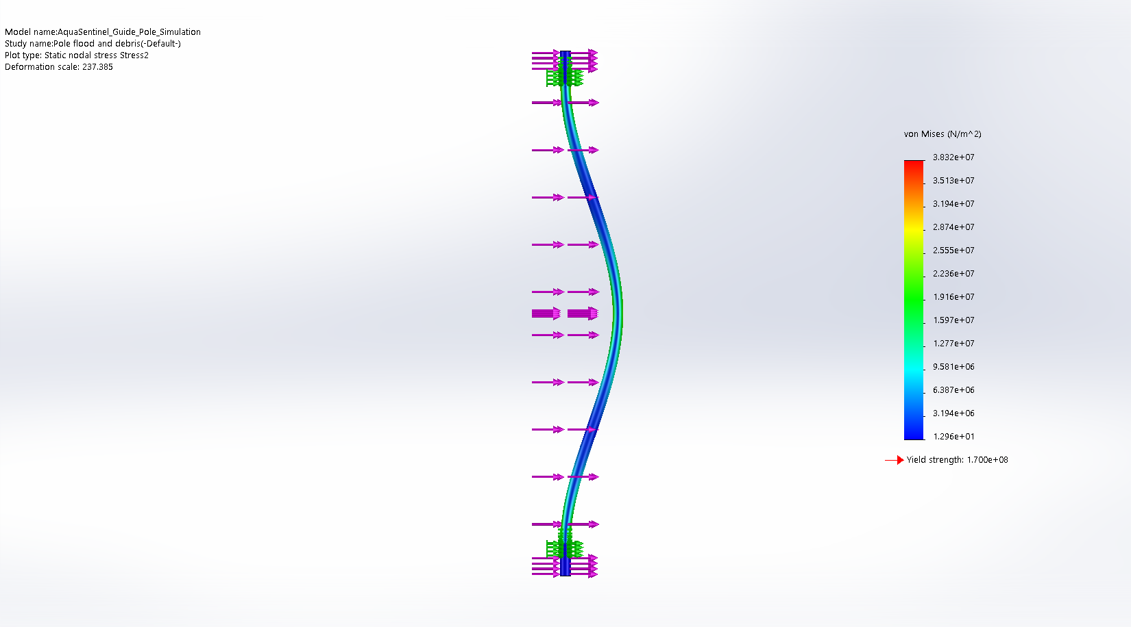
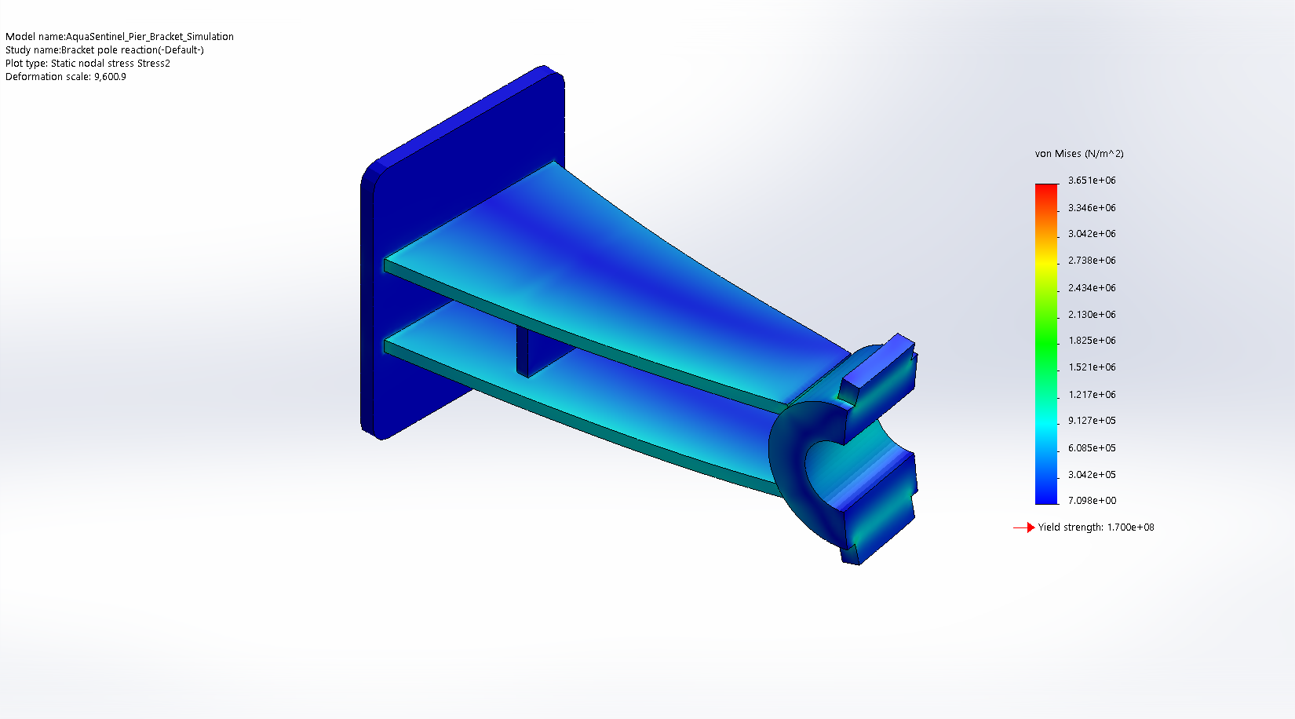
A2 · Pole safety factor: we quote the lowest
↩ Back to questions
Pole safety factor by idealisation (requirement ≥ 2.0)
Peak stress in MPa: FEA 38.3 · pinned 54.8 · pinned + moment 64.0 (316L yield 170)
Load: 642 N at the float = drag ½·1000·1.5²·1.05·0.120 m² = 142 N + 500 N debris (quasi-static), plus drag on the pole
Not yet included: debris impact factor, fatigue, vortex shedding
Bracket: 3.7 MPa peak under the 430 N reaction. Anchors, welds and debris impact still to check.
Notes:
4.4 is the SOLIDWORKS FEA with both clamp faces fixed (38.3 MPa). Real clamps on bolted brackets are not rigid, so the pinned hand calculation (54.8 MPa, SF 3.1) and the pinned case with the carriage couple (64.0 MPa, SF 2.66) are the conservative bounds. No dynamic factor for debris impact, fatigue or vortex shedding yet.

Slide 15
A3 · Power: about 12 days without sun (estimate)
↩ Back to questions
Daily energy by consumer, Wh per day (design estimate)
4.11 Wh/day
nominal, beacon included; 4.93 with a 20 % margin
61.4 Wh
usable: 12.8 V 6 Ah LiFePO4 at 80 % depth of discharge
≈ 12 days
with no sun (preliminary; 15 without the beacon)
39 Wh/day
20 W × 3.0 sun-hours on a monsoon day, after 35 % losses
Beacon assumed: 3 W strobe, 2 % duty, 12 h a night = 0.72 Wh/day. Pump, LTE peaks: measure on the bench
Notes:
Design estimate from hardware/power_budget.csv; nothing measured yet. The beacon is missing from the budget. LTE bursts of up to about 2 A need a stiff supply so the ESP32 does not brown out.

Slide 16
A4 · Decision engine, and the fixes we found
↩ Back to questions
How it decides (designed)
Our audit's fixes: in the firmware, bench test next
Reads pH, EC, DO and turbidity every 15 minutes; temperature and level are logged
Hard limits act at once, also while learning: pH < 6 or > 9, DO < 4 mg/L (CPCB Class C/D minimum), EC > 2,250 µS/cm (CPCB Class E maximum); our operating limits, tunable per site
A baseline per hour of the day (EWMA); a robust z-score above 3 counts as unusual
EVENT when 2 of the last 3 readings are unusual; normal again after 4 clean readings
First 7 days: baseline learning only. An early-warning system, not a chemical identifier: the lab confirms
A failed probe read sets a sensor-fault state, never 'normal water'
Save the learned baseline to flash, so a reboot doesn't erase it
One bottle per event, so 4 bottles cover 4 separate events
Clear stale alarm state when learning ends
Use river level to tell monsoon runoff from a discharge (planned)
Sources: our audit's analytics review (18 Oct); firmware anomaly_engine.cpp; analytics/evaluate.py on the synthetic dataset.
Notes:
Validated so far only on synthetic data (30 days; 4 of 4 events flagged within 30 min). The events were large compared with the noise, so moderate events and the real false-alarm rate need pilot data. The first four fixes are written in the ESP32 firmware and compile, with 26 unit tests. Nothing has run on hardware yet; the bench demo is their first hardware test.

Slide 17
A5 · Cost: ₹1.57 lakh a float, ₹1.24 lakh at 100
↩ Back to questions
Prototype cost: one float + its bridge kit, ₹ ex-GST (researched 23 Oct)
≈ ₹1.57 lakh
per float, ex-GST; bridge kit ₹0.29 lakh at each float's bridge; all 66 part numbers priced
−₹32.6k
revised estimate: contingency moved to the pilot budget (₹19.8k) + 4 design simplifications (₹12.8k)
≈ ₹1.24 lakh
per float at 100 units: one rotomould, welding jigs, probe volume price
Cost-down
next: probe volume pricing, a K = 1 EC cell; a Lite float (pH, EC) ≈ ₹1.13 lakh
Notes:
Costed BOM (investor_pitch_assets/AquaSentinel_R3_Costed_BOM.xlsx), Indian prices of 23 Oct 2026, ex-GST, all 66 part numbers. One float ₹157,492; the bridge kit (pole, brackets, clamps, collars, anchors) ₹29,218, bought once per site; together ₹186,710. At 100 units: float ₹123,746, kit ₹24,309. That is ₹32,638 less than our first estimate the same day (₹219,348): the 10 % contingency now sits once, in the pilot budget, and four design simplifications (pier bracket ₹5,708; pole clamp cap ₹3,903; stop collar ₹2,778; guide carriage - fixed half ₹268; guide carriage - opening gate ₹183). The bracket change is backed by the FEA: peak 3.7 MPa today, about 15 MPa with 6 mm plate, against 170 MPa yield; we re-check it in SOLIDWORKS before fabrication. If cost is the worry: customers pay ₹12,000 a month, not the hardware price; a Lite float with pH, EC, temperature and level only would be about ₹113,483.

Slide 18
A6 · Market: a large problem, sparse monitoring
↩ Back to questions
Fact | Number | Source
Polluted river stretches/locations, India | 296 on 271 rivers: 156 stretches + 140 locations (CPCB, published 2025, 2022–23 data) | PIB, 16 Mar 2026; CPCB
Maharashtra | 54, still the most of any state (55 in the 2022 assessment) | PIB; CPCB
National monitoring network | ≈ 4,922 locations, 2,265 on rivers; manual samples, monthly or quarterly | CPCB reply to NGT, OA 413/2025
Real-time station cost | ₹35–40 lakh for 10-parameter instruments; ≈ ₹50–84 lakh with systems | CSE; Lok Sabha reply 5115
Illustrative market size (assumptions)
Scope | Floats (3 per counted site) | Revenue at ₹1.44 lakh per float-year
Maharashtra, 54 sites | 162 | ≈ ₹2.33 crore a year
India, 296 sites | 888 | ≈ ₹12.8 crore a year
Market size is illustrative: floats per stretch and the fee (₹12,000 a month) are assumptions to validate in the pilot.
Notes:
3 floats per stretch and the ₹1.44 lakh per float-year fee (₹12,000 a month) are assumptions for sizing, not findings. At our estimated ₹77k a year cost to serve, that fee gives about a 46% gross margin. Water-works intakes and industrial estates are not counted.

Slide 19
A7 · Risks we know, and how we handle them
↩ Back to questions
Risk | Why it matters | How we handle it
Flood above 2 m of travel | the float is held under at the top stop | get gauge data (CWC/WRD); longer travel or a breakaway link; lift out on flood warnings
Bridge-pier wake | unsteady yaw and cyclic loads | observe in the tank and on site; side-face mounting if needed
Probe fouling and drift | false or missed alarms | wiper; monthly service with before/after readings; lab comparison
Level sensor blind zone | no river level near high water | compare a pressure transducer and a downward radar
Sample is not legal evidence | Water Act §21 needs the Board's procedure | a triage sample that triggers the Board's formal sampling
Beacon colours | red and green read as navigation marks | ask the waterway authority; yellow or shielded light
Permits | no pilot without them | bridge owner, river authority and MPCB: start now
Notes:
Answer risk questions with the mitigation and when it happens. Do not promise dates you have not planned.

Slide 20
A8 · Roadmap to the finale and the pilot
↩ Back to questions
24–25 Oct
Before 19 Nov
19–20 Nov
After the finale
After permits
14–17 Feb 2027
India Semi-Final (online)
1:5 model in water + electronics bench demo
India Geo Finale (in person)
Full-size tank test: draft, 2 m travel, roller friction
30-day Godavari pilot at Kopargaon
International AAKRUTI Finale, 3DEXPERIENCE World, Nashville
● competition dates (organisers) ● our plan
What we aim to show at the 19–20 Nov finale (our plan)
Our 1:5 scale model in water: measured draft, level trim, and the float riding up its pole
The decision logic running on the ESP32 with a real probe, on the bench
The fixes from our audit: sensor-fault state, saved baseline, one bottle per event
Notes:
Dates for the semi-final and finales come from the organisers (emails, dashboard). The rest is our plan: the 1:5 model water check and the electronics bench demo before the finale; the full-size tank test after it (it needs a full-size float, which isn't built yet); the pilot once permits are in place.

Slide 21
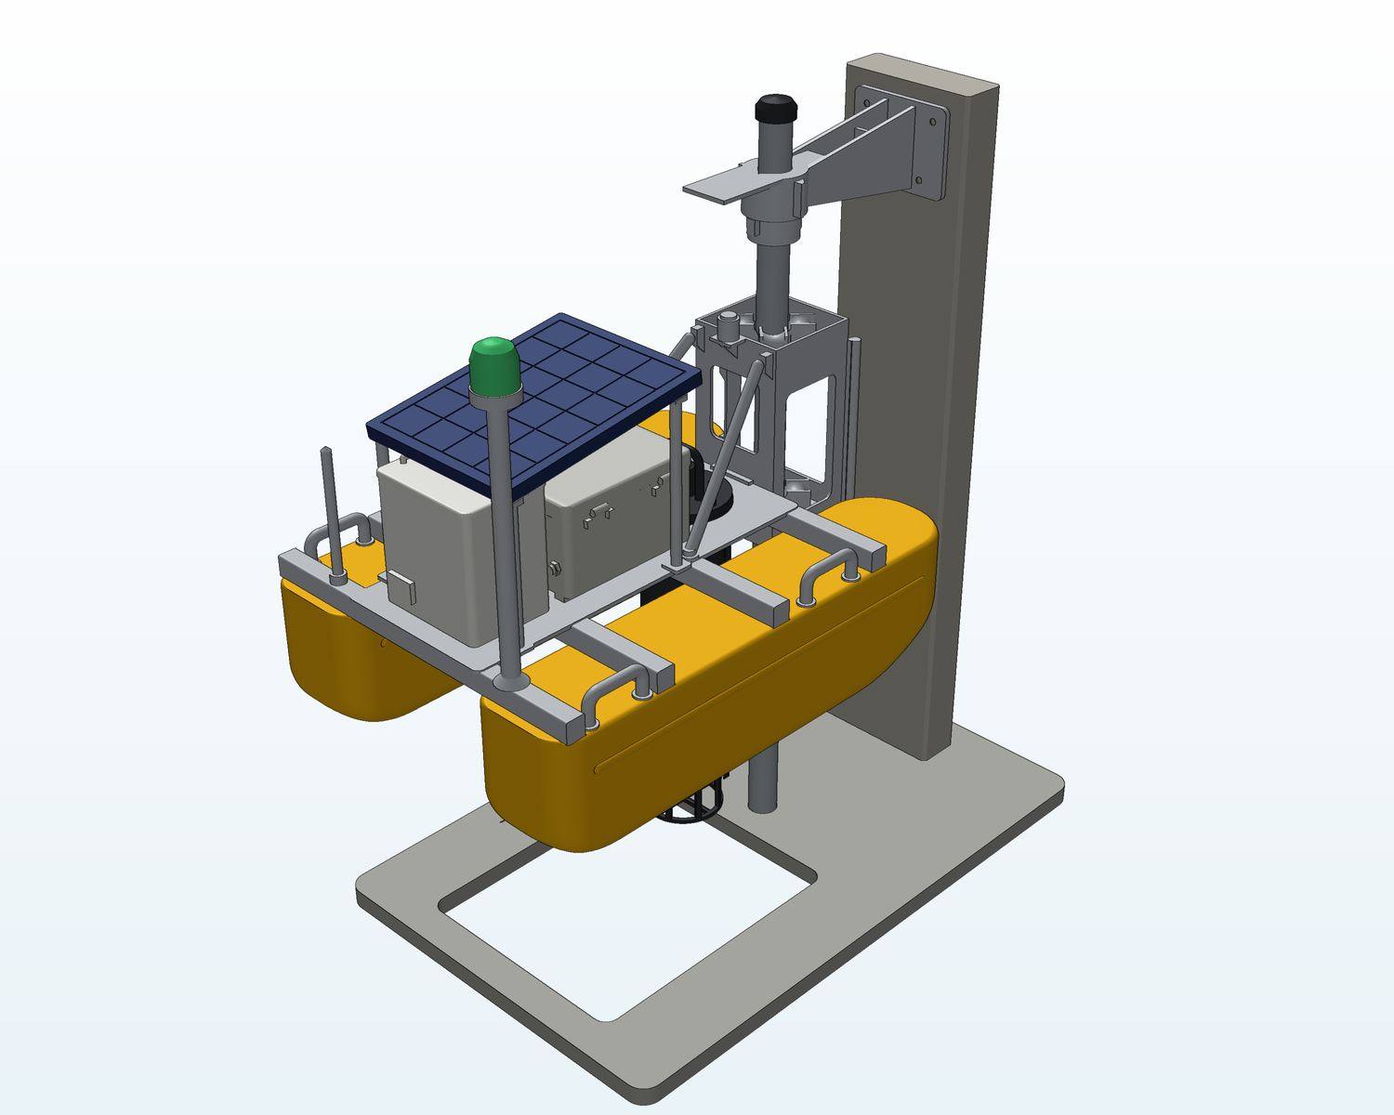
A9 · Prototype levels: where the 1:5 model fits
↩ Back to questions
Render, not a photo
made from our print files
Level | What it shows | Status
0 · Digital design | CAD, calculations and FEA; logic flags 4 of 4 simulated spills | ● Done
1 · 1:5 scale model | Layout and mechanism: float slides 65 mm up its pole (not the full 2 m); cartridge lifts out | ● In progress
2 · Electronics bench demo | ESP32 and a real probe: read, decide, act (light, pump, alert) | ● Next
3 · Tank test | Full-size float on a 2-inch pole: draft, 2 m travel, roller friction | ● Planned
4 · Godavari pilot | 30 days at Kopargaon; alerts checked against lab samples | ● After permits
A scale model shows form and mechanism.
It is not a working prototype: there are no electronics inside.
1:5 model of R3 on a pier-and-pole stand: hulls 200 mm, pole 12 mm, 65 mm travel (325 mm full scale)
Notes:
Use when asked 'Have you built anything?' or 'Which stage is the prototype at?'.
Say: 'This is a 1:5 scale model printed from our CAD. It shows the layout, how the float rides the pole and how the sensor cartridge comes out. It isn't a working prototype; the electronics bench demo is our next step.'
The picture is a RENDER made from the print files, and the red label says so. When you have photos of the printed model: right-click the picture > Change Picture, change the red label to 'Our printed 1:5 model', and change level 1 to 'Printed'.
The stand's travel is shortened: 65 mm on the model is 325 mm at full size; the design range is 2 m (400 mm at 1:5). Print files and guide: mechanical/scale_model_1to5/README.md.

