Slide 1



Vishwakarma Application ID
VK26-IITI-HT-0050
Dermasense: a laser-written strip that reads a dressing's own 'change line'
Soham Prabhakar Kadu · Bhakti Ajay Kadam
Health Tech: Emergency Response & Remote Monitoring
Evidence key: ● verified ● designed, lab test pending ● future scope
Notes:
Core innovation: two laser-carbonised electrode zones, at the pad centre and on the dressing maker's change line, let a clip-on reader say OK, CHANGE or CHECK without lifting the dressing.

Slide 2






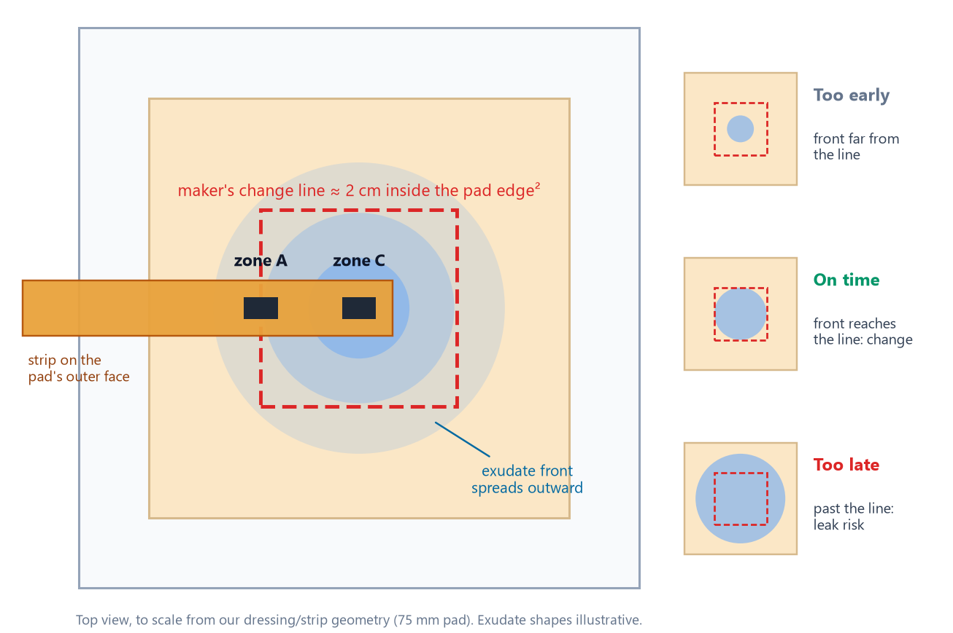

Problem Context
PUBLISHED EVIDENCE · CITED
44.9 %
≈ 2 cm
1 point
Uneven
OF 588 CHANGES MADE AT OPTIMAL MOISTURE¹
MAKER'S 'CHANGE NOW' LINE FROM PAD EDGE²
WHERE TODAY'S MOISTURE SENSOR READS¹
IN-VITRO MOISTURE MAP, 8 POINTS³
Target Beneficiary & Problem Statement
▪ Who: nurses and home carers of chronic wounds under foam dressings.
▪ Pain: the maker's 'change now' sign is visual¹⁴, and the dressing is covered.
▪ Today: change by the clock, by lifting the cover, or after a leak.
▪ Gap: in our search, no low-cost sensor reads that change line⁴⁵.
Figure: the change line is invisible under a cover (to scale, our design).
Problem: carers cannot see when a covered dressing is really full.
Notes:
Target user: nurses and carers (diabetic foot, venous leg, pressure ulcers). Public search: WoundSense reads one point [1]; a lab study mapped 8 points [3]; diaper wetness strips with clip-on readers exist [4]; smart bandages use custom electronics [5]. Visual change indicators exist (ALLEVYN LIFE: 'At 75%, it's time to change' [14]) but need the dressing face to be visible. Why now: some makers define 'full' as a distance from the pad edge [2] and conductive carbon can be laser-written on polyimide in one pass [7]. Project: Dermasense, VK26-IITI-HT-0050, Health Tech.

Slide 3
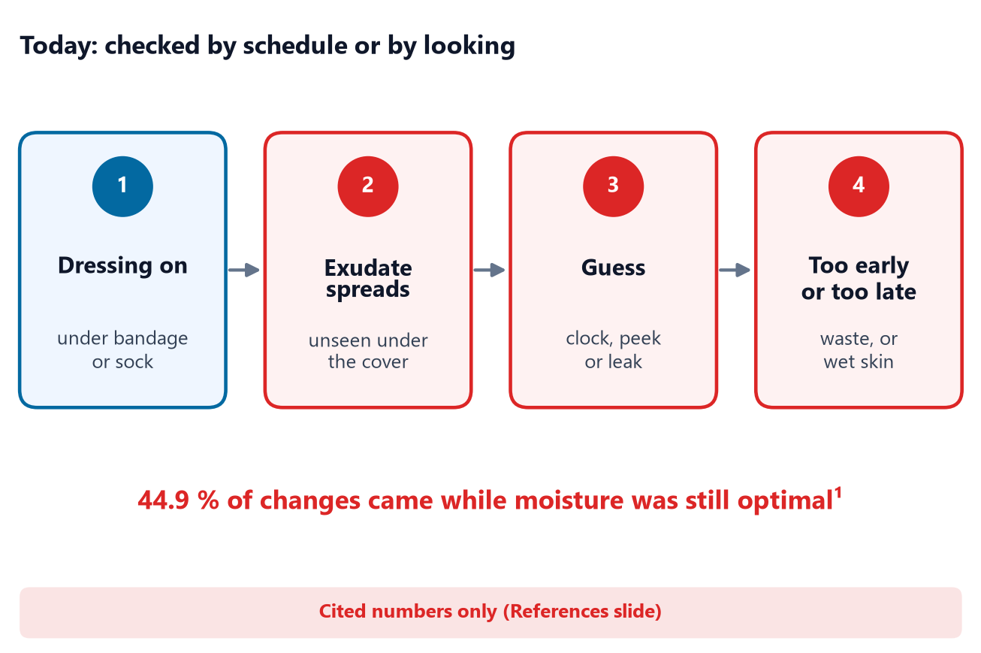
User Journey: Before State
CURRENT STATE · CITED
44.9 %
≈ 18 min
₹240–510
0.1–1.3 g/cm²·day
CHANGES WHILE MOISTURE WAS STILL OPTIMAL¹
A DRESSING VISIT, PATIENT-REPORTED¹³
ONE 10 × 10 CM FOAM DRESSING, RETAIL¹⁵
REPORTED EXUDATE RATES, 2 METHODS⁶
Current Pain Point Mapping
▪ Time: every check means unwrap, look, re-secure: about 18 min a visit¹³.
▪ Waste: 44.9 % of changes came while moisture was still optimal¹; each discards a dressing¹⁵.
▪ Risk: a late change can leak: wet skin, soiled clothing.
▪ Cause: reported exudate rates span over 10×⁶; a clock cannot follow.
Figure: today's pain-point map (cited numbers only).
Quantified Inefficiency: published figures only (a UK patient survey, Indian retail prices); we will time real checks with nurses.
Notes:
Sources: Milne 2016 [1]; Dealey 2006 [6] (0.10 and 0.21 g/cm²/24 h by one method, mean 1.3 by the other); UK survey of >200 patients commissioned by Mölnlycke, 2018 [13]: average dressing time 18 min, about 5 changes a week (patient-reported, industry-sponsored); Truemeds listings [15]: Mepilex Lite 10x10 cm Rs 242, Mepilex Border 10x10 cm Rs 514 (pack size unclear). Not yet measured: nurse minutes per check in Indian clinics.

Slide 4
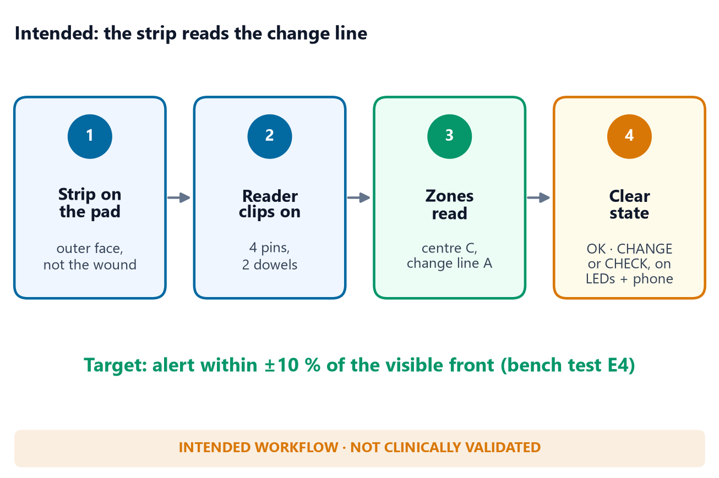
User Journey: After State (Intended)
INTENDED · NOT CLINICALLY VALIDATED
up to 44.9 %
≤ ₹100
±10 %
0
EARLY CHANGES A RELIABLE ALERT COULD AVOID¹
TARGET STRIP COST (ESTIMATE)
TARGET ALERT ACCURACY (BENCH, E4)
CONTACT WITH THE WOUND BED (BY DESIGN)
Future Solution Mapping & Quantified Efficiency
▪ Same routine: strip on the pad, reader clips on.
▪ Clear signal: CHANGE when the line is wet; CHECK if it wets first.
▪ Remote: the state is broadcast over Bluetooth to a phone.
▪ Payback: a ≤ ₹100 strip pays for itself if 1 in 2–5 changes is avoided¹⁵.
Figure: the intended workflow; bench-testable, not clinically validated.
Design Principle: only film and carbon are disposable; the strip never touches the wound.
Notes:
Targets and projections, not results. Payback: strip <= Rs 100 (estimate) / dressing Rs 242-514 [15] = 0.19-0.41, i.e. one avoided change in every 2.4-5.1 dressings. 'Up to 44.9 %' assumes every change waits for CHANGE; some changes are made for other clinical reasons, so the real figure is lower and must be measured. Bluetooth: compiled, not yet tested on hardware (bench test T11). FAULT covers a broken strip or reader error.

Slide 5
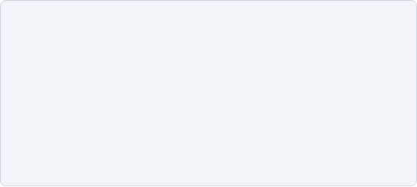

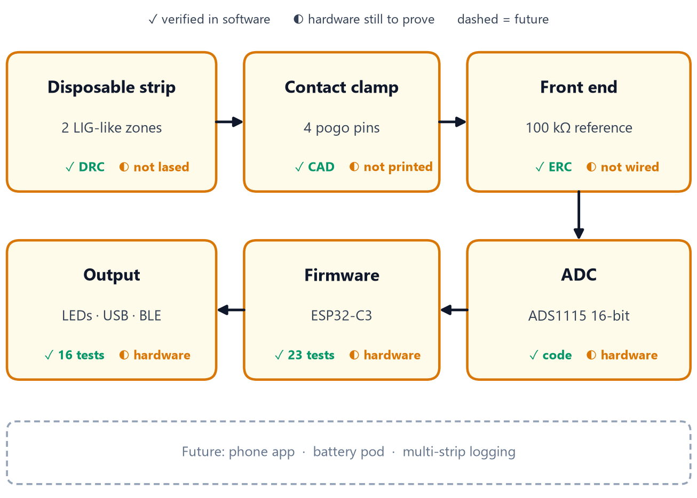

System Architecture & Specs
DESIGNED · LAB TEST PENDING
Target Specifications & Hardware
Parameter | Design value
Sensing zones | 2: pad centre C, change line A
Wet / dry | < 100 kΩ / > 300 kΩ, 3 scans
Drive | bipolar, ≤ 33 µA, no net DC
ADC / MCU | ADS1115 16-bit (I²C) · ESP32-C3
Contacts | 4 pogo pins + 2 dowels
Output | LEDs · USB log · BLE broadcast
Figure: subsystems; ✓ = verified in software, ◐ = hardware still to prove.
Architecture Rationale: only film and carbon are disposable; every electronic part is reused.
Notes:
Electrode lines/gaps 1.0 mm (provisional until E2). Windows 6 x 3.9 mm. Expected wet 4.2-14.8 kOhm, dry >= 1 MOhm (calc_readout.py). Self-check: 100 kOhm 0.1 % resistor (+/-5 %) and COM loop -> FAULT. BLE: one 13-byte advertisement per scan (ble_beacon.h), compiled, not run on hardware. Sources: config.h, strip_v0_1_geometry.json.

Slide 6
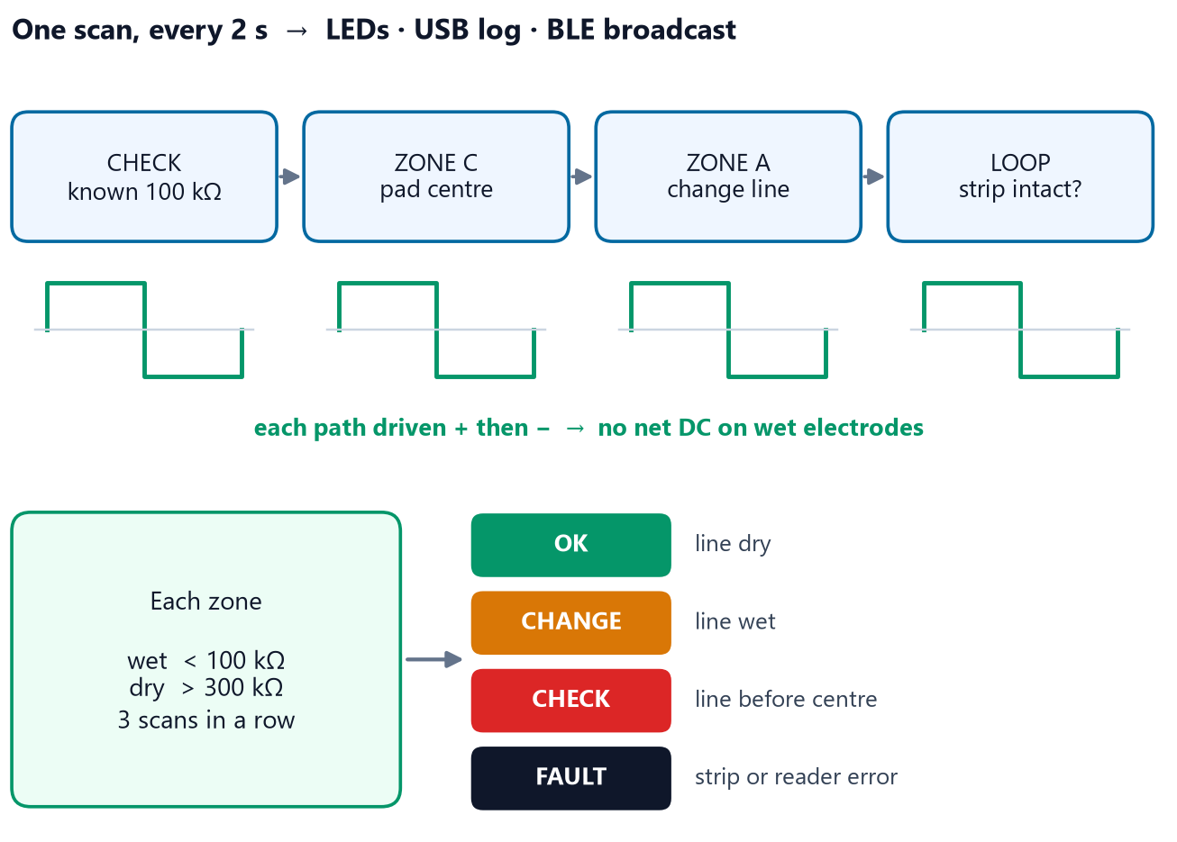

System Architecture & Specs: Firmware & Data Flow
VERIFIED IN SOFTWARE · HARDWARE PENDING
Firmware Logic & Data Flow
▪ Measure: each zone driven both ways, so no net DC.
▪ Read: 16-bit ADC, scaled to the 3V3 rail.
▪ Decide: wet < 100 kΩ, dry > 300 kΩ, 3 scans in a row.
▪ Self-check: a known 100 kΩ every scan, else FAULT.
▪ Share: CSV over USB, and a Bluetooth broadcast to a phone.
Figure: one reader scan, from measurement to state.
Software vs Hardware: 23 compile-time and 16 PC tests pass; not yet run on a wired board.
Notes:
ADS1115 single-shot 128 SPS, auto-range; A1 reads the 3V3 rail. Rx from both phases, averaged, scaled by the check resistor (+/-5 % else FAULT), minus 2 kOhm protection. Idle pins high-Z; zones frozen during FAULT. Compiles for ESP32-C3 with 0 warnings (650,349 bytes, 49 % of flash, with Bluetooth). BLE payload: state, wet flags, scan number, both zone resistances; unencrypted, test company ID 0xFFFF, bench only. Decoder: 7_firmware/tools/decode_beacon.py.

Slide 7
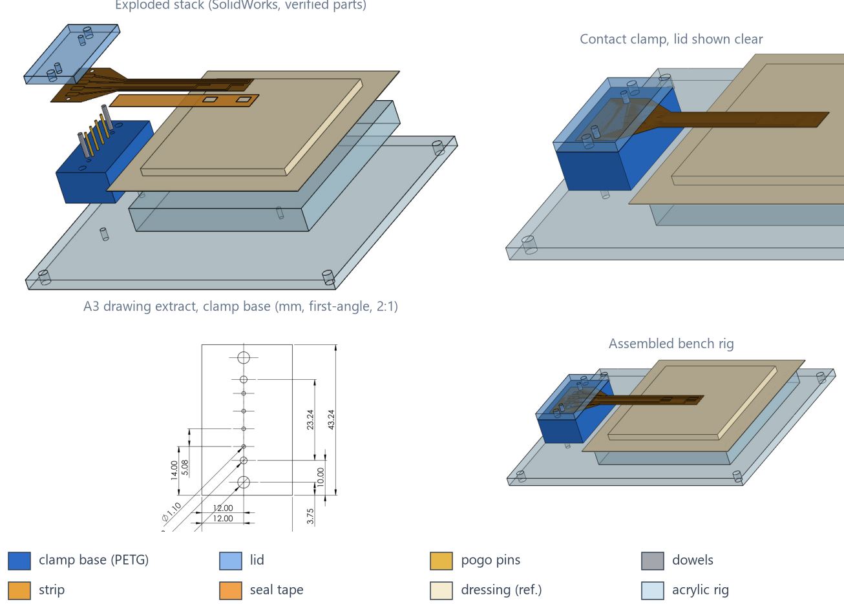
CAD Design & Mechanical Specs
DESIGNED · CAD VERIFIED · NOT YET BUILT
Materials & Mechanical Checks
▪ Materials: polyimide strip · PETG clamp · acrylic rig.
▪ Contact: 4 pogo pins, 0.72 N each (calculated).
▪ Alignment: 2.8× tolerance margin on 3 mm pads.
▪ Verified: 99 automated CAD checks pass, 0 fail.
▪ Provisional: strip sizes wait for E2 laser data.
Figure: our SolidWorks 2019 models: exploded stack, clamp, drawing, assembly.
Design Iteration: a clash check moved the seal tape off the clamp (decision D-013).
Notes:
Hand calculations (calc_mechanical.py): 1.48 mm pin compression, 2.9 N total, lid deflection 11 um, tolerance stack 0.49 mm vs +/-1.35 mm, 0.62 % bending strain at 10 mm radius, 20 MPa vs 231 MPa at the dowels. No FEA: loads < 3 N. 9 parts, 1 assembly, 7 A3 drawings, STEP. Seal clash was 9.0 mm3; now 0.

Slide 8
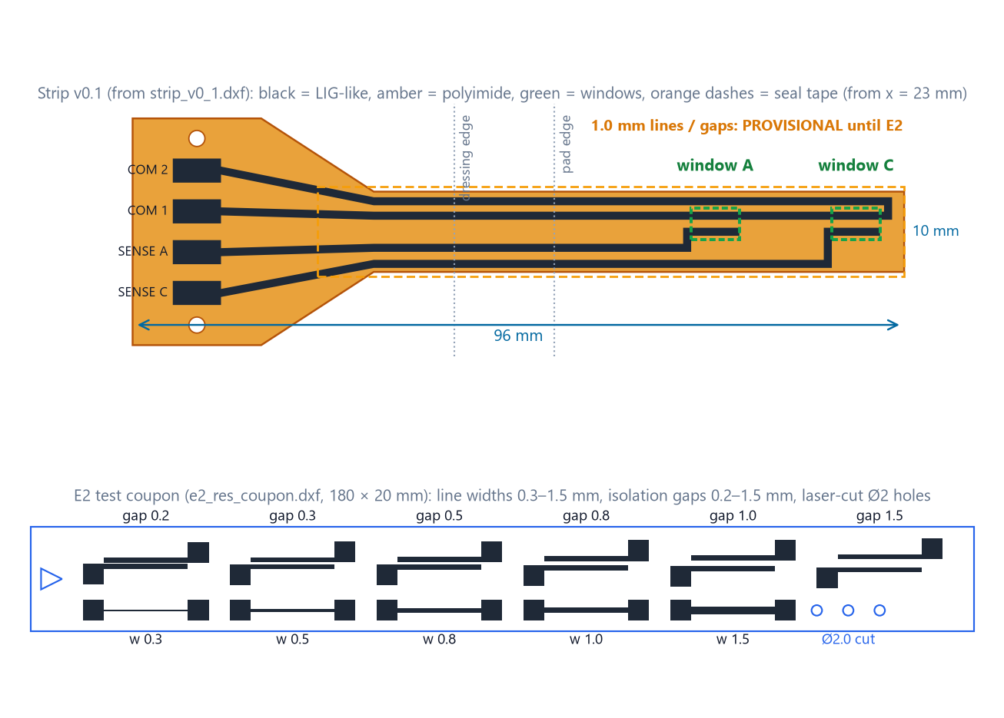
CAD Design & Mechanical Specs: Sensing Strip & Laser Process
DESIGNED · LAB TEST PENDING
Fabrication & Process Validation (E2)
▪ Material: laser-carbonised, LIG-like layer on polyimide⁷.
▪ Reference: setting '12', most likely % PWM, not watts.
▪ E2 plan: 7 coupons, 2 days, 72 pre-registered samples.
▪ Pass rules: CV ≤ 20 %, gaps > 3 MΩ, fixed beforehand.
▪ Sealed: leads under tape; LIG made in air wets easily⁹.
Figure: our laser files, drawn from the DXFs. Not yet lased.
Laser Files Verified: 35/35 file checks pass; LaserCAD import is checked at the machine.
Notes:
Graphene not confirmed until Raman. Machine (LaserCAD config): 1200 x 900 mm bed, 20 kHz PWM, 98 % cap. Logged per layer: min/max power, speed, 0.1 mm interval, passes, scan direction, focus, tube current. E2 = 4 bracket coupons (power 10/12/14, speed x0.67/1/1.5) + 3 resolution coupons.

Slide 9
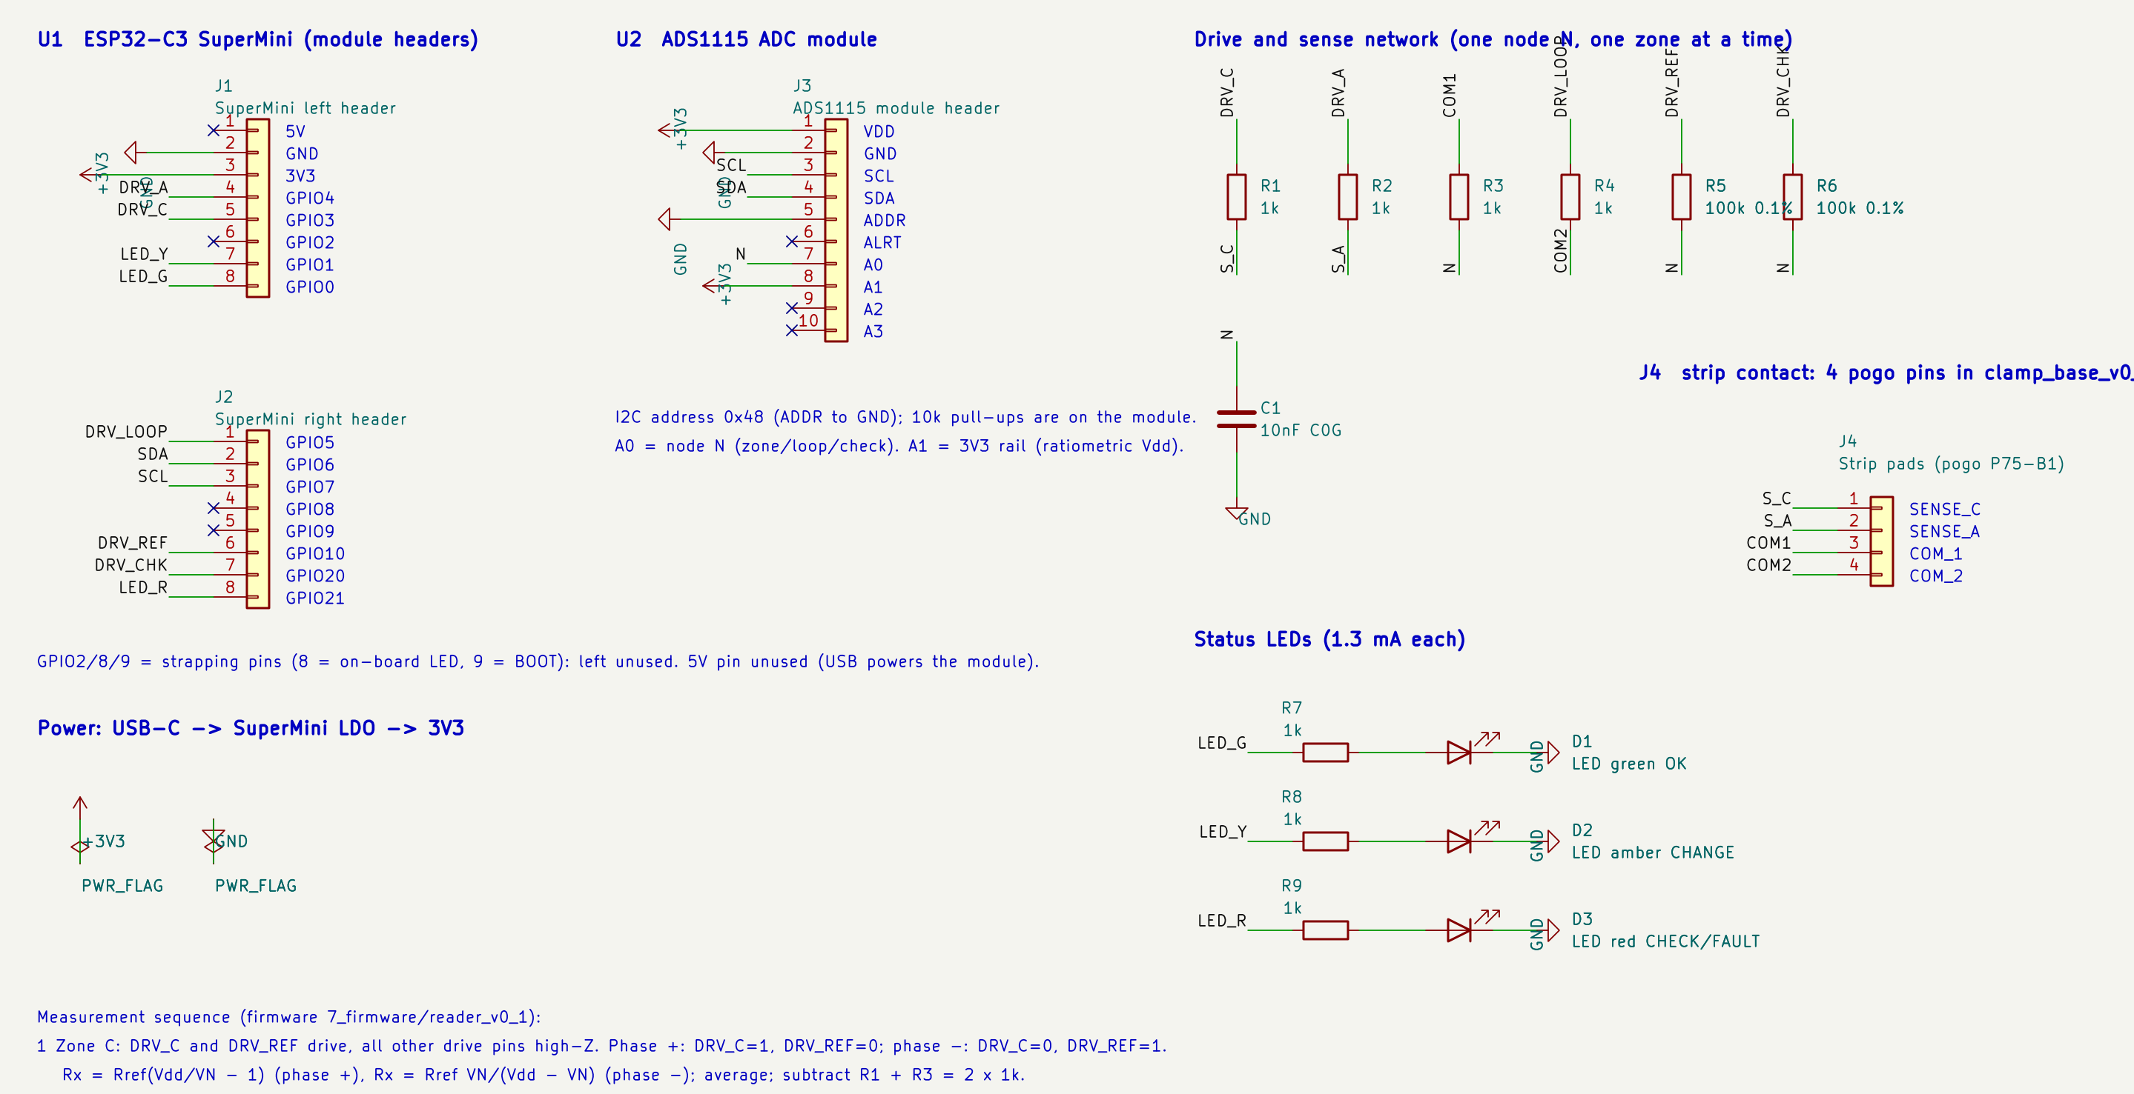

Electronics Schematics & BOM
ERC VERIFIED · NOT YET WIRED
Key Connections
▪ Drive: GPIO3 / GPIO4 → 1 kΩ → zones C, A.
▪ Sense: node N → 100 kΩ reference → ADC A0.
▪ Check: 100 kΩ on GPIO20; strip loop on GPIO5.
▪ Strip: 4 pogo pins on 3 × 6 mm pads.
▪ Power: USB-C → 3V3 regulator on the module.
Figure: our KiCad 10 schematic of the reader (exported by kicad-cli).
Verification: ERC 0 violations; netlist matches firmware and strip pads (0 mismatches).
Notes:
Full pin map: 7_firmware/WIRING.md (generated from the netlist). I2C on GPIO6/7 (ADS1115 0x48); A1 = 3V3 rail; LEDs on GPIO0/1/21; strapping pins GPIO2/8/9 unused.

Slide 10
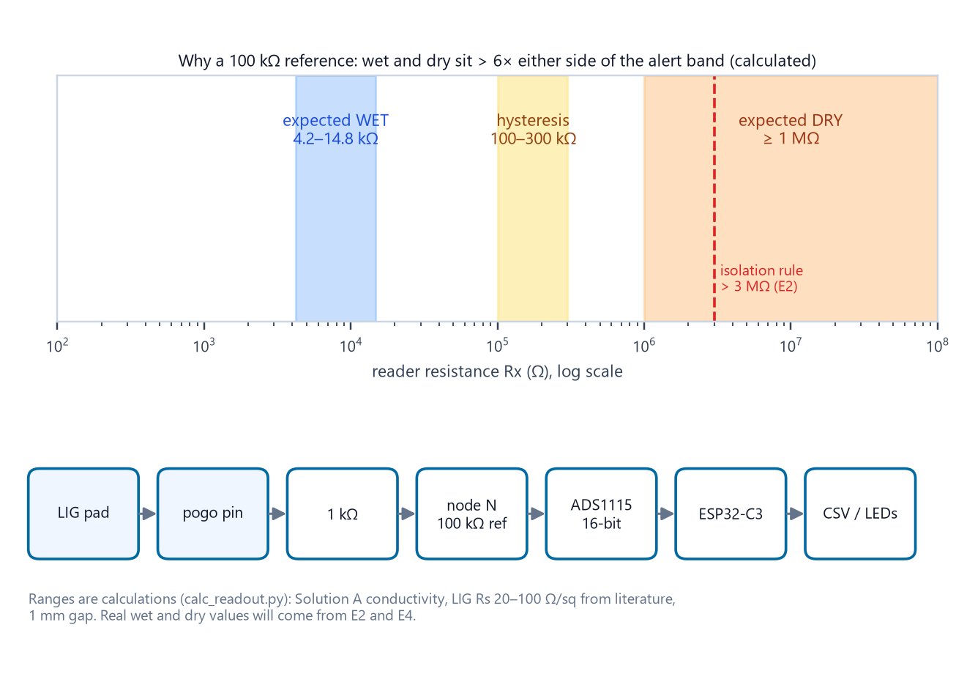
Electronics Schematics & BOM: Bill of Materials
3 PRICES QUOTED · NOTHING ORDERED
Prototype Bill of Materials
Item | Qty | Source | ₹
ESP32-C3 SuperMini | 1 | Probots · quoted | 242
ADS1115 16-bit ADC | 1 | Probots · quoted | 125
P75-B1 pogo pins | 100 | Hubtronics · quoted | 354
Resistors, C0G cap, LEDs, board | set | local / online | 158–421
Clamp + bench rig | set | lab / local | 100–1,240
Strip materials | set | lab / online | 800–3,500
Test consumables | set | local | 480–1,060
Total |  |  | ≈ 2,259–6,942
Figure: why a 100 kΩ reference (calculated ranges).
Procurement Status: reader parts and pins quoted 19 Oct, in stock in India; the rest are estimates.
Notes:
Line items: 6_electronics/bom_v0_1.csv (23 lines, each traced to the file that needs it). First order: silver paint, 1 % resistor set, 0.1 % 100 kOhm resistors, ADS1115, ESP32-C3. Quoted 19 Oct 2026 incl. GST: Probots PRO4607 ESP32-C3 SuperMini Rs 242; Probots PRO789 ADS1115 Rs 125; Hubtronics 05880 P75-B1 pack of 100 Rs 354. Total leaves out the borrowed meter, USB cable and E4 dressings. Ranges = sum of min/max estimates.

Slide 11
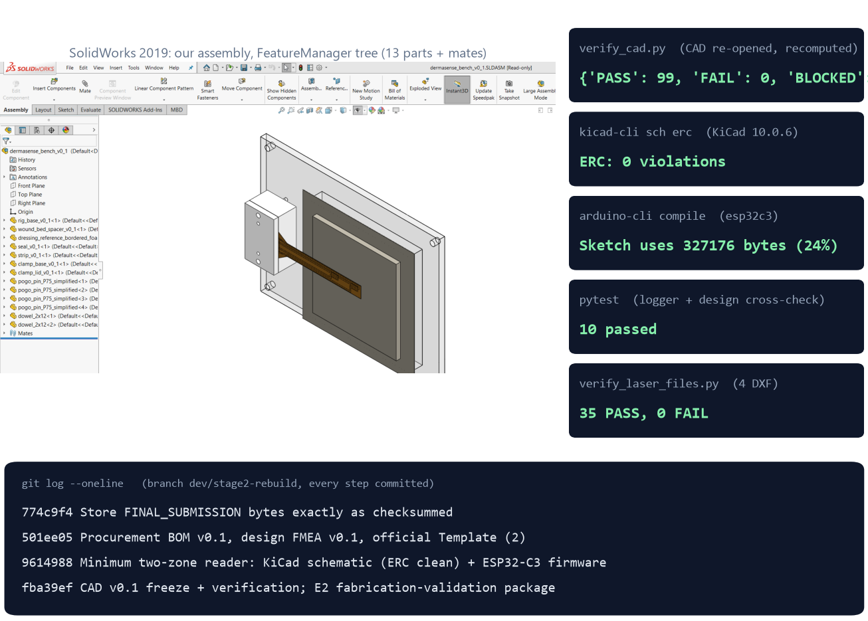

Maker Journey
GENUINE ARTIFACTS · NO STAGED EVIDENCE
Authenticity: What Each Artifact Proves
▪ CAD: our assembly open in SolidWorks, 13 parts.
▪ Checks: CAD, ERC, compile and tests all re-runnable.
▪ History: every step a git commit since 14 Oct.
▪ Photos: none yet; the first laser session is next.
Figure: our SolidWorks window and verbatim tool output (14–15 Oct 2026).
Raw Repository Linkage: [team to insert the GitHub / Drive link before upload]
Notes:
Native files in the repository: .SLDPRT, .SLDASM, .SLDDRW, .STEP, .kicad_sch, .ino, .dxf. CAD re-check: 99 pass, 0 fail. KiCad ERC log: 0 violations. Faculty sign-off follows the E2 review. We do not stage or generate lab photos.

Slide 12
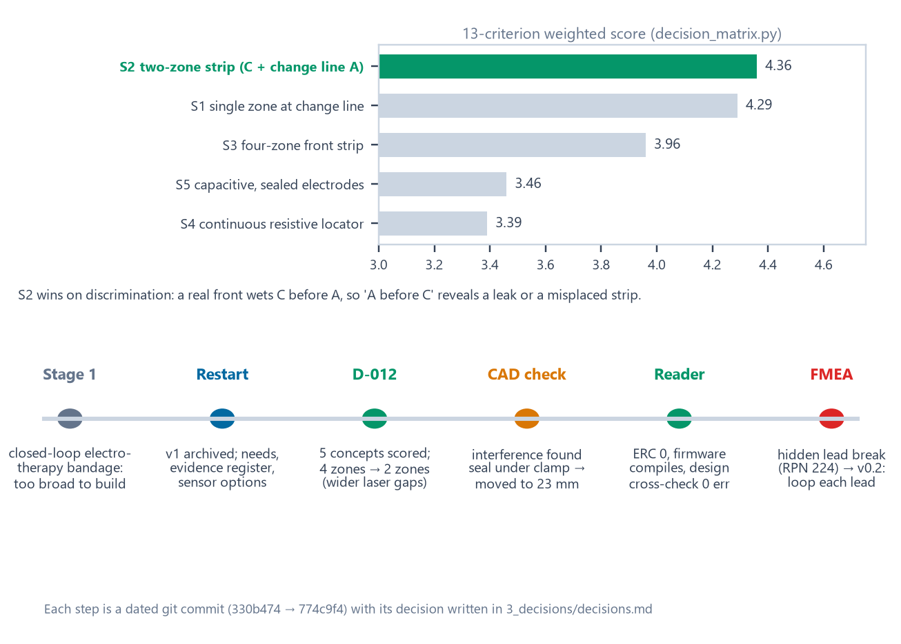
Maker Journey: Engineering Iterations
DOCUMENTED DECISIONS
Stage 1 to Stage 2 Iterations
▪ Pivot: therapy bandage (already shown in labs⁵) → one job: is it full?
▪ Choice: two-zone strip (4.36) beat one zone (4.29): it spots leaks.
▪ Kept: Stage 1's Bluetooth telemetry, now a state broadcast.
▪ Corrected: Stage 1 called Kapton 'medical-grade'; DuPont cautions otherwise¹¹.
▪ Redesign: FMEA risk → v0.2 loops each sense lead.
Figure: concept scores and the iteration path (each a dated commit).
Prior Art: diaper strips⁴ and visual change indicators¹⁴ exist; our novelty is reading the change line electrically, with an order check.
Notes:
5 concepts scored on 13 weighted criteria (3_decisions/decision_matrix.md). Verification fixes: seal moved off the clamp; STEP was in cm, now mm; drawings rebuilt first-angle. FMEA F04 (cracked sense lead reads dry, RPN 224). 4 zones were cut to 2 until E2 proves finer lines. Stage 1 also estimated '60 % fewer changes'; we dropped that number (no source). IP: concept and files are the team's own; no patent filed yet.

Slide 13

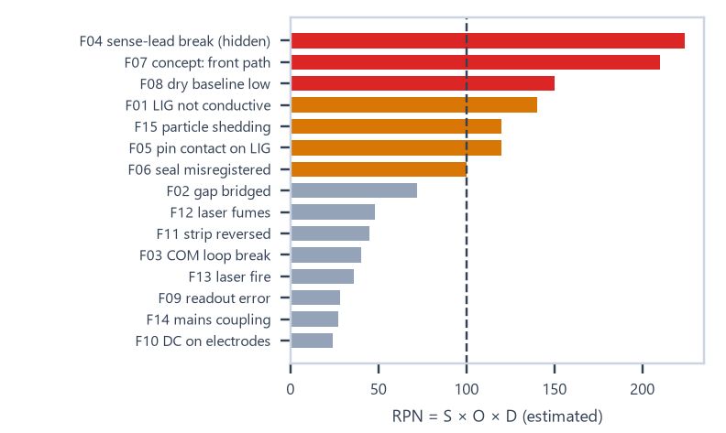


Safety & Hazard Mitigation
RISKS ESTIMATED · TESTS PLANNED
Design FMEA: top risks of 15 (ratings estimated before tests)
Failure mode | RPN | Fix
Cracked sense lead reads 'dry' | 224 | v0.2: loop each lead to a 2nd pad
Front path differs from model | 210 | test on real foam dressings (E4)
Humid dressing reads 'wet' | 150 | measure dry baselines (E4)
Fail-safes
Standards (considered, not claimed)
▪ Bench only: USB reader, never on a person.
▪ No net DC: bipolar drive, idle pins off.
▪ Self-check: every scan, else FAULT.
▪ No wound contact: strip on the pad's outer face.
▪ ISO 14971 risk management
▪ IEC 60601-1 future on-body reader
▪ ISO 10993-1 before any skin contact¹¹
▪ EN 13726 simulated exudate for tests¹⁰
▪ IEC 60825-1 laser work during fabrication
Notes:
Full FMEA: 3_decisions/fmea_v0_1.md (15 modes). Laser safety: signed checklist each session (4_sensor_strip/e2_experiment/E2_safety_checklist.md). Bench test T8 checks average DC < 5 mV.

Slide 14
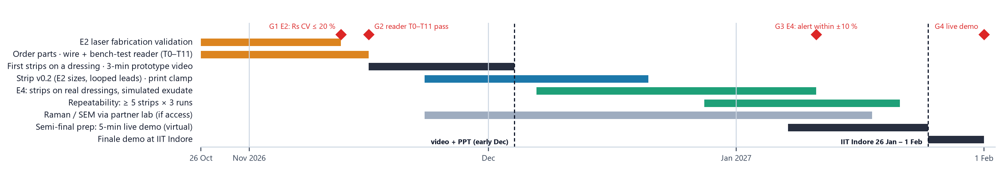
Roadmap
FUTURE SCOPE · GATED PLAN
4-Month Plan on the programme's own dates: each gate must pass first
Build & Bench (Months 1 - 2)
Validate & Demo (Months 3 - 4)
▪ Nov: E2 laser tests (G1); build and bench-test the reader (G2).
▪ Early Dec: first strips on a dressing; 3-min prototype video.
▪ Dec: strip v0.2 + printed clamp; E4 wet tests (G3).
▪ Jan: repeatability; virtual semi-final with a live demo.
▪ Stage 3: OK → CHANGE live on a dressing at IIT Indore.
Notes:
Gates: G1 E2 Rs CV <= 20 %; G2 reader bench test T0-T11; G3 E4 alert within +/-10 %; G4 live demo with logged raw data. Programme dates (vishwakarma-awards.org and the Internshala listing, read 19 Oct 2026): prototype video + updated PPT in December (listing: 4 Dec 2026); Health Tech semi-final interviews in January; IIT Indore bootcamp and finale 26 Jan - 1 Feb 2027. No patient use. Raman/SEM via a partner lab if access is granted.

Slide 15



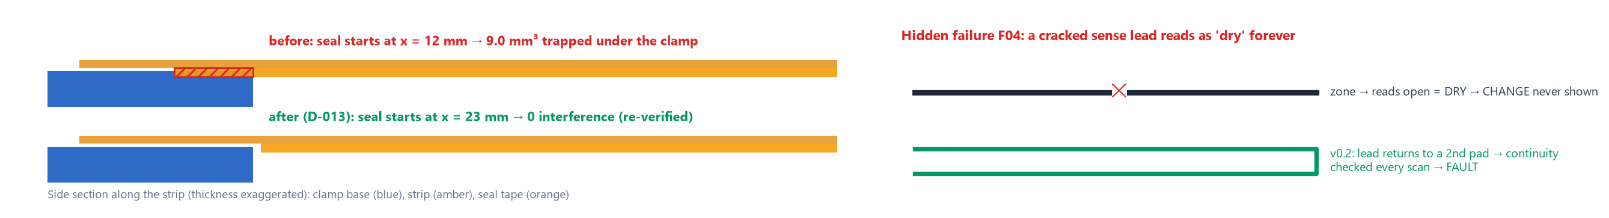
Technical Challenges & Risks
FOUND IN OUR OWN VERIFICATION
Geometry: Seal Under Clamp
Circuit: Hidden Lead Break
Process: Unknown Laser Recipe
Found: seal tape overlapped the clamp (9.0 mm³).
Impact: would lift the strip off the pins.
How: automated clash check.
Found: a cracked sense lead reads 'dry'.
Impact: CHANGE never shown, no alarm.
How: design FMEA (RPN 224).
Found: '12' is likely a % command; tubes are unsteady at low power⁸.
Impact: every strip size is provisional.
How: LaserCAD config audit.
Also Caught: STEP exported in cm (now mm); a drawing showed 0.13 for 0.125 mm (fixed).
Notes:
Evidence: 5_cad/verify_cad_report.md (interference), 3_decisions/fmea_v0_1.md, 4_sensor_strip/machine_record.md.

Slide 16
Potential Solutions & Risk Mitigation
FIXED · DESIGNED · FUTURE
Fixed & Verified
Designed, to Prove
Fallbacks
Seal: starts at x = 23 mm; 0 clash.
Units: all STEP files in mm.
Checks: 99 CAD checks pass.
v0.2 strip: every sense lead looped.
Contact: silver pads, rounded pins.
Self-test: check resistor → FAULT.
Wider lines: if E2 says so.
Process: slower passes, log current.
Concept: one-zone strip (score 4.29).
Future Scope & Validation Plan
▪ Experiments: E2 laser, reader bench test, E4 wet tests.
▪ Material: Raman and SEM before any 'graphene' claim.
▪ Reliability: bending, contact cycling, humidity drift.
▪ Product: battery pod; phone app on the BLE broadcast; strips per dressing.
▪ Before patients: ISO 10993, IEC 60601-1, ethics approval.
▪ Not claimed: sensing performance, graphene, clinical benefit.
Rule We Keep: no performance, graphene or clinical claim until it is measured.
Notes:
Future scope details: 4_sensor_strip/e2_experiment/E2_measurements_and_unknowns.md.

Slide 17


SOURCES WITH READING DEPTH
References & Sources
Numbers match the superscripts on each slide. After each source we state how deeply it was read; nothing is labelled verified beyond that.
1. Milne S.D. et al., A wearable wound moisture sensor as an indicator for wound dressing change, Int. Wound J. 13(6):1309–1314 (2016). doi:10.1111/iwj.12521 · full text read
2. Dressing instructions for use: some foam dressings say 'change when exudate approaches ~2 cm from the pad edge'; Mölnlycke Mepilex Border Flex brochure uses strike-through reaching 3 edges · manufacturer documents, read as excerpts
3. McColl D., Cartlidge B., Connolly P., Real-time monitoring of moisture levels in wound dressings in vitro, Int. J. Surg. 5(5):316–322 (2007). doi:10.1016/j.ijsu.2007.02.008 · abstract
4. US 5,469,145 and US 5,838,240 (wet diaper detector: detachable strip + clip-on detector); US 9,291,589; US 10,928,344 · patent summaries, claims not read
5. Jiang Y. et al., Wireless, closed-loop, smart bandage with integrated sensors and stimulators, Nat. Biotechnol. (2022). doi:10.1038/s41587-022-01528-3 · listing + coverage
6. Dealey C., Cameron J., Arrowsmith M., A study comparing two objective methods of quantifying the production of wound exudate, J. Wound Care 15(4):149–153 (2006) · abstract (methods disagree)
7. Lin J. et al., Laser-induced porous graphene films from commercial polymers, Nat. Commun. 5:5714 (2014). doi:10.1038/ncomms6714 · full text read
8. CO₂ laser tube current vs PWM setting, engineering measurements, softsolder.com (2022) · not peer-reviewed
9. Li Y. et al., Laser-induced graphene in controlled atmospheres: from superhydrophilic to superhydrophobic surfaces, Adv. Mater. 29:1700496 (2017). doi:10.1002/adma.201700496 · abstract
10. EN 13726-1:2002 / EN 13726:2023, Test methods for wound dressings (absorbency; 'Solution A') · catalogue entry; online link not reachable from our network
11. DuPont position statement on the use of DuPont materials in medical applications (Kapton caution) · web page
12. Texas Instruments ADS1115 datasheet (SBAS444); Espressif ESP32-C3 datasheet · vendor documents
13. Wounds UK news (22 Aug 2018) on a Mölnlycke-commissioned survey of >200 UK patients with chronic wounds: average dressing time 18 min · patient-reported, industry-sponsored; web page read
14. Smith+Nephew, ALLEVYN LIFE product page: visual change indicator ('At 75%, it's time to change your dressing') · manufacturer web page, read 19 Oct 2026
15. Truemeds.in retail listings: Mepilex Lite 10 × 10 cm ₹242; Mepilex Border 10 × 10 cm ₹514 (pack size unclear) · retail pages, read 19 Oct 2026
Notes:
Full list with verification notes: 2_research/literature.csv and research_matrix.csv (41 + 16 entries).

Slide 18






Image Sources
ALL IMAGES ORIGINAL
Every image in this deck was produced by the team from our own project files. No stock photos, no AI-generated images and no external images are used.
Problem illustration, drawn to scale
Source: make_figures.py · strip_v0_1_geometry.json
1_presentation/figures/fig_problem.png
Before-state pain-point map
Source: make_figures.py · cited sources 1–3
1_presentation/figures/fig_journey_before.png
After-state intended workflow
Source: make_figures.py · firmware states
1_presentation/figures/fig_journey_after.png
System block diagram
Source: make_figures.py · verification logs
1_presentation/figures/fig_block.png
Firmware scan and state logic
Source: make_figures.py · reader_v0_1 source
1_presentation/figures/fig_dataflow.png
SolidWorks renders + drawing
Source: render_cad.py · 5_cad/solidworks (our models)
1_presentation/figures/fig_cad.png
Strip and E2 coupon layers
Source: make_figures.py · our DXF files
1_presentation/figures/fig_strip.png
KiCad schematic export
Source: kicad-cli · reader_v0_1.kicad_sch (ours)
1_presentation/figures/fig_schematic.png
Measurement window
Source: make_figures.py · calc_readout.py
1_presentation/figures/fig_window.png
SolidWorks screenshot + logs
Source: screen capture of our machine · verbatim tool output
1_presentation/figures/fig_maker.png
Decision matrix + iterations
Source: make_figures.py · decision_matrix.md
1_presentation/figures/fig_decision.png
FMEA risk ranking
Source: make_figures.py · fmea_v0_1.csv
1_presentation/figures/fig_fmea.png
4-month roadmap
Source: make_figures.py · E2/bench/E4 plans
1_presentation/figures/fig_roadmap.png
Seal clash + lead-break diagrams
Source: make_figures.py · geometry + FMEA
1_presentation/figures/fig_challenges.png
Notes:
Generators: 1_presentation/render_cad.py and make_figures.py.

