Slide 1



Vishwakarma Application ID
VK26-IITI-HT-0050
Dermasense: a laser-written graphene strip that tells nurses when a wound dressing is full
Soham Prabhakar Kadu · Bhakti Ajay Kadam | Health Tech: Emergency Response & Remote Monitoring

Slide 2






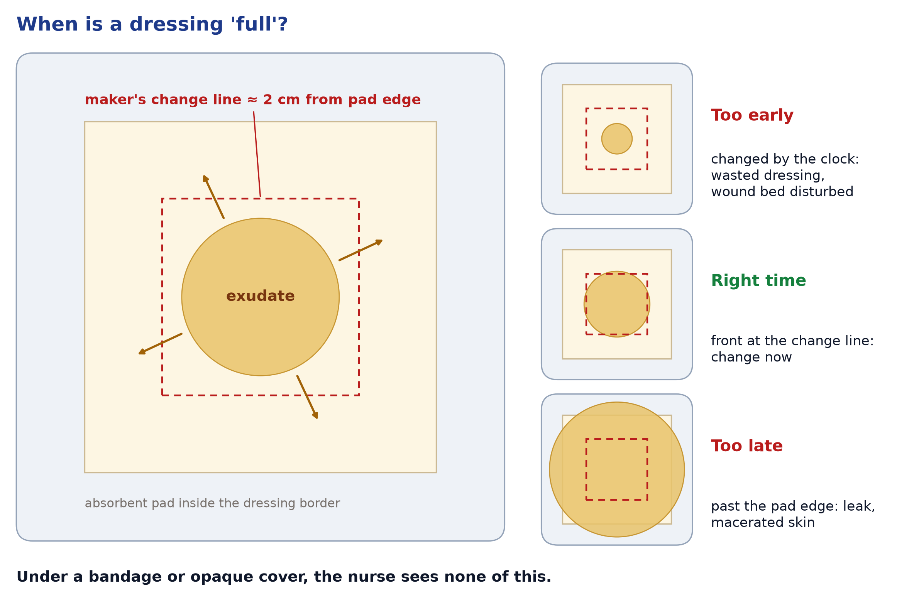
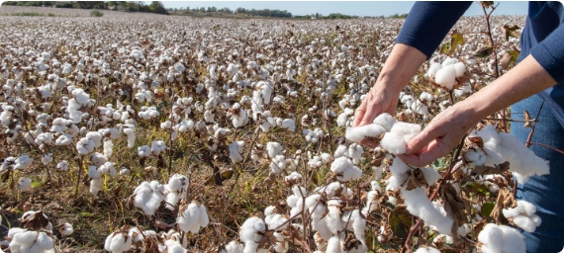
Problem Context
44.9 %
≈ 2 cm
1 spot
1 laser pass
OF CHANGES MADE AT OPTIMAL MOISTURE¹
MAKER'S 'CHANGE NOW' LINE FROM PAD EDGE²
WHAT TODAY'S MOISTURE SENSOR READS¹
TO WRITE A GRAPHENE ELECTRODE³
Target Beneficiary & Before-State User Flow
▪
Target User: wound-care nurses (clinics, home care) and patients with exuding chronic wounds: diabetic foot, pressure and venous leg ulcers.
▪
Operational Bottleneck: the 'change now' signal is visual. Under bandages or opaque covers it is hidden, so dressings are changed by the clock or after a leak.
▪
Before-State Flow: dressing on → exudate spreads unseen → changed too early (wasted dressing, disturbed wound) or too late (leak, macerated skin) → repeat.
▪
Public Search Disclosure: WoundSense reads moisture at one spot under the dressing¹; a 2007 lab array mapped moisture⁴; Stanford's smart bandage uses cleanroom electronics⁵; graphene wound sensors are still lab-only⁶. None reads the maker's change line at rupee cost.
Figure: exudate spreads outward; makers say change when it nears 2 cm from the pad edge², but under a bandage nobody can see it
Core Insight: dressing makers already define 'full' as a distance from the pad edge. Dermasense measures exactly that line, from outside the wound.

Slide 3
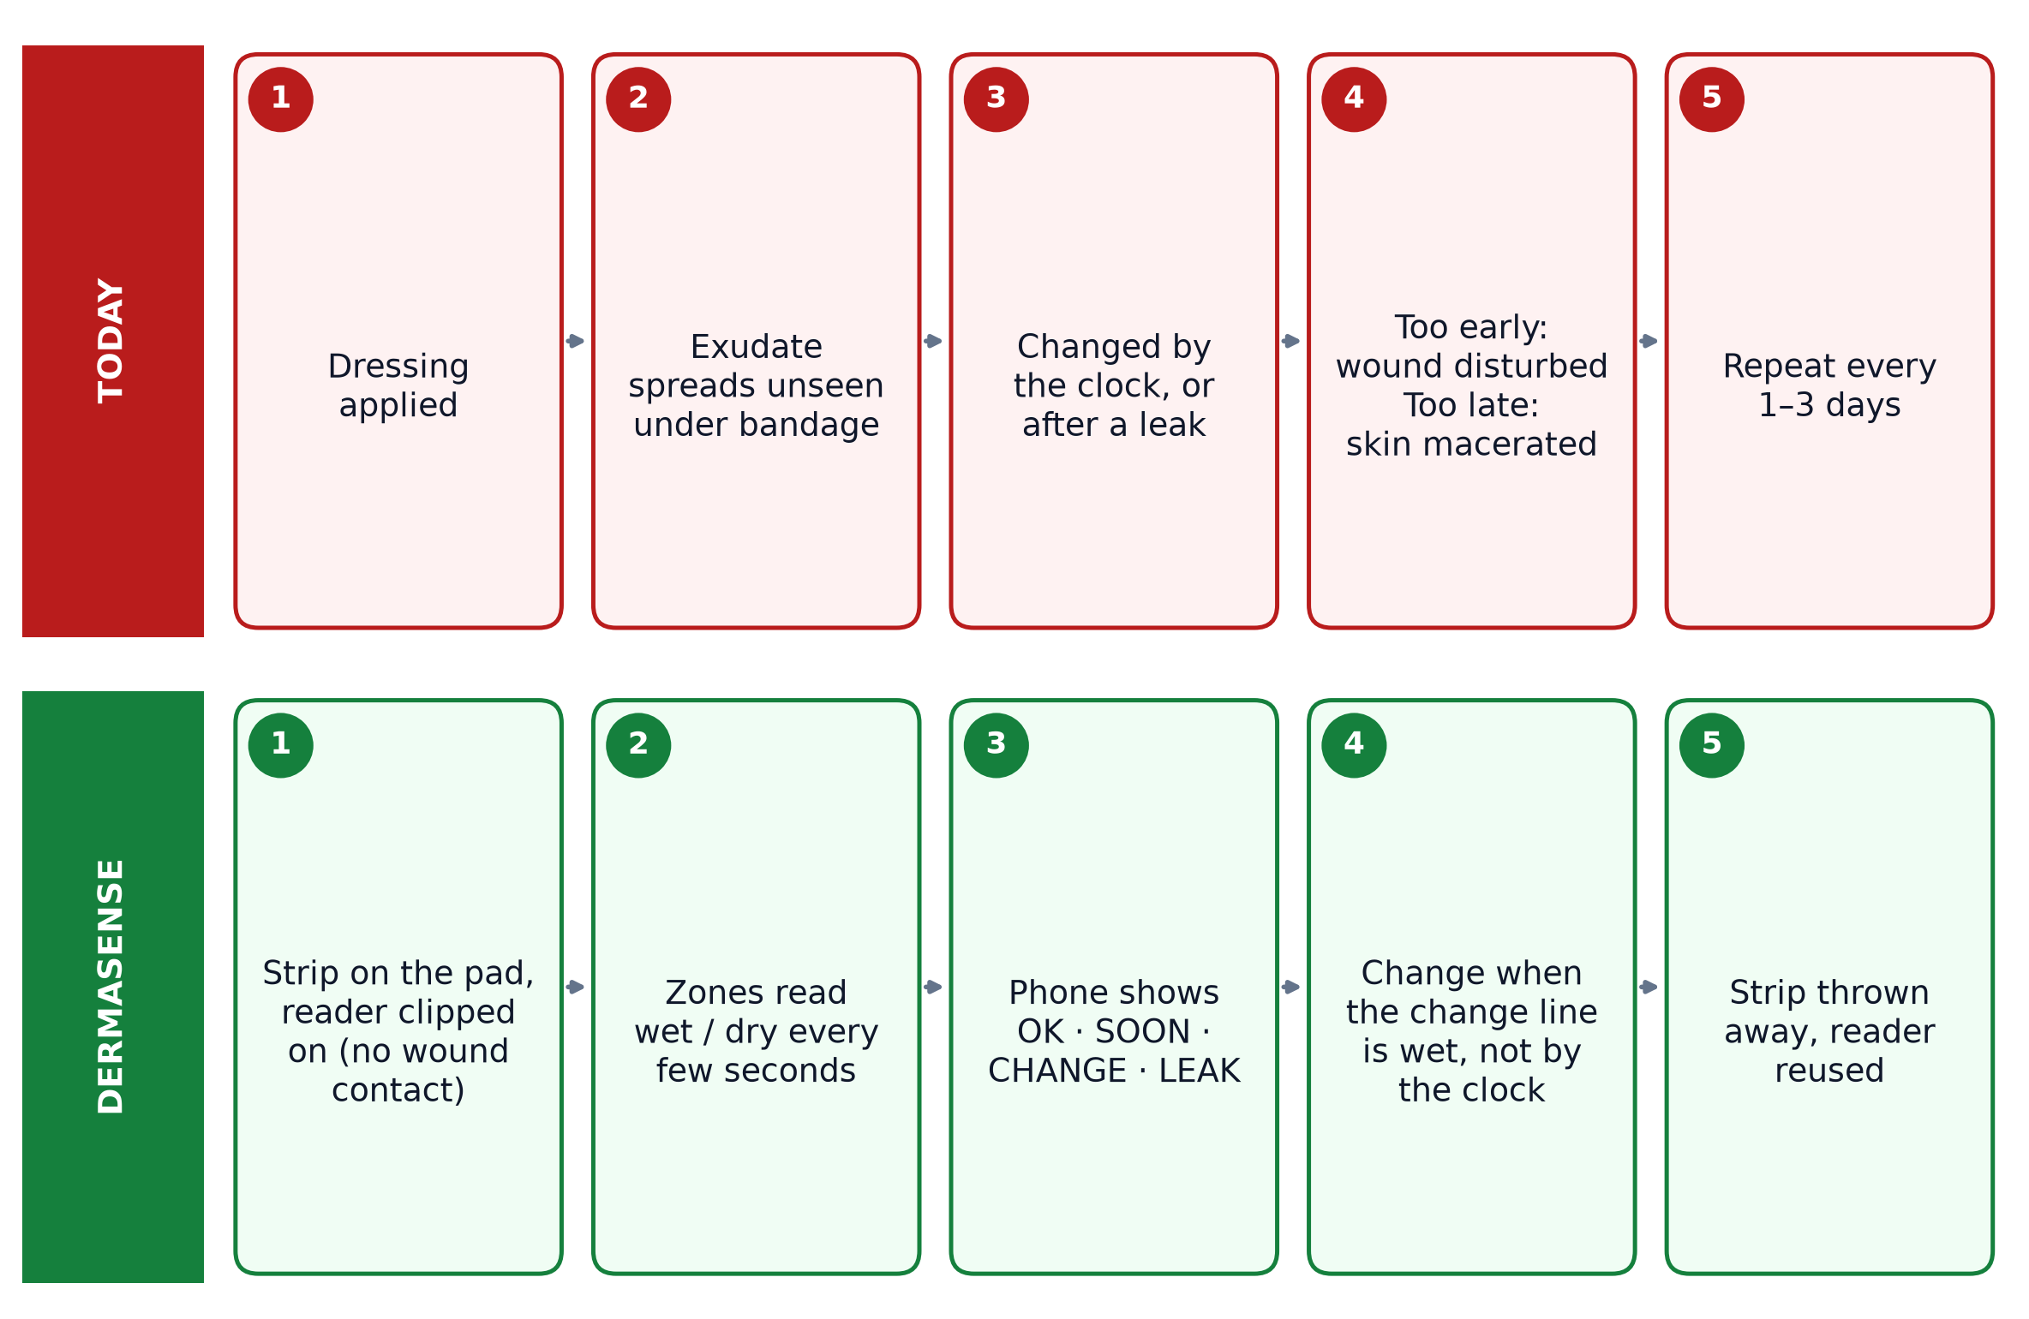
User Journey
By clock
4 zones
0
≤ ₹100
HOW DRESSINGS ARE CHANGED TODAY
CENTRE → EDGE ON ONE STRIP
CONTACT WITH THE WOUND BED
TARGET COST PER STRIP
After-State User Flow & Quantified Efficiency
▪
After-State Flow: strip on the pad, reader clipped on → zones read wet/dry → phone shows OK, SOON, CHANGE or LEAK → change when the change line is wet.
▪
Who Benefits: patients get fewer needless removals; nurses get a reason for every change; clinics waste fewer dressings.
▪
Efficiency Target: alert within ±10 % of the fluid volume at which exudate visibly reaches the change line, in bench tests with simulated exudate⁹.
▪
Not Claimed Yet: fewer dressing changes or faster healing. Those need clinical studies after the bench prototype works.
Figure: today's blind cycle vs the Dermasense cycle (target workflow, to be proven on the bench first)
Design Principle: the strip sits on the outer face of the absorbent pad, never on the wound: lower biocompatibility risk and no fouling of the sensor.

Slide 4


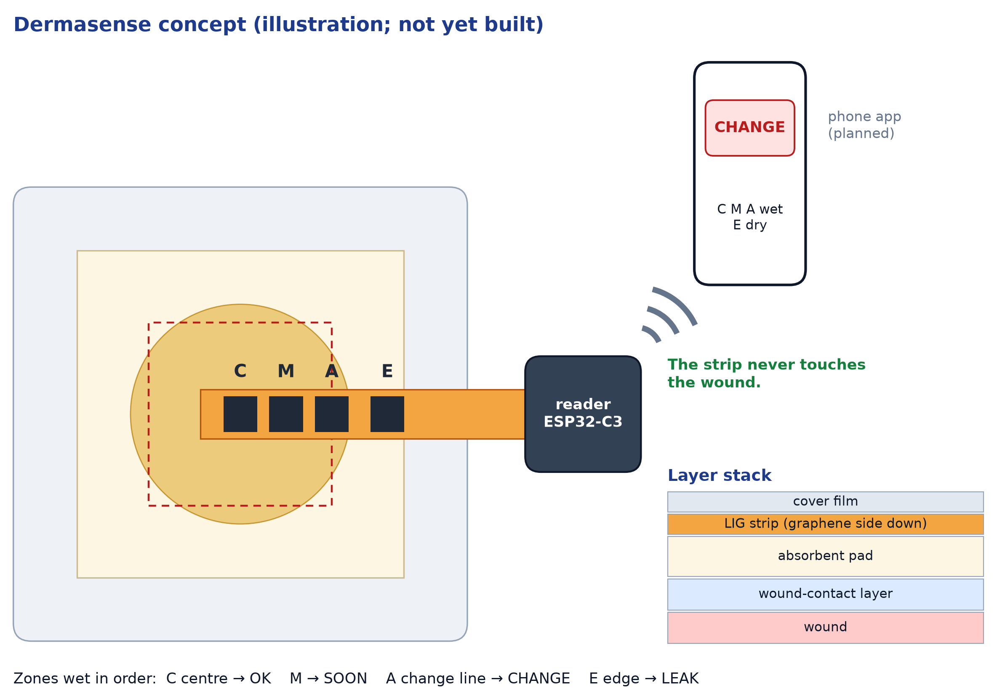

System Architecture & Specs
Engineering Target Specifications & Subsystems
Parameter | Target Spec | Selected Hardware / Protocol
Sensing strip | 4 wet/dry zones | Laser-induced graphene on Kapton
Zone signal | Dry/wet ≥ 100× (target) | AC drive between LIG electrodes
Reader | All zones every 5 s | ESP32-C3 + ADS1115 (16-bit)
Temperature ref. | ±0.1 °C class | TMP117, I²C
Display | OK / SOON / CHANGE / LEAK | USB log now, BLE app next
Strip cost | ≤ ₹100 (target) | One laser pass, no masks
Figure: disposable LIG strip on the pad + reusable clip-on reader + phone (concept illustration; not yet built)
Architecture Rationale: only film and graphene are thrown away; every electronic part lives in the reusable reader.

Slide 5
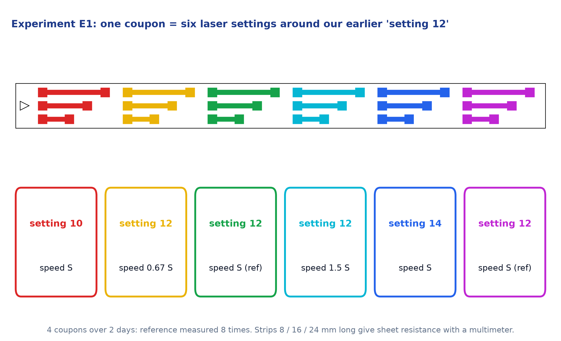

CAD Design & Mechanical Specs
Design Files & Laser Process Window
▪
Test Coupon: 6 cells × 3 graphene strips, 2 mm wide, 8/16/24 mm long; each colour is one laser setting.
▪
Measurement Trick: three lengths separate the graphene's sheet resistance from probe contact resistance, so a multimeter is enough.
▪
Reference: 'setting 12', where we saw a graphene-like layer, appears twice per coupon, on 2 days.
▪
Accept Rule: the recipe passes if sheet resistance varies ≤ 20 % between runs, fixed before testing.
▪
Next in SolidWorks: zone strip, clip-on reader and dressing test rig, sized from E1's measured line width.
Figure: our laser test coupon (real DXF from make_test_pattern.py) and the E1 settings around 'setting 12'
Why Process First: every graphene sensor needs a repeatable laser recipe, and '12' sits in the low-power range where CO₂ tubes can be unstable⁷.

Slide 6
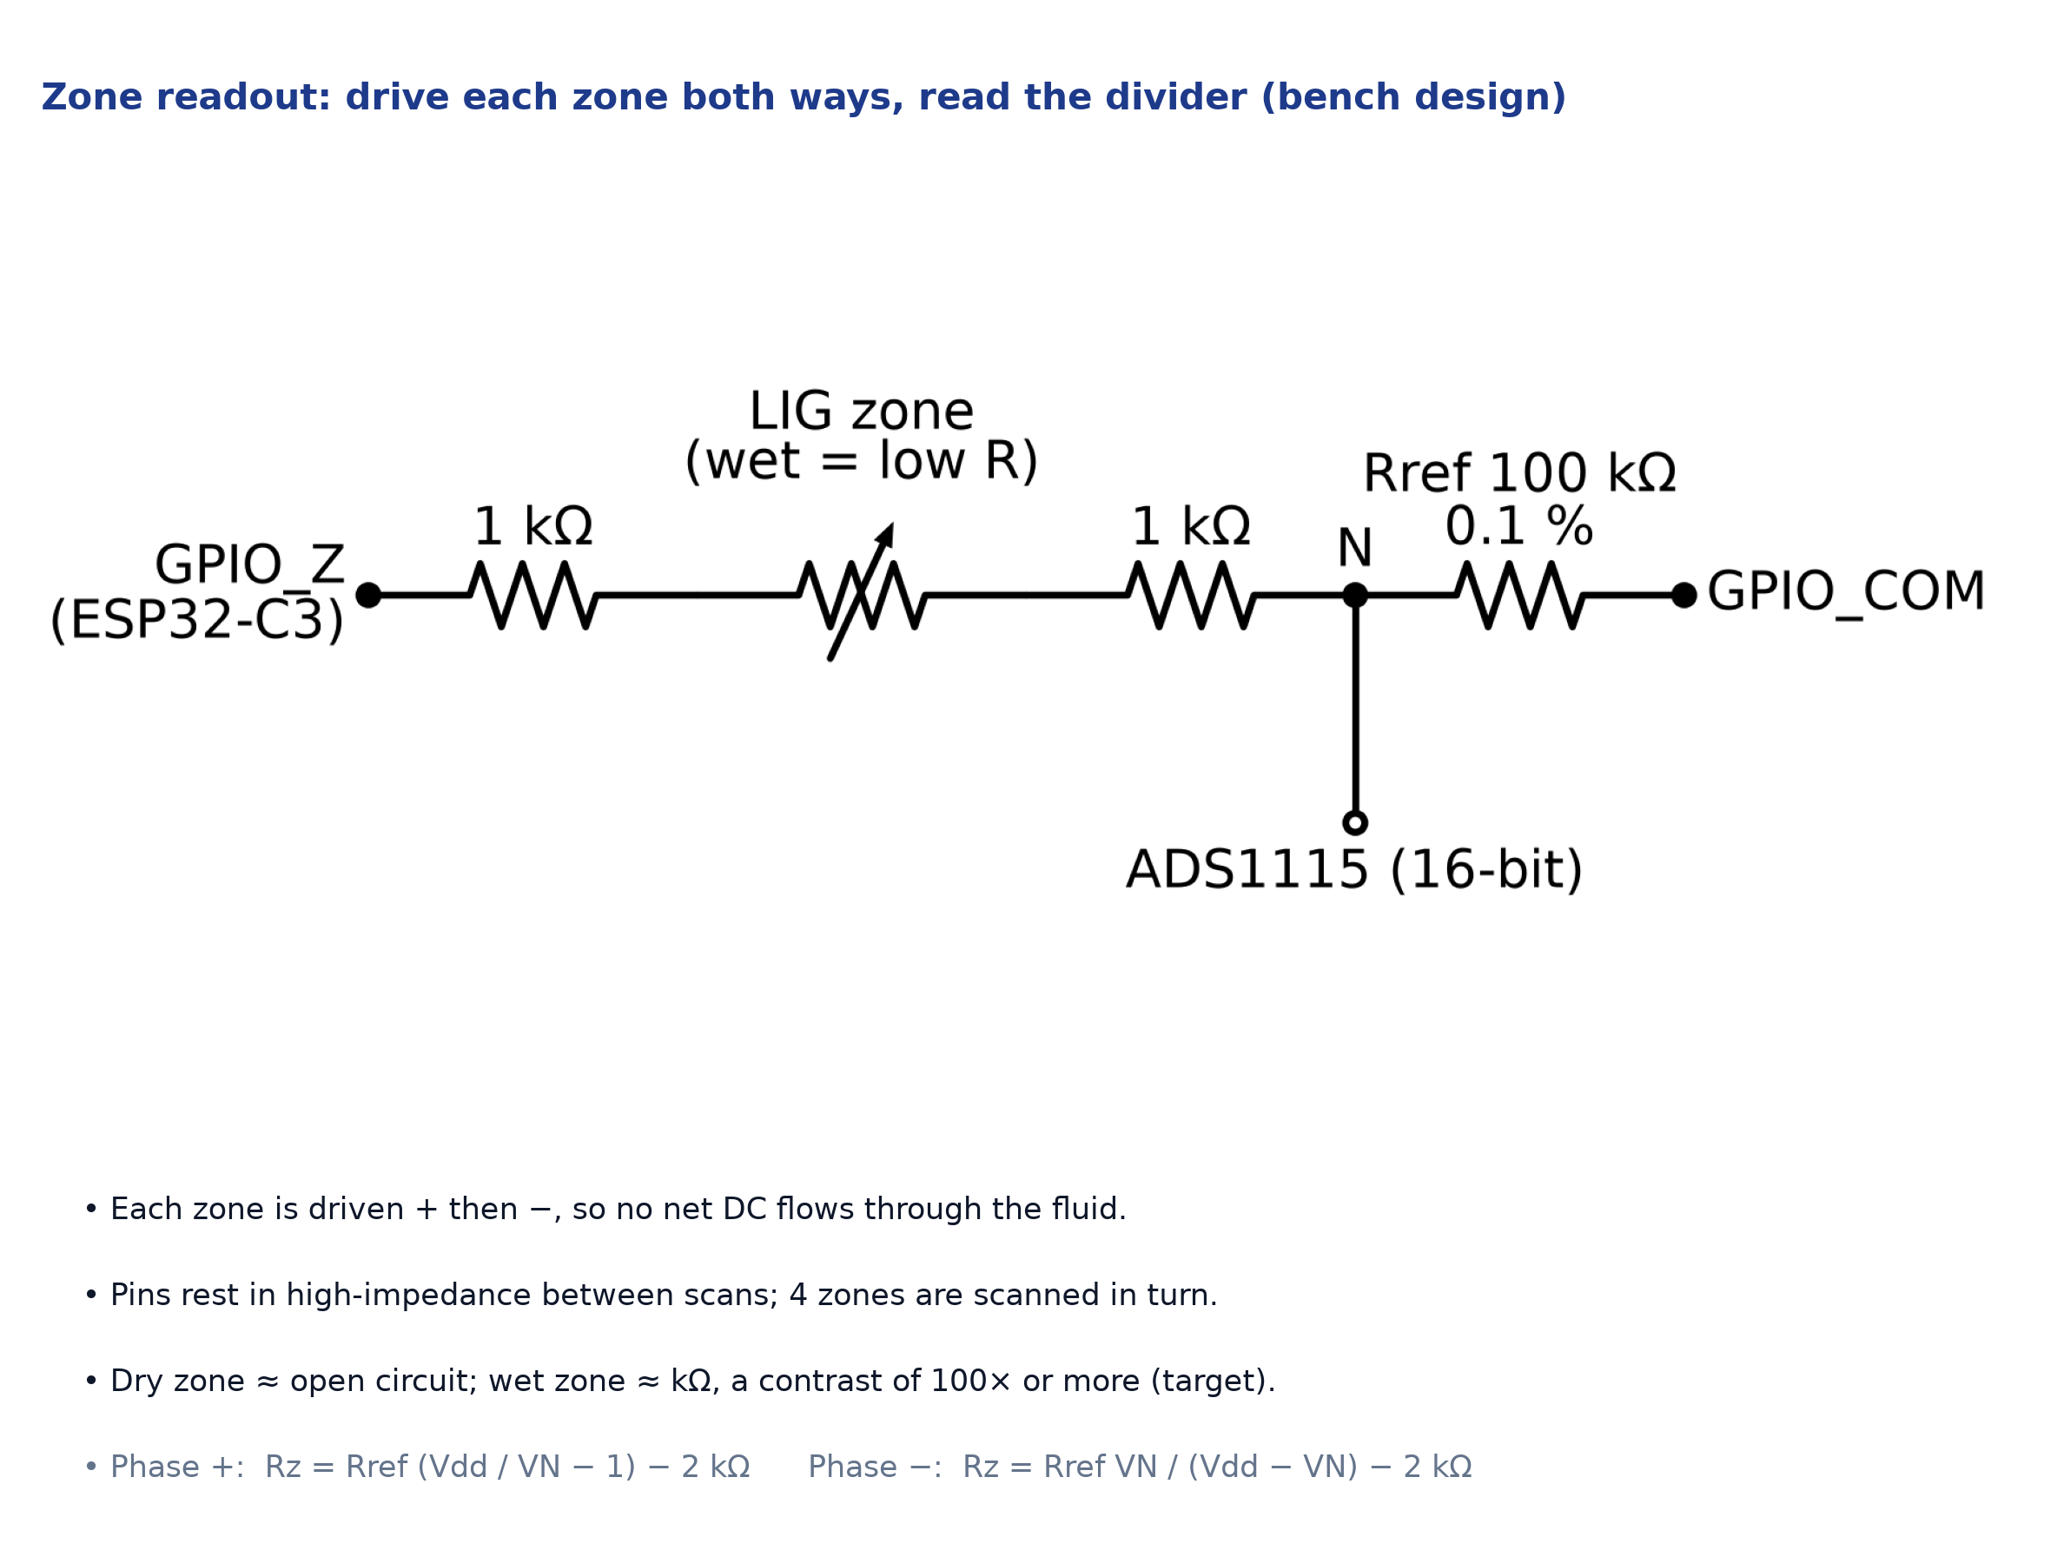

Electronics Schematics & BOM
Itemized Prototype Bill of Materials (BOM)
Component | Part / Specification | Qty | Lead Time | Cost (INR)
Microcontroller | ESP32-C3 dev board | 1 | Local | ₹250–700
ADC | ADS1115 16-bit, I²C | 1 | Local | ₹200–450
Temp. reference | TMP117 breakout | 1 | Online | ₹446
Resistors | 100 kΩ 0.1 %, 1 kΩ | 4 | Local | ₹40–160
Pad contacts | Silver paint + Cu tape | 1+1 | Local | ₹750–1,800
Test fluid | NaCl + CaCl₂ (Solution A) | Lab | Lab stock | ₹0
Total (excl. film) | ₹1.7–3.6k
Figure: zone readout; each zone is driven both ways and read by a 16-bit ADC (bench design; KiCad capture next)
Procurement Status: every part is available in India. Prices are estimates or listings seen on 14 Oct 2026; we order after E1 confirms the laser recipe.

Slide 7
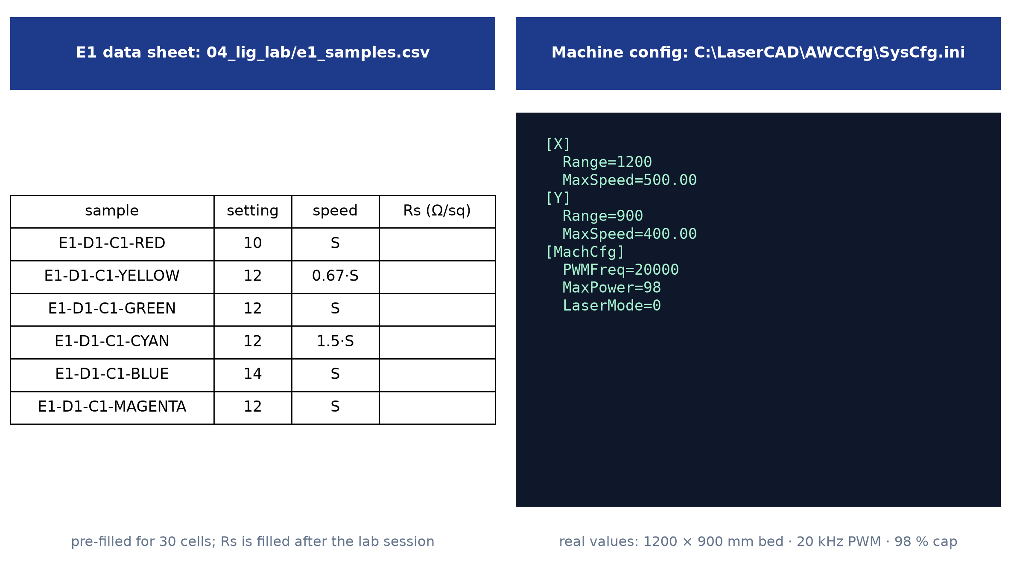
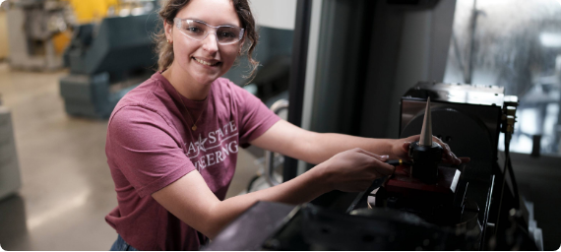
Maker Journey
Stage 1 to Stage 2 Engineering Iterations
▪
Iterative Pivot: Stage 1's closed-loop electrotherapy bandage was too broad to build well; we narrowed it to one measurable job: telling when a dressing is full.
▪
Laser Evidence: our earlier trial on Kapton at setting '12' gave a black, graphene-like layer; E1 repeats it with full records.
▪
Machine Facts: LaserCAD V8.28 on our laptop: 1200 × 900 mm bed, 20 kHz PWM, 98 % cap. So '12' is a % command, not watts.
▪
Repository: design scripts, coupon DXF, E1 protocol and data sheets under version control with timestamps (link to be added).
Figure: our real work so far: coupon design file, E1 data sheet, machine settings read from our LaserCAD install (lab photos follow E1)
Team: Soham Prabhakar Kadu & Bhakti Ajay Kadam. Faculty mentor sign-off to be added after the E1 review.

Slide 8



Safety by Design & Roadmap
Design FMEA (Failure Mode and Effects Analysis)
Failure Mode | Potential Hazard | Embedded Fail-Safe / Mitigation Response
Laser over-power | Burn-through, flame, polyimide fumes | Lowest setting first; exhaust on; never unattended; stop on any flame
Unstable low-power output | Graphene quality varies run to run | Log tube current; reference cell ×2 per coupon; repeat on 2 days
Electrodes near skin (future) | Irritation, current through tissue | Strip stays off the wound; AC only, ≤ 10 µA; ISO 10993 tests before skin use
Fabrication Phase (Months 1 - 2)
Integration & Bench Demo (Months 3 - 4)
▪
Oct 2026: E1: reproducible graphene on our laser; measure sheet resistance and line width (4 coupons, 2 days).
▪
Dec 2026: E3: strips on real dressings with simulated exudate⁹; zone alerts vs the visible stain front.
▪
Nov 2026: zone strip v0.1 cut from E1 dimensions; bench reader (ESP32-C3 + ADS1115) assembled and calibrated.
▪
Jan 2027: repeatability and bending tests; Stage 3 demo video with raw data.

Slide 9



Technical Challenges & Risks
Laser Repeatability
Is It Graphene?
Safety & Standards
Observed Risk: '12' is a low-power command on a 100 W tube; such tubes fire unevenly below ~25 %⁷, and the polyimide brand changes the result⁸.
Mitigation: log tube current, repeat the reference on 2 days, accept only if variation ≤ 20 %; fall back to slower or defocused passes.
Test: E1, 8 reference cells over 2 days, tube current logged.
Observed Risk: black and conductive is not proof of graphene; resistance alone cannot show graphitic carbon.
Mitigation: Raman (D, G, 2D peaks) and SEM through a university facility; until then we call it a graphene-like layer.
Test: Raman on our 3 best cells; graphene shows D ≈ 1350, G ≈ 1580 and 2D ≈ 2700 cm⁻¹ bands³.
Wound Contact: none by design; the strip sits on the outer face of the pad.
ISO 10993: required before any skin contact; Kapton is not sold as medical grade¹⁰.
IEC 60601-1: applies to the future on-body reader, not to bench tests.
Claims: bench data only, so no diagnostic or healing claims.
Fallback: if our laser cannot give repeatable graphene, we use a partner lab's laser; the strip design and reader stay the same.

Slide 10


References & Sources
(numbers match the superscripts on each slide)
1. Milne S.D. et al., A wearable wound moisture sensor as an indicator for wound dressing change, Int. Wound J. 13(6):1309–1314 (2016). doi:10.1111/iwj.12521
2. Dressing instructions for use: Mölnlycke Mepilex Border Flex 'time to change'; 3M Tegaderm silicone foam border guide; foam dressings citing the 2 cm rule.
3. Lin J. et al., Laser-induced porous graphene films from commercial polymers, Nat. Commun. 5, 5714 (2014). doi:10.1038/ncomms6714
4. McColl D., Cartlidge B., Connolly P., Real-time monitoring of moisture levels in wound dressings in vitro, Int. J. Surg. 5(5):316–322 (2007). doi:10.1016/j.ijsu.2007.02.008
5. Jiang Y. et al., Wireless, closed-loop, smart bandage with integrated sensors and stimulators, Nat. Biotechnol. (2022). doi:10.1038/s41587-022-01528-3
6. Asgharian H. et al., WoundMx: wound-infection biomarker detection with laser-induced graphene, Research Square preprint (2025). doi:10.21203/rs.3.rs-7274589/v1
7. CO₂ laser tube current vs PWM setting, engineering measurements, softsolder.com (2022), not peer-reviewed.
8. Influence of lasing parameters on the morphology and electrical resistance of polyimide-based LIG, Carbon Letters (2023).
9. EN 13726-1:2002 / EN 13726:2023, Test methods for primary wound dressings (absorbency; 'Solution A' simulated exudate).
10. DuPont statement on the use of DuPont materials in medical applications (Kapton medical caution).
11. Reviewed, not used as evidence: Rezaei I. et al., Wearable Kapton graphene biosensor for toxic gases, J. Hazard. Mater. Adv. 15, 100452 (2024), simulation only.

Slide 11






Image Sources
All figures were drawn by the team with Python from project files: problem, journey and concept illustrations; the coupon from lig_test_coupon.dxf; the schematic with schemdraw; machine settings from LaserCAD SysCfg.ini. Script: 08_submission/make_figures.py.
No stock photos and no AI-generated images are used; concept drawings are labelled as concepts.

