Slide 1



DERMASENSE
VK26-IITI-HT-0050
Health Tech · Emergency Response & Remote Monitoring
Team: Soham Prabhakar Kadu · Bhakti Ajay Kadam
Notes:
Template page 1 asks only for the Vishwakarma Application ID; team names added. Project title, track and core innovation are in the Project Overview bar on slide 2 (as in the template's example page 4).

Slide 2






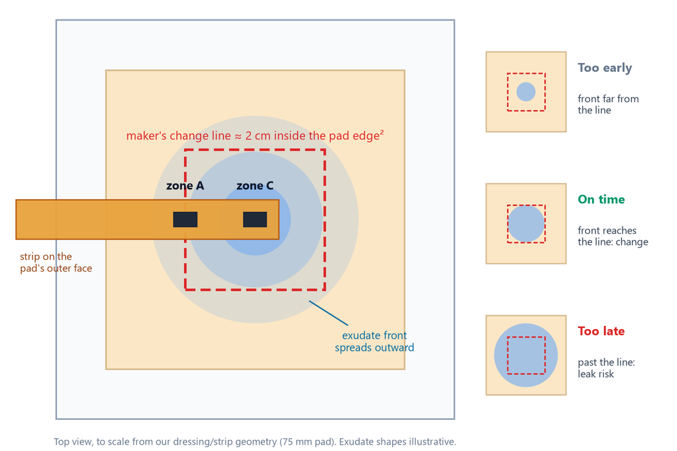
PROBLEM CONTEXT
EVIDENCE FROM PUBLISHED SOURCES
44.9 %
≈ 2 cm · 75 %
1 point
> 10×
DRESSING CHANGES MADE WHILE MOISTURE WAS OPTIMAL¹
SOME DRESSINGS SHOW WHEN IT IS TIME TO CHANGE [2, 14]
ONE EXISTING SENSOR TAKES A SINGLE-POINT READING¹
REPORTED EXUDATE AMOUNTS VARY BY >10×⁶
The problem and who we designed for
▪ Problem: a carer cannot see whether a covered foam dressing has reached its maker’s change line.
▪ Result: early changes mean needless pain and waste; late changes risk strike-through leakage [2] and periwound maceration (moisture-damaged skin) [21].
▪ Who: nurses and family carers supporting people with draining chronic wounds, including diabetic foot, leg and pressure ulcers.
▪ We will: show when that change line is reached, from outside, without lifting the dressing.
Our illustration shows why the change line can be hidden under a cover (drawn to scale from our strip design).
Project at a glance: Dermasense · Team VK26-IITI-HT-0050 · Health Tech: Emergency Response & Remote Monitoring · Our idea: read a dressing’s change line from outside, without lifting it.
Notes:
Milne 2016 [1]: 264 of 588 changes at optimal moisture (WoundSense spot readings). Change rules: some foam dressings ~2 cm from the pad edge [2]; ALLEVYN LIFE 'At 75%, it's time to change' [14]. Exudate 0.10-1.3 g/cm2/day by two methods [6]. Template page 2: Project Overview + Problem Statement.

Slide 3

What carers can use today — and what is still missing
EARLY SEARCH · NOT EXHAUSTIVE
Current options and their limits
What we searched and what we are testing
Today's option | Without lifting? | Maker's rule? | What limits it
Fixed schedule (clock) | ✗ | ✗ | hard to predict because fluid amounts vary >10×⁶
Lift and look | ✗ | ✓ | requires removing the dressing; removal can hurt²⁰
Visual change indicator¹⁴ | ✗ | ✓ | only works when the indicator is visible
Single-point moisture sensor¹ | ◐ | ✗ | measures moisture at one point
Closed-loop smart bandage⁵ | ✓ | ✗ | tested in mice; active therapy adds cost and a regulatory burden [5]
Diaper wetness strip⁴ | ✓ | ✗ | designed for diapers, not wound dressings
Dermasense (proposed) | ✓ | ✓ | not yet tested; E2 and E4 will evaluate it
▪ Searched: papers, patents and products [1, 4, 5, 14].
▪ Found: in our search, no low-cost sensor reads a dressing’s own change line.
▪ Our focus: show when fluid reaches that change line, without lifting the dressing.
▪ Why now: carbon can be laser-written on polyimide in one pass [7], and dressing makers already define a change line [2, 14].
▪ Not our goal: diagnosis or treatment. We are exploring a way to report how full the dressing is.
✓ yes ✗ no ◐ partly. Our search of papers, patents and products was not exhaustive.
Question we are trying to answer: How can a carer tell when a covered dressing needs changing without lifting it?
Notes:
Ticks are our reading of each source: WoundSense readings in Milne 2016 [1] were spot checks at dressing change; Jiang 2022 [5] is a mouse-model closed-loop bandage; diaper patents [4] use a strip plus clip-on detector; ALLEVYN LIFE [14] has a visual change indicator. Source: 2_research/research_gap.md.

Slide 4
User Journey: Before State
CURRENT CARE · PUBLISHED EVIDENCE
1.9–4.5 per 1,000
101 million
19–34 %
40.3 %
CHRONIC WOUND PREVALENCE IN TWO INDIAN SURVEYS [16, 17]
PEOPLE IN INDIA LIVING WITH DIABETES¹⁸
ESTIMATED LIFETIME FOOT-ULCER RISK WITH DIABETES¹⁹
PATIENTS SAY DRESSING-CHANGE PAIN IS THE WORST PART²⁰
Illustrative persona, not a real patient: a person with a diabetic foot ulcer living at home with family support and periodic nursing visits.
What published studies tell us
STAGE
1 Dressing is applied
2 Dressing fills over time
3 Carer decides
4 Change
5 Repeat
▪ Time: One UK patient survey reported about 18 minutes per dressing visit and five visits a week [13].
▪ Waste: In one study, 44.9% of recorded changes happened while moisture was still in the optimal range [1].
▪ Cost: Indian retail listings show ₹242–514 for one 10 × 10 cm foam dressing [15]; every premature change discards one.
▪ Safety: a dressing left on too long can leak and macerate the surrounding skin [21]; removal can hurt [20].
▪ Who carries it: the patient, family carer and nurse all manage this routine.
WHAT HAPPENS
A foam dressing sits under a bandage or sock
Fluid builds up beneath the cover
Follow a schedule, take a look, or wait for leakage
Too early or too late
About five visits a week¹³
PAIN POINT
The change line is hidden under the cover
There is no clear signal
The decision is uncertain
Painful removal and a wasted dressing, or leakage and skin maceration
About 18 minutes per visit¹³
Illustrative care journey based on published data; the persona is not a real patient.
Insight: when a dressing is covered, a carer cannot see whether it has reached its change line.
Notes:
WHO: Gupta 2004 [16] 31 chronic wounds in 6,917 people (4.5/1,000); Sharma 2024 [17] 19 in 10,003 (1.9/1,000), diabetic foot ulcers 36.8 % of them; ICMR-INDIAB [18] 101 million (11.4 %); Armstrong 2017 [19] 19-34 % lifetime (review estimate; upper bound contested); Price 2008 [20] 790 of 2,018 patients. Persona is illustrative, built from these data; not a real patient or interview. Quantified: Mölnlycke survey [13], Milne [1], Truemeds [15].

Slide 5
User Journey: After State (Intended)
DESIGN INTENT · NOT CLINICALLY TESTED
0 lifts
up to 44.9 %
≤ ₹100
2–5 strips
DESIGN GOAL: CHECK WITHOUT LIFTING
EARLY CHANGES A RELIABLE ALERT COULD AVOID¹
TARGET STRIP COST (ESTIMATE)
PAID BY ONE AVOIDED CHANGE (PROJECTION)¹⁵
The same illustrative persona with the proposed workflow. This has not been clinically tested.
What each person could gain
STAGE
1 Strip on
2 Reader on
3 Check status
4 Change line reached
5 Nearby check
▪ Patient: fewer needless removals, the step patients find most painful [20].
▪ Family carer: a clear OK / CHANGE signal instead of guesswork.
▪ Nurse: checks the status in seconds without unwrapping the bandage (design goal).
▪ Budget: reusable reader ≈ ₹560–1,160 (BOM estimate) + strip ≤ ₹100 (target); one avoided ₹242–514 dressing change pays for 2–5 strips (projection).
WHAT HAPPENS
placed on the pad's outer face
clips on: 4 pins, 2 dowels
Green OK, without lifting the dressing
Amber CHANGE; red CHECK for a possible leak
A nearby phone reads the status over Bluetooth (hardware test pending)
GAIN
nothing on the wound
same routine
A clearer decision, if testing supports it
A prompt to check the dressing
Status checked remotely, without disturbing the wrap
Intended workflow only. Bench testing comes first; the device has not been tested on people.
Design Principle: The intended setup keeps the usual care routine. The strip sits on the dressing’s outer face; the reader is reused. E4 will test the ±10% alert target.
Notes:
Targets and projections, not results. 'Up to 44.9 %' assumes every change waits for CHANGE; some changes have other clinical reasons. Payback: strip <= Rs 100 (estimate) / dressing Rs 242-514 [15] = 0.19-0.41. Bluetooth: compiled and tested in software only (bench test T11 pending); no phone app yet.

Slide 6


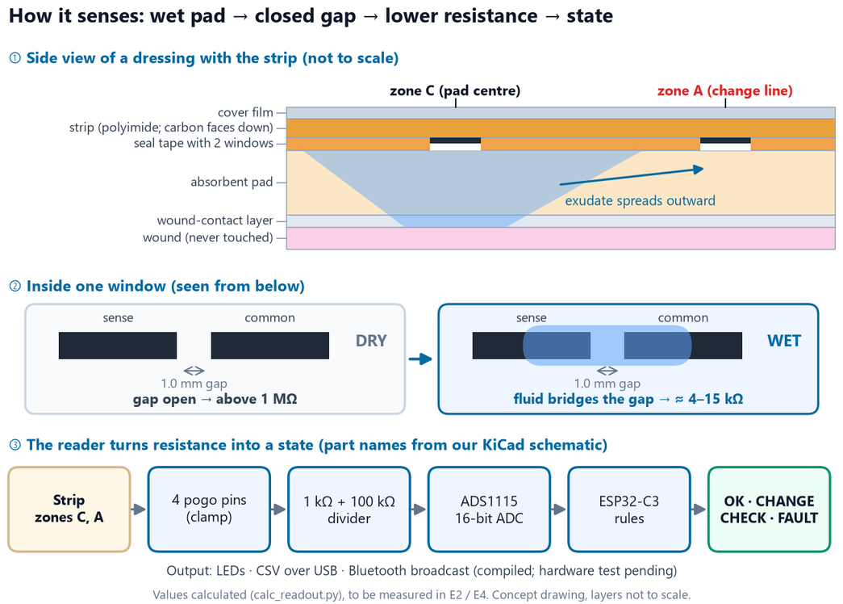
System Architecture & Specs
DESIGN TARGETS · NOT YET BENCH-TESTED
Design targets and hardware
Parameter | Design value | Basis
Sensing zones | 2: centre C, change line A | decision D-012
Electrodes | 1.0 mm lines and gaps | E2 pre-registered limits
Wet / dry | < 100 kΩ / > 300 kΩ, 3 scans | calc: wet 4–15 kΩ
Drive | bipolar, ≤ 33 µA, no net DC | calc · bench T8
ADC / MCU | ADS1115 16-bit (I²C) · ESP32-C3 | datasheets
Self-test | 100 kΩ check ±5 % + strip loop | show FAULT if the check fails
Contacts | 4 pogo pins + 2 dowels | CAD checked
Output | LEDs · USB log · BLE broadcast | BLE compiled only
Concept drawing: how a moisture reading could become a status. Values are design targets, not measured results.
Architecture Rationale: We are designing the reader for reuse; the strip is the disposable part.
Notes:
Electrode lines/gaps 1.0 mm (provisional until E2). Windows 6 x 3.9 mm. Expected wet 4.2-14.8 kOhm, dry >= 1 MOhm (calc_readout.py). Self-check: 100 kOhm 0.1 % resistor (+/-5 %) and COM loop -> FAULT. BLE: one 13-byte advertisement per scan (ble_beacon.h), compiled, not run on hardware. Sources: config.h, strip_v0_1_geometry.json.

Slide 7
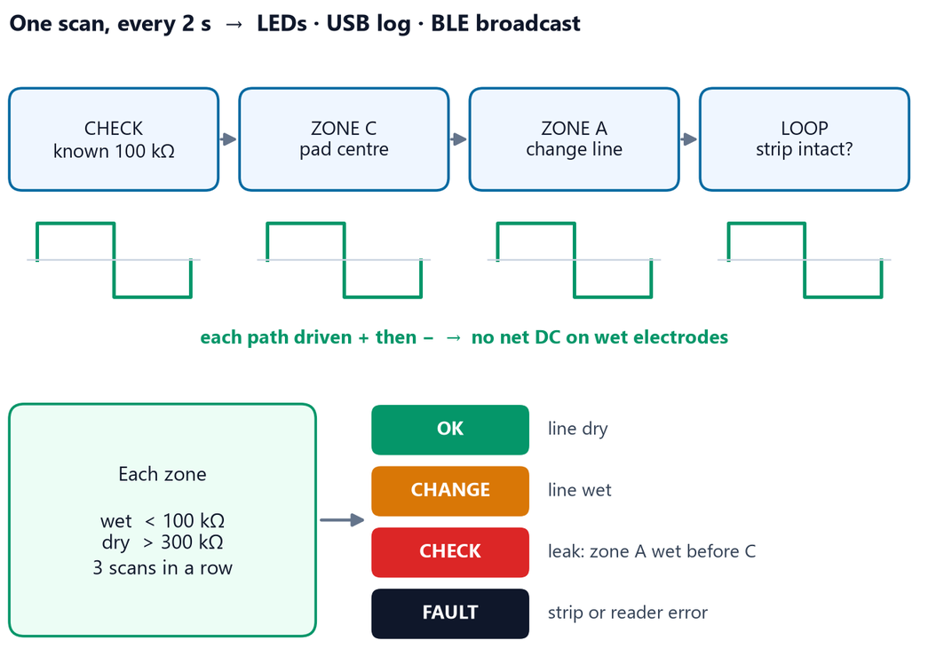
System Architecture & Specs: Firmware & Data Flow
SOFTWARE CHECKS PASSED · HARDWARE TESTING PENDING
How the firmware turns readings into a status
▪ Measure: Each zone is driven in both directions to avoid net DC; hardware testing is pending.
▪ Read: The 16-bit ADC reading is scaled to the 3.3 V rail.
▪ Decide: Design thresholds are wet <100 kΩ and dry >300 kΩ for three consecutive scans.
▪ Self-check: A known 100 kΩ reference is checked each scan; a failed check shows FAULT.
▪ Output: Status appears on LEDs; data can be logged over USB. There is no custom app yet.
▪ Remote monitoring: the reader broadcasts its status over Bluetooth Low Energy (BLE) to any nearby smartphone scanner, with no hospital Wi-Fi or cloud needed. Firmware done; hardware test pending.
This diagram follows one reader scan from measurement to status.
Software checks: We passed 23 compile-time checks and 16 PC-side tests. The firmware has not yet run on a wired board.
Notes:
ADS1115 single-shot 128 SPS, auto-range; A1 reads the 3V3 rail. Rx from both phases, averaged, scaled by the check resistor (+/-5 % else FAULT), minus 2 kOhm protection. Idle pins high-Z; zones frozen during FAULT. Compiles for ESP32-C3 with 0 warnings (650,349 bytes, 49 % of flash, with Bluetooth). BLE payload: state, wet flags, scan number, both zone resistances; unencrypted, test company ID 0xFFFF, bench only. Decoder: 7_firmware/tools/decode_beacon.py.

Slide 8
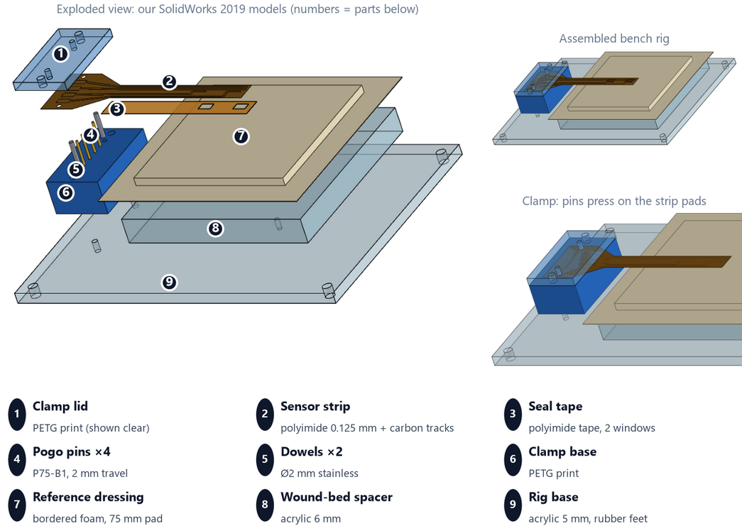
CAD Design & Mechanical Specs
DESIGNED · CAD VERIFIED · NOT YET BUILT
A clip-on clamp: 4 spring pins, 2 dowels
Check | Result | Basis
Materials | polyimide strip · PETG clamp · acrylic rig | printable, laser-cut
Pin force | 0.72 N each · 2.9 N total | calc
Lid bending | 11 µm vs 1.48 mm pin travel | calc
Alignment | 0.49 mm used of ±1.35 mm | calc · 2.8× margin
Strip bending | 0.62 % strain at 10 mm radius | calc · yield ≈ 3 %
CAD checks | 99 passed · 0 failed · 5 blocked until E2 measurements | verify_cad.py
Stress check | lid stress ≈ 0.4 MPa · FoS > 40 on PETG | beam-model hand calc; FEA not run
Our SolidWorks models and drawings; the clamp has not been built yet.
Design Iteration: We found that the seal tape would sit under the clamp. We moved it to x = 23 mm; the CAD check now reports no clash (D-013).
Notes:
Hand calculations: 5_cad/calc_mechanical_report.md (pin rate 0.49 N/mm from the P75-B1 listing; 1.48 mm compression; lid 4.0 mm PETG, span 35.7 mm, simply supported; tolerance stack worst case 0.49 mm, RSS 0.25 mm; t/2R strain; 10 N tug at the dowels). No FEA: loads are under 3 N, so stresses are far below PETG limits; SolidWorks Simulation is available if the judges want plots. CAD checks: 5_cad/verify_cad_report.md.

Slide 9
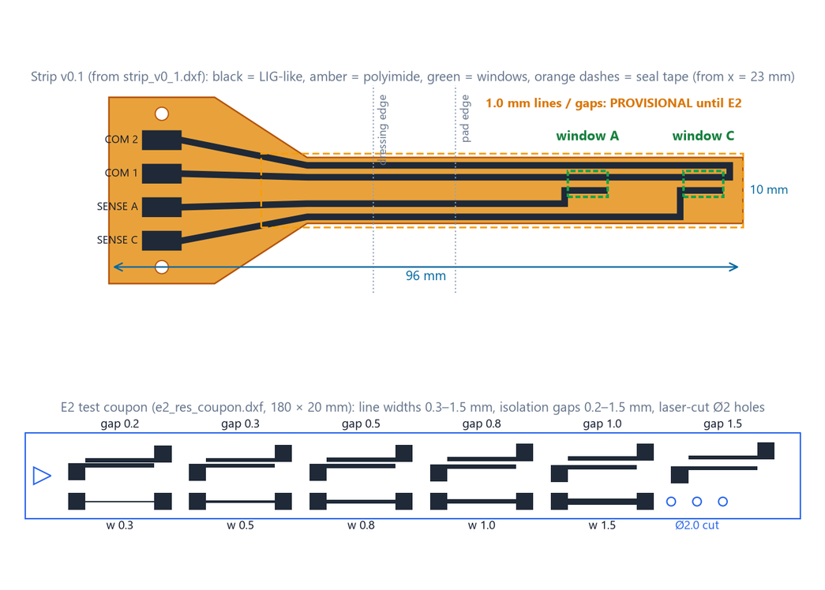
CAD Design & Mechanical Specs: Sensing Strip & Laser Process
DESIGNED · LAB TEST PENDING
E2: laser and strip validation
▪ Material: We plan to create a laser-carbonised, LIG-like layer on polyimide [7].
▪ Reference: The machine’s “12” setting is likely a PWM percentage, not watts; it still needs confirmation.
▪ E2 matrix: 7 coupons, 2 days, 72 pre-registered samples.
▪ Pass rules: Pre-set limits are CV ≤20% and electrical isolation across gaps >3 MΩ.
▪ Seal: laser-carbon made in air is superhydrophilic [9]; polyimide tape over the leads is designed to stop fluid wicking along the traces. E2 tests the seal.
Laser pattern from our DXF files; it has not been fabricated yet.
All 35 design-file checks pass. No v0.1 strip has been cut yet; the LaserCAD import is confirmed at the machine before fabrication.
Notes:
Graphene not confirmed until Raman. Machine (LaserCAD config): 1200 x 900 mm bed, 20 kHz PWM, 98 % cap. Logged per layer: min/max power, speed, 0.1 mm interval, passes, scan direction, focus, tube current. E2 = 4 bracket coupons (power 10/12/14, speed x0.67/1/1.5) + 3 resolution coupons.

Slide 10
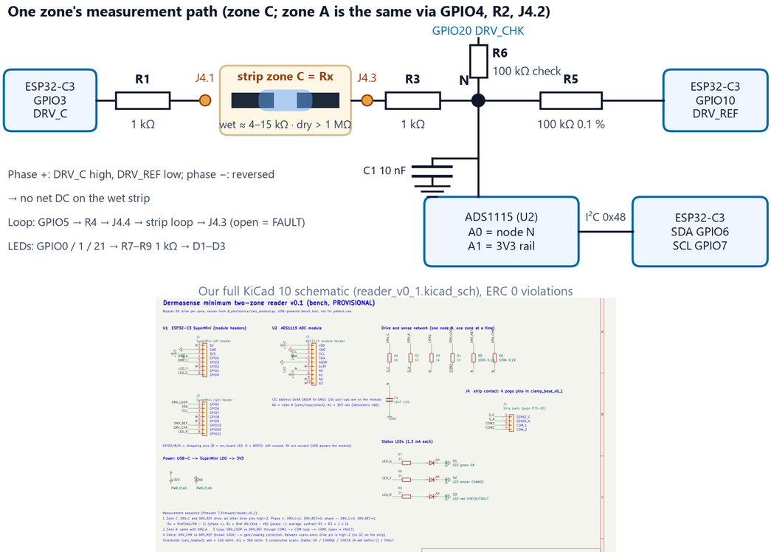
Electronics Architecture & Signal Path
SCHEMATIC CHECK PASSED · NOT YET WIRED
Pin and net map from our KiCad netlist
Net | Pin | Function
DRV_C · DRV_A | GPIO3 · GPIO4 | drive zone C · A via 1 kΩ
DRV_LOOP | GPIO5 | strip loop (broken strip)
DRV_REF | GPIO10 | 100 kΩ 0.1 % reference
DRV_CHK | GPIO20 | 100 kΩ self-check
SDA · SCL | GPIO6 · GPIO7 | I²C to ADS1115 (0x48)
N · 3V3 | ADS1115 A0 · A1 | node · rail (ratiometric)
LED G · Y · R | GPIO0 · 1 · 21 | OK · CHANGE · CHECK/FAULT
Strip pads | J4.1 – J4.4 | S_C · S_A · COM1 · COM2
Power | USB-C → 3V3 | LDO on the SuperMini
This figure shows zone C’s measurement path from our KiCad 10 netlist.
The electrical rules check found 0 violations. The netlist matches the firmware and strip pads, with 0 mismatches.
Notes:
Full pin map: 7_firmware/WIRING.md (generated from the netlist). I2C on GPIO6/7 (ADS1115 0x48); A1 = 3V3 rail; LEDs on GPIO0/1/21; strapping pins GPIO2/8/9 unused.

Slide 11
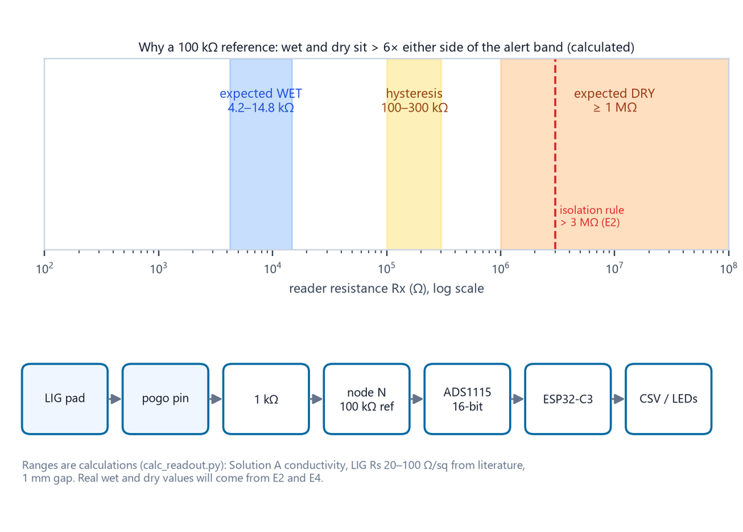
Electronics Schematics & BOM: Bill of Materials
3 ITEMS QUOTED · NOTHING ORDERED
Bulk prototype purchases and test setup
Item | Qty | Source | ₹
ESP32-C3 SuperMini (PRO4607) | 1 | Probots · quoted | 242
ADS1115 module (PRO789) | 1 | Probots · quoted | 125
P75-B1 pogo pins (05880) | 100 | Hubtronics · quoted | 354
Resistors, C0G cap, LEDs, board | set | local / online | 158–421
Clamp + bench rig | set | lab / local | 100–1,240
Strip materials | set | lab / online | 800–3,500
Test consumables | set | local | 480–1,060
Prototype bulk outlay |  |  | ≈ 2,259–6,942
Reusable reader ≈ ₹560–1,160 (BOM estimate) · Disposable strip: target ≤ ₹100
Parts status: Three items quoted on 19 Oct; nothing ordered; other costs are estimates. Total ₹2,259–6,942 covers bulk purchases and bench/test setup, not one strip.
Notes:
Line items: 6_electronics/bom_v0_1.csv (23 lines, each traced to the file that needs it). First order: silver paint, 1 % resistor set, 0.1 % 100 kOhm resistors, ADS1115, ESP32-C3. Quoted 19 Oct 2026 incl. GST: Probots PRO4607 ESP32-C3 SuperMini Rs 242; Probots PRO789 ADS1115 Rs 125; Hubtronics 05880 P75-B1 pack of 100 Rs 354. Total leaves out the borrowed meter, USB cable and E4 dressings. Ranges = sum of min/max estimates.

Slide 12
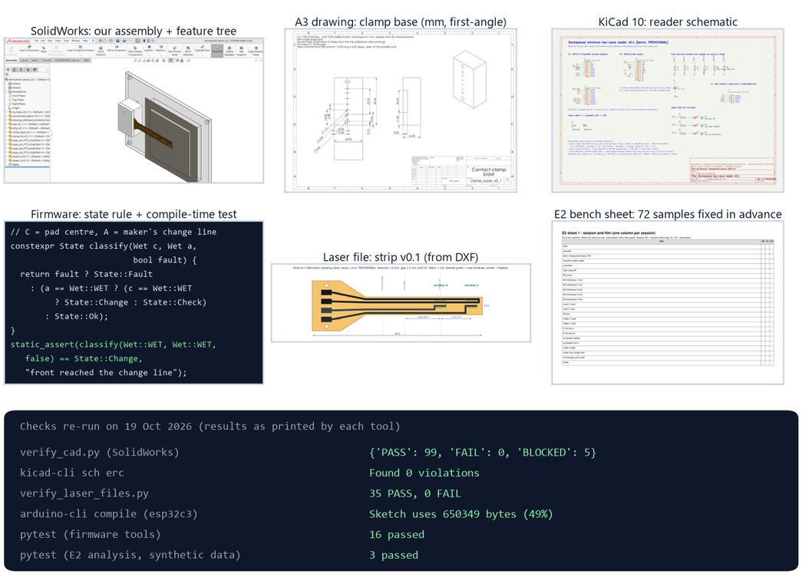
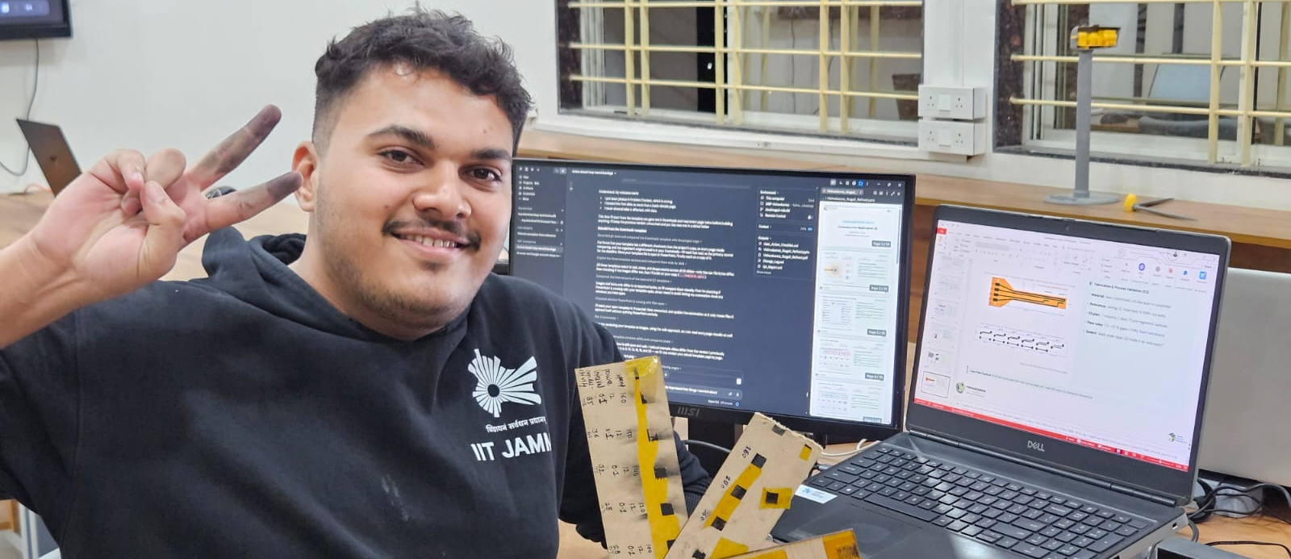
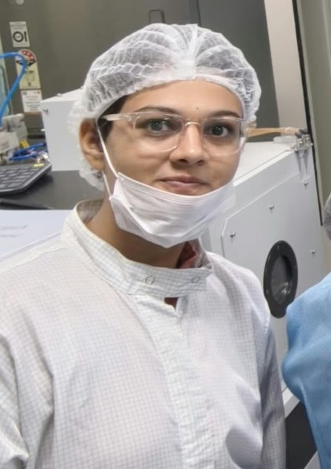

Maker Journey
PROJECT FILES · CHECKS CAN BE RERUN
Our team and project files
Soham Prabhakar Kadu · Lead, Mechanical Architecture & Sensor Design
Bhakti Ajay Kadam · Lead, Materials & Micro-fabrication (semiconductor background)
▪ Real files: The repository includes CAD models and drawings, the KiCad schematic, firmware and laser files, with dated work history since 14 October.
▪ Re-checkable: Project scripts can rerun the checks shown here.
▪ How we work: We used Claude to help write some scripts and reviewed their outputs. The physical build and tests are still planned, starting with E2.
▪ Photos: real, unedited photos of our team: Soham with early laser-written test samples; Bhakti in the cleanroom.
Evidence from our project files and checks rerun on 19 October 2026.
Project files: github.com/soham0777/dermasense-vishwakarma-2026 · native CAD, KiCad, firmware and laser files with dated work history.
Notes:
TEAM TO DO: replace the two photo placeholders (right-click > Change Picture, or put team.jpg and lab1.jpg in Stage2_Review_Output_2026-10-20/team_photos/ and rebuild), and the roles. Template page 11: lab photos of team members with institutional ID badges; joint photo with a faculty mentor only if one is attached. Every commit since 14 Oct carries a Co-Authored-By: Claude line.

Slide 13
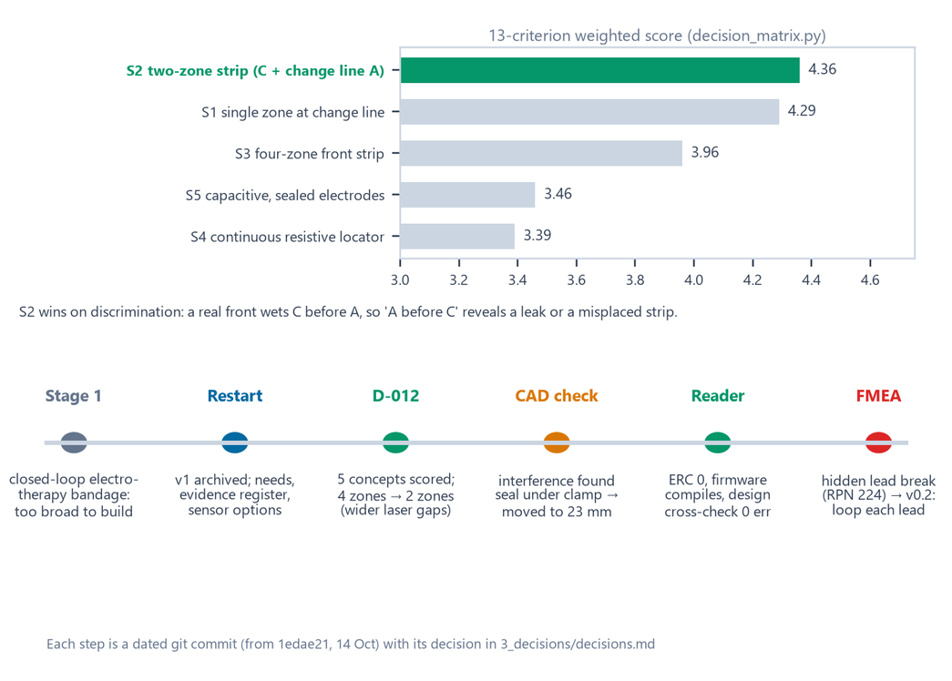
Maker Journey: Engineering Iterations
DECISIONS RECORDED IN OUR PROJECT
How our design changed from Stage 1 to Stage 2
▪ Pivot: We narrowed the idea from a therapy bandage to one question: has the dressing reached its change line?
▪ Choice: two zones (score 4.36) beat one zone (4.29), because only two zones give the order check (centre before change line) that flags leaks.
▪ Kept: We kept Bluetooth as a local status broadcast. It compiles; hardware testing is pending.
▪ Corrected: We corrected the Stage 1 description of Kapton: DuPont cautions against calling it medical-grade [11].
▪ Redesign: To address the FMEA risk, version 0.2 loops each sensing lead.
Figure: concept scores and the iteration path (each a dated commit).
Existing options: diaper strips⁴ and visual change indicators¹⁴ already exist. We are testing a two-zone strip that reads the change line electrically and checks which zone wets first.
Notes:
5 concepts scored on 13 weighted criteria (3_decisions/decision_matrix.md). Verification fixes: seal moved off the clamp; STEP was in cm, now mm; drawings rebuilt first-angle. FMEA F04 (cracked sense lead reads dry, RPN 224). 4 zones were cut to 2 until E2 proves finer lines. Stage 1 also estimated '60 % fewer changes'; we dropped that number (no source). IP: concept and files are the team's own; no patent filed yet.

Slide 14

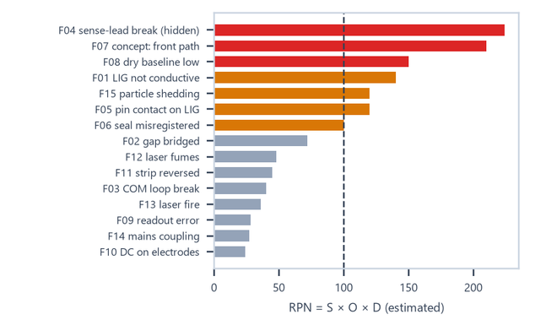


Safety & Hazard Mitigation
RISKS ESTIMATED · TESTS PLANNED
We ranked 15 possible failure modes before testing. These are the five highest estimated risks.
Failure mode | Effect | RPN | Fix / test
F04 cracked sense lead | zone reads 'dry' forever; no alert | 224 | v0.2 loops each lead · T-MECH-01
F07 front path differs | CHANGE late or missing | 210 | E4 on real foam dressings
F08 humid dry baseline | humidity reads as 'wet' | 150 | measure baselines (E4)
F01 weak carbon layer | both zones always read 'dry' | 140 | E2 + per-strip QC record
F05 pin contact on carbon | readings drift high | 120 | rounded pins · T-CON-01
Fail-safes
Standards (considered, not claimed)
▪ Bench only: Use the USB reader on the bench only; do not put it on a person.
▪ No net DC: The drive is bipolar and idle pins are off. Planned bench test T8 checks for less than 5 mV residual.
▪ Self-check: Run a self-check each scan; show FAULT if it fails.
▪ No wound contact: The strip is designed to sit on the pad’s outer face, with sealed leads.
▪ Laser work: Complete and sign the laser-safety checklist before each session.
▪ ISO 14971 risk management
▪ IEC 60601-1 future on-body reader
▪ ISO 10993-1 before any skin contact¹¹
▪ EN 13726 simulated exudate for tests¹⁰
▪ IEC 60825-1 laser work during fabrication
Notes:
Full FMEA: 3_decisions/fmea_v0_1.md (15 modes). Laser safety: signed checklist each session (4_sensor_strip/e2_experiment/E2_safety_checklist.md). Bench test T8 checks average DC < 5 mV.

Slide 15
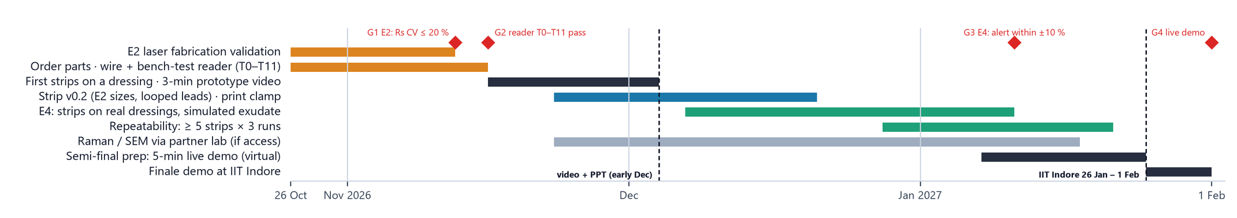
Roadmap
PLANNED WORK · GATED MILESTONES
Four-month plan aligned with the programme dates. Each step depends on passing the previous gate.
Build & Bench (Months 1 - 2)
Validate & Demo (Months 3 - 4)
▪ Nov: Run E2 laser tests (G1), then build and bench-test the reader (G2).
▪ By 4 Dec: If gates pass, complete the first dressing demo, prototype video and revised Stage 3 deck.
▪ Before 4 Dec: Build strip version 0.2 and a printed clamp; run E4 wet tests (G3) if earlier gates pass.
▪ Jan: Prepare for virtual jury interviews.
▪ If selected, Grand Finale at IIT Indore (26 Jan–1 Feb 2027): live jury demo of the strip and reader on a dressing, showing OK → CHANGE.
Notes:
Gates: G1 E2 Rs CV <= 20 %; G2 reader bench test T0-T11; G3 E4 alert within +/-10 %; G4 live demo with logged raw data. Programme dates (vishwakarma-awards.org and the Internshala listing, read 19 Oct 2026): prototype video + updated PPT in December (listing: 4 Dec 2026); Health Tech semi-final interviews in January; IIT Indore bootcamp and finale 26 Jan - 1 Feb 2027. No patient use. Raman/SEM via a partner lab if access is granted.

Slide 16



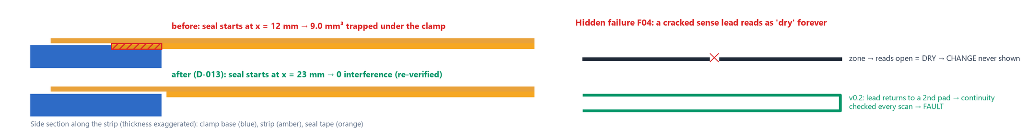
Technical Challenges & Risks
ISSUES FOUND DURING OUR CHECKS
Geometry: seal tape under the clamp
Circuit: a broken lead can look dry
Process: low-PWM tube current stability
Found: We found the seal tape overlapped the clamp by 9.0 mm³.
Impact: This could lift the strip off the contact pins.
How: We found it with an automated CAD clash check.
Found: A cracked sensing lead could make the reader report “dry”.
Impact: The CHANGE status might never appear, so there would be no alert.
How: The FMEA ranked this risk at 224.
Found: The machine’s “12” setting is likely a PWM percentage, not a current measurement. Laser output can be unstable at low power [8].
Impact: trace widths are held at a conservative 1.0 mm until E2 calibrates the laser setting (and the tube current, if a meter is available).
How: We found the uncertainty while checking the LaserCAD configuration.
We also corrected two drawing issues: STEP files now export in millimetres, and a 0.125 mm dimension is shown correctly.
Notes:
Evidence: 5_cad/verify_cad_report.md (interference), 3_decisions/fmea_v0_1.md, 4_sensor_strip/machine_record.md.

Slide 17
Potential Solutions & Risk Mitigation
CHECKED · DESIGNED · TO TEST
Checked in CAD or software
Designed, not yet tested
Fallbacks
Seal: starts at x = 23 mm; 0 clash.
Units: all STEP files in mm.
Checks: 99 checks passed, 0 failed; 5 await E2 measurements.
v0.2 strip: every sense lead looped.
Contact: silver pads, rounded pins.
Self-test: check resistor → FAULT.
Wider lines: if E2 says so.
Process: slower passes, log current.
Concept: one-zone strip (score 4.29).
What we still need to test
▪ Experiments: Run E2 laser tests, bench-test the reader, then run E4 wet tests.
▪ Material: Use Raman and SEM before describing the material as graphene.
▪ Reliability: Test bending, contact wear and humidity-related drift.
▪ Product: Explore a battery-powered reader and a secure local phone connection. Neither is built yet; one strip is intended per dressing.
▪ Before any study with people: address relevant biocompatibility and electrical-safety requirements and obtain ethics approval.
▪ Not claimed: We have not established sensor performance, graphene identity or clinical benefit.
Our rule: we will not claim sensor performance, graphene identity or clinical benefit until tests support those claims.
Notes:
Future scope details: 4_sensor_strip/e2_experiment/E2_measurements_and_unknowns.md.

Slide 18
References & Sources
SOURCES AND WHAT WE READ
Sources are numbered below. Reading depth is noted; a citation does not mean a claim was independently verified.
1. Milne S.D. et al., A wearable wound moisture sensor as an indicator for wound dressing change, Int. Wound J. 13(6):1309–1314 (2016). doi:10.1111/iwj.12521 · full text read
2. Dressing instructions for use: some foam dressings say 'change when exudate approaches ~2 cm from the pad edge'; Mölnlycke Mepilex Border Flex brochure uses strike-through reaching 3 edges · manufacturer documents, read as excerpts
3. McColl D., Cartlidge B., Connolly P., Real-time monitoring of moisture levels in wound dressings in vitro, Int. J. Surg. 5(5):316–322 (2007). doi:10.1016/j.ijsu.2007.02.008 · abstract
4. US 5,469,145 and US 5,838,240 (wet diaper detector: detachable strip + clip-on detector); US 9,291,589; US 10,928,344 · patent summaries, claims not read
5. Jiang Y. et al., Wireless, closed-loop, smart bandage with integrated sensors and stimulators, Nat. Biotechnol. (2022). doi:10.1038/s41587-022-01528-3 · listing + coverage
6. Dealey C., Cameron J., Arrowsmith M., A study comparing two objective methods of quantifying the production of wound exudate, J. Wound Care 15(4):149–153 (2006) · abstract (methods disagree)
7. Lin J. et al., Laser-induced porous graphene films from commercial polymers, Nat. Commun. 5:5714 (2014). doi:10.1038/ncomms6714 · full text read
8. CO₂ laser tube current vs PWM setting, engineering measurements, softsolder.com (2022) · not peer-reviewed
9. Li Y. et al., Laser-induced graphene in controlled atmospheres: from superhydrophilic to superhydrophobic surfaces, Adv. Mater. 29:1700496 (2017). doi:10.1002/adma.201700496 · abstract
10. EN 13726-1:2002 / EN 13726:2023, Test methods for wound dressings (absorbency; 'Solution A') · catalogue entry; online link not reachable from our network
11. DuPont position statement on the use of DuPont materials in medical applications (Kapton caution) · web page
12. Texas Instruments ADS1115 datasheet (SBAS444); Espressif ESP32-C3 datasheet · vendor documents
13. Wounds UK news (22 Aug 2018) on a Mölnlycke-commissioned survey of >200 UK patients with chronic wounds: average dressing time 18 min · patient-reported, industry-sponsored; web page read
14. Smith+Nephew, ALLEVYN LIFE product page: visual change indicator ('At 75%, it's time to change your dressing') · manufacturer web page, read 19 Oct 2026
15. Truemeds.in retail listings: Mepilex Lite 10 × 10 cm ₹242; Mepilex Border 10 × 10 cm ₹514 (pack size unclear) · retail pages, read 19 Oct 2026
16. Gupta N., Gupta S.K., Shukla V.K., Singh S.P., An Indian community-based epidemiological study of wounds, J. Wound Care 13(8):323–325 (2004). doi:10.12968/jowc.2004.13.8.26657 · abstract
17. Sharma A. et al., Epidemiological profile of chronic wounds in an Indian population, Cureus 16(9):e68684 (2024). doi:10.7759/cureus.68684 · full text
18. Anjana R.M. et al., ICMR-INDIAB national cross-sectional study (ICMR-INDIAB-17), Lancet Diabetes Endocrinol. 11(7):474–489 (2023) · abstract and summaries
19. Armstrong D.G., Boulton A.J.M., Bus S.A., Diabetic foot ulcers and their recurrence, N. Engl. J. Med. 376:2367–2375 (2017). doi:10.1056/NEJMra1615439 · summaries; range is an estimate and contested
20. Price P.E. et al., Dressing-related pain in patients with chronic wounds: an international patient perspective, Int. Wound J. 5(2):159–171 (2008). doi:10.1111/j.1742-481X.2008.00471.x · abstract
21. Lavery L.A. et al., WHS guidelines update: diabetic foot ulcer treatment guidelines, Wound Repair Regen. (2024). doi:10.1111/wrr.13133 · full text
Notes:
Full list: 2_research/literature.csv and research_matrix.csv (41 + 16 entries); refs 16-20 added 20 Oct (Stage2_Review_Output_2026-10-20/new_sources.csv).

Slide 19

Where the figures came from
FIGURES MADE FROM OUR PROJECT FILES
The illustrations come from our CAD, schematic exports and plots made from project files. We did not use stock images or AI image generators. Team photos on slide 12 are the team's own.
Problem illustration, drawn to scale
Source: make_figures.py · strip_v0_1_geometry.json
1_presentation/figures/fig_problem.png
How it senses (concept)
Source: make_figures.py · sensor_selection.md, calc_readout.py
1_presentation/figures/fig_howitworks.png
Firmware scan and state logic
Source: make_figures.py · reader_v0_1 source
1_presentation/figures/fig_dataflow.png
Annotated SolidWorks views
Source: render_cad.py + make_figures.py · 5_cad/solidworks
1_presentation/figures/fig_cad.png
Strip and E2 coupon layers
Source: make_figures.py · our DXF files
1_presentation/figures/fig_strip.png
Measurement path + KiCad sheet
Source: make_figures.py · reader_v0_1 netlist + KiCad PDF
1_presentation/figures/fig_schematic.png
Measurement window
Source: make_figures.py · calc_readout.py
1_presentation/figures/fig_window.png
Evidence gallery + tool output
Source: our files, screen capture, 19 Oct tool runs
1_presentation/figures/fig_maker.png
Decision matrix + iterations
Source: make_figures.py · decision_matrix.md
1_presentation/figures/fig_decision.png
FMEA risk ranking
Source: make_figures.py · fmea_v0_1.csv
1_presentation/figures/fig_fmea.png
4-month roadmap
Source: make_figures.py · E2/bench/E4 plans
1_presentation/figures/fig_roadmap.png
Seal clash + lead-break diagrams
Source: make_figures.py · geometry + FMEA
1_presentation/figures/fig_challenges.png
Notes:
Generators: 1_presentation/render_cad.py and make_figures.py. Photos: 1_presentation/team_photos/.

