Slide 1



Vishwakarma Application ID
VK26-IITI-HT-0050
Dermasense: a laser-written moisture strip that reads a wound dressing's own 'change line'
Team: Soham Prabhakar Kadu · Bhakti Ajay Kadam
Track: Health Tech: Emergency Response & Remote Monitoring
Core innovation: two laser-carbonised electrode zones, at the pad centre and on the dressing maker's change line, let a clip-on reader say OK, CHANGE or CHECK without lifting the dressing.
Evidence key on every slide: ● completed & verified ● designed, physical validation pending ● future scope
Notes:
Cover. Application ID from the Stage 2 invitation. Team names as registered. No institution or mentor is shown until confirmed (see PPT_QA_Report.md).

Slide 2






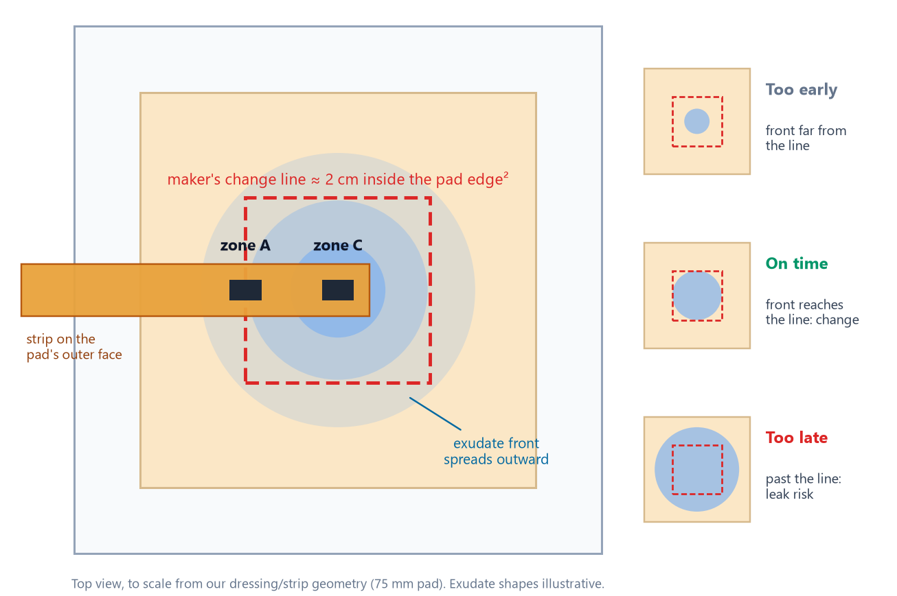

Problem Context
PUBLISHED EVIDENCE · CITED
44.9 %
≈ 2 cm
1 point
Uneven
OF 588 CHANGES MADE AT OPTIMAL MOISTURE¹
MAKER'S 'CHANGE NOW' LINE FROM PAD EDGE²
WHERE TODAY'S MOISTURE SENSOR READS¹
IN-VITRO MOISTURE MAP, 8 POINTS³
Target Beneficiary & Problem Statement
▪ Target user: nurses and home carers looking after exuding chronic wounds (diabetic foot, venous leg and pressure ulcers) under foam dressings.
▪ Operational pain point: the 'change now' signal is visual. Under bandages, socks or compression it is hidden, so dressings are changed by the clock, by lifting the cover, or after a leak.
▪ Problem statement: carers need a reliable, low-cost signal that exudate has reached the maker's change line, without lifting the dressing.
▪ Public search disclosure: WoundSense reads moisture at one point¹; a lab study mapped 8 points³; diaper wetness strips with clip-on readers exist⁴; smart bandages use custom electronics⁵. In our search, none reads a dressing's own change line.
▪ Why now: some makers already define 'full' as a distance from the pad edge², and conductive carbon can be laser-written onto polyimide in one pass⁷: a sensor can follow the maker's own rule at low cost.
Figure: the maker's change line (≈ 2 cm inside the pad edge²) is invisible under a cover. To scale.
Project Overview: Dermasense · Team ID VK26-IITI-HT-0050 · Track: Health Tech · Core innovation: a laser-written two-zone strip that tells carers when a dressing has reached its own change line.
Notes:
Sources: L08 Milne 2016 (full text), L28 dressing IFUs, L26 McColl 2007, P01/P02 patents, L03 Jiang 2022. Figure: Stage2_Final/figures/fig_problem.png (geometry from strip_v0_1_geometry.json).

Slide 3
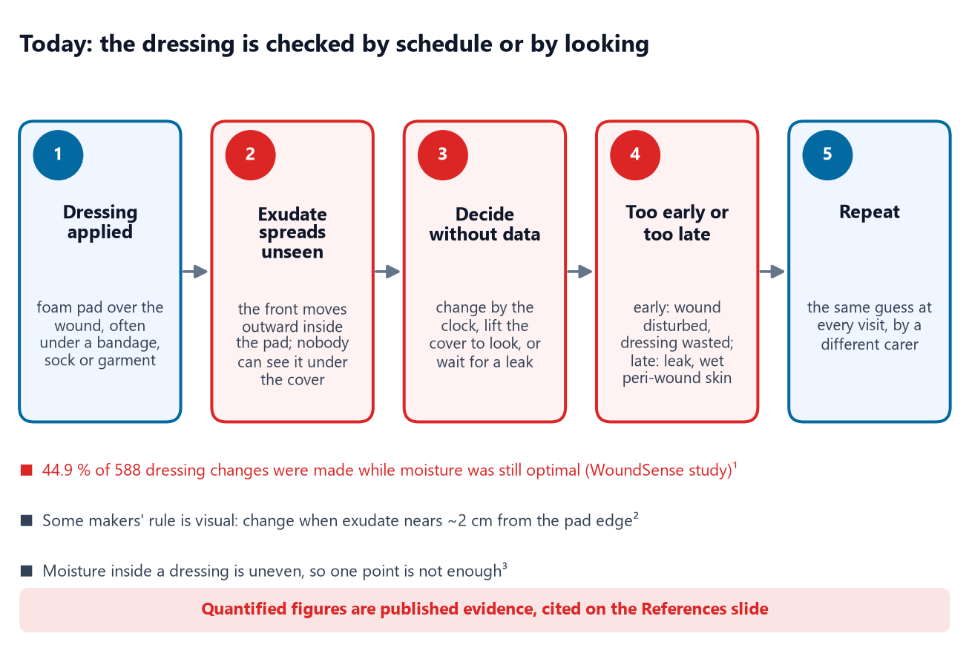
User Journey: Before State
CURRENT STATE · CITED
44.9 %
0.1–1.3 g/cm²·day
Hidden
Lift to look
CHANGES WHILE MOISTURE WAS STILL OPTIMAL¹
REPORTED EXUDATE RATES, 2 METHODS⁶
EXUDATE FRONT UNDER BANDAGE OR GARMENT
THE ONLY WAY TO CHECK A COVERED PAD
Current Pain Point Mapping
▪ Time loss: each check means unwrapping the limb or lifting the border, then re-securing it. Minutes per check will be measured in our nurse interviews (not yet done).
▪ Material waste: in the WoundSense study 44.9 % of 588 changes happened while moisture was still optimal¹: dressings with capacity left were discarded and the wound disturbed.
▪ Safety hazard: a late change lets exudate reach the border or leak: wet peri-wound skin (maceration risk) and soiled clothing.
▪ Why a schedule fails: reported exudate production ranged from 0.10 to 1.3 g/cm² per day across patients and two methods⁶; a fixed interval cannot follow that.
▪ Root cause: the decision signal, the exudate front against the maker's line², is visual, and the dressing is covered.
Figure: current pain-point map. Numbers are cited; steps follow dressing instructions.
Quantified Inefficiency: only published figures are used; we have not yet measured nurse time or dressing cost per patient, and we do not estimate them here.
Notes:
Sources: L08 Milne 2016; L38 exudate quantification study (abstract; two methods disagree).

Slide 4
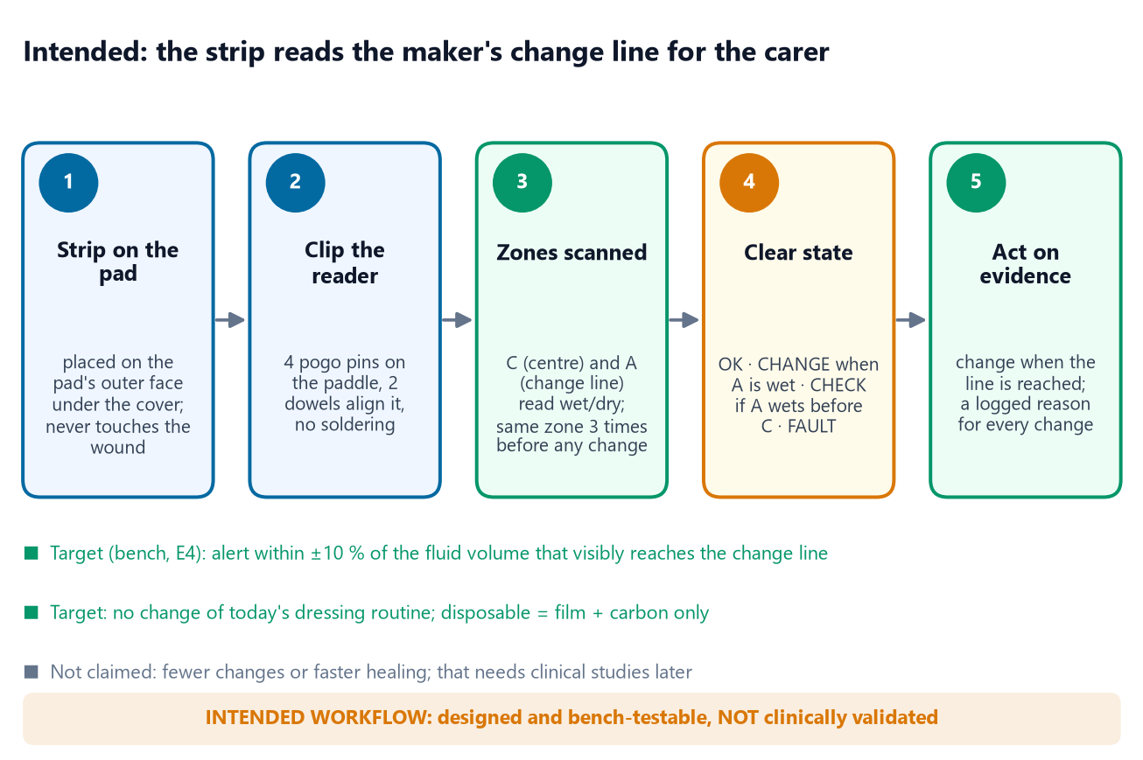
User Journey: After State (Intended)
INTENDED WORKFLOW · NOT CLINICALLY VALIDATED
2 zones
4 states
±10 %
0
CENTRE C + MAKER'S CHANGE LINE A
OK · CHANGE · CHECK · FAULT
TARGET ALERT ACCURACY (BENCH, E4)
CONTACT WITH THE WOUND BED (BY DESIGN)
Future Solution Mapping & Quantified Efficiency
▪ Fits today's routine: the strip goes on the pad's outer face when the dressing is applied; the reader clips onto its paddle. Nothing else changes.
▪ Decision support: CHANGE when the front reaches the maker's line; CHECK if A wets before C (edge leak or misplaced strip); FAULT for a broken strip or reader error.
▪ Efficiency targets (to measure in E4): alert within ±10 % of the fluid volume at which the front visibly reaches the line; zero lifts of the dressing just to look.
▪ Cost target: ≤ ₹100 per disposable strip: polyimide film + laser time only; the reader is reused (estimate from the BOM film price).
▪ Who benefits (expected, to verify): patients: fewer needless removals; carers: a logged reason for each change; clinics: fewer wasted dressings.
Figure: intended workflow, designed and bench-testable, not clinically validated.
Design Principle: the strip never touches the wound bed; only film and carbon are thrown away; every electronic part lives in the reusable reader.
Notes:
Targets, not results. E4 (strips on real dressings with simulated exudate) will measure the alert accuracy.

Slide 5


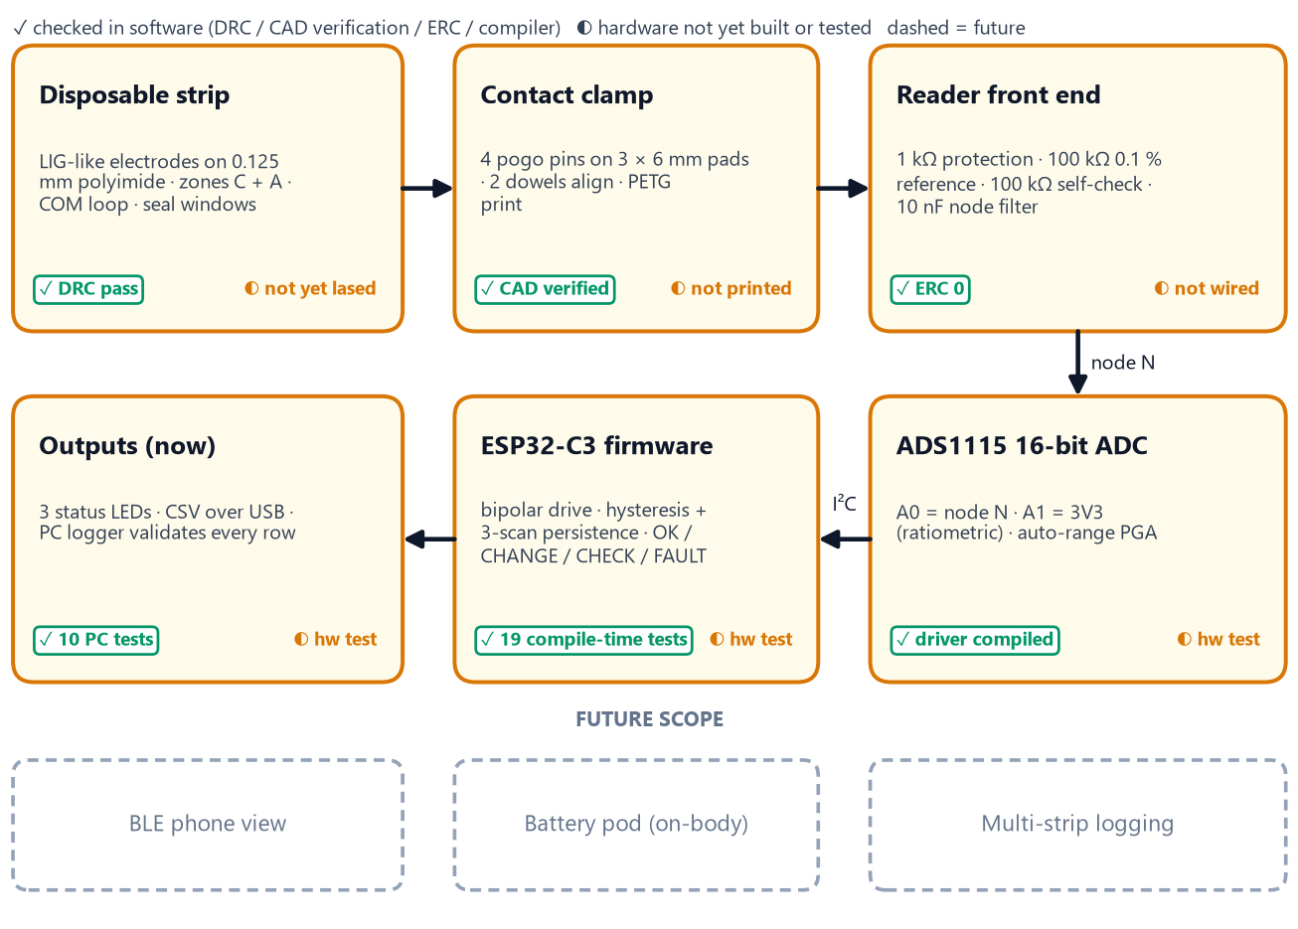

System Architecture & Specs
DESIGNED · PHYSICAL VALIDATION PENDING
Engineering Target Specifications & Subsystems
Parameter | Target / design value | Selected hardware / basis
Sensing zones | 2: C (pad centre), A (change line); windows 6 × 3.9 mm | LIG-like electrodes on 0.125 mm polyimide
Electrode line / gap | 1.0 / 1.0 mm (provisional) | fixed by E2 line-width and isolation data
Wet / dry decision | < 100 kΩ wet, > 300 kΩ dry, 3 scans | calc: wet 4–15 kΩ, dry ≥ 1 MΩ
Excitation | bipolar, ≤ 33 µA, idle high-Z | ESP32-C3 GPIO through 1 kΩ
Measurement | 16-bit, auto-range, ratiometric | ADS1115 (I²C 0x48), 100 kΩ 0.1 % ref
Self-test | check resistor ±5 % + COM loop | 100 kΩ 0.1 %; FAULT state
Contacts | 4 pads at 5.08 mm, 2 dowels | P75-B1 pogo pins, PETG clamp
Output | CSV over USB + 3 LEDs (now) | BLE phone view = future scope
Figure: block diagram with the software-verified and hardware-pending status of each block.
Architecture Rationale: only film and carbon are disposable. Bipolar drive keeps the net DC on wet electrodes near zero, and a known resistor checks the reader on every scan.
Notes:
Values: 05_electronics/calc_readout_report.md, 07_firmware/reader_v0_1/config.h, 04_lig_lab/strip_v0_1_geometry.json.

Slide 6
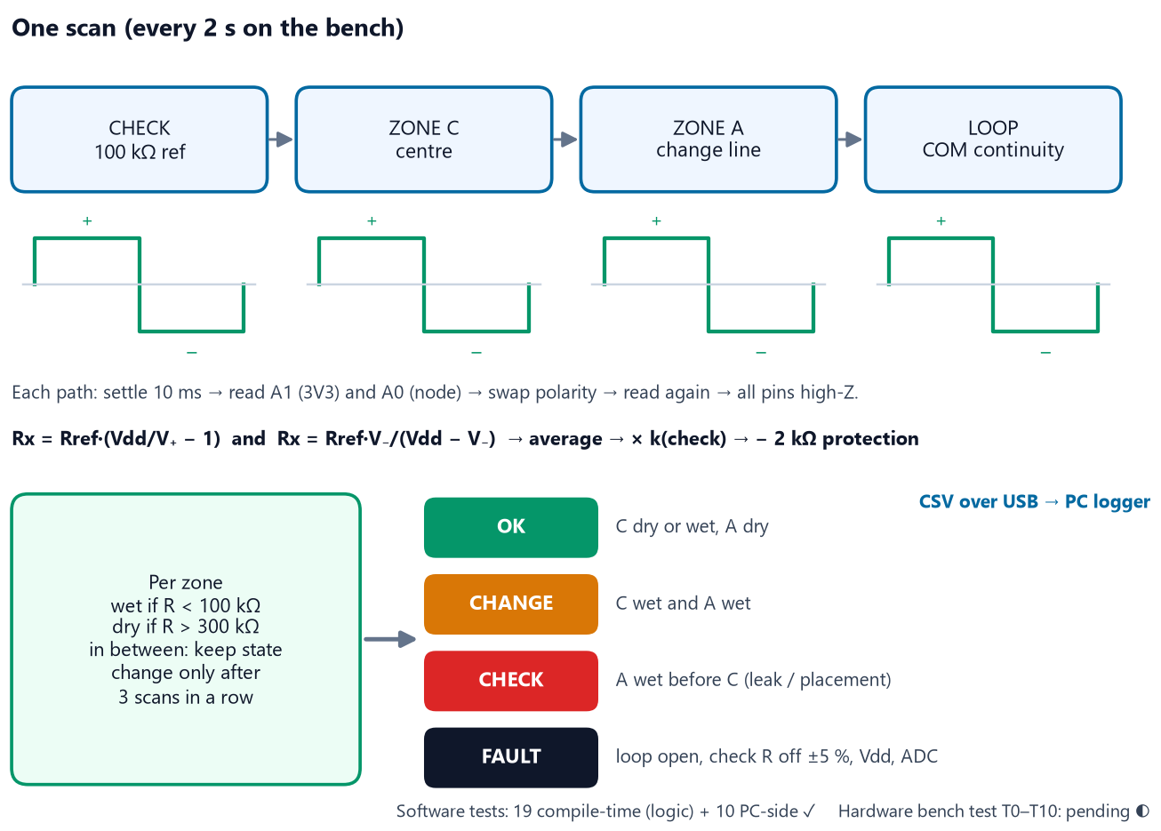

System Architecture & Specs: Firmware & Data Flow
VERIFIED IN SOFTWARE · HARDWARE PENDING
Firmware Logic, Signal Measurement & Logging
▪ Resistance measurement: each path is driven both ways through a 100 kΩ 0.1 % reference. Equal + and − phases leave no net DC on wet electrodes.
▪ ADC acquisition: ADS1115 single-shot at 128 SPS, auto-ranged. A1 reads the 3V3 rail, so the maths is ratiometric.
▪ Processing: Rx from both phases, averaged, scaled by the on-board 100 kΩ check (must read within ±5 %, else FAULT), minus the 2 kΩ of protection resistors.
▪ Interpretation: wet below 100 kΩ, dry above 300 kΩ, three scans in a row; LEDs show OK, CHANGE, CHECK (blinking) or FAULT.
▪ Logging: one CSV line per scan over USB. The PC logger checks the header and every row, adds PC time and keeps bad lines apart.
▪ Fail-safe behaviour: between scans every drive pin is high-impedance, so no current flows through the strip; during a FAULT the zone states are frozen, not guessed.
Figure: one reader scan: four bipolar measurements, then hysteresis and the state decision.
Software vs Hardware: 19 compile-time logic tests and 10 PC-side tests pass; the firmware compiles for ESP32-C3 with 0 warnings. It has not run on a wired board yet (bench test T0–T10 is next).
Notes:
Evidence: 07_firmware/reader_v0_1/zone_logic_tests.h, tools/test_*.py, arduino-cli output (327,176 bytes, 24 %).

Slide 7
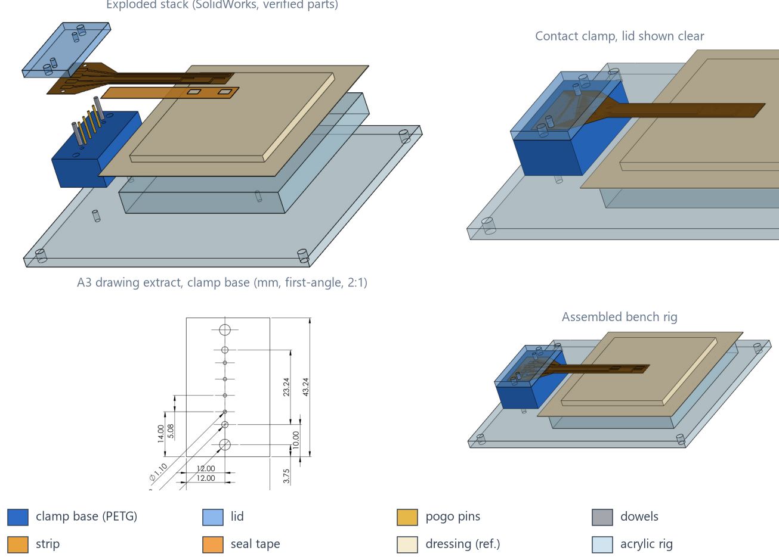
CAD Design & Mechanical Specs
DESIGNED · CAD VERIFIED · NOT YET BUILT
Material Selection & Mechanical Validation
▪ Materials: polyimide 0.125 mm (laser-carbonisable, flexible); PETG clamp (printable, tough); cast acrylic rig (laser-cut); stainless 2 mm dowels; P75-B1 pogo pins.
▪ Contact force (hand calculation): 1.48 mm pin compression → 0.72 N per pin, 2.9 N total; the 4 mm lid deflects 11 µm, so the springs set the force.
▪ Alignment: worst-case tolerance stack 0.49 mm against ±1.35 mm allowed on a 3 mm pad (2.8× margin).
▪ Strip loads: 0.62 % bending strain at a 10 mm radius (polyimide yields near 3 %); a 10 N tug gives 20 MPa at the dowels against 231 MPa tensile.
▪ No FEA: loads are below 3 N, so hand calculations suffice; the contact itself is tested physically (T-CON-01).
▪ Independent check: verify_cad.py re-opens every file: units, volumes, 13 positions, interference, drawings → 99 pass, 0 fail, 5 waiting for E2.
Figure: our SolidWorks 2019 models (9 parts, 1 assembly, 7 A3 drawings, STEP), v0.1 bench rig.
Design Iteration: interference detection found the seal tape trapped under the clamp (9.0 mm³). The seal now starts at x = 23 mm, re-verified with 0 interference (decision D-013).
Notes:
Evidence: 06_cad/calc_mechanical_report.md, 06_cad/verify_cad_report.md, 06_cad/solidworks/*.

Slide 8
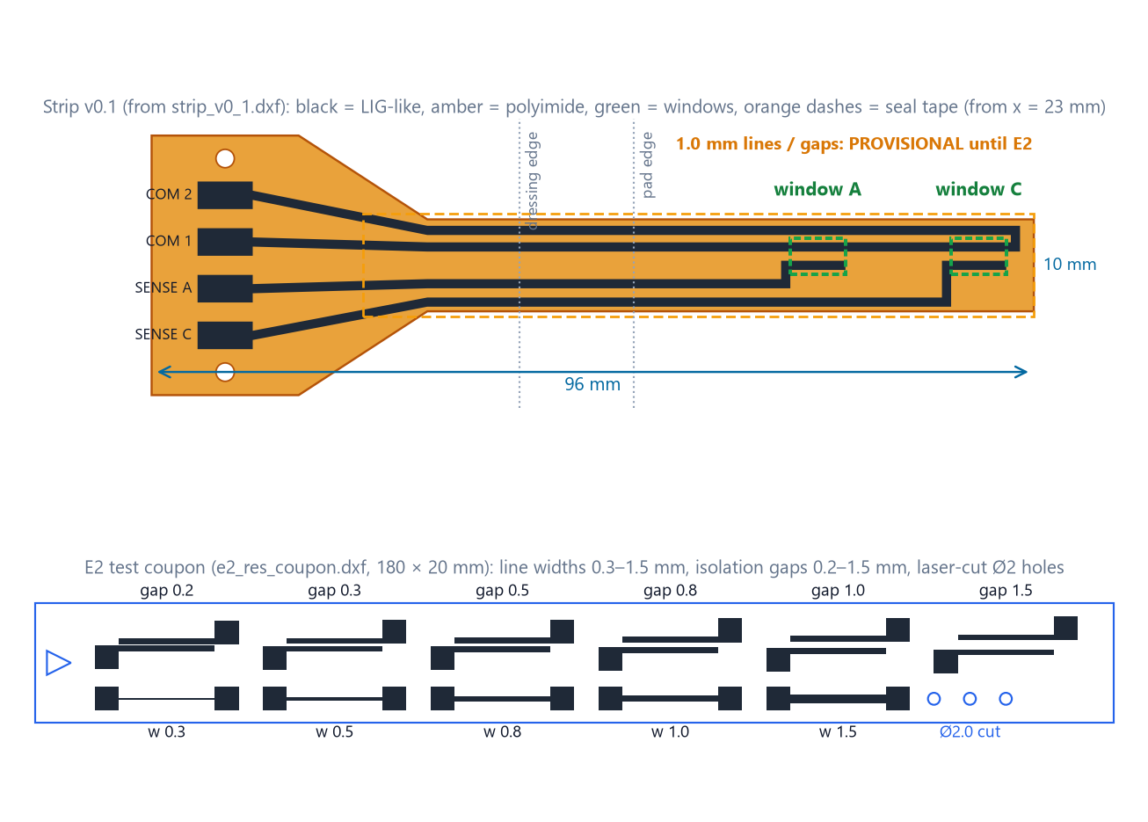
CAD Design & Mechanical Specs: Sensing Strip & Laser Process
DESIGNED · PHYSICAL VALIDATION PENDING
Fabrication Approach & Process Validation (E2)
▪ Material: polyimide written by our CO₂ laser in one raster pass⁷. We call it a LIG-like laser-carbonised conductive layer until Raman confirms graphene.
▪ Machine facts (LaserCAD config): 1200 × 900 mm bed, 20 kHz PWM, 98 % power cap. Our reference '12' is most likely a % PWM command, not watts.
▪ Critical parameters logged: min/max power %, speed, 0.1 mm interval, passes, scan direction, focus and tube current, copied from every layer dialog.
▪ E2 plan: 4 bracket coupons (power 10/12/14, speed ×0.67/1/1.5) on 2 days + 3 resolution coupons; 72 pre-registered samples.
▪ Pass rules, fixed before testing: sheet-resistance CV ≤ 20 %; smallest reliable line and gap; gaps > 3 MΩ; laser-cut holes 2.00–2.10 mm.
▪ Sealed leads: LIG made in air is superhydrophilic⁹, so every lead outside the two windows is covered by polyimide tape.
Figure: our laser files drawn from the DXFs: strip v0.1 and the E2 coupon. Not yet lased.
Laser Files Verified: 4 DXFs pass 35/35 checks (mm units, closed outlines, no overlaps, minimum line and gap, fits the bed). The import into LaserCAD is checked at the machine (E2 step S0-6).
Notes:
Evidence: 04_lig_lab/laser_files_check.md, 04_lig_lab/e2/E2_procedure.md, e2_sample_matrix.csv, machine_record.md.

Slide 9
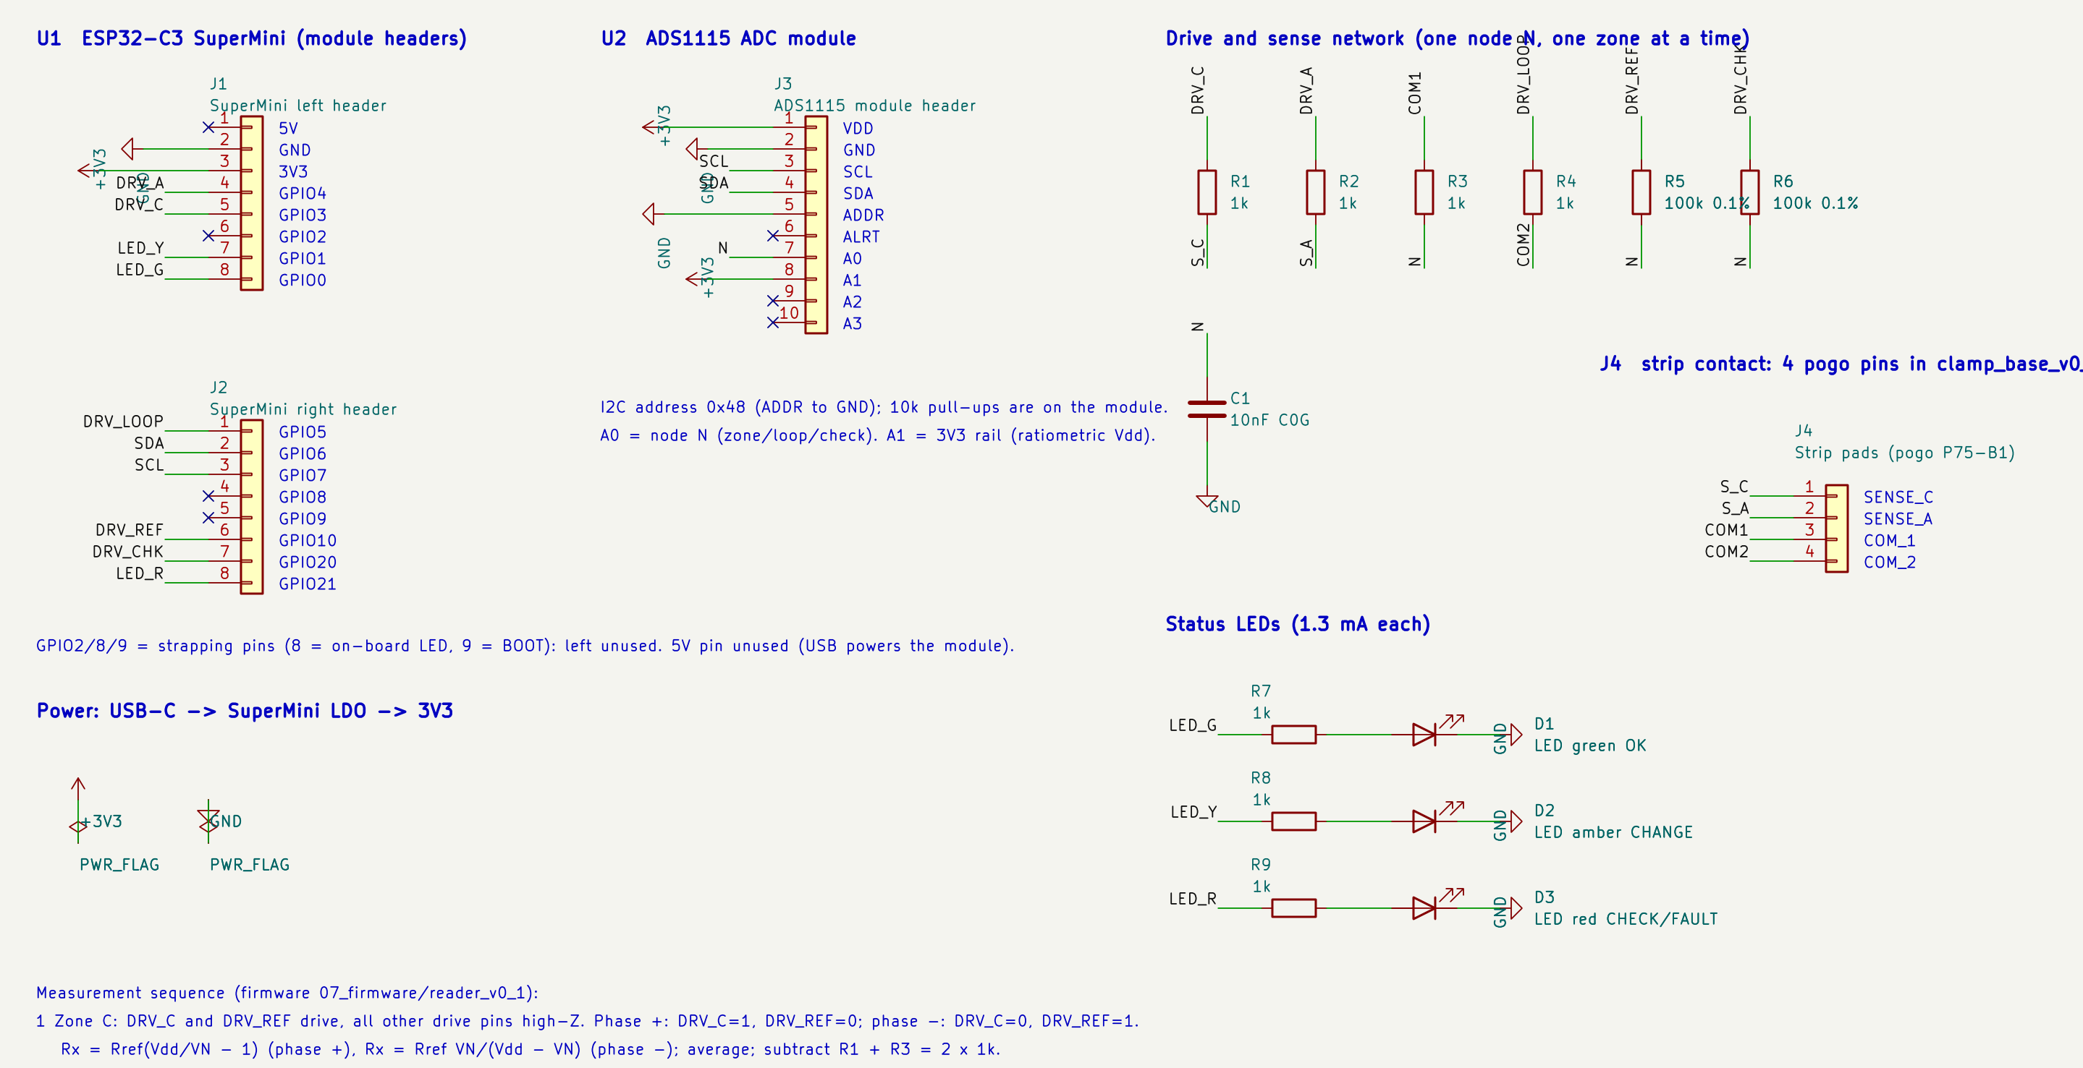

Electronics Schematics & BOM
ERC VERIFIED · NOT YET WIRED
Pinout & Connection Map (from the netlist)
Net | ESP32-C3 / module pin | Function
DRV_C · DRV_A | GPIO3 · GPIO4 | drive zone C · zone A through 1 kΩ
DRV_LOOP | GPIO5 | COM loop continuity (broken strip)
DRV_REF | GPIO10 | 100 kΩ 0.1 % reference to node N
DRV_CHK | GPIO20 | 100 kΩ self-check to node N
SDA · SCL | GPIO6 · GPIO7 | I²C to ADS1115 (0x48)
N · +3V3 | ADS1115 A0 · A1 | node voltage · rail (ratiometric)
LED_G/Y/R | GPIO0 · GPIO1 · GPIO21 | OK · CHANGE · CHECK/FAULT
S_C S_A COM1 COM2 | J4 pins 1–4 | pogo pins on the strip pads
not used | GPIO2 · 8 · 9 | strapping pins kept free
Figure: our KiCad 10 schematic of the two-zone reader, exported by kicad-cli.
▪ Power distribution: USB-C → SuperMini 3V3 regulator → ADS1115 and node network; the 3V3 rail is measured on A1 every scan.
▪ Connection strategy: 4 pogo pins press on the strip's 3 × 6 mm pads (no soldering, no ZIF on porous carbon); 2 dowels through laser-cut holes align it.
Verification: KiCad ERC 0 violations. A script checks the netlist against the firmware pins and strip pad order (0 mismatches) and writes the perfboard wiring table.
Notes:
Evidence: 05_electronics/kicad/out/erc.rpt, 07_firmware/tools/check_consistency.py, 07_firmware/WIRING.md.

Slide 10
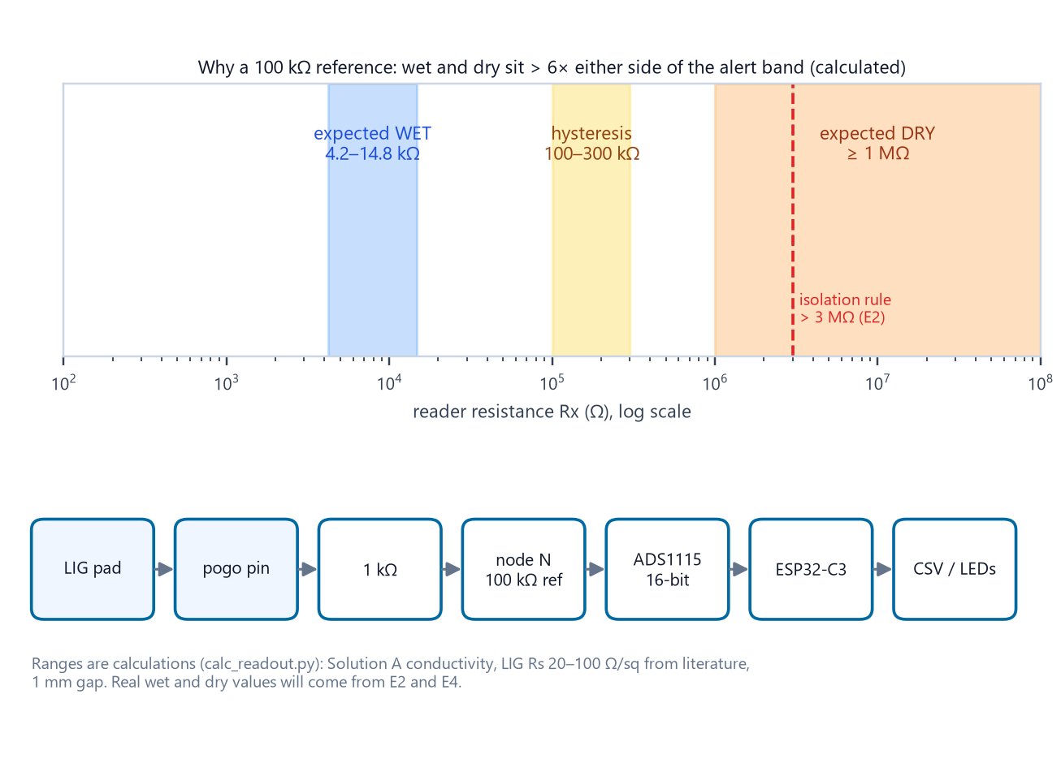
Electronics Schematics & BOM: Bill of Materials
ESTIMATES · NOT YET ORDERED
Itemized Prototype Bill of Materials (estimates)
Component | Specification | Qty | Source | Est. ₹
ESP32-C3 SuperMini | USB-C, native USB serial | 1 | Local / online | 250–450
ADS1115 module | 16-bit I²C ADC, auto-range | 1 | Local / online | 200–450
Precision resistors | 100 kΩ 0.1 % ×2 · 1 kΩ 1 % ×7 | 9 | Online (element14 / Mouser IN) | 47–141
C0G capacitor, LEDs, perfboard | 10 nF C0G · 3 LEDs · headers | set | Local | 111–280
Pogo pins P75-B1 | 1.02 mm, 2 mm travel (4 + 2 spare) | 6 | Online (Probots) | 90–240
Clamp + bench rig | PETG print · acrylic · M3/M4 · dowels | set | Lab / local | 100–1,240
Strip materials | polyimide film · seal tape · silver paint | set | Lab / online | 800–3,500
Test consumables | 1 % resistor set · IPA · gloves · saline | set | Local | 480–1,060
Total (excl. DMM, E4 dressings) |  |  |  | ≈ 2,078–7,361
Figure: why these values; ranges are calculations, to be replaced by E2/E4 data.
Procurement Status: nothing ordered yet. Prices are estimates to confirm on supplier pages; all parts are sold in India. First order: silver paint, 1 % resistor set, 0.1 % resistors, ADS1115, ESP32-C3.
Notes:
Totals computed from 09_procurement/bom_v0_1.csv (ranges = sum of min and max estimates).

Slide 11
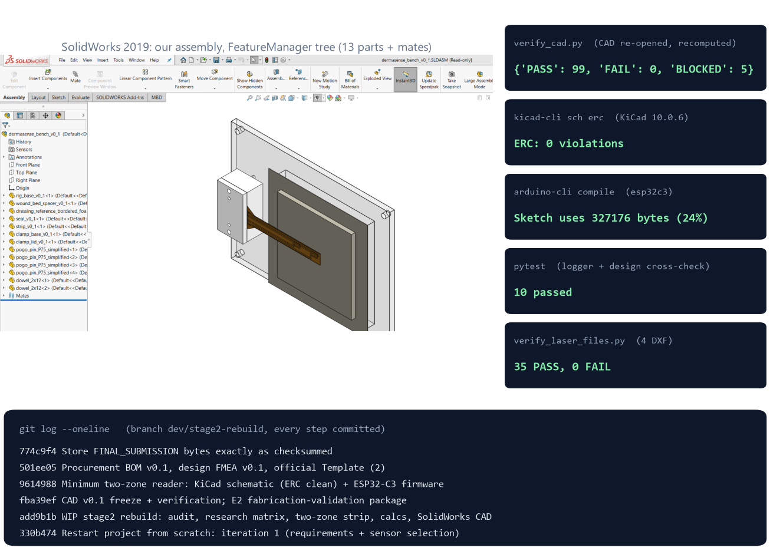

Maker Journey
GENUINE ARTIFACTS · NO STAGED EVIDENCE
Authenticity Verification: What Each Artifact Proves
▪ CAD in active use: our native assembly open in SolidWorks with its FeatureManager tree (13 components + mates); .SLDPRT, .SLDASM, .SLDDRW and .STEP files.
▪ Independent re-check: a script re-opens every CAD file and recomputes volumes and positions from the design data: 99 pass, 0 fail.
▪ EDA + firmware: KiCad schematic with its ERC log (0 violations); firmware built by arduino-cli; logger and cross-check tests pass.
▪ Timestamps: every step is a git commit since the 14 Oct restart, with raw native files (.SLDPRT, .STEP, .kicad_sch, .ino, .dxf) for audit.
▪ Lab photographs: none yet. The first laser session (E2) will be photographed with ID badges. We do not stage or generate lab photos.
Figure: SolidWorks window captured on our machine + verbatim tool output (14–15 Oct 2026).
Raw Repository Linkage: [team to insert the GitHub / Drive link before upload]: full history from commit 330b474. Faculty sign-off follows the E2 review.
Notes:
The repository link is the one item the team must add (see PPT_QA_Report.md). Screenshot: Stage2_Final/figures/sw_ui_assembly.png (captured by render_cad.py).

Slide 12
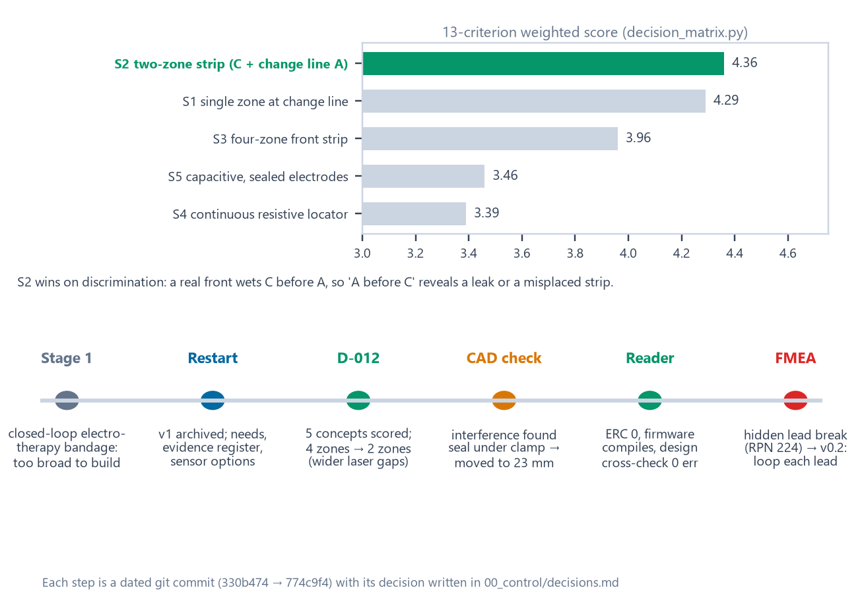
Maker Journey: Engineering Iterations
DOCUMENTED DECISIONS
Stage 1 to Stage 2 Engineering Iterations
▪ Iterative pivot: Stage 1's closed-loop electrotherapy bandage was too broad to build and validate in four months; we narrowed it to one measurable job: is the dressing full?
▪ Concept selection: 5 sensing concepts scored on 13 weighted criteria. S2 (4.36) beat the simpler S1 (4.29) because its order check separates a real front from a leak.
▪ Fit the process we have: 4 zones → 2 zones, and 1 mm lines and gaps until E2 measures what our laser can resolve.
▪ Verification-driven fixes: seal moved off the clamp; assembly STEP was in cm, now mm; drawings rebuilt first-angle with every dimension once.
▪ Risk-driven redesign: the FMEA showed a cracked sense lead would read 'dry' forever (RPN 224), so v0.2 loops each sense lead to a second pad.
Figure: weighted concept scores and the iteration path; each step is a dated git commit.
Prior Art We Respect: diaper wetness strips with clip-on readers exist⁴. Our contribution is the change-line placement, the order check and a reproducible laser process.
Notes:
Evidence: 03_sensors/decision_matrix.md, 00_control/decisions.md (D-009…D-013), git history.

Slide 13

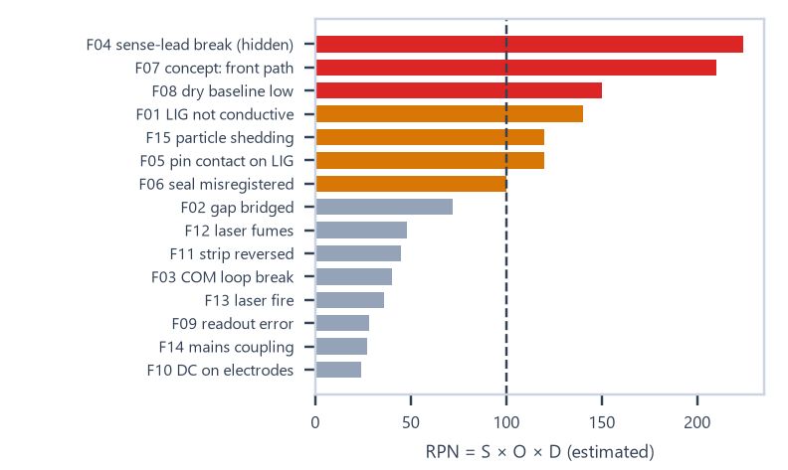


Safety & Hazard Mitigation
RISKS ESTIMATED · TESTS PLANNED
Design FMEA v0.1: 15 failure modes (ratings estimated before tests)
Failure mode | Effect | RPN | Mitigation / verification
F04 cracked sense lead | zone reads 'dry' forever, no alarm | 224 | v0.2: loop each lead to a 2nd pad · T-MECH-01
F07 front path differs | CHANGE late or never | 210 | E4 on real foam dressings
F08 humid dry baseline | false wet | 150 | measure baselines (E4); thresholds in config.h
F01 weak conductive layer | zones always dry | 140 | E2 bracket + per-strip QC record
F05 pin contact on porous LIG | readings drift high | 120 | silver pads, rounded pins · T-CON-01
Physical & Embedded Fail-safes
Standards Compliance (considered, not claimed)
▪ Bench only: the USB reader is not for patient use; an on-body version must be battery-only and isolated.
▪ No net DC: bipolar drive, high-Z idle; bench test T8 checks < 5 mV average.
▪ Self-check every scan: known 100 kΩ resistor + COM loop → FAULT instead of a wrong state.
▪ No wound contact: strip on the pad's outer face; leads sealed under polyimide tape.
▪ Laser work: signed checklist each session: exhaust, never unattended, CO₂ extinguisher, lowest power first.
▪ ISO 14971: risk-management approach; the FMEA is updated with test data.
▪ IEC 60601-1: electrical safety for any future on-body reader.
▪ ISO 10993-1: biological evaluation before any skin or dressing contact; polyimide film is not sold as medical grade¹¹.
▪ EN 13726: simulated exudate ('Solution A') for bench dressing tests¹⁰.
▪ Laser safety: IEC 60825-1 class rules and the lab's SOP during fabrication.
Notes:
Evidence: 00_control/fmea_v0_1.csv, 04_lig_lab/e2/E2_safety_checklist.md. Standards are considered in the design; no compliance is claimed.

Slide 14
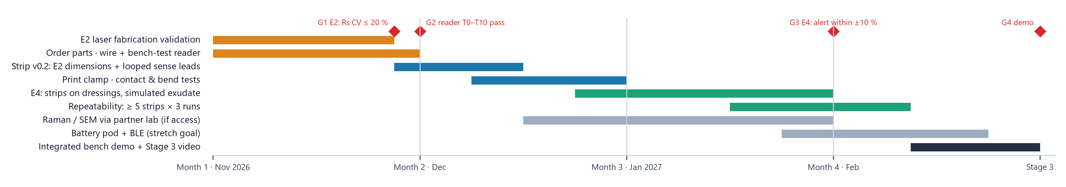
Roadmap
FUTURE SCOPE · GATED PLAN
4-Month Fabrication & Validation Plan (each gate must pass before the next step)
Fabrication & Bench Phase (Months 1 - 2)
Validation & Stage 3 Demo (Months 3 - 4)
▪ Nov 2026: E2 laser validation (S0, Day 1, Day 2); order parts; wire and bench-test the reader (T0–T10).
▪ Dec 2026: strip v0.2 from E2 data with looped sense leads; print the clamp; contact (T-CON-01) and bend (T-MECH-01) tests.
▪ Jan 2027: E4: strips on real foam dressings with simulated exudate: dry baselines, thresholds, alert vs the visible front.
▪ Feb 2027: repeatability (≥ 5 strips × 3 runs); integrated bench demo and Stage 3 video with raw data.
▪ Stage 3 Target: a working bench prototype (strip + clamp + reader) showing OK → CHANGE on a real dressing, with logged data. No patient use.
Notes:
Gate criteria from 04_lig_lab/e2/E2_procedure.md and 07_firmware/BENCH_TEST.md. Calendar months assume the first laser session in the week after submission.

Slide 15



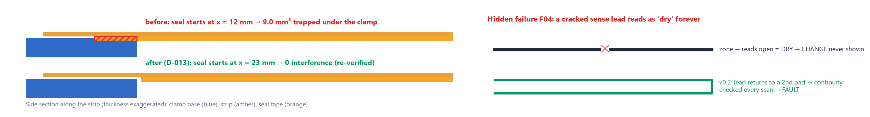
Technical Challenges & Risks
FOUND IN OUR OWN VERIFICATION
Geometry: Seal Trapped Under Clamp
Circuit: A Hidden Sense-Lead Failure
Process: An Unknown Laser Recipe
Observed: the 0.09 mm seal tape began at x = 12 mm, but the clamp reaches x = 22 mm: a 9.0 mm³ overlap.
Impact: tape under the paddle lifts the strip off the pogo pins: no contact, or an unreliable one.
How found: automated interference detection in our CAD verification script.
Observed: the reader checks the COM loop, but a cracked SENSE lead simply reads open, which looks like 'dry' (FMEA F04, RPN 224).
Impact: CHANGE would never appear and nothing would alarm.
How found: design FMEA of strip + reader together.
Observed: '12' is a % PWM command on an unidentified tube; CO₂ tubes fire unevenly at low settings⁸. Line width, gap isolation and contact on porous carbon are unmeasured.
Impact: every strip dimension is provisional.
How found: LaserCAD config audit + literature.
Also Caught in Verification: assembly STEP exported in cm (now mm); drawings showed 0.13 mm for a 0.125 mm film and repeated dimensions (fixed); a SolidWorks API crash on colour arrays (typed arrays).
Notes:
Evidence: 06_cad/verify_cad_report.md (interference), 00_control/fmea_v0_1.md, 04_lig_lab/machine_record.md.

Slide 16
Potential Solutions & Risk Mitigation
FIXED · DESIGNED · FUTURE SCOPE
Fixed & Verified
Designed, to Prove on Hardware
Fallbacks if E2 Disappoints
Seal: now starts at x = 23 mm; re-verified with 0 interference (D-013).
Units & drawings: all STEP in mm; first-angle A3 drawings; CAD checks 99 pass / 0 fail.
Design consistency: schematic ↔ firmware ↔ strip pads checked by script.
v0.2 strip: each sense lead loops back to a second pad (6 pads), so every lead is checked every scan.
Contact: silver-painted pads and rounded pogo tips; contact resistance over clamp cycles (T-CON-01).
Self-test: check resistor and loop → FAULT, verified in bench test T2–T9.
Wider features: set lines and gaps to what E2 resolves, re-run the DRC.
Process: bracket power and speed, slower or defocused passes, log tube current.
Partner laser: same DXF files on another lab's machine.
Concept: S1 single-zone strip (score 4.29) if two zones cannot be resolved.
Future Scope & Validation Plan: evidence needed before practical or clinical use
▪ Remaining physical experiments: E2 fabrication; reader bench test; E4 wetting tests with simulated exudate on foam dressings; repeatability.
▪ Material characterisation: Raman (D, G, 2D bands) and SEM through a partner facility before any 'graphene' claim.
▪ Reliability: bending (T-MECH-01), contact cycling (T-CON-01), storage and humidity drift.
▪ Product steps: battery-only isolated pod with BLE; multi-strip logging; a strip layout matched to each dressing model's change line.
▪ Before any patient use: ISO 10993 biological evaluation, IEC 60601-1 electrical safety, clinician feedback and an ethics-approved study.
▪ Not claimed today: that the sensor works, that the material is graphene, or any clinical benefit.
Rule We Keep: no claim of sensing performance, graphene identity or clinical benefit until the measurement exists.
Notes:
Future scope and validation plan below the cards; details in E2_measurements_and_unknowns.md.

Slide 17


SOURCES WITH READING DEPTH
References & Sources
Numbers match the superscripts on each slide. After each source we state how deeply it was read; nothing is labelled verified beyond that.
1. Milne S.D. et al., A wearable wound moisture sensor as an indicator for wound dressing change, Int. Wound J. 13(6):1309–1314 (2016). doi:10.1111/iwj.12521 · full text read
2. Dressing instructions for use: some foam dressings say 'change when exudate approaches ~2 cm from the pad edge'; Mölnlycke Mepilex Border Flex brochure uses strike-through reaching 3 edges · manufacturer documents, read as excerpts
3. McColl D., Cartlidge B., Connolly P., Real-time monitoring of moisture levels in wound dressings in vitro, Int. J. Surg. 5(5):316–322 (2007). doi:10.1016/j.ijsu.2007.02.008 · abstract
4. US 5,469,145 and US 5,838,240 (wet diaper detector: detachable strip + clip-on detector); US 9,291,589; US 10,928,344 · patent summaries, claims not read
5. Jiang Y. et al., Wireless, closed-loop, smart bandage with integrated sensors and stimulators, Nat. Biotechnol. (2022). doi:10.1038/s41587-022-01528-3 · listing + coverage
6. Dealey C., Cameron J., Arrowsmith M., A study comparing two objective methods of quantifying the production of wound exudate, J. Wound Care 15(4):149–153 (2006) · abstract (methods disagree)
7. Lin J. et al., Laser-induced porous graphene films from commercial polymers, Nat. Commun. 5:5714 (2014). doi:10.1038/ncomms6714 · full text read
8. CO₂ laser tube current vs PWM setting, engineering measurements, softsolder.com (2022) · not peer-reviewed
9. Li Y. et al., Laser-induced graphene in controlled atmospheres: from superhydrophilic to superhydrophobic surfaces, Adv. Mater. 29:1700496 (2017). doi:10.1002/adma.201700496 · abstract
10. EN 13726-1:2002 / EN 13726:2023, Test methods for wound dressings (absorbency; 'Solution A') · catalogue entry; online link not reachable from our network
11. DuPont position statement on the use of DuPont materials in medical applications (Kapton caution) · web page
12. Texas Instruments ADS1115 datasheet (SBAS444); Espressif ESP32-C3 datasheet · vendor documents
Notes:
Full list with verification notes: 02_research/literature.csv and research_matrix.csv (36 + 16 entries).

Slide 18






Image Sources
ALL IMAGES ORIGINAL
Every image in this deck was produced by the team from our own project files. No stock photos, no AI-generated images and no external images are used.
Problem illustration, drawn to scale
Source: make_final_figures.py · strip_v0_1_geometry.json
Stage2_Final/figures/fig_problem.png
Before-state pain-point map
Source: make_final_figures.py · cited sources 1–3
Stage2_Final/figures/fig_journey_before.png
After-state intended workflow
Source: make_final_figures.py · firmware states
Stage2_Final/figures/fig_journey_after.png
System block diagram
Source: make_final_figures.py · verification logs
Stage2_Final/figures/fig_block.png
Firmware scan and state logic
Source: make_final_figures.py · reader_v0_1 source
Stage2_Final/figures/fig_dataflow.png
SolidWorks renders + drawing
Source: render_cad.py · 06_cad/solidworks (our models)
Stage2_Final/figures/fig_cad.png
Strip and E2 coupon layers
Source: make_final_figures.py · our DXF files
Stage2_Final/figures/fig_strip.png
KiCad schematic export
Source: kicad-cli · reader_v0_1.kicad_sch (ours)
Stage2_Final/figures/fig_schematic.png
Measurement window
Source: make_final_figures.py · calc_readout.py
Stage2_Final/figures/fig_window.png
SolidWorks screenshot + logs
Source: screen capture of our machine · verbatim tool output
Stage2_Final/figures/fig_maker.png
Decision matrix + iterations
Source: make_final_figures.py · decision_matrix.md
Stage2_Final/figures/fig_decision.png
FMEA risk ranking
Source: make_final_figures.py · fmea_v0_1.csv
Stage2_Final/figures/fig_fmea.png
4-month roadmap
Source: make_final_figures.py · E2/bench/E4 plans
Stage2_Final/figures/fig_roadmap.png
Seal clash + lead-break diagrams
Source: make_final_figures.py · geometry + FMEA
Stage2_Final/figures/fig_challenges.png
Notes:
Generators: Stage2_Final/figures/src/render_cad.py and make_final_figures.py.

