Slide 1
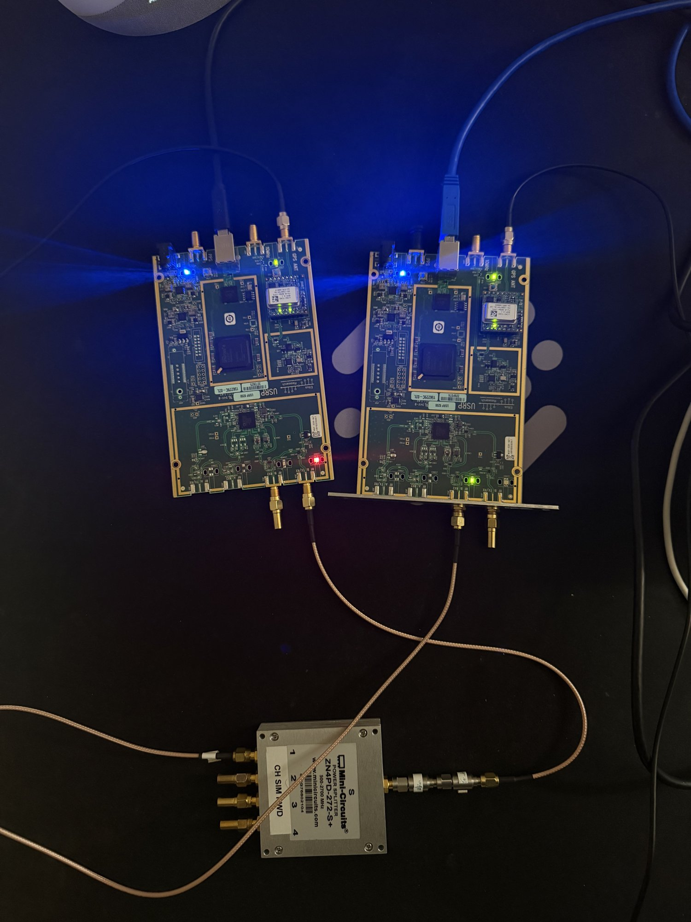
GRCON 2026
NTN ISAC in GNU Radio
Open blocks for sensing with a 5G LEO downlink, from simulation to real radios
Soham
Notes:
Title slide. Your opening material goes on the next two slides.

Slide 2

WHY NTN ISAC
ISAC is back, and satellites can take it where base stations can't
ISAC
TERRESTRIAL ISAC
NTN ISAC
One signal, two jobs
Needs dense base stations
Coverage from orbit
Communication and sensing share one waveform and one hardware chain, with no new spectrum.
Base-station ISAC for drone detection and tracking is being demonstrated, but it relies on a dense network of sites. Remote areas rarely have one.
Non-terrestrial networks extend 5G where infrastructure cannot reach. ISAC and NTN together are widely seen as a key enabler for 6G.
IoT · drone detection · vehicular · remote sensing
The promise: sensing over remote land and oceans.
NTN ISAC in GNU Radio · GRCon 2026
02
Notes:
Integrated sensing and communication has made a comeback as an active research area, mostly because of its wide applications across IoT, drone detection, vehicular communications and remote sensing, all without allocating new spectrum, which is scarce. Many operators and partners have started developing and demonstrating base stations that enable ISAC applications, particularly drone detection and tracking. That is promising, but it depends on a dense network of base stations, which is often not the case in remote areas, where drone sensing can matter most. The convergence of ISAC and non-terrestrial networks is emerging as a key enabler for 6G. ISAC unifies radar sensing and wireless communication in a shared hardware and signal framework, while NTN extends connectivity to areas where infrastructure cannot reach. I see a lot of promise in NTN ISAC, especially over remote areas and oceans.

Slide 3
OPEN QUESTIONS
Open problems, and what I built to test them
THE LITERATURE FLAGS
WHAT THIS WORK DOES
Fast LEO motion: delay and Doppler change quickly
A LEO channel block that emulates the pass, with moving and stationary objects and clutter
No channel models for joint NTN comms and sensing
Scenes in YAML: define targets and clutter, then see how their echoes reach the receiver
Unmodified OFDM waveform: the pilots are sparse
Payload-assisted sensing: reuse the data the receiver already demodulates
Tight clock sync across the bistatic nodes
Tests on Real hardware: Two RF chains, Two LO, Two independently disciplined SDRs via GPSDOs
This work highlights a receiver's view from the ground, using a signal of opportunity: a 5G NR downlink meant for something else.
NTN ISAC in GNU Radio · GRCon 2026
03
Notes:
Most of the research literature highlights the challenges in NTN ISAC: the rapid motion of LEO satellites, the unmodified OFDM waveform and its limits, the need for tight clock synchronization across the bistatic nodes, and a lack of channel models for joint NTN communication and sensing, among others. I work in the 5G NTN space, and I am a fan of signals of opportunity: using existing signals meant for one thing to do something else entirely. So I wanted to explore how ISAC can work over LEO satellites from the point of view of an end user, a receiver on the ground. I wanted to build on current research and test the limits on actual hardware, so I took a few of these open questions and started building. First, a standalone simulator with standard 5G NR waveforms and a new channel block for a LEO system, where you can add moving and stationary objects and clutter and see how the echoes arrive at the receiver. Second, accuracy. Most of the literature uses pilot signals, which are broadcast periodically but are not dense. For sensing, a denser reference should do better. The receiver has already demodulated the data for communication, so why not use it for sensing too? That is payload-assisted sensing. Third, how this holds up on an actual hardware platform, across different synchronization levels and different RF chains, since that is a highlighted open research item. Wording tips so every claim is exact: say demodulated rather than decoded (the chain uses hard QPSK decisions, with no LDPC decoding). Payload-aided references are known from DVB-T and DAB passive radar (Poullin, 2005) and recent 5G NR passive radar; what is new here is doing it for NTN and comparing pilots, payload and genie from one dwell. The hardware tests so far are conducted over cable.

Slide 4
THE CONTRIBUTION
gr-ntnisac: open GNU Radio blocks for 5G NTN ISAC
To our knowledge, GNU Radio had no open blocks for sensing with a 5G NTN downlink.
LEO Channel
Es/N0 Noise · LEO Truth
C++ satellite pass: a sum of delayed copies, driven by a YAML scene
controlled SNR, and commanded truth published as messages
A public testbed anyone can run: on one laptop with no radio, or on two USRPs. Tested conducted over cable; the same blocks can run radiated.
SSB Coarse
Grid Sense
coarse sensing from the SSB, on every dwell
refined fine sensing: payload-aided, on the full grid
Every result is scored against exact ground truth, so it can be checked, not just shown.
OTA Sense
Link Budget
real-radio receive path: acquisition, CLEAN, micro-Doppler
what a geometry and target can, and cannot, detect
NTN ISAC in GNU Radio · GRCon 2026
04
Notes:
I am making this testbed public. It contains blocks for the LEO NTN ISAC channel, and the sensing receiver modules: coarse sensing, then refined fine sensing. The same blocks run on SDRs; so far they are tested conducted over cable, and they can be tested radiated as well. Why it matters: the NTN-ISAC literature is mostly analytical and the experimental work is closed, so there was nothing a GNU Radio user could pick up and try. gr-ntnisac is an out-of-tree module whose blocks sit on the GRC canvas next to ordinary sources and sinks. What is in the repo: the OOT module (C++ channel, Python sensing blocks), the DSP in py/ntn_isac, scene files in scenes/*.yml, tests with a target-absent control for every measurement, and a ZMQ dashboard. Map of the talk: first what an NTN link does to a signal (delay, resolution, long dwells, ephemeris, link budget), then the blocks (channel, detection, payload-aided reference), then results on real radios and why they differ from simulation, then next steps and an invitation to collaborate.

Slide 5
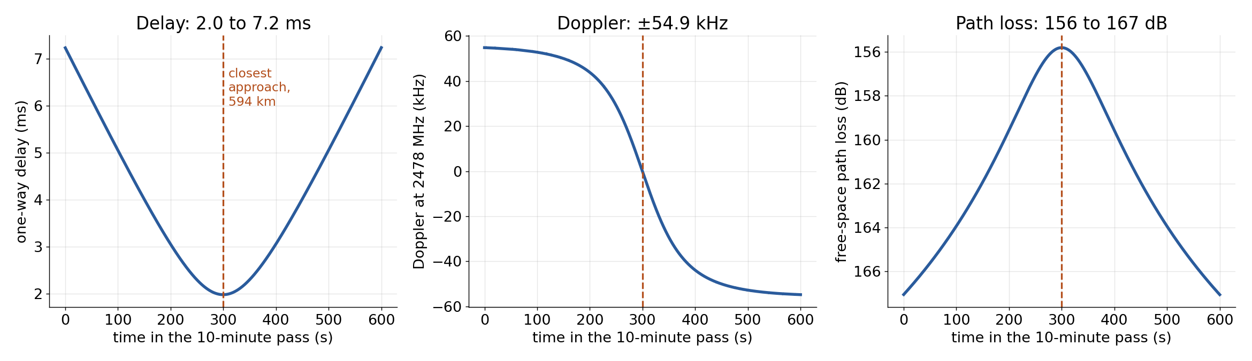
BACKGROUND · NTN
NTN: 5G NR from a satellite, and what a pass does
Rel-17
5.3 ms
±54.9 kHz
11 dB
3GPP NR over satellite: bands n255 (L) and n256 (S), 5 to 20 MHz carriers
change in one-way delay over the pass: up to 22 µs every second
Doppler at 2478 MHz, changing up to 678 Hz/s
path-loss swing: 156 dB overhead to 167 dB at the window edges
NTN ISAC in GNU Radio · GRCon 2026
05
Notes:
NTN, non-terrestrial networks: 3GPP Release 17 made 5G NR work over satellites, with new FR1 bands n255 (L-band) and n256 (S-band) and 5 to 20 MHz channels. The UE copes with the moving satellite using broadcast ephemeris (SIB19), timing advance and frequency pre-compensation on the uplink. The pass we emulate: a 550 km orbit, 67.5 degrees maximum elevation, a 10-minute window. Slant range goes from about 2170 km at the window edges down to 594 km at closest approach, so one-way delay goes from 7.2 ms to 2.0 ms and back: 5.3 ms of change. The range rate peaks at 6.64 km/s, which moves the delay by 22 µs every second. Doppler at our bench carrier of 2478 MHz reaches ±54.9 kHz and sweeps through zero at closest approach, changing fastest there (678 Hz/s). Signal strength: free-space path loss alone changes by 11 dB over the pass. The absolute received power also depends on the satellite's EIRP and both antennas; we treat the direct path's carrier-to-noise as an input (link budget slide). Note: 2478 MHz is ISM and our tests are conducted over cable. Real S-band NTN downlink (n256) is at 2170 to 2200 MHz; the numbers scale with carrier.

Slide 6
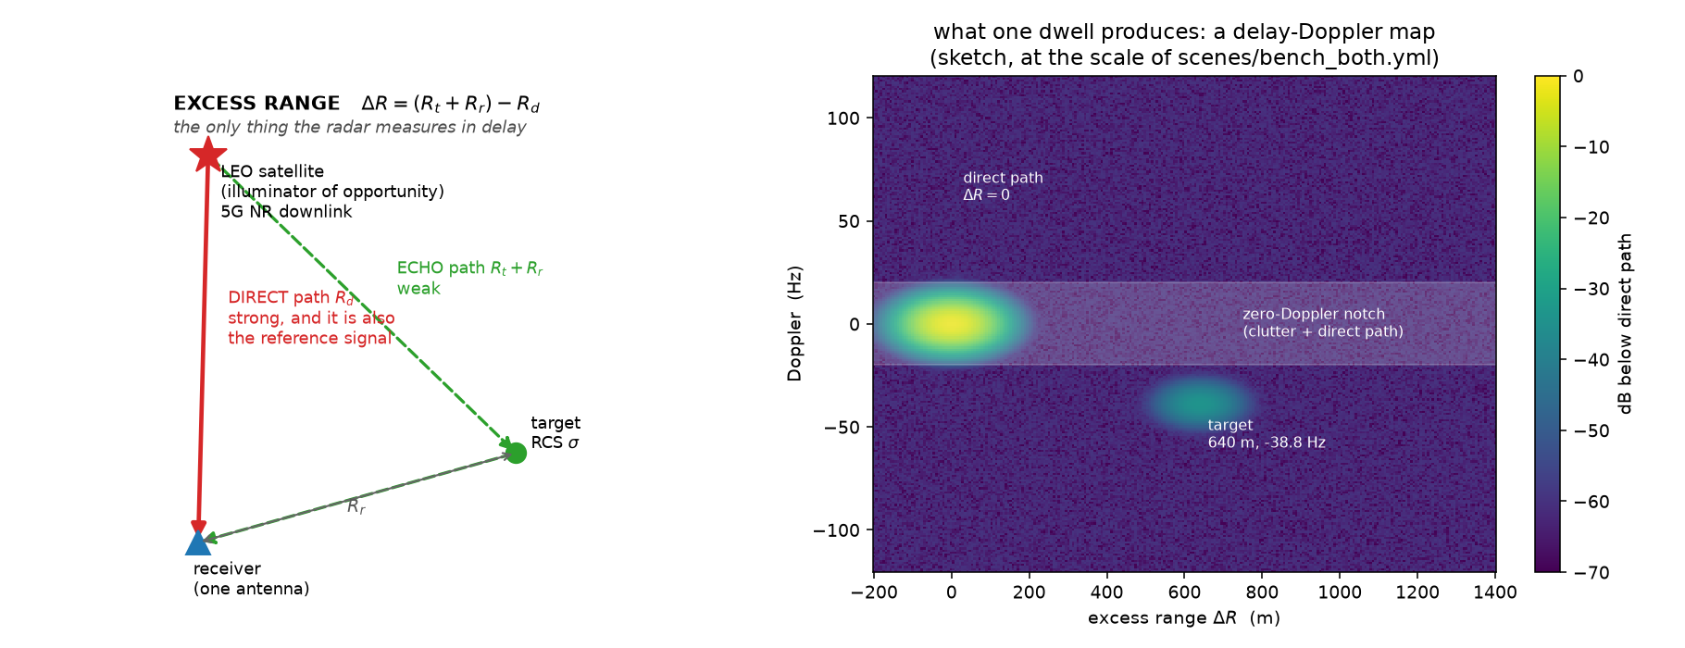
BACKGROUND · ISAC
One receiver, two paths, two observables
Direct path
strong. It is the comms signal and the radar's reference for what was sent
Echo
weak and later. Correlate it against the reference to find it
Two numbers per dwell
excess range ΔR = (Rt + Rr) − Rd, and Doppler. One antenna gives no 3-D position
NTN ISAC in GNU Radio · GRCon 2026
06
Notes:
ISAC: integrated sensing and communication, one signal doing both jobs. Here the signal is a 5G NR downlink from a LEO satellite, and we only own the receiver. The receiver hears the direct path from the satellite, which is also the communication signal and therefore our reference for what was transmitted, and a weak echo off an object, arriving later. Correlating the echo against the reference gives two quantities per dwell: excess range (how much longer the echo's path was) and Doppler (how fast that path length is changing). One receiver with one antenna cannot say where the target is in 3-D, only how much longer its path was; the tracker state is just excess range and range rate. That is one reason combining several receivers is on the next-steps slide.

Slide 7
RESOLUTION
Bandwidth sets delay resolution, dwell sets Doppler
Carrier | Occupied | Delay cell
5 MHz, 25 PRB at 15 kHz (ours) | 4.5 MHz | 66.6 m
20 MHz, 106 PRB at 15 kHz | 19.08 MHz | 15.7 m
100 MHz, 273 PRB at 30 kHz (terrestrial) | 98.28 MHz | 3.05 m
66.6 m
two reflectors closer than this in excess path fall into one cell
Not ours to choose
Excess-range cell = c / occupied bandwidth.
a downlink we listen to gives us its bandwidth. More bandwidth also means more samples: 100 MHz needs 122.88 MS/s, about 490 MB/s each way over USB
Coherent dwell | Doppler cell
20 ms | 50 Hz
100 ms | 10 Hz
1 s | 1 Hz
Longer dwell, finer Doppler
but over a long dwell the target moves. Next slide
NTN ISAC in GNU Radio · GRCon 2026
07
Notes:
Delay resolution depends only on bandwidth: one cell is c divided by the occupied bandwidth. Our waveform is a 5 MHz NR carrier: 25 PRB × 12 subcarriers × 15 kHz = 4.5 MHz occupied, so 66.6 m per cell. Two reflectors closer than that in excess path merge. More bandwidth would help (100 MHz gives about 3 m), but two separate limits apply. On our bench it is plumbing: 7.68 MS/s is already 30.7 MB/s each way over USB, and 100 MHz would need 122.88 MS/s, a 10 GbE USRP rather than a B200. In reality it is not our choice at all: we do not control the transmitter, and NTN carriers are 5 to 20 MHz. So 66.6 m cells are what a real NTN downlink would hand a real receiver. Doppler resolution is one over the coherent dwell: 100 ms gives 10 Hz cells, 1 s gives 1 Hz. So you want long dwells, which is exactly what the next slide is about.

Slide 8
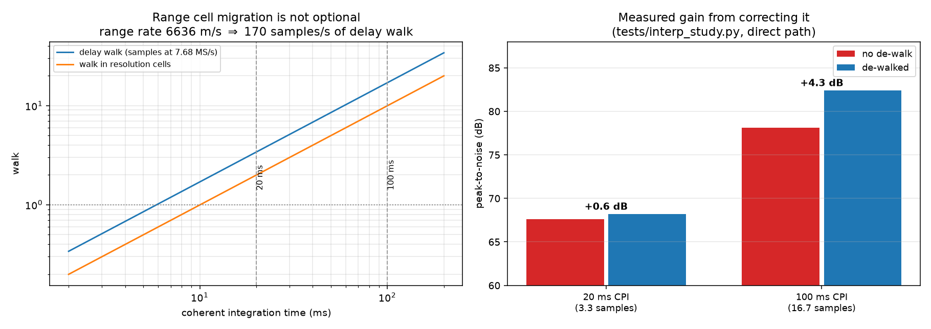
LONG DWELLS
Over a 100 ms dwell, the echo walks ten cells
170 sa/s
delay drift at a 6.636 km/s range rate, sampled at 7.68 MS/s
≈ 10 cells
walk across one 100 ms dwell: the peak smears instead of stacking
Interval | Delay walk | Delay cells
one OFDM symbol, 71.35 µs | 0.012 samples | 0.01
one slot, 1 ms | 0.17 samples | 0.10
one 100 ms sensing dwell | 17 samples | 9.9
+4.3 dB
back from a per-subcarrier phase slope, no resampling
NTN ISAC in GNU Radio · GRCon 2026
08
Notes:
Why long dwells are hard: the satellite moves so fast that the delay changes by 170 samples every second. Over a 100 ms coherent dwell the echo slides 17 samples, about 10 resolution cells, so its energy spreads over ten cells instead of stacking in one. This is range cell migration, standard in classical radar, and the NTN-ISAC surveys do not mention it. The fix is nearly free: a delay is a linear phase ramp across subcarriers. After shifting each symbol by a whole number of samples, the leftover fraction is removed by multiplying each subcarrier by a phase slope. Measured: +4.3 dB at a 100 ms dwell, +0.6 dB at 20 ms; the gain grows with dwell because the walk does. One subtlety that cost real time: index the retiming by arrival time, not transmit time. The two differ by the delay itself (up to about 5 ms here), which at 170 samples/s is about 0.85 samples of bias; measured, the peak sat at −0.85 samples before the fix and 0.000 after.

Slide 9
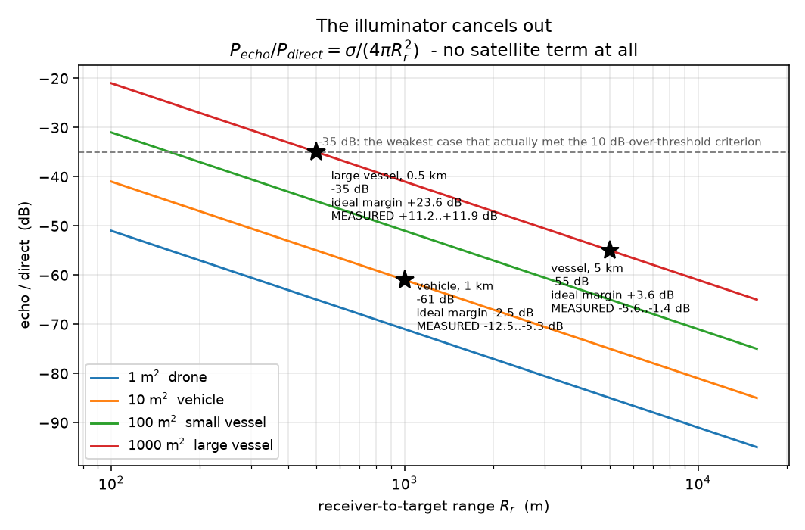
LINK BUDGET
What wider carriers and longer dwells can detect
Target | Echo / direct | Measured margin
Vehicle, 10 m² at 1 km | −61 dB | −12.5 to −5.3 dB
Vessel, 1000 m² at 5 km | −55 dB | −5.6 to −1.4 dB
Large vessel, 1000 m² at 0.5 km (passes) | −35 dB | +11.2 to +11.9 dB
Only the large vessel clears 10 dB over threshold.
The Link Budget block answers this for any RCS, range and dwell.
NTN ISAC in GNU Radio · GRCon 2026
10
Notes:
Same formula as before, now for wider carriers. Rel-17 NTN bands support 5, 10, 15 and 20 MHz carriers. At 15 kHz subcarrier spacing a 10 MHz carrier is 52 PRB (9.36 MHz occupied) and a 20 MHz carrier is 106 PRB (19.08 MHz occupied). Detection margin = direct C/N + 10·log10(occupied bandwidth × dwell) + echo-to-direct ratio − 13 dB threshold. The echo-to-direct ratio is σ / (4π R²), the target's RCS over the receiver-to-target distance; the satellite's range, power and antenna cancel from it. The key assumption: the satellite keeps the same EIRP per MHz when the carrier widens, so the direct C/N stays at 15 dB and the processing gain grows with bandwidth: +3.2 dB at 10 MHz and +6.3 dB at 20 MHz over today's 4.5 MHz. If instead the same total power is spread over a wider carrier, C/N drops by exactly as much as the processing gain rises: you gain resolution (32 m or 15.7 m cells), not SNR. A 1 s coherent dwell adds another 10 dB over 100 ms. What that buys, ideally: at 20 MHz and 100 ms a vehicle at 300 m and a small vessel at 1 km clear the 10 dB bar; at 20 MHz and 1 s so do a vessel at 5 km, and a 10 m² vehicle at 1 km, which is the same echo as a 0.1 m² drone at 100 m (−61 dB). A 0.1 m² drone at 300 m still does not. These are ideal numbers against thermal noise. The simulation campaign measured 3 to 12 dB of implementation loss, and on hardware a second limit appears: the direct path itself. Both come back after the real-radio results, where we close both budgets.

Slide 10
THE CHANNEL BLOCK
LEO Channel: a sum of delayed copies
y(t) = Σ a_p · x(t − τ_p(t))
scene.yml
build_scene.py
traj.csv
LEO Channel
you describe each path: type, excess path, rate, gain
compiles the scene with the satellite pass
one range history per path, 1000 samples/s
C++: delay = range / c, 12 to 22 MS/s
Delay is the only thing injected
Exact truth
Doppler falls out of the carrier phase as the delay changes, so delay and Doppler can never disagree.
LEO Truth publishes the same paths as messages, so every detection can be scored against them.
NTN ISAC in GNU Radio · GRCon 2026
11
Notes:
The channel is emulated in software and played through real radios, which is why the truth is exact. It is one block, ntnisac.leo_channel, and it does one thing: a sum of delayed, scaled copies of the transmitted signal. Each path is a range history: a table of distance against time. The block reads it, divides by c to get a delay, and delays the signal by it, with a sinc interpolator for fractional delays. We deliberately do not inject Doppler anywhere: if a path should show a Doppler, its excess path is made to change at the matching rate, and the carrier phase produces the Doppler by itself. A delay and a Doppler specified separately would describe an object that cannot exist. The channel is a file contract, not an API: anything that adds a column to traj.csv adds a path, and nothing downstream needs to know where it came from. The C++ block matches the Python reference to 9e-8, the float32 floor.

Slide 11
THE CHANNEL BLOCK
Defining clutter, a drone and a blade in YAML
Path | Defined as | What it tests
satellite | direct | the reference
clutter | static, 250 m, −20 dB | must not make a track: zero Doppler, inside the notch
drone | linear, 640 m, +4.7 m/s, −25 dB | exact commanded truth at −38.8 Hz
blade | rotating, r = 0.25 m, 7 rev/s, −30 dB | micro-Doppler; 0.4 m of excess path puts it in the direct path's cell
paths:
- type: direct
name: satellite
- type: static
name: clutter
excess_m: 250
gain_db: -20
- type: linear
name: drone
excess_m: 640
excess_rate_mps: 4.7 # -38.8 Hz
gain_db: -25
- type: rotating
name: blade
excess_m: 0.4
radius_m: 0.25
rot_hz: 7
gain_db: -30
Also: pendulum · custom (any expression in t)
· ntn_tdl (3GPP TR 38.811, off by default).
gain_db is echo-to-direct: RCS and range folded together.
NTN ISAC in GNU Radio · GRCon 2026
12
Notes:
This is scenes/bench_both.yml, trimmed. YAML is just indentation for nesting, a dash for a list item, key: value for a field. Four paths, each exercising something different. The satellite is the direct path and the reference. The clutter is a static scatterer 250 m of excess path out at −20 dB: it must not produce a track, because it has no Doppler and sits in the zero-Doppler notch. The path named drone is a linear mover at 640 m, growing 4.7 m/s, at −25 dB: exact commanded truth, and 4.7 m/s of excess-path rate gives −38.8 Hz at 2478 MHz. Be careful with the name: −25 dB is an echo-to-direct ratio, not a drone RCS. The blade is a rotating reflector, radius 0.25 m at 7 rev/s: its excess path oscillates, so its echo is a comb of Doppler lines. At 0.4 m of excess path it sits inside the direct path's own 66.6 m cell, so Doppler is its only observable. Adding an object is one block of YAML and a recompile with tools/build_scene.py. Every type can take window_s so an object exists for part of the pass. The TR 38.811 multipath option is off by default because its clusters have no ground truth.

Slide 12
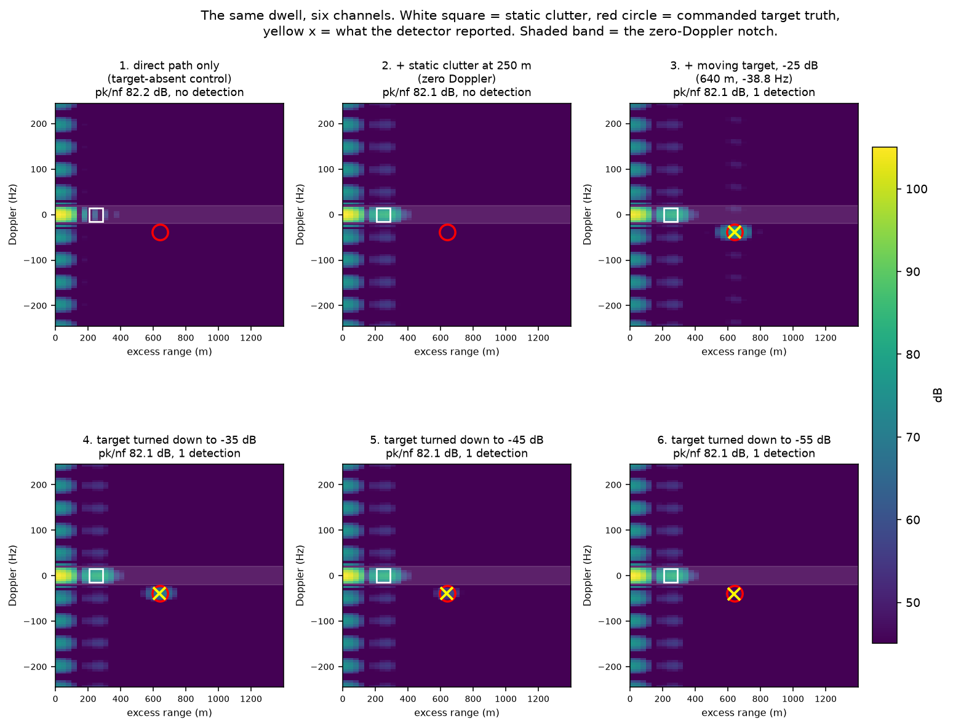
WHAT THE RECEIVER SEES
Six channels, one dwell: what is seen and what is not
1 · Direct path only
the target-absent control: nothing at the red truth circle
2 · + clutter at 250 m
visible, but at zero Doppler inside the notch: correctly not detected
3 · + drone at −25 dB
detected at 640 m and −38.8 Hz, on the truth circle
4 to 6 · turned down
−35, −45 and −55 dB: still detected, fading toward the floor
NTN ISAC in GNU Radio · GRCon 2026
13
Notes:
Same dwell of the same waveform, six times, changing only the channel's path list. Read the top row left to right. Panel 1 is the direct path alone, the target-absent control: all the energy is the ridge at zero excess range and the red circle where the target would be is empty. Panel 2 adds the static clutter: a second blob at 250 m, at zero Doppler, inside the shaded notch, and it correctly produces no detection. Panel 3 adds the drone path: it appears at 640 m and −38.8 Hz, with the detector's yellow cross on the red truth circle. The bottom row turns the same object down to −35, −45 and −55 dB. It fades and at −55 dB it is nearly gone. pk/nf in the titles is peak-to-noise-floor: the highest point on the map (the direct path) over the map's noise floor. It is measured, not commanded, and it barely moves (82.0 to 82.2 dB) because the direct path is the same in every panel.

Slide 13
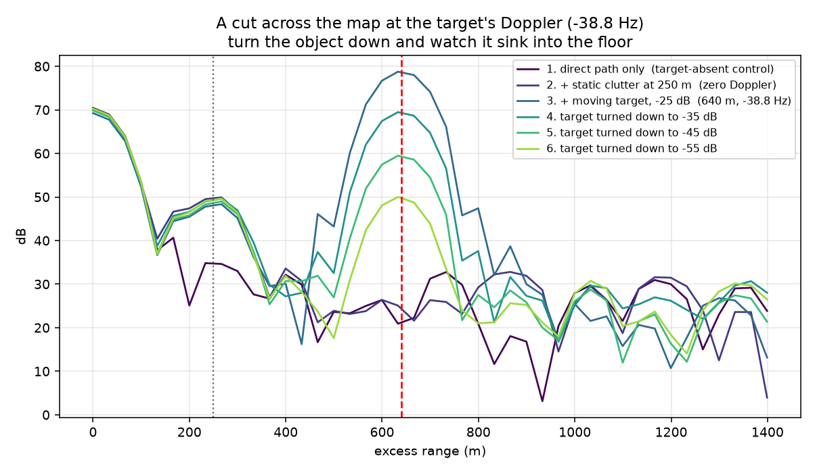
WHAT THE RECEIVER SEES
One cut through the map: the gap is the measurement
Dark trace: target absent
the baseline. Everything above it at 640 m is the object
−25 to −55 dB
the peak drops about 9 to 10 dB for every 10 dB of echo
The floor is not flat
the wiggles at 20 to 35 dB are the direct path's sidelobes: structure, not noise
NTN ISAC in GNU Radio · GRCon 2026
14
Notes:
A cut across the map at the target's Doppler shows it more clearly than the images. The dark purple trace is the target-absent control; everything above it at 640 m is the object, and that vertical gap is the measurement. Without the control you would be looking at a bump and guessing. As the echo is turned down in 10 dB steps, the peak drops by about the same amount, which is what a measurement of the echo should do. The control also shows that the floor is not flat: the wiggles around 20 to 35 dB are the direct path's sidelobes. They are deterministic structure, not noise, and CFAR (which sets its threshold against noise) does not protect you from them. That is why the real-radio path subtracts the direct path (CLEAN) rather than thresholding around it.

Slide 14
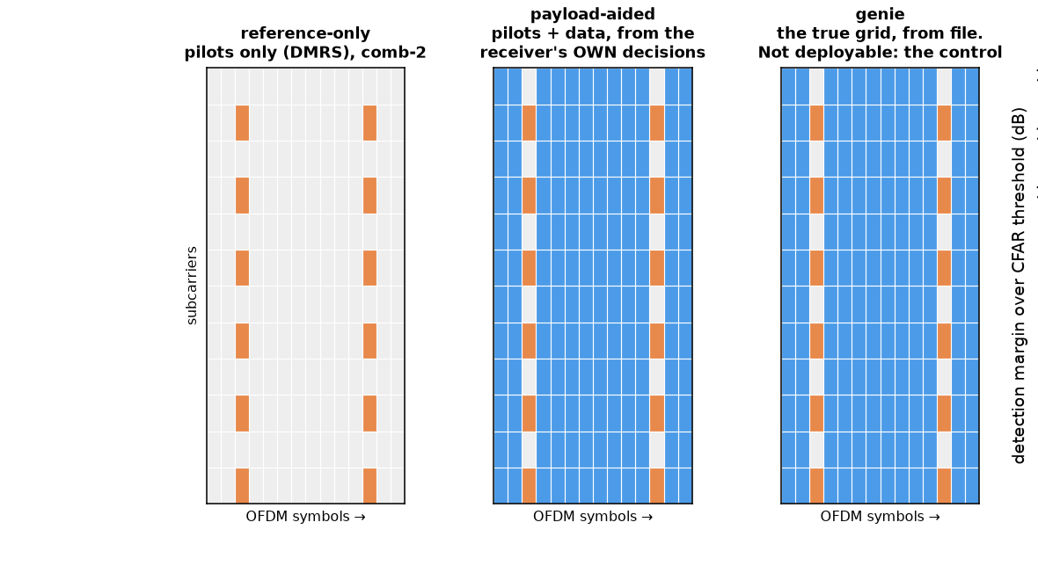
PAYLOAD-AIDED ISAC
Three references: pilots only, payload-aided, genie
The receiver chain. Only step 4 differs.
Demodulate the dwell into a grid Y: subcarrier × symbol
Estimate the channel on the pilots (least squares), interpolate
Equalise (MMSE)
Build the reference: pilots only · pilots + own QPSK decisions · the true grid
Correlate: Z = Y · conj(X_ref) / |X_ref| on the occupied REs
2-D FFT: subcarriers → delay, symbols → Doppler
All three from one dwell and one channel estimate
a controlled comparison, not three separate runs
Orange: DMRS pilots (type 1: every other subcarrier, on 2 of 14 symbols). Blue: data resource elements.
NTN ISAC in GNU Radio · GRCon 2026
15
Notes:
A radar has to know what was transmitted to recognise its echo. For a signal we do not control there are three ways to know it. Reference-only uses just the pilots (DMRS), which are known in advance, so it always works even if nothing decodes; but pilots are a small, sparse part of the grid. Payload-aided demodulates the data, slices each symbol to the nearest QPSK point, and uses pilots plus those decisions as the reference: the whole occupied grid instead of the pilots. The catch is that every wrong decision puts an error into the reference. Genie uses the true transmitted grid from file. It is not deployable; it is the control that proves payload-aided is not cheating. Step 5 divides by the reference's magnitude, a reciprocal filter rather than a matched filter; with QPSK (constant modulus) the division adds no noise. The reconstruction idea is prior art from DVB-T/DAB passive radar (Poullin, 2005); what the block adds is all three variants from one dwell and one shared channel estimate, so the comparison is controlled. Grid Sense takes extra_variants for exactly that. Be precise if asked: these are hard QPSK decisions. There is no LDPC decoding in the chain.

Slide 15
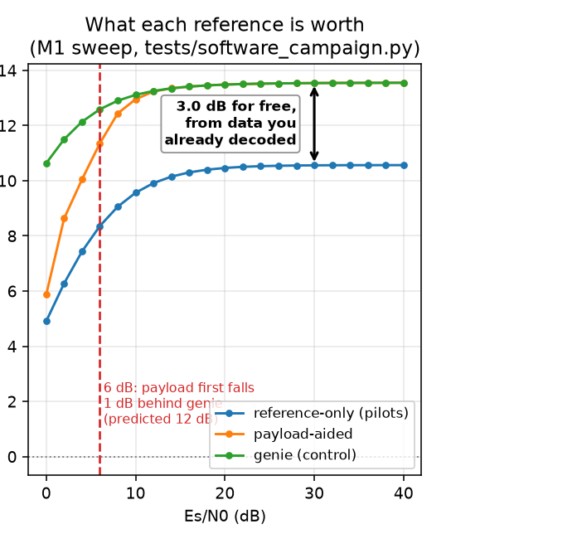
PAYLOAD-AIDED ISAC
Payload-aided buys about 3 dB, for free
Es/N0 | SER | Pilots | Payload | Genie
0 dB | 0.37 | 4.9 | 5.9 | 10.6
6 dB | 0.070 | 8.4 | 11.4 | 12.6
8 dB | 0.023 | 9.1 | 12.4 | 12.9
12 dB | 4.4e-4 | 9.9 | 13.2 | 13.3
20 dB | 0 | 10.5 | 13.5 | 13.5
Detection margin over the CFAR threshold, dB; SER is uncoded. Same received dwell for all three.
≈ +3 dB
≤ 0.5 dB
Knee at 6 dB
over pilots, from data already demodulated
behind genie from 8 dB Es/N0 up
≥ 1 dB behind genie; design said 12
Hard QPSK decisions, no LDPC decoding. Decoding first should move the knee lower: not yet measured.
NTN ISAC in GNU Radio · GRCon 2026
16
Notes:
The sweep runs all three references on the same received dwell, which is what makes it a comparison. Payload-aided is worth about 3 dB of detection margin over pilots alone, and it costs nothing: it uses data the receiver already demodulated. At useful SNRs it tracks genie: within 0.5 dB from 8 dB Es/N0 up, and 0.1 dB at 12 dB. The red dashed line on the plot sits at 6 dB Es/N0: where payload-aided first falls a full dB behind genie. Left of it, the receiver's own decisions are wrong often enough (7% of symbols at 6 dB) that the rebuilt reference is measurably worse. The design had predicted that point at 12 dB, so payload-aided works over a wider SNR range than expected. Why a symbol error rate of 4.4e-4 at 12 dB costs nothing: the few wrong symbols are spread thinly across the whole aperture instead of piling up anywhere. If asked: measured SER is about 1 to 1.7 dB worse than ideal QPSK in AWGN, which is the loss from estimating the channel on two DMRS symbols per slot.

Slide 16


DETECTION BLOCKS
Two stages: SSB Coarse finds, Grid Sense refines
coarse: where to look
Grid Sense (stage 2)
SSB Coarse (stage 1)
Full grid and payload-aided reference, inside the gate
Expensive, 1 dwell in N: about 480 ms per 100 ms dwell in Python
Publishes detections as “sense”, and “refine” back to stage 1
Uses only the SSB: one every 20 ms
Cheap, runs on every dwell: 82 ms per 100 ms dwell in Python
Publishes a range gate as “coarse”
refine: the real Doppler
Why the loop runs both ways
One SSB every 20 ms samples the target's phase at 50 Hz, so stage 1 alone is ambiguous beyond ±25 Hz: a −31.5 Hz target reads +18.5 Hz. Stage 2's answer fixes it in 1 dwell (±0.04 Hz), against about 4 dwells without it.
NTN ISAC in GNU Radio · GRCon 2026
17
Notes:
Building the full delay-Doppler map every dwell over the whole search space is expensive and mostly wasted. So detection is two blocks. Stage 1, SSB Coarse, uses only the synchronisation block: a tiny amount of data, cheap enough to run on every dwell. It produces a rough range and a gate: roughly where the target is and how sure it is. Stage 2, Grid Sense, uses the full grid with the payload-aided reference, inside stage 1's gate, and runs on every Nth dwell by decision. The message loop runs both ways and that is the design: stage 1 publishes coarse to stage 2; stage 2 publishes refine back into stage 1's tracker. Remove the return arrow and stage 1's Doppler ambiguity never gets resolved. The ambiguity in one line: one SSB per 20 ms means stage 1 samples the target's phase 50 times a second, so like any sampled signal it cannot tell apart frequencies 50 Hz apart. A target at −31.5 Hz reads +18.5 Hz, precisely wrong. No averaging fixes undersampling; you need the answer from somewhere else, which is stage 2. Timing: in the Python reference the full chain takes about 480 ms per 100 ms dwell, but stage 1 alone takes 82 ms, inside the dwell. That is the Python reference implementation, not a limit of the architecture. On the GRC canvas at stride 4: 14 stage-1 dwells, 4 stage-2, 10 skipped by decision.

Slide 17
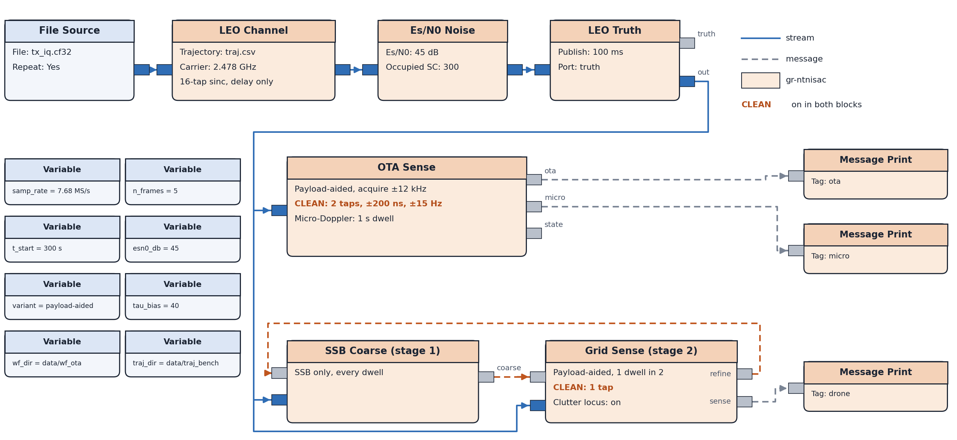
IN GNU RADIO
The whole chain on one GRC canvas
What CLEAN does
Finds the direct path's delay, Doppler and gain, then subtracts its known shape from the map.
Why we need it
The direct path is up to a million times (60 dB) stronger than the echoes we want, and its sidelobes are structure, not noise: a detection threshold cannot remove them.
On in both blocks here: OTA Sense (2 taps) and Grid Sense (1 tap). Runs on a laptop, no radio.
NTN ISAC in GNU Radio · GRCon 2026
18
Notes:
This is gr-ntnisac/examples/ntnisac_ota_bench.grc, redrawn in full from the .grc file: the same receive chain as the real-radio flowgraph, with no radio. File Source plays the NR waveform, LEO Channel applies the satellite pass at 2.478 GHz, Es/N0 Noise sets the SNR (45 dB here), LEO Truth publishes commanded truth. The stream then feeds three sensing blocks: OTA Sense, SSB Coarse and Grid Sense, with the two stages exchanging coarse and refine messages. Results go to Message Print here; in the real-radio flowgraph the same messages go out over ZMQ to the dashboard. CLEAN is not a separate block: it is a step inside OTA Sense (n_clean = 2) and Grid Sense (clean_components = 1), and it is on in both. What CLEAN does, in one breath: it finds the strongest thing on the map, the direct path, estimates its exact delay, Doppler and complex gain, and subtracts it. Because our aperture is known exactly (it ships with the waveform), the direct path's shape on the map is known in closed form, so this is a least-squares fit of one number per tap, not an adaptive filter, and it removes nothing a target could occupy. Why we need it: the direct path is enormous, up to about 60 dB above the echoes we care about, and it has sidelobes that spread across the map. CFAR sets its threshold against noise, so it cannot tell these deterministic sidelobes from targets; they must be subtracted, not thresholded around. It matters most here because this bench scene is the direct path plus a rotating blade at 0.4 m of excess path, inside the direct path's own delay cell: without CLEAN the blade is buried under the direct path. In simulation CLEAN takes the direct path down 73.6 dB; on real radios 35 to 39 dB, which is the gap explained later.

Slide 18
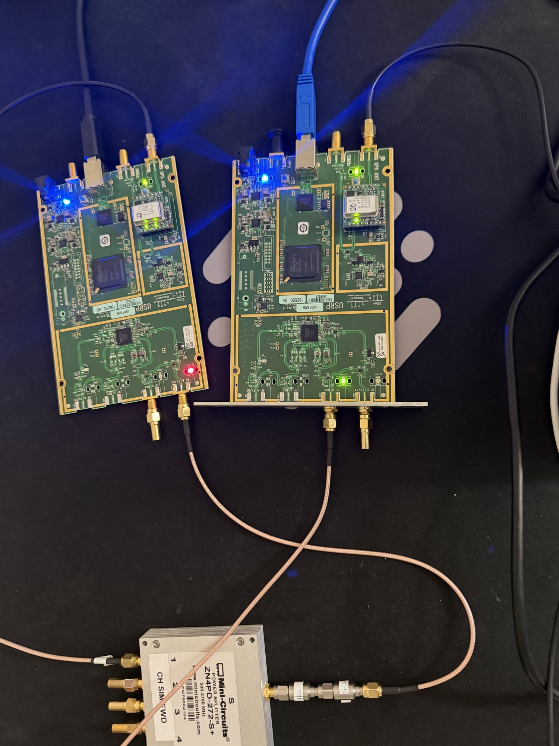
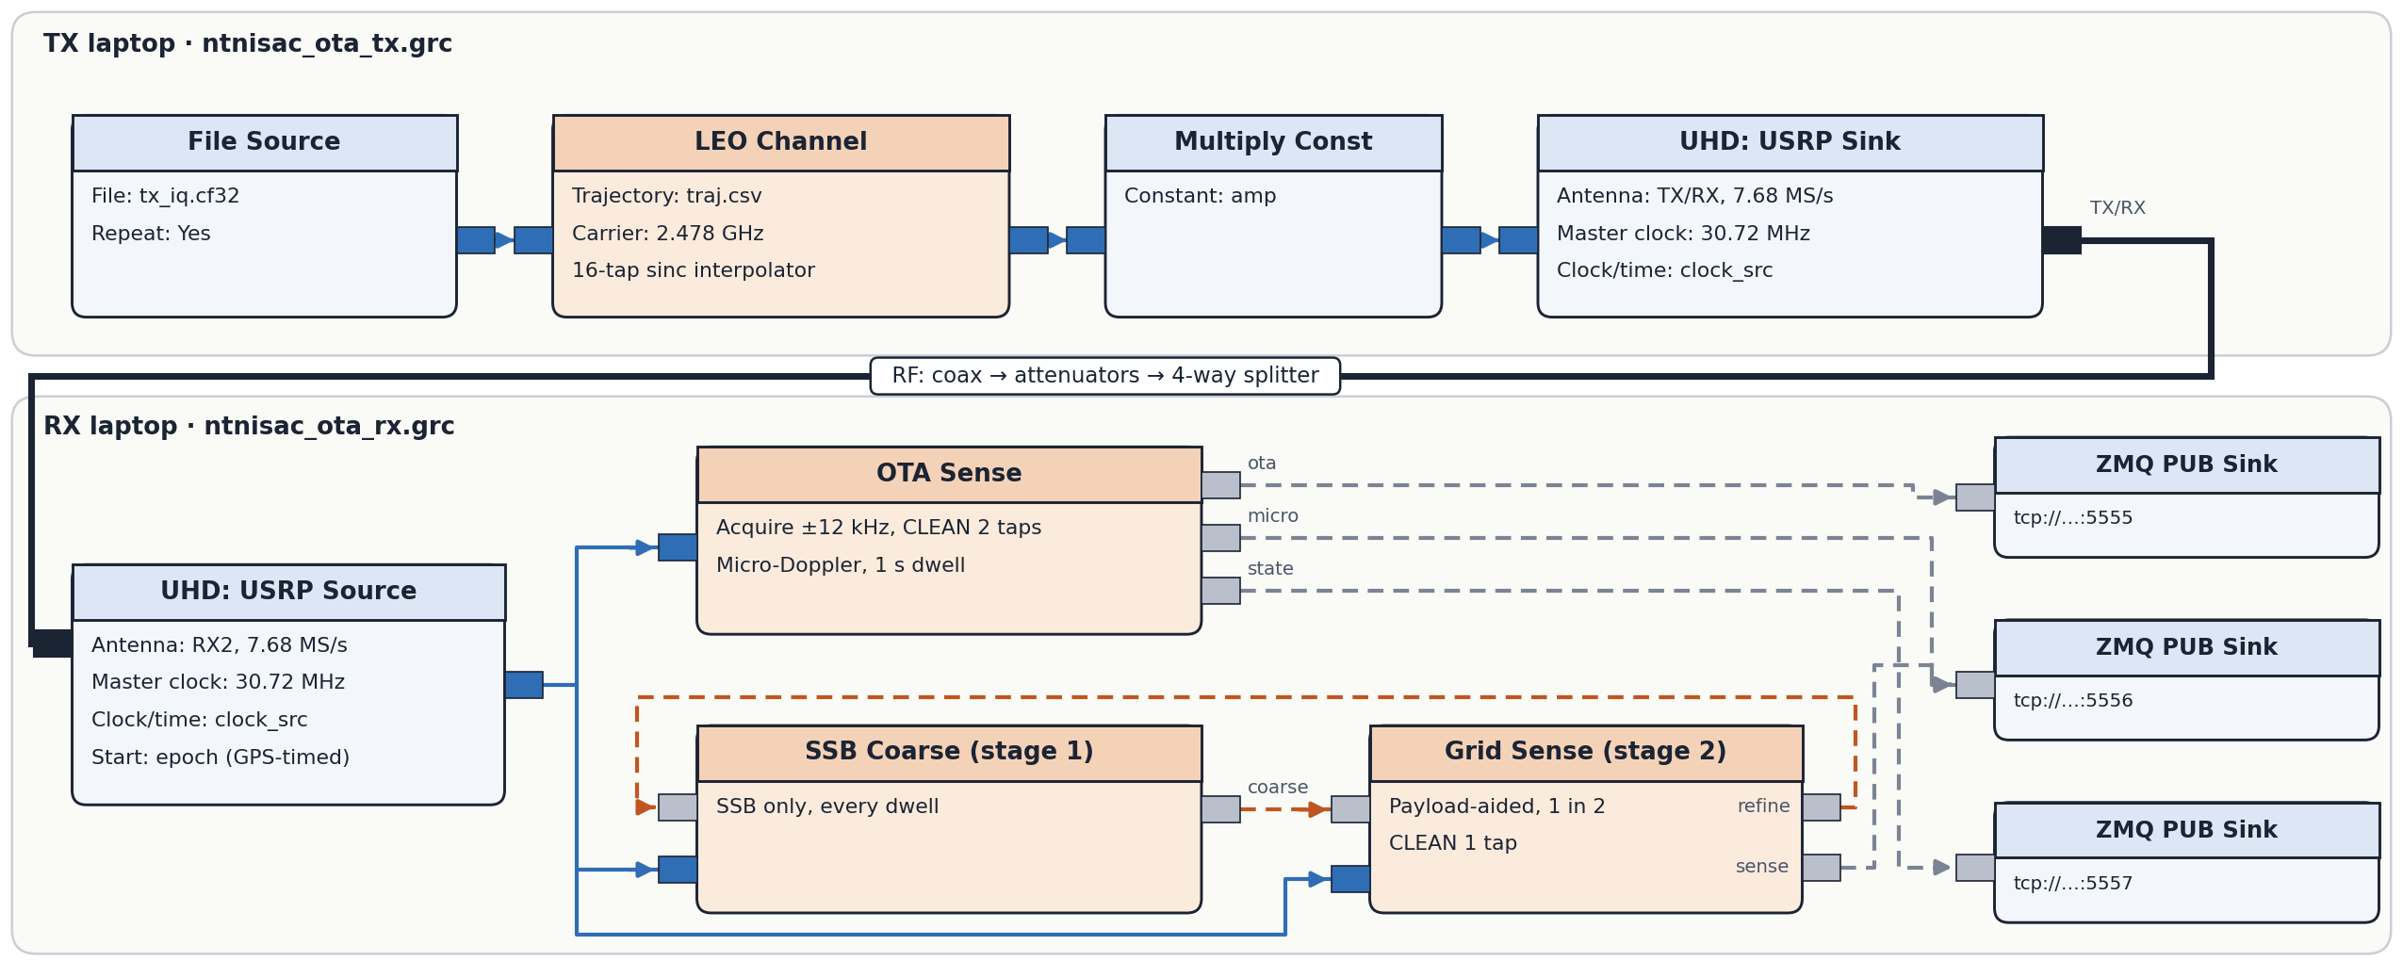
ON REAL RADIOS
Two laptops, two USRP B200s, one cable
Conducted over coax, attenuators and a splitter at 2478 MHz (ISM). Master clock 30.72 MHz. Each B200 on its own GPSDO, with a GPS-timed start epoch.
NTN ISAC in GNU Radio · GRCon 2026
19
Notes:
Same blocks, now on real RF. The TX laptop runs File Source into LEO Channel into a USRP Sink, so the satellite pass and the targets are applied in software before transmission. The RX laptop runs a USRP Source into OTA Sense (the real-radio receive path: acquisition, CLEAN cancellation of the direct path, micro-Doppler) and into the two detection stages, with results out over ZMQ. This is conducted, not over the air: the two B200s are joined by coax, attenuators and a 4-way splitter. That is deliberate. It is the only setup where real hardware (DAC, filters, ADC, USB, clocks) and exact commanded truth exist at the same time, so any change from simulation is caused by the hardware alone. Over the air indoors, a real object adds under a metre of excess path, less than 1/50 of a delay cell. In the photo: left board transmitting (red TX/RX LED), right board receiving (green RX2 LED), both GPS-locked. Master clock 30.72 MHz so 7.68 MS/s is an exact decimation by 4. Two independent GPSDOs give a clock offset of about 1 to 3 parts per billion, and a GPS-timed start pins the transmit-to-receive offset.

Slide 19
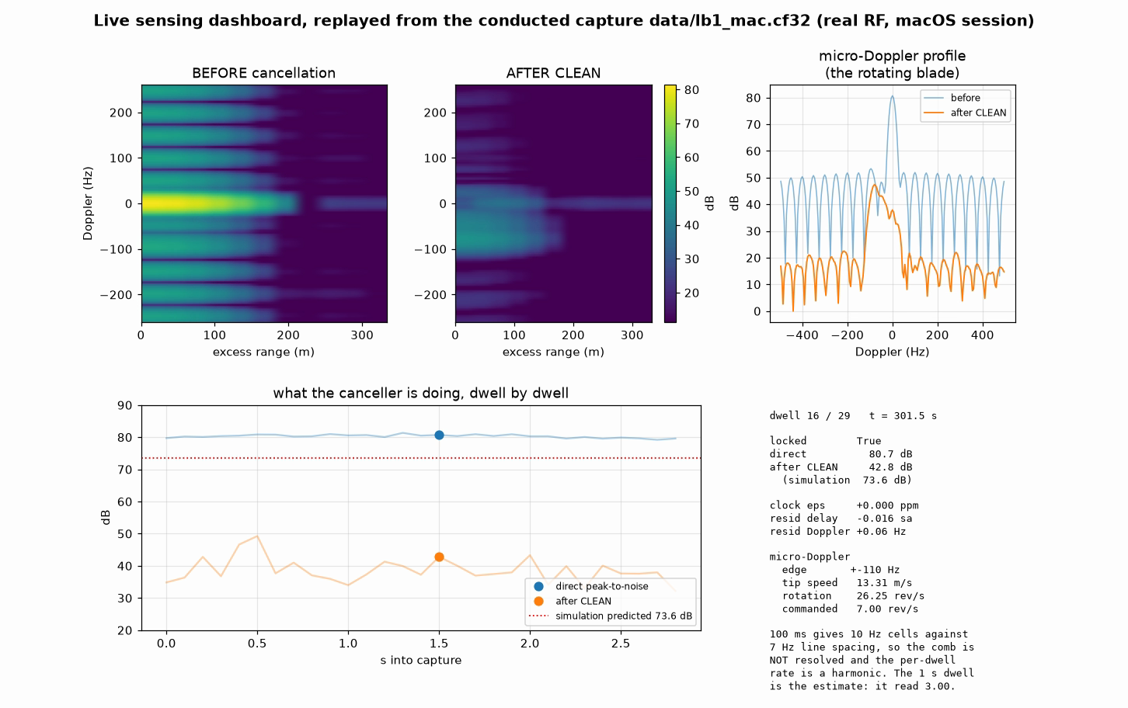
RESULTS OVER ZMQ
What the blocks publish, dwell by dwell
Before and after CLEAN
one 100 ms dwell as a delay-Doppler map, then with the direct path subtracted
Micro-Doppler profile
the Doppler cut at the direct path's delay cell, where the blade lives
Dwell by dwell
direct path about 80 dB over noise; after CLEAN 32 to 49 dB
Status
locked, residual delay −0.016 samples, residual Doppler +0.06 Hz
NTN ISAC in GNU Radio · GRCon 2026
20
Notes:
This is a replay of a real conducted capture (data/lb1_mac.cf32, the macOS session). Every frame is one real 100 ms dwell, drawn from what the sensing block publishes, the same messages that go out over ZMQ to gr/ota_dashboard.py in a live run. Top left, BEFORE cancellation: the delay-Doppler map around the direct path. The bright ridge at zero excess range and zero Doppler is the direct path; its spread across delay and the horizontal stripes are its point spread function, structure rather than noise. Top middle, AFTER CLEAN: the same dwell with the modelled direct path subtracted, on the same colour scale. The ridge drops by 32 to 49 dB depending on the dwell (38.6 dB on average), but a residual remains. That residual is the gap to simulation on the next two slides. Top right, micro-Doppler profile: the Doppler cut at the direct path's own delay cell, which is where the blade is (0.4 m of excess path). Blue is before CLEAN, orange after. The blade shows up as lines spaced at its rotation rate within its Doppler edge; the card reports the edge (±110 Hz, a tip speed of 13.3 m/s against 11 m/s commanded). Caution on rotation: a 100 ms dwell gives 10 Hz cells against 7 Hz line spacing, so the per-dwell rate is a harmonic. The 1 s estimate reported 3.00 rev/s, which turned out to be the default bottom of the search range (rot_min_hz). With the floor raised it finds 7.00. Radius is not recovered. Bottom: direct path peak-to-noise stays near 80 dB every dwell (the coherent gain survives), while after-CLEAN depth wanders between 32 and 49 dB against 73.6 dB in simulation. Status text: locked, clock offset 0 (one radio), residual delay −0.016 samples, residual Doppler +0.06 Hz: the receiver is tracking the direct path precisely, so the shortfall is not a tracking error.

Slide 20
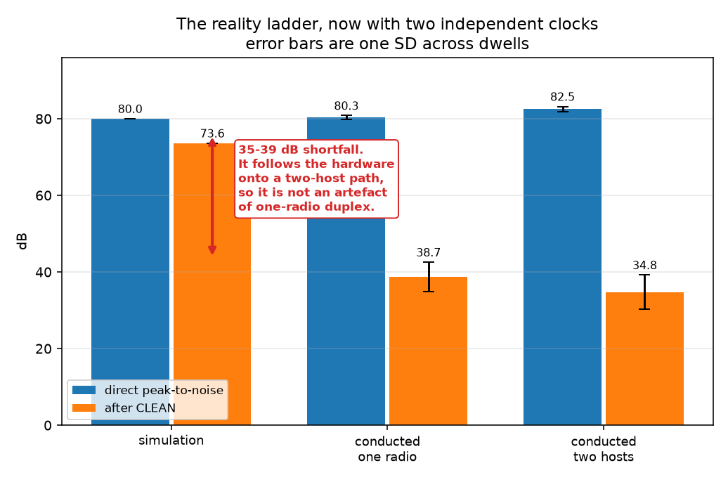
SIMULATION VS REAL RADIOS
Gain survives the hardware, cancellation does not
 | Sim. | 1 radio | 2 hosts
Direct peak-to-noise | 80.0 dB | 80.3 dB | 82.5 dB
Cancellation depth | 73.6 dB | 38.6 dB | 34.8 dB
Clock offset | none | ≈ 0 | 1–3 ppb
35 to 39 dB short of simulation
reproduced on two machines and two operating systems, and again on two hosts with two independent clocks.
Direct peak-to-noise: the receiver chain works on real RF. Cancellation depth: how far CLEAN pulls the direct path down.
NTN ISAC in GNU Radio · GRCon 2026
21
Notes:
Two real-radio rungs against simulation. First, one B200 transmitting to itself, on two different machines (Linux and macOS). Then two hosts: one laptop transmitting, the other receiving, one B200 each, each on its own GPSDO. What survived: direct peak-to-noise, 80.0 dB predicted, 80.3 on one radio, 82.5 on two hosts. The whole receive chain (acquisition, de-ramping, retiming, de-walking, the map) does on a real DAC and ADC what it does in simulation. What did not: cancellation depth. CLEAN pulls the direct path down 73.6 dB in simulation, 38.6 on one radio, 34.8 on two hosts. That is 35 dB short, then 38.8 dB short. It reproduced on two machines with different operating systems and RF paths, so it is not software, and it followed the hardware onto two hosts, so it is not an artefact of one board transmitting to itself. Clock offset: zero by construction on one radio; about 1 to 3 parts per billion between two GPSDOs, with the sign changing between captures, as expected for two independent disciplined clocks. Do not quote the 2.18 dB better direct path on two hosts until a second capture agrees.

Slide 21
NEXT STEPS
Where this goes next
Combine several devices
Close the cancellation gap
one receiver only gives excess range. Several receivers, and several illuminators, can intersect those measurements into positions and fuse detections.
model the front end (band response, phase noise), terminate spare ports, re-measure
Real NTN signals
Outdoors
the file contract (waveform file plus traj.csv) is designed to let a real or recorded downlink replace the generator
a geometry where delay becomes observable, not just Doppler
NTN ISAC in GNU Radio · GRCon 2026
25
Notes:
Combining several devices is the big one. One receiver measures excess range, which only places the target somewhere on a surface of constant path length around the transmitter and receiver. Several receivers give several such surfaces, and their intersection is a position; fusing detections across receivers also improves sensitivity and rejects false alarms. Several satellites or beams as illuminators add geometry the same way. Closing the cancellation gap: the previous slide's candidates, cheapest first. Decoding before rebuilding: today the reference uses hard decisions; LDPC decoding and re-encoding should extend payload-aided to lower SNR (a hypothesis, not measured). Real NTN signals: the waveform generator sits behind a file contract, so swapping in a real base station or a recorded downlink is meant to be a drop-in; it has not been done yet. Outdoors: indoors only Doppler is observable; delay needs tens of metres of excess path. Speed: the full sensing chain in Python takes about 480 ms per 100 ms dwell; stage 1 alone runs in 82 ms and keeps up, and the C++ channel already runs faster than real time.

Slide 22
LET'S BUILD IT IN THE OPEN
Help build open NTN and ISAC blocks for GNU Radio
3GPP NTN channel models
Real-time NTN emulation
TR 38.811 NTN-TDL and NTN-CDL, and TR 38.821 scenarios, as GNU Radio blocks
satellite passes, delay and Doppler, beams and handovers on SDR hardware
ISAC channel models
Receivers, detectors and data
3GPP Rel-19 target and background channels (TR 38.901, section 7.9)
better cancellers, trackers and multi-receiver fusion, and shared captures to test them on
https://github.com/soham12112/NTN_ISAC_GRCON26
Thank you · Questions
Soham
soham.d.desai@gmail.com
Notes:
The ask: this should not be one person's module. Four places people can help. 3GPP NTN channel models: TR 38.811 defines NTN-TDL and NTN-CDL profiles and TR 38.821 the scenarios; gr-ntnisac has a TR 38.811 TDL path type, but proper, validated blocks would help everyone doing NTN work in GNU Radio, sensing or not. Real-time NTN emulation: passes, delay and Doppler, beams and handovers running on SDR hardware. ISAC channel models: 3GPP Release 19 added an ISAC channel model to TR 38.901 (section 7.9), with a target channel and a background channel; turning that into blocks would let people test sensing against a standard model. And receivers, detectors and data: better cancellers, trackers, multi-receiver fusion, and shared captures. Point people to the repo and the scene files: one YAML file is enough to start.

