Slide 1

SignSense
Real-Time Sign Language Recognition using MediaPipe Holistic and LSTM
Team 16
Soham Bacchuwar
20233571
Sri Ram Varun Dittakavi
20233574
Shubham Daya Vadher
20233568
Varun Kumar
20233581
Notes:
Introduce SignSense: a system that recognises three signs - hello, thanks and I love you - live from a webcam and shows them as text. Introduce the four team members.

Slide 2


Problem and objective
The problem
Our objective
Sign language users often cannot communicate directly with people who do not know sign language.
An automatic translator from signs to text can help bridge this gap.
Recognise signs live from an ordinary webcam.
Track body and hand movement with MediaPipe Holistic.
Classify the movement over 30 frames with an LSTM network.
Show the recognised words on screen as a sentence.
Notes:
Explain the motivation and the four goals of the project.

Slide 3
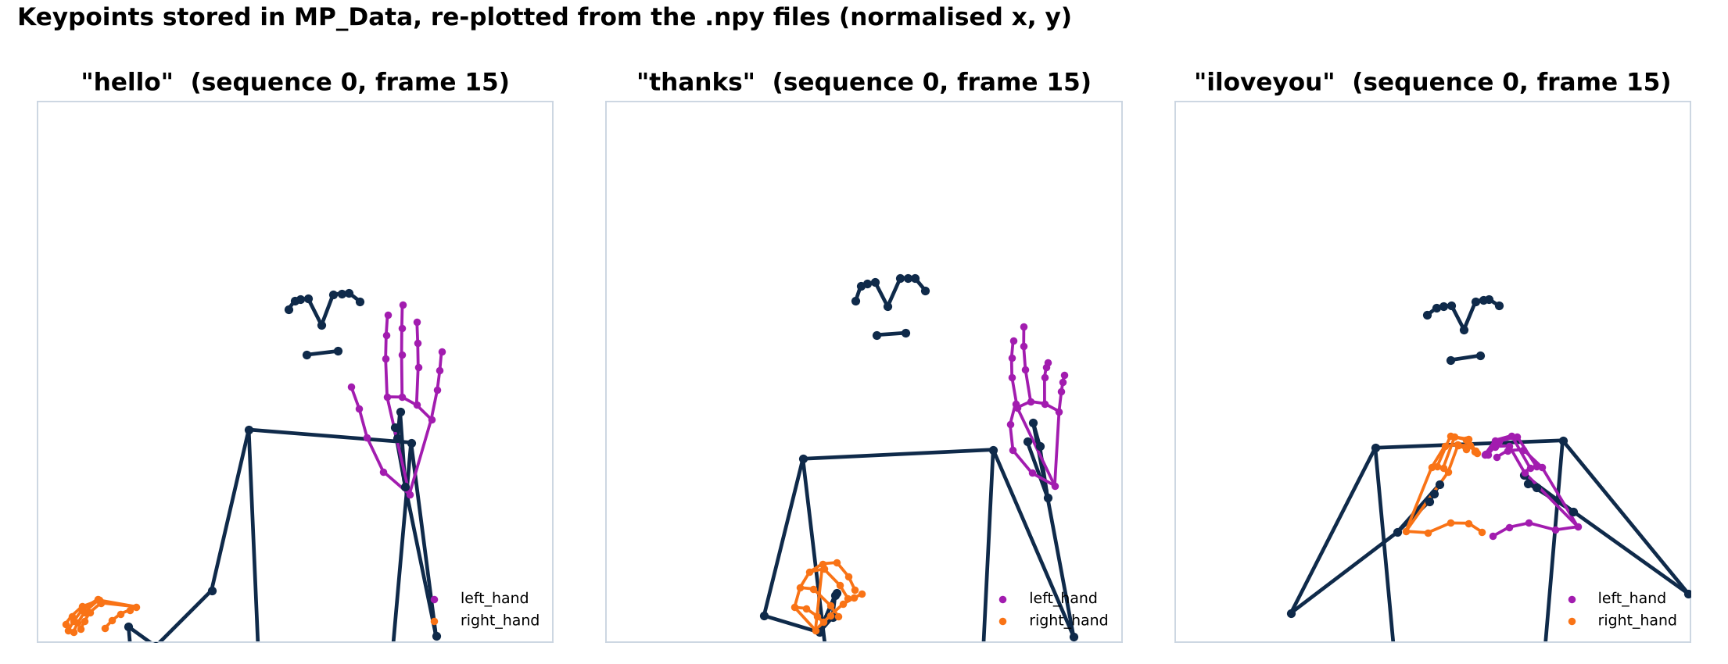
Three signs, recognised from keypoints
Real frames from our dataset (sequence 0, frame 15), re-plotted from the saved .npy files. The model never sees the video pixels - only these landmark coordinates.
Notes:
The three classes are hello, thanks and iloveyou. These skeletons are drawn from our own dataset files: pose in navy, the left-hand block in purple and the right-hand block in orange.

Slide 4






How SignSense works
Webcam
MediaPipe Holistic
Keypoints
30-frame window
LSTM model
Text on screen
OpenCV reads a frame from camera 0
finds pose and hand landmarks
258 numbers per frame
last 30 frames fed to the model
probability for each sign
shown if confidence > 0.9
The same extract_keypoints() function creates the saved training data and the live input, so the model sees data in exactly the same format during training and in the live demo.
Notes:
Walk through the six stages from webcam frame to on-screen word. These are the stages of Section 11 of the notebook; Sections 2 to 5 use the first three stages to build the dataset.

Slide 5
From landmarks to a 258-value feature vector
132
extract_keypoints(results)
Pose
33 landmarks x (x, y, z, visibility)
Each landmark list is flattened into one long 1-D array.
Zero padding: if a hand or the body is not detected, its slot is filled with zeros, so every frame always gives exactly 258 numbers.
Face left out: the 468 face landmarks (1,404 values) are commented out - this keeps the input small and focused on the hands and body.
x and y are normalised to the frame size (0 to 1) by MediaPipe.
63
Left hand
21 landmarks x (x, y, z)
63
Right hand
21 landmarks x (x, y, z)
= 258 values per frame
Notes:
mediapipe_detection converts BGR to RGB, marks the image read-only and runs Holistic with detection and tracking confidence 0.5. extract_keypoints then builds the 258-value vector described here.

Slide 6
Our dataset: MP_Data
3
90
30
2,700
Folder structure
signs
sequences
frames each
.npy files
MP_Data/
hello/
0/ 0.npy ... 29.npy
...
29/
thanks/ (0 ... 29)
iloveyou/ (0 ... 29)
Recorded by our team with the notebook's collection code (Section 5).
Stores keypoints, not video: each file is one frame's 258-value vector.
Path: MP_Data/<sign>/<sequence>/<frame>.npy
Loaded as X with shape (90, 30, 258).
hello is essentially one-hand in our data (right-hand block present in 1.6 % of frames); thanks and iloveyou use both hands.
Notes:
90 sequences in total: 30 per sign, 30 frames each. Computed from the dataset: hello uses essentially one hand block (right hand present in only 1.6 percent of frames), while thanks and iloveyou use both.

Slide 7




How the data was collected
5 s
2 s
30x30
.npy
Get ready
Start of each video
Record
Save
The notebook waits 5 seconds before recording each sign.
"STARTING COLLECTION" is shown and the code pauses 2 seconds between repetitions.
30 sequences of 30 frames are captured per sign while landmarks are drawn live.
extract_keypoints() output for every frame is saved with np.save().
Sections 4 and 5 of the notebook: actions = ['hello', 'thanks', 'iloveyou'], no_sequences = 30, sequence_length = 30
Notes:
Section 4 creates the folders MP_Data/<action>/<sequence>. Section 5 loops over actions, sequences and frames, shows the webcam feed with a status message, and saves every frame's keypoints.

Slide 8
Preparing the data for training
1
Load
All 30 frames of each sequence are loaded in order
X -> (90, 30, 258)
2
Label
label_map = {hello: 0, thanks: 1, iloveyou: 2}
y -> 90 labels
3
One-hot
to_categorical(labels): thanks -> [0, 1, 0]
y -> (90, 3)
4
Split
train_test_split(X, y, test_size=0.05)
85 train | 5 test
Notes:
One-hot labels are needed because the model ends in a 3-unit softmax trained with categorical cross-entropy. test_size 0.05 holds out 5 of the 90 sequences for testing.

Slide 9
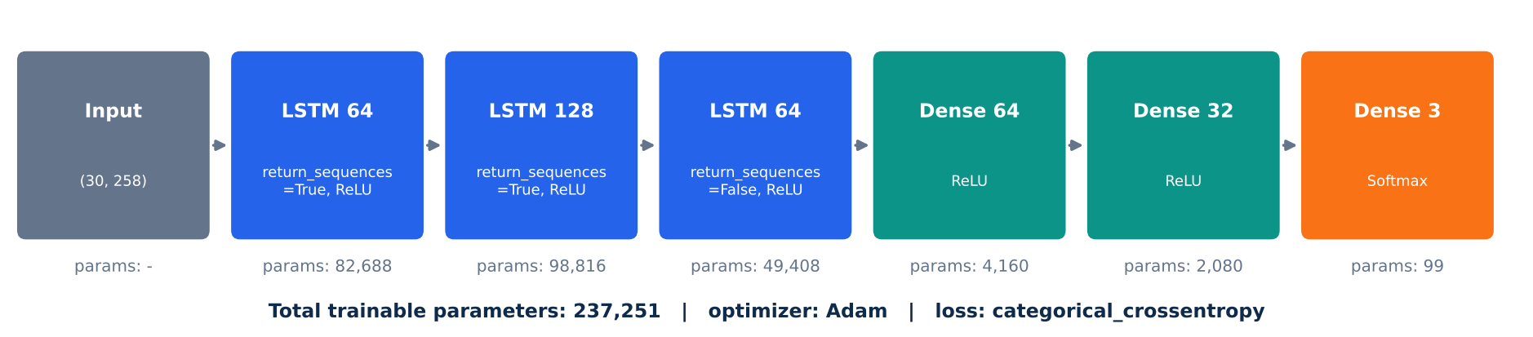
Stacked LSTM network
Why an LSTM?
How the layers work together
A sign is a movement, not a single pose. An LSTM reads the 30 frames in order and keeps a memory controlled by input, forget and output gates, so it learns how the keypoints change over time.
LSTM 1 and 2 return the full sequence to the next layer.
LSTM 3 returns one summary vector for the whole movement.
Dense layers + softmax give one probability per sign.
Notes:
Three LSTM layers of 64, 128 and 64 units with ReLU activation, then Dense 64, Dense 32 and a softmax output of 3. 237,251 trainable parameters in total.

Slide 10
Training: 700 epochs
Epoch 9
Epochs 13-62
Epochs 63-700
8.13e-8
first 100 % accuracy
unstable loss (peak 15.67)
100 % every epoch
final loss
Notes:
Adam optimiser, categorical cross-entropy loss, default batch size 32 (3 steps per epoch on 85 samples), TensorBoard logging to Logs. The curves are from the training log printed in the notebook.

Slide 11
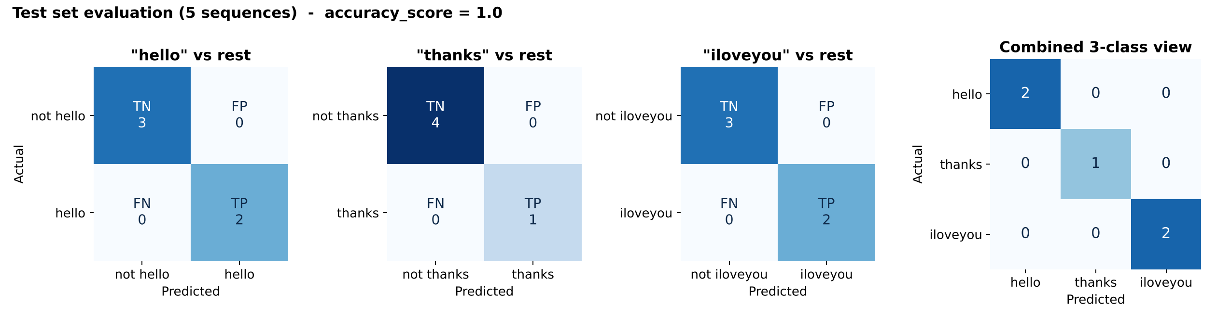
Evaluation on the test set
100%
Test set: 2 hello, 1 thanks, 2 iloveyou - all classified correctly.
No false positives and no false negatives for any sign (output of multilabel_confusion_matrix, Section 10).
accuracy_score on the 5 test sequences
Notes:
The model predicts on X_test, argmax turns probabilities and one-hot labels into class indexes, and sklearn computes the per-class confusion matrices and the accuracy. Test set: 2 hello, 1 thanks, 2 iloveyou.

Slide 12


Real-time recognition
Sliding window
Observed in the live test
Every new frame is added and only the last 30 are kept: sequence[-30:].
hello
The printed prediction stream followed the signer through these signs, each held over many consecutive frames. Most predictions took about 15-40 ms.
Predict
thanks
model.predict on shape (1, 30, 258) gives 3 probabilities.
iloveyou
Confidence > 0.9
thanks
Only confident predictions can be written to the screen.
hello
No repeats, last 5 words
thanks
A word is added only if it differs from the previous one; 5 words are kept.
Notes:
Section 11: MediaPipe runs on every frame, the last 30 keypoint vectors are fed to the model, and confident new words are written in a banner at the top of the OpenCV window. Press q to quit.

Slide 13
Tools and libraries
Python 3.11
OpenCV
MediaPipe
NumPy
Programming language
Webcam, drawing, display
Holistic landmark detection
Arrays and .npy dataset
scikit-learn
TensorFlow / Keras
TensorBoard
Jupyter Notebook
Split and evaluation metrics
LSTM model and training
Training logs (Logs/)
Development environment
Notes:
Versions used: TensorFlow 2.15.0, OpenCV 4.11.0.86, MediaPipe 0.10.21, scikit-learn 1.6.1, NumPy 1.26.4, Python 3.11.8.

Slide 14




Limitations and future work
More signs
More data
Only 3 signs today. New signs can be added to the actions array, recorded with Section 5 and trained.
90 sequences recorded by our team. More signers, backgrounds and lighting would improve robustness.
Stronger evaluation
Speech output
The test split is 5 sequences. A larger test set or k-fold cross-validation would be more reliable.
Recognised words are shown as text; text-to-speech could let the system speak them.
Notes:
Be open about the limits: small vocabulary, small dataset, small test split. Each has a clear next step.

Slide 15

Conclusion
SignSense recognises hello, thanks and I love you live from a webcam.
MediaPipe Holistic turns each frame into 258 keypoints; a stacked LSTM classifies 30-frame movements.
Trained on our own 90-sequence dataset, it classified all 5 test sequences correctly.
Confident predictions (> 0.9) are shown on screen as a running sentence.
github.com/soham200521/TEAM_16
Thank you
Notes:
Summarise and invite questions. Code, dataset, model, report and this presentation are all in the GitHub repository.

